Slide 1
Flowing In The
Turbulent But Life-Giving
River of God
Sunday, October 25, 2020

Slide 2
We are in the most exciting times because we cannot help but bear witness to the Gospel – because the Gospel applies to everything we are going through. (And The darkness cannot quench the light.)
Dr. James White

Slide 3
Allow The Gifts Of God and the Gifts of The Spirit To Turn Into Blessings
As you go, preach this message: 'The kingdom of heaven is near.' ⁸ Heal the sick, raise the dead, cleanse those who have leprosy, drive out demons. Freely you have received, freely give. Matthew 10:7-8 (NIV)
Learn to Separate the Wheat From The Chaff
The prophet that has a dream, let him tell a dream; and he that has My Word, let him speak My Word faithfully. What is the chaff to the wheat? Says the LORD. ²⁹ Is not My Word like as a fire says the LORD; and like a hammer that breaks the rock in pieces? Jeremiah 23:28-29 (KJV)

Slide 4
Over-arching Passage
In the day of great slaughter, when the towers fall, streams of water will flow on every high mountain and every lofty hill. ²⁶ The moon will shine like the sun, and the sunlight will be seven times brighter, like the light of seven full days, when the LORD binds up the bruises of His people and heals the wounds He inflicted. Isaiah 30:25-26

Slide 5
Maintaining Unity
In The River Of God
With Many Different Currents

Slide 6
Being In Different Currents
WHILE IN THE SAME RIVER
Now about spiritual gifts, brothers, I do not want you to be ignorant… There are different kinds of gifts, but the same Spirit. ⁵ There are different kinds of service, but the same Lord. ⁶ There are different kinds of working, but the same God works all of them in all men. ⁷ Now to each one the manifestation of the Spirit is given for the common good. ⁸ To one there is given through the Spirit the word of wisdom, to another the word of knowledge by means of the same Spirit, ⁹ to another faith by the same Spirit, to another gifts of healing by that one Spirit, ¹⁰ to another miraculous powers, to another prophecy, to another distinguishing between spirits, to another speaking in different kinds of tongues, and to still another the interpretation of tongues. ¹¹ All these are the work of one and the same Spirit, and He gives them to each one, just as He determines.
1 Corinthians 12:1-11 (NIV)

Slide 7
The Waters of Ezekiel Chapter 47
The Church Has Different Currents
Anyone who believes in me may come and drink! For the Scriptures declare, ‘Rivers of living water will flow from his heart.’” John 7:38 (NLT2)
Intercession / Awakening – Book of Acts
Word of God – Gifts of the Spirit are limited
Sovereignty of God - Freewill
Worship in
Spirit and
Truth
Fullness of The Spirit
RIVER OF LIFE
Social Issues – Abortion
Word of God – Gifts of the Spirit are unlimited
End-Time Prophecies – Rapture
Mercy Ministries – Feeding the poor - Isa. 58
Because this water flows there and makes the salt water fresh; so where the river flows everything will live. Ezekiel 47:9
But its swamps and marshes will not become wholesome …. they shall [as the river subsides] be left encrusted with salt and given over to it. Ezekiel 47:11 (AMP)

Slide 8
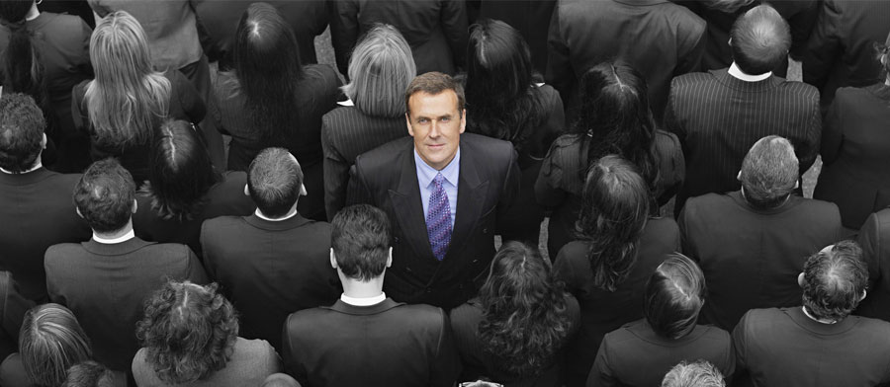
Sameness – is Neater
But Not Necessarily Effective
Greatest Danger -
Never risk -
Operate in an Echo Chamber

Slide 9
A Story About the Messiness of The Gospel
Now one of the Pharisees invited Jesus to have dinner with him, so he went to the Pharisee's house and reclined at the table. ³⁷ When a woman who had lived a sinful life in that town learned that Jesus was eating at the Pharisee's house, she brought an alabaster jar of perfume, ³⁸ and as she stood behind him at his feet weeping, she began to wet his feet with her tears. Then she wiped them with her hair, kissed them and poured perfume on them. ³⁹ When the Pharisee who had invited him saw this, he said to himself, "If this man were a prophet, he would know who is touching him and what kind of woman she is--that she is a sinner." ⁴⁰ Jesus answered him, "Simon, I have something to tell you." "Tell me, teacher," he said. ⁴¹ "Two men owed money to a certain moneylender. One owed him five hundred denarii, and the other fifty. ⁴² Neither of them had the money to pay him back, so he canceled the debts of both. Now which of them will love him more?" ⁴³ Simon replied, "I suppose the one who had the bigger debt canceled." "You have judged correctly," Jesus said. ⁴⁴ Then he turned toward the woman and said to Simon, "Do you see this woman? I came into your house. You did not give me any water for my feet, but she wet my feet with her tears and wiped them with her hair. ⁴⁵ You did not give me a welcoming kiss, but this woman, from the time I entered, has not stopped kissing my feet. ⁴⁶ You did not put oil on my head, but she has poured perfume on my feet. ⁴⁷ Therefore, I tell you, her many sins have been forgiven--for she loved much. But he who has been forgiven little loves little." ⁴⁸ Then Jesus said to her, "Your sins are forgiven." ⁴⁹ The other guests began to say among themselves, "Who is this who even forgives sins?" ⁵⁰ Jesus said to the woman, "Your faith has saved you; go in peace." Luke 7:36-50 (NIV)

Slide 10
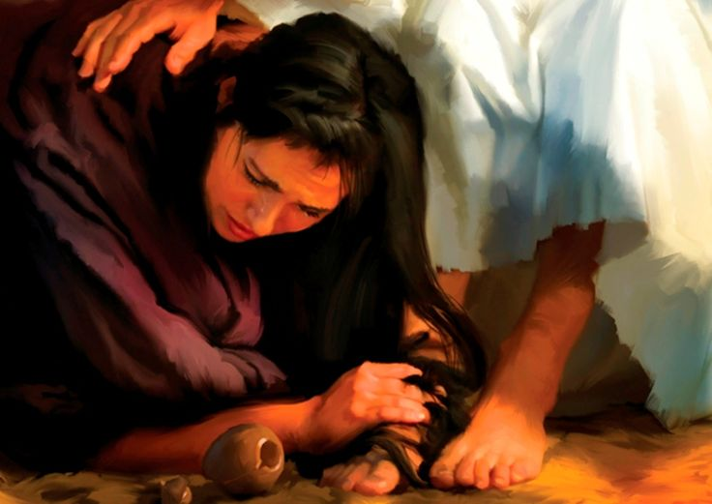
Jesus has this amazing ability to welcome a sinner THE WAY THEY ARE while still confronting their depravity – and yet in this humbling of being laid open before God – they want to be in His presence because they know they are blessed by Him, BELONG TO HIM and owe Him EVERYTHING. Therefore, cleansing, repentance, forgiveness, and gratefulness all flow together as ONE.

Slide 11
Understanding God’s Ways In Conversion
Contending For Kingdom Momentum
Effective Anointed Ministry of the Spirit
Both Personally and Corporately
Increase
Christ-likeness
Anointing
From the days of John the Baptist until now, the kingdom of heaven has been forcefully advancing, and forceful men lay hold of it. Matthew 11:12 (NIV)
Holy Spirit Is
Key To Momentum
Fresh Filling
Powerfully Effective
Christian
Soul Crisis
Fresh Filling
Conversion
Conversion
Nominal Christian
Baseline Living
Unsaved state
Soul Crisis
Momentum
Release –
Bounce
Therefore, I tell you, her many sins have been forgiven--for she loved much. But he who has been forgiven little loves little." Luke 7:47 (NIV)
Depth of rebellion
Resisting the truth
Distorting the Image of God
Soul Crisis

Slide 12
Being In Different Currents
WHILE IN THE SAME RIVER
Now about spiritual gifts, brothers, I do not want you to be ignorant… There are different kinds of gifts, but the same Spirit. ⁵ There are different kinds of service, but the same Lord. ⁶ There are different kinds of working, but the same God works all of them in all men. ⁷ Now to each one the manifestation of the Spirit is given for the common good. ⁸ To one there is given through the Spirit the word of wisdom, to another the word of knowledge by means of the same Spirit, ⁹ to another faith by the same Spirit, to another gifts of healing by that one Spirit, ¹⁰ to another miraculous powers, to another prophecy, to another distinguishing between spirits, to another speaking in different kinds of tongues, and to still another the interpretation of tongues. ¹¹ All these are the work of one and the same Spirit, and He gives them to each one, just as He determines.
1 Corinthians 12:1-11 (NIV)

Slide 13
"Again, it will be like a man going on a journey, who called his servants and entrusted his property to them. ¹⁵ To one he gave five talents of money, to another two talents, and to another one talent, each according to his ability. Matthew 25:14-15 (NIV)
Everyone who has been given much, much will be expected; and from the one who has been entrusted with much, much more will be asked. Luke 12:48 (NIV)

Slide 14
I thought If It Was a Spiritual Gift
God Just Gave it To you –
You have nothing to do –
Sovereignty of God
How shall we escape if we ignore such a great salvation? This salvation, which was first announced by the Lord, was confirmed to us by those who heard Him. ⁴ God also testified to it by signs, wonders and various miracles, and gifts of the Holy Spirit distributed according to His will. Hebrews 2:3-4
Stirring Up The Gifts
But it is Not Forced
Wherefore I put you in remembrance that you stir up the gift of God, which is in you by the putting on of my hands. ⁷ For God hath not given us the spirit of fear; but of power, and of love, and of a sound mind. 2 Timothy 1:6-7 (KJV)

Slide 15
Some Believers Supernaturally
Get a Momentum Shift and
Supernatural Gifts Immediately
Others Have To Stir up and Seek
A Greater Release

Slide 16
Can We gain more gifts – Develop Gifts?
²⁷ Now you are the body of Christ, and each one of you is a part of it. ²⁸ And in the church God has appointed first of all apostles, second prophets, third teachers, then workers of miracles, also those having gifts of healing, those able to help others, those with gifts of administration, and those speaking in different kinds of tongues. ²⁹ Are all apostles? Are all prophets? Are all teachers? Do all work miracles? ³⁰ Do all have gifts of healing? Do all speak in tongues? Do all interpret? ³¹ But eagerly desire the greater gifts. 1 Corinthians 12:27-31 (NIV)
Therefore, my brothers, be eager to prophesy, and do not forbid speaking in tongues. ⁴⁰ But everything should be done in a fitting and orderly way.
1 Corinthians 14:39-40 (NIV)

Slide 17
Why Does LifeGate Believe In All the Gifts
What nobler deed than to tread under foot the gods of the nations, to cast out evil spirits, to perform healings, to seek divine revelation, to live to God? These are the pleasures, these are the spectacles that befit Christians – holy, everlasting, and free. Tertullian (A.D. 198)
“There are still preserved among Christians gifts of that Holy Spirit that appeared in the form of a Dove. They expel evil spirits, perform many cures, and foresee certain events.” -- Tertullian, c. 212,

Slide 18
²³ So if the whole church comes together and everyone speaks in tongues, and some who do not understand or some unbelievers come in, will they not say that you are out of your mind? ²⁴ But if an unbeliever or someone who does not understand comes in while everybody is prophesying, he will be convinced by all that he is a sinner and will be judged by all, ²⁵ and the secrets of his heart will be laid bare. So he will fall down and worship God, exclaiming, "God is really among you!" 1 Corinthians 14:23-25 (NIV)

Slide 19
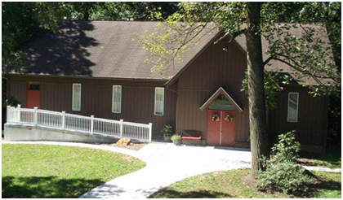
How LifeGate Desires To
Host The Presence Of The Lord
Compromise – The Bible is outdated
Word of God – Gifts of the Spirit are limited
Intercession / Awakening – Book of Acts
Sovereignty of God - Freewill
Fullness of The Spirit
RIVER OF LIFE
Discernment – Walking in the TRUTH – not judgment
Word of God – Gifts of the Spirit are unlimited
End-Time Prophecies – Rapture
Mercy Ministries – Feeding the poor - Isa. 58
"O God, do all Your will in LifeGate; then put her in any position which will most fully illustrate and lift up Your saving grace. No matter what it is, only let LifeGate greatly glorify Your name, amen." (Asa Mahan 1835)

Slide 20
The River Of God is Both Challenging and Exhilarating
¹ Some men came down from Judea to Antioch and were teaching the brothers: "Unless you are circumcised, according to the custom taught by Moses, you cannot be saved." ² This brought Paul and Barnabas into sharp dispute and debate with them. So Paul and Barnabas were appointed, along with some other believers, to go up to Jerusalem to see the apostles and elders about this question. ³ The church sent them on their way, and as they traveled through Phoenicia and Samaria, they told how the Gentiles had been converted. This news made all the brothers very glad. ⁴ When they came to Jerusalem, they were welcomed by the church and the apostles and elders, to whom they reported everything God had done through them. ⁵ Then some of the believers who belonged to the party of the Pharisees stood up and said, "The Gentiles must be circumcised and required to obey the law of Moses." ⁶ The apostles and elders met to consider this question. ⁷ After much discussion, Peter got up and addressed them: "Brothers, you know that some time ago God made a choice among you that the Gentiles might hear from my lips the message of the gospel and believe. ⁸ God, who knows the heart, showed that he accepted them by giving the Holy Spirit to them, just as he did to us. ⁹ He made no distinction between us and them, for he purified their hearts by faith. ¹⁰ Now then, why do you try to test God by putting on the necks of the disciples a yoke that neither we nor our fathers have been able to bear? ¹¹ No! We believe it is through the grace of our Lord Jesus that we are saved, just as they are." ¹² The whole assembly became silent as they listened to Barnabas and Paul telling about the miraculous signs and wonders God had done among the Gentiles through them. Acts 15:1-12 (NIV)

Slide 21
THE HUNGER AND
LESSONS LEARNED OVER THE CENTURIES
“Oh, if we didn’t so often hinder the Holy Spirit with much fleshly serving and much trying to serve, how surely and mightily would He accomplish His own work of renewing the Church.
Andrew Murray 1890
We should have emphasized the teaching of ABSOLUTE OBEDIENCE TO THE HOLY SPIRIT more than we did. I believe it was this lack of obedience that grieved the Holy Spirit and stopped the flow of this revival.” 1905
“Make much of the Word of God, make much of the Blood, make much of total dependence on the Holy Spirit, and make much of the shortness of time.” Stanley Frodsham 1969

Slide 22
How Do We Bring All The Currents
Together – Honoring Them
But Not Limiting Ourselves
To Those who would struggle?
APPLICATION
Stir One another up – without judging and without compromise. We will not BABY each other – but we will not BULLY each other either – NOR BECOME PRIDEFUL
Allow The Gifts and Ministries To flow while still KEEPING JESUS AND THE GOSPEL THE CENTER -
There are immature and mature believers – but not FIRST and SECOND CLASS Christians (EXAMPLE – “Praying In The Spirit.” – not forcing people to speak in tongues – but inviting them to hunger for more of the Holy Spirit)
Learn to separate the WHEAT from the CHAFF – chew on the MEAT – spit out the BONES – Don’t throw out the BABY WITH THE BATH WATER

Slide 23
Final Passage
Each man will be like a shelter from the wind and a refuge from the storm, like streams of water in the desert and the shadow of a great rock in a thirsty land. 3 Then the eyes of those who see will no longer be closed, and the ears of those who hear will listen. 4 The mind of the rash will know and understand, and the stammering tongue will be fluent and clear. 5 No longer will the fool be called noble nor the scoundrel be highly respected. 6 For the fool speaks folly, his mind is busy with evil: He practices ungodliness and spreads error concerning the LORD; the hungry he leaves empty and from the thirsty he withholds water. 7 The scoundrel's methods are wicked, he makes up evil schemes to destroy the poor with lies, even when the plea of the needy is just. 8 But the noble man makes noble plans, and by noble deeds he stands. Isaiah 32:2-8 (NIV)

Slide 24
Satisfied (Hymn)
1875
All my life long I had a longing
For a drink from some cool spring,
That I hoped would quench the burning
Of the thirst I felt within.
Hallelujah! I have found Him
Whom my soul so long has craved!
Jesus satisfies my longings;
Through His life I am now saved.
2
Feeding on the husks around me,
Till my strength was almost gone,
Longed my soul for something better,
Only still to hunger on.
3
Poor I was, and sought for riches,
Something that would satisfy,
But the dust I gathered round me
Only mocked my soul’s sad cry.
4
Well of water, ever springing,
Bread of life, so rich and free,
Untold wealth that never faileth,
My Redeemer is to me.

Slide 25
Red Letters
David Crowder
2018
Felt like lightning hit my veins
My dead heart began to beat
Breath of God filled my lungs
And the Holy Ghost awakened me
Yeah, the Holy Ghost awakened me
There I was on death row
Guilty in the first degree
Son of God hanging on a hill
Hell was my destiny
The crowd was shouting crucify
Could've come from these lips of mine
The dirty shame was killing me
It would take a miracle to wash me clean
[Chorus]
Then I read the red letters
And the ground began to shake
The prison walls started falling
And I became a free man that day

