Slide 1
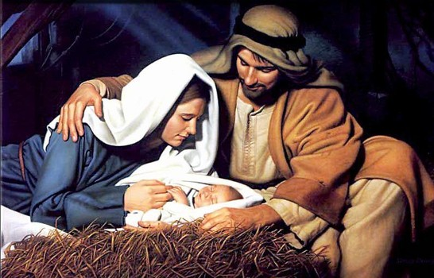
Christmas Sermon 2020
Sunday, December 20, 2020

Slide 2
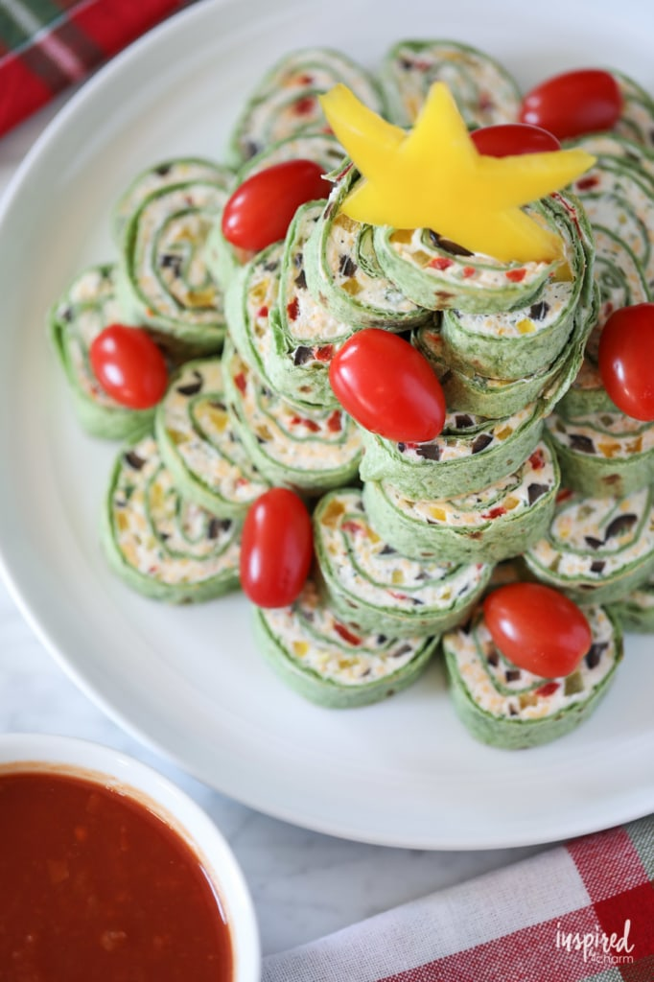
Pre- Message
Appetizer
We are in a SEISMIC SHIFT
God is Changing and majorly adjusting His PRIESTHOOD in the earth
1 - Semantics - Keep
your heart right – spirit
free
Zechariah Is a Priest God was upgrading Him – He had become familiar with God but was full of unbelief (could not speak for nine months - LUKE 1
2 - Faith/ Unbelief
Mary and Her Prayer – is very powerful – But it is Elizabeth that Identifies the great
God is dealing with
His Priesthood
Hannah – In The Old Testament Seals the deal – when God was upgrading the Priesthood in that moment 1 Samuel 2
Thwarting the Anti-Christ

Slide 3
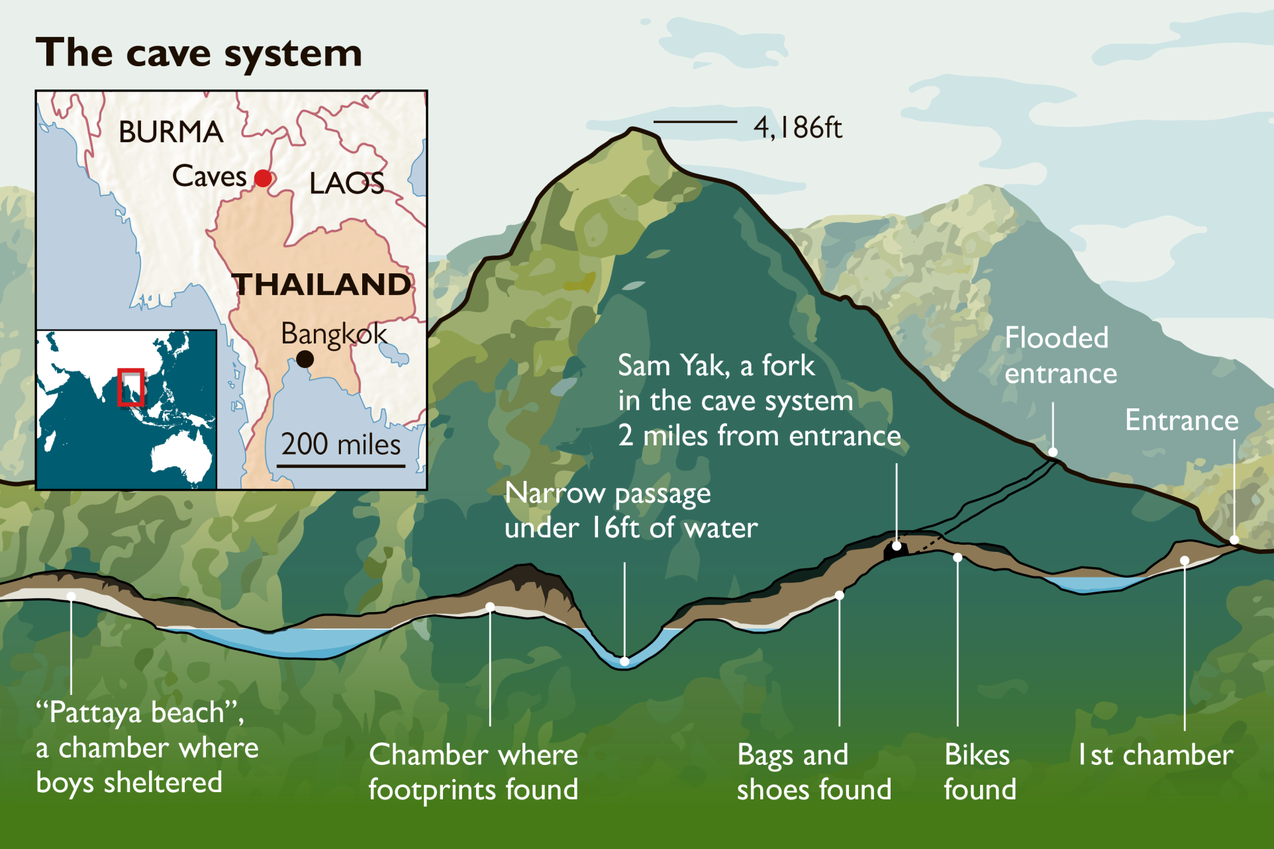
Thailand Rescue 2018

Slide 4
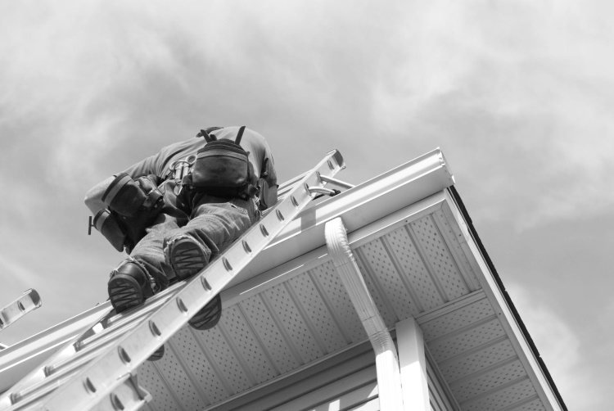
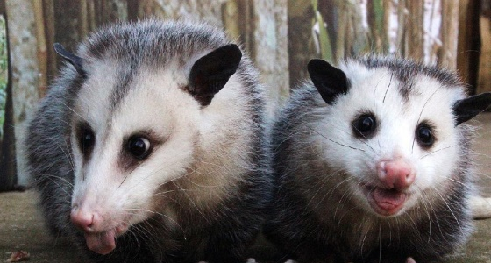
What Does The Word
RESCUE mean?
To save (someone) from a dangerous or distressing situation.
INTERVENTION - action taken to improve a situation from the same word as INTERCESSION
The Possum Rescue Story

Slide 5
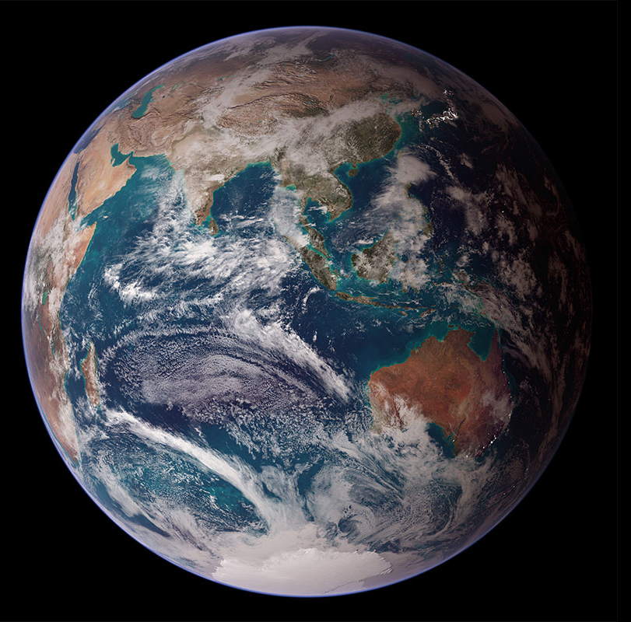
So How Would You Rescue
The World?

Slide 6
The Most Explosive Message
Ever Delivered To Mankind
But the angel said to them (Shepherds), "Do not be afraid. I bring you good news of great joy that will be for all the people. ¹¹ Today in the town of David a Savior has been born to you; He is Christ the Lord. ¹² This will be a sign to you: You will find a baby wrapped in (Swaddling) cloths and lying in a manger." ¹³ Suddenly a great company of the heavenly host appeared with the angel, praising God and saying, ¹⁴ "Glory to God in the highest, and on earth peace to men on whom His favor rests." Luke 2:10-14 (NIV)

Slide 7
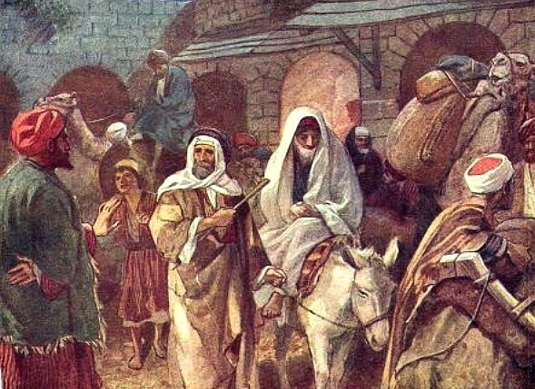
Providentially manipulated details
Joseph and Mary
¹ In those days Caesar Augustus issued a decree that a census should be taken of the entire Roman world. ² (This was the first census that took place while Quirinius was governor of Syria.) ³ And everyone went to his own town to register. Luke 2:1-3 (NIV)
"But you, Bethlehem Ephrathah, though you are small among the clans of Judah, out of you will come for me one who will be ruler over Israel, whose origins are from of old, from ancient times." Micah 5:2 (NIV)

Slide 9
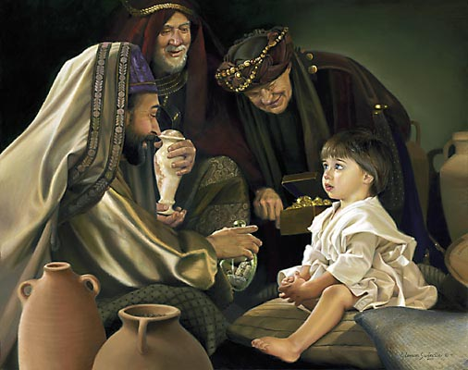
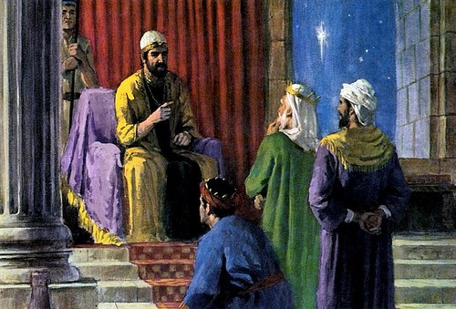
¹ After Jesus was born in Bethlehem in Judea, during the time of King Herod, Magi from the east came to Jerusalem ² and asked, "Where is the one who has been born king of the Jews? We saw his star in the east and have come to worship him." Matthew 2:1-2
Providentially manipulated details
On coming to the house, they saw the child with his mother Mary, and they bowed down and worshiped him. Then they opened their treasures and presented him with gifts of gold and of incense and of myrrh.
Matthew 2:11

Slide 10
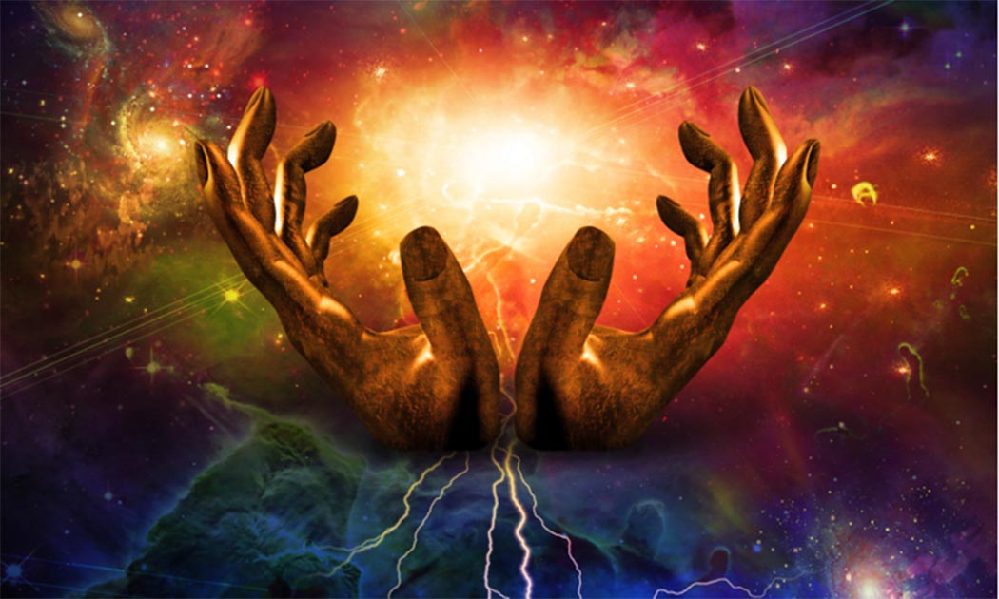
God Spoke the Universe Into Existence

Slide 11
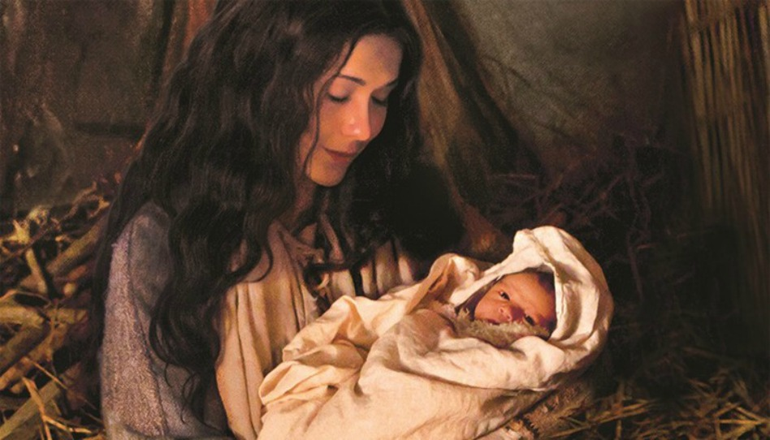
But Becomes a Vulnerable
Little Baby To Begin the Rescue
of Mankind

Slide 12
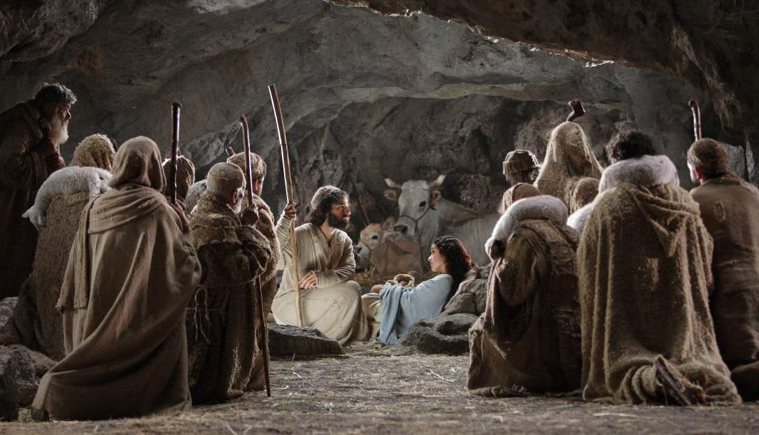
The Shepherds Respond to
The Angels Dramatic Announcement
¹⁵ When the angels had left them and gone into heaven, the shepherds said to one another, "Let's go to Bethlehem and see this thing that has happened, which the Lord has told us about." ¹⁶ So they hurried off and found Mary and Joseph, and the baby, who was lying in the manger. ¹⁷ When they had seen him, they spread the word concerning what had been told them about this child, ¹⁸ and all who heard it were amazed at what the shepherds said to them. ¹⁹ But Mary treasured up all these things and pondered them in her heart. ²⁰ The shepherds returned, glorifying and praising God for all the things they had heard and seen, which were just as they had been told. Luke 2:15-20 (NIV)

Slide 13
Lessons Learned From The Shepherds
Did the Shepherds obey what God said to do through the Angels?
Were the Shepherds bored and lazy and lethargic about the announcement that the Angel made?
After they had seen Jesus what did they do?
Were these bottom of the barrel – lowest of the culture guys effective in what they shared?
When they got back to base camp with the sheep what did they do?
How should we respond to the GOOD NEWS Jesus has come and is our Savior?

Slide 14
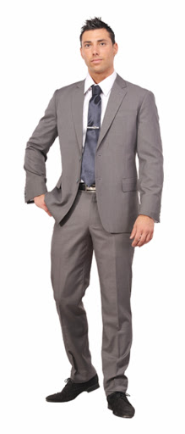
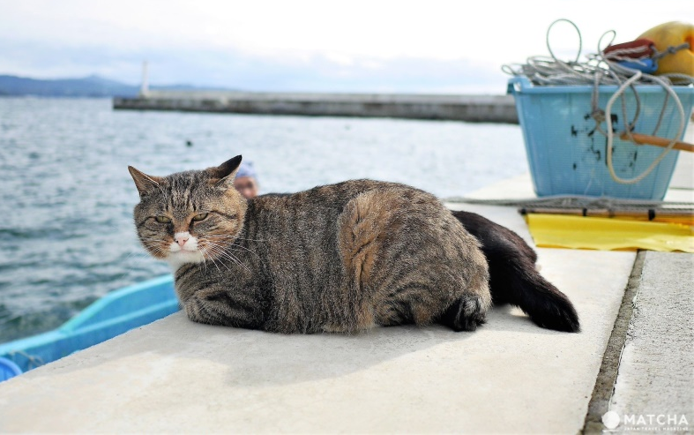
God sent His Best To Rescue us
If you are more advanced than someone you can always humble yourself and help the person not as advanced as you -
But if you are very weak or un-advanced – inferior - you can’t help the person above you – you are simply unable to give them what they need.

Slide 15
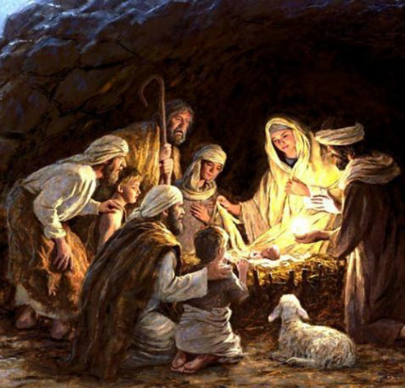
A Daring Rescue
It was a time of war so many lives were lost
Then news came of souls who were caught
Behind enemy lines they were entirely trapped
A recovery was planned to bring them back
Everyone said, “in that place no one could’ve survived.”
But the General in command said, “We must try.”
Pains were taken to risk and prepare for the worst
The best Unit joined the mission to train and rehearse

Slide 16
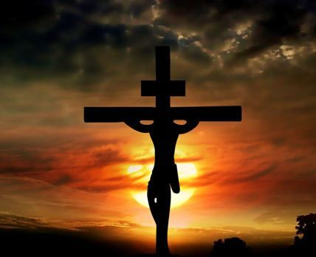
A daring rescue took place when all were hopeless
Into the enemy’s stronghold the Commander went
But it was found the men had actually defected
And they killed Him and laughed at His attempt

Slide 17
So the facts proved the gloating traitors had lied
But a few escaped claiming the General was still alive
They took courage in their hearts and believed His word
With hope they prayed He would soon return
For a season it appeared the rebels cheated death
Even as they misled friends and partied with the rest
Then to their surprise the General came in force
Not to set them free this time - but something much worse

Slide 18
A daring rescue took place when all were hopeless
Into the enemy’s stronghold the Commander went
But it was found the men had actually defected
And they killed Him and laughed at His attempt

Slide 19
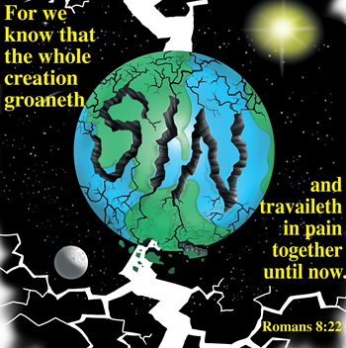
You see this story’s about our world and those on its face
It’s so easy to blame God for all the suffering and hate
But when you grasp how He was treated - at our hands
It’s false teaching that says, “God won’t judge sinful man”
God’s holy - Yet He’s willing to give us a second chance
Though we fight against Him – He’s the first to reach
out a hand
Why not trust His heart and make Him your first love
So when He returns you won’t need to “fear” – but trust”

Slide 20
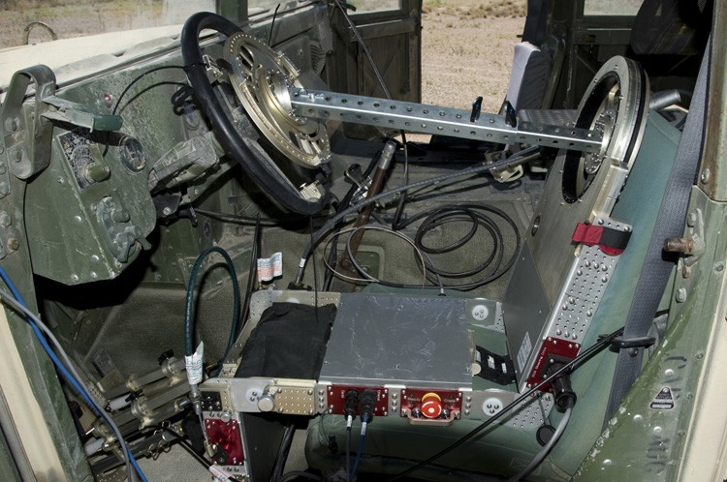

Slide 21
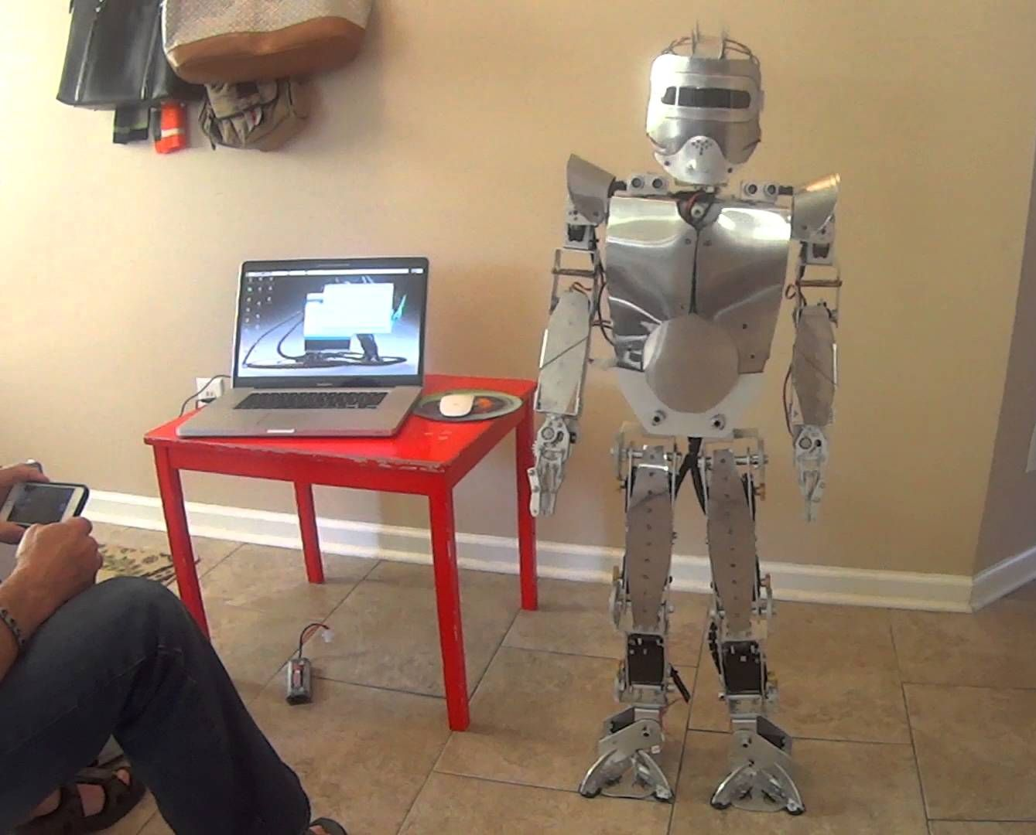
What If You Made A Robot That Rebelled Against You

Slide 22
Application
Have you responded to this GOOD NEWS – have you allowed Jesus to rescue you from Your selfish heart – from the world around you that tempts you to stay in the rebellion?
Are You GRATEFUL that the Lord made a way for you to come out of your sins and be RESCUED?
Will you tell others of this GOOD NEWS like the shepherds did?

