Slide 1
LifeGate Youth Sermon February 21, 2021

Slide 4
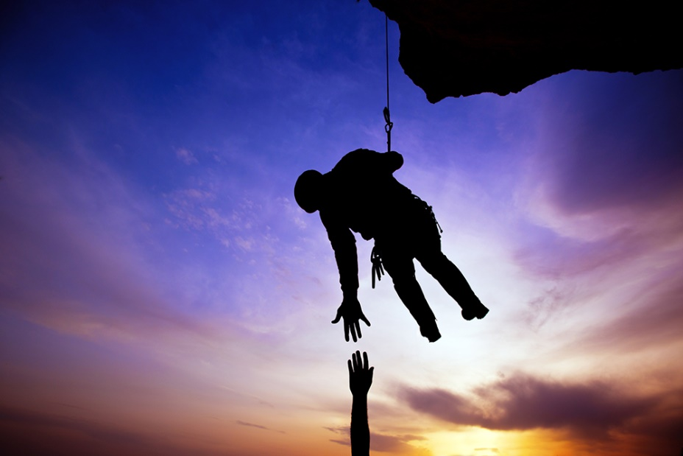
Definition Of RESCUE:
To save (someone) from a dangerous or distressing situation. To deliver, redeem, ransom, reclaim, save mean to set free.

Slide 5
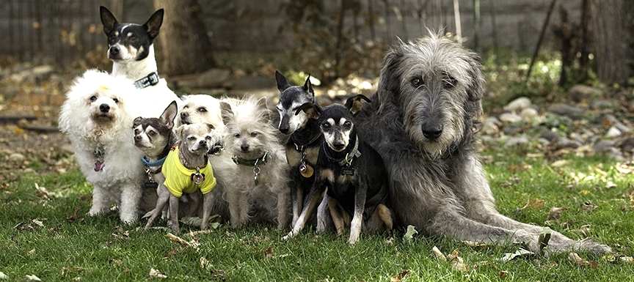
Have You Ever
Been Rescued?

Slide 6
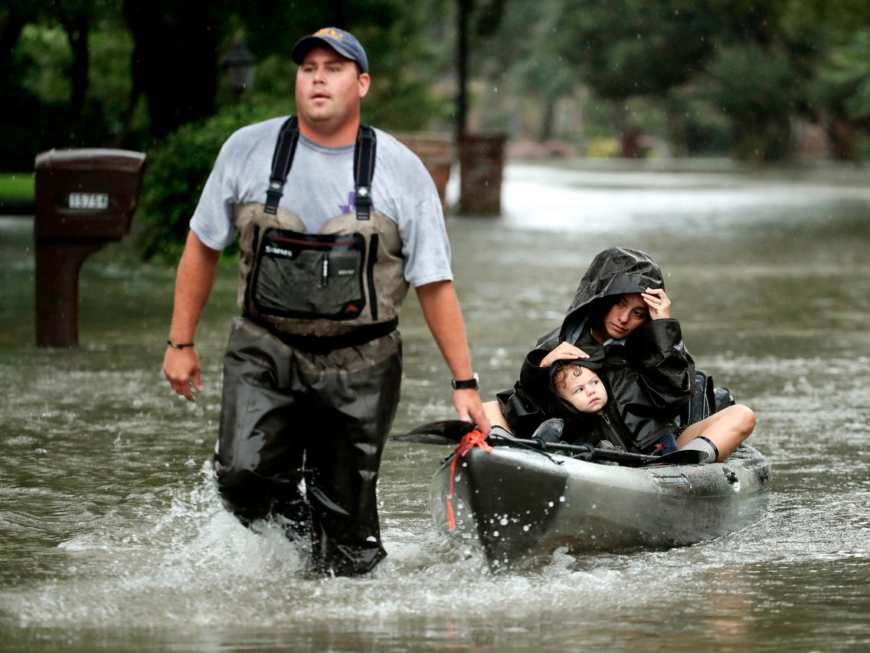
Have You Ever Rescued Someone?

Slide 7
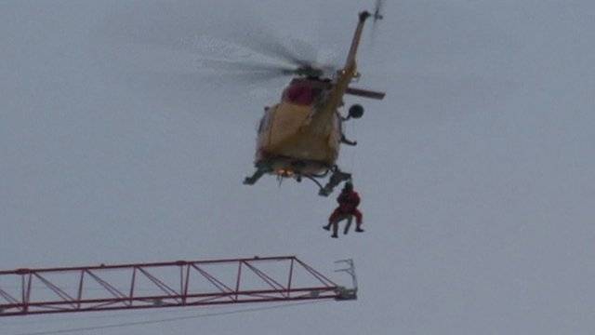
Can You Predict When Someone Needs Rescued?

Slide 8
Can God Predict When Someone Needs Rescued?
(THERE WILL BE JUDGMENT FOR) -all whose names have not been written in the book of life belonging to the Lamb that was slain from the creation of the world. Revelation 13:8 (NIV)

Slide 9
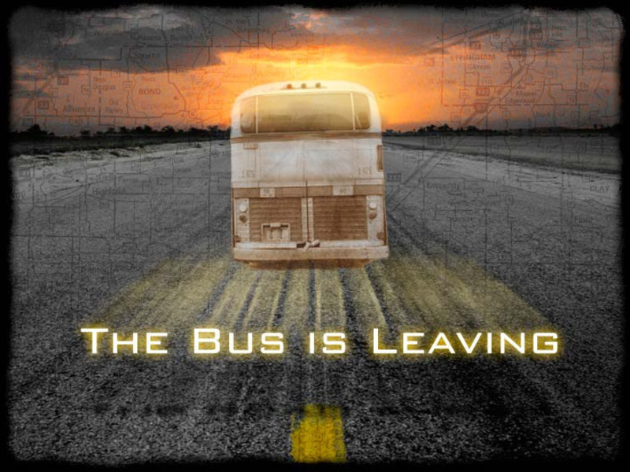
What If You Ignore A Warning?

Slide 10
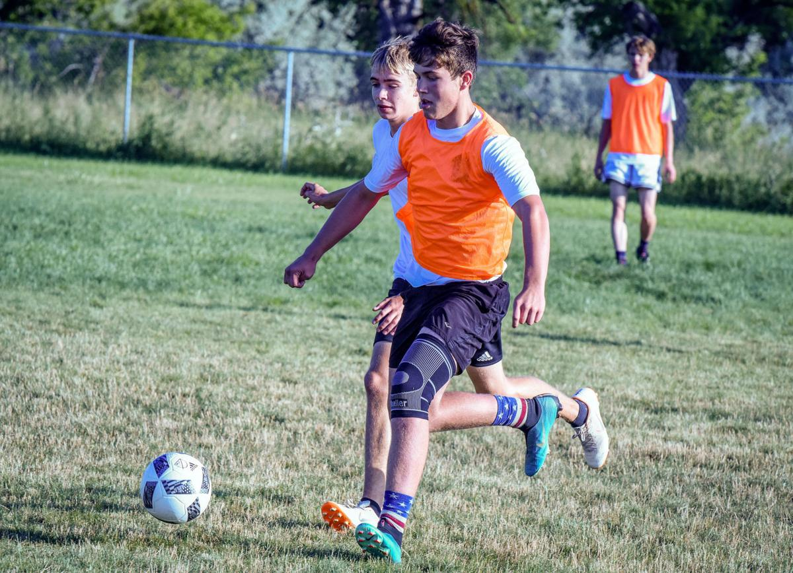
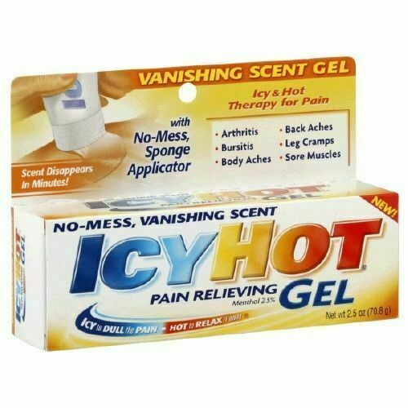
The Soccer Bully Story

Slide 11
Key Verse
Grace and peace to you from God our Father and the Lord Jesus Christ, 4 Who gave Himself for our sins to rescue us from the present evil age, according to the will of our God and Father, 5 to Whom be glory for ever and ever. Amen. Galatians 1:3-5 (NIV)

Slide 13
WHOSE TO BLAME HERE?
Who gave Himself for our sins
WHAT DID WE NEED RESCUED FROM ?
To rescue us
From the present evil age
WHAT IS SO EVIL ABOUT THIS EVIL AGE?

Slide 14
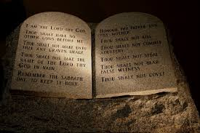
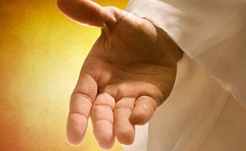
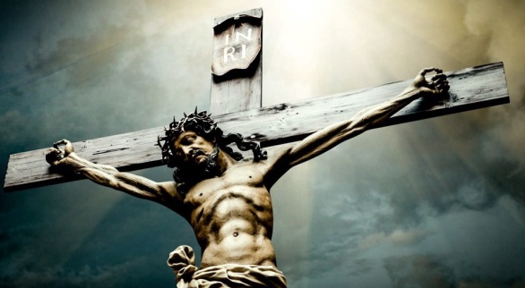
God’s Eternal Design Of Rescue
Genesis 1:27
Romans 5:12
2
1
REBELLION
Good
Fantastic Plan
Bad
Foolishness
Genesis 3:24 – Romans 3:12;23
Romans 6:20-23
Romans 3:26
3
4
God Does Not Set Aside
His Law and Judgments
Good/
Bad
Freewill
Good
Firm
Isaiah 44:22
Isaiah 53:5,6
5
God Asks Us To Return To Him
Frees Us
Good

Slide 15
Jesus Rescues Us
Through The Cross by:
1
Getting Our Attention – From Being Clueless We are Doing something dangerous
2
Taking Our Penalty – Jesus took our punishment – fought the Bully for us – paid our fine – went to JAIL/ HELL for us.
3
Making Us Sorry For Our Sins – Helping us to want to live for this amazing Savior

Slide 16
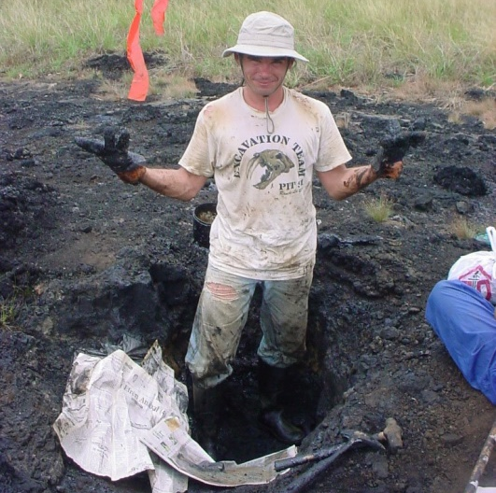
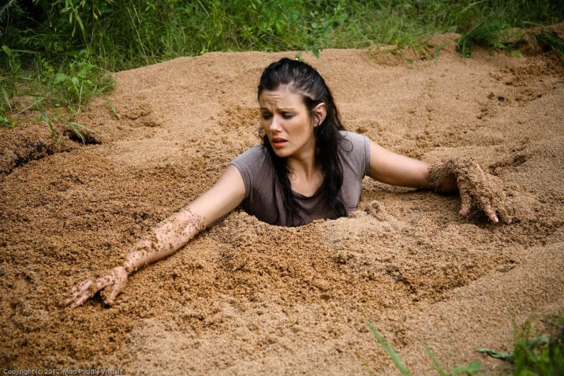
What Is Harder To Be Rescued From?

Slide 17
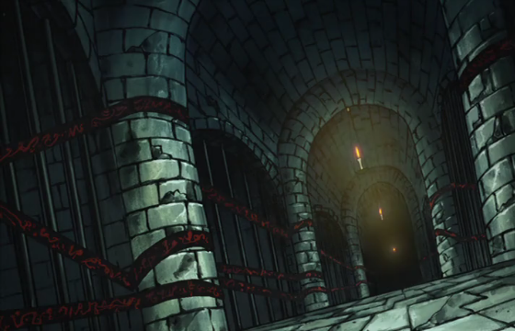
WHY DID GOD MAKE
SOUL PRISON/ JAIL – HELL?
"Then he will say to those on his left, 'Depart from me, you who are cursed, into the eternal fire prepared for the devil and his angels. Matthew 25:41 (NIV)
FOR THE FIRST BULLY IN THE UNIVERSE – Satan –
TO KEEP ALL OF THE OTHER BULLIES OUT OF HEAVEN

Slide 18
Have You Ever Seen A Child Get Bossy with Their Parents?

Slide 19
Have You Ever Seen An Ant Get Bossy With A Human?

Slide 20
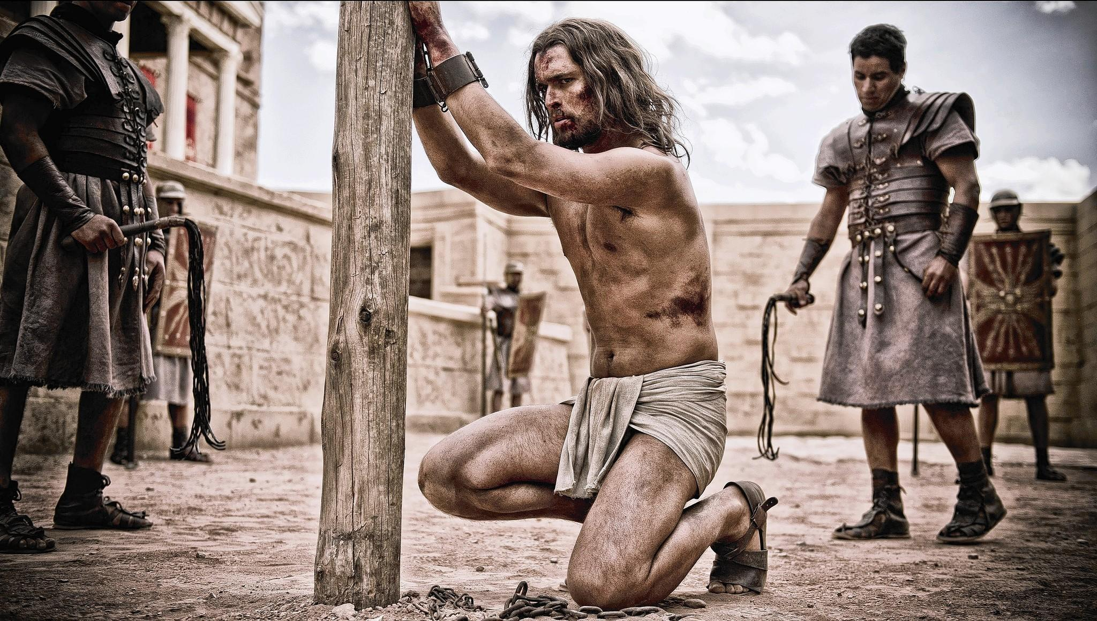
Created Humans Take Charge Of the Creator

Slide 21
One Of The Most Shocking
Verses Of The Bible
Finally Pilate handed Him (Jesus) over to them to be crucified. So the soldiers took charge of Jesus. ¹⁷ Carrying His own cross, he went out to the place of the Skull (which in Aramaic is called Golgotha). ¹⁸ Here they crucified him, and with him two others--one on each side and Jesus in the middle. John 19:16-18 (NIV)

Slide 22
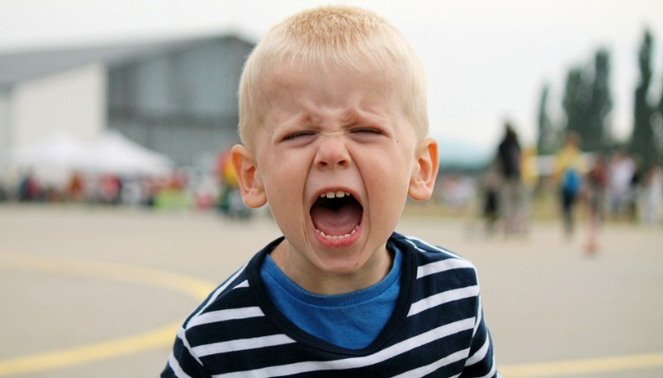
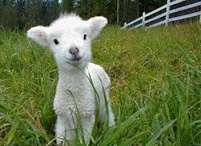
The Whole Thing That Makes Jesus Dying For Us – So Crazy – Is That We Deserve The Punishment – He is Innocent
You
Jesus
Jesus did something painful and crazy for you to give you a blessing you didn't deserve Jesus was innocent and he was treated as a criminal he was treated as deserving death when he deserved to be exalted and lifted high

Slide 23
What If?

Slide 24
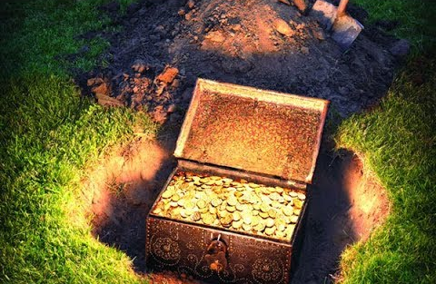
Every Person On The Earth
Today Has Access To The
Key To An Unthinkable
Hidden Treasure

Slide 25
What Is The Key That Opens
The Treasures Of The Cross?

Slide 26
Why Do People Make Fun Of This Plan Of God?
Do you love Jesus for being such a great King?
Will you give Him your heart through the key of FAITH?

