Slide 1
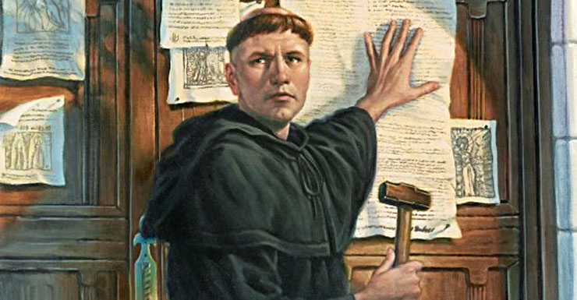
504 Years Since The
Great Reformation
LifeGate Sermon
October 31, 2021

Slide 2
This Is The The Moment
We Are In
¹⁶ Then those who feared the LORD talked with each other, and the LORD listened and heard. A scroll of remembrance was written in his presence concerning those who feared the LORD and honored his name. ¹⁷ "They will be mine," says the LORD Almighty, "in the day when I make up my treasured possession. I will spare them, just as in compassion a man spares his son who serves him. ¹⁸ And you will again see the distinction between the righteous and the wicked, between those who serve God and those who do not. Malachi 3:16-18 (NIV)

Slide 3
Three Revelations
Of 21st Century Reformation
1
God is removing the two primary evil roots that we inherited from the weak Christianity that morphed over probably 50 years in America into DEAD RELIGION. We inherited a double minded spirit that took the GRACE OF GOD and played with sin instead of overcoming it. And secondly we inherited a prayerless church. We did not know how to build an altar of radical prevailing intercession to the Lord. We do not know how to operate out of delegated authority given to God’s people.
2
OVERCOMING THE LIE OF BEING UNQUALIFIED TO SERVE THE LORD - These searched for their family records, but they could not find them and so were excluded from the priesthood as unclean. Ezra 2:62 (NIV) - ¹⁰ For we are God's workmanship, created in Christ Jesus to do good works, which God prepared in advance for us to do. Ephesians 2:10-
3
UNDERSTANDING THE SEASONS OF GOD’S DEALINGS - IT IS TIME TO ACTIVATE A NEW LEVEL OF INTERCESSION AND WORSHIP – I WILL USE YOUR PRAYERS AND OBEDIENCE TO BRING MERCY TO YOUR NATION

Slide 4
How Did We Get Here?
PEOPLE LOOK LIKE THEY WANT GOD – THEY HAVE ENOUGH OF THE LEFT OVER SPIRITUAL CAPITAL FROM THE PREVIOUS GENERATION TO KNOW WHAT IS RIGHT – BUT THEIR HEARTS ARE NOT IN IT – THEY WANT GOD’S PROTECTION AND PROVISION AND BLESSINGS - BUT NOT HIS HOLINESS AND HIS INTENSE NEAR FELLOWSHIP.

Slide 6
Three Revelations
Of 21st Century Reformation
1
God is removing the two primary evil roots that we inherited from the weak Christianity that morphed over probably 50 years in America into DEAD RELIGION. We inherited a double minded spirit that took the GRACE OF GOD and played with sin instead of overcoming it. And secondly we inherited a prayerless church. We did not know how to build an altar of radical prevailing intercession to the Lord. We do not know how to operate out of delegated authority given to God’s people.

Slide 7
Isaiah 58 Challenge
"Shout it aloud, do not hold back. Raise your voice like a trumpet. Declare to my people their rebellion and to the house of Jacob their sins. 2 For day after day they seek me out; they seem eager (inclined with - seem pleased) to know My ways, as if they were a nation that does what is right and has not forsaken the commands of its God. They ask me for just decisions and seem eager for God to come near them. Isaiah 58:1-2

Slide 8
They Seem Eager For God
Think about it – there is a God-shaped hole in our hearts and so coming into a seeking mode to know God “feels good.” But without surrender, without leaving our false-lovers, and repentance the issue remains in doubt – we do not come into UNION WITH GOD without being all in – we may draw near with pretense – but our hearts are in it.
The Lord says: "These people come near to me with their mouth and honor me with their lips, but their hearts are far from me. Their worship of me is made up only of rules taught by men. (Isaiah 29:13)

Slide 9
What Does Total
Surrender Look Like
Elevates God into the Highest Place of Importance in your life – He is number one.
Sustain a proper alignment toward the things of the world
Don’t over-indulge the flesh
Don’t covet things
Don’t become bitter because of pain and suffering.
Love your neighbor for their best interest.

Slide 10
I Thought If We Are Saved
By Grace - God Does It All
It does not, therefore, depend on man's desire or effort, but on God's mercy. Romans 9:16 (NIV)
For the grace of God that brings salvation has appeared to all men. ¹² It teaches us to say "No" to ungodliness and worldly passions, and to live self-controlled, upright and godly lives in this present age, Titus 2:11-12 (NIV)
But by the grace of God I am what I am, and His grace to me was not without effect. No, I worked harder than all of them--yet not I, but the grace of God that was with me. 1 Corinthians 15:10 (NIV)

Slide 11
Three Revelations
Of 21st Century Reformation
2
OVERCOMING THE LIE OF BEING UNQUALIFIED TO SERVE THE LORD - These searched for their family records, but they could not find them and so were excluded from the priesthood as unclean. Ezra 2:62 (NIV) - ¹⁰ For we are God's workmanship, created in Christ Jesus to do good works, which God prepared in advance for us to do. Ephesians 2:10-

Slide 12
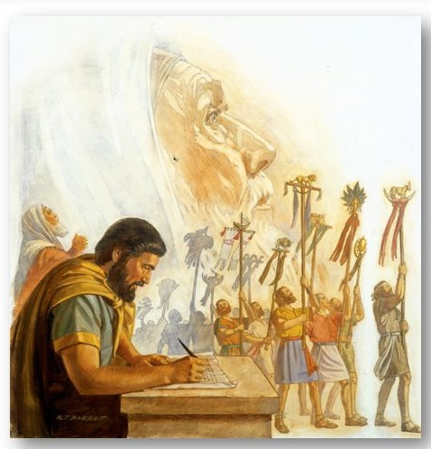
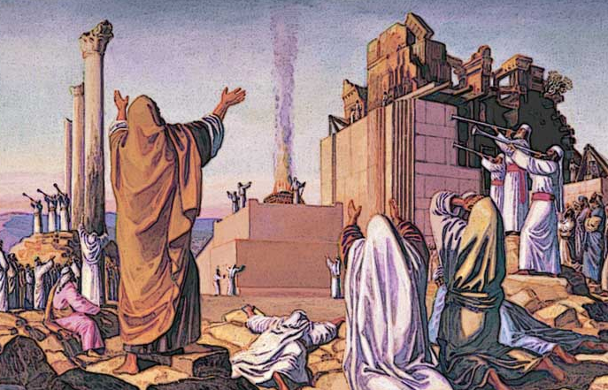
Can You Imagine The Excitement of Returning To The
Promised Land

Slide 13
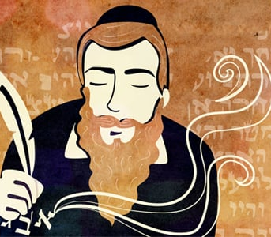
Do Not Believe The Lie
That You Are Disqualified
And from among the priests: The descendants of Hobaiah, Hakkoz and Barzillai 62 These searched for their family records, but they could not find them and so were excluded from the priesthood as unclean. Ezra 2: 61, 62 (NIV)
For we are God's workmanship, created in Christ Jesus to do good works, which God prepared in advance for us to do. Ephesians 2:10-

Slide 14
Practical Application of Overcoming
The Lie Of I’m Unqualified
¹⁷ Therefore, if anyone is in Christ, he is a new creation; the old has gone, the new has come! 2 Corinthians 5:17 (NIV)
I want to reiterate that there is no amount of is of self goodness or self effort that can make us become qualified and holy enough and pure enough and anointed enough to serve God as kings and priests. Only the blood of Jesus purifies us from all unrighteousness and his DNA in us removes self- reliance – fleshly pride and those voices and those circumstances and those lies that tell us we are never going to serve God good enough – we are unclean.
⁹ And they sung a new song, saying, Thou art worthy to take the book, and to open the seals thereof: for You were slain, and have redeemed us to God by thy blood out of every kindred, and tongue, and people, and nation; ¹⁰ And You have made us unto our God kings and priests: and we shall reign on the earth. Revelation 5:9-10 (KJV)

Slide 15
Only Two Things
Make Us Unclean –
Or Disqualify US
¹⁰ And we pray this in order that you may live a life worthy of the Lord and may please him in every way: bearing fruit in every good work, growing in the knowledge of God, ¹¹ being strengthened with all power according to his glorious might so that you may have great endurance and patience, and joyfully Colossians 1:10-11 (NIV)
1
Unconverted Heart – I have not Given my FIRST LOVE TO GOD and repented of my sins – (I AM NOT IN COVENANT WITH GOD)
2
Backslidden Heart – I have forsaken my FIRST LOVE TO GOD – I need to

Slide 16
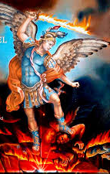
Short Tutorial On God and
Delegated Authority
PART ONE
And God blessed them, and God said unto them, Be fruitful, and multiply, and replenish the earth, and subdue it: and have dominion Genesis 1:28
For God's gifts and His call are irrevocable. Romans 11:29
Wherein in times past you walked according to the course of this world, according to the prince of the power of the air, the spirit that now worketh in the children of disobedience: Ephesians 2:2 (KJV)
But even the archangel Michael, when he was disputing with the devil about the body of Moses, did not dare to bring a slanderous accusation against him, but said, "The Lord rebuke you!" Jude 1:9
Daniel. Since the first day that you set your mind to gain understanding and to humble yourself before your God, your words were heard, and I have come in response to them. ¹³ But the prince of the Persian kingdom resisted me twenty-one days. Then Michael, one of the chief princes, came to help me, because I was detained there with the king of Persia. Daniel 10:12-13) (ALSO – Daniel 9:20-23)
²⁰ The God of peace will soon crush Satan under your feet. The grace of our Lord Jesus be with you. Romans 16:20

Slide 17
Short Tutorial
On God and Delegated Authority
PART TWO
¹⁵ And having disarmed the powers and authorities, he made a public spectacle of them, triumphing over them by the cross. Colossians 2:15 (NIV)
SATAN IS ALREADY DEFEATED BUT HE IS NOT ETERNALLY JUDGED
¹⁸ Then Jesus came to them and said, "All authority in heaven and on earth has been given to me. ¹⁹ Therefore go and make disciples of all nations, baptizing them in the name of the Father and of the Son and of the Holy Spirit, Matthew 28:18-19 (NIV)
⁴ The weapons we fight with are not the weapons of the world. On the contrary, they have divine power to demolish strongholds. 2 Corinthians 10:4 (NIV)
⁵ made us alive with Christ even when we were dead in transgressions--it is by grace you have been saved. ⁶ And God raised us up with Christ and seated us with him in the heavenly realms in Christ Jesus, Ephesians 2:5-6 (NIV)

Slide 18
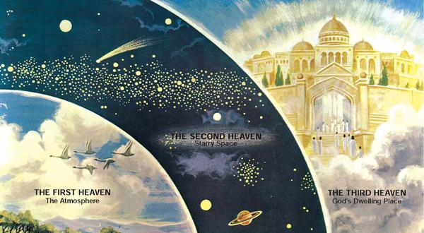
Operating Out of
Third Heaven Authority
Demonic
Principalities
Wickedness In High Places
Third Heaven
Authority
Seated With Christ
PRINCE OF THE POWER OF THE AIR
Spiritual Warfare – RESISTING THE DEVIL
Praise be to the LORD my Rock, who trains my hands for war, my fingers for battle. He is my loving God and my fortress, my stronghold and my deliverer, my shield, in whom I take refuge, who subdues peoples under me. Psalm 144:1-2 (NIV)

Slide 19
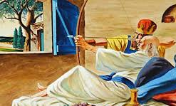
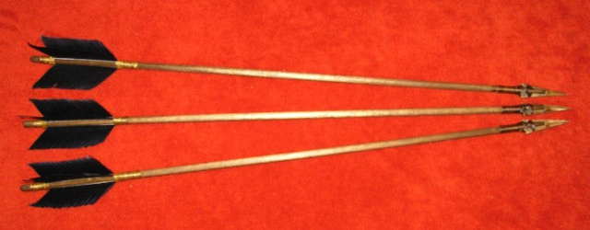
Use Your Delegated
Authority
Elisha said, "Get a bow and some arrows," and he did so. ¹⁶ "Take the bow in your hands," he said to the king of Israel. When he had taken it, Elisha put his hands on the king's hands. ¹⁷ "Open the east window," he said, and he opened it. "Shoot!" Elisha said, and he shot. "The LORD's arrow of victory, the arrow of victory over Aram!" Elisha declared. "You will completely destroy the Arameans at Aphek." ¹⁸ Then he said, "Take the arrows," and the king took them. Elisha told him, "Strike the ground." He struck it three times and stopped. ¹⁹ The man of God was angry with him and said, "You should have struck the ground five or six times; then you would have defeated Aram and completely destroyed it. But now you will defeat it only three times." 2 Kings 13:15-19 (NIV)

Slide 20
Prayer Tools

Slide 21
Three Revelations
Of 21st Century Reformation
3
UNDERSTANDING THE SEASONS OF GOD’S DEALINGS - IT IS TIME TO ACTIVATE A NEW LEVEL OF INTERCESSION AND WORSHIP – I WILL USE YOUR PRAYERS AND OBEDIENCE TO BRING MERCY TO YOUR NATION

Slide 22
Understanding The Seasons
Of God from David’s Trial
Again the anger of the LORD burned against Israel, and he incited David against them, saying, "Go and take a census of Israel and Judah." (¹ Satan rose up against Israel and incited David to take a census of Israel. 1 Chronicles 21:1

Slide 23
God is Grieved Over His Backsliding People
“Aha Moment” Produces
Conviction of sin and desire to take ownership for their selfish choices.
God uses our prayers and obedience to bring
mercy to our
nation
The illumination and exposure of issues and evil.
It is time
to activate a
new level of intercession and worship and obedience
The “whoops
– there is something dreadfully wrong here.” moment
Seasons
Of God’s Dealings
God does come in mercy and interrupt the judgment
The God relents moment – things begin to change – Cease and desist orders are
given
The corrective grace
of God speaks of coming adjustment and judgment
Shaking is
Coming in
Some
Specific
Ways
The sins are forgiven but the judgment and consequences
are still in motion
Get into a deeper place of mercy so you can touch God’s
heart
Perseverance is required
When it seems the shaking
Will not end well
A desperation to touch
The compassion of God moves faith into intercession

Slide 24
Prayer Tools

Slide 25
We May Be In Battle
But We Will Win
And such as do wickedly against the covenant (God’s people) shall he corrupt by flatteries: but the people that do know their God shall be strong, and do exploits. Daniel 11:32 (KJV)

Slide 26
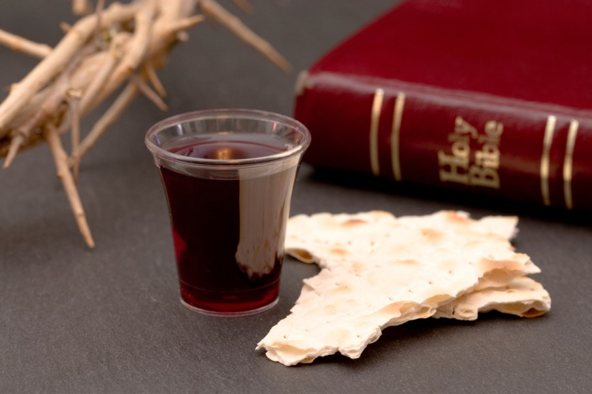
We Are Only Going
To Be Able To Do Exploits
Because Of The Cross
¹⁰ Concerning this salvation, the prophets, who spoke of the grace that was to come to you, searched intently and with the greatest care, ¹¹ trying to find out the time and circumstances to which the Spirit of Christ in them was pointing when He predicted the sufferings of Christ and the glories that would follow. ¹² It was revealed to them that they were not serving themselves but you, when they spoke of the things that have now been told you by those who have preached the gospel to you by the Holy Spirit sent from heaven. Even angels long to look into these things. 1 Peter 1:10-12 (NIV)

