Slide 2
Isaiah Chapter 55
The Final 14 Chapters
Chapters 53-66
Sunday, January 23, 2022

Slide 3
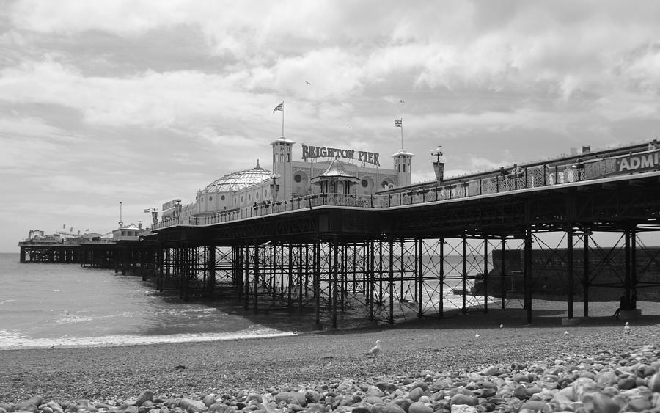
When We Forsake God

Slide 4
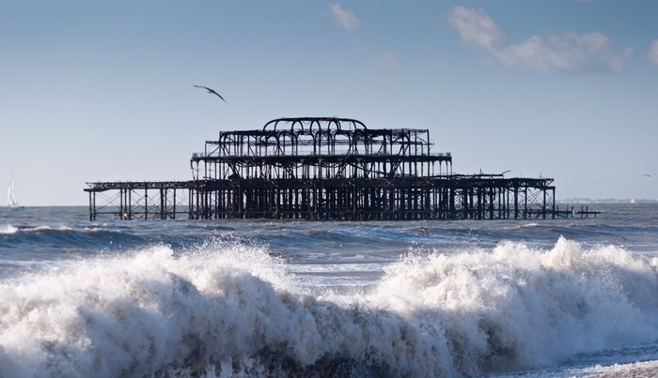
The Skeleton Can Remain

Slide 5
At Some Point We Have To Live Out - Our Mission
We all go through a process to prepare us for things God intends to accomplish in and through our lives. This process takes place as we live life and walk with the Lord. However, our lives are not meant to be a perpetual preparation process. When we cross over into the timing of God—our ‘such a time as this’ moment—there is a thrust from Him that accelerates us into position. Then the revealing and release of the purposes of God through us can occur. We can never come to the place where we stop growing and learning, but we do eventually come to those moments, as did Esther, which launch us into the position of (effectual spiritual impact)! Gina Gholston

Slide 6
Let’s Revisit Isaiah 54
"Sing, O barren woman, you who never bore a child; burst into song, shout for joy, you who were never in labor; because more are the children of the desolate woman than of her who has a husband," says the LORD. Isaiah 54:1 (NIV)
For it is written that Abraham had two sons, one by the slave woman and the other by the free woman. 23 His son by the slave woman was born in the ordinary way; but his son by the free woman was born as the result of a promise. Galatians 4:21-23 (NIV)

Slide 7
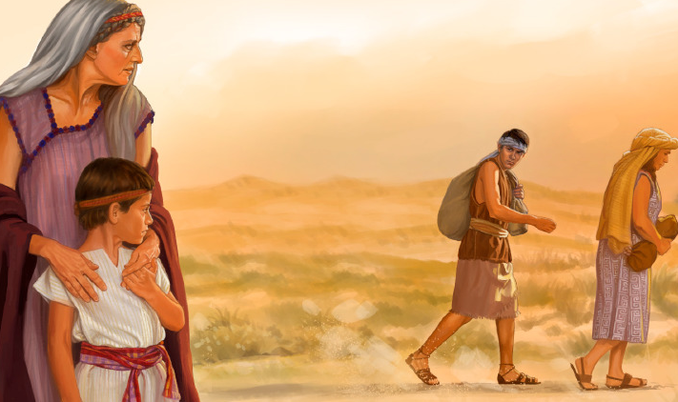
THE PRINCIPLE OF FAITH Vs. FLESH
THERE IS THIS PRINCIPLE OF LIVING IN FAITH – AND GOD ALLOWS YOU TO FEEL BARREN (EVEN AS YOU PURPOSE TO LIVE IN FAITH) – SO YOU TRY TO FIX THINGS IN THE FLESH. BUT IF YOU STAY IN FAITH – YOU WILL ULTIMATELY BE MORE FRUITFUL THAN DOING THINGS IN THE FLESH – EVEN THOUGH YOU WILL HAVE A SEASON WHERE RELIGION WILL MOCK YOU AND SHOW YOU ALL HER CHILDREN.

Slide 8
Isaiah 55
¹ "Come, all you who are thirsty, come to the waters; and you who have no money, come, buy and eat! Come, buy wine and milk without money and without cost. ² Why spend money on what is not bread, and your labor on what does not satisfy? Listen, listen to me, and eat what is good, and your soul will delight in the richest of fare. ³ Give ear and come to me; hear me, that your soul may live. I will make an everlasting covenant with you, my faithful love promised to David. ⁴ See, I have made Him a witness to the peoples, a leader and commander of the peoples. ⁵ Surely you will summon nations you know not, and nations that do not know you will hasten to you, because of the LORD your God, the Holy One of Israel, for He has endowed you with splendor." ⁶ Seek the LORD while He may be found; call on Him while He is near. ⁷ Let the wicked forsake his way and the evil man his thoughts. Let him turn to the LORD, and He will have mercy on him, and to our God, for He will freely pardon. ⁸ "For My thoughts are not your thoughts, neither are your ways My ways," declares the LORD. ⁹ "As the heavens are higher than the earth, so are My ways higher than your ways and My thoughts than your thoughts. ¹⁰ As the rain and the snow come down from heaven, and do not return to it without watering the earth and making it bud and flourish, so that it yields seed for the sower and bread for the eater, ¹¹ so is My Word that goes out from My mouth: It will not return to me empty, but will accomplish what I desire and achieve the purpose for which I sent it. ¹² You will go out in joy and be led forth in peace; the mountains and hills will burst into song before you, and all the trees of the field will clap their hands. ¹³ Instead of the thornbush will grow the pine tree, and instead of briers the myrtle will grow. This will be for the LORD's renown, for an everlasting sign, which will not be destroyed." Isaiah 55:1-13 (NIV)

Slide 9
The Prophetic Pathways of Isaiah
Prophetic Tense or Trajectory
A NOW WORD to a current King who was alive during Isaiah’s ministry.
A Future word for a future leader in the earth
A FUTURE WORD predicting the coming of Jesus the Messiah
A future word of the type of ministry Jesus was going to operate in and accomplish
A NOW WORD calling Israel and her Kings and people to obedience and repentance
A FUTURE WORD of the Gospel calling future generations into spiritual victory
A FUTURE PROPHETIC WORD concerning the Church impacting the world
A FUTURE PROPHETIC WORD concerning the LAST DAYS
A FUTURE PROPHETIC WORD concerning the Millennium (Thousand year reign of Christ)
FUTURE PROPHETIC WORD concerning eternity with God or eternity in hell

Slide 10
Isaiah 55:1
"Come, all you who are thirsty, come to the waters; and you who have no money, come, buy and eat! Come, buy wine and milk without money and without cost.
WE ARE THIRSTY FOR SOMETHING – WHAT ARE WE THIRSTY FOR?
On the last and greatest day of the Feast, Jesus stood and said in a loud voice, "If anyone is thirsty, let him come to me and drink. ³⁸ Whoever believes in me, as the Scripture has said, streams of living water will flow from within him." John 7:37-38 (NIV)

Slide 11
The Pie Chart of Thirst

Slide 12
God Made Us To Thirst After Himself
¹⁹ And the LORD said, "I will cause all my goodness to pass in front of you, and I will proclaim my name, the LORD, in your presence. I will have mercy on whom I will have mercy, and I will have compassion on whom I will have compassion. Exodus 33:19 (NIV)
As the deer pants for streams of water, so my soul pants for you, O God. ² My soul thirsts for God, for the living God. When can I go and meet with God? Psalm 42:1-2 (NIV)
⁶ Blessed are those who hunger and thirst for righteousness, for they will be filled. Matthew 5:6 (NIV)

Slide 13
How Do We Drink Jesus?
We DRINK Jesus by taking our thirstiness and surrendering it to the LORDSHIP of Christ and confessing we have drunk from other wells that have not SATISFIED - CONFESSION AND REPENTANCE
¹³ "My people have committed two sins: They have forsaken me, the spring of living water, and have dug their own cisterns, broken cisterns that cannot hold water. Jeremiah 2:13 (NIV)
We DRINK Jesus by moving beyond this world of distraction and even religious duties and seeking the Lord with ALL OF OUR HEART – putting aside laziness – false thirsts – dead religion and persistently FELLOWSHIPPING WITH THE LORD
²⁰ Here I am! I stand at the door and knock. If anyone hears my voice and opens the door, I will come in and eat with him, and he with me. Revelation 3:20 (NIV)

Slide 14
THE FOUR ROOT LIES THAT LEAD TO NOT TASTING THAT THE LORD IS GOOD
They know there is an expectation in God for them to forsake and cut off all of their ties to their sexual perversions their financial perversions their relationship perversions and their attitude perversions - but they reason away the call of God’s Word to live out a true repentance. And come up with, “The Scripture really doesn’t say that.” TWISTING THE TRUTH
Others do not THIRST AFTER GOD because they believe it's not possible not only do the y think that God does not require us to drink deeply of Himself but they believe it’s an impossible standard. “We're always going to be compromised.” We are saved by grace and God loves the sinner we are good to go. - NO EXPECTATION FOR VICTORY!
The third reason is just plain ignorance they don't know any better this is the way to live and they do not even think about HUNGERING AND THIRSTING AFTER GOD - IGNORANCE
The fourth reason is “I know GOD WANTS ME TO THIRST AFTER HIMSELF - but I am stubborn I am a person of resistance; I have a chip on the shoulder I'm going to do what I want - If God doesn’t like that - I don't care and nobody else cares. HORRIBLE SELFISH REBELLION

Slide 15
Isaiah 55:2, 3
Why spend money on what is not bread, and your labor on what does not satisfy? Listen, listen to Me, and eat what is good, and your soul will delight in the richest of fare.
THERE’S NO WAY YOU CAN PAY FOR WHAT YOU REALLY NEED – YOU HAVE NO MONEY TO BUY SALVATION AND SATISFACTION.
Give ear and come to me; hear me, that your soul may live. I will make an everlasting covenant with you, my faithful love promised to David.

Slide 16
True Covenant is hated by the Devil
One of the greatest lies that the enemy has perpetrated from the very beginning is that uncovenanted living together is more exciting than being in a committed relationship. The enemy is constantly breaking up or making fun of deeply committed relationships between people. This is why the masses are doing whatever they want to do. They have no respect or hunger for covenant relationships. God is at the highest level of that assault. The Devil is always attacking covenant with God. He glamorizes compromised living and paints devotion to God and marriage as old-fashioned.

Slide 17
True Satisfaction
Emptiness will always cry out to be satisfied. This will never change. And as long as we continue to fill our emptiness with fleshly things we will only experience more emptiness and grieve the heart of God. Jesus the bondage Breaker introduces a radical motive into our life that is not rooted in getting our way, escaping pain, getting a better life, or having more intense pleasure: It is rooted in God-centeredness. This motive is the motive of pure love for an all-deserving Savior. And this love choses to “taste and see that the Lord is good.” Once we taste the Lord, our emptiness is exposed for the selfish thing that it is and true satisfaction begins to fill our whole life as we pursue the Lord for HIS NAME SAKE. Don Lamb

Slide 19
Isaiah 55:4, 5
See, I have made Him (Jesus) a Witness to the peoples, a leader and commander of the peoples. 5 Surely you (church) will summon nations you know not, and nations that do not know you will hasten to you, because of the LORD your God, the Holy One of Israel, for he has endowed you with splendor."
Jesus is the ULTIMATE WITNESS – (literal Prince)
The Gospel in the hands of the Church is a WITNESS TO THE NATIONS

Slide 20
Isaiah 55:6, 7
6 Seek the LORD while He may be found; call on Him while He is near. 7 Let the wicked forsake His way and the evil man his thoughts. Let him turn to the LORD, and He will have mercy on him, and to our God, for He will freely pardon.
GOD HAS ALREADY MOVED – HE IS NOT WAITING TO MOVE – HE HAS MOVED – HE IS NEAR. SALVATION REQUIRES REPENTANCE – A CHANGE OF HEART – YES INITIATED BY GOD – BUT RECEIVED AND EMBRACED BY THE SOUL OF MAN

Slide 21
Isaiah 55:8, 9
"For my thoughts are not your thoughts, neither are your ways my ways," declares the LORD. 9 "As the heavens are higher than the earth, so are my ways higher than your ways and my thoughts than your thoughts.
We live in a world that ARROGANTLY IMPUGNS GOD when it can’t figure out what He is doing – or it judges that HIS WORD is old fashioned or out of touch or simply UNTRUSTWORTHY
We can REST IN THE FACT – that we will not always figure out instantly what God is doing – but we can be ASSURED that He is HOLY.

Slide 22
Isaiah 55:10, 11
As the rain and the snow come down from heaven, and do not return to it without watering the earth and making it bud and flourish, so that it yields seed for the sower and bread for the eater, 11 so is my Word that goes out from my mouth: It will not return to me empty (VOID) , but will accomplish what I desire and achieve the purpose for which I sent it.
The word of God acts supernaturally according to LAWS OF FAITH AND TRUTH – just like the rain and clouds operate according to natural laws of moisture and evaporation. – YOU CAN’T STOP THESE LAWS – JUST BECAUSE YOU DON’T WANT TO BELIEVE IN THEM

Slide 23
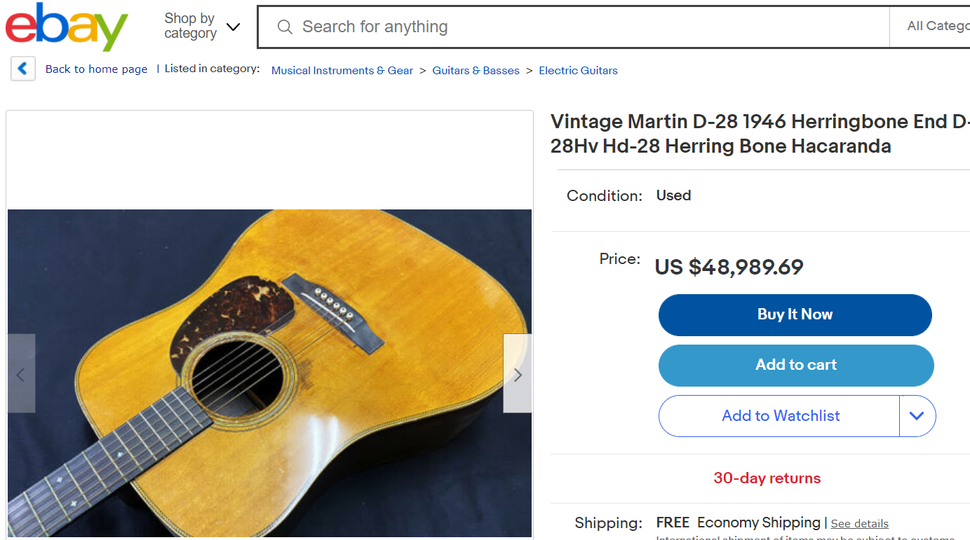
The Frequency of God’s Word

Slide 24
Isaiah 55:12, 13
. ¹² You will go out in joy and be led forth in peace; the mountains and hills will burst into song before you, and all the trees of the field will clap their hands. ¹³ Instead of the thornbush will grow the pine tree, and instead of briers the myrtle will grow. This will be for the LORD's renown, for an everlasting sign (concealed vanishing point) , which will not be destroyed." Isaiah 55:1-13
There will be a real TRANSFORMATION – when things happen spiritually – PEACE WILL COME – SONGS WILL COME – thorns will become pine -

Slide 25
Everlasting Salvation Or Judgment
The mighty God, The everlasting Father,
(mankind) has broken the everlasting covenant
for in the LORD JEHOVAH is everlasting strength
who among us shall dwell with everlasting burnings?
and everlasting joy upon their heads:
an everlasting salvation
for the LORD shall be thine everlasting light
²⁴ "And they will go out and look upon the dead bodies of those who rebelled against me; their worm will not die, nor will their fire be quenched, and they will be loathsome to all mankind." Isaiah 66:24 (NIV)

Slide 26
How To Be An Isaiah 55 Influence
1 – Encourage people to seek the Lord for true freedom and satisfaction
2- Sow the seeds of the Gospel – give them bread
3 – Encourage people concerning their true Purpose to life.
4 – Give them the revelation of SEEKING GOD while He is NEAR.
5 - Stand on the Word and let it speak don’t apologize
Be an influence of peace and productive rebuilding where possible.

