Slide 2
Isaiah 56 “A Name Better than Sons and Daughters!

Slide 3
Isaiah-Mini-bible
https://isaiahminibible.com
66 Chapters of the Book of Isaiah
66 Books of the Bible
Each book correspond to a chapter

Slide 4
Isaiah 1-39=The Creation, Fall, Israel, The Law, and Judgement of God
Isaiah 40-66 = Salvation, the Coming of the Lord and the Eternal State

Slide 5
ISAIAH 43:10 …understand that I am he: before me there was no God formed, neither shall there be after me.
____________________________________ JOHN 13:19 …when it is come to pass, ye may believe that I am he. JOHN 8:24 …if ye believe not that I am he, ye shall die in your sins. JOHN 8:28 …then shall ye know that I am he… JOHN 18:8 Jesus answered, I have told you that I am he…

Slide 6
Isaiah 39:5-7
⁵ Then Isaiah said to Hezekiah, “Hear the word of the Lord Almighty:
⁶ The time will surely come when everything in your palace, and all that your predecessors have stored up until this day, will be carried off to Babylon. Nothing will be left, says the Lord.

Slide 7
⁷ And some of your descendants, your own flesh and blood who will be born to you, will be taken away, and they will become eunuchs in the palace of the king of Babylon.”

Slide 8
Isaiah 40
Comfort, comfort my people, says your God. ² Speak tenderly to Jerusalem, and proclaim to her that her hard service has been completed, that her sin has been paid for, that she has received from the Lord’s hand double for all her sins.

Slide 9
³ A voice of one calling: “In the wilderness prepare the way for the Lord; make straight in the desert a highway for our God.

Slide 10
⁴ Every valley shall be raised up, every mountain and hill made low; the rough ground shall become level, the rugged places a plain.

Slide 11
Isaiah 56
1“Maintain justice and do what is right, for my salvation is close at hand and my righteousness will soon be revealed. ² Blessed is the one who does this— the person who holds it fast, who keeps the Sabbath without desecrating it, and keeps their hands from doing any evil.”

Slide 12
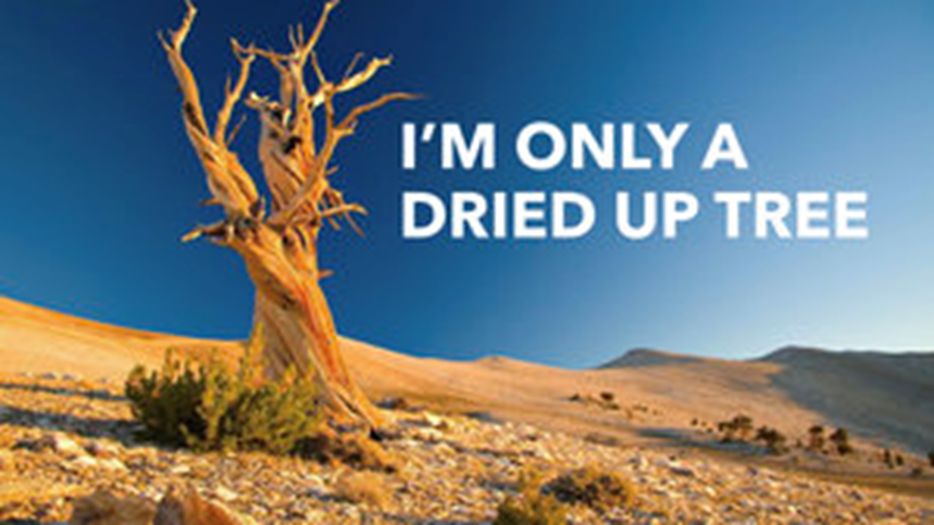
³ Let no foreigner who is bound to the Lord say, “The Lord will surely exclude me from his people.” And let no eunuch complain, “I am only a dry tree.”

Slide 13
⁴ For this is what the Lord says:
“To the eunuchs who keep my Sabbaths, who choose what pleases me and hold fast to my covenant—

Slide 14
⁵ to them I will give within my temple and its walls a memorial and a name better than sons and daughters; I will give them an everlasting name that will endure forever.

Slide 15
⁵ to them I will give within my temple and its walls a memorial and a name better than sons and daughters; I will give them an everlasting name that will endure forever.

Slide 16
⁶ And foreigners who bind themselves to the Lord to minister to him, to love the name of the Lord, and to be his servants, all who keep the Sabbath without desecrating it and who hold fast to my covenant—

Slide 17
⁷ these I will bring to my holy mountain and give them joy in my house of prayer. Their burnt offerings and sacrifices will be accepted on my altar; for my house will be called a house of prayer for all nations.”

Slide 18
⁸ The Sovereign Lord declares— he who gathers the exiles of Israel: “I will gather still others to them besides those already gathered.”

Slide 19
⁹ Come, all you beasts of the field, come and devour, all you beasts of the forest!

Slide 20
¹⁰ Israel’s watchmen are blind, they all lack knowledge; they are all mute dogs, they cannot bark; they lie around and dream, they love to sleep.

Slide 21
¹¹ They are dogs with mighty appetites; they never have enough. They are shepherds who lack understanding; they all turn to their own way, they seek their own gain.

Slide 22
¹² “Come,” each one cries, “let me get wine! Let us drink our fill of beer! And tomorrow will be like today, or even far better.”

Slide 23
ISAIAH 56:1 “Maintain justice and do what is right, for my salvation is close at hand and my righteousness will soon be revealed.”
Titus 2:12 Teaching us that… we should live soberly, righteously, and godly… 13Looking for… the glorious appearing of the great God and our Saviour Jesus Christ;

Slide 24
Titus 3:1-2 Be subject to ruler and authorities, to be obedient, to be ready to do whatever is good, to slander no one, to be peaceable and considerate, and to sho true humility toward all men.

Slide 25
How shall we do this?
Know who you are!
You have Name better than sons and daughters.

Slide 26
1 John 4: 16 “And so we know and rely on the love God has for us. God is love Whoever lives in love lives in God, and God in them.
¹⁷ This is how love is made complete among us so that we will have confidence on the day of judgment: In this world we are like Jesus.

Slide 27
²⁰ That, however, is not the way of life you learned ²¹ when you heard about Christ and were taught in him in accordance with the truth that is in Jesus. ²² You were taught, with regard to your former way of life, to put off your old self, which is being corrupted by its deceitful desires; ²³ to be made new in the attitude of your minds; ²⁴ and to put on the new self, created to be like God in true righteousness and holiness.

Slide 28
1 Corinthians 6:17 “ He who unites himself with the Lord is ONE with him in spirit.”
One=grk- singular one to the exclusion of the other.

Slide 29
2 Corinthians 5:17 “ Therefore, if anyone is in Christ, the new creation has come: The old has gone, the new is here!”

Slide 30
²⁰ We are therefore Christ’s ambassadors, as though God were making his appeal through us. We implore you on Christ’s behalf: Be reconciled to God.

Slide 31
²¹ God made him who had no sin to be sin^{[b]} for us, so that in him we might become the righteousness of God.

Slide 32
1 Corinthians 2:15-16
¹⁵ The person with the Spirit makes judgments about all things, but such a person is not subject to merely human judgments, ¹⁶ for,
“Who has known the mind of the Lord so as to instruct him?”
But we have the mind of Christ.

Slide 33
So What?
Maintain Justice
Do what is right
Believe that his Salvation is close at hand
Discern what is happening in the spirit
Your holiness is not based on your performance
“Created” means you had nothing to do with it.
Your spirit is perfect= Your spirit is identical to the Lord’s Spirit
Acknowledge God in all of your ways

Slide 34
Come on my soul
Oh don’t you get shy on me
Lift up your song
‘Cause you’ve got a lion inside of those lungs
Get up and praise the Lord

