Slide 1
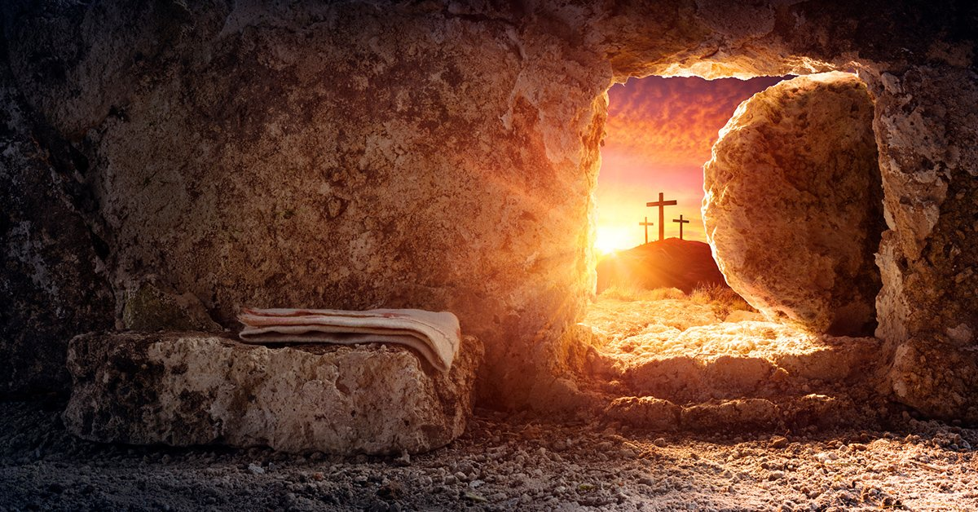
Sunday, April 17, 2022
The Resurrection Of Jesus
Changes Iron Hearts

Slide 2
The Resurrection
The Greatest Culmination
Of A Divine Rescue Operation
May the God of peace, who through the blood of the eternal covenant brought back from the dead our Lord Jesus, that great Shepherd of the sheep, ²¹ equip you with everything good for doing His will, and may He work in us what is pleasing to Him, through Jesus Christ, to Whom be glory for ever and ever. Amen. Hebrews 13:20-21 (NIV)

Slide 3
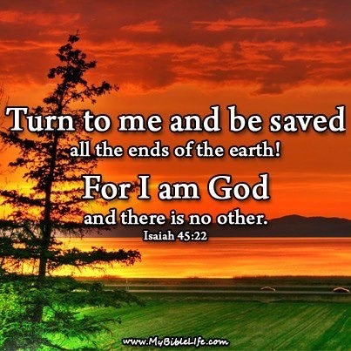
If There Were Going
To Be Humans?
There Had To
Be A Savior
To Rescue
Them

Slide 4
ISAIAH DECLARES– GOD DOES THE RIGHT THING –
SETS US UP FOR SUCCESS – AND THEN MANKIND STILL REBELS - ADAM AND EVE – ISRAEL – THE CHURCH
Hear, O heavens! Listen, O earth! For the LORD has spoken: "I reared children and brought them up, but they have rebelled against me. Isaiah 1:2 (NIV)
He dug it up and cleared it of stones and planted it with the choicest vines. He built a watchtower in it and cut out a winepress as well. Then He looked for a crop of good grapes, but it yielded only bad fruit. 3 "Now you dwellers in Jerusalem and men of Judah, judge between me and my vineyard. 4 What more could have been done for my vineyard than I have done for it? When I looked for good grapes, why did it yield only bad? Isaiah 5:2-4 (NIV)

Slide 5
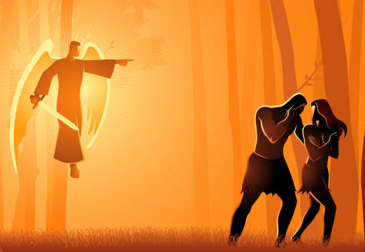
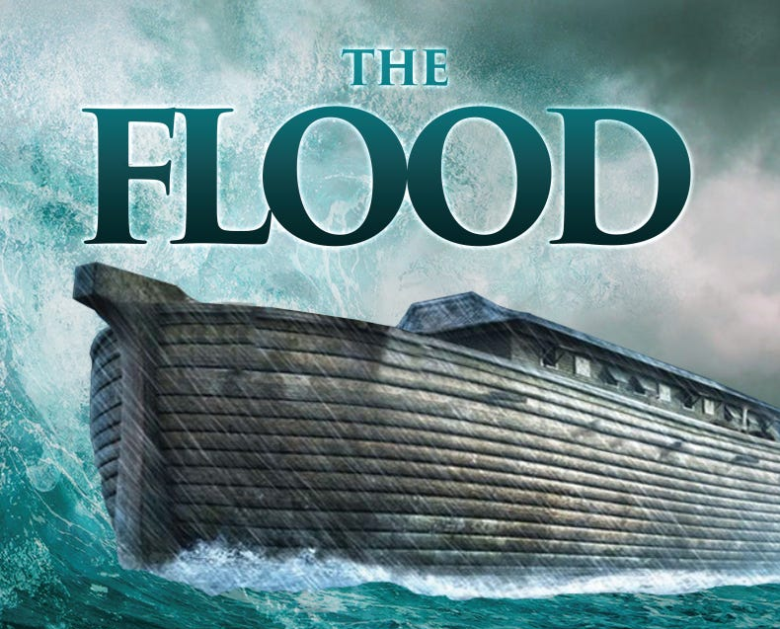
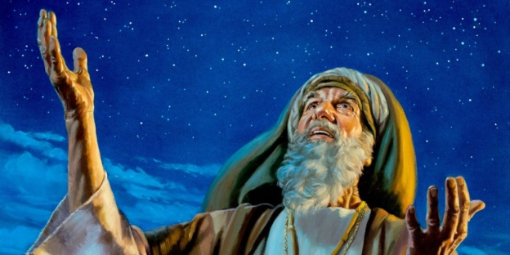
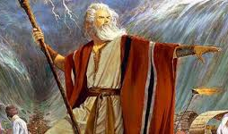
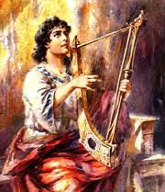
The Radical Plan –
Nothing Was An Accident
Abraham
Creation – Adam and Eve
Moses
David
Isaiah
Jesus Christ

Slide 6
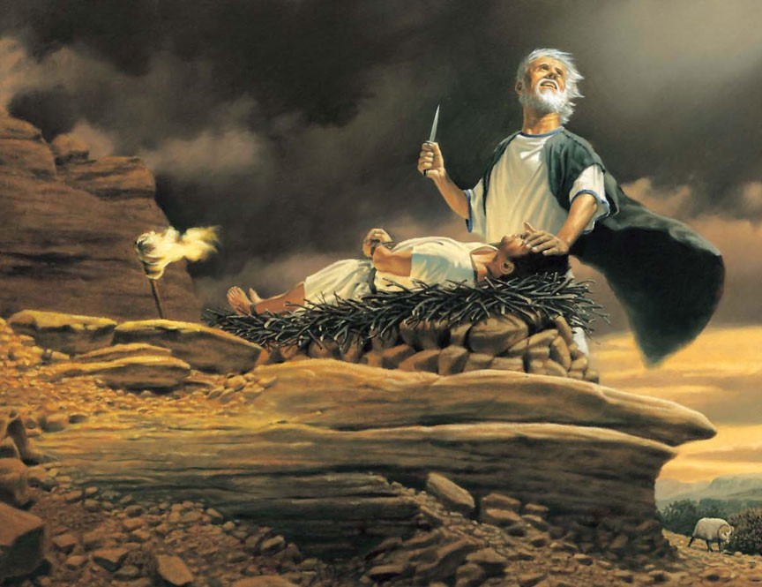
WHEN IS THE FIRST TIME THE WORD LOVE
SHOWS UP IN SCRIPTURE?
Then God said, "Take your son, your only son, Isaac, whom you love, and go to the region of Moriah. Sacrifice him there as a burnt offering on one of the mountains I will tell you about." Genesis 22:2 (NIV)

Slide 7
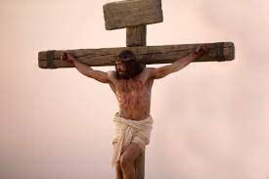
LOVE
For

Slide 8
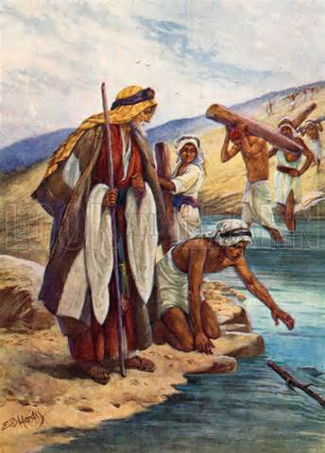
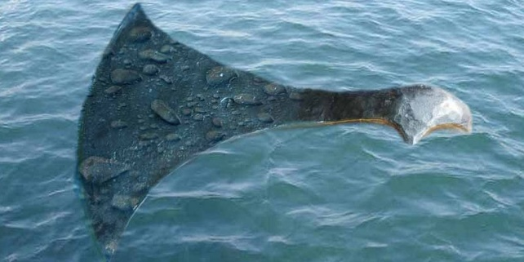
A Short Story Tells It All
. They went to the Jordan and began to cut down trees. ⁵ As one of them was cutting down a tree, the iron axhead fell into the water. "Oh, my lord," he cried out, "it was borrowed!" ⁶ The man of God asked, "Where did it fall?" When he showed him the place, Elisha cut a stick (branch) and threw it there, and made the iron float. ⁷ "Lift it out," he said. Then the man reached out his hand and took it. 2 Kings 6:4-7

Slide 9
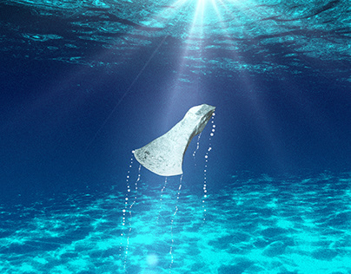
Detached From God WE SINK Down Into
THE RIVER OF SELFISHNESS AND SIN

Slide 10
PUTTING THE BRANCH OF CHRIST AND His
RESURRECTING POWER OVER US
REVERSES OUR SINKING INTO THE RIVER OF SIN
⁵ "The days are coming," declares the LORD, "when I will raise up to David a righteous Branch, a King Who will reign wisely and do what is just and right in the land. ⁶ In His days Judah will be saved and Israel will live in safety. This is the Name by which He will be called: The LORD Our Righteousness. Jeremiah 23:5-6 (NIV)

Slide 11
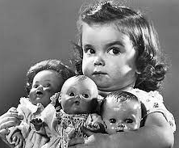
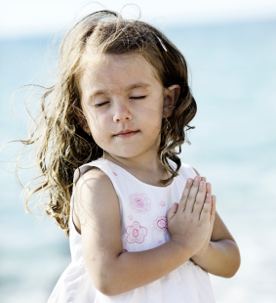
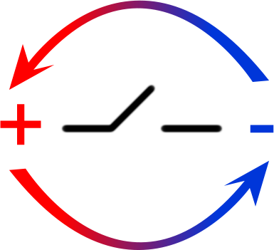
THE CROSS AND THE RESURRECTION
REVERSES THE POLARITY
OF OUR SELFISH HEART
-
+
Selfish
Loving

Slide 12
Heart of Stone Into A Living Heart
I will give them an undivided heart and put a new spirit in them; I will remove from them their heart of stone and give them a heart of flesh. Ezekiel 11:19 (NIV)
I will give you a new heart and put a new spirit in you; I will remove from you your heart of stone and give you a heart of flesh. Ezekiel 36:26 (NIV)

Slide 13
FLOATING ABOVE THE RIVER OF SIN INTO THE PLACE SNATCHED BY THE FATHER FOR HIS RESTORED PURPOSES
Think about this Divine revelation that Jesus on the cross redeemed everything – especially our cold selfish hearts.
Your life is borrowed and though it may seem like it's an accident (IT BELONGS TO GOD) and it will keep sinking down into the river selfishness unless God redeems it.

Slide 14
And so the Father in His sovereign love picks up a Branch (Christ and His saving work on the cross) and spreads it over that river of death and made the axe head of your iron heart float.
And by faith – our cold iron heart starts to float above the river of selfishness - the river of sin - the river of bondage because of the Cross
Think about it - if you don't apply the cross to your appetites you will sink in the river of self-gratification forever. So when you put the cross to your sexuality you will live pure and you will live in Covenant with someone of the opposite sex biblically in self-control and love.

Slide 15
When you put the cross over your finances you will use your finances and steward them in the fear of the Lord and you're not constantly shopping just to get a high and feel good or to make yourself happy but you're always using your money in the fear of the Lord which otherwise you wouldn't do.
So the power of the Cross is that God actually gets you into a place where you're floating above the river of selfishness and sin and you pursue Him - which in all cases you would not have done if there was not a Branch stretched out over you motivating your iron heart to float. Without that influence you're a complete failure at life – you roam the world indulging and living for the continual downward spiral of the river of self-worship.

Slide 16
DIVINE RUPTURE OF THE HEAVENS
CALLOUSED HEARTS BEGIN TO LOVE
SCALED OVER EYES BEGIN TO SEE
The God of our fathers raised Jesus from the dead--whom you had killed by hanging Him on a tree. 31 God exalted Him to his own right hand as Prince and Savior that he might give repentance and forgiveness of sins to Israel. 32 We are witnesses of these things, and so is the Holy Spirit, whom God has given to those who obey him." Acts 5:30-32 (NIV)

Slide 17
New Testament Scriptures
Declaring The Iron Floats
But thanks be to God that, though you used to be slaves to sin, you wholeheartedly obeyed the form of teaching to which you were entrusted. 18 You have been set free from sin and have become slaves to righteousness. Romans 6:17-18 (NIV)
Therefore, if anyone is in Christ, he is a new creation; the old has gone, the new has come! 18 All this is from God, who reconciled us to himself through Christ and gave us the ministry of reconciliation: 2 Corinthians 5:17-18 (NIV)

Slide 18
The Lord Doesn’t Want Us Focused
on What We Hate About Ourselves
Many times we focus on what we hate about ourselves.
But we need to focus MORE on what we LOVE ABOUT GOD. We constantly come back to our own deficiencies and problems without allowing there to be a faith declaration that God is working in us to change us.
So many people have a negative natural tendency about themselves they hate their lethargic lazy moody self. So they don't make friends well - they struggle with depression so they are always thinking about themselves and they can never get their eyes on Jesus for any length of time – the ONE who is holding the CROSS over their lives so they can float above the river of sin.
meditate on what they hate about themselves and wonder why they're depressed were their circumstances why their circumstances continue to be extraordinary really worse than everybody else's again they're not thinking about Jesus Paul tells us in Colossians 3 sink on these things above not on worldly things where your life is hid in Christ so as you think of Christ you're thinking of your life as you think of Jesus you're thinking about your life as you think about his qualities of persistence daring rescuing forgiving love that is what gives us hope that is what gives us strength that is what gives us the ability to deal with are negatives

Slide 19
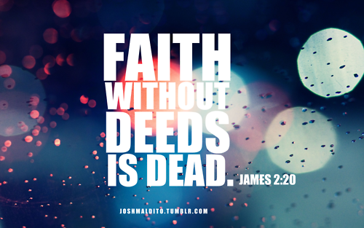
We Have To Partner With God
To Receive The Blessing
ACTION

Slide 21
JUDE’s FINAL WORDS
²² Be merciful to those who doubt; ²³ snatch others from the fire and save them; to others show mercy, mixed with fear--hating even the clothing stained by corrupted flesh. ²⁴ To Him who is able to keep you from falling and to present you before His glorious presence without fault and with great joy-- ²⁵ to the only God our Savior be glory, majesty, power and authority, through Jesus Christ our Lord, before all ages, now and forevermore! Amen. Jude 1:22-25 (NIV)

Slide 22
PAUL’S DOXOLOGY
Now to Him Who is able to establish you by my gospel and the proclamation of Jesus Christ, according to the revelation of the mystery hidden for long ages past, ²⁶ but now revealed and made known through the prophetic writings by the command of the eternal God, so that all nations might believe and obey Him-- ²⁷ to the only wise God be glory forever through Jesus Christ! Amen. Romans 16:25-27 (NIV)

