Slide 1
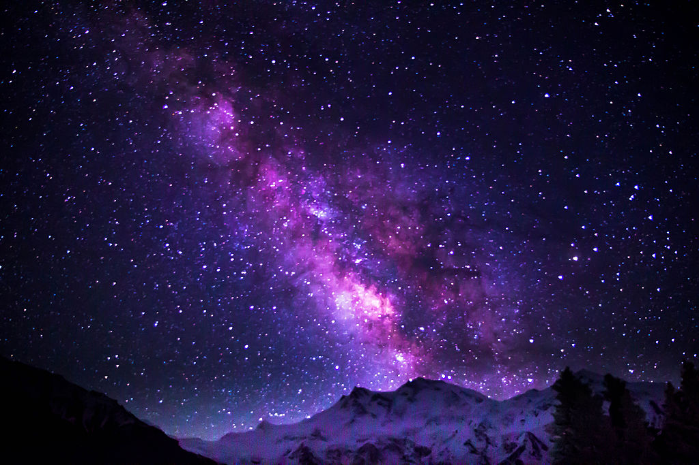
WHERE DOES GOD LIVE?

Slide 2
Where Does God Live?
2 Chronicles 2:6
⁶ But who is able to build a temple for him, since the heavens, even the highest heavens, cannot contain him? Who then am I to build a temple for him, except as a place to burn sacrifices before him?

Slide 4
66

Slide 5
Isaiah 66
(WHERE DOES GOD LIVE?)
Judgement and Hope
(WHERE DOES GOD LIVE?)

Slide 7
1 Kings 8:25-27
²⁶ And now, God of Israel, let your word that you promised your servant David my father come true.
²⁷ “But will God really dwell on earth? The heavens, even the highest heaven, cannot contain you. How much less this temple I have built!

Slide 8
This is what the Lord says:
“Heaven is my throne, and the earth is my footstool. Where is the house you will build for me? Where will my resting place be?
² Has not my hand made all these things, and so they came into being?” declares the Lord.

Slide 9
“These are the ones I look on with favor: those who are humble and contrite in spirit, and who tremble at my word.

Slide 10
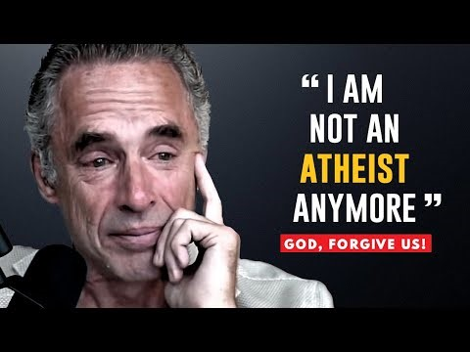

Slide 11
Isaiah 57:15 For this is what the high and exalted One says— he who lives forever, whose name is holy: “I live in a high and holy place, but also with the one who is contrite and lowly in spirit, to revive the spirit of the lowly and to revive the heart of the contrite.

Slide 12
Contrite- feeling or expressing remorse or penitence; affected by guilt

Slide 13
Isaiah 51:17 My sacrifice, O God, is a broken spirit; a broken and contrite heart you, God, will not despise.

Slide 14
Where do I live?
Everywhere!
Where do I want to live and hang out?
He lives Everywhere vs. 1,2
He lives in Righteousness vs. 3-6

Slide 15
Isaiah 66
³ But whoever sacrifices a bull is like one who kills a person, and whoever offers a lamb is like one who breaks a dog’s neck;

Slide 16
whoever makes a grain offering is like one who presents pig’s blood, and whoever burns memorial incense is like one who worships an idol. They have chosen their own ways, and they delight in their abominations;

Slide 17
⁴ so I also will choose harsh treatment for them and will bring on them what they dread. For when I called, no one answered, when I spoke, no one listened. They did evil in my sight and chose what displeases me.”

Slide 18
⁵ Hear the word of the Lord, you who tremble at his word: “Your own people who hate you, and exclude you because of my name, have said, ‘Let the Lord be glorified, that we may see your joy!’ Yet they will be put to shame.

Slide 19
⁶ Hear that uproar from the city, hear that noise from the temple! It is the sound of the Lord repaying his enemies all they deserve.

Slide 20
Where do I want to live and hang out?
He lives Everywhere vs. 1,2
He lives in Righteousness vs. 3-6

Slide 21
1 Corinthians 6:
¹⁷ But whoever is united with the Lord is ONE with him in spirit.

Slide 22
⁷ “Before she goes into labor, she gives birth; before the pains come upon her, she delivers a son.

Slide 23
⁸ Who has ever heard of such things? Who has ever heard of such things? Can a country be born in a day or a nation be brought forth in a moment? Yet no sooner is Zion in labor than she gives birth to her children.

Slide 24
⁹ Do I bring to the moment of birth and not give delivery?” says the Lord. “Do I close up the womb when I bring to delivery?” says your God.

Slide 25
1 Kings 8:25-27
²⁶Now Lord, the God of Israel, keep for your servant David my father the promises you made to him when you said, ‘You shall never fail to have a successor to sit before me on the throne of Israel, if only your descendants are careful in all they do to walk before me faithfully as you have done.’

Slide 26
Psalm 138:2
² I will worship toward thy holy temple, and praise thy name for thy lovingkindness and for thy truth: for thou hast magnified thy word above all thy name.
Name=authority and reputation.

Slide 27
¹⁰ “Rejoice with Jerusalem and be glad for her, all you who love her; rejoice greatly with her, all you who mourn over her.

Slide 28
¹¹ For you will nurse and be satisfied at her comforting breasts; you will drink deeply and delight in her overflowing abundance.”

Slide 29
¹² For this is what the Lord says:
“I will extend peace to her like a river, and the wealth of nations like a flooding stream; you will nurse and be carried on her arm and dandled on her knees.

Slide 30
¹³ As a mother comforts her child, so will I comfort you; and you will be comforted over Jerusalem.”

Slide 31
¹⁴ When you see this, your heart will rejoice and you will flourish like grass; the hand of the Lord will be made known to his servants, but his fury will be shown to his foes.

Slide 32
John 14
¹⁵ “If you love me, keep my commands. ¹⁶ And I will ask the Father, and he will give you another advocate to help you and be with you forever— ¹⁷ the Spirit of truth. The world cannot accept him, because it neither sees him nor knows him. But you know him, for he lives with you and will be in you. ¹⁸ I will not leave you as orphans; I will come to you.

Slide 33
He lives Everywhere vs. 1,2
He lives in Righteousness vs. 3-6
He lives among the living vs. 7-9
He lives through His promises vs. 10-14
The SON

Slide 34
¹⁵ See, the Lord is coming with fire, and his chariots are like a whirlwind; he will bring down his anger with fury, and his rebuke with flames of fire.

Slide 35
¹⁶ For with fire and with his sword the Lord will execute judgment on all people, and many will be those slain by the Lord.

Slide 36
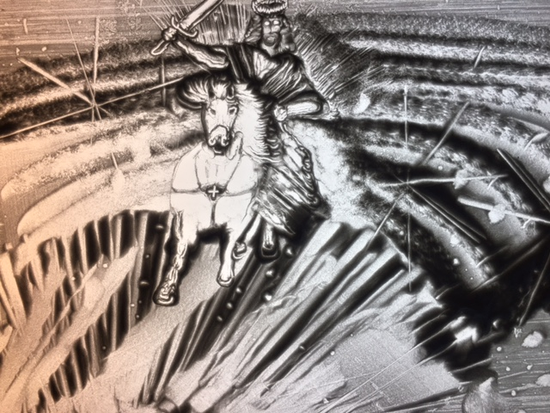

Slide 37
¹⁷ “Those who consecrate and purify themselves to go into the gardens, following one who is among those who eat the flesh of pigs, rats and other unclean things—they will meet their end together with the one they follow,” declares the Lord.

Slide 38
Where do I want to live and hang out?
He lives in Heaven & Everywhere vs. 1,2
He lives in Righteousness vs. 3-6
He lives among the living vs. 7-9
He lives through His promises vs.10-14
He lives with Justice vs. 14-17
He lives as the KING ETERNAL vs. 18
The SON

Slide 39
¹⁸ “And I, because of what they have planned and done, am about to come and gather the people of all nations and languages, and they will come and see my glory.

Slide 40
¹⁹ “I will set a sign among them, and I will send some of those who survive to the nations—to Tarshish, to the Libyans and Lydians (famous as archers), to Tubal and Greece, and to the distant islands that have not heard of my fame or seen my glory. They will proclaim my glory among the nations.

Slide 41
²⁰ And they will bring all your people, from all the nations, to my holy mountain in Jerusalem as an offering to the Lord—on horses, in chariots and wagons, and on mules and camels,” says the Lord.
“They will bring them, as the Israelites bring their grain offerings, to the temple of the Lord in ceremonially clean vessels.

Slide 42
²¹ And I will select some of them also to be priests and Levites,” says the Lord.

Slide 43
²² “As the new heavens and the new earth that I make will endure before me,” declares the Lord, “so will your name and descendants endure.

Slide 44
²³ From one New Moon to another and from one Sabbath to another, all mankind will come and bow down before me,” says the Lord.

Slide 45
²⁴ “And they will go out and look on the dead bodies of those who rebelled against me; the worms that eat them will not die, the fire that burns them will not be quenched, and they will be loathsome to all mankind.”

