Slide 1
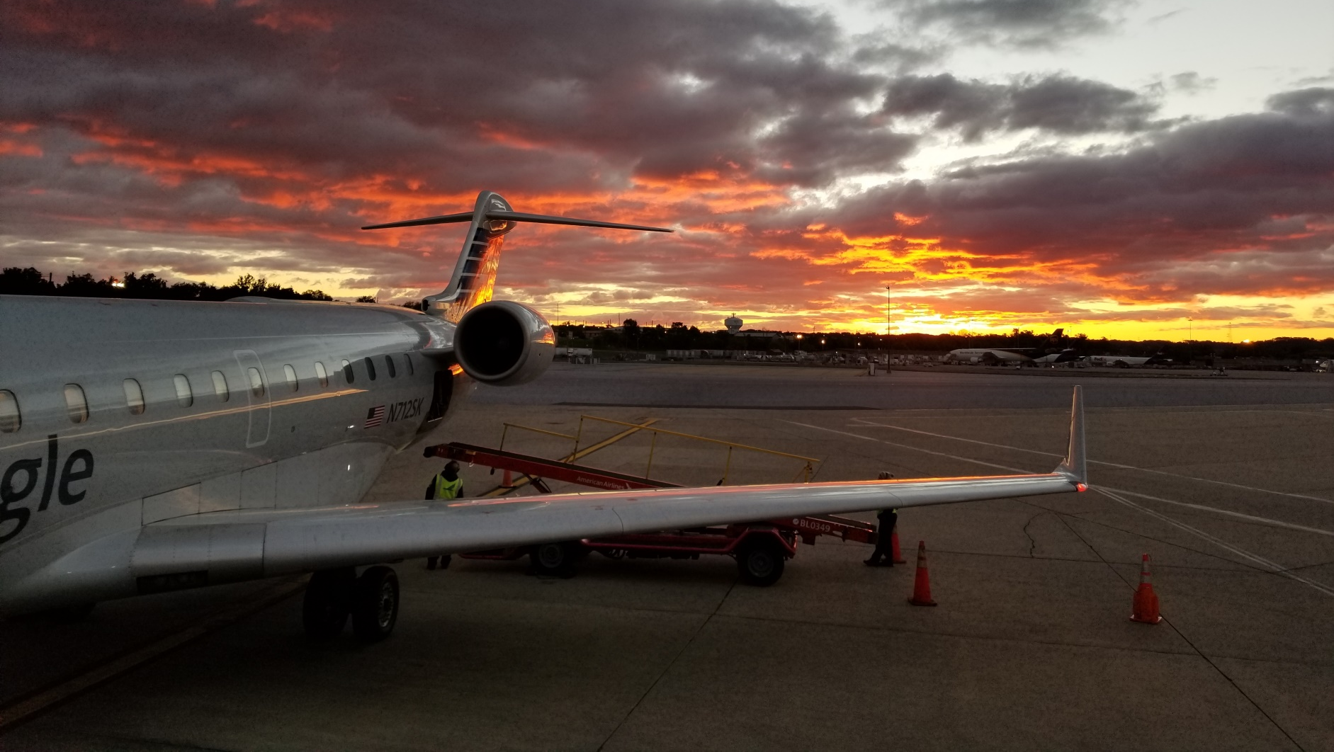
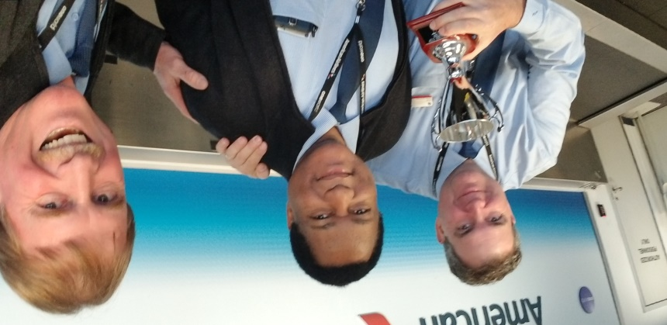
Ten Years OF Serving
American Airlines With
Piedmont

Slide 2
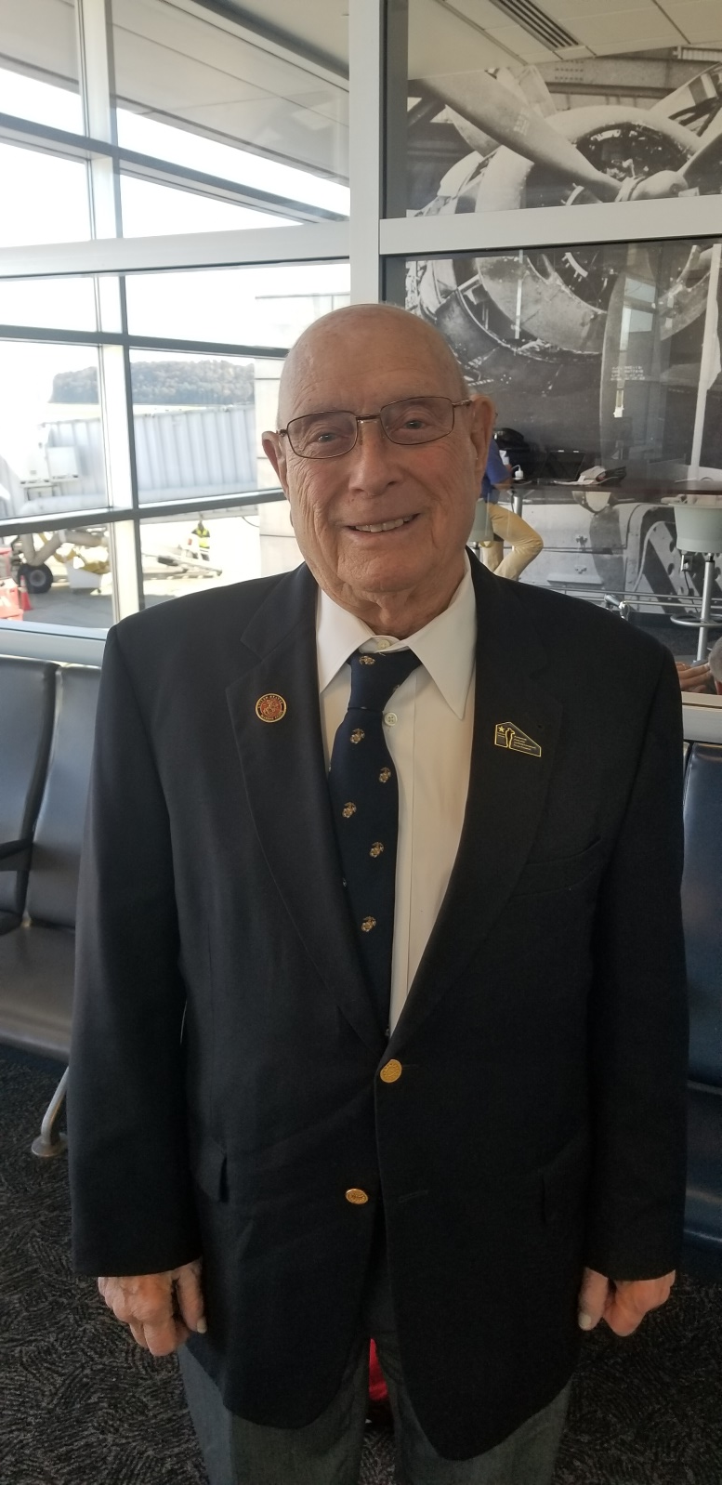
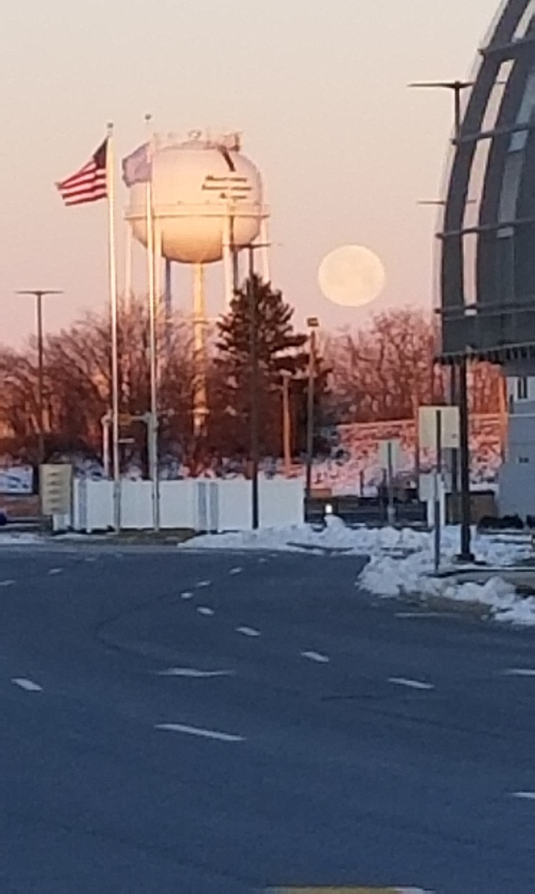
Meeting Amazing People

Slide 3
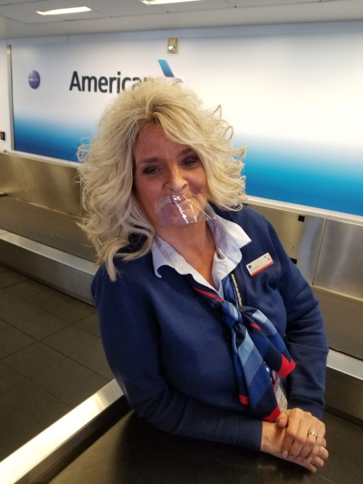
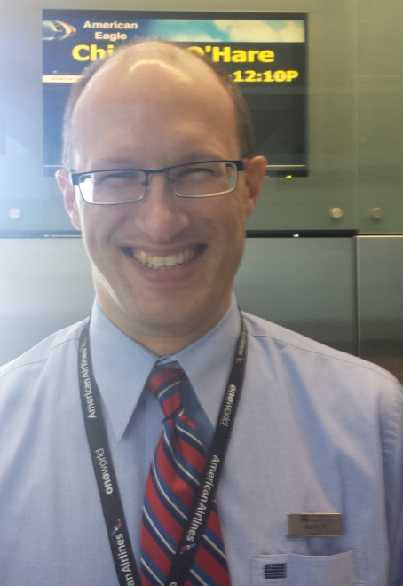
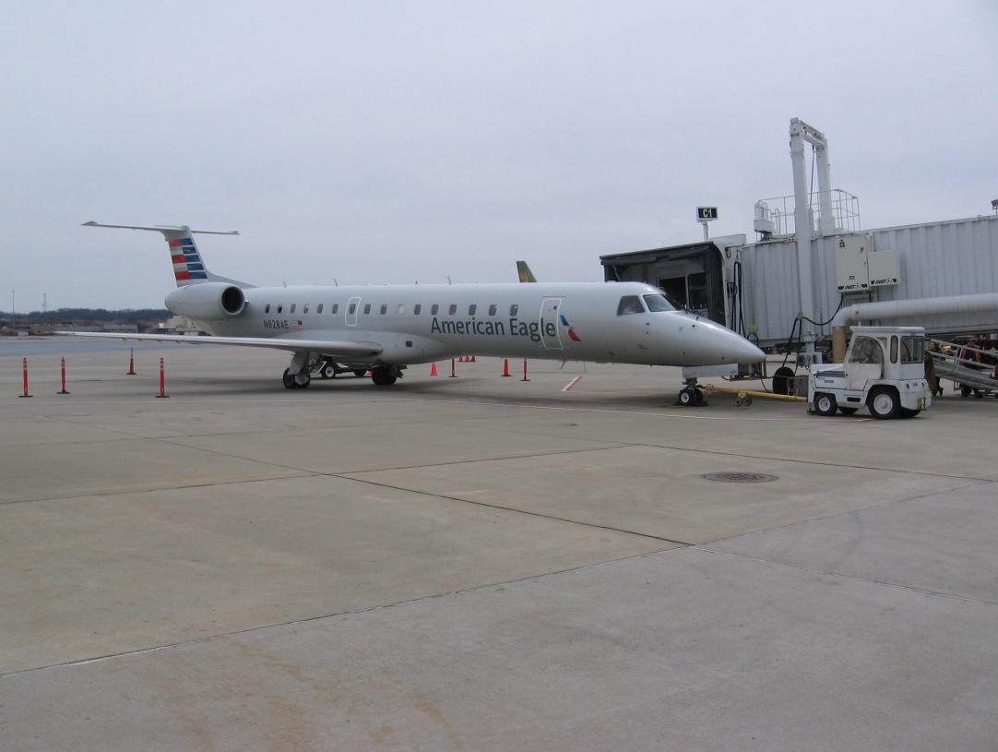

Slide 4
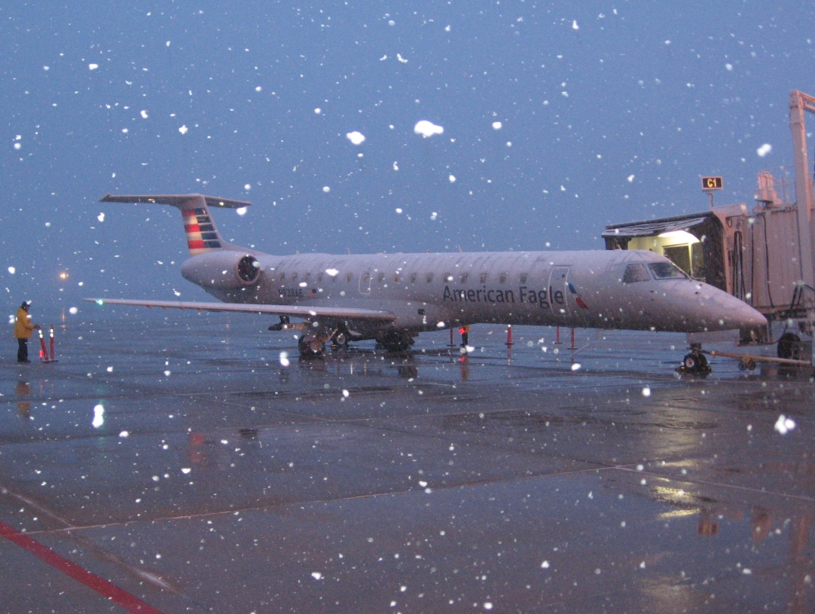
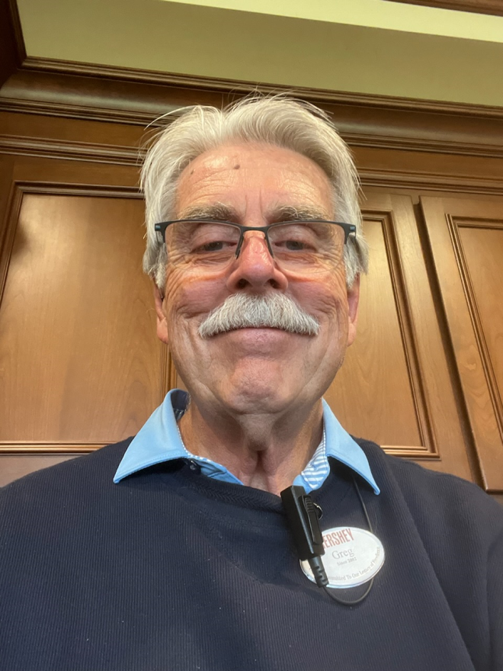
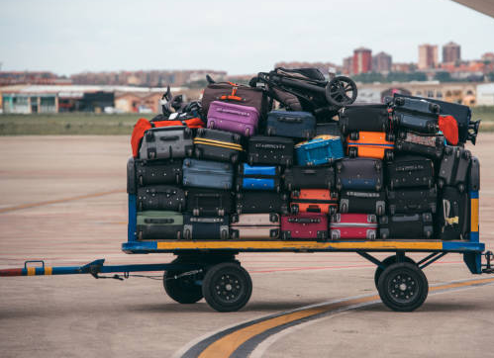
Destiny Partners
Character
Development

Slide 5
Sunday, May 1, 2022
Healthy Heart, Healthy Mind, Healthy Mouth
Experiencing Real Change

Slide 6
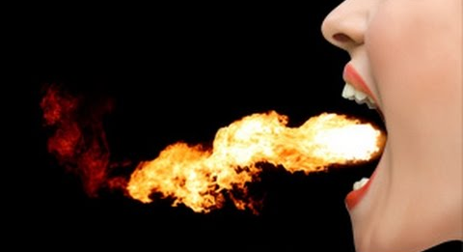
THE MOUTH IS CRITICAL EVIDENCE OF THE
MOVING OF THE HOLY SPIRIT IN YOUR LIFE
IN REGARDS TO HOW YOU ARE BEING CHANGED
⁵ Likewise the tongue is a small part of the body, but it makes great boasts. Consider what a great forest is set on fire by a small spark. ⁶ The tongue also is a fire, a world of evil among the parts of the body. It corrupts the whole person, sets the whole course of his life on fire, and is itself set on fire by hell. James 3:5-6 (NIV)

Slide 7
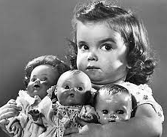
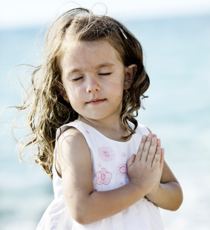
THE CROSS AND THE RESURRECTION
REVERSES THE POLARITY
OF OUR SELFISH HEART
-
+
Selfish
Loving

Slide 8
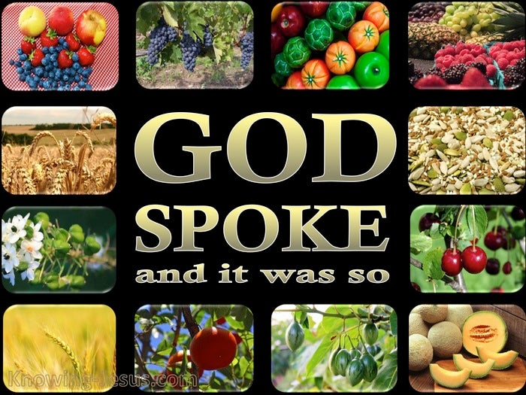
Jim’s Word - Sowing By Faith
Each According To It’s Kind

Slide 9
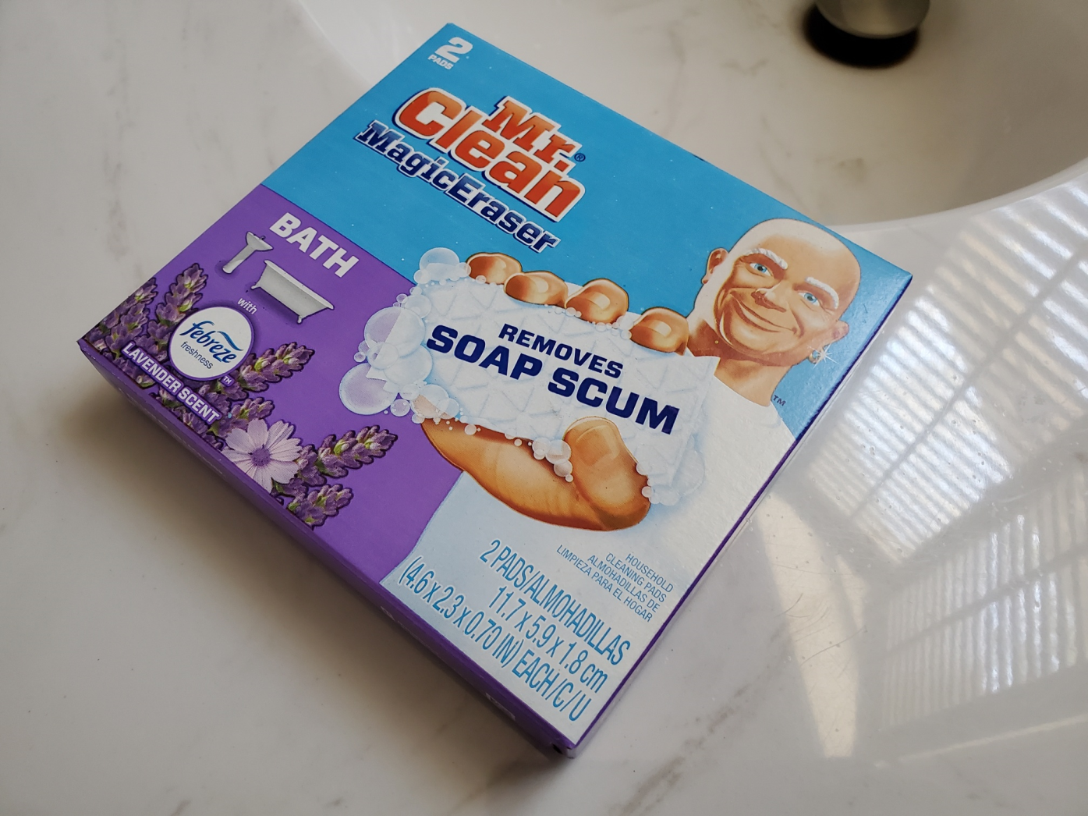
Knowing How To Fix
Something That SEEMS IMPOSSIBLE

Slide 10
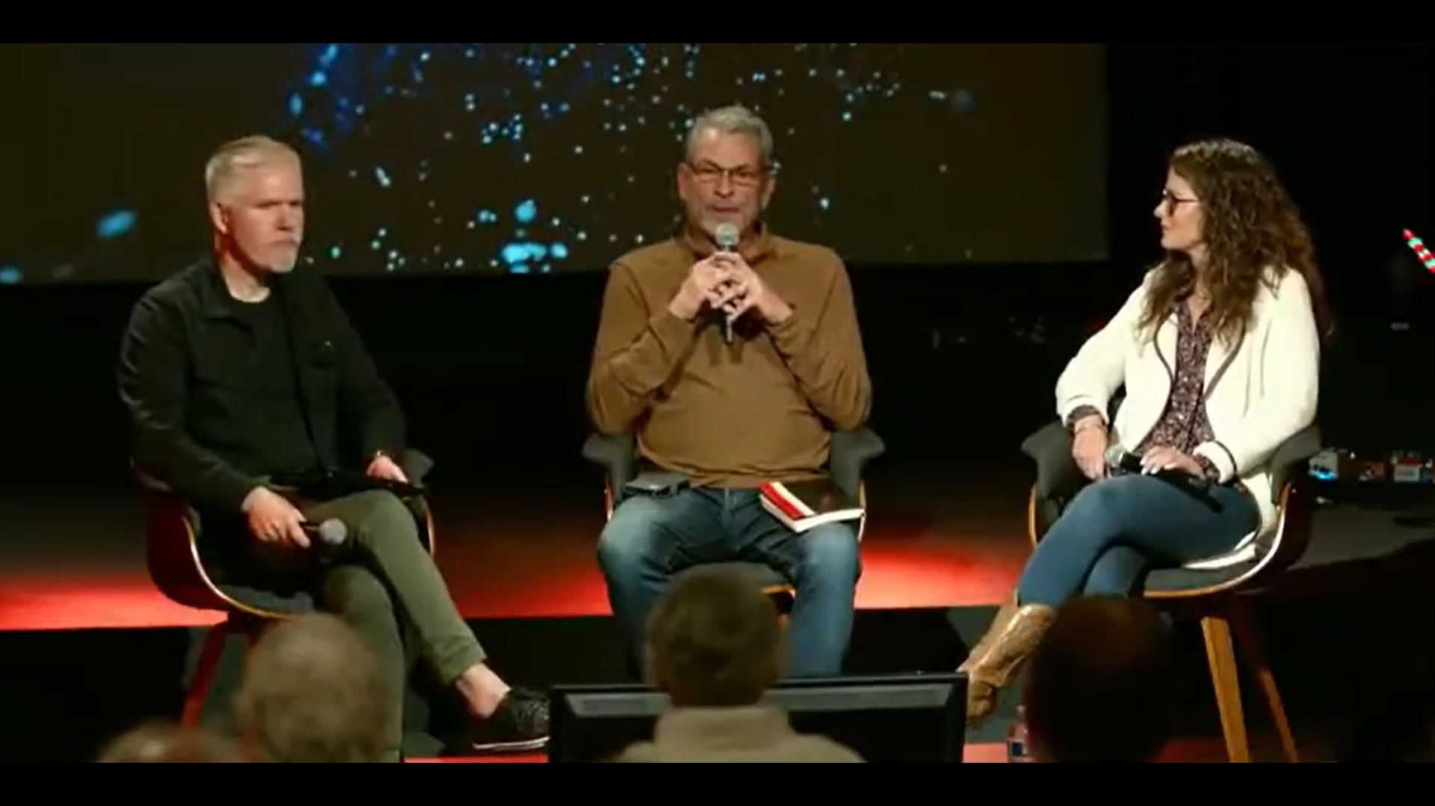
A Succinct Word

Slide 11
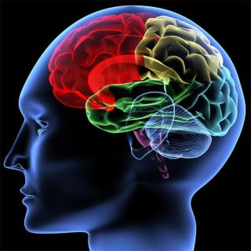
MIND
HEART

Slide 12
MIND
HEART
INFORMS
THINKS THROUGH
PROCESSES
CATEGORIZES
FIXATES/ FREEZES
CHOOSES
DISCERNS
GIVES CONSENT
HAS AFFECTION FOR
CONNECTS
²⁷ And he answering said, Thou shalt love the Lord thy God with all thy heart, and with all thy soul, and with all thy strength, and with all thy mind; and thy neighbor as thyself. Luke 10:27 (KJV)
³² All the believers were one in heart and mind. No one claimed that any of his possessions was his own, but they shared everything they had. Acts 4:32 (NIV)

Slide 13
OUR MOUTH IS CRITICAL EVIDENCE OF THE MOVING OF THE HOLY SPIRIT IN YOUR LIFE IN SANCTIFICATION
Death and life are in the power of the tongue: and they that love it shall eat the fruit thereof. Proverbs 18:21 (KJV)
²³ He who guards his mouth and his tongue keeps himself from calamity. Proverbs 21:23 (NIV)

Slide 14
I Began to See A Pattern
LEVI - My covenant was with him, a covenant of life and peace, and I gave them to him; this called for reverence and he revered me and stood in awe of my name. ⁶ True instruction was in his mouth and nothing false was found on his lips. He walked with me in peace and uprightness, and turned many from sin. Malachi 2:5-6 (NIV)
144 Thousand They follow the Lamb wherever He goes.. 5 No lie was found in their mouths; they are blameless. Revelation 14:4-5 (NIV)
But the cowardly, the unbelieving, the vile, the murderers, the sexually immoral, those who practice magic arts, the idolaters and all liars--their place will be in the fiery lake of burning sulfur. This is the second death." Revelation 21:8 (NIV)

Slide 15
WHEN OUR HEART IS HEALTHY
OUR MIND IS HEALTHY
AND OUR MOUTH IS HEALTHY
A good man out of the good treasure of his heart brings forth that which is good; and an evil man out of the evil treasure of his heart brings forth that which is evil: for of the abundance of the heart his mouth speaks.
Luke 6:45 (KJV)
⁸ Finally, brothers, whatever is true, whatever is noble, whatever is right, whatever is pure, whatever is lovely, whatever is admirable--if anything is excellent or praiseworthy--think about such things. Philippians 4:8

Slide 16
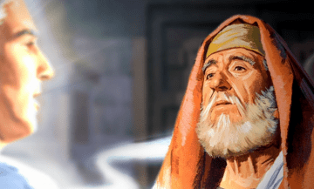
What You Speak With
Your Mouth Many Times Reveals
The Battle You Are In
¹⁹ The angel answered, "I am Gabriel. I stand in the presence of God, and I have been sent to speak to you and to tell you this good news. ²⁰ And now you will be silent and not able to speak until the day this happens, because you did not believe my words, which will come true at their proper time." ²¹ Meanwhile, the people were waiting for Zechariah and wondering why he stayed so long in the temple. ²² When he came out, he could not speak to them. They realized he had seen a vision in the temple, for he kept making signs to them but remained unable to speak. Luke 1:19-22 (NIV)
Zechariah

Slide 17
A Healthy Heart
And A Healthy Mind
Healthy Mouth
MIND
HEART
Mouth
⁹ That if you confess with your mouth, "Jesus is Lord," and believe in your heart that God raised him from the dead, you will be saved. ¹⁰ For it is with your heart that you believe and are justified, and it is with your mouth that you confess and are saved. Romans 10:9-10 (NIV)

Slide 18
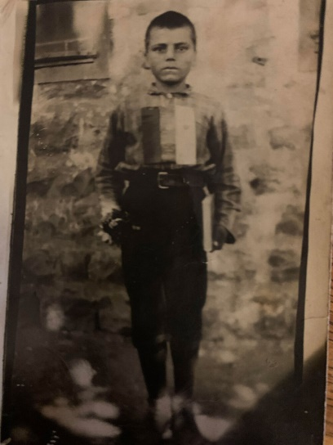
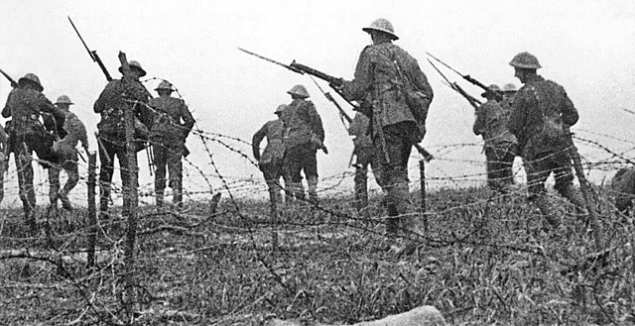
A Short STORY Tells HOW IMPORTANT ARE THE WORDS GOD GIVES
World War 1
Breaks out 1914
1.5 Million Christians are killed in Armenia
13 yr old Armenian Peasant Prophet
1855
Efim Gerasemovitch Klubniken
Karla Kala
But the refugees were not to settle down there, the prophecy continued. They were to continue travelling until they reached the west coast of the new land. There, the boy wrote, God would bless them and prosper them, and cause their seed to be a blessing to the nations.
1900 – the Time Has Come
Need to Move - 58 years old

Slide 19
CHANGING A Heart of Stone
Into A Living Heart
I will give them an undivided heart and put a new spirit in them; I will remove from them their heart of stone and give them a heart of flesh. Ezekiel 11:19 (NIV)
I will give you a new heart and put a new spirit in you; I will remove from you your heart of stone and give you a heart of flesh. Ezekiel 36:26 (NIV)

Slide 20
You Once Were
For you were once darkness, but now you are light in the Lord. Live as children of light Ephesians 5:8 (NIV)
Once you were alienated from God and were enemies in your minds because of your evil behavior. Colossians 1:21 (NIV)
Once you were not a people, but now you are the people of God; once you had not received mercy, but now you have received mercy. 1 Peter 2:10 (NIV)

Slide 21
The Most Powerful Verse on Change
And Yet The Most Confusing
As To How it Happens
Therefore, if anyone is in Christ, he is a new creation; the old has gone, the new has come! 18 All this is from God, who reconciled us to Himself through Christ and gave us the ministry of reconciliation: 2 Corinthians 5:17-18 (NIV)

Slide 22
We Have To Partner With God
To Receive The Blessing
4 Therefore we are buried with him by baptism into death: that like as Christ was raised up from the dead by the glory of the Father, even so we also should walk in newness of life. Romans 6:4 (KJV)
You used to walk in these ways, in the life you once lived. Colossians 3:7 (NIV)
and have put on the new self, which is being renewed in knowledge in the image of its Creator. Colossians 3:10 (NIV)

Slide 23
OUR FAITH DECLARATION
LORD WE THANK YOU FOR MAKING THE WAY POSSIBLE TO BE A NEW CREATION IN YOU. THAT YOU ARE THE ONLY ONE AND THE ONLY NAME GIVEN UNDER HEAVEN BY WHICH WE CAN BE SAVED AND BY WHICH WE CAN BE DAILY TRANSFORMED. THANK YOU FOR CREATING IN US A CLEAN HEART. THANK YOU FOR RENEWING OUR MINDS. THANK YOU FOR CAUSING US TO SPEAK FAITH OUT OF OUR MOUTHS. THANK YOU THE FOUNDATION IS ALREADY FINISHED. HELP US TO WORK OUT OUR SALVATION WITH YOU AND ENTER INTO THE COMPLETION OF THE PROMISE THAT “ALL THINGS ARE BECOME NEW.”

