Slide 1
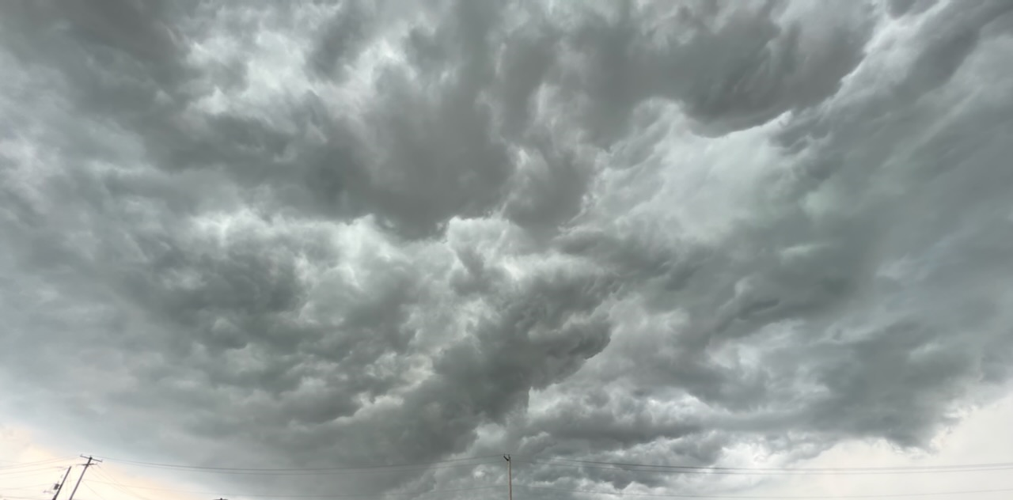
Maintaining Vision
And Purpose
During Times of Distress
A SERMON TO ALL GENERATIONS
Sunday, May 22, 2022

Slide 2
“Be Strong Do Not Fear”
Strengthen the feeble hands, steady the knees that give way; ⁴ say to those with fearful hearts, "Be strong, do not fear; your God will come, he will come with vengeance; with divine retribution he will come to save you." ⁵ Then will the eyes of the blind be opened and the ears of the deaf unstopped. ⁶ Then will the lame leap like a deer, and the mute tongue shout for joy. Water will gush forth in the wilderness and streams in the desert.
Isaiah 35:3-6 (NIV)

Slide 3
“That God will Make You Fit For
What He’s Called You To Be”
With this in mind, we constantly pray for you, that our God may count you worthy of His calling, and that by His power He may fulfill every good purpose of yours and every act prompted by your faith. 12 We pray this so that the Name of our Lord Jesus may be glorified in you, and you in Him, according to the grace of our God and the Lord Jesus Christ. 2 Thessalonians 1:11-12 (NIV)

Slide 4
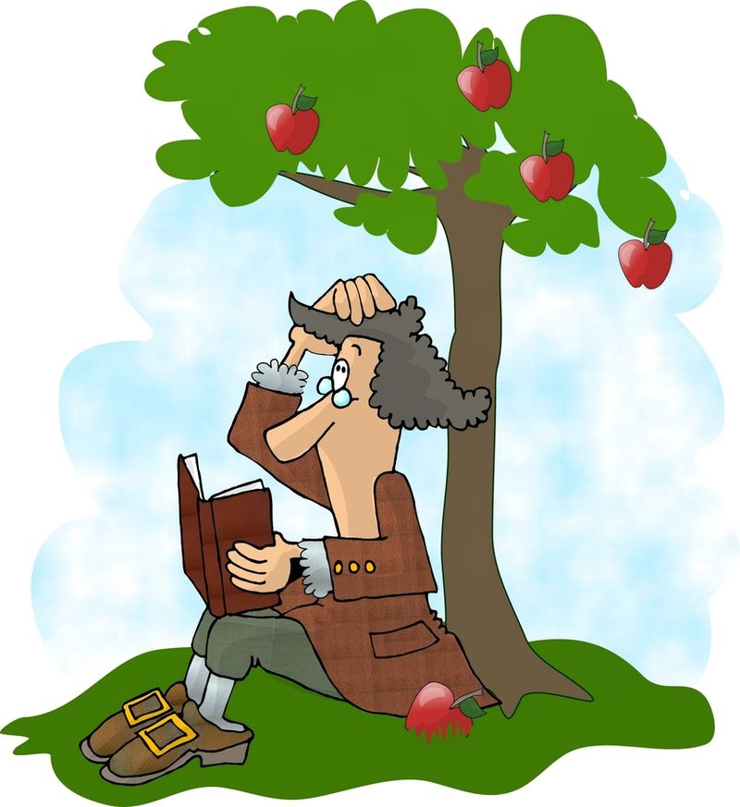
We used to have Absolute truths!
The sky is blue!
Grass is green!
Fire is hot!
Ice is cold!
2 + 2 = 4
Men & Women are different.
An apple falls to the ground.

Slide 5
God Sometimes Allows
Life To Become Unbearable
The Spirit of God came upon Azariah son of Oded. 2 He went out to meet Asa and said to him, "Listen to me, Asa and all Judah and Benjamin. The LORD is with you when you are with Him. If you seek Him, He will be found by you, but if you forsake Him, He will forsake you. 3 For a long time Israel was without the true God, without a priest to teach and without the law. 4 But in their distress they turned to the LORD, the God of Israel, and sought him, and He was found by them. 5 In those days it was not safe to travel about, for all the inhabitants of the lands were in great turmoil. 6 One nation was being crushed by another and one city by another, because God was troubling them with every kind of distress. 7 But as for you, be strong and do not give up, for your work will be rewarded." 2 Chronicles 15:1-7 (NIV)
Entered Into A Time Of Reformation
They took an oath to the LORD with loud acclamation, with shouting and with trumpets and horns. ¹⁵ All Judah rejoiced about the oath because they had sworn it wholeheartedly. They sought God eagerly, and he was found by them. So the LORD gave them rest on every side. 2 Chronicles 15:14-15 (NIV)

Slide 6
Four Spiritual Revelation
Earthquakes Take Place
1 - The Revelation of only TWO outcomes – Either we are pursuing God or checking out
“If you seek Him, He will be found by you, but if you forsake Him, He will forsake you.”
2 - The Revelatioin of unbearable living awakens a seeking after a spiritual solution
“But in their distress they turned to the LORD, the God of Israel, and sought Him, and He was found by them.”
3 - The Revelation of God coming as the
UNRAVELER
“Because God was troubling them with every kind of distress.”
4 - The Revelation of PROMISED REWARD to persistent faith. (Hebrews 11:6)
“But as for you, be strong and do not give up, for your work will be rewarded.”

Slide 7
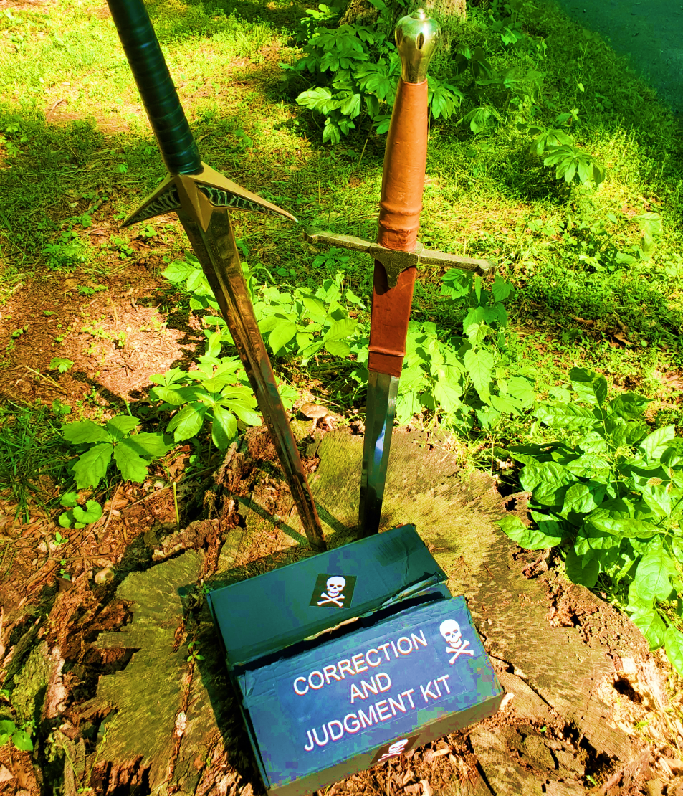
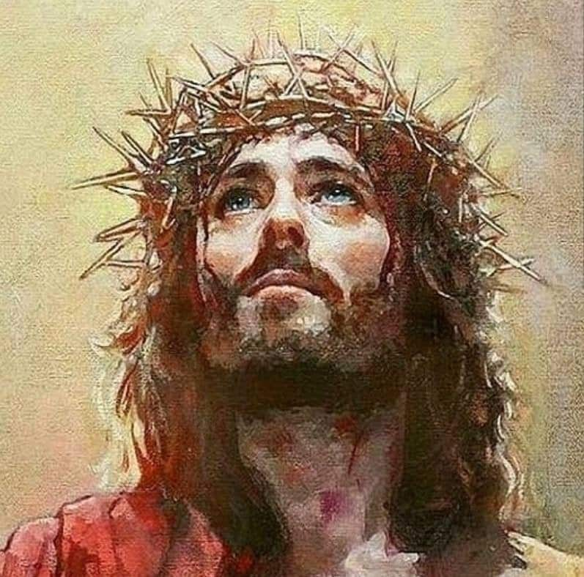
The Two Kits God Has Stored In Heaven
I form the light and create darkness, I bring prosperity and create disaster; I, the LORD, do all these things. Isaiah 45:7
"Have you entered the storehouses of the snow or seen the storehouses of the hail, ²³ which I reserve for times of trouble, for days of war and battle? Job 38:22-23 (NIV)

Slide 8
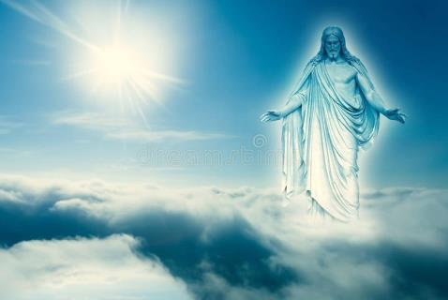
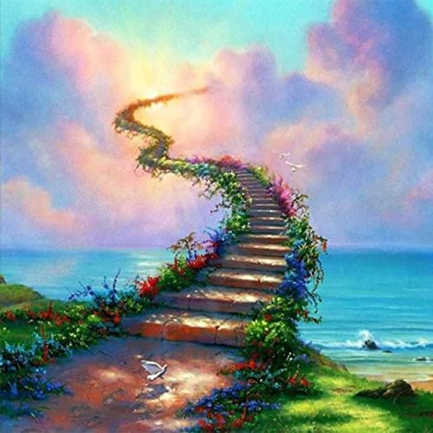
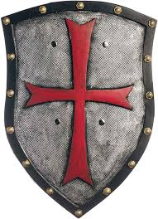
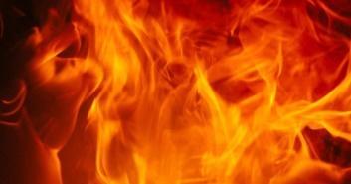
The Godhead Stewarding The Universe
And God said, Let us make man in our image, after our likeness: Genesis 1:26
Holy Holy Holy
Father, Son, Holy Spirit
And God saw every thing that he had made, and, behold, it was very good.. Genesis 1:31
One thing God has spoken, two things have I heard: that you, O God, are strong, ¹² and that you, O Lord, are loving. Surely you will reward each person according to what he has done.
Psalm 62:11-12 (NIV)
In those days it was not safe to travel about, for all the inhabitants of the lands were in great turmoil. One nation was being crushed by another and one city by another, because God was troubling them with every kind of distress.
2 Chronicles 15:5, 6
In those days it was not safe to travel about, for all the inhabitants of the lands were in great turmoil. One nation was being crushed by another and one city by another, because God was troubling them with every kind of distress.
2 Chronicles 15:5, 6
I form the light and create darkness, I bring prosperity and create disaster; I, the LORD, do all these things. Isaiah 45:7
God troubles mankind by:
Removing the hedge
Withdrawing His presence and miracles
Makes the chariot wheels come off – Exodus 14:25
Uses evil tyrants to oppress the people – Judges 2:18
Storehouse of Heaven | Toolbox of Correction/ Judgment
I created you to have these blessings | I did not Create you to LIVE IN THESE CURSES
Faith | Fear (unhealthy)
Salvation | Judgment
Righteousness/ Holiness | Sin/ selfishness/ evil
Healing | Sickness
Life | Death
Fellowship | Separation
Joy | Sorrow
Eternal companionship | Eternal loneliness/ hell
Freedom | Bondage
Freewill
God puts a hedge or shield
Job 1
Restrains evil by the Holy Spirit
2 Thess. 2:6
"Then he will say to those on his left, 'Depart from me, you who are cursed, into the eternal fire prepared for the devil and his angels. Matthew 25:41 (NIV)
HELL

Slide 9
THE CYCLE OF BLESSING AND Judgment
God is using the UNBEARABLE distress to cause people to seek the God who can bring His presence and salvation.
Turn from their folly
If the Church abandons all hope for an invasion of the Holy Spirit’s observable works, and ceases all cooperation with the Lord, then the chastisement has not been improved upon. In this case Satan’s evil will have its way; the advantage is still publically on his side, and further humblings are to be expected. James Caughey
He, that being often reproved hardens his neck, shall suddenly be destroyed, and that without remedy. Proverbs 29:1

Slide 10
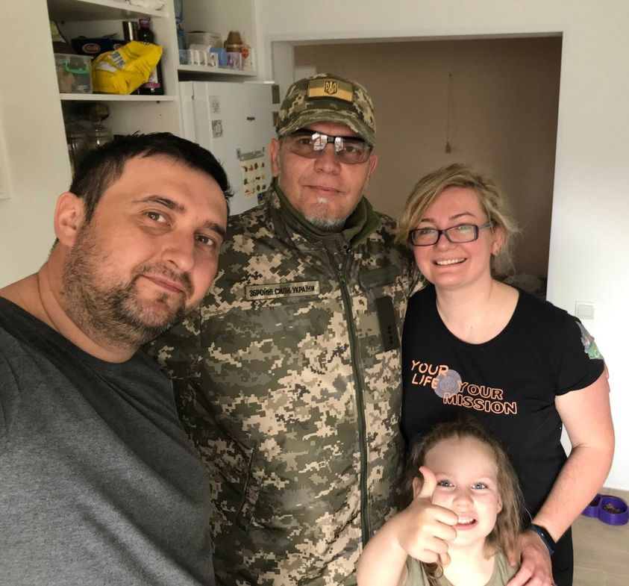
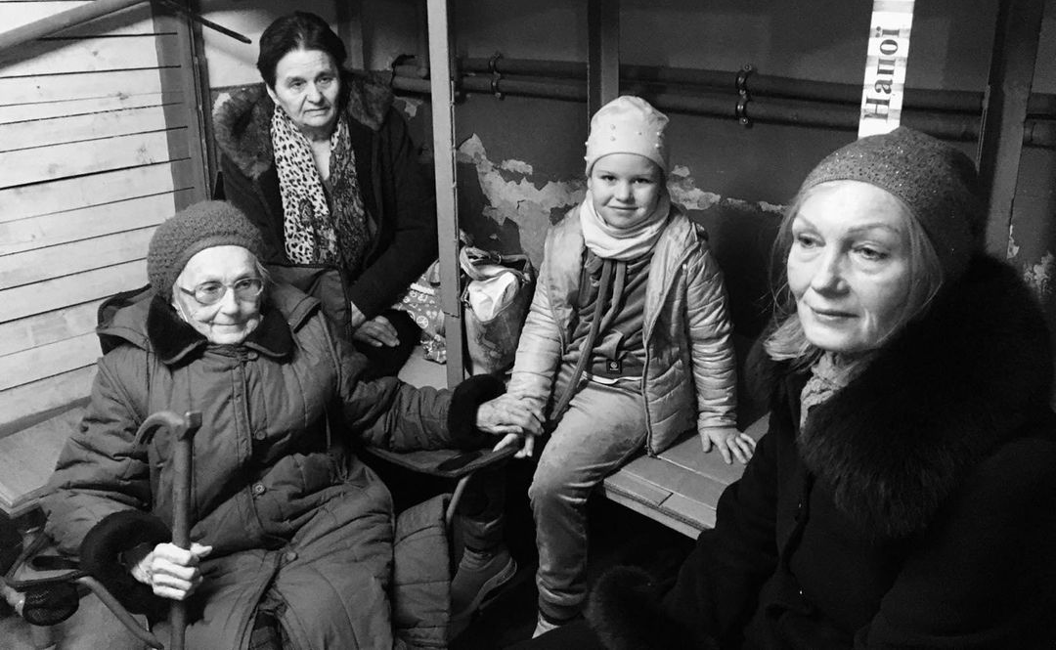
IT IS CRITICAL TO HAVE A VISION AND PURPOSE
ESPECIALLY DURING TIMES OF SHAKING
Where there is no vision, the people perish: but he that keeps the law, happy is he. Proverbs 29:18 (KJV)
Vira, Andry, Nadyika

Slide 11
THE CORE VISION OF A BELIEVER’S LIFE –
EVEN IF THE DETAILS AREN’T FILLED IN
I was once separated from a perfect and loving God by my arrogant and selfish choices and headed to hell.
Without deserving it – God came to rescue me out of my sin and VISIONLESS life and saved me by the WAY of faith in Christ and His finished work on the cross.
Though I don’t know ALL THE DETAILS OF MY CALLING I am immediately part on a world-wide family, being made into God’s image and placed among those who (should) love me, build my character, and hold me accountable.
I am immediately called to be an influencer who is part of a world-wide intervention to pluck more people from this evil generation. (Galatians 1:4).
Now you are the body of Christ, and each one of you is a part of it.
1 Corinthians 12:27

Slide 12
God Does UNFOLD THE DETAILS
I have been given a specific gift and calling as a chess piece on the board of God’s world map to put the enemy in checkmate.
I am either called to send or be sent- Support others or be supported.
I can raise my children to join me (us) in this mission.
I can use my career – education and gifts to MODEL JESUS to others – and to BRING OTHERS TO HIM.
We have different gifts, according to the grace given us. If a man's gift is prophesying, let him use it in proportion to his faith. ⁷ If it is serving, let him serve; if it is teaching, let him teach; ⁸ if it is encouraging, let him encourage; if it is contributing to the needs of others, let him give generously; if it is leadership, let him govern diligently; if it is showing mercy, let him do it cheerfully. Romans 12:6-8
⁴ In all my prayers for all of you, I always pray with joy ⁵ because of your partnership in the gospel from the first day until now, ⁶ being confident of this, that he who began a good work in you will carry it on to completion until the day of Christ Jesus. Philippians 1:4-6 (NIV)

Slide 13
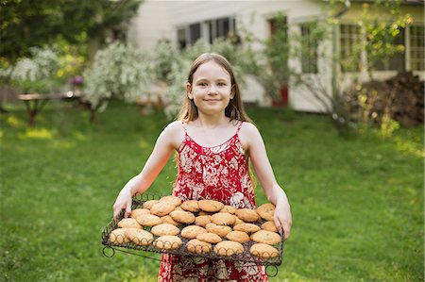
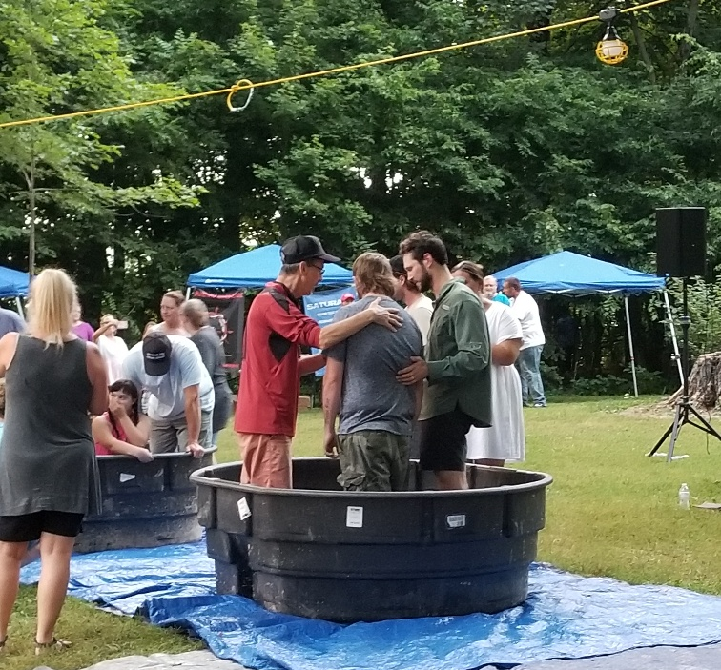
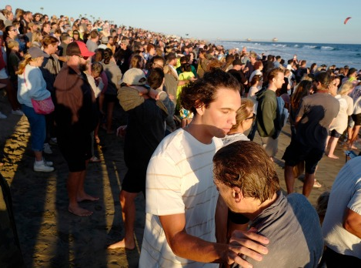
DOING THE NEXT THING IN FRONT OF YOU

Slide 14
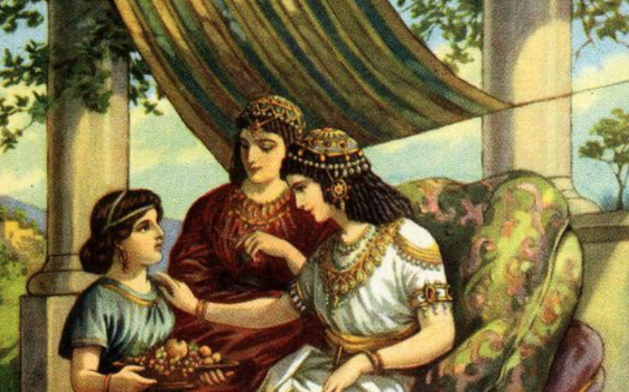
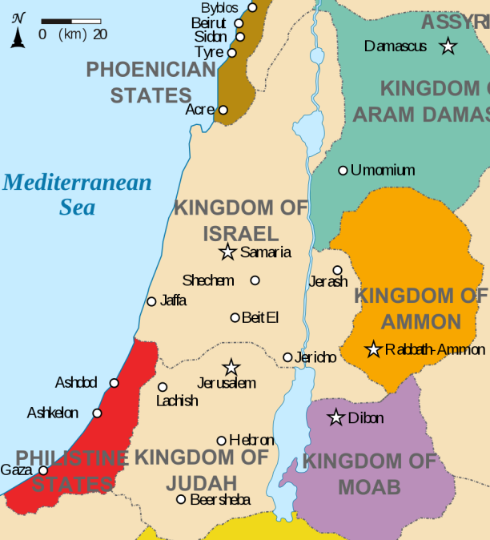
IT’s Not The Circumstances That Define US
It’s What we do by faith in the circumstances
² Now bands from Aram had gone out and had taken captive a young girl from Israel, and she served Naaman's wife. ³ She said to her mistress, "If only my master would see the prophet who is in Samaria! He would cure him of his leprosy." 2 Kings 5:2-3
This is the very spirit with which we should seek God for this blessing. (of direction and purpose) "O my Lord, do all Your will in me; then put me in any position which will most fully illustrate and lift up Your grace. No matter what it is, only let it greatly glorify Your name, amen."
Asa Mahan

Slide 15
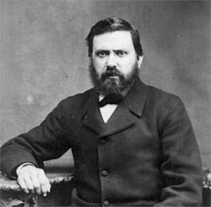
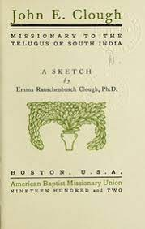
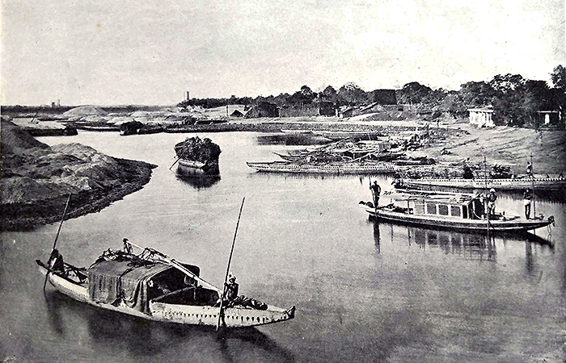
How did this all come about? “An unusual condition of preparedness was waiting with an opportunity for John Clough. The man or woman seldom creates the situation; the two must find each other.
“Everyone was praying for rain. The Hindus prayed to the gods of the land. The Muslims besought Allah. We Christians begged our God to send rain. The time passed. No rain came. We all knew that now it would become a case of hand-to-hand combat in our fight with death.”

Slide 16
John Clough was immediately confronted with a dilemma. The higher caste of Indians refused to attend church with the lower caste (the untouchables). Praying for wisdom, John Clough randomly opened his Bible and read in
1 Corinthians 1:26-29 of God choosing the lowly. Across the room at the same moment, his wife randomly opened her Bible to the same place. Clough, amazed, took it as divine guidance. He announced that all were welcome in his church, that he would not accept a segregated congregation.
“The facts were simple, and distinctly practical, nevertheless most supernatural. The mass baptism of nearly nine thousand people in a six weeks received its appealingly picturesque setting inside a huge famine camp, where the starving people were brought together. Yet, neither the pangs of hunger, nor the hope of help could wholly explain how the spiritual impulse could move thousands to awaken out of the apathy of their ignorant, downtrodden – idolatry-filled lives, and walk long distances to give expression to a newly-born faith within them, and to demand the Christian ordinance of water baptism.”

Slide 17
Here Is Where It Get’s EXCITING
“Even on our best day we can’t do this without Him.”
Men who have risked their lives for the name of our Lord Jesus Christ. Acts 15:26 (NIV)
“What’s the meaning of this story? The power of evil is great – we are at our limit of courage - of ability and it’s not enough. Even on our best day it’s not enough. But we call on Jesus Name and He comes right through us and finds a solution and brings good out of it.” David Eubank

Slide 18
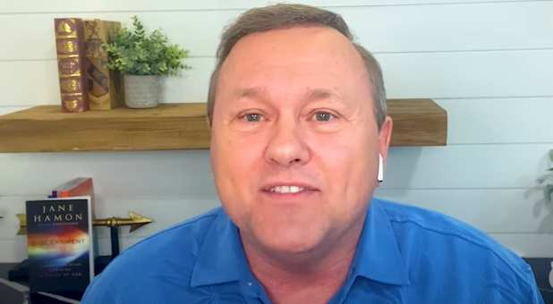
The Harvest Is
Coming In Now
The Lord said to me “this is the year that the great harvest is going to begin to be brought in but we must be careful not to be too focused on what we think is our mission and miss the divine appointments that may present themselves to us along the way in our journey of ministry, family, and business.”
The Church cannot be like the overly focused, prideful priest and Levite (Good Samaritan story) and miss the real appointments God has for us in this hour. We must minister to the hurting right in front of us because that is how the real breakthrough and harvest are going to come. God wants to pour upon the mountains of culture and upon our nation to bring great healing during these troubling times in 2022! We have to be His heart expressed and hands extended to bring this prophesied harvest to our generation! Tom Hamon

Slide 19
Activating All The Generations
¹ In those days when the number of disciples was increasing, the Grecian Jews among them complained against the Hebraic Jews because their widows were being overlooked in the daily distribution of food. ² So the Twelve (average age 40) gathered all the disciples together and said, "It would not be right for us to neglect the ministry of the word of God in order to wait on tables. ³ Brothers, choose seven men (average age 20) from among you who are known to be full of the Spirit and wisdom. We will turn this responsibility over to them ⁴ and will give our attention to prayer and the ministry of the word." ⁵ This proposal pleased the whole group. They chose Stephen, a man full of faith and of the Holy Spirit; also Philip, Procorus, Nicanor, Timon, Parmenas, and Nicolas from Antioch, a convert to Judaism. ⁶ They presented these men to the apostles, who prayed and laid their hands on them. ⁷ So the word of God spread. The number of disciples in Jerusalem increased rapidly, and a large number of priests became obedient to the faith. ⁸ Now Stephen, a man full of God's grace and power, did great wonders and miraculous signs among the people. ⁹ Opposition arose, however, from members of the Synagogue of the Freedmen (as it was called)--Jews of Cyrene and Alexandria as well as the provinces of Cilicia and Asia. These men began to argue with Stephen, ¹⁰ but they could not stand up against his wisdom or the Spirit by whom he spoke. Acts 6:1-10 (NIV)

Slide 20
In TheSE Days of Challenge
We are the Children of God – Therefore, Children of:
Opportunity
Obedience
Opened Heavens
Fall in love with Jesus every day
Pray for fresh fillings of the Holy Spirit
Discern what you can DO RIGHT NOW
Expect God to come through

