Slide 1
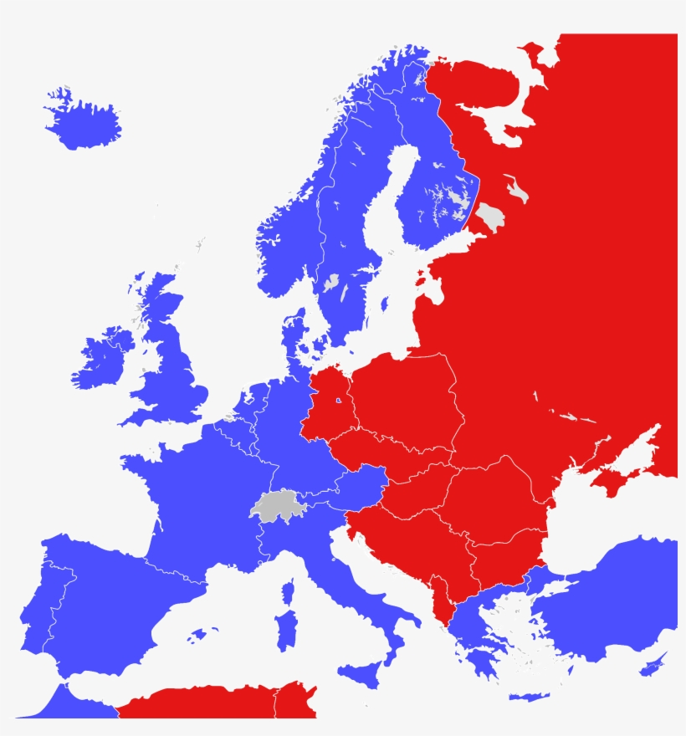
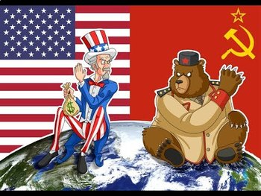
A Return to Bipolar Absolutism
Cold War Theology

Slide 2
Russia vs. United States (Cold War)
Communism vs. Capitalism
State Run vs. Free Enterprise
Command Economy vs. Free Market
Totalitarian vs. Representative Republic

Slide 3
We used to have Absolute truths!
The sky is blue!
Grass is green!
Fire is hot!
Ice is cold!
2 + 2 = 4
Men & Women are different.
An apple falls to the ground.

Slide 4
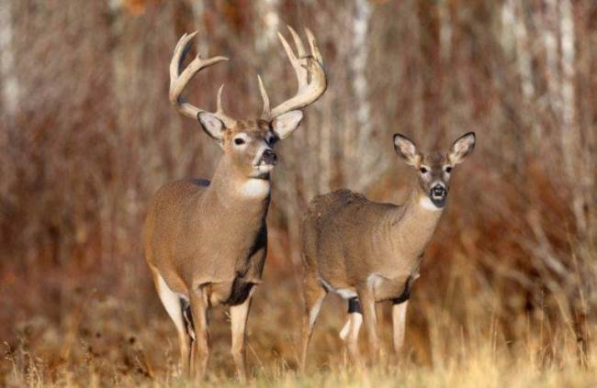
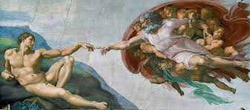
Bipolar Truths in the Bible?
Light vs. Darkness (John 1:4-5), (Romans 13:12-13)
Day vs. Night (Genesis 1:3-5)
Life vs. Death (Gen. 2:7, 2:20b-23), (Gen. 3:17-19)
Male & Female (Gen. 1:26-27)

Slide 5
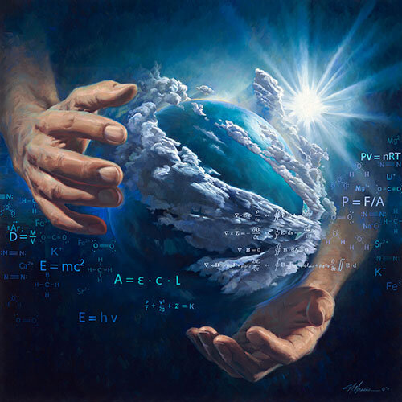
Design vs. Chance
“In the beginning God created the heavens and the earth.” (Gen. 1:1)
1 In the beginning was the Word, and the Word was with God, and the Word was God. ² He was with God in the beginning. ³ Through him all things were made; without him nothing was made that has been made. ⁴ In him was life, and that life was the light of all mankind. ⁵ The light shines in the darkness, and the darkness has not understood it. (John 1:1-5)

Slide 6
Heaven vs. Hell
Our paths part here, goodbye my friend.

Slide 7
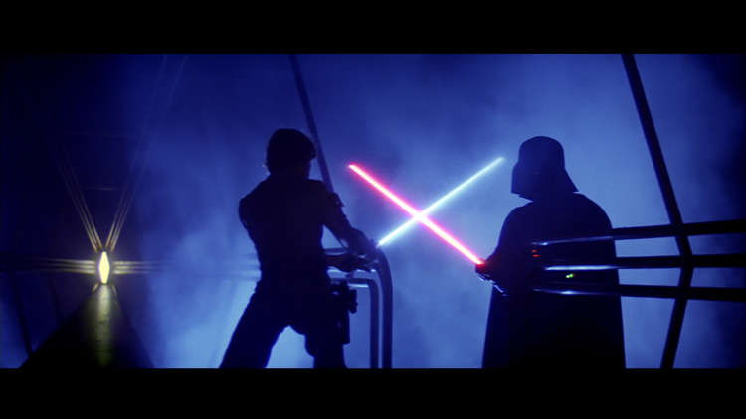
Good vs. Evil
“Woe to those who call evil good and good evil, who put darkness for light and light for darkness, who put bitter for sweet and sweet for bitter.” (Isaiah 5:20)
This verse exemplifies our post-modern culture like no other!
In post-modernity, “my truth is as valid as your truth!”

Slide 8
Now, we hear a lot of Relative truths.
“We don’t need to get married.” (Divorce is normal / Cohabitate)
“My body, My choice!” (Abortion as legit birth control)
“Man, I feel like a woman!” (Gender identity confusion)
“I can quit anytime.” (Drug addiction / legalized MJ)
“Hands up, don’t shoot!” (Perverted Justice System)
Police are attacked, bum-rushed, targeted and killed.
Thieves break in and steal, but you’re at fault.
Smash and grab is commonplace in our big cities.
Criminals are defended; law-abiding are criminalized.
“It’s just private property.” -Vandalism & violence don’t matter.
A society living without any consequences for their actions.

Slide 9
What does scripture say?
“There is a way that seems right to a man, but in the end it leads to death.” (Proverbs 14:12, 16:25)
“For the wages of sin is death” (Romans 6:23)
“Play a stupid game, win a stupid prize!” (Candace Owens)
On the contrary…
⁵ Trust in the Lord with all your heart and lean not on your own understanding; ⁶ in all your ways submit (acknowledge) to him, and he will make your paths straight.” (Prov. 3:5-6)

Slide 10
Truth vs. Falsehood
Dispute Over Whose Children Jesus’ Opponents Are
³¹ To the Jews who had believed him, Jesus said, “If you hold to my teaching, you are really my disciples. ³² Then you will know the truth, and the truth will set you free.”
³⁶ So if the Son sets you free, you will be free indeed.
⁴³ Why is my language not clear to you? Because you are unable to hear what I say. ⁴⁴ You belong to your father, the devil, and you want to carry out your father’s desires. He was a murderer from the beginning, not holding to the truth, for there is no truth in him. When he lies, he speaks his native language, for he is a liar and the father of lies. ⁴⁵ Yet because I tell the truth, you do not believe me!
- (Excerpts from John 8)

Slide 11
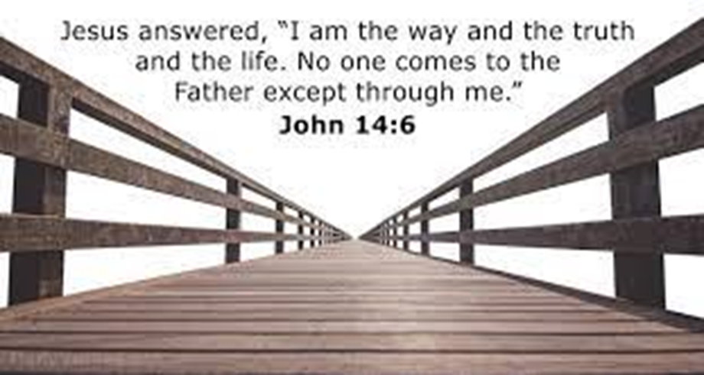
Disinformation Governance Board: Biden’s ‘Ministry of Truth’ How can any government be an arbiter of what is true and what is false? - The Washington Times - May 2, 2022

Slide 12
Wisdom vs. Foolishness
² The heart of the wise inclines to the right, but the heart of the fool to the left. ³ Even as fools walk along the road, they lack sense and show everyone how stupid they are. (Eccl. 10:2-3)
¹⁸ For the message of the cross is foolishness to those who are perishing, but to us who are being saved it is the power of God…. ²⁵ For the foolishness of God is wiser than human wisdom, and the weakness of God is stronger than human strength. (1 Cor. 1:18,25)
¹⁸ Do not deceive yourselves. If any of you think you are wise by the standards of this age, you should become “fools” so that you may become wise. ¹⁹ For the wisdom of this world is foolishness in God’s sight. As it is written: “He catches the wise in their craftiness”; ²⁰ and again, “The Lord knows that the thoughts of the wise are futile.” (1 Cor. 3:18-20)

Slide 13
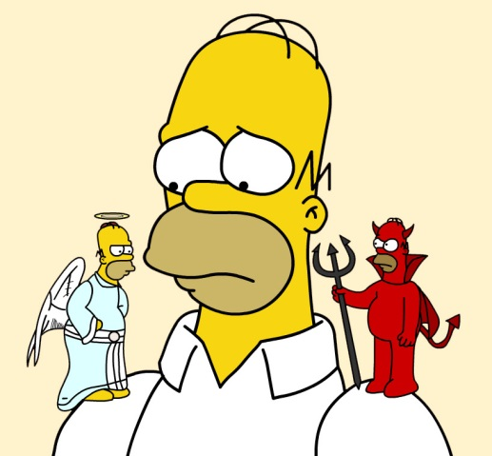
Spirit vs. Flesh (Gal. 5:16-23)
¹⁶ So I say, walk by the Spirit, and you will not gratify the desires of the flesh. ¹⁷ For the flesh desires what is contrary to the Spirit, and the Spirit what is contrary to the flesh. They are in conflict with each other, so that you are not to do whatever you want. ¹⁸ But if you are led by the Spirit, you are not under the law.
¹⁹ The acts of the flesh are obvious: sexual immorality, impurity and debauchery; ²⁰ idolatry and witchcraft; hatred, discord, jealousy, fits of rage, selfish ambition, dissensions, factions ²¹ and envy; drunkenness, orgies, and the like. I warn you, as I did before, that those who live like this will not inherit the kingdom of God.
²² But the fruit of the Spirit is love, joy, peace, forbearance, kindness, goodness, faithfulness, ²³ gentleness and self-control. Against such things there is no law.

Slide 14
So what are you saying Steve?
Today’s society (world) almost demands that we seek the middle ground.
We are taught to embrace the “gray area.”
“a color made by mixing black and white”
“designating a vague, intermediate area” - (Webster’s Dictionary)
Is this what we are called to as Christians?
Do not turn to the right or the left; keep your foot from evil. (Prov. 4:27) - also (Joshua 1:7)
¹⁶ Do not be over righteous, neither be overwise— why destroy yourself? ¹⁷ Do not be overwicked, and do not be a fool— why die before your time? ¹⁸ It is good to grasp the one and not let go of the other. Whoever fears God will avoid all extremes. (Eccl. 7:16-18)

Slide 15
But then…?
³⁷ All you need to say is simply ‘Yes’ or ‘No’; anything beyond this comes from the evil one. (Matt. 5:37)
¹⁴ “To the angel of the church in Laodicea write:
These are the words of the Amen, the faithful and true witness, the ruler of God’s creation. ¹⁵ I know your deeds, that you are neither cold nor hot. I wish you were either one or the other! ¹⁶ So, because you are lukewarm—neither hot nor cold—I am about to spit you out of my mouth. (Rev. 3:14-16)
What do we do with the Ten Commandments?
You shall have no other gods before me.
You shall not murder.
You shall not commit adultery.
You shall not steal.
Don’t these seem pretty straight-forward?

Slide 16
The Great Commission (Matt. 28:18-20)
¹⁸ Then Jesus came to them and said, “All authority in heaven and on earth has been given to me. ¹⁹ Therefore go and make disciples of all nations, baptizing them in the name of the Father and of the Son and of the Holy Spirit, ²⁰ and teaching them to obey everything I have commanded you. And surely I am with you always, to the very end of the age.”
John 8:31 - Jesus said, “If you hold to my teaching, you are really my disciples.
Is the Church teaching with moral authority anymore?
As the Church, we are often quick to evangelize and baptize, but we often slip up on the teaching & discipleship part!
What does Jesus teach on…purity, property, power, personal freedom?
“All the miseries and evils which men suffer from vice, crime, ambition, injustice, oppression, slavery, and war, proceed from their despising or neglecting the precepts contained in the Bible.” - (Noah Webster)

Slide 17
“The church must take right ground in regard to politics. Politics are part of a religion in a country as this, and Christians must do their duty to their country as a part of their duty to God. God will bless or curse this nation according to the course Christians take in politics.” - (Charles Finney)
What are we often told?
Politics and religion don’t mix!
Keep politics out of the church.
You don’t want to lose your ‘tax exempt’ status…
What does this say about the Separation of Church and State?
It’s time for this lie from the “Father of Lies” to crumble!
Truth is…True faith cannot separate one’s moral beliefs from one’s political policy if the Bible is really one’s standard for faith & practice!

Slide 18
“Human law must rest its authority ultimately upon the authority of that law which is divine. Far from being rivals or enemies, religion and law are twin sisters, friends, and mutual assistants. Indeed, these two sciences run into each other.” - James Wilson (Signer of the Constitution)

Slide 19
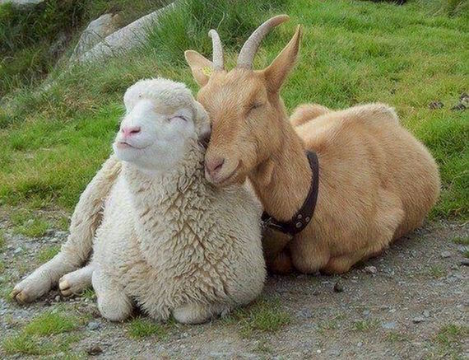
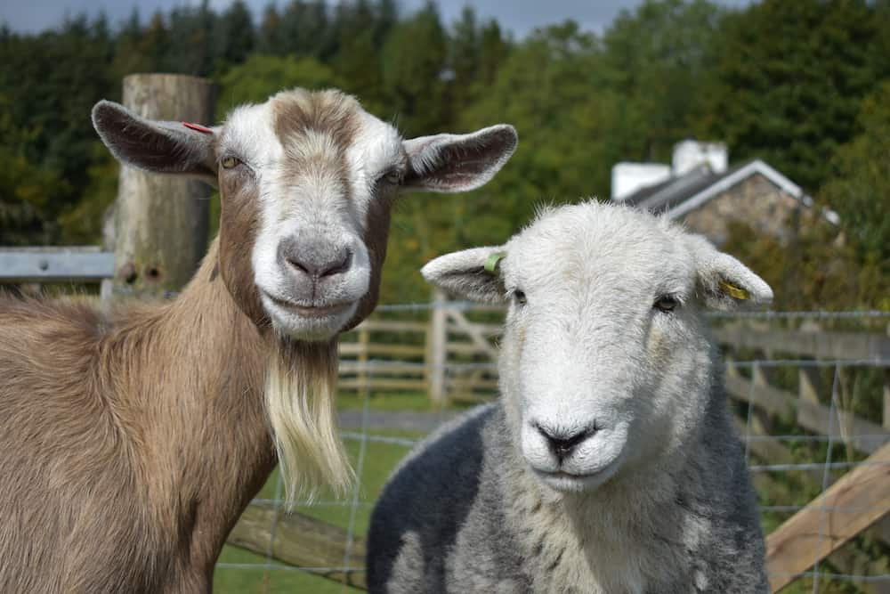
Sheep vs. Goats (Matthew 25:31-33)
³¹ When the Son of Man comes in his glory, and all the angels with him, he will sit on his glorious throne. ³² All the nations will be gathered before him, and he will separate the people one from another as a shepherd separates the sheep from the goats. ³³ He will put the sheep on his right and the goats on his left.
What do you know about sheep and goats?

Slide 20
Sheep & Goats are quite different.
SHEEP | GOATS
54 Chromosomes | 60 Chromosomes
Tails hang down | Tails point upward
Wooly (Need shearing) | Don’t need shearing
Thick, curvy horns | Narrow, straight horns
Meatier & thicker | Slimmer & more compact
Mellow, less curious, less agile | More adventurous, troublesome
Flock together in large groups | Playful together in smaller groups
Stressed when alone | More independent
Graze at ground level | Browse at eye level and up

Slide 21
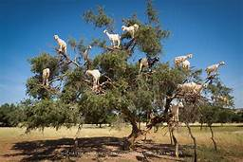
Other sheep / goat facts:
They don’t mate together well.
They don’t make a good “hybrid.”
Many times the offspring doesn’t even survive!

Slide 22
Action Steps:
St. Francis of Assissi - “Preach the gospel at all times and when necessary use words.”
¹⁶ For I am not ashamed of the gospel, because it is the power of God that brings salvation to everyone who believes: first to the Jew, then to the Gentile. (Romans 1:16)
³² “Whoever acknowledges me before others, I will also acknowledge before my Father in heaven. ³³ But whoever disowns me before others, I will disown before my Father in heaven.” (Matt. 10:32-33)
Love & Witness (by our lives)
Evangelize (by our words)
Stand & Defend Godly principles
Practice Apologetics & Defend Absolute Truths
Vote Accordingly for Faith-Based Candidates

