Slide 1
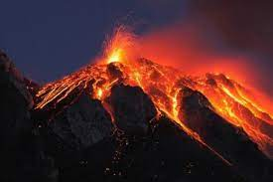
Endurance and Hope
AND THE WHITE HOT LAVA OF GOD’S REVELATION
THROUGH THE HOLY SPIRIT
A SERMON TO LIFEGATE
Pentecost Sunday, June 5, 2022

Slide 2
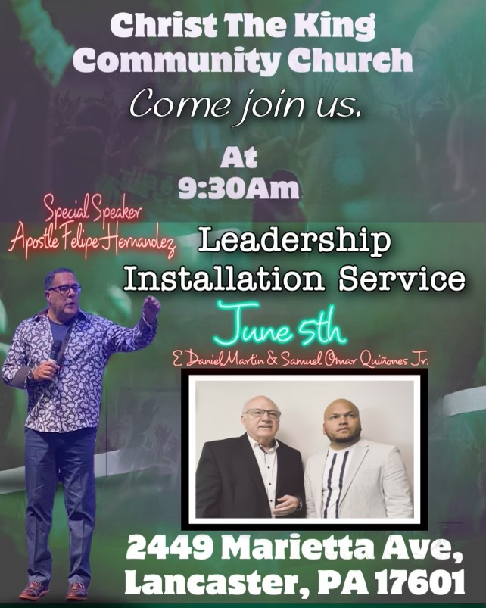

Slide 3
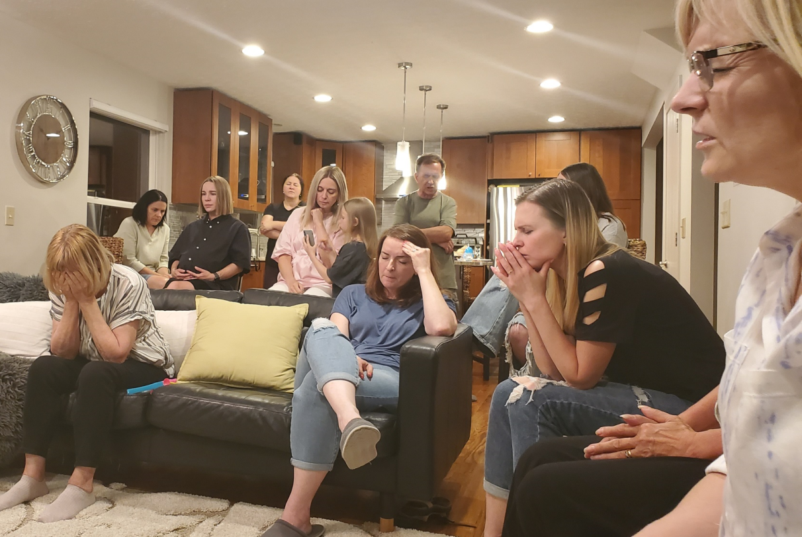
Looking For Grace In The Shaking

Slide 4
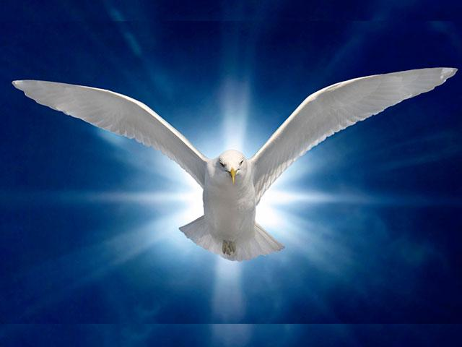
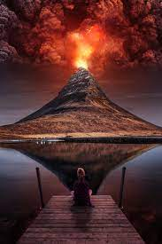
Revelation
In the day of great slaughter, when the towers fall, streams of water will flow on every high mountain and every lofty hill. ²⁶ The moon will shine like the sun, and the sunlight will be seven times brighter, like the light of seven full days, when the LORD binds up the bruises of his people and heals the wounds he inflicted. Isaiah 30:25-26 (NIV)

Slide 5
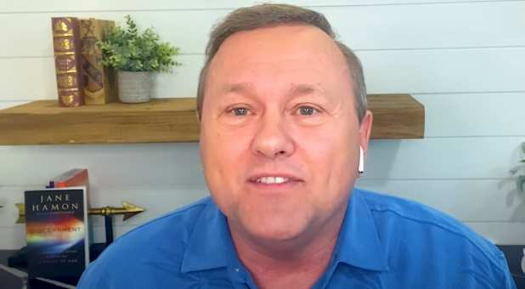
The Harvest Is
Coming In Now
The Lord said to me “this is the year that the great harvest is going to begin to be brought in but we must be careful not to be too focused on what we think is our mission and miss the divine appointments that may present themselves to us along the way in our journey of ministry, family, and business.”
The Church cannot be like the overly focused, prideful priest and Levite (Good Samaritan story) and miss the real appointments God has for us in this hour. We must minister to the hurting right in front of us because that is how the real breakthrough and harvest are going to come. God wants to pour upon the mountains of culture and upon our nation to bring great healing during these troubling times in 2022! We have to be His heart expressed and hands extended to bring this prophesied harvest to our generation! Tom Hamon

Slide 6
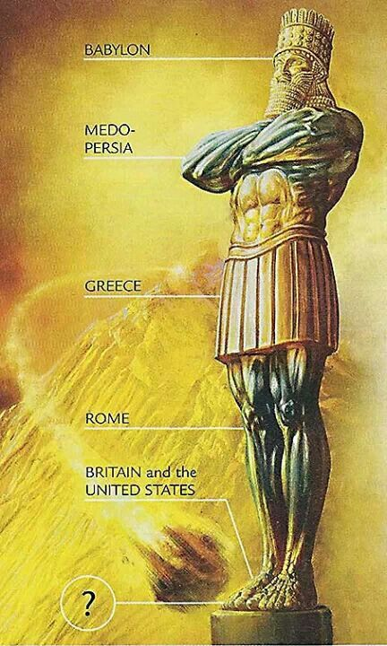
Where Are We On God’s Clock?
"In the time of those kings, (Biden, Putin, Soros, Xi, Macron, Trudeau ) the God of heaven will set up a kingdom that will never be destroyed, nor will it be left to another people. It will crush all those kingdoms and bring them to an end, but it will itself endure forever. 45 This is the meaning of the vision of the rock cut out of a mountain, but not by human hands--a rock that broke the iron, the bronze, the clay, the silver and the gold to pieces. Daniel 2:44,45
THE ROCK THAT CRUSHES THE WORLD IS: Is the revelation of Jesus Christ through the invading power of the Holy Spirit pouring out the uncompromising Word of God resulting in extraordinarily changed individuals and cities and regions living in unity and faith furthering the Gospel.

Slide 7
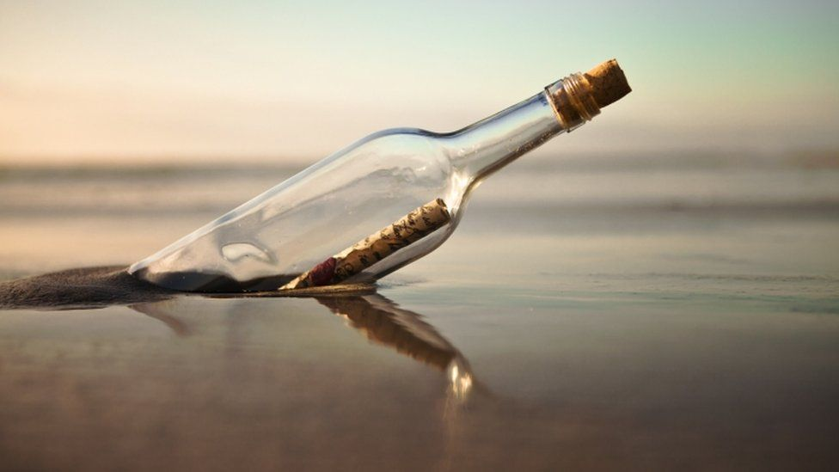
The Whole Kingdom In A Bottle
¹⁴ And we urge you, brothers, warn those who are idle, encourage the timid, help the weak, be patient with everyone. ¹⁵ Make sure that nobody pays back wrong for wrong, but always try to be kind to each other and to everyone else. ¹⁶ Be joyful always; ¹⁷ pray continually; ¹⁸ give thanks in all circumstances, for this is God's will for you in Christ Jesus. ¹⁹ Do not put out the Spirit's fire; ²⁰ do not treat prophecies with contempt. ²¹ Test everything. Hold on to the good. ²² Avoid every kind of evil. ²³ May God Himself, the God of peace, sanctify you through and through. May your whole spirit, soul and body be kept blameless at the coming of our Lord Jesus Christ. ²⁴ The one who calls you is faithful and He will do it. 1 Thessalonians 5:14-24 (NIV)

Slide 8
“THERE IS ONLY ONE WAY TO GO THROUGH THIS CRUCIBLE MOMENT AS FOLLOWERS OF JESUS CHRIST – AND IT IS TO COMMIT OUR ALL TO HIM WHO SITS ON THE THRONE AND UNTO THE LAMB – AND BE POWERFULLY FILLED WITH THE HOLY SPIRIT.” Don Lamb
They will be my people, and I will be their God. ³⁹ I will give them singleness of heart and action, so that they will always fear me for their own good and the good of their children after them. Jeremiah 32:38-39 (NIV)

Slide 9
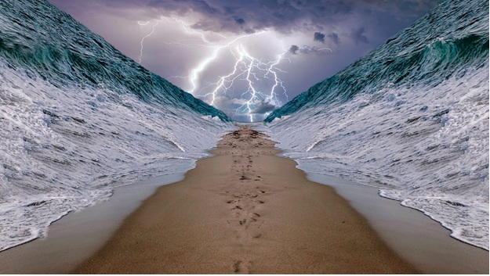
THE DRIVING MOTIVATION OF
SEEKING INTERVENTION IS THAT PEOPLE
AROUND US WILL KNOW OUR GOD
Now, O LORD our God, deliver us from his hand, so that all kingdoms on earth may know that you alone, O LORD, are God." 2 Kings 19:19 (NIV)

Slide 10
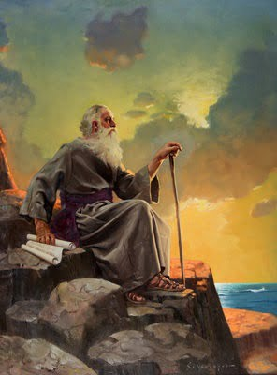
Three Chord Strand
I, John, your brother and companion (co-participant) in the suffering and kingdom (realm and rule) and patient endurance that are ours in Jesus, was on the island of Patmos because of the word of God and the testimony of Jesus. Revelation 1:9

Slide 11
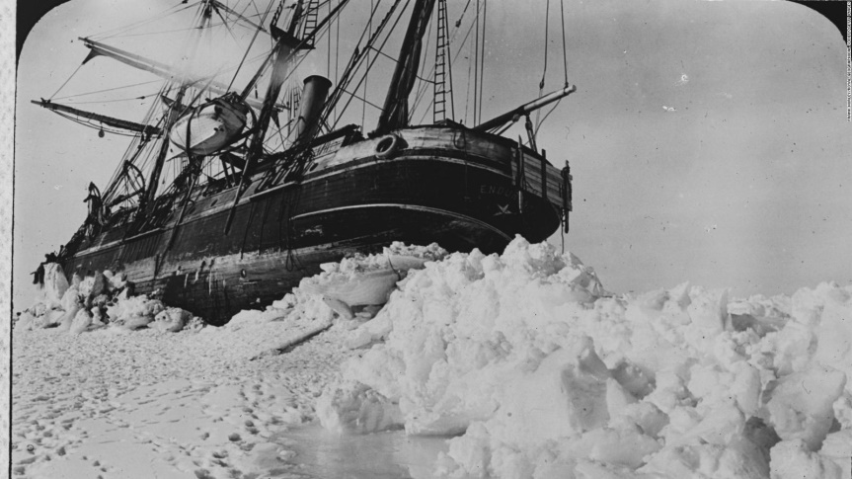
ENDURANCE
HOOPA-MOE-NAY - constancy :- enduring, patience, patient continuance (waiting). (FROM THE ROOT – to bear trials and have fortitude
We continually remember before our God and Father your work produced by faith, your labor prompted by love, and your endurance inspired by hope in our Lord Jesus Christ. 1 Thessalonians 1:3
This calls for patient endurance and faithfulness on the part of the saints.
Revelation 13:10
This calls for patient endurance on the part of the saints who obey God's commandments and remain faithful to Jesus. Revelation 14:12

Slide 12
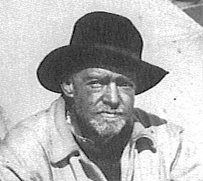
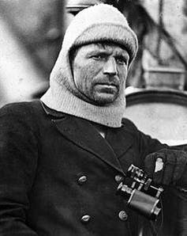
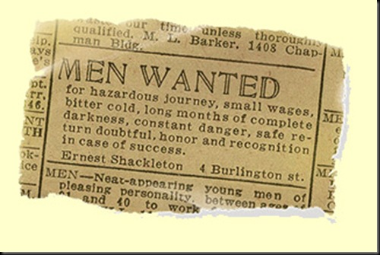
The 1914 Imperial
Trans-Antarctic Expedition
Sir Ernest Shackleton
Fortitudine vincimus
Frank Worsley
1400 Applications were sorted into three piles: Mad (insane), Hopeless or Possible.

Slide 13
Endurance Is Inspired by Hope
But Enhanced By Understanding
How To Work Together
My brothers, some from Chloe's household have informed me that there are quarrels among you. ¹² What I mean is this: One of you says, "I follow Paul"; another, "I follow Apollos"; another, "I follow Cephas"; still another, "I follow Christ." ¹³ Is Christ divided? Was Paul crucified for you? Were you baptized into the name of Paul? 1 Corinthians 1:11-13 (NIV)
⁴ For when one says, "I follow Paul," and another, "I follow Apollos," are you not mere men? ⁵ What, after all, is Apollos? And what is Paul? Only servants, through whom you came to believe--as the Lord has assigned to each his task. ⁶ I planted the seed, Apollos watered it, but God made it grow. ⁷ So neither he who plants nor he who waters is anything, but only God, who makes things grow. ⁸ The man who plants and the man who waters have one purpose, and each will be rewarded according to his own labor. 1 Corinthians 3:4-8 (NIV)

Slide 14
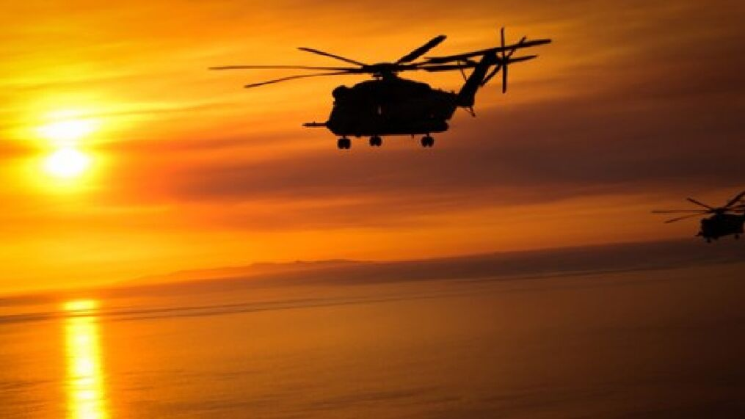
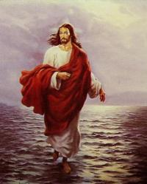
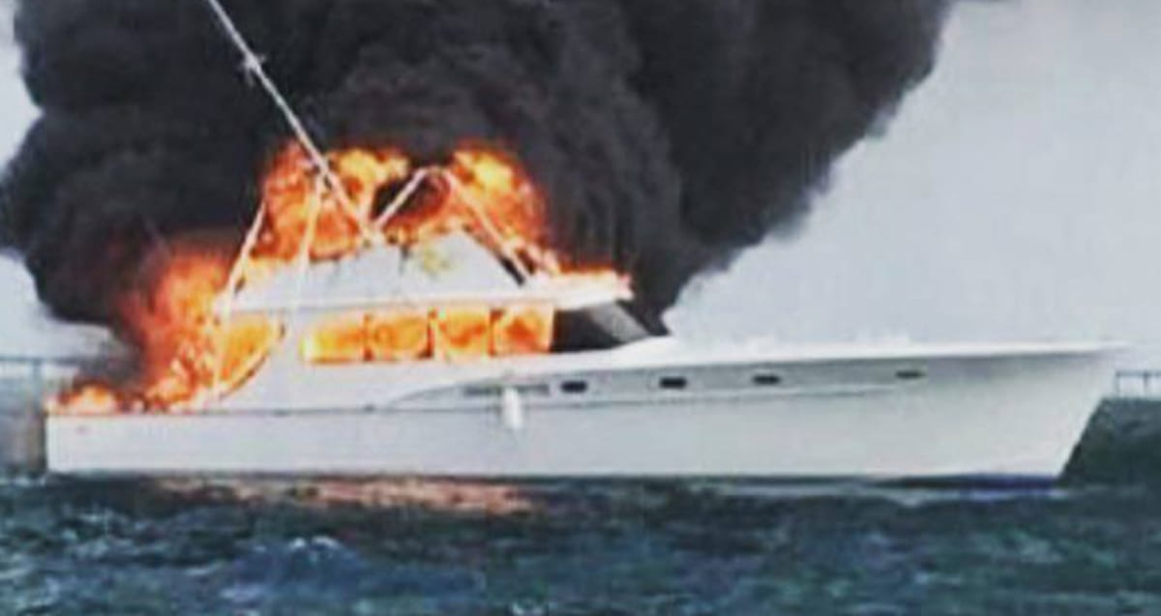
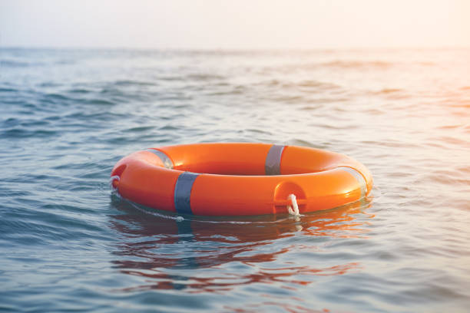
Parable – “What is Most Important”
Gifts and Callings
of the Spirit

Slide 15
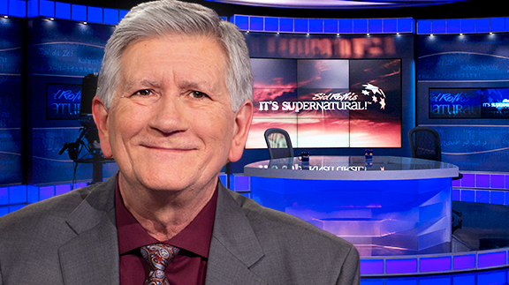
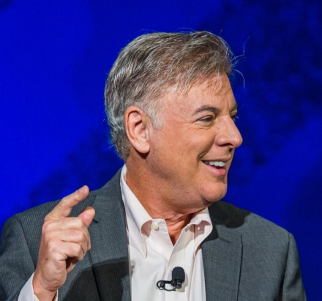
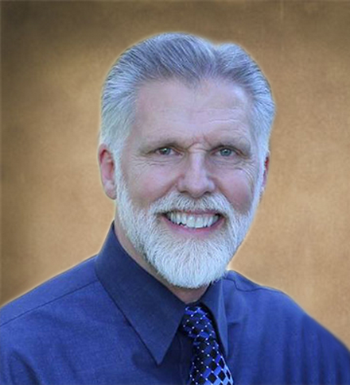
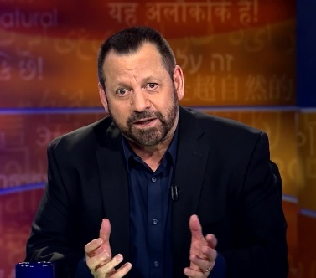
Different Giftings
Bring Different Intensities of Grace
Mike Thompson
Lance Wallnau
Joe Sweet
STATESMAN PROPHETIC INTERCESSOR
Learning to pray from Third Heaven Authority – overcoming the Spirit of Jezebel and Pharisee
PROPHETIC –STATESMAN – TEACHER ACTIVATOR - Gift to distill the CRITICAL ISSUE God is working into His people – brings streams together – but we have to have FAITH IN ACTION.
PASTORAL – REVIVALIST – SEER -Gift to keep the Church grounded in the Word and the Spirit – brings streams together
PROPHETIC EVANGELIST TO THE COLLAPSED WINESKINS around the world. (By building New Wineskins) Gift to uncover GENERATIONAL systems and strongholds and research how to overcome the enemy through bold faith.
STATESMAN – REVIVALIST – EVANGELIST –Pure Gospel – with signs and wonders - Mixed with God calls the church to STEWARD AMERICA.
Mario Murillo

Slide 16
Effective Leadership
Will Have to Be Bold Leadership
HOW WILL WE DEFEAT JEZEBEL – AND THE OCCUPYING SPIRIT IN AMERICA – IF YOU DO NOT ACCEPT THE INTENSITY OF THE LEADERSHIP GOD IS USING BOTH SPIRITUALLY AND NATIONALLY? – Mike Thompson – 5-23-21

Slide 17
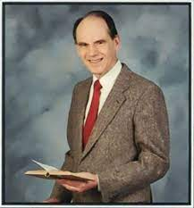
“Narrow Visions Can Limit
God’s Full Potential In His Church”
God intended that all these streams (waves of spiritual recovery) in the 1950’s would blend together into one glorious whole with a balance of truth and a dynamic of life, but instead there was limitation of vision, each one thinking that the part he held was the whole (or most important).
Arthur Wallis 1962

Slide 18
Job Was An Influencer
STATESMAN ANOINTING
7 "When I went to the gate of the city and took my seat in the public square, 8 the young men saw me and stepped aside and the old men rose to their feet;
9 the chief men refrained from speaking and covered their mouths with their hands;
10 the voices of the nobles were hushed, and their tongues stuck to the roof of their mouths. 11 Whoever heard me spoke well of me, and those who saw me commended me,
RESCUING ANOINTING
12 because I rescued the poor who cried for help, and the fatherless who had none to assist him. - 15 I was eyes to the blind and feet to the lame. 16 I was a father to the needy; I took up the case of the stranger. 17 I broke the fangs of the wicked and snatched the victims from their teeth. Job 29: 7-16
JOB SENSED THAT HIS BLESSING CAME FROM THE GIFT OF GOD’S PRESENCE When His lamp shone upon my head and by His light I walked through darkness! 4 Oh, for the days when I was in my prime, when God's intimate friendship blessed my house,
Job 29:3,4

Slide 19
Salvation Is The Blessings
Of Faith and The
Promise Of The Spirit
He redeemed (purchased) us in order that the blessing given to Abraham might come to the Gentiles through Christ Jesus, so that by faith we might receive the promise of the Spirit. Galatians 3:14 (NIV)

Slide 20
How Do We Posture Ourselves
For The Revelations of the Holy Spirit?
²⁵ Now to him who is able to establish you by my gospel and the proclamation of Jesus Christ, according to the revelation of the mystery hidden for long ages past, ²⁶ but now revealed and made known through the prophetic writings by the command of the eternal God, so that all nations might believe and obey him-- ²⁷ to the only wise God be glory forever through Jesus Christ! Amen. Romans 16:25-27 (NIV)
But on Mount Zion will be deliverance; it will be holy, and the house of Jacob will possess its inheritance. ¹⁸ The house of Jacob will be a fire and the house of Joseph a flame; the house of Esau will be stubble, and they will set it on fire and consume it. There will be no survivors from the house of Esau." The LORD has spoken. Obadiah 1:17-18 (NIV)

Slide 21
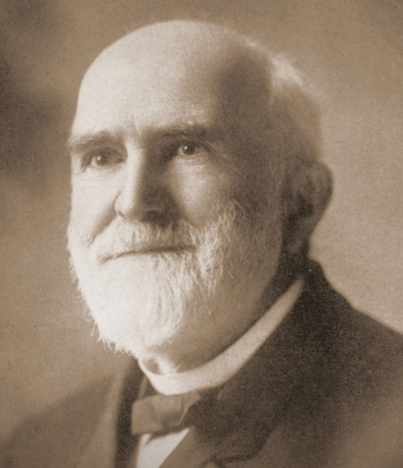
“Oh! It is grand to be absolutely conquered by the Holy Spirit, and swing out a thousand miles from all the fears of life into the ocean of God’s presence, and work with Him in humility, without stumbling over others, without spiritual pride, and bend to every plan God has for us.” G. D. Watson

Slide 22
HOW DO WE MAKE THIS PERSONAL?
1. Fall in love with Jesus every day
2 . Pray without ceasing for fresh fillings of the Holy Spirit
3. Discern what you can DO RIGHT NOW
4. Expect God to come through in your battles.
5. Get freedom from hindering personality traits – negative childhood shaping – cultural bondage through the Supernatural working of the Holy Spirit’s internal encountering glory that will CARRY YOU THROUGH into purity, freedom, purpose, hope, and endurance.

