Slide 1
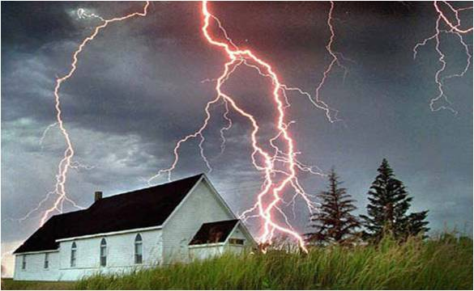
The Awakening
Will Match and Exceed
The Shaking
Barrier- Breaking Grace
A SERMON TO LIFEGATE
Sunday, July 3, 2022

Slide 2
This Is Our Present Inheritance
Praise be to the God and Father of our Lord Jesus Christ, who has blessed us in the heavenly realms with every spiritual blessing in Christ. ⁴ For he chose us in him before the creation of the world to be holy and blameless in his sight. In love ⁵ he predestined us to be adopted as his sons through Jesus Christ, in accordance with his pleasure and will-- ⁶ to the praise of his glorious grace, which he has freely given us in the One he loves. ⁷ In him we have redemption through his blood, the forgiveness of sins, in accordance with the riches of God's grace ⁸ that he lavished on us with all wisdom and understanding. Ephesians 1:3-8 (NIV)

Slide 3
Application To America and the
Victory of Roe V. Wade
¹³ Shout for joy, O heavens; rejoice, O earth; burst into song, O mountains! For the LORD comforts His people and will have compassion on His afflicted ones. ¹⁴ But Zion said, "The LORD has forsaken me, the Lord has forgotten me." ¹⁵ "Can a mother forget the baby at her breast and have no compassion on the child she has borne? Though she may forget, I will not forget you! ¹⁶ See, I have engraved you on the palms of my hands; your walls are ever before me. ¹⁷ Your sons hasten back, and those who laid you waste depart from you. ¹⁸ Lift up your eyes and look around; all your sons gather and come to you. ¹⁹ "Though you were ruined and made desolate and your land laid waste, now you will be too small for your people, and those who devoured you will be far away. ²⁰ The children born during your bereavement will yet say in your hearing, 'This place is too small for us; give us more space to live in.' Isaiah 49:13-20 (NIV)
Application Also To LifeGate

Slide 4
JOURNEY TO BUILDING
FROM 2018 - 2022

Slide 5
FALL OF 2018 INTO FEBRUARY 2019

Slide 6
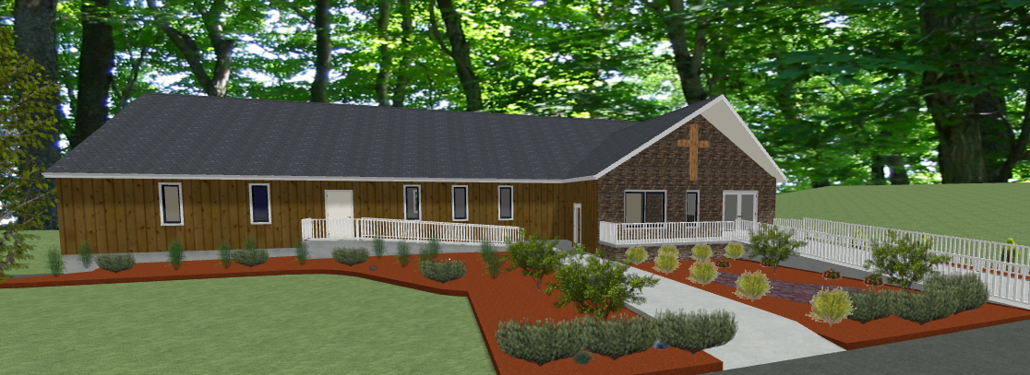
FEBRUARY 2020

Slide 7
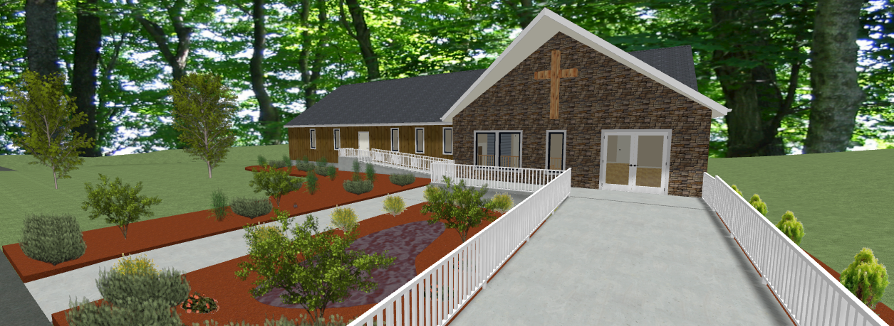
FEBRUARY 2020

Slide 8
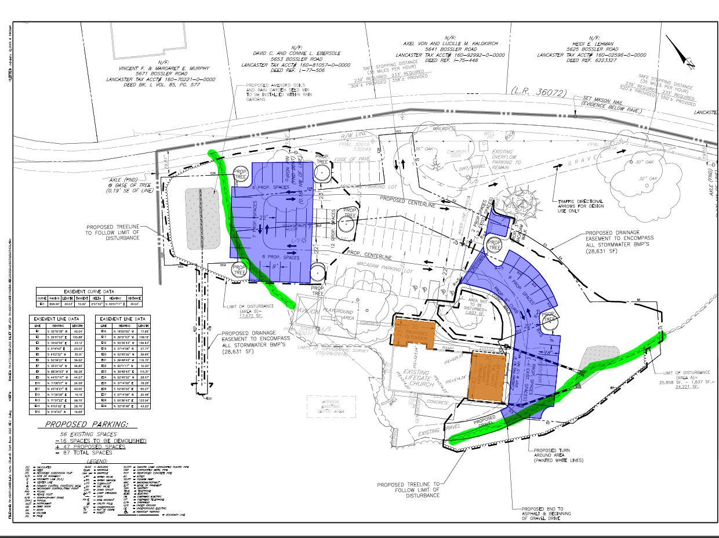
SUMMER 2020

Slide 9
FEBRUARY 2020

Slide 10
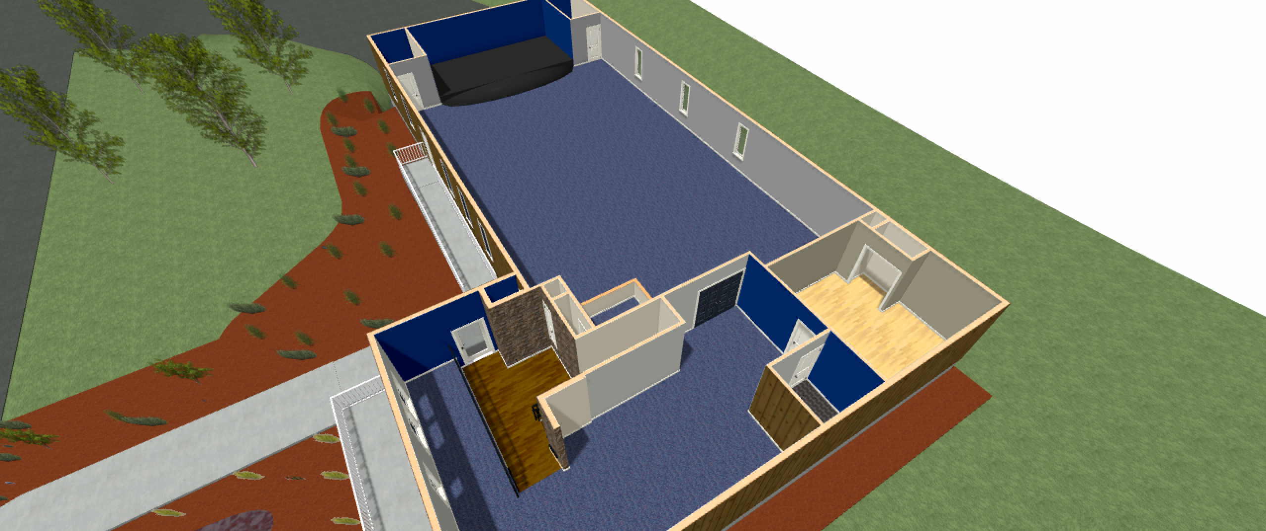
FEBRUARY 2020

Slide 11
FEBRUARY 2020

Slide 12
FEBRUARY 2020

Slide 13
Building Proposal –
Phase One and Two
Phase 2
Phase 1
Phase 2
FALL 2021

Slide 14
Phase One Building Front Right
FALL 2021

Slide 15
Phase One Building Layout
FALL 2021

Slide 16
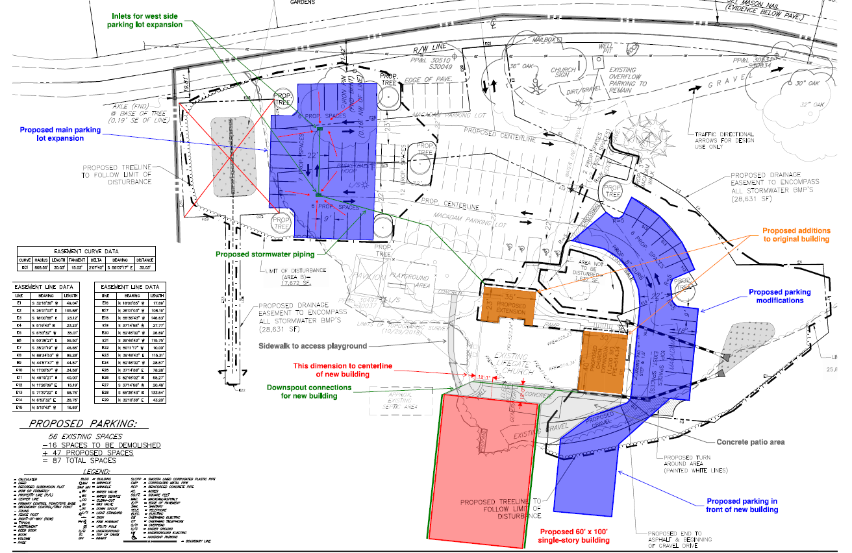
PROPOSED PHASE TWO ADDITIONS
Phase 2
Phase 2
SUMMER 2022
Phase 1

Slide 17
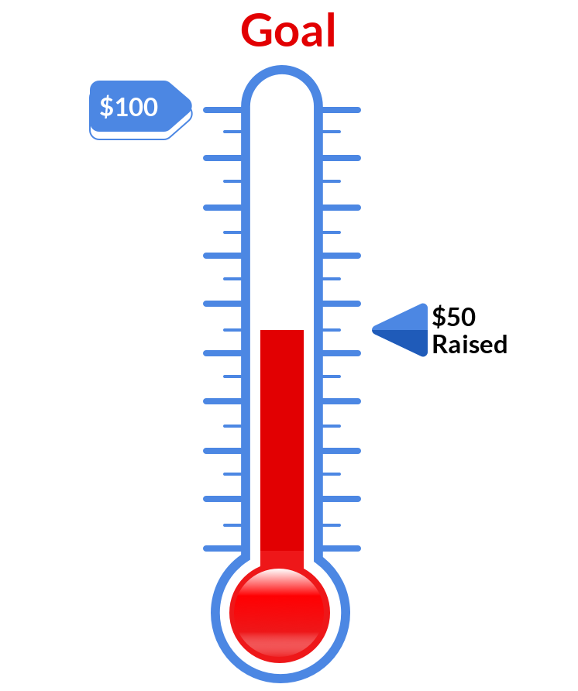
LIFEGATE FUND RAISING GOALS CAPITAL CAMPAIGN
$800,000
$412,000
$325,000
52%
35%

Slide 19
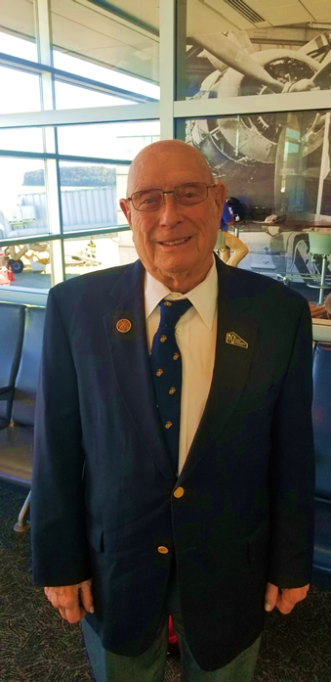
A picture of Jesus hangs on his wall, a symbol of the profound religious awakening 58 years ago in the Pea Ridge Methodist Church that Williams said ended his nightmares and transformed his life.

Slide 20
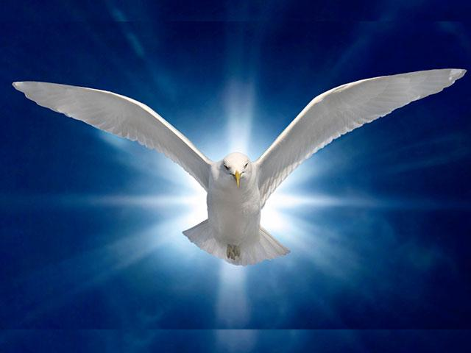
One of the things that has struck me is the faithfulness of the Holy Spirit. The continued endurance of His ministry to us and among us when we are many times very oblivious of how we grieve and quench His glorious work.

Slide 21
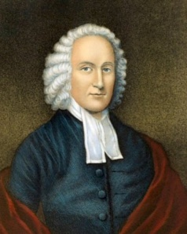
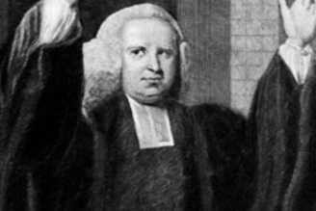
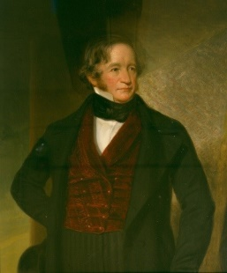
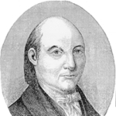
Learning From The Past
Awakenings and Shakings
George Whitefield
Jonathan Edwards
The revival of Ipswich Massachusetts
Nathaniel Appleton
From Cambridge
Rev. John Caldwell, Irish Presbyterian minister
Awakening breaks out under Pastor
Daniel Rogers
The opponents of the awakenings, especially Charles Chauncy, used Davenport as the ultimate example of the madness the revivals generated. Moderate evangelicals would eventually denounce Davenport in order to preserve what they saw as the godly parts of the awakenings.
James Davenport
Benjamin Colman and other leading moderate ministers in Boston had become increasingly disturbed by the radicals’ behavior. Colman wrote to Whitefield in June about the controversies in Connecticut. “The fervent, pious Mr. Devenport, and Mr. Crosswell, have been too much under the Impressions of a heated imagination, and no doubt often preached under actual fevers.”

Slide 22
THE FINAL BATTLES OF THE FIRST
GREAT AWAKENING
Such [that] thee ministers there cant invite him, into [their] pulpits [they] look upon him—as an enthusiastic—I pray God to Direct him & keep him [from] dishonoring God.
The newspaper further described Davenport as roaming the streets “with a large Mob at his Heels, singing all the Way thro’ the Streets, he with his Hands extended
Davenport continued preaching in Boston after the declaration of the ministers. The expulsion from Connecticut and the Boston declaration helped make him the hottest topic in town that summer.
New London in the first week of March 1743. He apparently meant to organize a church there among students at the radical Shepherd’s Tent. Suffering from an ailment in his leg, Davenport was carried about in a chair. On the Sabbath, Davenport called on his followers to begin burning books of popular authors opposed to him, or Reformed classics he perceived as Arminian. Among the authors deemed fit for the flames were John Flavel, Increase Mather, Benjamin Colman, Joseph Sewall, Charles Chauncy, Jonathan Dickinson, and New London’s own Eliphalet Adams.

Slide 23
The next day Davenport called on his followers to burn vain clothing. Some apparently began to comply, casting down such items as “Scarlet Cloaks, Velvet Hoods, fine Laces, and every Thing that had two Colours.” Others had second thoughts about these extremes. Davenport himself reportedly contributed a pair of plush breeches to the growing pile, but a young woman thought all this crossed the line of propriety and she snatched out his pants, cried, “The calf you have made is too big,” and “flung Davenports Plush Breeches into his Face.” This act of defiance broke Davenport’s spell over the radical crowd, which quickly turned against him.
For consider him that endured such contradiction of sinners against himself, lest ye be wearied and faint in your minds. Hebrews 12:3 (KJV)

Slide 24
What does it mean to stay balanced in Grace and Truth?
LET US NOT MAKE IT OUR GOAL TO BRING A BACKLASH AGAINST PEOPLE BUT AGAINST THE TRUE ENEMY LUCIFER – AND HIS SYSTEMS OF LIES AND TYRANNY.
WE CANNOT LIVE WANTING TO BE LIKED – WE HAVE TO LIVE WANTING TO PLEASE OUR LORD JESUS CHRIST.
BEING LOVING IS BEING AUTHENTIC AND BEING CONTAGIOUS WITH TRUTH AND GRACE

Slide 25
As Watchman on the Wall
WE ARE NOT CALLED TO OPERATE IN A WAY SO AS TO DEVELOP STREET CRED WITH OUR CULTURE BECAUSE WE COME UP WITH A VIBE EITHER CONSERVATIVE OR LIBERAL THAT MAKES EVERYONE LIKE US. WE ARE STANDING IN THE GAP AND SOMETIMES OUR POSITIONS ARE HOSTILE TO THE LIES THAT HAVE BECOME COMMON PLACE. IN ADDITION, WE ARE NOT GOING TO SCRIPTURE WHIP PEOPLE INTO A JUDEA CHRISTIAN WORLD VIEW. WE ARE GOING TO HAVE TO BE DRENCHED IN THE HOLY SPIRIT AND WILLING TO LISTEN TO THOSE WITH MERCY AND WISDOM GIFTS THAT HAVE GONE INTO THE LIONS DEN AND COME OUT WITH SCARS IN SOME OF THE MOST CHALLENGING SITUATIONS YET ARE NOT GIVING THE WICKED A FREE PASS. DON LAMB

Slide 26
“THERE IS ONLY ONE WAY TO GO THROUGH THIS CRUCIBLE MOMENT AS FOLLOWERS OF JESUS CHRIST – AND IT IS TO COMMIT OUR ALL TO HIM WHO SITS ON THE THRONE AND UNTO THE LAMB – AND BE POWERFULLY FILLED WITH THE HOLY SPIRIT.” Don Lamb
They will be my people, and I will be their God. I will give them singleness of heart and action, so that they will always fear me for their own good and the good of their children after them. Jeremiah 32:38-39 (NIV)

Slide 27
Wrapping this up
Through a Word given to
A brother under a severe Test
You are God’s man, faithful in your ministry and anointed, but I am sure the humanity in you is reeling from the physical news you face. Yes, at this point there is a lot to sort out concerning this but at the end of the sorting, there is God with His mercy and faithfulness for we “walk not after the flesh but after the Spirit.”
This battle, I am convinced is the Lord’s. He is your shield and buckler especially now personally. Fred meditate on these two words “shield and buckler”. He is your strong defense going forward. He has brought you this far and by His grace and mercy He will get you through this.

Slide 28
As I have said, this is not about you but the anointing invested in you. Have the faithful ones in your church pray, binding the situation that is wanting to play out in your body.
Brother, I was in earnest prayer last week for a man that was in a potentially a life crushing situation. it was enormous. The burden in my spirit for him was strong, so my prayer was reaching out to God for His mercy and that He would make a way where there seemed to be no way, this is when God spoke to me this “I am the God of the impossible”. At that word the burden was lifted and I was blocked from further prayer for him. That evening the man called me with a good report.
Though your faith is strong. God wants to me to remind you that He is the God of the impossible and I think of the song “I will not be moved”.
My wife has had a health issue. God spoke to her, that if she would trust Him he would heal her body. She has been fighting the good fight of faith. God reminded me of His word “Whose report will you believe”. Since He spoke these words she has been symptom free. Praise God!
I hear in my spirit the word, position. He is positioning and strengthening His warrior ministers for the battles ahead. Brother be of good cheer, you are being called to bring precious eternal souls into His kingdom. In your favor is LIFE and life more abundantly

Slide 29
Keep in mind that this battle you are in is a actually a call to arms. It’s war. Your assignment from God will play a critical part in this war. This is the perspective and mind set God is presenting to you to walk in.
In your assignment you will not and do not walk alone. God has provided co-warriors to fight the fight of faith with you. There are many more coming your way. Just think of the precious souls through your assignment that will be won for Christ. Now Fed, I speak very seriously to you, Buttress up you heart and soul and walk strong as a man on assignment.

Slide 30
This Is Our Present Inheritance
Praise be to the God and Father of our Lord Jesus Christ, who has blessed us in the heavenly realms with every spiritual blessing in Christ. ⁴ For he chose us in him before the creation of the world to be holy and blameless in his sight. In love ⁵ he predestined us to be adopted as his sons through Jesus Christ, in accordance with his pleasure and will-- ⁶ to the praise of his glorious grace, which he has freely given us in the One he loves. ⁷ In him we have redemption through his blood, the forgiveness of sins, in accordance with the riches of God's grace ⁸ that he lavished on us with all wisdom and understanding. Ephesians 1:3-8 (NIV)

Slide 31
HOW DO WE MAKE THIS PERSONAL?
1. You have an assignment – find out what it is
2 . Pray without ceasing for fresh fillings of the Holy Spirit
3. Do not get into the flesh – if you are CANCELLED or resisted – STAY ABOVE THE FLESH through the Holy Spirit
4. Expect God to come through in your battles.
5. Get freedom from hindering personality traits – negative childhood shaping – cultural bondage through the Supernatural working of the Holy Spirit’s internal encountering glory that will CARRY YOU THROUGH into purity, freedom, purpose, hope, and endurance.

