Slide 1
Philippians 2:5
A SERMON TO LIFEGATE
Sunday, August 7, 2022

Slide 2
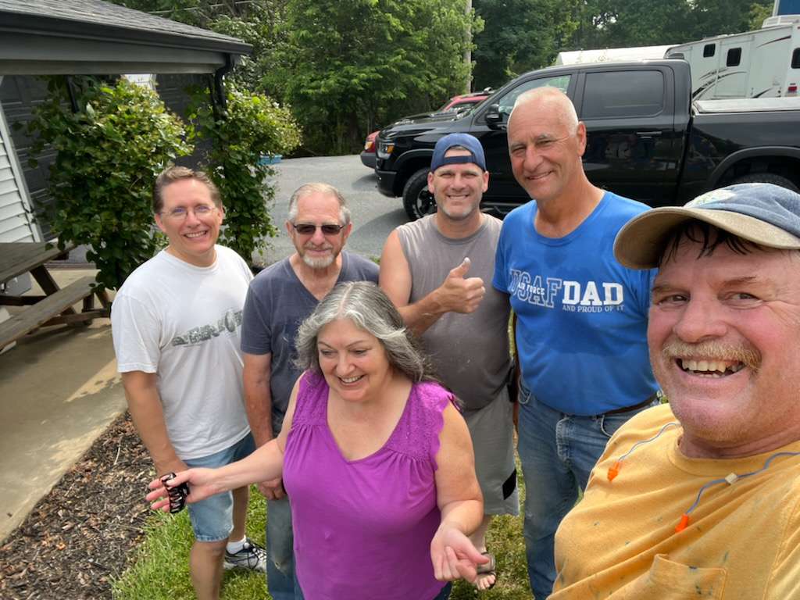

Slide 3
Living Out The Character of Jesus
in a generation that says,
“Tell me I’m right or else you’re a bigot.”
Philippians 2:5
A SERMON TO LIFEGATE
Sunday, July 17, 2022

Slide 4
Paul the greatest Gospel Communicator Asked for Prayer
Pray also for me, that whenever I open my mouth, words may be given me so that I will fearlessly make known the mystery of the Gospel, ²⁰ for which I am an ambassador in chains. Pray that I may declare it fearlessly, as I should. Ephesians 6:19-20 (NIV)

Slide 5
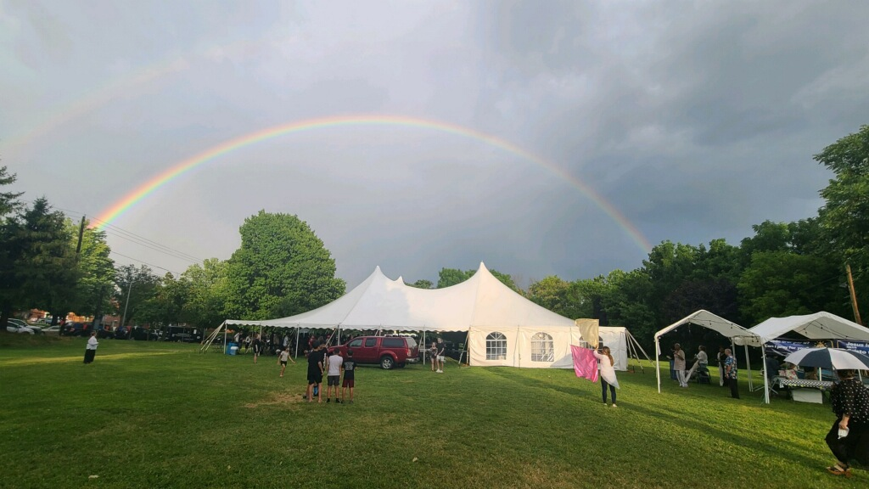
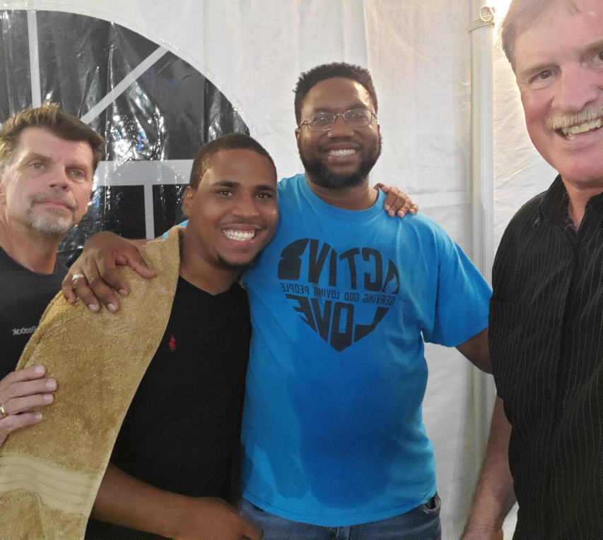
The Spirit of Humility Coupled With Kingdom Boldness and Truth Ignites An
Opportunity for Breakthrough

Slide 6
The Holy Spirit
Reminds Me of A Hummingbird
Nectar

Slide 7
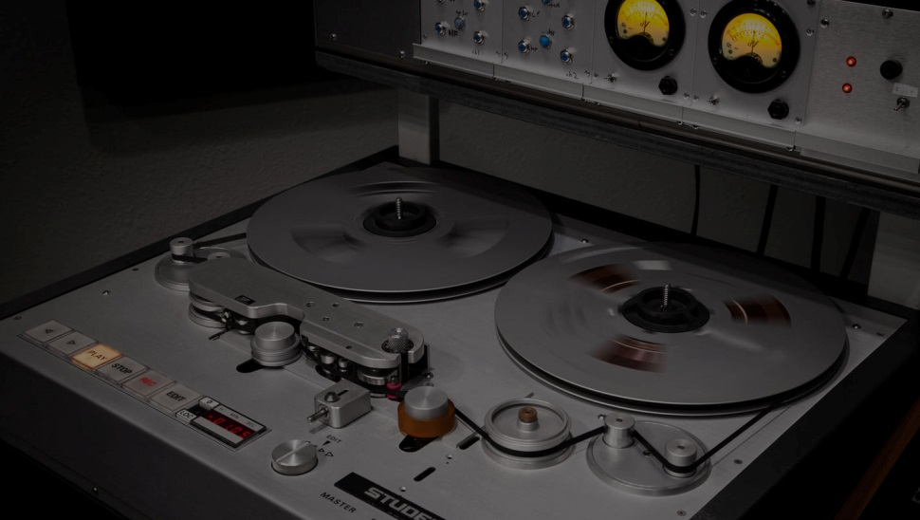
Audiophile
The MoFi revelation will prove what (we’ve) been saying for years, that the anti-digital crowd has been lying to itself: “These people who claim they have golden ears and can hear the difference between analog and digital, well, it turns out you can’t.”
LP Vinyl 100 kbps – 12 bit (Pure ANALOG)
MP3s 320 kbps -24 bit
CDs use a sample rate of 44.1kHz at 16-bit Lossless Digital up to 192kHz at 24-bit.
Mike Esposito
“One of the reasons they want to excoriate MoFi is for lying,” says Howarth. “The other part that bothers them is that they’ve been listening to digital all along and they’re highly invested in believing that any digital step will destroy their experience. And they’re wrong.”

Slide 9
Vignette ONE – Being Human
Multitudes who sleep in the dust of the earth will awake: some to everlasting life, others to shame and everlasting contempt. ³ Those who are wise will shine like the brightness of the heavens, and those who lead many to righteousness, like the stars for ever and ever. Daniel 12:2-3 (NIV)
This day I call heaven and earth as witnesses against you that I have set before you life and death, blessings and curses. Now choose life, so that you and your children may live ²⁰ and that you may love the LORD your God, listen to his voice, and hold fast to him. For the LORD is your life- Deuteronomy 30:19-20 (NIV)
The heart is deceitful above all things and beyond cure. Who can understand it? ¹⁰ "I the LORD search the heart and examine the mind, to reward a man according to his conduct, according to what his deeds deserve." Jeremiah 17:9-10 (NIV)
But each one is tempted when, by his own evil desire, he is dragged away and enticed. ¹⁵ Then, after desire has conceived, it gives birth to sin; and sin, when it is full-grown, gives birth to death. James 1:14-15 (NIV)

Slide 10
This is Why Everyone Needs A Savior
The most indestructible part of being human is our Soul and Spirit and memories it is eternal and will go on for eternity. (Daniel 12:2,3)
The most dangerous part of being human is our free will the ability to choose whatever we want without constraint - free will is dangerous because we can choose to do very stupid things. (Deut. 30:19,20)
The most deceived part of being human is our heart and mind (Jeremiah 17:9,10)
The most tempting part of being human is our flesh. (James 1:14,15)

Slide 11
Vignette TWO – Being Found By God
I have found David my servant; with my sacred oil I have anointed him. 21 My hand will sustain (establish) him; surely my arm will strengthen him. Psalm 89:20-21 (NIV)
HE FINDS US
HE ANOINTS US
HE ESTABLISHES - FIXES US (Sustain - position)
HE STRENGTHENS US – ROOT Alert – courageous - (fortify, increase, prevail)

Slide 12
Then the man and his wife heard the sound of the LORD God as he was walking in the garden in the cool of the day, and they hid from the LORD God among the trees of the garden. 9 But the LORD God called to the man, "Where are you?" Genesis 3:8-9 (NIV)
And now, dear children, continue in Him, so that when He appears we may be confident and unashamed before Him at His coming. 1 John 2:28

Slide 13
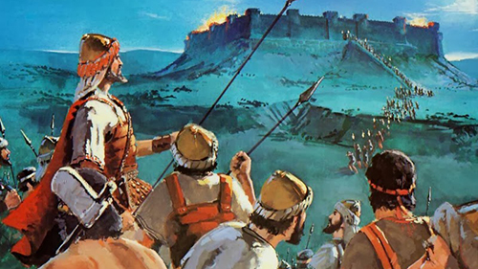
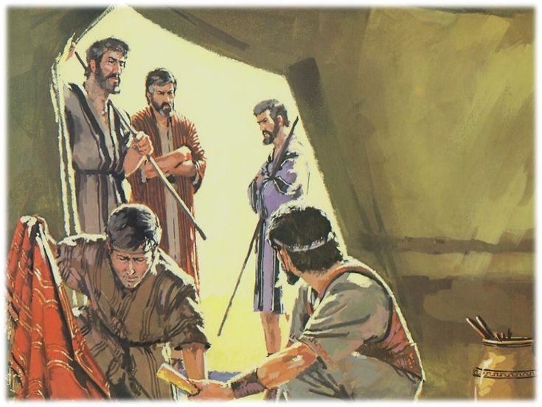
OVERCOMING SHAME
Study on Joshua
Sin of Achan
Joshua Eventually takes Ai

Slide 14
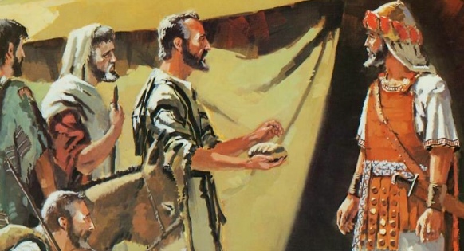
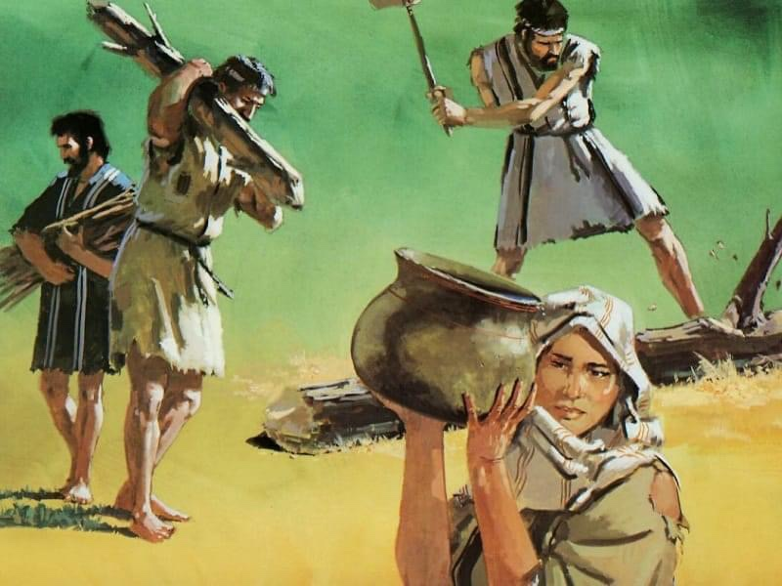
Joshua and Shame
Gibeonites Deceive Joshua
Joshua honors the Treaty
But makes them into servants
WE HAVE TO DO IT IN THE WILL OF GOD GOING FORWARD

Slide 15
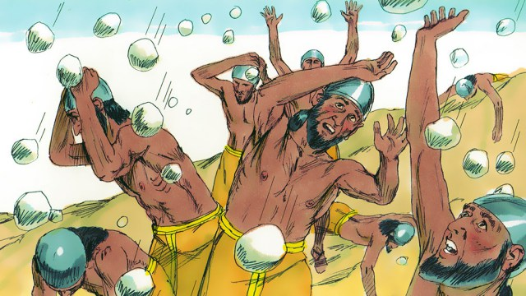
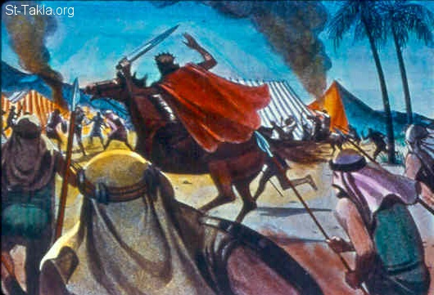
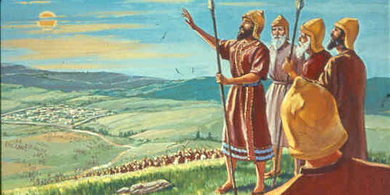
The Battle Against Shame
Facing the Consequences
After Forgiveness (Is God Going To Come Through?)
God
Sends
Hail
Gibeonites are attacked
By Five Kings
Joshua Asks The Sun To Stand Still

Slide 16
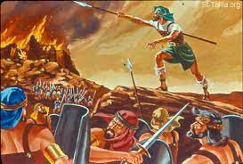
God Abundantly Forgives
Joshua and Crowns Him
With an Astounding Victory

Slide 17
The Gates Of Shame
Things that happen to us from others who sin against us – use us and abuse us.
Things that happen to us because we sin against God and others.
Decisions we make with the best light at the moment but we are not able to discern correctly and a bad outcome takes place.

Slide 18
Repentance Removes Our Shame
IF WE TRULY AND FULLY REPENT (NOT JUST FEELING SORRY FOR OUR GETTING CAUGHT – BUT TRULY FORSAKE OUR SIN) – WE NEED TO LET GO OF THE SHAME OF OUR SIN – THAT GUT WRENCHING REGRET THAT WE DID SOMETHING SUPER STUPID.
"Then will I purify the lips of the peoples, that all of them may call on the name of the LORD and serve him shoulder to shoulder. - On that day you will not be put to shame for all the wrongs you have done to me. Zephaniah 3:9,11
If we confess our sins, He is faithful and just and will forgive us our sins and purify us from all unrighteousness. 1 John 1:9

Slide 19
No one whose hope (WRAP TOGETHER – TO EXPECT – WAIT PATIENTLY) is in You will ever be put to shame, Psalm 25:3 (NIV)

Slide 20
And now, dear children, continue in Him, so that when He appears we may be confident and unashamed before Him at His coming. 1 John 2:28
WE MUST CONTINUE IN FAITH
WE MUST CONTINUE IN TRUTH
WE MUST CONTINUE IN SURRENDER/ OBEDIENCE
WE MUST CONTINUE IN WORSHIP
WE MUST CONTINUE IN GRACE
WE MUST CONTINUE IN LOVE
WE MUST CONTINUE IN AWE AND WONDER
WE MUST CONTINUE IN BOLD FAITH AND EXPECTATION

Slide 21
Build Yourselves Up In Your
Most Holy Faith and Pray
But, dear friends, remember what the apostles of our Lord Jesus Christ foretold. ¹⁸ They said to you, "In the last times there will be scoffers who will follow their own ungodly desires." ¹⁹ These are the men who divide you, who follow mere natural instincts and do not have the Spirit. ²⁰ But you, dear friends, build yourselves up in your most holy faith and pray in the Holy Spirit. ²¹ Keep yourselves in God's love as you wait for the mercy of our Lord Jesus Christ to bring you to eternal life. Jude 1:17-21 (NIV)

Slide 22
Prayer of Declaration
Lord I repent and turn away from my sins and my decisions where I have missed Your will.
Lord I thank You for forgiving me of my sins and stupid decisions.
Lord I purpose, with Your grace helping me, to have a godly forward trajectory of obedience and dependence on You to live victoriously.
I ask that Your mercy would cover not only my sins but help me past the consequences of my poor decisions.
Finally, Lord renew my mind and heal my memories and emotions to break the cycle of FALSE SHAME – I release these lies and take hold of faith in Your Name Amen!!!

