Slide 1
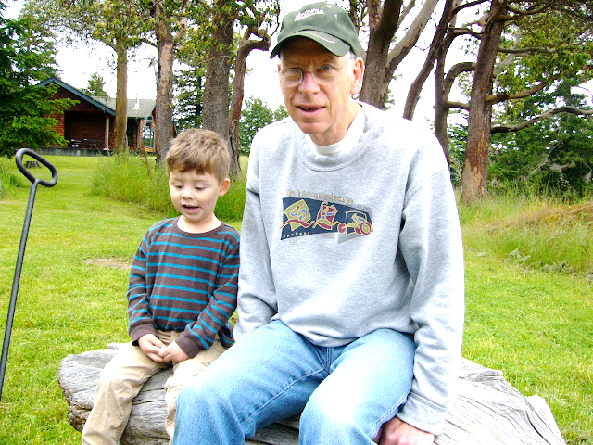

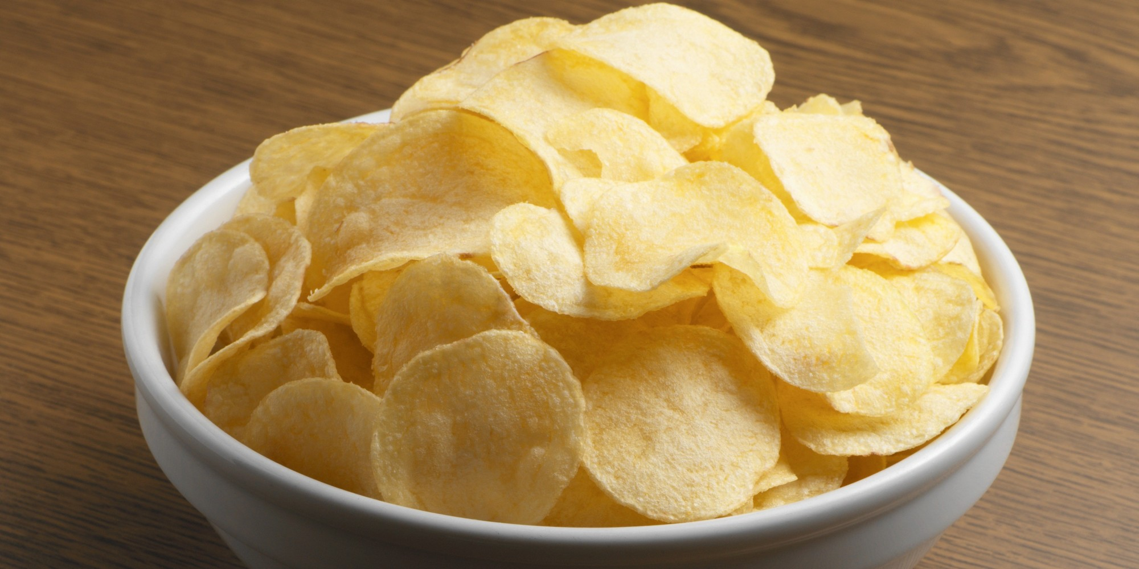

Slide 2

Phillies Lose but We All Win!

Slide 3
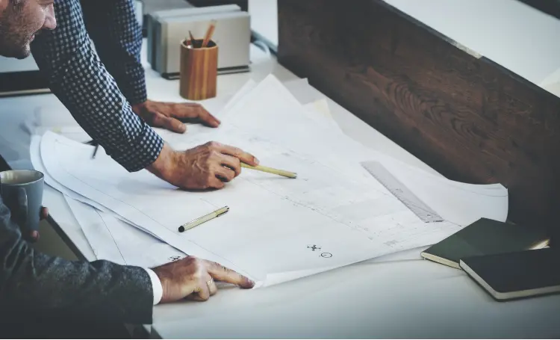

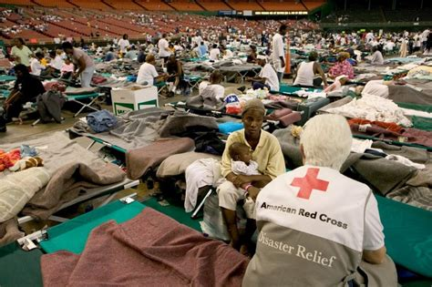


Slide 4
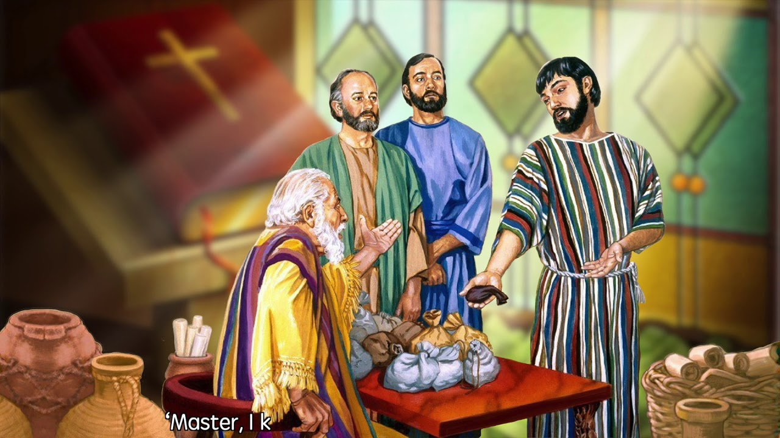
Matthew 25:14-30

Slide 5
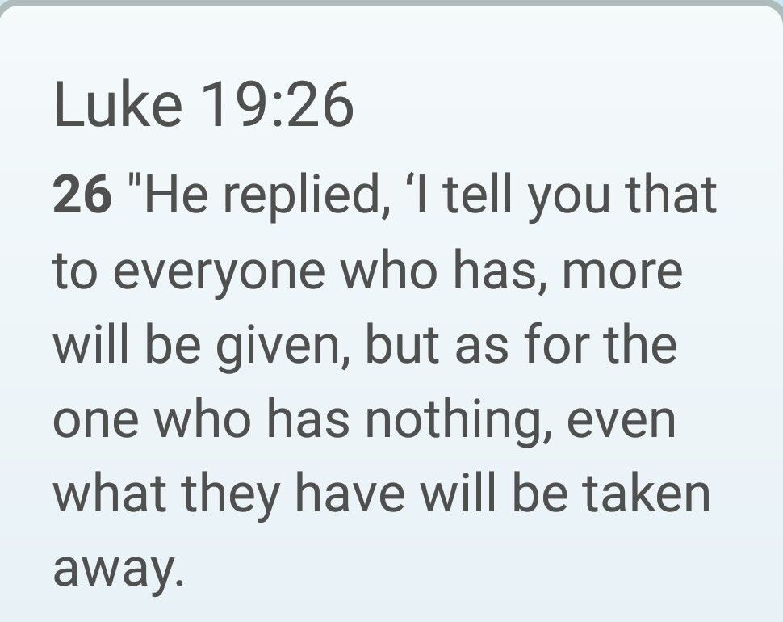

Slide 6
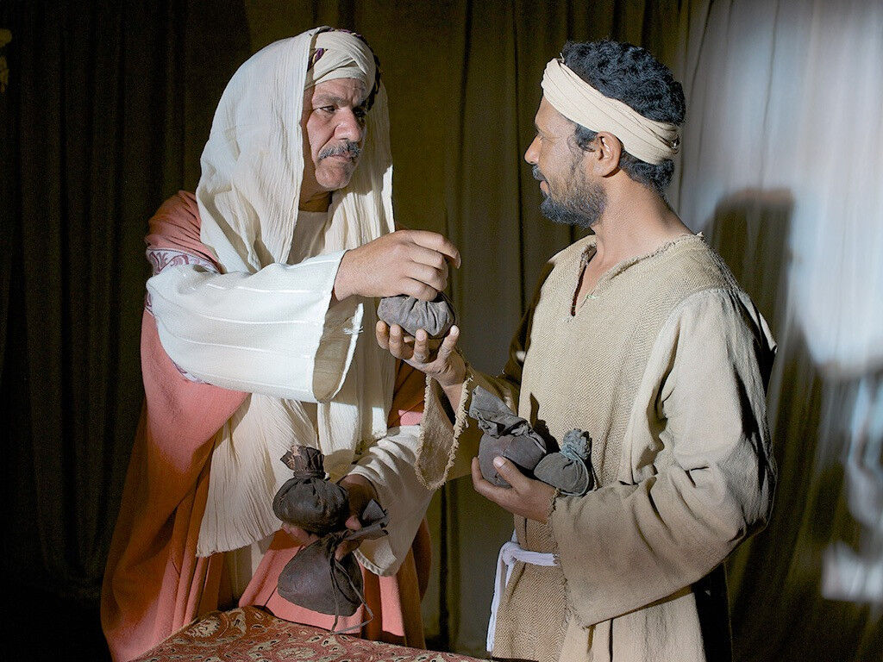
The Meaning of Matthew 25:14-30

Slide 7
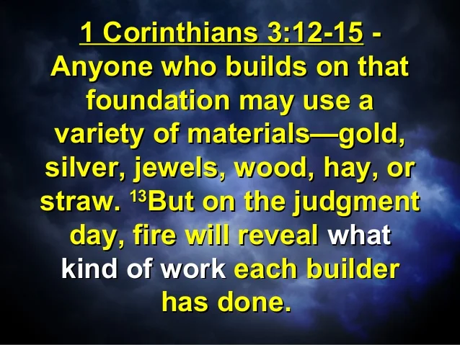
The Verdict
Revelation 20:11-15 and 1 Corinthians 3:12-15

Slide 8
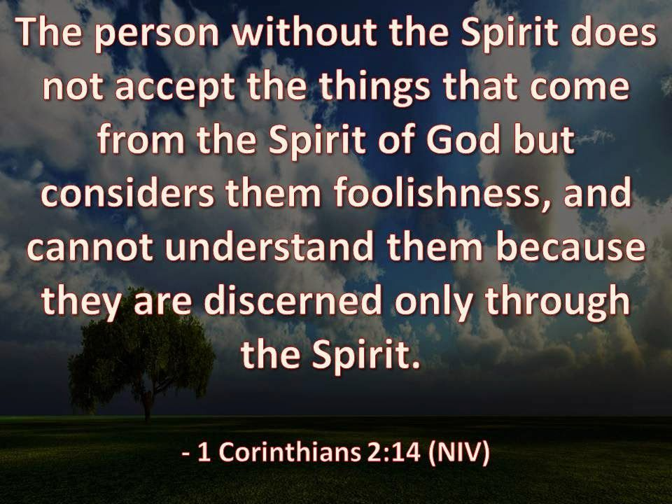

Slide 9
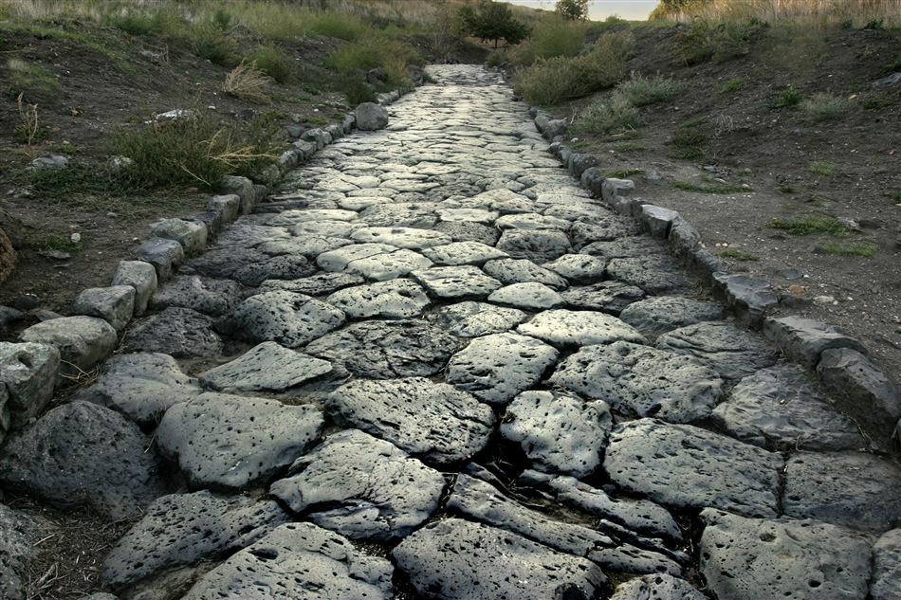
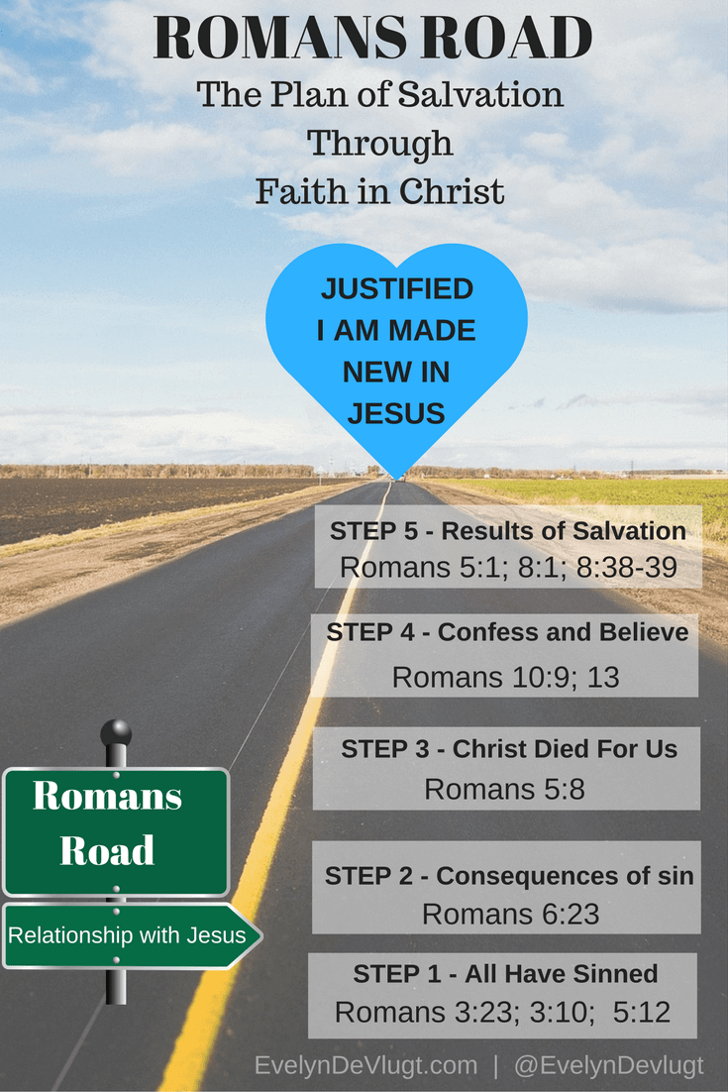

Slide 10


Slide 11
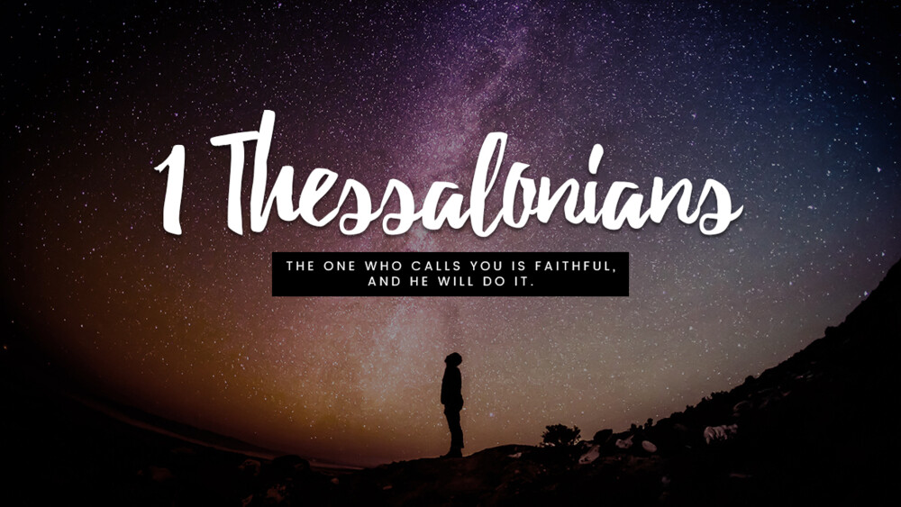

Slide 12
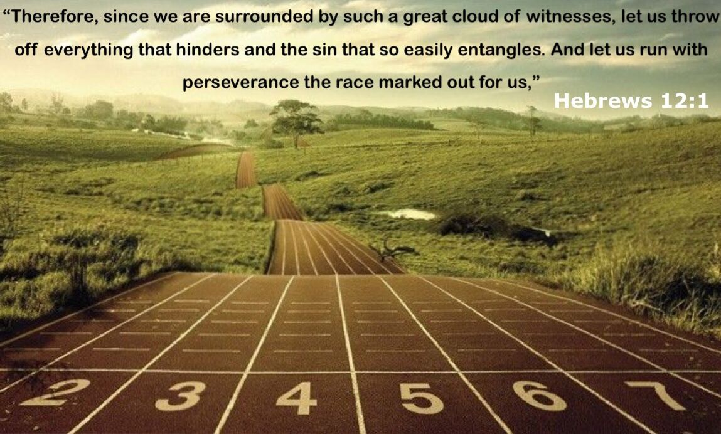

Slide 14
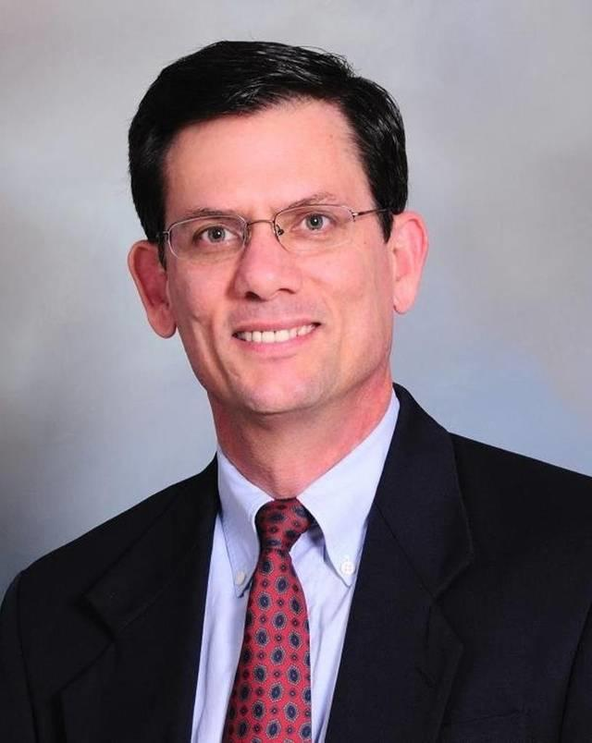
“Screaming, shouting, and even resorting to terror and violence against one another in the streets have become normal campaign tactics.”

Slide 15
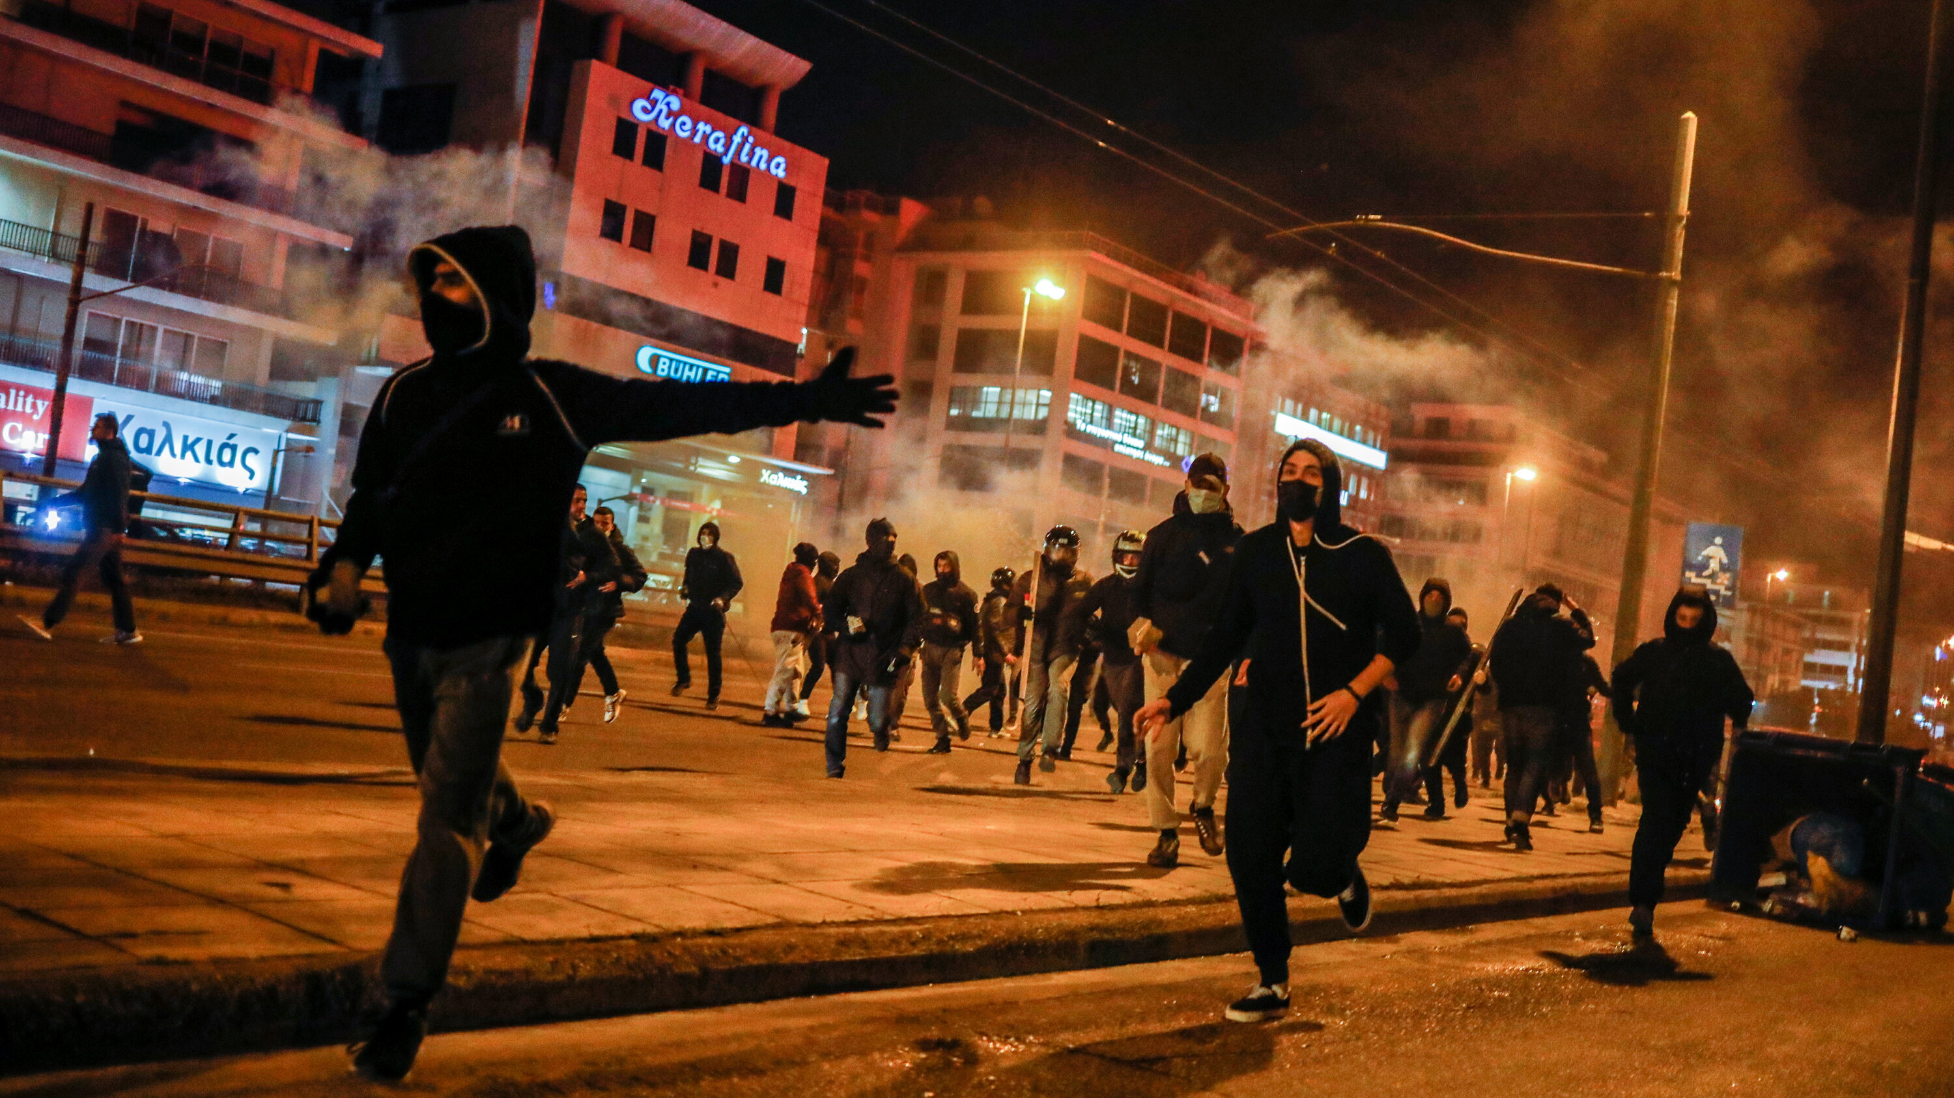
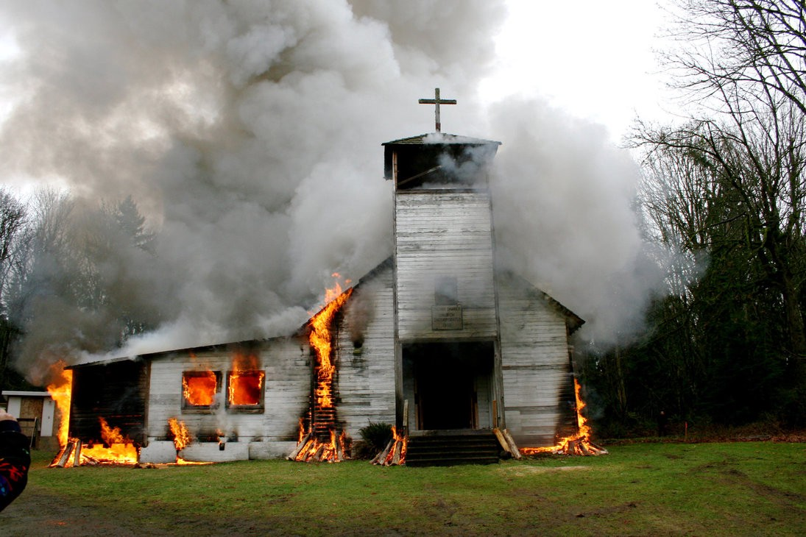
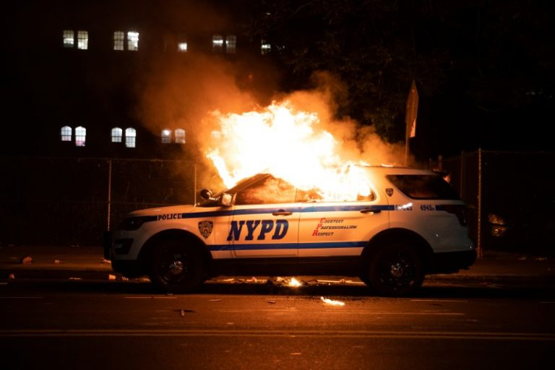
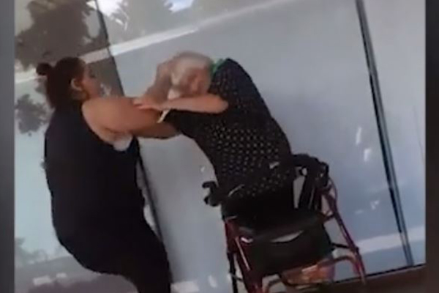

Slide 16
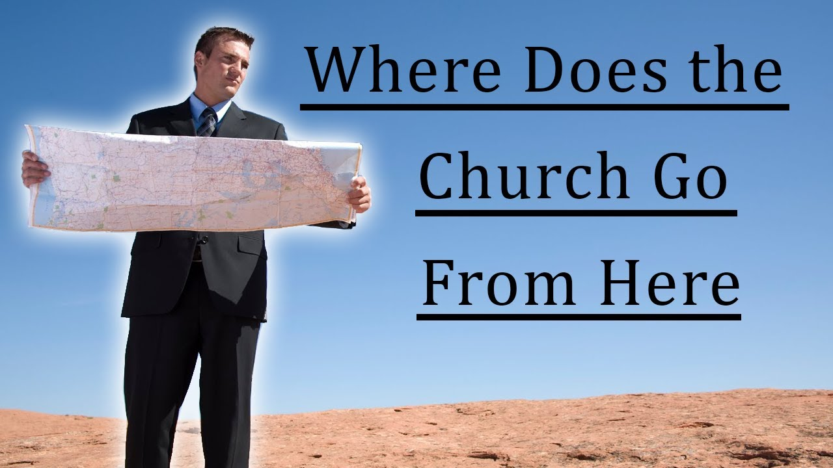

Slide 17
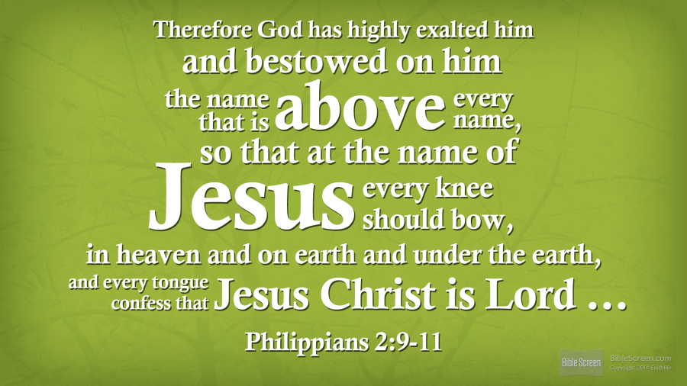

Slide 18


Slide 19
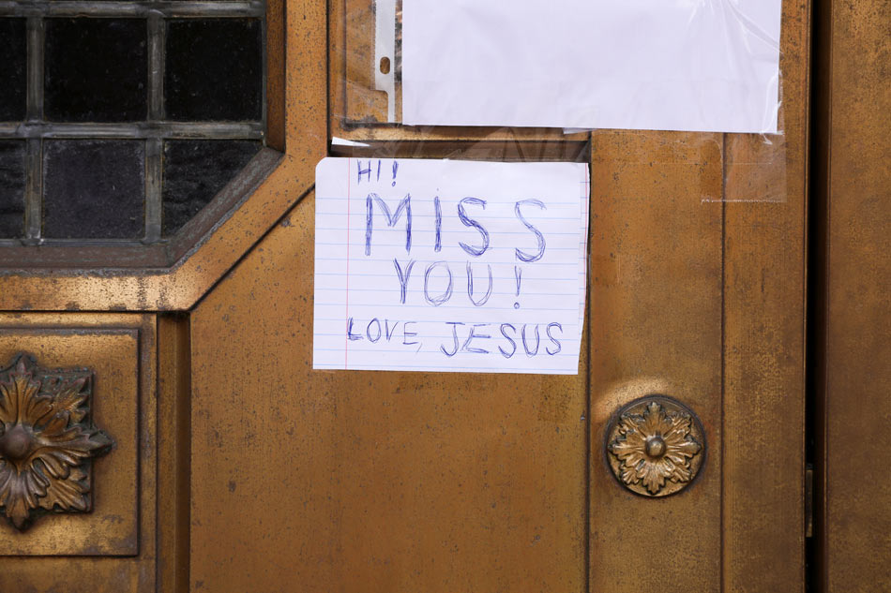

Slide 20


Slide 21
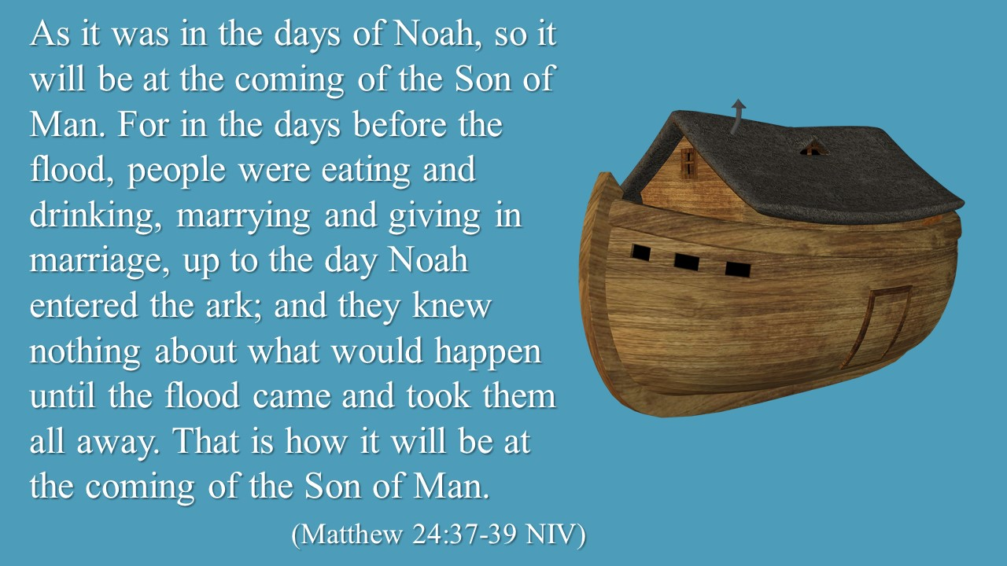

Slide 22
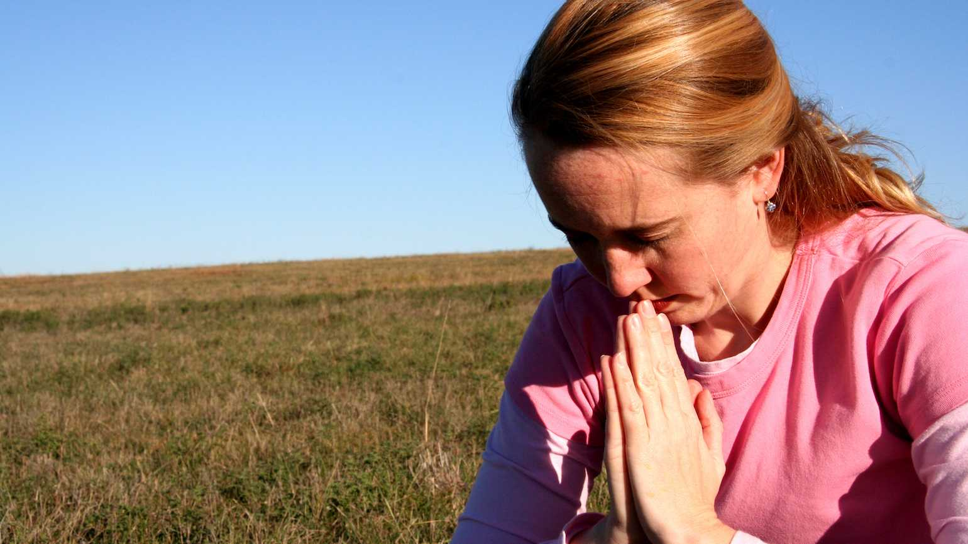
How is your prayer life?

Slide 23
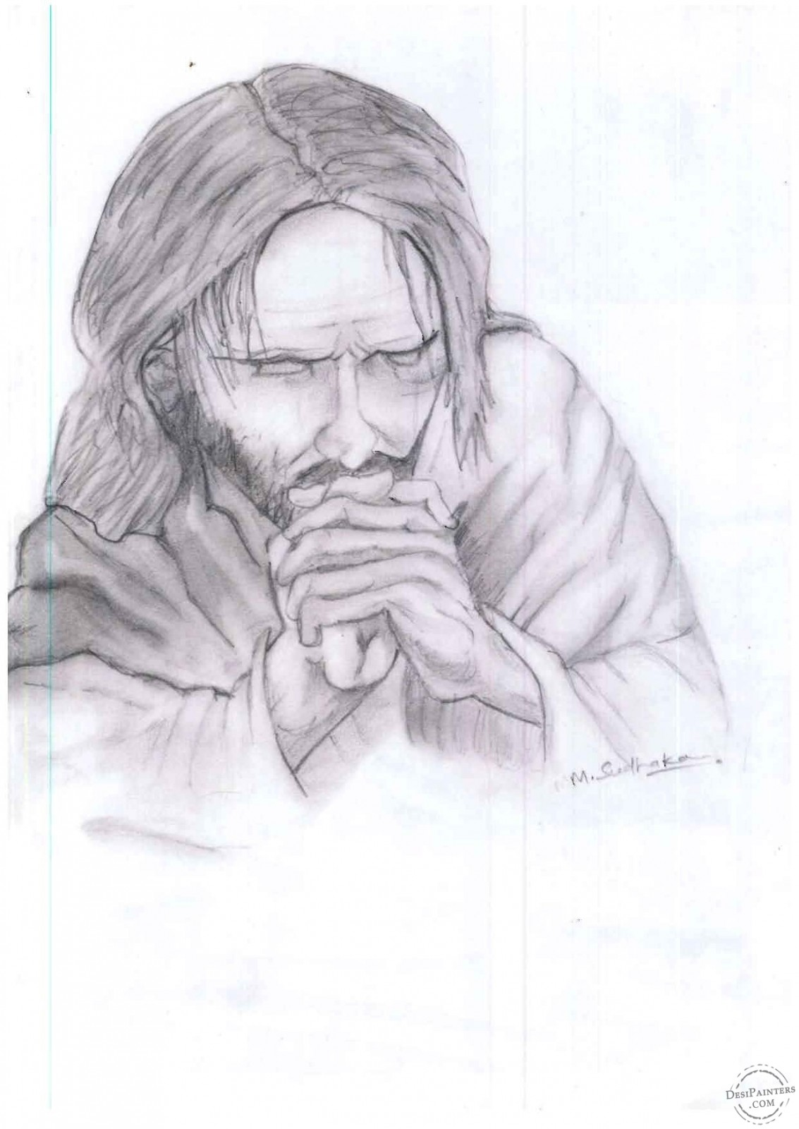

Slide 24
• He prayed alone
• He prayed in public
• He prayed before meals
• He prayed before important decisions
• He prayed before healing
• He prayed after healing
• to do the Father’s will

Slide 25
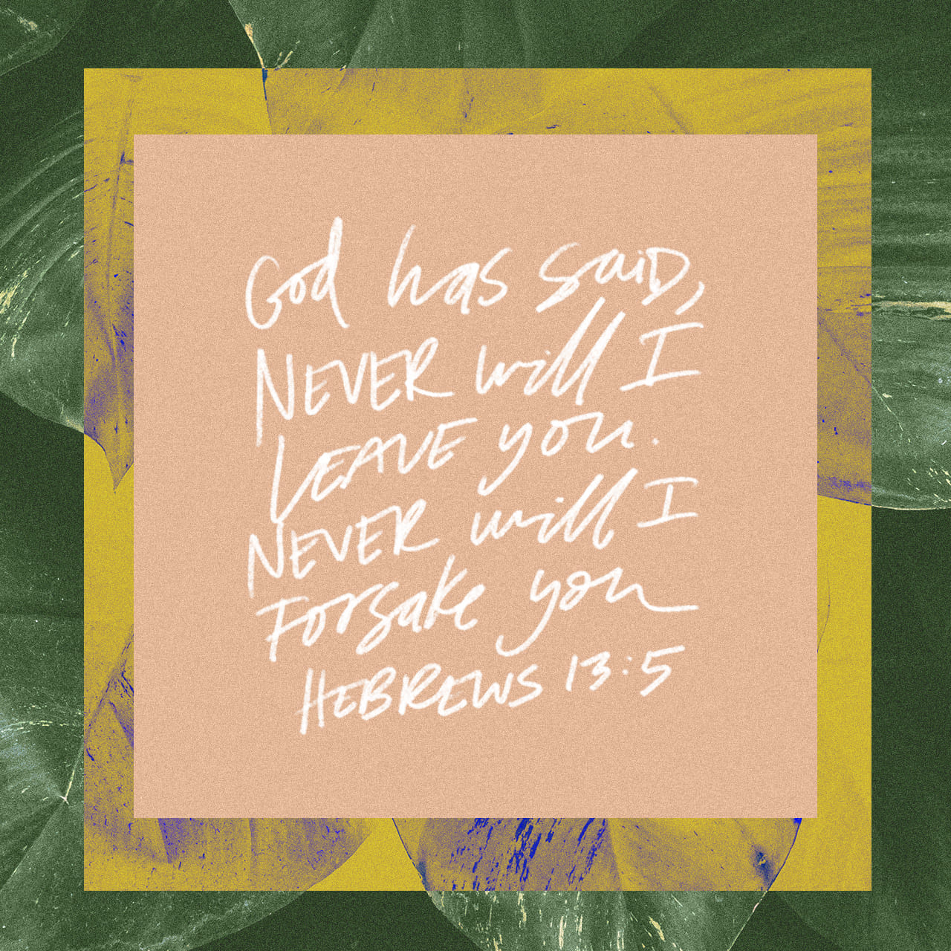

Slide 26
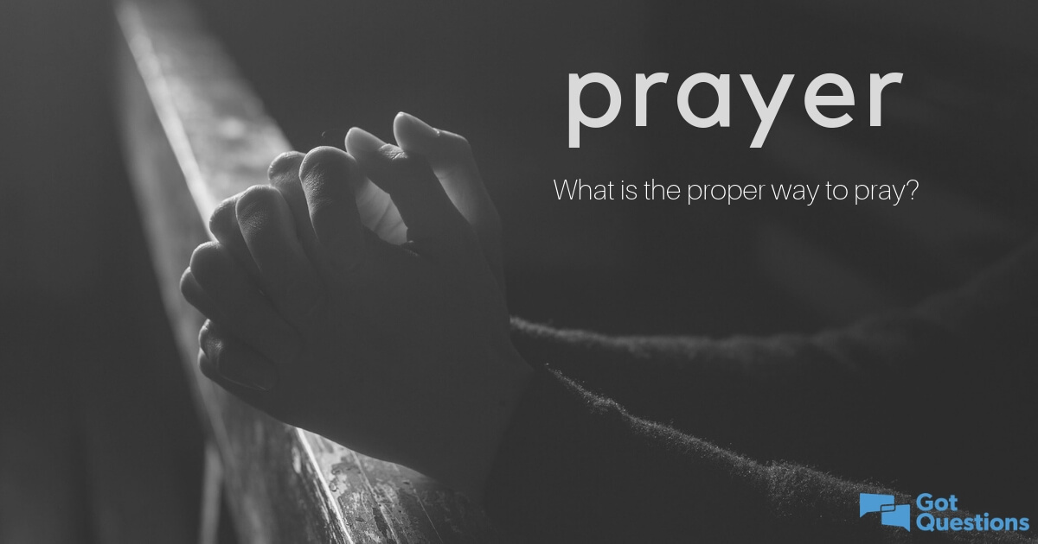

Slide 27
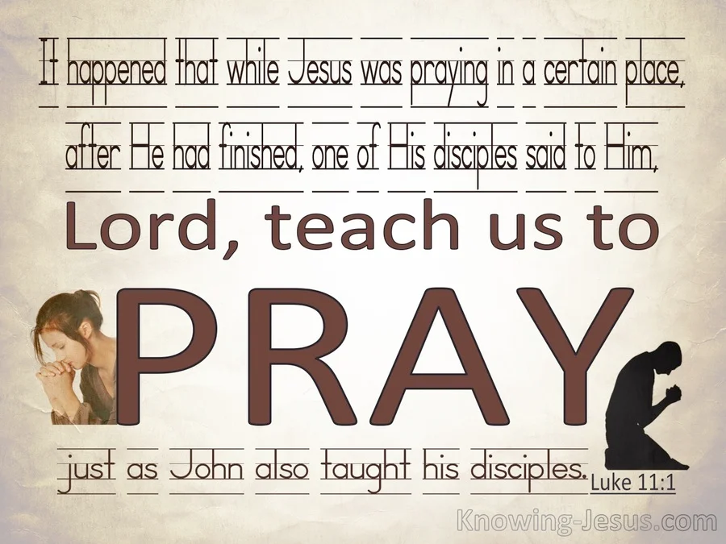

Slide 28
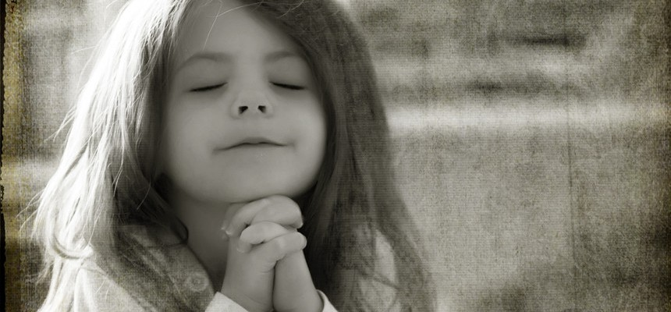
What should we pray for?

Slide 29
WEDNESDAY NIGHT PRAYER - LifeGate 7:00 PM
COME AND PRAY FOR OUR OUTREACH ON SUNDAY NIGHT AT THE PARK - AND OUR NATION THAT IS IN DESPERATE NEED OF MERCY.

Slide 30
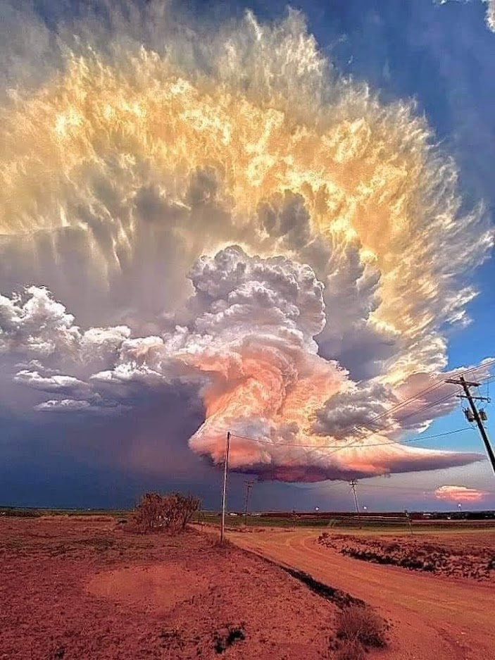
1Thessalonians 5:17 NIV
17 pray continually

