Slide 1
Philippians 2:5
Radically Changing Our View Of Prayer
A SERMON TO LIFEGATE
Sunday, September 4, 2022

Slide 2
Thanking the Lord For
Serendipitous Windows of Grace

Slide 3
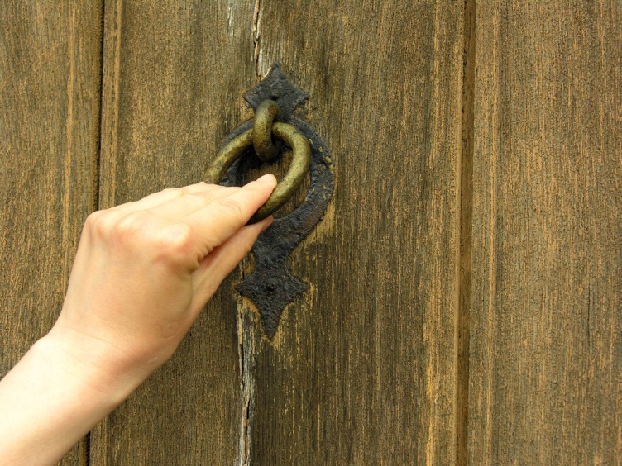
I have (just) taken off my robe-- must I put it on again? I have washed my feet-- must I soil them again? 4 My lover thrust his hand through the latch-opening; my heart began to pound for him. 5 I arose to open for my lover, and my hands dripped with myrrh, my fingers with flowing myrrh, on the handles of the lock. 6 I opened for my lover, but my lover had left; he was gone. My heart sank at his departure. Song of Songs 5:3-6 (NIV)

Slide 4
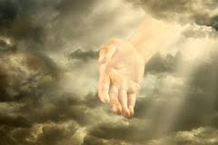
A Holy God, who reaches out His hand towards me and loves me and puts His hand through the latch of the Earth, so to speak, and I see Him and I smell Him and I know He’s real and I know that He paid a real price for me; and I'm engraved on the Palm of His hands. That's what motivates me not just that I'm a son of God and I'm never going to lose my position with Him. But He is the outstanding among 10,000. I love Him and He deserves my all and I'm captured by His glory.

Slide 5
In those days Hezekiah became ill and was at the point of death. The prophet Isaiah son of Amoz went to him and said, "This is what the LORD says: Put your house in order, because you are going to die; you will not recover." 2 Kings 20:1

Slide 6
God Calls Us to Bring All Into The Storehouse
Then suddenly the Lord you are seeking will come to his temple; the messenger of the covenant, whom you desire, will come," says the LORD Almighty. ² But who can endure the day of His coming? Who can stand when He appears? For He will be like a refiner's fire or a launderer's soap. ³ He will sit as a refiner and purifier of silver; He will purify the Levites and refine them like gold and silver. Then the LORD will have men (and women) who will bring offerings in righteousness, ⁻ ⁵ "So I will come near to you for judgment. I will be quick to testify against sorcerers, adulterers and perjurers, against those who defraud laborers of their wages, who oppress the widows and the fatherless, and deprive aliens of justice, but do not fear Me," says the LORD Almighty. ⁶ "I the LORD do not change. Return to Me, and I will return to you," says the LORD Almighty. "But you ask, 'How are we to return?' ⁸ "Will a man rob God? Yet you rob me. "But you ask, 'How do we rob you?' "In tithes and offerings. ⁹ You are under a curse--the whole nation of you--because you are robbing me. ¹⁰ Bring the whole tithe into the storehouse, that there may be food in my house. Test me in this," says the LORD Almighty, "and see if I will not throw open the floodgates of heaven and pour out so much blessing that you will not have room enough for it. ¹¹ I will prevent pests from devouring your crops, and the vines in your fields will not cast their fruit," says the LORD Almighty. ¹² "Then all the nations will call you blessed, for yours will be a delightful land," says the LORD Almighty. Malachi 3:1-3, 5-12 (NIV)

Slide 7
When The Message Get’s Garbled
It Can Paralyze The People And the Mission
WHAT IS THE ACHILLES HEEL OF THE AMERICAN CHURCH?
Passivity in the name of love – Kris Vallotton
Fear of Rejection – Danny Silk
ILLUSTRATION:
Go to the center of town and east the high school and stop at the gas station and go not go in but hide in the bushes and wait the victory.

Slide 8
“People can believe good ideas for bad reasons, and there are bad arguments for good ideas. The problem with not taking an issue with these two things is that sooner or later bad arguments and bad reasons will turn into bad ideas.” Author Unknown

Slide 9
Tyranny Is A Bad Idea That People
Actually Try To Convince Us is Good
God’s Gold Standard
In righteousness you will be established: Tyranny will be far from you; you will have nothing to fear. Terror will be far removed; it will not come near you. Isaiah 54:14 (NIV)

Slide 10
Living Under Tyrants
Fools are put in many high positions. Ecclesiastes 10:6
He has also set eternity in the hearts of men; yet they cannot fathom what God has done from beginning to end. ¹² I know that there is nothing better for men than to be happy and do good while they live. ¹³ That everyone may eat and drink, and find satisfaction in all his toil--this is the gift of God. Ecclesiastes 3:11-13 (NIV) (LIFE, LIBERTY, AND THE PURSUIT IF HAPPINESS)
THERE IS GOD-GIVEN DESIRE IN MANKIND TO BE FREE – ALTHOUGH THEY ARE EVIL AND LIVE IN LONG SEASONS OF NOT RECOGNIZING THEIR TYRANTS AND YIELDING TO THE FLESH AND IDOLS OF THEIR GENERATION.

Slide 11
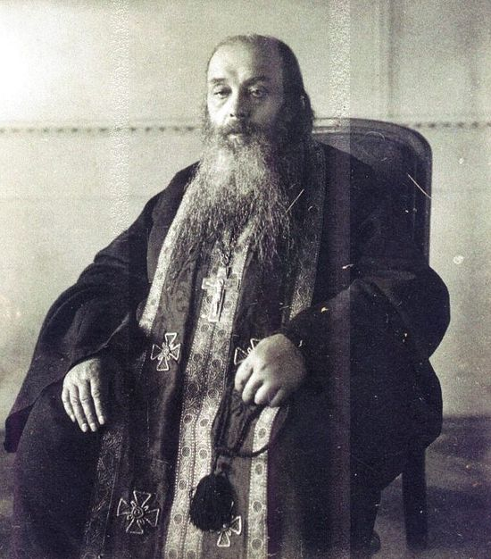
An Unusually Accurate Prophecy in 1911
“Not one country will be without trial – do not be frightened by anything you will hear. An evil will shortly overtake Russia and wherever this evil goes, rivers of blood will flow. This evil will take the whole world and wherever it goes, rivers of blood will flow because of it.
“It is not the Russian soul, but an imposition on the Russian soul. !t is not an ideology, or a philosophy, but a spirit from Hell.
“In the last days Germany will be divided in two. France will just be nothing. Italy will be judged by natural disasters. Britain will lose her empire and all her colonies and will come to almost total ruin, but will be saved by praying women.
America will feed the world, but will finally collapse. Russia and China will destroy each other. Finally, Russia will be free.”
RUSSIAN
Bishop ARISTOKLY

Slide 12
Tyrants maintain control by these three things
The thief comes only to steal and kill and destroy; I have come that they may have life, and have it to the full. John 10:10 (NIV)
Propaganda – grooming – deception – lies
Police state - Control - manipulation - forced
Panic – fear - anxiety- distress

Slide 13
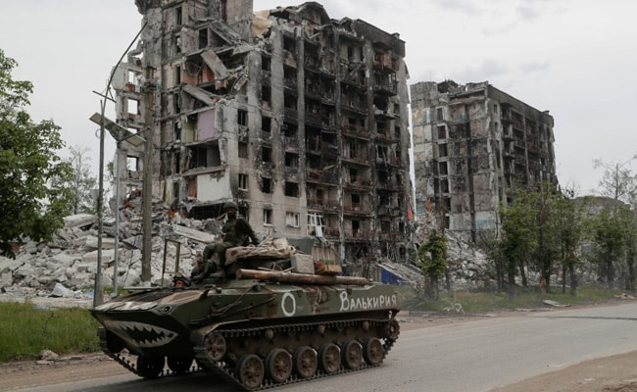
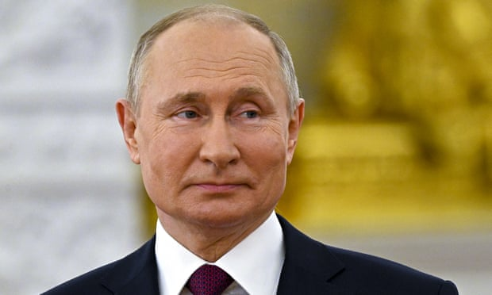
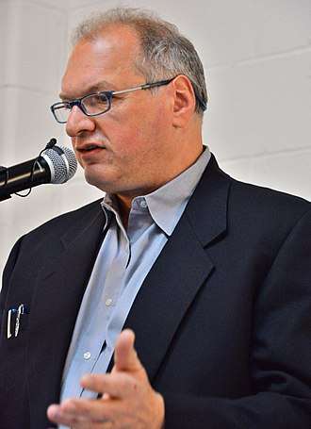
This is What makes the Horror of Ukraine
A tragedy we all need to care about
THE EVIL OF THE STATE SECURITY FORCES OF RUSSIA UNDER PUTIN - A KGB COLONEL IS THAT THEY HAVE NEVER BEEN TRAINED TO CREATE AND BUILD – THEY WERE CREATED TO KILL AND DESTROY
Yuri Felshtinsky

Slide 14
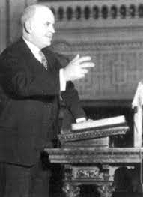
God Versus The Enemy
In every Spiritual Awakening, whenever the work of grace is going on, Satan is ever present among the people. He seeks to destroy this work first by ridicule and second by duplicating it. If Satan cannot discredit the work of God outright, he will duplicate it as nearly as near as possible for purposes of deception. Observing how the work of Christ (Judeo-Christian values) improves personal and social life, increases culture foundations and multiplies physical comforts, Satan needs to secure the same results up to the point of accepting regeneration or salvation, but not that.
Dr. M. E. Dodd

Slide 15
Profound Insight
"In other words, Christ and Satan work in exactly the opposite directions. Christ creates a changed life first and then works toward human betterment in all things. Satan begins with human betterment and seeks as much physical comfort and mental achievement in social culture as possible, provided there will be no regeneration, no salvation of the soul."
Dr. M.E. Dodd
So – putting our house I order will not be achieved by self- improvement but by Heart surrender and deeper fillings of the Holy Spirit – guiding us into the place of breakthrough and transformation.

Slide 16
“Truth is mightier than error, God is stronger then Satan, but Satan is allowed to take the field almost alone. He wields the press, and makes it groan in excitement drawing men in the wrong direction. Now, if God's children were really awake, they would come forth and devote their money, their talents, and their influence, to searching out (Spirit-led) ways for putting the Gospel before their neighbors and leading them on the right track, and opposing the ways of wicked men; they would lift up their hearts in believing prayer, and soon we would see the mighty truths of God prevailing over the masses around them.” Charles Finney 1854

Slide 17
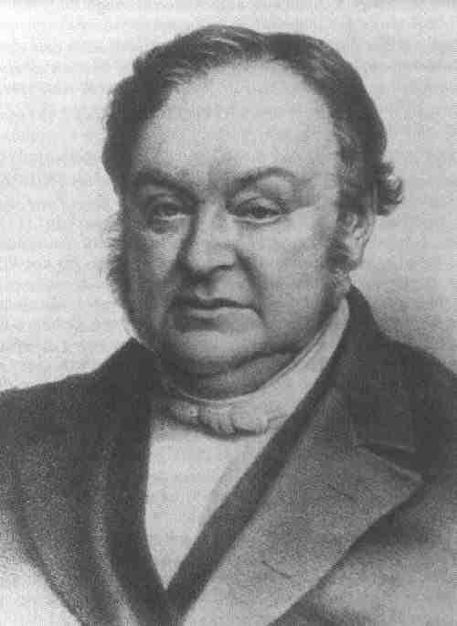
Be Careful How You Comfort
Yourself In Christian Platitudes
“Don’t comfort yourself with that sort of Christianity which today practices the art of decking out every distress and wrapping everything in phrases to the effect that “whatever happens is good.” Don’t accept such comfort; but seek with me people who stand before God and say, “Dear Father in heaven, we are not worthy to be called your children—but oh, that You would use us as Your servants!” Johann Blumhardt

Slide 18
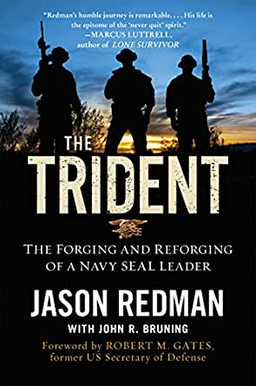
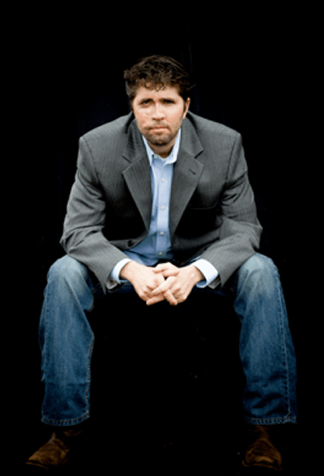
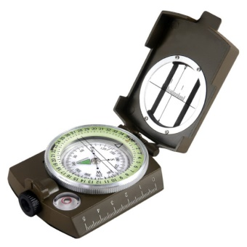
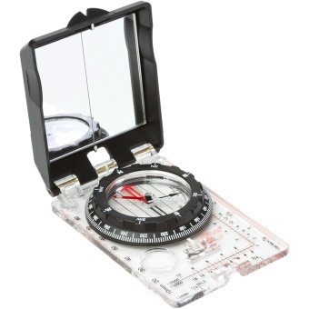
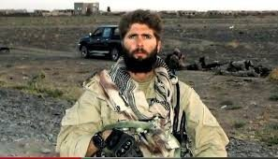
Lensatic
Silva
In the SEAL Teams we use the Silva Ranger compass for our land navigation. The army uses the Lensatic compass.
Fails an
Over-watch mission
Afghanistan

Slide 19
The Phone Call
YOU’VE GOT TO BE kidding me. This colonel is friends with the one SEAL on the planet who I respect above all others. I had planned on the colonel basically saying, “Get lost, quitter,” and I’d be on my way. Now I faced explaining to my mentor why I was train-wrecking my life.
A swell of fear rose in me. What on earth would Vince Peterson think of what had become of me? What would he say when he learned that he’d stuck his neck out for a failure, a tactical screwup, a man whose bitterness had devoured his will to lead?
“Red, have you ever thought that maybe there is an opportunity here?”
“Sir?”
“You have a chance to learn something of value. If you’re willing to take it.”
I didn’t know what to say to that. I’d not been trying to learn anything since Afghanistan. I’d been trying to defend and justify.
“You’re getting ready to throw your career away, Red.”

Slide 20
Jesus Is the Greatest Leader Ever
He leads His Team Well
We simply Need to Execute His Plans
SINE PARI – WITHOUT EQUAL
My lover is radiant - outstanding among ten thousand. Song of Songs 5:10 (NIV)
“Vince Peterson was the greatest natural leader I’ve ever known. He had a knack of expressing where the team needed to go with just a few words. He’d plant the seeds, let his men take ownership of the plan, then watch as everything went forward. When the plan succeeded, and it almost always did, he never took the credit. He gave it to everyone else.”

Slide 21
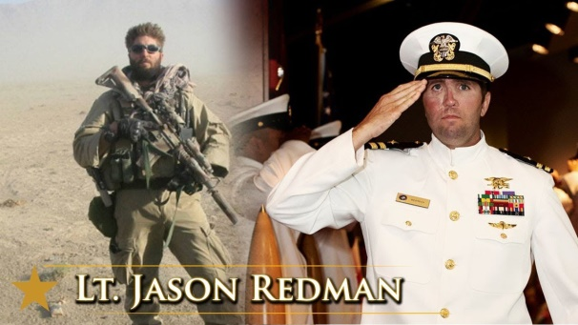
The Breakthrough
Moment
For a second I stood on a mental precipice, looking down at that void that I’d fallen into after my last mission in Afghanistan. No. I refuse to go there. Not this time. What’s the takeaway? How can I fix this?
Don’t let the reaction to the mistake destroy your relationship with your teammates. I let one of my own weaknesses beat me again.
. “Look, Red, you’re doing a great job but you suck at taking criticism. Someone offers you advice after you make a mistake and you take it personally. We’re trying to help you grow, make you a better leader. You got this. We all mess up. Just happens. Learn to absorb the lessons, take the heat, and move on.”

Slide 22
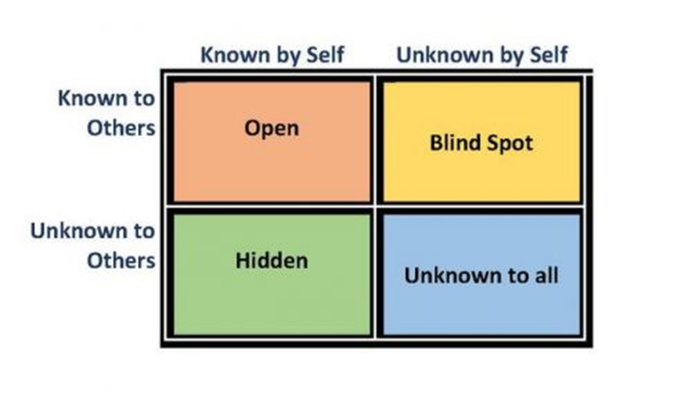
The Johari Window

Slide 23
When Self –Esteem became God
Now this is what the LORD Almighty says: "Give careful thought to your ways. 6 You have planted much, but have harvested little. You eat, but never have enough. You drink, but never have your fill. Haggai 1:5-6 (NIV)
Psychologist Nathaniel Branden stated: "[I] cannot think of a single psychological problem – from anxiety and depression, to fear of intimacy or of success, to spouse abuse or child molestation – that is not traced back to the problem of low self-esteem“ 1970’s
The Very Thing we are seeking is more elusive then when we started

Slide 24
The Only Way True Self-Esteem is Built
Is not by words alone but by developing Core Competencies and Skillsets
Core Competency | Fruit
Faith | Overcoming doubt/ actions of love
Obedience | Overcoming the flesh
Intimacy | Hungering for God’s presence
Forgiveness/ prayer | Standing in the gap for your family and nation
Filled with the Holy Spirit | Carrier of the Presence of God

Slide 25
HONESTY Flows from the Grace of God
It Helps to Put Our Houses Back In Order
“So I learned that whenever you turn off (your response to people, you turn off pain, but you also turn off your heart to everything else. You can't choose what you become numb to. Because you will become numb to the people around you..” Mark DeJesus
“I made a decision that whatever pain (or disappointment) I had to face was whatever I got to get healed from. It helped bring me to the place where I was free from chronic anxiety, where I had tools to overcome depression.”

Slide 26
As The Lord Brings Order To
Our Houses – We are emptied of our Flesh
Couples | Singles
Communication | Friendships
Finances | Finances
Intimacy/ Purity | Loneliness/purpose/ Purity
Pulling together/ Unity | Collaborating with others
The more I prayed and sought, however, the more difficult everything became. The way simply led to black darkness. I did not understand then, that one who is to be filled must first be emptied. The Spirit of God threw stronger light upon the ministry which was being rendered in my own strength. It was all wood, hay and stubble which could only be burned.
Marie Monsen 1930 China

Slide 27
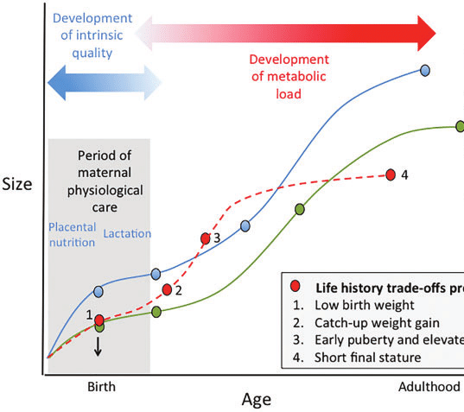
For God's gifts and His call are irrevocable. Romans 11:29 (NIV)
Life Growth
Green dotted Line is God’s Best
Red Dotted Line is you going back and forth
Blue Line Is The Enemy’s corrupted plan for your life

Slide 28
If We Do Not Put Our Houses In Order
If we turn away from the Lord (during the season of cleansing and awakening), as sometimes it can happen, abandoning all hope for an invasion from heaven, and ceasing all cooperation with the Holy Spirit, then the chastisement and refining of God has not been improved upon. In this case dead religion and Satan’s evil schemes have their way; the advantage is on his side, and further humblings are to be expected. JAMES CAUGHEY (paraphrased by Don Lamb)

Slide 29
We’re Back To Go Thrusting His Hand
Through The Latch – making our heart pound
There is no fear in love. But perfect love drives out fear, because fear has to do with punishment. The one who fears is not made perfect in love. 1 John 4:18 (NIV)
¹⁹ All whom I hold dear, I reprove and chastise; therefore be in earnest and repent. ²⁰ I am now standing at the door and am knocking. If any one listens to My voice and opens the door, I will go in to be with him and will feast with him, and he shall feast with Me. Revelation 3:19-20 (WEY)

Slide 30
In Following The Lead of The Spirit
To Putting Your House in Order
Do Not Bite Off More than You Can Chew
Since we live by the Spirit, let us keep in step with the Spirit. Galatians 5:25 (NIV)
PURPOSE TO DEVELOP ONE COMPETENCY – SKILL SET FOR YOUR LIFE – AS A COUPLE – AS A SINGLE - DON’T OVERWHELM YOURSELF IN TOTAL HOME MAKEOVER.
“Whatever it takes, find avenues where you can process through the pain in your life so that you can also process through with God and begin to see transformation happen, because how is God going to heal our heart if He doesn't have access to it? “ Mark DeJesus

Slide 31
God Will Succeed
I have come that they may have life, and have it to the full. John 10:10 (NIV)
YES GOD WILL SUCCEED – BUT TO ACCOMPLISH THIS HE WILL POWERFULLY GAIN THE CONSENT OF A PEOPLE WHO WILL:
YIELD TO THE CALL
TAKE HIM AT HIS WORD
PREVAIL ON HIS OPEN PROMISES
LIVE OUT THE MISSION HE HAS GIVEN THEM

Slide 32
Concluding Prayer Of Engagement
“Lord we say, “here we are send us” into the realm of prevailing faith that receives the outworking of Your promises. We are here to receive the fulfillment of Your promises that are in motion continuously in the Church age. They are promises that do not have an expiration date. They continue to unfold every time Your Church endorses them.”
“Lord, we strike the Earth (like the King in the Old Testament) with faith in Your promises that You will pour out Your Holy Spirit now in this dark hour. That You will give us all that we need that in the day of great slaughter when the towers fall. That You will pour out the Holy Spirit on every mountain of influence. We receive that we have been afflicted because of our sin but we have been saved because of the Cross. And, therefore, as the Hannah's and the Esther's and the Debra's and the Sarah's of the earth we transact for the fulfillment of these promises –and we declare that they will be fulfilled on our watch.

