Slide 1
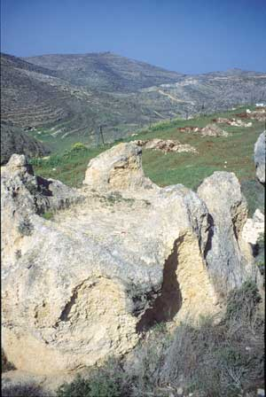
Tear down the high places; build up your faith
Tear down the high places;
Build up your faith!
Tear Dow

Slide 2
Hear, O Israel: The LORD our God, the LORD is One. And you shall love The LORD your God with all your heart and with all your soul and with all your strength.
-Deuteronomy 6:4-5

Slide 3
“These are the statutes and rules that you shall be careful to do in the land that the Lord, the God of your fathers, has given you to possess, all the days that you live on the earth. ² You shall surely destroy all the places where the nations whom you shall dispossess served their gods, on the high mountains and on the hills and under every green tree. ³ You shall tear down their altars and dash in pieces their pillars and burn their Asherim with fire. You shall chop down the carved images of their gods and destroy their name out of that place…

Slide 4
⁴ You shall not worship the Lord your God in that way. ⁵ But you shall seek the place that the Lord your God will choose out of all your tribes to put his name and make his habitation there. There you shall go, ⁶ and there you shall bring your burnt offerings and your sacrifices, your tithes and the contribution that you present, your vow offerings, your freewill offerings, and the firstborn of your herd and of your flock. ⁷ And there you shall eat before the Lord your God, and you shall rejoice, you and your households, in all that you undertake, in which the Lord your God has blessed you. (Deuteronomy 12:1-7)

Slide 5
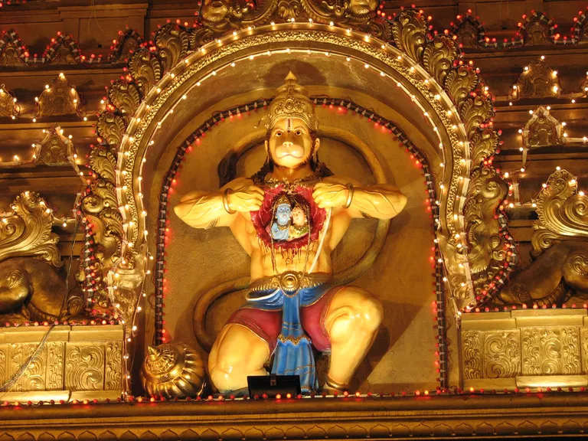
Behind idols, false gods, and false religions are demons.
The worship of such incites human beings to do terrible things

Slide 6
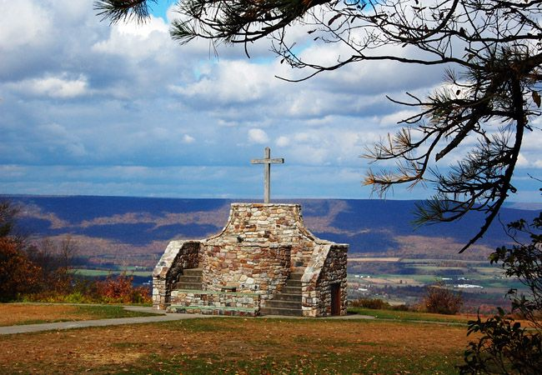
.
There has always been a draw to the high hills and the mountains as a place of worship.

Slide 7
Now Solomon made a treaty with Pharaoh king of Egypt, and married Pharaoh’s daughter; then he brought her to the City of David until he had finished building his own house, and the house of the Lord, and the wall all around Jerusalem. ² Meanwhile the people sacrificed at the high places, because there was no house built for the name of the Lord until those days. ³ And Solomon loved the Lord, walking in the statutes of his father David, except that he sacrificed and burned incense at the high places.” (1 Kings 3:1-3 NKJV, emphasis added)

Slide 8
“Then Solomon, and all the assembly with him, went to the high place that was at Gibeon; for the tabernacle of meeting with God was there, which Moses the servant of the Lord had made in the wilderness. ⁴ But David had brought up the ark of God from Kirjath Jearim to the place David had prepared for it, for he had pitched a tent for it at Jerusalem.” (2 Chronicles 1:3-4 NKJV)

Slide 10
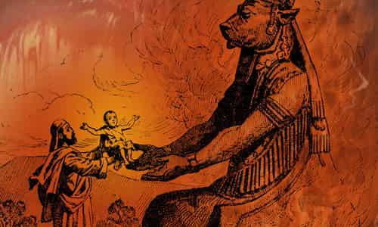
Later, we see Solomon “ did evil the sight of the Lord; unlike his father David, he did not follow the Lord completely. At that time on a hill east of Jerusalem, Solomon built a high place for Chemosh the abomination of Moab and for Molech the abomination of the Ammonites.…” (1 Kings 11:6-7).

Slide 11
Commonwealth Games in Birmingham, England
August 2022

Slide 12
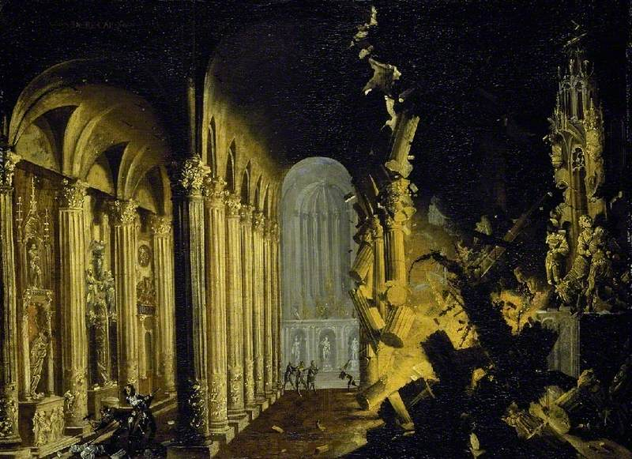
King Asa of Judah Destroying the Idols (François Nomé – Fitzwilliam Museum)

Slide 13
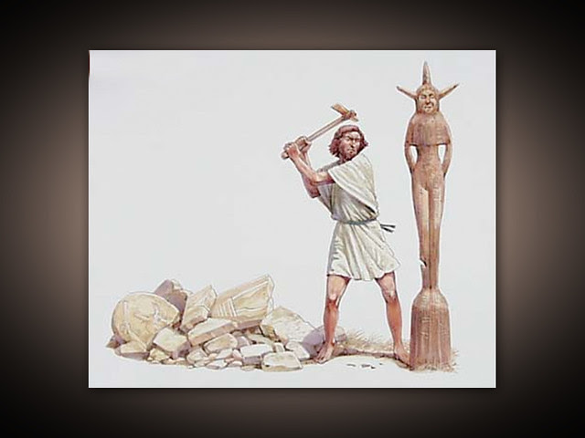
King Hezekiah destroying the carved images

Slide 15
Western Wall and the Temple Mount

Slide 16
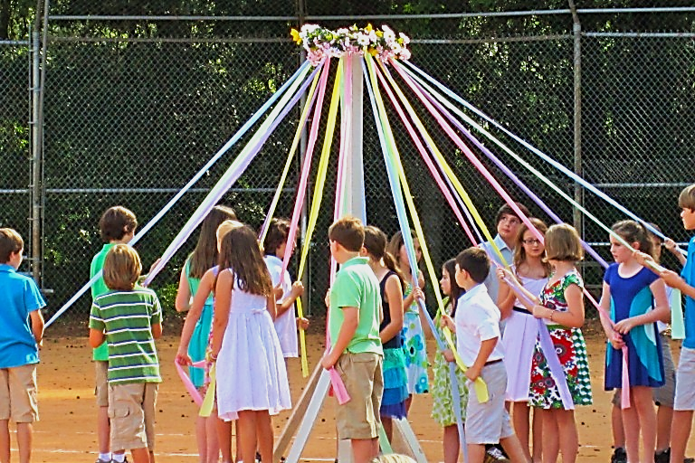
High places can signify worship of Jehovah alongside other gods prevalent in the culture

Slide 17
High places represent any kind of wrong thinking on our part. This can be deception, but also any thing that has a stronghold over the mind, will, and emotion.

Slide 18
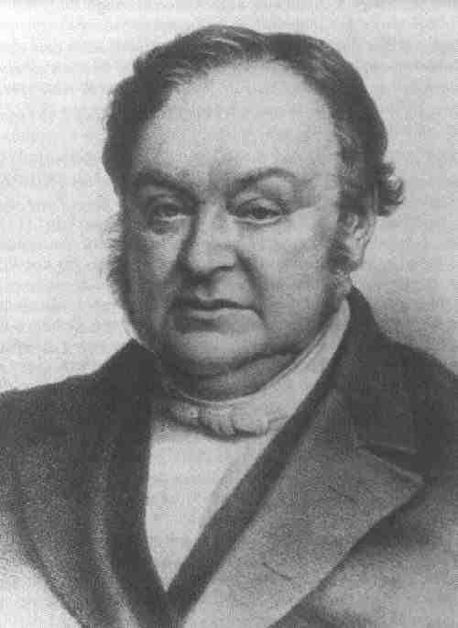

Slide 19
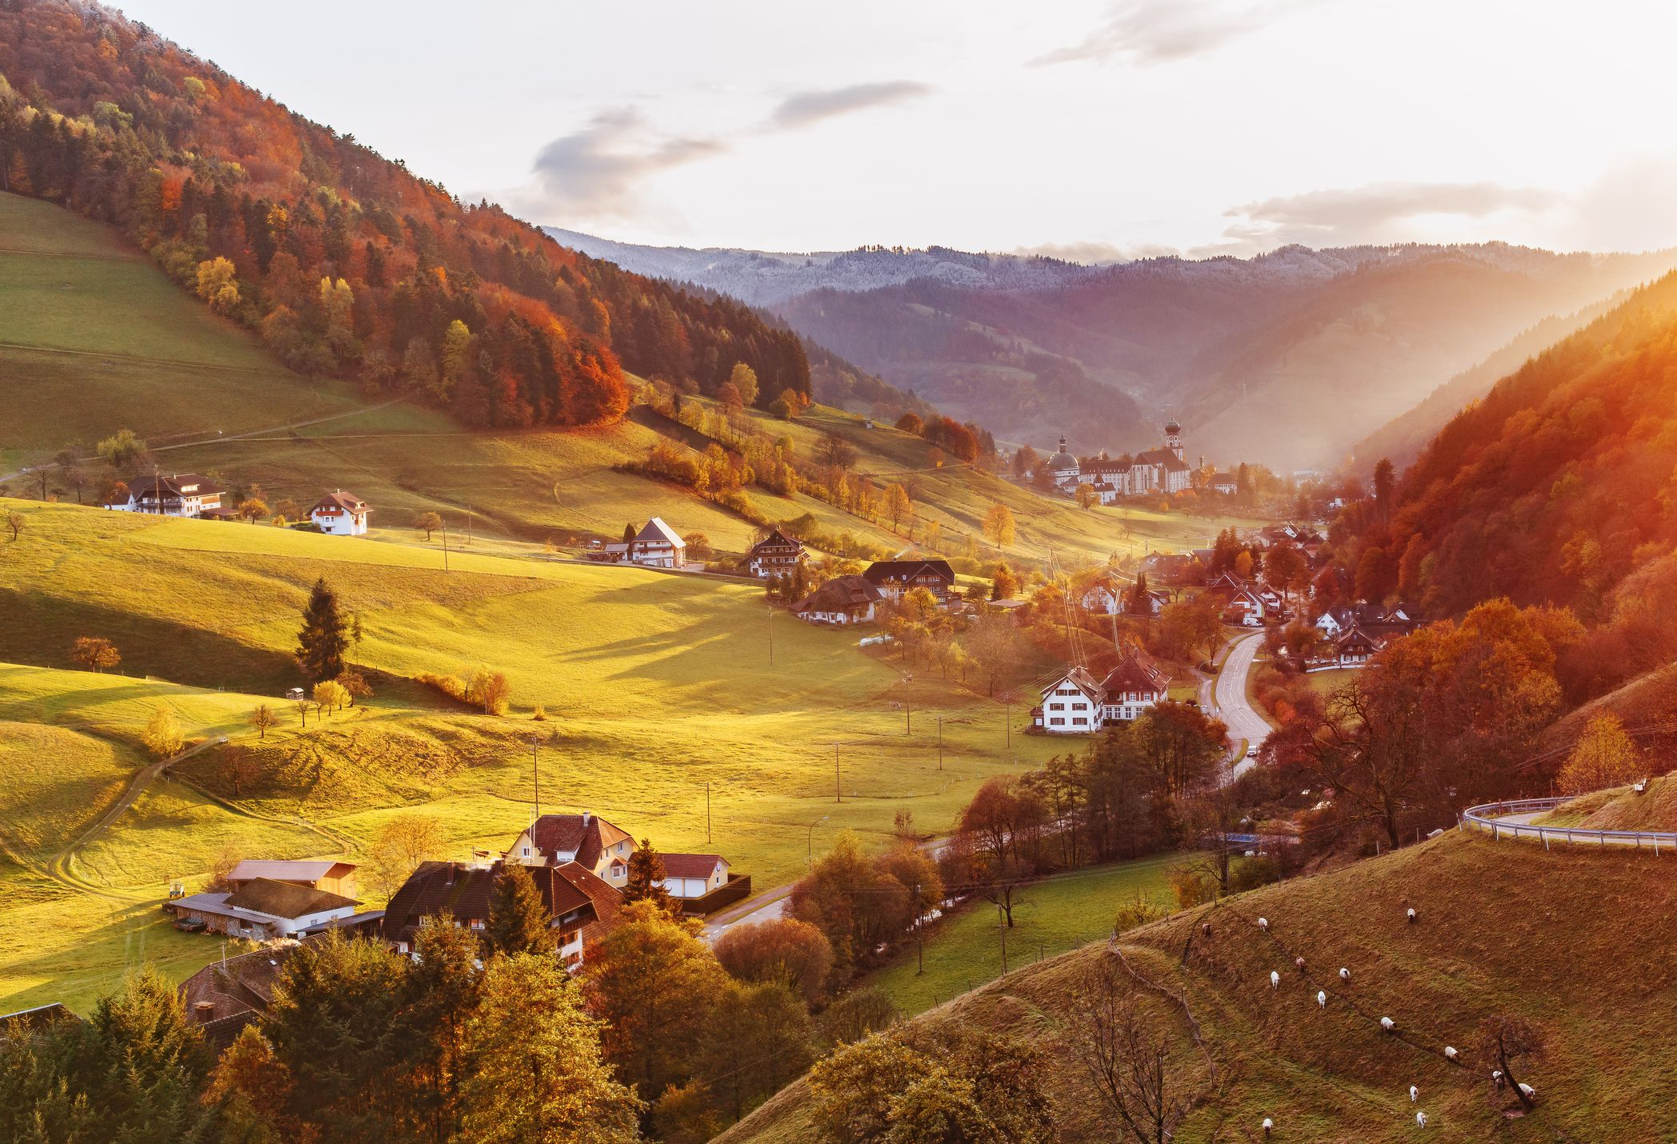
Möttlingen, Germany

Slide 20
“I was pained that no remedy had been found for the horrible affair. As I pondered this, indignation seized me – I believe it was an inspiration from above. I walked purpose fully over to Gottliebin and grasped her cramped hands. Then, trying to hold them together as best as possible (she was unconscious), I shouted into her ear, “Gottliebin, put your hands together and pray, ‘Lord Jesus, help me!’ We have seen enough of what the devil can do; now let us see what the Lord Jesus can do!”

Slide 21
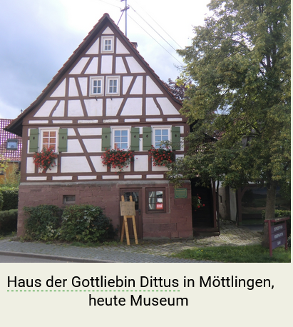

Slide 22
At that time Jesus stood at the door and knocked, and I opened it to him. This is the call of Him who wants to come again: “Behold, I stand at the door; I am already waiting there. I want to come into your life, want to break into your ‘reality’ with the full power of grace given me by the Father, to prepare for my full return. I am knocking, but you are so engrossed in your possessions, your [petty] quarrels, and theological wrangling, that you do not hear my voice.”

Slide 23
“Christus Victor”

Slide 24
Friedrich Zuendel

Slide 25
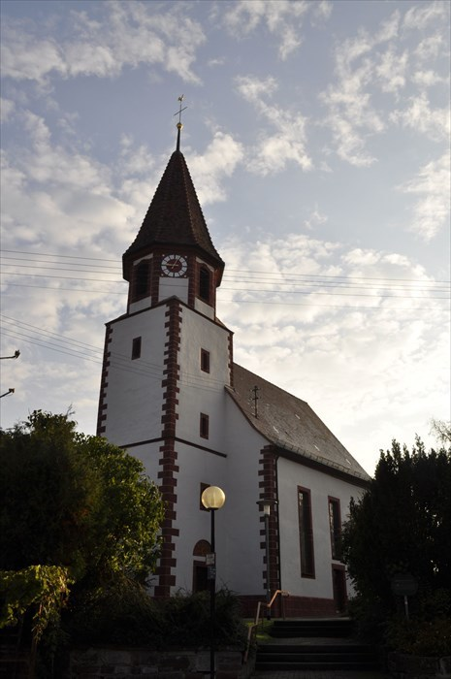
Blumhardtkirch - Möttlingen, Germany

Slide 26
“I must also admit that I felt ashamed to give in to the devil – in my own heart and before my Savior, whose active help I had experienced so many times. I often had to ask myself, “Who is Lord?” And I always heard an inner voice call: “Forward!
We may first have to descend into the deepest depths, but it must come to a good end, if it is true that Jesus crushed the Serpent’s head.”
- Johann Christoph Blumhardt

