Slide 1
Wheat & Weeds
²⁴ Jesus told them another parable: “The kingdom of heaven is like a man who sowed good seed in his field. ²⁵ But while everyone was sleeping, his enemy came and sowed weeds among the wheat, and went away. ²⁶ When the wheat sprouted and formed heads, then the weeds also appeared.
²⁷ “The owner’s servants came to him and said, ‘Sir, didn’t you sow good seed in your field? Where then did the weeds come from?’
²⁸ “‘An enemy did this,’ he replied.
“The servants asked him, ‘Do you want us to go and pull them up?’
²⁹ “‘No,’ he answered, ‘because while you are pulling the weeds, you may uproot the wheat with them. ³⁰ Let both grow together until the harvest. At that time I will tell the harvesters: First collect the weeds and tie them in bundles to be burned; then gather the wheat and bring it into my barn.’”

Slide 2
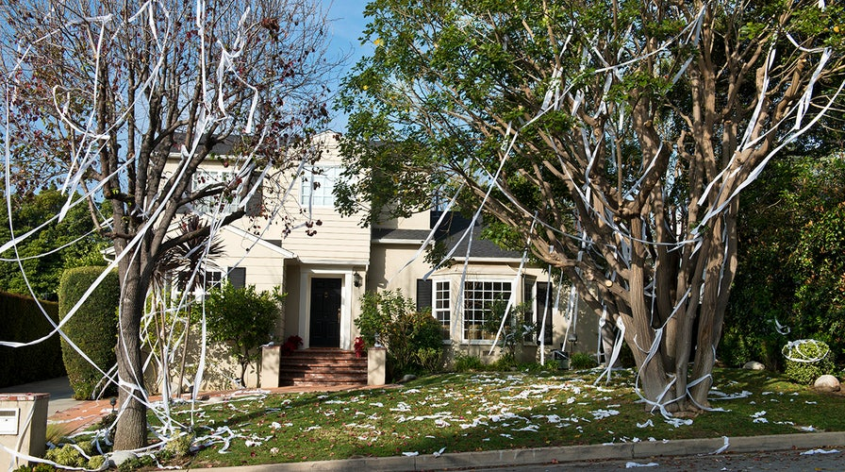
The Devil is responsible for spiritual vandalism!

Slide 3
The Bearded Darnel

Slide 4
The Parable of the Pharisee and the Tax Collector
⁹ To some who were confident of their own righteousness and looked down on everyone else, Jesus told this parable: ¹⁰ “Two men went up to the temple to pray, one a Pharisee and the other a tax collector. ¹¹ The Pharisee stood by himself and prayed: ‘God, I thank you that I am not like other people—robbers, evildoers, adulterers—or even like this tax collector. ¹² I fast twice a week and give a tenth of all I get.’
¹³ “But the tax collector stood at a distance. He would not even look up to heaven, but beat his breast and said, ‘God, have mercy on me, a sinner.’
¹⁴ “I tell you that this man, rather than the other, went home justified before God. For all those who exalt themselves will be humbled, and those who humble themselves will be exalted.”

Slide 5
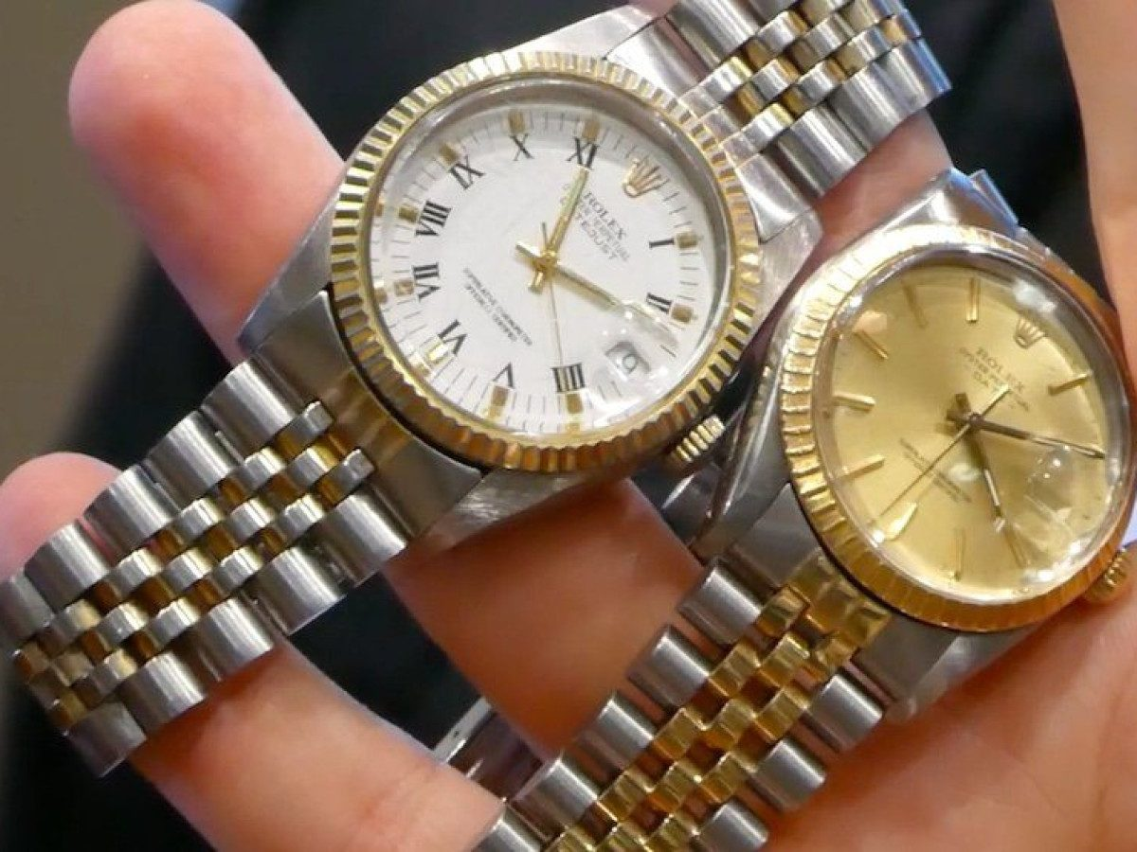
Modern-day Imitations

Slide 6
¹⁴ I looked, and there before me was a white cloud, and seated on the cloud was one like a son of man with a crown of gold on his head and a sharp sickle in his hand. ¹⁵ Then another angel came out of the temple and called in a loud voice to him who was sitting on the cloud, “Take your sickle and reap, because the time to reap has come, for the harvest of the earth is ripe.” ¹⁶ So he who was seated on the cloud swung his sickle over the earth, and the earth was harvested. (Rev. 14)
¹³ Nothing in all creation is hidden from God’s sight. Everything is uncovered and laid bare before the eyes of him to whom we must give account. (Heb. 4:13)
²⁸ A person is not a Jew who is one only outwardly, nor is circumcision merely outward and physical. ²⁹ No, a person is a Jew who is one inwardly; and circumcision is circumcision of the heart, by the Spirit, not by the written code. (Romans 2)

Slide 7
Pulling the weeds can destroy the wheat!
⁹ I wrote to you in my letter not to associate with sexually immoral people— ¹⁰ not at all meaning the people of this world who are immoral, or the greedy and swindlers, or idolaters. In that case you would have to leave this world. ¹¹ But now I am writing to you that you must not associate with anyone who claims to be a brother or sister but is sexually immoral or greedy, an idolater or slanderer, a drunkard or swindler. Do not even eat with such people.
¹² What business is it of mine to judge those outside the church? Are you not to judge those inside? ¹³ God will judge those outside. “Expel the wicked person from among you.” (1 Cor. 5)
However, we do need Church Discipline!

Slide 8
But, Scripture does say…
True and False Prophets
¹⁵ “Watch out for false prophets. They come to you in sheep’s clothing, but inwardly they are ferocious wolves. ¹⁶ By their fruit you will recognize them. Do people pick grapes from thornbushes, or figs from thistles? ¹⁷ Likewise, every good tree bears good fruit, but a bad tree bears bad fruit. ¹⁸ A good tree cannot bear bad fruit, and a bad tree cannot bear good fruit. ¹⁹ Every tree that does not bear good fruit is cut down and thrown into the fire. ²⁰ Thus, by their fruit you will recognize them. (Matthew 7)
^{40 ”}for whoever is not against us is for us.” (Mark 9)

Slide 9
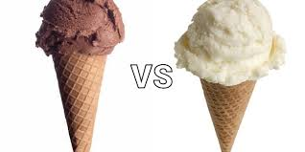
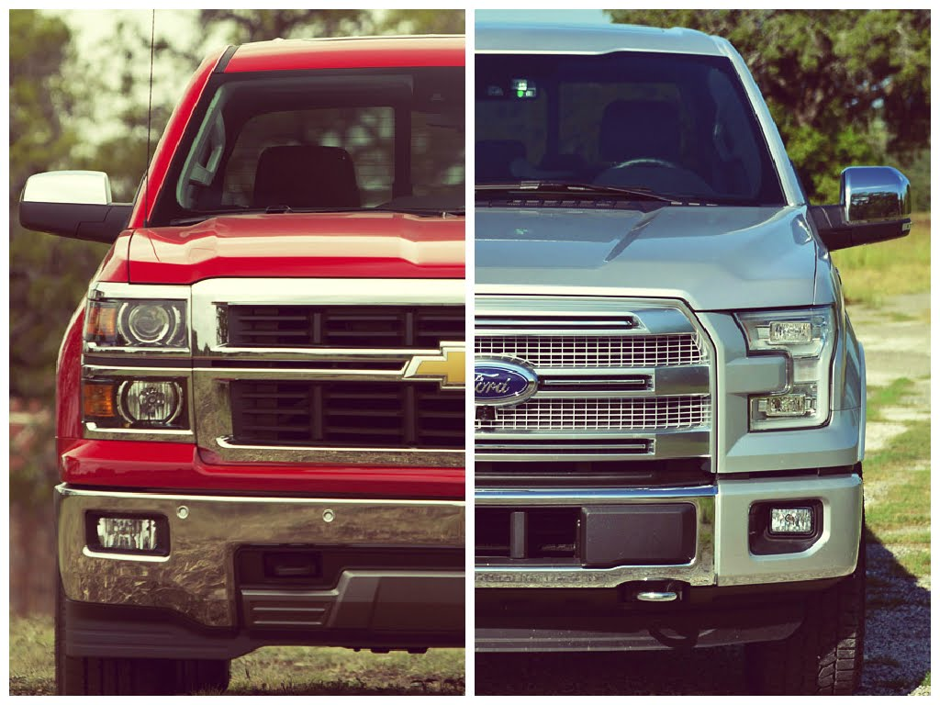
We make decisions in every day life:

Slide 10
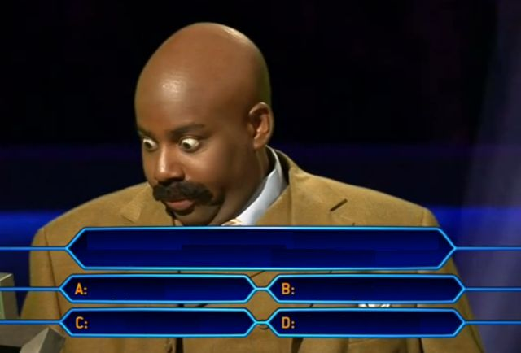
Remember TEST TIME in school?

Slide 12
⁵⁴ He said to the crowd: “When you see a cloud rising in the west, immediately you say, ‘It’s going to rain,’ and it does. ⁵⁵ And when the south wind blows, you say, ‘It’s going to be hot,’ and it is. ⁵⁶ Hypocrites! You know how to interpret the appearance of the earth and the sky. How is it that you don’t know how to interpret this present time? (Luke 12)

Slide 13
20 In those days Hezekiah became ill and was at the point of death. The prophet Isaiah son of Amoz went to him and said, “This is what the Lord says: Put your house in order, because you are going to die; you will not recover.”
² Hezekiah turned his face to the wall and prayed to the Lord, ³ “Remember, Lord, how I have walked before you faithfully and with wholehearted devotion and have done what is good in your eyes.” And Hezekiah wept bitterly.
⁴ Before Isaiah had left the middle court, the word of the Lord came to him: ⁵ “Go back and tell Hezekiah, the ruler of my people, ‘This is what the Lord, the God of your father David, says: I have heard your prayer and seen your tears; I will heal you. On the third day from now you will go up to the temple of the Lord. ⁶ I will add fifteen years to your life. And I will deliver you and this city from the hand of the king of Assyria. I will defend this city for my sake and for the sake of my servant David.’” (2 Kings 20)

Slide 15
¹⁵ Instead, speaking the truth in love, we will grow to become in every respect the mature body of him who is the head, that is, Christ. (Ephesians 4:15)

Slide 16
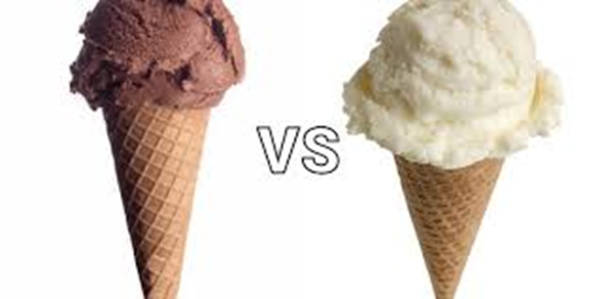
What have you done with Jesus?
Accepted / Rejected / Tabled It

