Slide 1
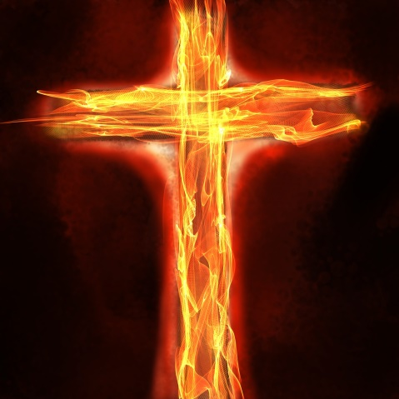
Is
To Win This
A SERMON TO LIFEGATE
Sunday, November 13, 2022

Slide 2
Philippians 2:5
Final Sermon in Series
THE HARVEST IS HERE
ALTHOUGH IT IS BEING FIERCELY RESISTED

Slide 3
God Invites Us Into The Radical Vertical
And Radical Horizontal
'Call to me and I will answer you and tell you great and unsearchable things you do not know.' Jeremiah 33:3 (NIV)
³⁷ "This is what the Sovereign LORD says: Once again I will yield to the plea of the house of Israel and do this for them: I will make their people as numerous as sheep, Ezekiel 36:37 (NIV)
¹⁹ This is what the LORD said to me: "Go and stand at the gate of the people, through which the kings of Judah go in and out; stand also at all the other gates of Jerusalem. ²⁰ Say to them, 'Hear the word of the LORD, O kings of Judah and all people of Judah and everyone living in Jerusalem who come through these gates. Jeremiah 17:19-20 (NIV)

Slide 4
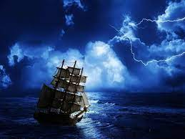
The Deep Roots Of America
“For we must consider that we shall be as a city upon a hill. The eyes of all people are upon us. – (But) if we shall deal falsely with our God in this work we have undertaken, and so cause Him to withdraw His present help from us, we shall be made a story and a by-word throughout the world. And if our hearts shall turn away, so that we will not obey, but shall be seduced, and worship other gods, our pleasures, and profits, and serve them; it is submitted unto us this day, we shall surely perish out of the good land which we pass over this vast sea to possess. John Winthrop 1630

Slide 5
The Beyond-Measure Culture Change
A HUGE CHANGE IN HUMAN CULTURE CAME ABOUT IN 1620 and 1776 AND 1787 – THE GENIE WAS OUT OF THE BOTTLE – PEOPLE WHO LIVED IN A DEMOCRATIC REPUBLIC NEEDED TO STEWARD IT AND STAND IN THE GATES OF INFLUENCE (ESPECIALLY CHRISTIANS) – AND GOD ALLOWED THE UNITED STATES TO BE RAISED UP TO HOLD BACK THE ANTI-CHRIST AGENDAS JUST LONG ENOUGH TO GET IN SOME MAJOR LAST DAYS HARVESTS.
WE HAVE LOST OUR WAY AS THE CHURCH – AND THOUGH SOME JOSHUA AND CALEB’S AND ESTHER’S AND DEBORAH’S HAVE STEPPED UP – THE TIDE DOES NOT TURN INSTANTLY.
THE HARDEST PART OF THIS JOURNEY IS BEING A JOSHUA AND A CALEB, AND ESTHER OR HANNAH – ENDURING THE DELAYS – GIVING A GOOD REPORT – BUT NO ONE BELIEVES IT – AND ENDURING THE SEASON OF CONTRADICTION UNTIL FULFILLMENT COMES NOT LETTING GO OF THE PROMISE DURING APPARENT SET BACKS.

Slide 6
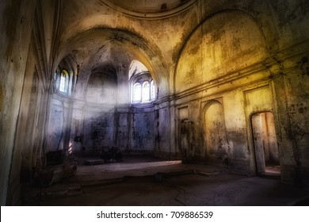
Case Study 1 Of A Challenging Season
The Church At Thessalonica – Acts 17:1-9
“Would their immature faith prove equal to the challenge? It did, outstandingly so.” F. F. Bruce
So that no one would be unsettled by these trials. You know quite well that we were destined for them. 1 Thessalonians 3:3
Therefore, brothers, in all our distress and persecution we were encouraged about you because of your faith. 1 Thessalonians 3:7
May the Lord make your love increase and overflow for each other and for everyone else, just as ours does for you. 13 May He strengthen your hearts so that you will be blameless and holy in the presence of our God and Father when our Lord Jesus comes with all His holy ones. 1 Thessalonians 3:12-13

Slide 7
The Lord Knows There is Going To
Be Problems But Does Not Abandon Us
I know that the LORD will maintain the cause of the afflicted, and the right of the poor. Psalm 140:12 (KJV)
With this in mind, we constantly pray for you, that our God may count you worthy of his calling, and that by his power he may fulfill every good purpose of yours and every act prompted by your faith. 12 We pray this so that the name of our Lord Jesus may be glorified in you, and you in him, according to the grace of our God and the Lord Jesus Christ. 2 Thessalonians 1:11-12 (NIV)

Slide 8
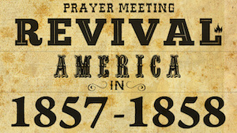
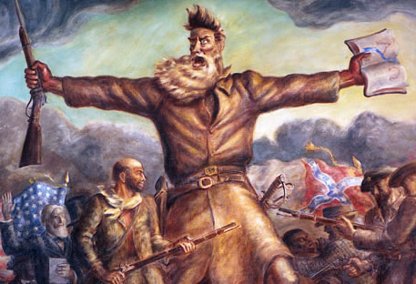
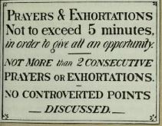
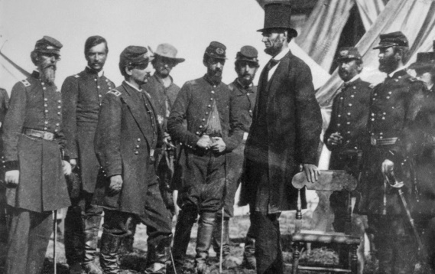
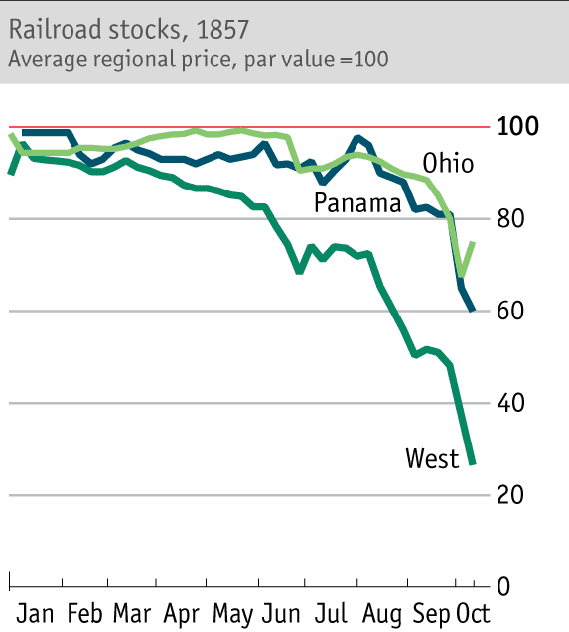
Case Study 2 From A Challenging Season
American Church 1857- 1868
John Brown 1800 - 1859
Rev. Alfred Cookman
1828-1871
Civil War 1861-1865
Great National Holiness Camp Meeting
Manheim, PA – July 13 1868

Slide 9
What Is Going On?
“Induced Labor”
As a time of severe shaking continues it APPEARS THAT EVIL HAS THE UPPER HAND. (Only in the natural.) For us who are crying out for reprieve- we are gut-punched and disappointed that the season of CORRECTION is continuing. The fiasco in this last election is a prophetic inducement of God stirring up an intensified faith to prepare His people to not give up when it feels hopeless. But to cry out all the more – (Mark 10:48) (Revelation 17:14)
Many will be purified, made spotless and refined, but the wicked will continue to be wicked. None of the wicked will understand, but those who are wise will understand. Daniel 12:10 (NIV)

Slide 10
1
Paul and Luke In The
Storm – Apply to
Our Situation
On the third day, they threw the ship's tackle overboard with their own hands. 20 When neither sun nor stars appeared for many days and the storm continued raging, we finally gave up all hope of being saved. 21 After the men had gone a long time without food, Paul stood up before them and said: "Men, you should have taken my advice not to sail from Crete; then you would have spared yourselves this damage and loss. 22 But now I urge you to keep up your courage, because not one of you will be lost; only the ship will be destroyed. 23 Last night an angel of the God whose I am and whom I serve stood beside me 24 and said, 'Do not be afraid, Paul. You must stand trial before Caesar; and God has graciously given you the lives of all who sail with you.' 25 So keep up your courage, men, for I have faith in God that it will happen just as he told me. 26 Nevertheless, we must run aground on some island." Acts 27:19-26

Slide 11
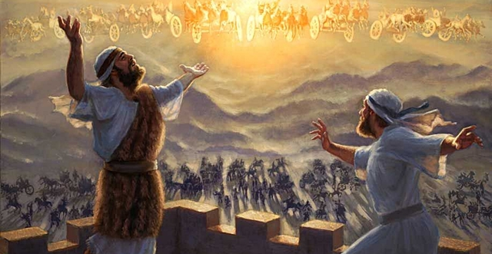
Oh My What Are We Going To Do?
2
When the servant of the man of God got up and went out early the next morning, an army with horses and chariots had surrounded the city. "Oh, my lord, what shall we do?" the servant asked. ¹⁶ "Don't be afraid," the prophet answered. "Those who are with us are more than those who are with them." ¹⁷ And Elisha prayed, "O LORD, open his eyes so he may see." Then the LORD opened the servant's eyes, and he looked and saw the hills full of horses and chariots of fire all around Elisha. 2 Kings 6:15-17 (NIV)

Slide 12
3
The Wrong Vision In A Time of Opportunity
They gave Moses this account: "We went into the land to which you sent us, and it does flow with milk and honey! Here is its fruit. 28 But the people who live there are powerful, and the cities are fortified and very large. We even saw descendants of Anak there.
Then Caleb silenced the people before Moses and said, "We should go up and take possession of the land, for we can certainly do it."
We can't attack those people; they are stronger than we are." 32 And they spread among the Israelites a bad report about the land they had explored. They said, "The land we explored devours those living in it. All the people we saw there are of great size. Numbers 13:27-32
Only do not rebel against the LORD. And do not be afraid of the people of the land, because we will swallow them up. Their protection is gone, but the LORD is with us. Do not be afraid of them." Numbers 14:6-9

Slide 13
Giving A Good Report
ALL OF THOSE WHO STOOD FOR A PRACTICAL “LINE IN THE STAND” CONCERNING UNHOLY BOOKS IN A PUBLIC SCHOOL LIBRARY TO BE DISTRIBUTED WITH WISDOM AND RIGHTEOUS BOUNDARIES – AND THE CULTURE LAUGHED AT YOU AND VOTED AGAINST YOU – YOU GAVE A GOOD REPORT
ALL OF YOU WHO LABORED FOR GOOD GOVERNMENTAL CANDIDATES TO RULE IN PENNSYLVANIA AND WASHINGTON D.C. DOOR KNOCKING – WORKING THE POLLS – ENCOURAGING YOUR NEIGHBORS TO VOTE - AND YOUR EFFORTS LOOK LIKE THEY FAILED – THE MAFIA MACHINERY STOLE YOUR FRUIT - YOU GAVE A GOOD REPORT
ALL WHO PRAYED AND FASTED FOR THE EXPOSING AND BREAKING OF THE DEEP STATE MACHINERY IN OUR NATION – AND AN OUTPOURING OF THE HOLY SPIRIT FOR REVIVAL – AND THE ANSWER WAS DEFERRED – YOU GAVE A GOOD REPORT

Slide 14
4
God’s Providentially Allowed Setbacks
Are Not Meant to Paralyze Us but Provoke Faith
When David and his men came to Ziklag, they found it destroyed by fire and their wives and sons and daughters taken captive. ⁴ So David and his men wept aloud until they had no strength left to weep. ⁵ David's two wives had been captured--Ahinoam of Jezreel and Abigail, the widow of Nabal of Carmel. ⁶ David was greatly distressed because the men were talking of stoning him; each one was bitter in spirit because of his sons and daughters. But David found strength in the LORD his God. ⁷ Then David said to Abiathar the priest, the son of Ahimelech, "Bring me the ephod." Abiathar brought it to him, ⁸ and David inquired of the LORD, "Shall I pursue this raiding party? Will I overtake them?" "Pursue them," he answered. "You will certainly overtake them and succeed in the rescue." 1 Samuel 30:3-8 (NIV)
They will make war against the Lamb, but the Lamb will overcome them because He is Lord of lords and King of kings--and with Him will be His called, chosen, and faithful followers." Revelation 17:14 (NIV)

Slide 15
Ultimately A “Now” Faith Must Be Stirred Up
I believe that God is still putting before us a huge opportunity to CRY OUT FOR AND RECEIVE LOCAL AND NATIONAL MIRACLES – and we can’t let go of that – yes it will be in the trenches getting people to get involved – dynamic discipleship – and high level intercession and warfare and worship - but there is this SUPERNATURAL aspect of it that the INTERCESSORY PROPHETS lift the Church up to believe for. And without that we really don’t expect anything.
Finally we have to have a profound crescendo of intensified faith to get over this mountain of familiar organized religion and generational unbelief that still STALKS us. Prevailing intensified prayer is growing in our midst and God is going to kindle His Glory among us.
Don Lamb December 2020.

Slide 16
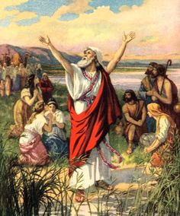
Just Because You Are On God’s Mission
Doesn’t Mean You Won’t Face Opposition
5
There, by the Ahava Canal, I proclaimed a fast, so that we might humble ourselves before our God and ask him for a safe journey for us and our children, with all our possessions. ²² I was ashamed to ask the king for soldiers and horsemen to protect us from enemies on the road, because we had told the king, "The gracious hand of our God is on everyone who looks to Him, but His great anger is against all who forsake Him." ²³ So we fasted and petitioned our God about this, and He answered our prayer. Ezra 8:21-23 (NIV)

Slide 17
The Upside Down Kingdom
Three times I pleaded with the Lord to take it (Thorn in the flesh) away from me. ⁹ But he said to me, "My grace is sufficient for you, for my power is made perfect in weakness." Therefore I will boast all the more gladly about my weaknesses, so that Christ's power may rest on me. ¹⁰ That is why, for Christ's sake, I delight in weaknesses, in insults, in hardships, in persecutions, in difficulties. For when I am weak, then I am strong. 2 Corinthians 12:8-10 (NIV)

Slide 18
Why Does The Church Not
Leverage Her Kingdom Privileges?
"O Jerusalem, Jerusalem, you who kill the prophets and stone those sent to you, how often I have longed to gather your children together, as a hen gathers her chicks under her wings, but you were not willing! Luke 13:34 (NIV)
As he approached Jerusalem and saw the city, he wept over it ⁴² and said, "If you, even you, had only known on this day what would bring you peace--but now it is hidden from your eyes. ⁴³ The days will come upon you when your enemies will build an embankment against you and encircle you and hem you in on every side. ⁴⁴ They will dash you to the ground, you and the children within your walls. They will not leave one stone on another, because you did not recognize the time of God's coming to you. (Time of visitation (inspection)." Luke 19:41-44 (NIV)

Slide 19
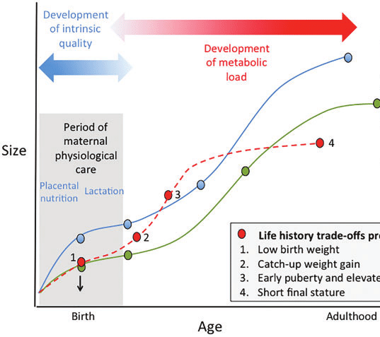
For God's gifts and His call are irrevocable. Romans 11:29 (NIV)
For we are God's workmanship, created in Christ Jesus to do good works, which God prepared in advance for us to do. Ephesians 2:10
Providentially manipulated details
All the days ordained for me were written in your book before one of them came to be.
Psalm 139:16
Life Growth
Green dotted Line is God’s Best
Red Dotted Line is you going back and forth
Blue Line Is The Enemy’s corrupted plan for your life

Slide 20
Application
Let us draw near to God with a sincere heart in full assurance of faith, having our hearts sprinkled to cleanse us from a guilty conscience and having our bodies washed with pure water. 23 Let us hold unswervingly to the hope we profess, for he who promised is faithful. 24 And let us consider how we may spur one another on toward love and good deeds. 25 Let us not give up meeting together, as some are in the habit of doing, but let us encourage one another--and all the more as you see the Day approaching. Hebrews 10:22-25 (NIV)

Slide 21
Spiritual Faith Declaration
“Heavenly Father,
I declare that I have repented of my sins and received true pardon from the grace lavished on me at the Cross of Your Son Jesus Christ. In His finished work, I have Your favor today because of Your perfect work. I declare that I am, by Your Holy Spirit strong and well able to fulfill my God-given calling through grace. I know You are fighting my battles as I stand in faith.”
“I declare that all my days were ordained for me before I was born. That my mission is to do the works you have prepared for me to accomplish. Your success is upon my labors and I expect to succeed in my mission and not fail.”
“Father, I thank You for causing me to make good decisions with a clear mind. I declare that You are the greatest Leader of the universe and that You work in me what is well pleasing in Your sight so that I can do all things through Christ who strengthens me and you set me up for victory.”

Slide 22
“Forgive me, when I become obsessed with my needs and problems and those problems in my nation and I stop seeking FIRST Your Kingdom and righteousness by prayer and by sharing the spiritual wealth you gave me.”
“I thank You for Your favor today not JUST because of who I am, but because of Whose I am. I am a child of the Most High God, the Creator of the whole universe. I commit this day to You. I have been saved, adopted, transformed, filled, and given the opportunity to shine Your love and truth into the world.”
“Lord do all Your will in me; and put me in any position which will most fully illustrate and extol Your grace, no matter what it is, only let it greatly glorify Your name. Amen!”

