Slide 1
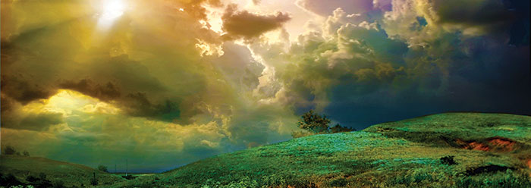
The Paradox of Faith
A SERMON TO LIFEGATE
Sunday, November 27, 2022

Slide 2
The Paradox Of Faith
God is our refuge and strength, an ever-present help in trouble. ² Therefore we will not fear, though the earth give way and the mountains fall into the heart of the sea, ³ though its waters roar and foam and the mountains quake with their surging. Selah Psalm 46:1-3 (NIV)
"Be still, and know that I am God; I will be exalted among the nations, I will be exalted in the earth." Psalm 46:10 (NIV)

Slide 3
“If I were God.”
“Why Does God do it that way?”
Why are the “Principles of Prayer” such a mystery? Why doesn’t God answer sometimes – or answer more quickly?
Why is God so slow to anger – He could restrain wickedness better if He brought judgment immediately?
Why does effective “mountain-moving” faith seem impossible or too complicated to attain?
Why is God so hard to find for so many people?
Why does God allow us to deceive ourselves?
Why does God allow things to go “sideways” even for His people that are IN THE WILL OF GOD?”
Why does God seemingly bless people with an effective anointing even when they are compromised in their character or methods?

Slide 4
The Paradox Of Faith
When We Are In The Dark
"For my thoughts are not your thoughts, neither are your ways my ways," declares the LORD. ⁹ "As the heavens are higher than the earth, so are my ways higher than your ways and my thoughts than your thoughts. Isaiah 55:8-9 (NIV)

Slide 5
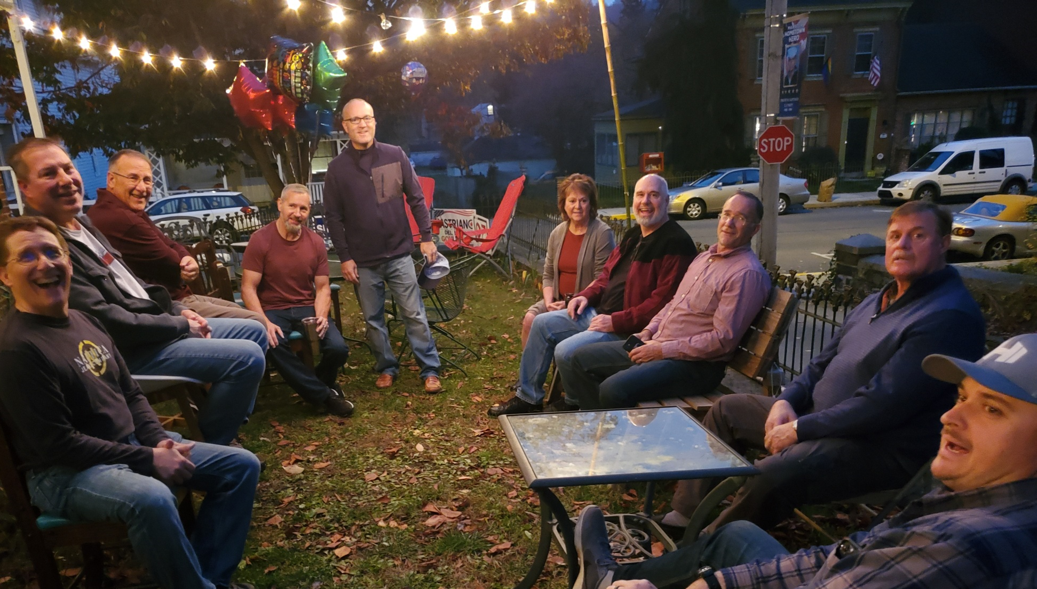
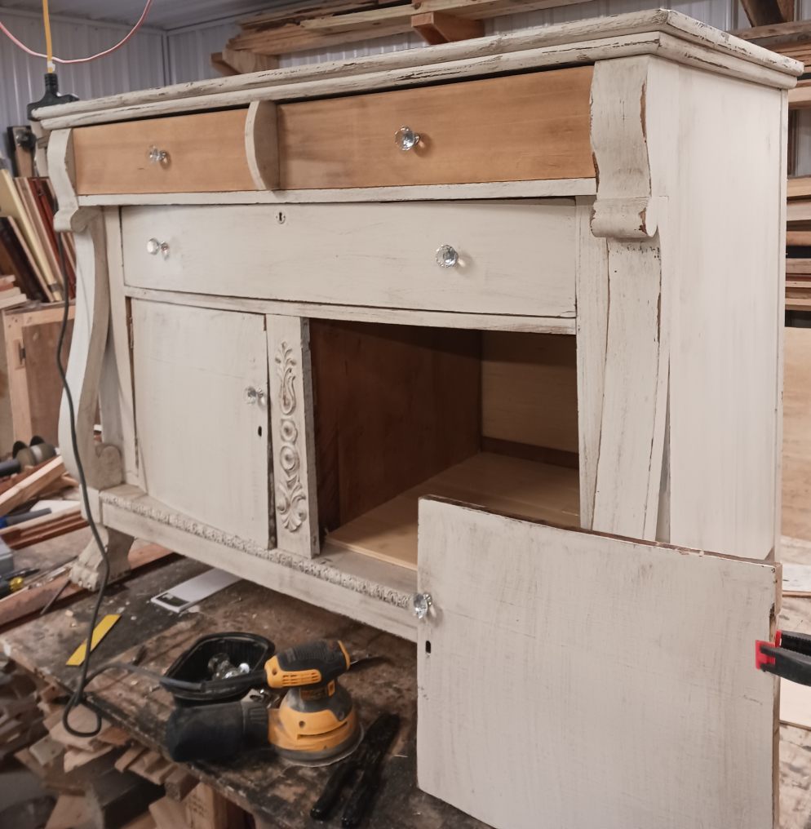

Slide 6
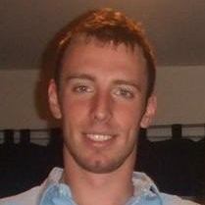
Sovereign Mysteries
Patrick Ford
Envoy Pilot
(November 19)
Greg “The painter”
(November 14)
Roger the Amazing
(November 21)
How great are your works, O LORD, how profound your thoughts! Psalm 92:5 (NIV)
Jim Morrison (Week of November 12 ??)
Yours Truly Sept 23

Slide 7
David’s Song About Jonathan
David Said 3032 years ago after circumstances in which he had no control over and lost his best friend Jonathan in battle. David wrote a song about Jonathan:
I grieve for you, Jonathan my brother; you were very dear to me. Your love for me was wonderful (distinguished), 27 "How the mighty have fallen!" 2 Samuel 1:26-27

Slide 8
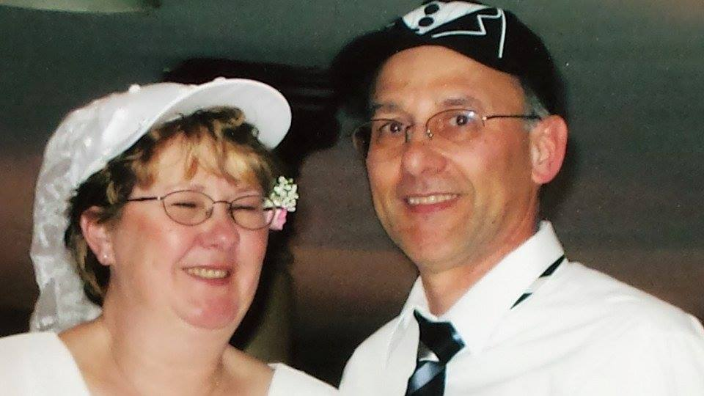
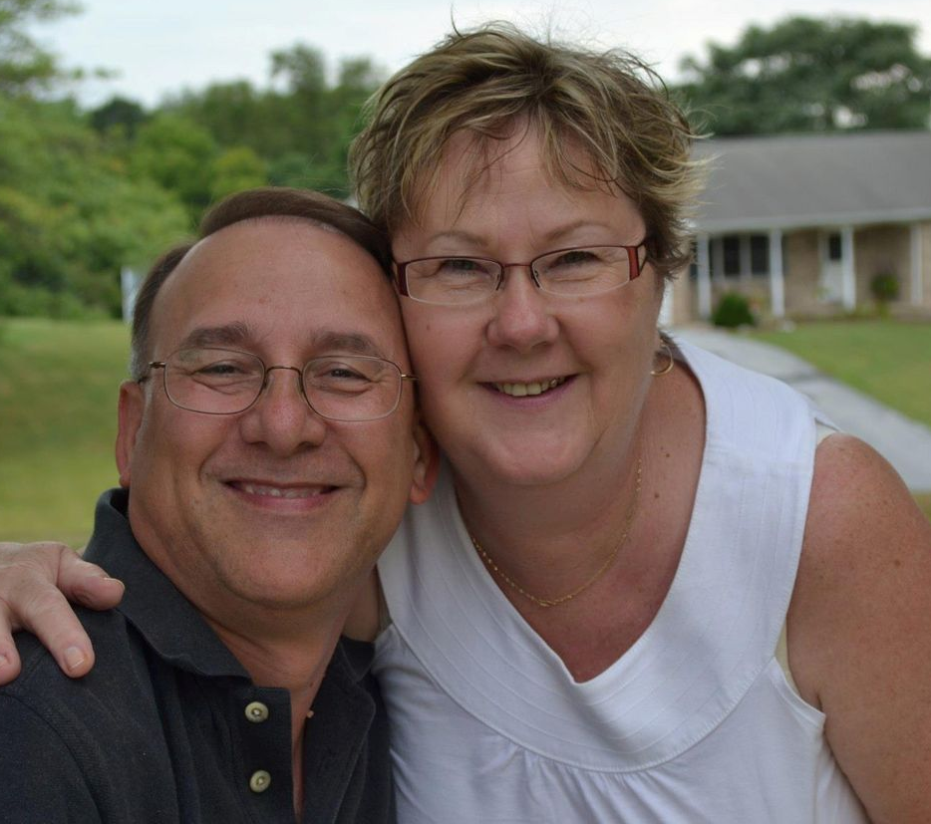
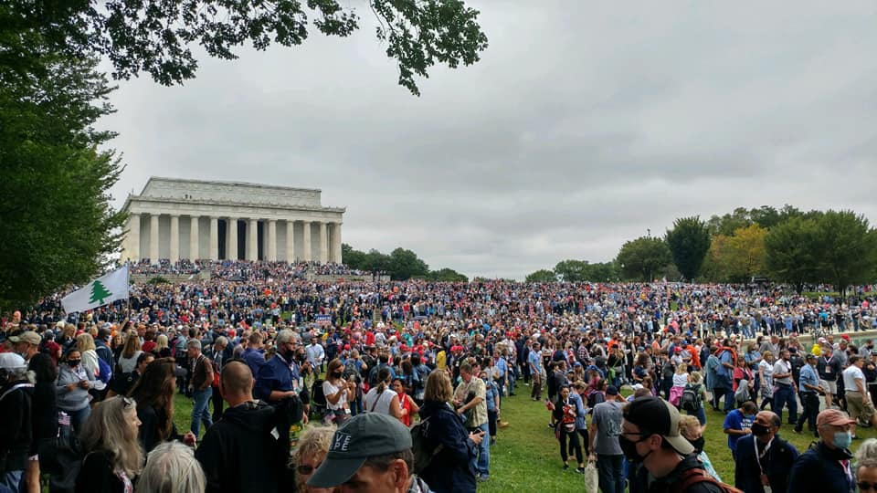
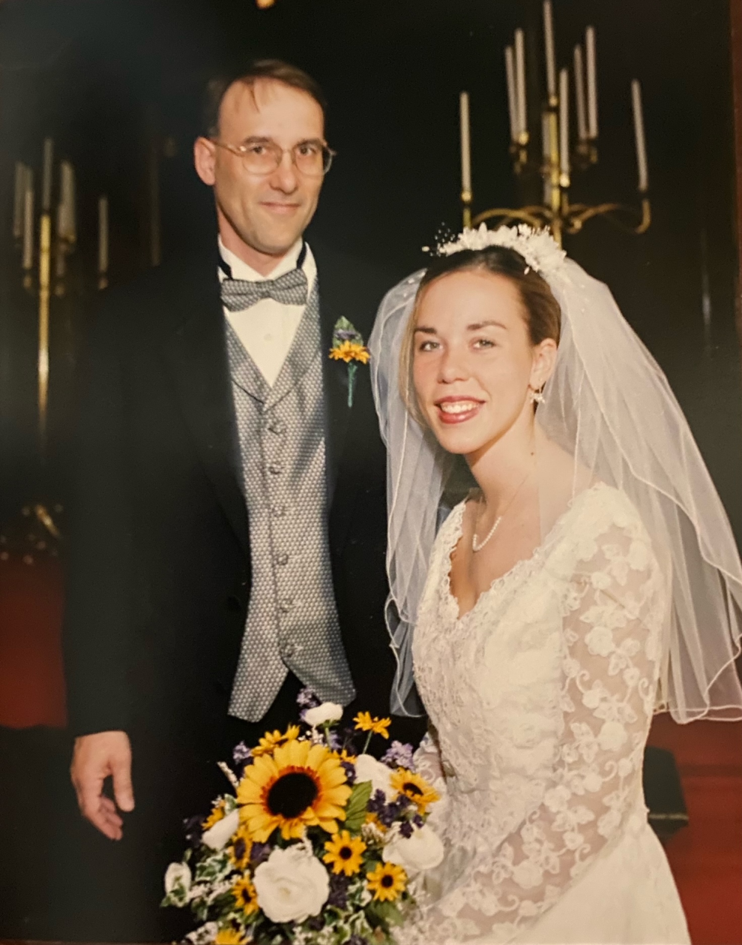
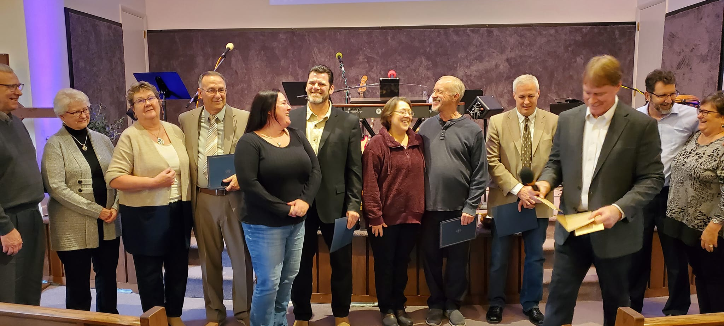
Don’s Song To Roger

Slide 9
So What Is Going On?
As a time of shaking continues preparing the Church for BOTH HARVEST and JUDGMENT - it APPEARS THAT EVIL HAS THE UPPER HAND. (Only in the natural.) For us who are crying out for reprieve- we are gut-punched and disappointed that the season of REFINING is continuing. God is stirring up an intensified faith to build in His people a conquering faith to not give up when it feels hopeless. But to cry out all the more – (Mark 10:48) (Revelation 17:14)
Many will be purified, made spotless and refined, but the wicked will continue to be wicked. None of the wicked will understand, but those who are wise will understand. Daniel 12:10 (NIV)

Slide 10
The Kingdom of God And The
Gospel Applies To Everything
I served the Lord with great humility and with tears, although I was severely tested by the plots of the Jews. ²⁰ You know that I have not hesitated to preach anything that would be helpful to you but have taught you publicly and from house to house. ²¹ I have declared to both Jews and Greeks that they must turn to God in repentance and have faith in our Lord Jesus. Acts 20:19-21 (NIV)

Slide 11
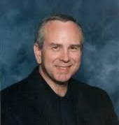
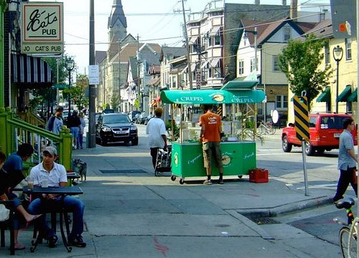
The Jesus Phone 1975
Risen Savior
Fellowship
Vard Gainor
Milwaukee East side

Slide 12
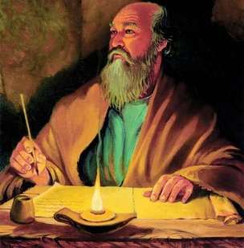
Paul Was A Powerful Voice
Of Faith in Challenging Times
More books of the New Testament were written by the Apostle Paul than any other New Testament author. He was certainly a man God used in special ways to minister to the Church, but it is important to recognize that none of the New Testament writers wrote in a vacuum nor were their writings the product of simple dictation. While they wrote under the inspired guidance of the Holy Spirit, they wrote from the source of their personal relationship with the Lord Jesus and what God was doing or had done in their hearts and to their thinking, values, goals, sources of trust, and purposes for life. This is also the exact kind of change God wants to bring about in our lives. Author Unknown

Slide 13
Paul Spent Most of His Writings On Salvation by Grace And The Power of Faith
¹⁶ Therefore, the promise comes by faith, so that it may be by grace and may be guaranteed to all Abraham's offspring--not only to those who are of the law but also to those who are of the faith of Abraham. He is the father of us all. -the God who gives life to the dead and calls things that are not as though they were.
¹⁸ Against all hope, Abraham in hope believed and so became the father of many nations, - ¹⁹ Without weakening in his faith, he faced the fact that his body was as good as dead--since he was about a hundred years old--and that Sarah's womb was also dead. ²⁰ Yet he did not waver through unbelief regarding the promise of God, but was strengthened in his faith and gave glory to God, ²¹ being fully persuaded that God had power to do what he had promised. ²² This is why "it was credited to him as righteousness." ²³ The words "it was credited to him" were written not for him alone, ²⁴ but also for us, to whom God will credit righteousness--for us who believe in him who raised Jesus our Lord from the dead. Romans 4:16-24 (NIV)

Slide 14
Faith Doesn’t Grow in Blue Sky Moments
But when the Storm is Raging
Through faith also Sara herself received strength to conceive seed, and was delivered of a child when she was past age, because she judged him faithful who had promised. Hebrews 11:11 (KJV)
Who through faith conquered kingdoms, administered justice, and gained what was promised; who shut the mouths of lions, ³⁴ quenched the fury of the flames, and escaped the edge of the sword; whose weakness was turned to strength; and who became powerful in battle and routed foreign armies. ³⁵ Women received back their dead, raised to life again. Others were tortured and refused to be released, so that they might gain a better resurrection. Hebrews 11:33-35 (NIV)

Slide 15
Jesus Is Still Building His Church
Through Revelation and the Paradox of Faith
¹³ When Jesus came to the region of Caesarea Philippi, he asked his disciples, "Who do people say the Son of Man is?" ¹⁴ They replied, "Some say John the Baptist; others say Elijah; and still others, Jeremiah or one of the prophets." ¹⁵ "But what about you?" he asked. "Who do you say I am?" ¹⁶ Simon Peter answered, "You are the Christ, the Son of the living God." ¹⁷ Jesus replied, "Blessed are you, Simon son of Jonah, for this was not revealed to you by man, but by my Father in heaven. ¹⁸ And I tell you that you are Peter, and on this rock I will build my church (Congregation of Governing authority) , and the gates of Hades will not overcome it. ¹⁹ I will give you the keys of the kingdom of heaven; whatever you bind on earth will be bound in heaven, and whatever you loose on earth will be loosed in heaven." ²⁰ Then he warned his disciples not to tell anyone that he was the Christ. Matthew 16:13-20 (NIV)

Slide 16
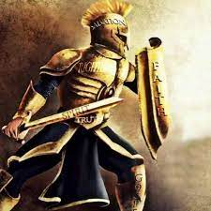
Standing In The Day Of Evil
Therefore put on the full armor of God, so that when the day of evil comes, you may be able to stand your ground, and after you have done everything, to stand. Ephesians 6:13 (NIV)

Slide 17
The Crux of This Paradox of Faith
Is That Jesus Died On The Cross
To Draw Us Into A position Of Confidence
God is developing us – God is building something into us. Not Just theories – but functioning authority – anointing
God is not uncaring about our sorrows, apparent losses, and griefs. (Isaiah 53)
Stay close to the Lord and each other – the longer the breakthrough is resisted the more powerful will be the eventual VICTORY. (How much More – Through principle)

