Slide 1
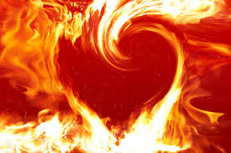
God Is Discipling Us In The Fire
A SERMON TO LIFEGATE
Sunday, December 4, 2022

Slide 2
Disastrous Indifference
October
2015
Ignored the updated Data – REVELATIONS COULD HAVE SAVED THEM
Had a overwhelming desire to go to the next level that he ignored the NOW
Did not work with His team

Slide 3
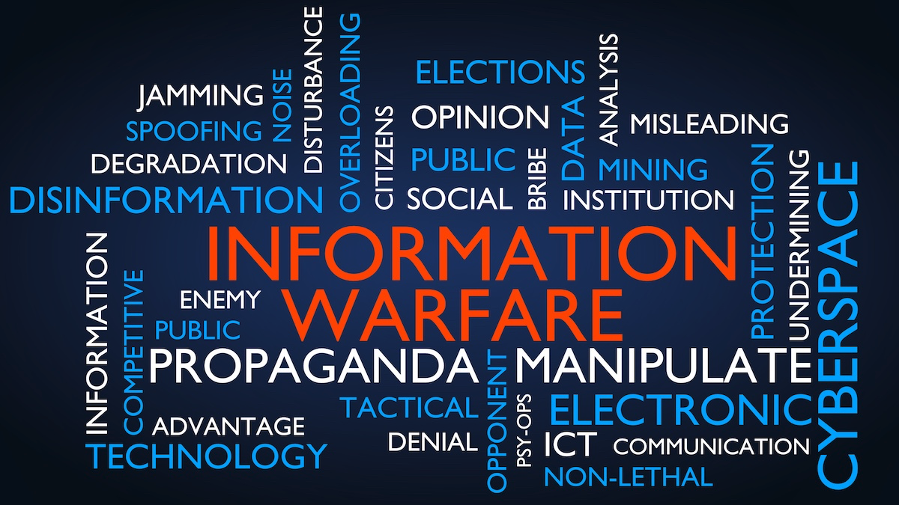
The Church Is In An Unrestricted

Slide 4
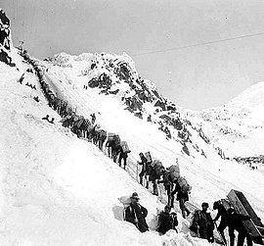
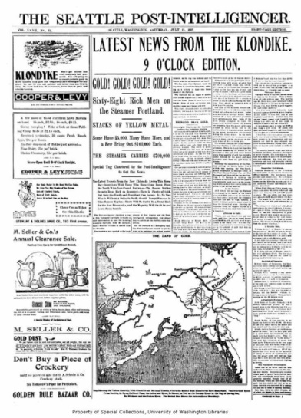
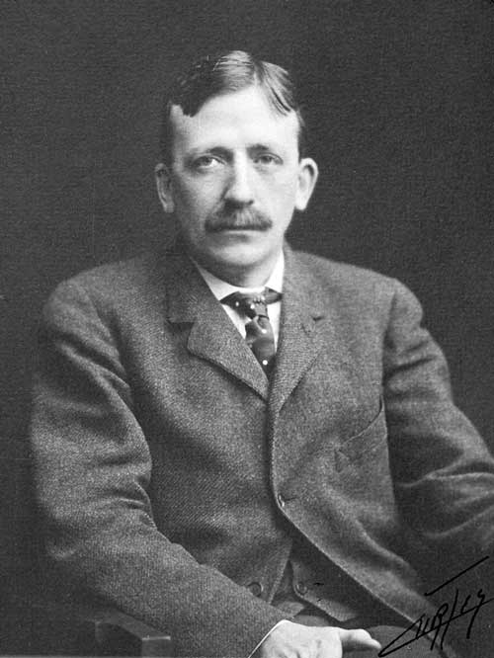
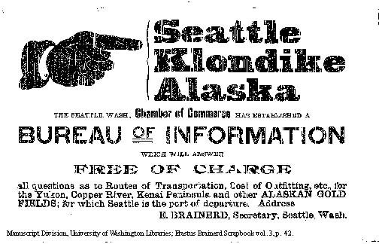
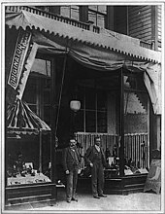
The Klondike Gold
Rush 1897
Erastus Brainerd
100,000 people crossed America – 30,000 made it to the Yukon - only 4,000 found gold
Nordstrom Shoe Store
“Historians often say the 1893 depression made people more vulnerable to stories of riches. But newspapers had evolved into a trusted source of information. These stories were reportedly “true,” which encouraged people to shift their critical thinking responsibilities to the papers.” Joan Pepin

Slide 5
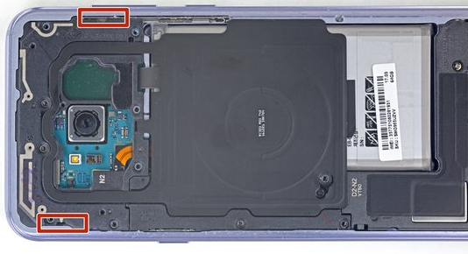
How Many Are You?
IN THIS SEASON WE ALMOST NEED TO BE BOTH

Slide 6
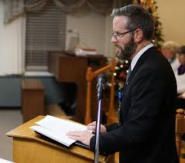
Quote of the Year
“In the days ahead, the world and its systems will try to demoralize you, take your income, your peace, your possessions, your economy, your life, and your family. The enemy will try to discourage, discredit, and bring disillusionment, disagreement, and disunity. You as a priest must be listening to God, not the voice of the enemy. You as a priest must walk humbly before your God and represent Him to the people. You must stay vigilant, sober, in prayer, in His word, with His people, praying in the Spirit.” Peter Ogilvie (Sunday October 23)

Slide 7
LifeGate Leadership
4 D Discipleship
Sometimes
10,000 foot level
Sometimes down
In the trenches

Slide 8
Key Passage
⁸ "Hear, O my people, and I will warn you-- if you would but listen to me, O Israel! ⁹ You shall have no foreign god among you; you shall not bow down to an alien god. ¹⁰ I am the LORD your God, who brought you up out of Egypt. Open wide your mouth and I will fill it. ¹¹ "But my people would not listen to me; Israel would not submit to me. ¹² So I gave them over to their stubborn hearts to follow their own devices. ¹³ "If my people would but listen to me, if Israel would follow my ways, ¹⁴ how quickly would I subdue their enemies and turn my hand against their foes! ¹⁵ Those who hate the LORD would cringe before him, and their punishment would last forever. ¹⁶ But you would be fed with the finest of wheat; with honey from the rock I would satisfy you."
Psalm 81:8-16

Slide 9
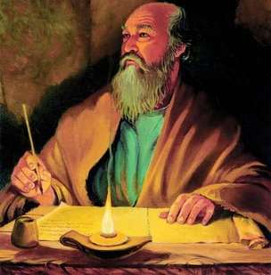
Paul Was A Powerful Voice
Of Faith in Challenging Times
More books of the New Testament were written by the Apostle Paul than any other New Testament author. He was certainly a man God used in special ways to minister to the Church, but it is important to recognize that none of the New Testament writers wrote in a vacuum nor were their writings the product of simple dictation. While they wrote under the inspired guidance of the Holy Spirit, they wrote from the source of their personal relationship with the Lord Jesus and what God was doing or had done in their hearts and to their thinking, values, goals, sources of trust, and purposes for life. This is also the exact kind of change God wants to bring about in our lives. Author Unknown

Slide 10
God Is A God Of Thoughts
Words and Actions
For I know the thoughts that I think toward you, saith the LORD, thoughts of peace, and not of evil, to give you an expected end. ¹² Then shall ye call upon me, and ye shall go and pray unto me, and I will hearken unto you. ¹³ And you shall seek me, and find me, when you shall search for me with all your heart. Jeremiah 29:11-13 (KJV)
Therefore, God leads and communicates and persuades us through His messages of truth that come from His thoughts and ideas. God’s Word is God’s thoughts. God’s Word is to CHANGE US -

Slide 11
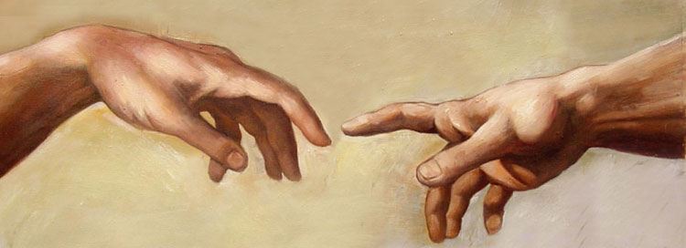
We Are Created In God’s Image
For as he (man) thinks in his heart, so is he. Proverbs 23:7 (AMP)
We are guided, informed, and directed by our minds and thoughts – this is unavoidable. We must take captive every thought and bring it into obedience to the Lord.
⁵ We demolish arguments and every pretension that sets itself up against the knowledge of God, and we take captive every thought to make it obedient to Christ. 2 Corinthians 10:5 (NIV)

Slide 12
Trying to Persuade Others Feels So Weak
The Communicated Truth
THE CHALLENGE WE FACE AS CHRISTIANS IS THAT THE COMMUNICATION OF THIS WORLDVIEW FEELS SO WEAK – IT FEELS LIKE IT IS ALMOST “NOT UP TO THE TASK”. LIKE WHY DID THE GODHEAD MAKE THE MOST IMPORTANT THING THAT YOU NEED TO LEARN AND UNDERSTAND – SO CONTESTED AND “OUT THERE” – AND THE MESSAGE THAT IS ETERNALLY CRITICAL TO KNOW AND ACT ON – IS SO FRAGILE – SO EASILY MESSED WITH? WHY COULDN’T IT HAVE BEEN MORE LOGICAL MORE TANGIBLE OR VISIBLE? IT SEEMS THE FLESH AND DEVIL ALWAYS WINS OUT.

Slide 13
A Case Study On COMMUNICATION
OF THE GOSPEL and Conflicting Worldviews
At Iconium Paul and Barnabas went as usual into the Jewish synagogue. There they spoke so effectively that a great number of Jews and Gentiles believed. 2 But the Jews who refused to believe stirred up the Gentiles and poisoned their minds against the brothers. 3 So Paul and Barnabas spent considerable time there, speaking boldly for the Lord, who confirmed the message of his grace by enabling them to do miraculous signs and wonders. 4 The people of the city were divided; some sided with the Jews, others with the apostles. Acts 14:1-4 (NIV)

Slide 14
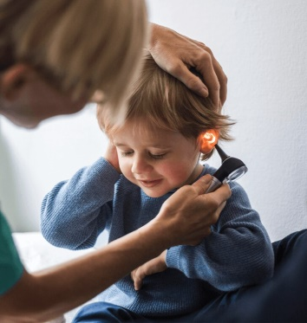
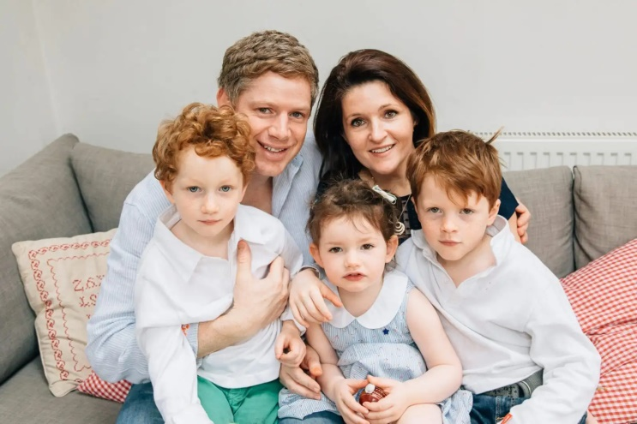
The Family Parable – HOW TO PRIORITIZE SACRIFICE AS PART OF STANDING IN THE GAP
But when he( Peter) saw the wind, he was afraid and, beginning to sink, cried out, "Lord, save me!"
Matthew 14:30 (NIV)
And He replied to them, This kind cannot be driven out by anything but prayer and fasting. Mark 9:29 (AMP)
Serious Ear Problem
VERY SENSITIVE
After four days of being quiet – Zach finally blurts out – “Why does Jessie have to get all the attention – why do we have to be so quiet for her – this is getting old?”
This is where we learn to “DIE TO SELF” – Focus on the Lord - and live for the blessing of others – we are a team and we don’t succeed when we just think about ourselves. .

Slide 15
We Need To Keep Ourselves
Centered On the Lord During This Intense
Season of Refining and Preparation
Likewise, you husbands, dwell with them (Wives) according to knowledge, giving honor unto the wife, as unto the weaker vessel, and as being heirs together of the grace of life; that your prayers be not hindered (frustrated, cut down). 1 Peter 3:7 (KJV)
As God-fearing Couples you are not made to PRIMARILY be a love machine – a party machine – but a Faith and Prayer Machine -

Slide 16
Everything Is Made
By Jesus Christ And For Jesus
For in Him was created the universe of everything in heaven and on earth, things seen and things unseen, thrones, dominions, princedoms, powers—all were created, and exist through and for Him. 17 And HE IS before all things and in and through Him the universe is a harmonious whole. 18 Moreover He is the Head of His Body, the Church. He is the Beginning, the Firstborn from among the dead, in order that He Himself may in all things occupy the foremost place. Colossians 1:16-18 (WEY)

Slide 17
There Is No Separating
¹ The Spirit of the Sovereign LORD is on me, because the LORD has anointed me to preach good news to the poor. He has sent me to bind up the brokenhearted, to proclaim freedom for the captives and release from darkness for the prisoners, ² to proclaim the year of the LORD's favor and the day of vengeance of our God, to comfort all who mourn, ³ and provide for those who grieve in Zion-- to bestow on them a crown of beauty instead of ashes, the oil of gladness instead of mourning, and a garment of praise instead of a spirit of despair. They will be called oaks of righteousness, a planting of the LORD for the display of his splendor. Isaiah 61:1-3 (NIV)

