Slide 1
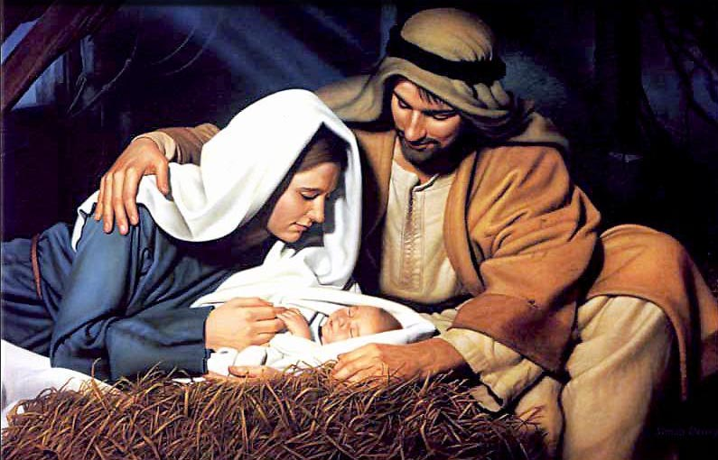
Divine Intervention Invaded On Christmas Day
A SERMON TO LIFEGATE
Sunday, December 25, 2022

Slide 2
God Sent His Son Into A Howling Wilderness Of Sin And Darkness And Despair
For the LORD'S portion is His people; Jacob is the lot of His inheritance. He found him (Israel) in a desert land, and in the waste howling wilderness; He led him about, He instructed him, He kept him as the apple of His eye. 11 As an eagle stirreth up her nest, fluttereth over her young, spreadeth abroad her wings, taketh them, beareth them on her wings: 12 So the LORD alone did lead him, and there was no strange god with Him. 13 He made him ride on the high places of the earth, that he might eat the increase of the fields; and He made him to suck honey out of the rock, and oil out of the flinty rock; Deuteronomy 32:9-13 (KJV)

Slide 3
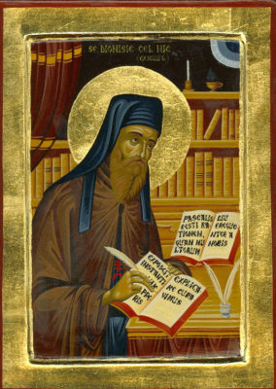
How Did We Get “A.D. 1” ?
ROMAN CALENDAR
Year | Month | Day
15th Yr. Tiberius Caesar | January | 1
247 Yr. From Diocletian | June | 6
Dionysius Exiguus
The Anno Domini dating system was devised in 525 by Dionysius Exiguus to enumerate the years in his Easter table. His system was to replace the Diocletian era that had been used in older Easter tables, as he did not wish to continue the memory of a tyrant who persecuted Christians. The last year of the old table, Diocletian Anno Martyrium 247, was immediately followed by the first year of his table, Anno Domini 532.

Slide 4
Jesus Came Into the World and Broke Into
The Closed Loop of Mankind’s
Systems of Sin, Idolatry, and Tyranny
Sin
People Want More
Idols To Medicate
Idolatry
Lie To The Masses
The god of this age has blinded the minds of unbelievers, so that they cannot see the light of the Gospel of the glory of Christ, who is the image of God.
2 Corinthians 4:4
Tyranny
For God, who said, "Let light shine out of darkness," made his light shine in our hearts to give us the light of the knowledge of the glory of God in the face of Christ. 2 Corinthians 4:6

Slide 5
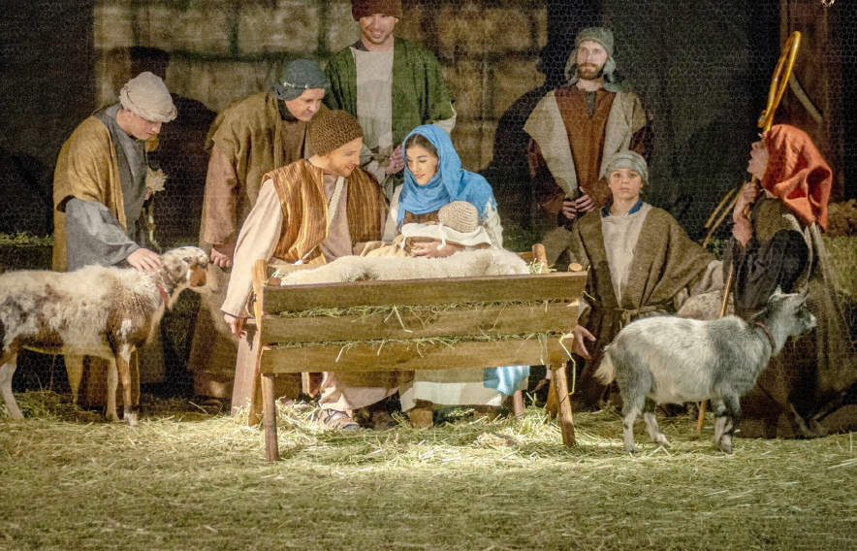
The Inconveniences Of Christ’s Coming

Slide 6
The Inconveniences Of Christ’s Coming
THE INCONVENIENCE OF A LARGE DOMINEERING CLOSED LOOP GOVERNMENT DOING A WORLD-WIDE CENSUS TO TAX YOU MORE
THE INCONVENIENCE OF BEING PREGNANT AND YOU’RE NOT MARRIED YET – OR YOU’RE JOSEPH AND WALK WITH INTEGRITY – AND YOUR GIRL FRIEND IS PREGNANT
THE INCONVENIENCE OF TRAVELING FROM NAZARETH TO BETHLEHEM AS A PREGNANT MOTHER. (70 – 90 miles)
THE INCONVENIENCE OF ARRIVING LATE AND THERE ARE NO ROOMS AT THE INN - SO YOU SLEEP WITH THE ANIMALS. AND THE BABY COMES BEFORE MORNING
THEN YOU FINALLY FALL ASLEEP AND A BUNCH OF SHEPHERDS SHOW UP AND START TELLING YOU ABOUT ANGELS AND THEY WORSHIP YOUR BABY BOY.
TWO YEARS LATER – A GROUP OF EASTERN HIGH LEVEL WISE MEN SHOW UP AND WORSHIP YOUR BOY AND LEAVE GIFTS - ONLY FOR AN ANGEL TO TELL YOU TO GET UP AND QUICKLY GO TO EGYPT – TO PROTECT YOUR LIVES

Slide 7
The Inconveniences Of Life
You’re going to have to fight against enemies that will appear to be defeating you – but they are only making you stronger. I'm not always going to be defending you the way you want me too, but I’m going to get a victory through you or you will come home to be with Me. Don Lamb June 2021
Strengthening the disciples and encouraging them to remain true to the faith. "We must go through many hardships to enter the kingdom of God," they said. Acts 14:22 (NIV)
But He said to me, "My grace is sufficient for you, for my power is made perfect in weakness." Therefore I will boast all the more gladly about my weaknesses, so that Christ's power may rest on me. ¹⁰ That is why, for Christ's sake, I delight in weaknesses, in insults, in hardships, in persecutions, in difficulties. For when I am weak, then I am strong.
2 Corinthians 12:9-10 (NIV)

Slide 8
The Favor Of God Brought Jesus To
The Earth To SHIFT Mankind
Into God’s Realm of CHANGE AND PEACE
Suddenly a great company of the heavenly host appeared with the angel, praising God and saying, "Glory to God in the highest, and on earth peace to men on whom His favor rests.“ Luke 2:13,14

Slide 9
The God of All Peace In Times Of War
Then pealed the bells more loud and deep: “God is not dead, nor does He sleep, For Christ is here; His Spirit near Brings peace on earth, good will to men.”
For the kingdom of God is not a matter of eating and drinking, but of righteousness, peace and joy in the Holy Spirit,
Romans 14:17 (NIV)
And the God of peace shall bruise Satan under your feet shortly. The grace of our Lord Jesus Christ be with you. Amen. Romans 16:20 (KJV)

Slide 10
God Brings Us Into TRUE Peace
Finally, brothers, good-by. Aim for perfection, listen to my appeal, be of one mind, live in peace. And the God of love and peace will be with you.
2 Corinthians 13:11 (NIV)
May the God of hope fill you with all joy and peace as you trust in Him, so that you may overflow with hope by the power of the Holy Spirit.
Romans 15:13 (NIV)

Slide 11
Conclusion
WHY DOES GOD ALLOW HIS PEOPLE TO CONTEND WITH CRAZY INCONVENIENCES IN LIFE – THEY HAVE SORROWS – THEY HAVE BROKENNESS – THEY HAVE PAIN – THEY HAVE SETBACKS AND FAILURES?
WELL THE ONLY THING THAT MAKES SENSE – IS THAT GOD INCONVENIENCED HIMSELF MORE THAN ANYTHING WE WILL EXPERIENCE JUST TO BRING US SALVATION AND IT’S THE UNDERSERVING NATURE OF JESUS’ INTERVENTION – THAT CAPTURES OUR HEARTS AND CHANGES THE WHOLE EQUATION – AND BRINGS US INTO GRATEFULNESS AND PEACE – EVEN IN THE UPSIDE DOWN MOMENTS WHEN IT LOOKS LIKE JESUS LEFT US DOWN – HE IS STILL WORTHY.
THEREFORE, WE NEED TO TEACH OTHERS TO HOLD ON TO JESUS – THAT EVEN WHEN WE WERE DISAPPOINTED – WHEN WE FEEL LEFT DOWN – WE STILL FOUND HIM ALTOGETHER LOVELY - WE FOUND HIM ALTOGETHER FAITHFUL - WE FOUND HIM ALTOGETHER HOLY
SO ABOVE IT ALL – WE FIND THE ONE AND ONLY LOVER OF OUR SOUL – WHO SPOKE LIFE OVER OUR DEAD HEARTS – WHO SPOKE LIFE OVER OUR DISCOURAGED SPIRITS – HE IS TRULY THE WAYMAKER – THE PEACE MAKER – THE JOY MAKER – AND HE WILL NEVER LEAVE US OR FORSAKE US.

