Slide 1
The Return of the gods
If a Nation founded on the pattern of Ancient Israel, America, shall apostacize (fall away) from God, then it would become subject to the same gods and principalities that ancient Israel became subject to in its apostasy.

Slide 3
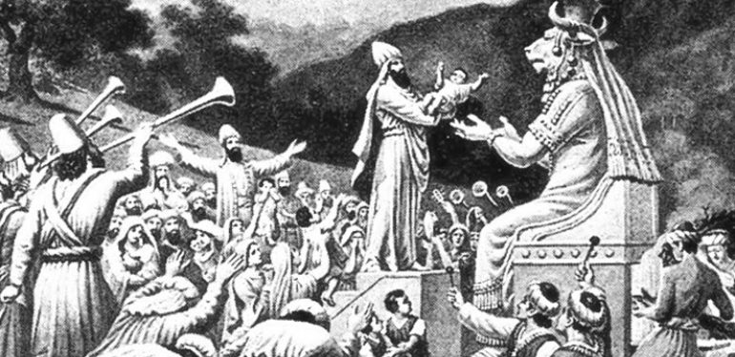
Baal- The Chief god of the Canaanite Pantheon

Slide 4
Baal- The king of the gods and chief enemy of Israel. The Lord of the clouds- the god of fertility, Lord of rain, master of the waters the caused the earth to bear fruit. If he prospered, the land prospered, if he languished, so did the people.

Slide 5
Judges 2:10-13
¹⁰ After that whole generation had been gathered to their ancestors, another generation grew up who knew neither the Lord nor what he had done for Israel. ¹¹ Then the Israelites did evil in the eyes of the Lord and served the Baals. ¹² They forsook the Lord, the God of their ancestors, who had brought them out of Egypt. They followed and worshiped various gods of the peoples around them. They aroused the Lord’s anger ¹³ because they forsook him and served Baal and the Ashtoreths. ¹⁴ In his anger against Israel the Lord gave them into the hands of raiders who plundered them. He sold them into the hands of their enemies all around, whom they were no longer able to resist.

Slide 6
“They served their idols, which became a snare to them. The even sacrificed their sons and daughters to shedim.”
Psalm 106:36-37

Slide 7
“They sacrificed to shedim, not to God, to gods they did not know, to new gods, new gods that had come. Deut 32:17

Slide 8
Shedim- Heb. pl. n - ‘shud’ v. - to act violently, lay waste, to devastate, that which brings destruction.

Slide 9
2 Kings 17:7-23
⁷ All this took place because the Israelites had sinned against the Lord their God, who had brought them up out of Egypt from under the power of Pharaoh king of Egypt. They worshiped other gods ⁸ and followed the practices of the nations the Lord had driven out before them, as well as the practices that the kings of Israel had introduced. ⁹ The Israelites secretly did things against the Lord their God that were not right. From watchtower to fortified city they built themselves high places in all their towns.

Slide 10
¹⁰ They set up sacred stones and Asherah poles on every high hill and under every spreading tree. ¹¹ At every high place they burned incense, as the nations whom the Lord had driven out before them had done. They did wicked things that aroused the Lord’s anger. ¹² They worshiped idols, though the Lord had said, “You shall not do this.” ¹³ The Lord warned Israel and Judah through all his prophets and seers: “Turn from your evil ways. Observe my commands and decrees, in accordance with the entire Law that I commanded your ancestors to obey and that I delivered to you through my servants the prophets.”

Slide 11
¹⁴ But they would not listen and were as stiff-necked as their ancestors, who did not trust in the Lord their God. ¹⁵ They rejected his decrees and the covenant he had made with their ancestors and the statutes he had warned them to keep. They followed worthless idols and themselves became worthless. They imitated the nations around them although the Lord had ordered them, “Do not do as they do.”

Slide 12
¹⁶ They forsook all the commands of the Lord their God and made for themselves two idols cast in the shape of calves, and an Asherah pole. They bowed down to all the starry hosts, and they worshiped Baal. ¹⁷ They sacrificed their sons and daughters in the fire. They practiced divination and sought omens and sold themselves to do evil in the eyes of the Lord, arousing his anger.

Slide 13
¹⁸ So the Lord was very angry with Israel and removed them from his presence. Only the tribe of Judah was left, ¹⁹ and even Judah did not keep the commands of the Lord their God. They followed the practices Israel had introduced. ²⁰ Therefore the Lord rejected all the people of Israel; he afflicted them and gave them into the hands of plunderers, until he thrust them from his presence.

Slide 14
²¹ When he tore Israel away from the house of David, they made Jeroboam son of Nebat their king. Jeroboam enticed Israel away from following the Lord and caused them to commit a great sin. ²² The Israelites persisted in all the sins of Jeroboam and did not turn away from them ²³ until the Lord removed them from his presence, as he had warned through all his servants the prophets. So the people of Israel were taken from their homeland into exile in Assyria, and they are still there.

Slide 15
Daimonion- Greek- a spirit, a principality, an occult entity, - a god.
Both Deut 32:17 and Psalm 106:36-37 translate Shedim as daimoniois
‘gods’ are demons!

Slide 16
The Oracle of Delphi

Slide 17
The Twilight of the Gods
Ekballo- to expel, to eject, to cast out, to send away.

Slide 18
The Clash of the Gods
Acts 16:16, ESV: As we were going to the place of prayer, we were met by a slave girl who had a ‘spirit of divination’
(puthon or python) and brought her owners much gain by fortune-telling.

Slide 19
1 Corinthians 10:20 … The things which the Gentiles sacrifice they sacrifice to the daimonia and not to God, and I do not want you to have fellowship with daimonia.

Slide 20
¹⁷ She followed Paul and us, crying out, “These men are servants of the Most High God, who proclaim to you the way of salvation.”
¹⁸ And this she kept doing for many days. Paul, having become greatly annoyed, turned and said to the spirit, “I command you in the name of Jesus Christ to come out of her.” And it came out that very hour.

Slide 21
The Spell was Broken (Every realm of society was effected)
The degradation of human life was transformed as paganism yielded to the new belief that life was now sacred.
The individual was also sacred and possessed immutable rights
Women were sacred and treated as equal heirs of the kingdom (1Peter 3:7)
The Poor and the Weak were no less created in image of God than the rich and powerful
Every life was now of inestimable value and equally precious in the sight of God

Slide 22
The Spell was Broken (Every realm of society was effected)
Sexuality was now to be treated as a sacred gift from God, to be honored and kept in the equally sacred vessel of marriage. (one genetic male and one genetic female).
Children were a gift and no longer to be abused or mistreated. To take their lives because they were unwanted was a crime.
Emperors and Rulers, governors and kingdoms could no longer claim the authority of godhood.

Slide 23
1Peter 3:7 “Likewise, husbands, live with your wives in an understanding way, showing honor to the woman as the weaker vessel, since they are heirs with you of the grace of life, so that your prayers may not be hindered.”

Slide 24
Mass Exorcism
Matthew 12:43-44
“When the unclean spirit has gone out of a person, it passes through waterless places seeking rest, but finds none.
⁴⁴ Then it says, ‘I will return to my house from which I came.’ And when it comes, it finds the house empty, swept, and put in order.
⁴⁵ Then it goes and brings with it seven other spirits more evil than itself, and they enter and dwell there, and the last state of that person is worse than the first. So also will it be with this evil generation.”

Slide 25
Pre-Christian Vs. Post-Christian
A post-Christian civilization will end up in afar darker state than a pre-Christian civilization.
A pre-Christian civilization may produce a Caligula or a Nero or a Diocletian, but a Post-Christian civilization will produce a Stalin or a Hitler.
A pre-Christian society may give birth to barbarism, but a Post-Christian society will give birth to an even darker off-spring, Fascism, Communism, and Nazism.
A pre-Christian nation may erect an altar of human sacrifice. But a Post-Christian nation will build Auschwitz

Slide 27
“..it would be peculiarly improper to omit in this first official Act, my fervent supplications to that Almighty Being who rules over the Universe, who presides in the Councils of Nations, and whose providential aids can supply every human defect, that his benediction may consecrate to the liberties and happiness of the People of the United States,”
No People can be bound to acknowledge and adore the invisible hand, which conducts the Affairs of men more than the People of the United States. Every step, by which they have advanced to the character of an independent nation, seems to have been distinguished by some token of providential agency.
And in the important revolution just accomplished in the system of their United Government, the tranquil deliberations and voluntary consent of so many distinct communities, from which the event has resulted, cannot be compared with the means by which most Governments have been established, without some return of pious gratitude along with an humble anticipation of the future blessings which the past seem to presage. These reflections, arising out of the present crisis, have forced themselves too strongly on my mind to be suppressed. You will join with me I trust in thinking, that there are none under the influence of which, the proceedings of a new and free Government can more auspiciously commence.”

Slide 28
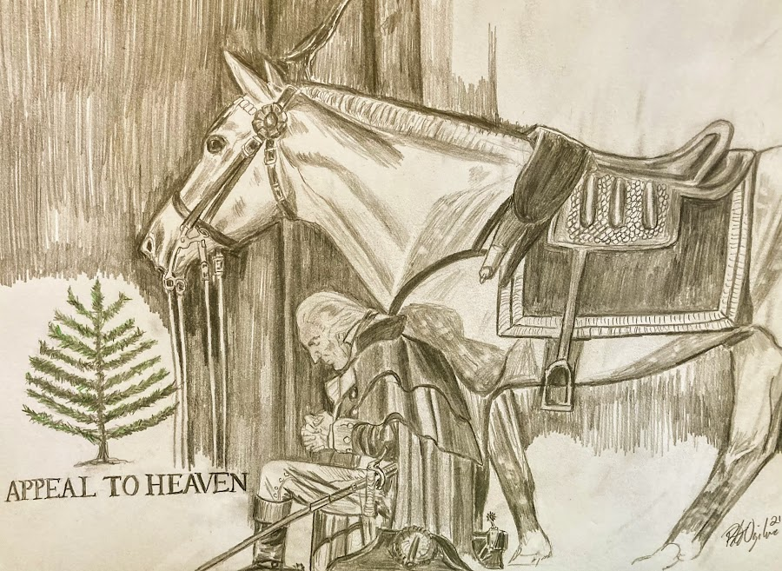
Translation:
“If America ever turned away from God and His eternal Laws, its blessings would be removed.”

Slide 29
“The Lord will be our God, and delight to dwell among us, as his one people, and will command a blessing upon us in all our ways. So that we shall see much more of his wisdom, power, goodness and truth, than formerly we have been acquainted with. We shall find that the God of Israel is among us, when ten of us shall be able to resist a thousand of our enemies; when he shall make us a praise and glory that men shall say of succeeding plantations, “the Lord make it likely that of New England.” For we must consider that we shall be as a city upon a hill. The eyes of all people are upon us. So that if we shall deal falsely with our God in this work we have undertaken, and so cause him to withdraw his present help from us, we shall be made a story and a by-word through the world. We shall open the mouths of enemies to speak evil of the ways of God, and all professors for God’s sake. We shall shame the faces of many of God’s worthy servants, and cause their prayers to be turned into curses upon us till we be consumed out of the good land whither we are a going.” John Winthrop “A Model of Christian Charity” 1630

Slide 30
“If America followed the ways of God, it would become the most blessed, prosperous and powerful of civilizations. But if our hearts turn away, so that we will not obey, but shall be seduced, and worship and serve other gods, our pleasure and profits, and serve them… we shall surely perish!”

Slide 31
“Where there is God, there is Truth. But where there is more than one god or may gods or Baals, the door is open for many “truths”, conflicting truths and thus no truth.” Jonathan Cahn

Slide 32
The Mission of Baal is to cause a nation that has known God to stop knowing Him and then to forget Him, and then to forget that it ever knew Him.

Slide 34
Jeremiah 23:27 They think the dreams they tell one another will make my people forget my name, just as their ancestors forgot my name through Baal worship.

Slide 35
American Amnesia
In the case of America, Baal would use the same strategy: First seek to separate the nation from the Word of God and His ways.
1960s Prayer and the Bible out of Schools
1980 Supreme court struck down The Ten Commandments of Public School and in the public Square
Baal’s agenda would permeate every sphere of American culture. Newspapers would no longer publish sermons, magazines no longer endorse Christian values. Entertainment would no longer uphold biblical morality. TV stations no longer promote prayer or present the ways of God in a positive light but would war against them. Hostile to Jesus.

Slide 36
Since the Word of God served as safeguards against the gods and paganism, their removal opened the door for the gods to come in unhindered. It could now indulge on all that the commandments had warned against. The guardrails are down. The nation was left wide open to the subjection and dominion of the gods.

Slide 37
The Spell was Broken (Every realm of society was effected)
The degradation of human life was transformed as paganism yielded to the new belief that life was now sacred.
The individual was also sacred and possessed immutable rights
Women were sacred and treated as equal heirs of the kingdom (1Peter 3:7)
The Poor and the Weak were no less created in image of God than the rich and powerful
Every life was now of inestimable value and equally precious in the sight of God

Slide 38
The Spell was Broken (Every realm of society was effected)
Sexuality was now to be treated as a sacred gift from God, to be honored and kept in the equally sacred vessel of marriage. (one genetic male and one genetic female).
Children were a gift and no longer to be abused or mistreated. To take their lives because they were unwanted was a crime.
Emperors and Rulers, governors and kingdoms could no longer claim the authority of godhood.

Slide 39
Practical Applications for your “House”

Slide 40
How Demons can cause you to think Negatively
Demons are persons without bodies
How Demons can Cause you to Think Negatively
3 Objectives that Demons have.
Torment and Torture
To keep you from knowing Christ as savior
If you come to Christ, to keep you from serving Him effectively
Flesh- the old nature of Adam. Adam did not have any children until he was a rebel. Every descendent has the nature of a rebel in them.
Evil Spirits It is important to know what you’re dealing with because the remedies are going to be different. You may be trying to deal with something as if it’s the flesh. You may be trying to crucify the flesh . You can’t crucify a demon. Neither can you cast out your flesh.

Slide 41
Characteristics of Demons
Entice- you to do evil. Negative attraction (tempt, beguile, seduce, bait). Anything that came to you in words, came from a person.
Harass-in a moment of weakness, it slips in
Torment- the tormentor “God doesn’t love you, you’re not really saved. They torment emotionally with fear, torment physically with sickness
Compel- make us do things that we really don’t want to do.
Enslave- Make you a slave. Person is a slave of whatever has mastered him. Person can sin and stop sinning. Ex. get drunk, stop getting drunk because he’s not enslaved. An alcoholic is a person who can’t stop sinning. pornography, over-eating, sexual sin, voyeurism, cell-phone.
When you put the word “compel” and “enslave” together, you get the word addiction and that is demonic. If the Son sets you free, you are free indeed!
Defile- Make you feel dirty and unclean. Evil an impure images and thoughts and words in our minds. Anything that wants to keep you from worship of God.
Distract- Cell phones, people and events to keep you from focus
Deceive- behind all forms of religious deception. Fake news, gaslighting, etc. Be careful how your hear. Test everything!
Sickness, tiredness or Kill you.
Areas they operate: pride, rebellion, witchcraft, fear

