Slide 1
A Message of Hope
And Activation
A SERMON FOR LIFEGATE
Sunday, January 1, 2023

Slide 2
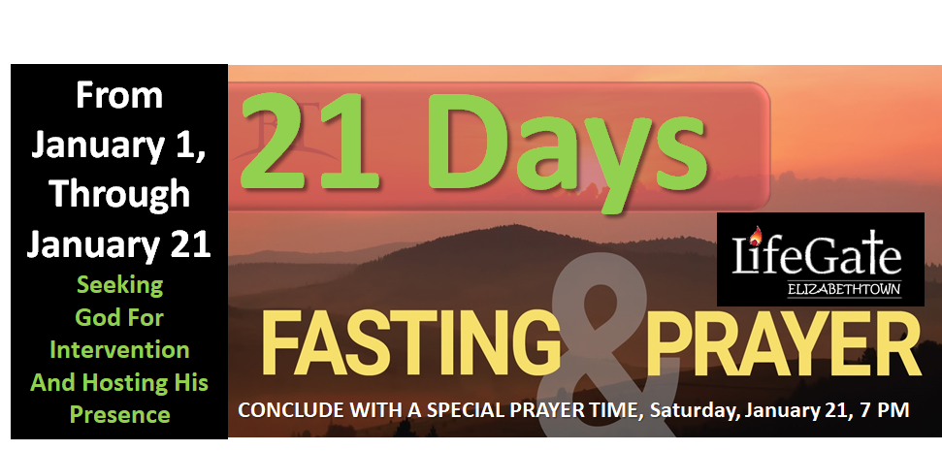
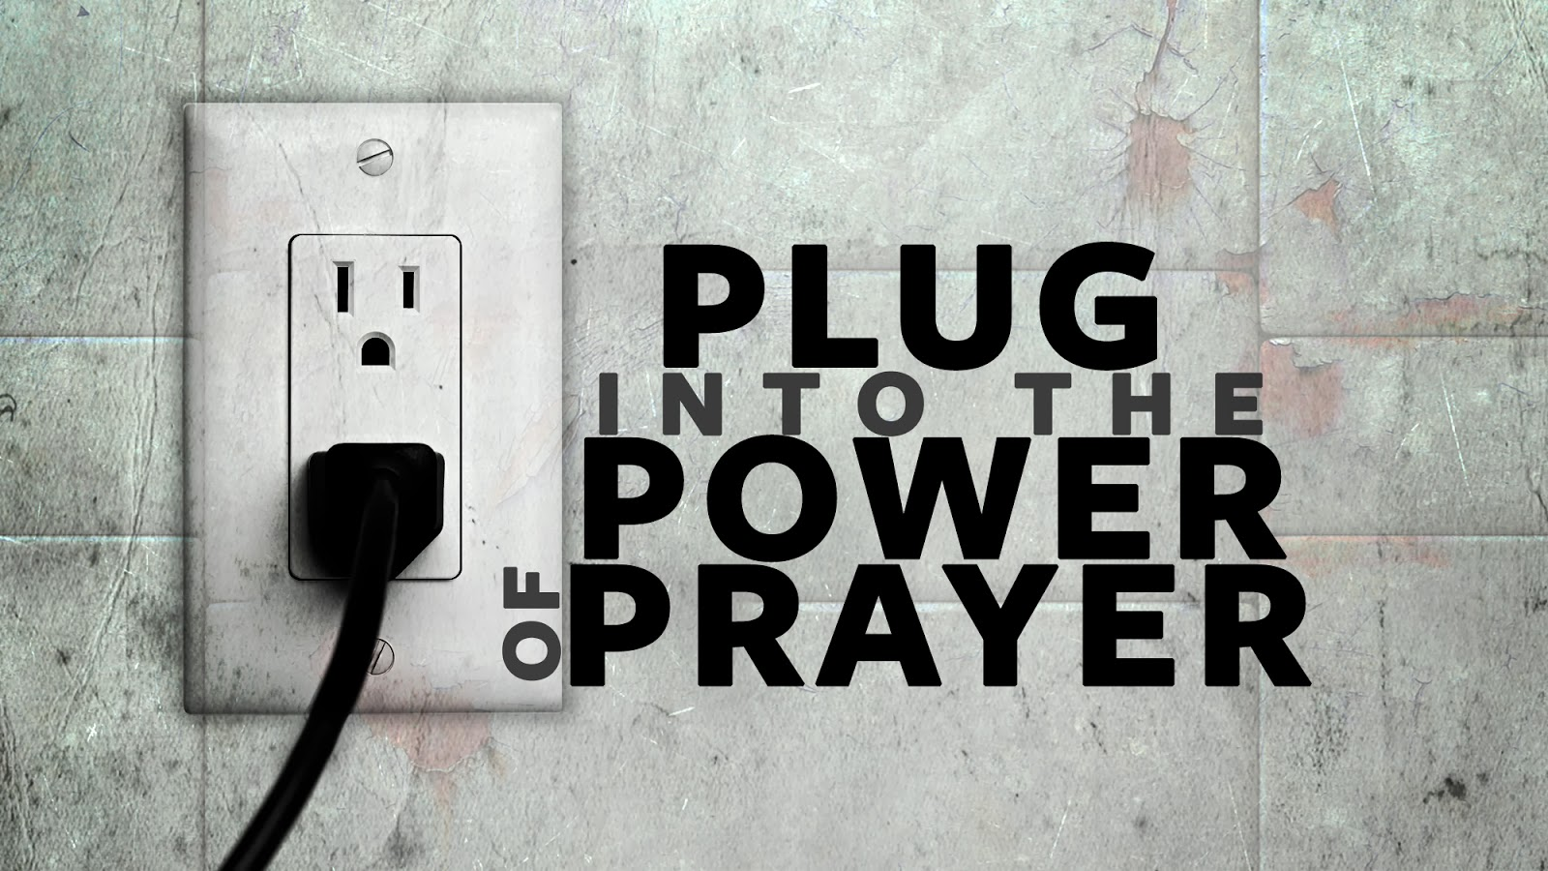
And Fasting
Whatever you secretly believe about God will be true of your prayer life. That’s how you will pray (personally and corporately.” Corey Russell

Slide 3
“Since mankind's natural development is so far ahead of the spiritual it is more imperative than ever that we go into the means of grace called fasting. I say that it is more important that we fast today than it was in the time of Christ. It is the only way we can bring about national revival. America is drunk with food, entertainment, alcohol, sex, and money. People are literally saturated with all of these things and what little faith many Christians have left is smothered out with food . There are many more potlucks then there are prayer meetings.” Franklin Hall 1948

Slide 4
Fasting is a deliberate choice to ABSTAIN from food or other things to PRIORITIZE the spiritual burdens of the Lord for the purpose of focused prayer and for humbling ourselves for an intervention.
Fasting is a spiritual urgency that resists the appetites of the natural flesh to touch and agree with God for Kingdom answers.
Fasting is a form of SPIRITUAL WARFARE that puts God on the front-burner and the flesh on the back-burner.
Fasting detoxes the soul from food – media – carnal fixations and emotional bondages.

Slide 5
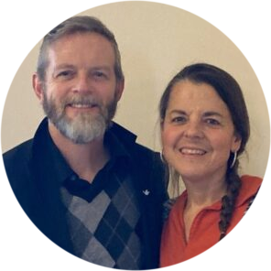
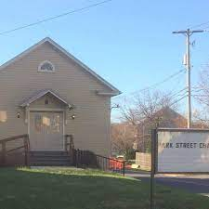
LifeGate Ministry Updates
Men’s Ministry Team
Park St. Chapel

Slide 6
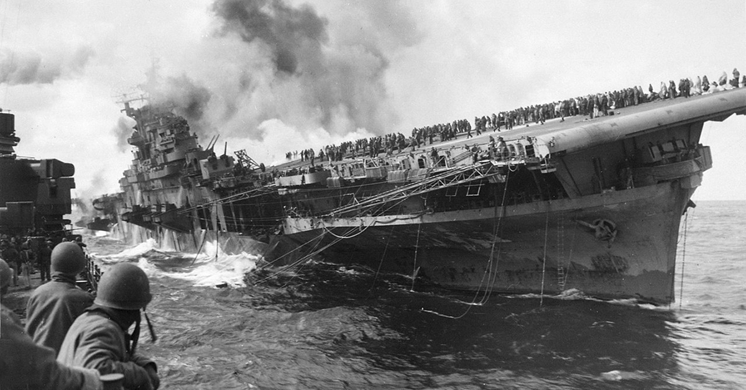
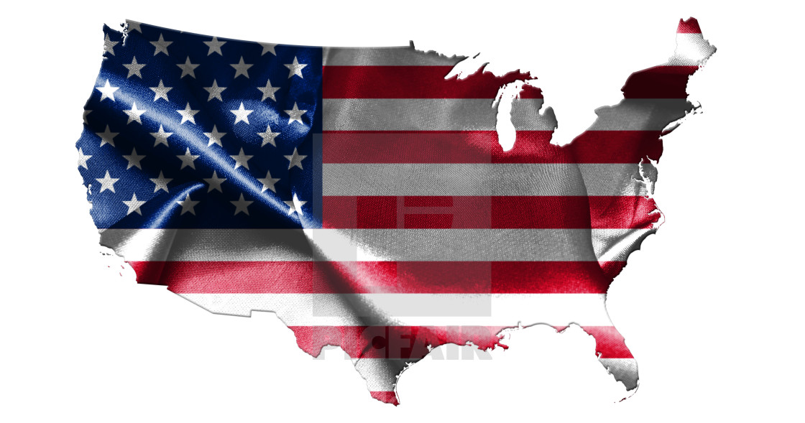
You Are Discerning Correctly
When You Sense Danger

Slide 7
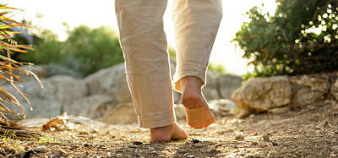
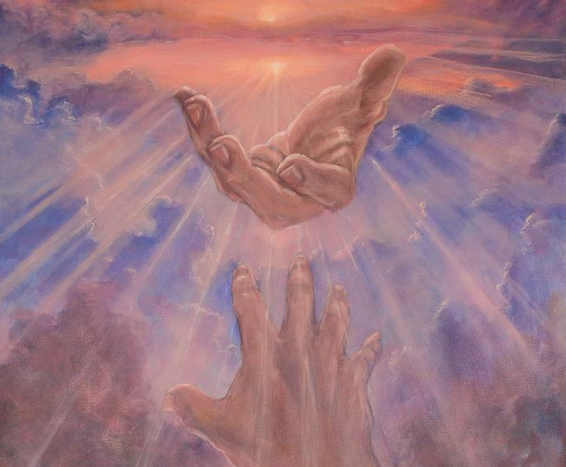
Feet On The Ground
Faith In The God of Heaven
Practical Application of
Touching The Earth
Through Spirit-led
Obedience. (Joshua 1:3)
Laying Hold of The
Only One Who Can Supernaturally Turn the Tables and Overcome For His Glory and our Blessing (Esther 9:2)

Slide 8
Summon your power, O God; show us your strength, O God, as you have done before.
Psalm 68:28
For the kingdom of God does not consist in words but in power. 1 Corinthians 4:20 (NASB)
Then I heard a loud voice in heaven say: "Now have come the salvation and the power and the kingdom of our God, and the authority of His Christ. For the accuser of our brothers, who accuses them before our God day and night, has been hurled down. 11 They overcame him by the blood of the Lamb and by the word of their testimony; they did not love their lives so much as to shrink from death. Revelation 12:10-11 (NIV)

Slide 9
We Are Not Waiting On Something Big To Happen To Be Victorious
Repent ye therefore, and be converted, that your sins may be blotted out, when the times of refreshing shall come from the presence of the Lord; Acts 3:19 (KJV)
With many other words he warned them; and he pleaded with them, "Save yourselves from this corrupt generation." Acts 2:40 (NIV)

Slide 10
We Are Not Waiting On Something Big To Happen To Be Victorious
We are not waiting for something big to start an invasion from heaven. God has already invaded from heaven. Something big happened two thousand years ago. Yes we can underutilize the privileges, power, and authority of that first invasion by Jesus Christ and secondly when He sent the Holy Spirit at Pentecost.
But it has been proven beyond any doubt that God can pour out His extraordinary presence and convicting grace through genuine revival in the Church any time His people humble themselves and seek His face and repent of their entanglements with Jezebel, the world, and dead religion, and their own pansy flesh and prevail in effectual prayer.

Slide 11
God Expects His People To Rise Up Under The Most Challenging Circumstances
Awake, awake, O Zion, clothe yourself with strength. Put on your garments of splendor, O Jerusalem, the holy city. The uncircumcised and defiled will not enter you again. ² Shake off your dust; rise up, sit enthroned, O Jerusalem. Free yourself from the chains on your neck, O captive Daughter of Zion. Isaiah 52:1-2 (NIV)

Slide 12
We Have What It Takes To Shake This Generation To The Core
Therefore, God is waiting on the Church to rise up. He is waiting for US TO RISE UP. He is waiting for a people of faith to rise up. He is waiting on intercessors to press in, contend, and decree, and receive the abundant answers. He is waiting on bold determined obedient warriors of grace to stand in the gap.
Economic collapse is not going to bring or hinder revival. War is not going to bring revival or hinder revival. An EMP or nuclear attack with no electricity is not going to bring or hinder revival. Another world-wide medical fiasco is not going to bring or hinder spiritual awakening. In short, outward circumstances do not bring breakthrough in the earth The Church obeys, LIVES ABOVE THE CHAOS and receives the promises, and HEAVEN RELEASES THE ALREADY PAID FOR VICTORY.

Slide 13
Lessons Learned From 2022
GOD HAS REVEALED HIMSELF FAITHFUL EVEN WHEN WE FEEL FRUSTRATED BY DELAYS AND OUTCOMES THAT GRIEVE US.
GOD IS CALLING US TO DECLARE THAT HE IS HOLY EVEN WHEN THE WORLD IS MOCKING HIM AND WE LOOK LIKE LOSERS.
GOD IS ASKING US TO CRY OUT FOR HEAVEN’S INVASIONS TO BREAK THE “CLOSED LOOPS OF EVIL SYSTEMS” THAT REINFORCE TYRANNY, LIES, BONDAGE, IDOLATRY, AND DESTRUCTION OF COMMUNITIES AND NATION AND WORLD.
GOD IS SHOWING US OUR TOTAL DEPENDENCY ON THE HOLY SPIRIT TO ENGAGE HARDENED HEARTS, CITIES, AND NATIONS, TO PERSUADE THEM TO TURN TO GOD IN WHOLE HEARTED DEVOTION – WE MUST EXPECT BAPTISMS OF THE HOLY SPIRT TO OVERCOME THE SENSE OF WEAKNESS THAT GOD USES MAINLY TRUTHS AND TEACHINGS AND COMPELLING REVELATIONS TO MOVE PEOPLE OUT OF THEIR LIES AND DECEPTIONS TO ACCEPT HIS FREE GRACE.

Slide 14
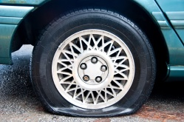
Lessons Learned From 2022
GOD IS REVEALING THAT THERE WILL BE MUCH SPIRITUAL WARFARE AND WE WILL HAVE TO LEARN THE METHODS AND MEANS OF STANDING IN THE AUTHORITY OF CHRIST AND REBUKING THE ENEMY AND DECLARING RESTRAINING ORDERS OVER SPIRIT REALMS OF DARKNESS TO WALK IN SUSTAINED REVIVAL.
WE HAVE TO SHOW PEOPLE THAT THE FALSE LOVERS OF THIS WORLD WILL LEAVE THEM DOWN AND ARE WAY LESS FULFILLING THEN THE FAIREST OF THEM ALL – JESUS CHRIST OF NAZARETH.
THERE IS A HOLY BIRTH PANG OF RIGHTEOUS JEALOUSY FOR BRINGING FORTH FRUIT UNTO THE LORD – WE ARE NOT SATISFIED WITH RELIGIOUS PLATITUDES THAT SAY – “GUYS GOD BRINGS THE INCREASE – BE CONTENT YOU AT LEAST TRIED.”
UNDERSTANDING AND DISCERNING AND RECEIVING WARNINGS IS CRITICAL TO PREVENTING MORE SEVERE CORRECTION OR JUDGMENT IN OUR LIVES. What we realize is that when things come without warning it is very sudden and very dangerous. Warnings are a blessing.

Slide 15
Realize There are Seasons of Waiting In The Journey For The Next ASSIGNMENT
No one reaches advanced levels of spiritual maturity and desirable promised lands without several significant seasons of waiting or delay. I'll take that even further: no one deserves spiritual maturity and promised lands if you cannot wait for God patiently, purposefully, and transformationally. There are reasons and ways to wait on our God. It does not have to be confusing and miserable. Stop your toddler tantrum, sit at Jesus' feet every morning, open the Word, and hear the general and individual revelations you need for your next assignment. Junior DeSouza

Slide 16
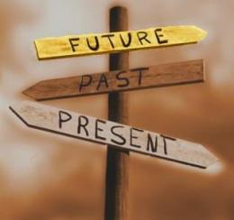
God Uses The Past To Teach Us How To Navigate The Present and Future
These things happened to them as examples and were written down as warnings for us, on whom the fulfillment of the ages has come. 1 Corinthians 10:11

Slide 17
WHAT LED UP TO THIS MOMENT?
¹ Early in the morning Joshua and all the Israelites set out from Shittim and went to the Jordan, where they camped before crossing over. ² After three days the officers went throughout the camp, ³ giving orders to the people: "When you see the ark of the covenant of the LORD your God, and the priests, who are Levites, carrying it, you are to move out from your positions and follow it. ⁴ Then you will know which way to go, since you have never been this way before. But keep a distance of about a thousand yards between you and the ark; do not go near it." ⁵ Joshua told the people, "Consecrate yourselves, for tomorrow the LORD will do amazing things among you." ⁶ Joshua said to the priests, "Take up the ark of the covenant and pass on ahead of the people." So they took it up and went ahead of them. Joshua 3:1-8 (NIV)

Slide 18
A POWERFUL PROMISE OF INHERITING PROVISION
Generational Hand Off With A Powerful Trajectory
"Moses my servant is dead. Now then, you and all these people, get ready to cross over the Jordan River into the land I am about to give to them--to the Israelites. I will give you every place where you set your foot, as I promised Moses. No one will be able to stand up against you all the days of your life. As I was with Moses, so I will be with you; I will never leave you nor forsake you. Be strong and very courageous. Be careful to obey all the law my servant Moses gave you; do not turn from it to the right or to the left, that you may be successful wherever you go. Joshua 1:2,3, 5,7 (NIV)
So Joshua ordered the officers of the people: ¹¹ "Go through the camp and tell the people, 'Get your supplies ready. Three days from now you will cross the Jordan here to go in and take possession of the land the LORD your God is giving you for your own.'" Joshua 1:10-11 (NIV)

Slide 19
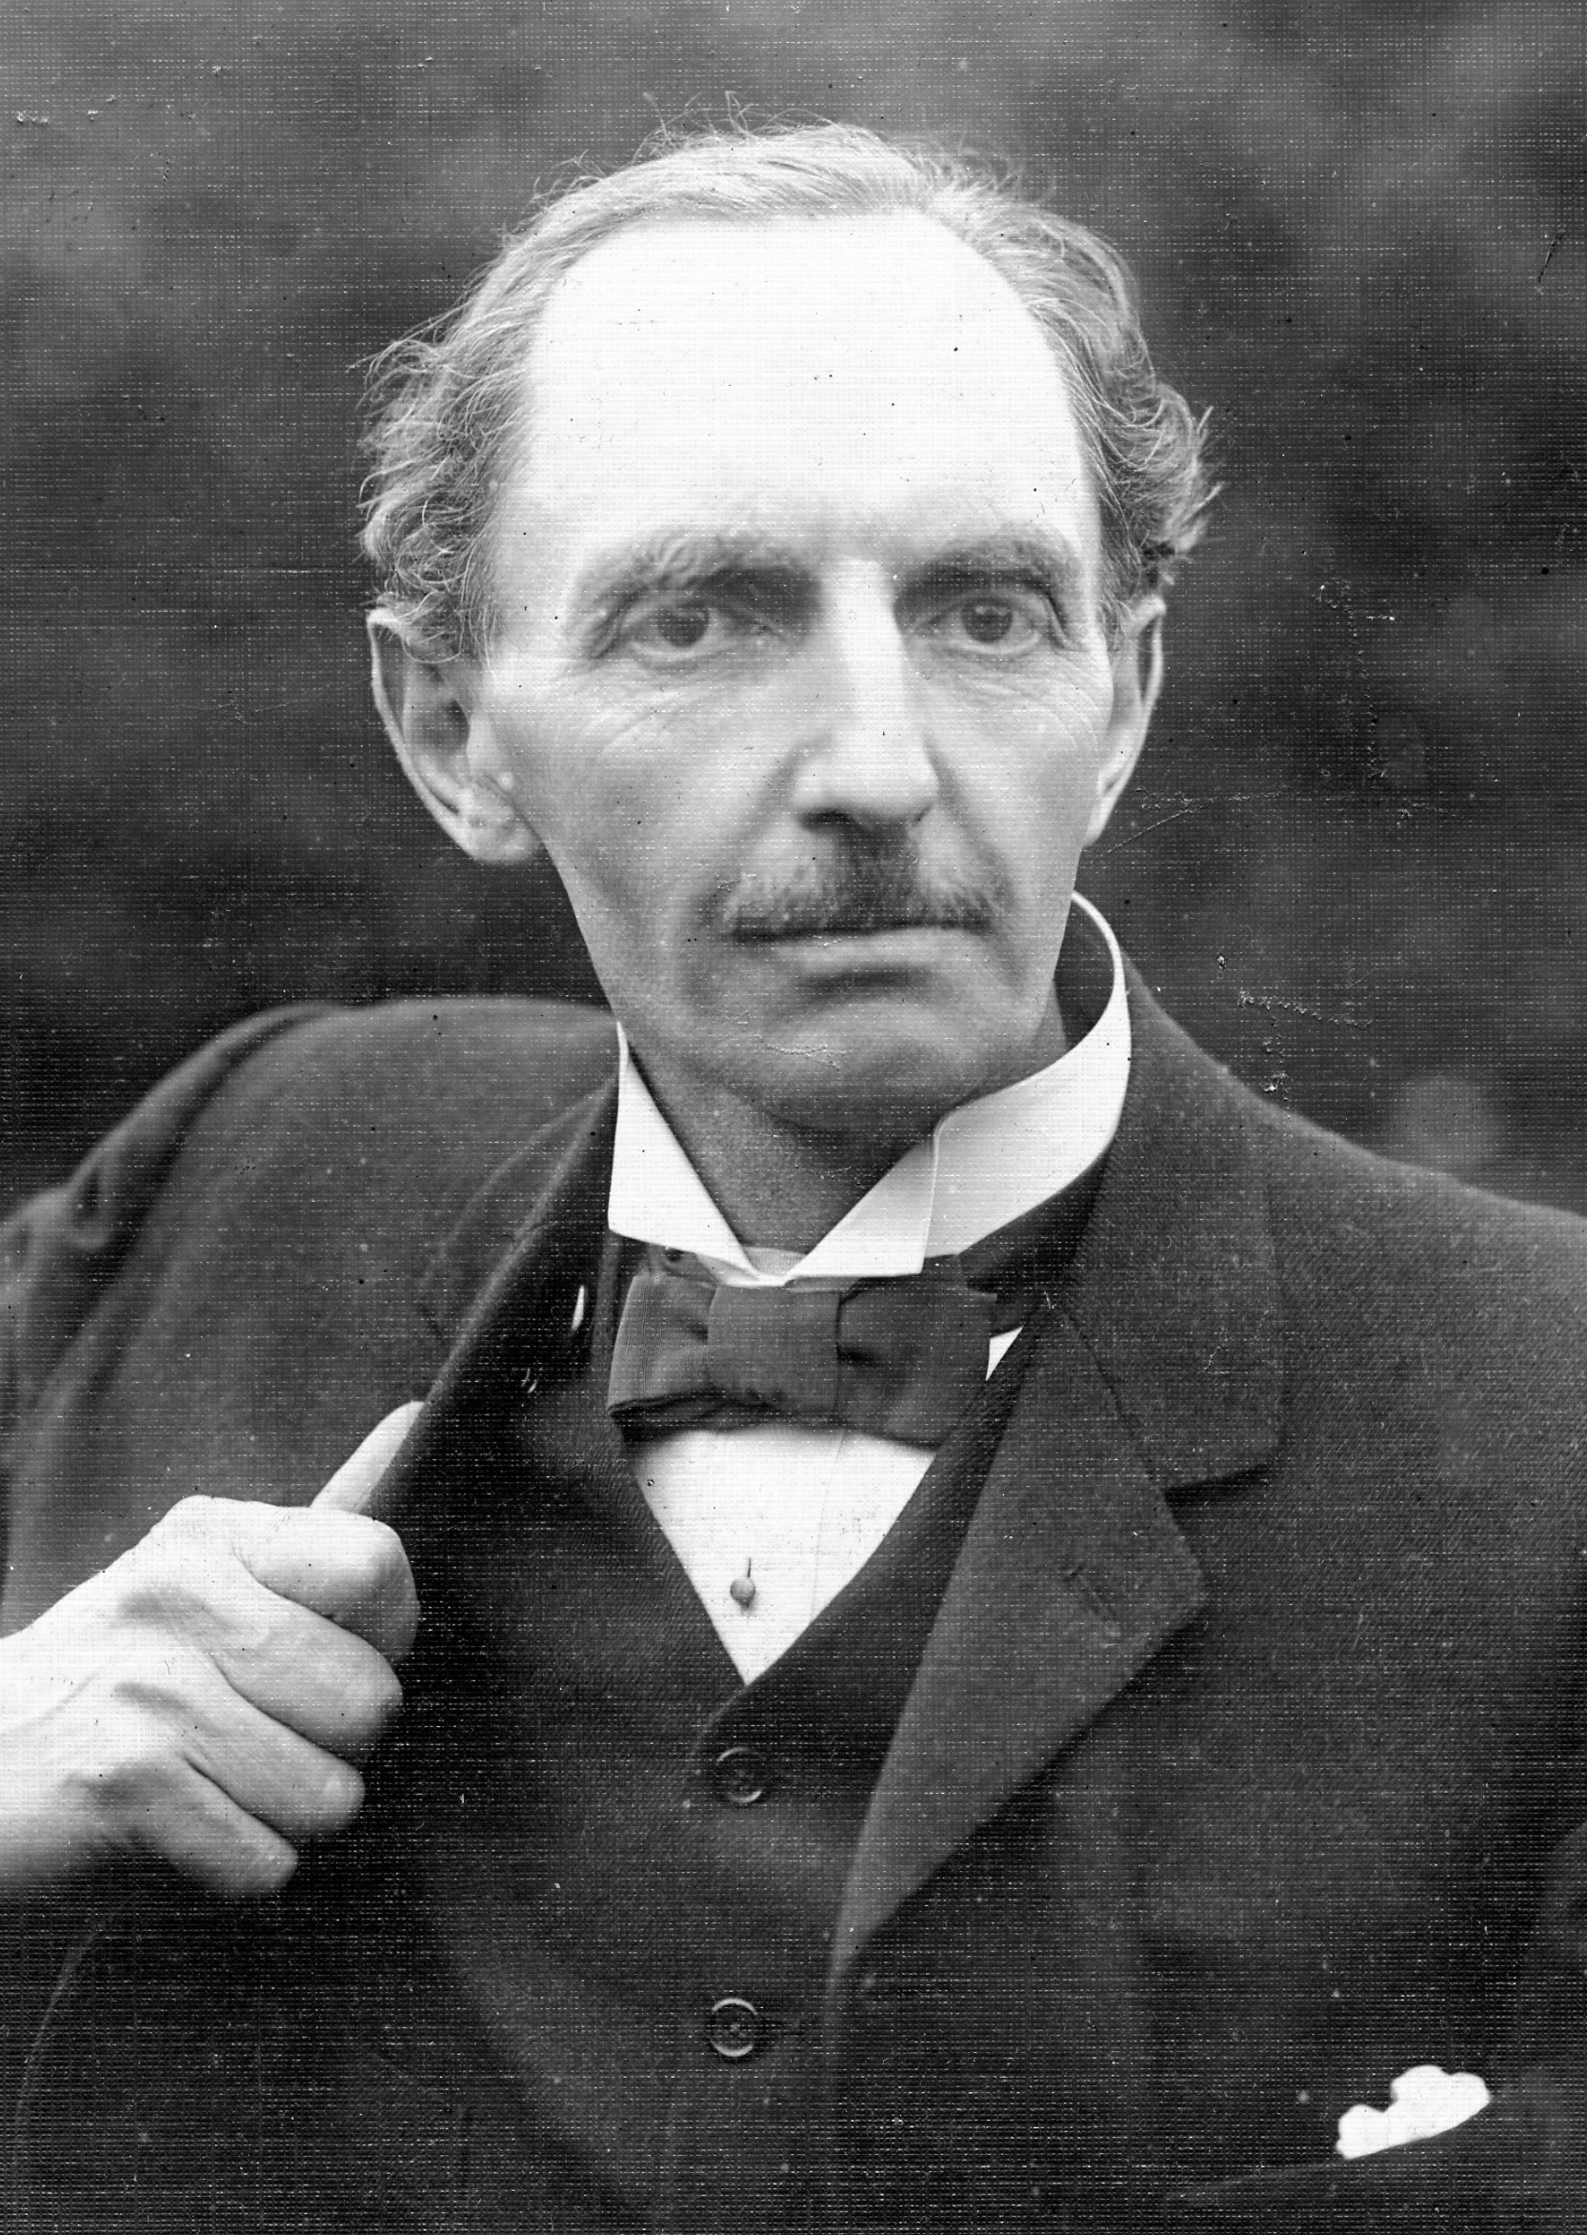
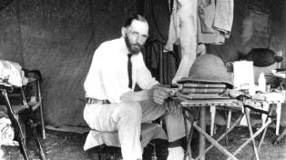
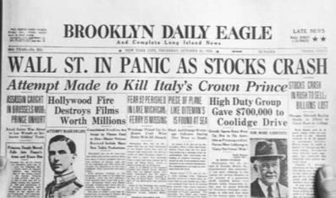
Example - From 1931
Ministry in the Congo
Norman Grubb
C. T. Studd
Crisis
Of Faith
And Direction
35 Missionaries in Congo
The Great Depression is going on
"Not only for the heart of Africa but for the whole unevangelized world."

Slide 20
The Breakthrough Revelation
Well, I had learned the first step of PREVAILING PRAYER from Rees Howells. Not JUST calling on God and asking Him for deliverance; nor listening to man - but listening to God. In other words, not what we “think” should be done alone, but what does He have to say to us about the situation.
Then we saw it. We got into focus how Joshua and all such men spoke their words of faith over the situation. They named their needs. They, not God. “What things soever you desire, when you pray, believe that you receive them, and you shall have them. Mark 11:24 This was the secret. The hidden key. This life is not to be God’s people pathetically pleading with God, calling on God as though He is at a distance and not willing to help. It is God’s marvelous plan of entrusting Himself to man, joining Himself to man. It is God’s Children speaking as God led by the Spirit. It is fasith in action, just like with Moses, Elijah, and the rest.

Slide 21
The Impossibility Met
The First year by end of 1932 - 10 new missionaries
1933 fifteen,
1934 twenty-five,
1935 fifty,
1936 seventy-five
1976 - 1500 workers in 40 countries

Slide 22
Four Keys to Crossing Into Your New Assignment
Identify by LISTENING PRAYER the next assignment the Lord has directed you toward.
Face your impossibility, obstacle, spiritual battle, adversary through LIVING-BOLD-FAITH in God
Confess you cannot cross in your own strength – but pray, declare, and speak the Lord’s WILL concerning overcoming the impossibility – believe you will cross over into your calling and inheritance - step by step.
If you are overwhelmed by the impossibility and the distance to your next assignment – seek for clarity and a merciful co-laborer to walk with you.

Slide 23
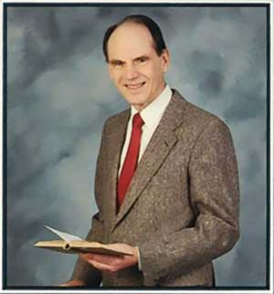
God Is Always Working To Bring His People Into Fulfillment – But They Have to participate with Him and Believe His Promises
Here is a solemn lesson, just as God cannot compel sinners to repent by force, so He cannot force His Saints to be radical. Arthur Wallis

Slide 24
Jesus Came Into the World and Broke Into
The Closed Loop of Mankind’s
Systems of Sin, Idolatry, and Tyranny
Sin
People Want More
Idols To Medicate
Normalize
Idolatry
The god of this age has blinded the minds of unbelievers, so that they cannot see the light of the Gospel of the glory of Christ, who is the image of God.
2 Corinthians 4:4
Tyrants
Take over
Lie To The Masses

Slide 25
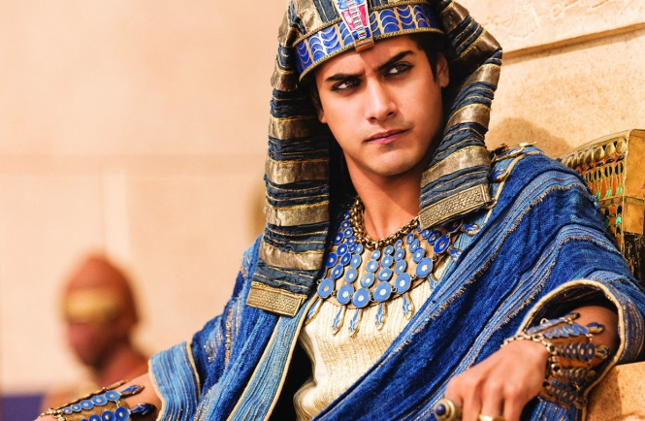
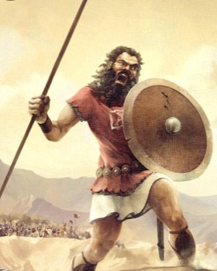
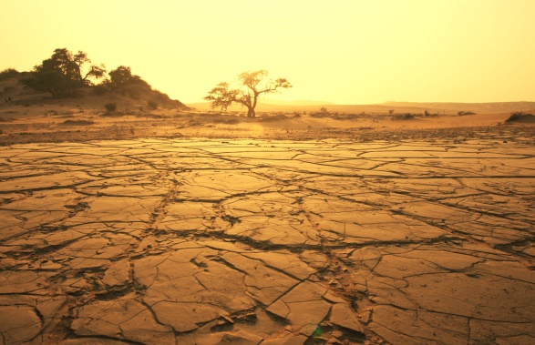
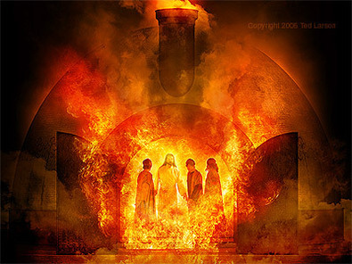
GOD IS ABLE TO OVERCOME
EVERY EVIL ATTACK AND
ANTI-CHRIST AGENDA
3 ½ Year Famine
And Idolatry
Pharaoh
Goliath
Haman and Esther
Jezebel
King Nebuchadnezzar

Slide 26
God Has The Power To Turn The Tables
Feet on The Ground
Faith In God’s Supernatural Working
On this day the enemies of the Jews had hoped to overpower them, but now the tables were turned and the Jews got the upper hand over those who hated them. Esther 9:1

Slide 27
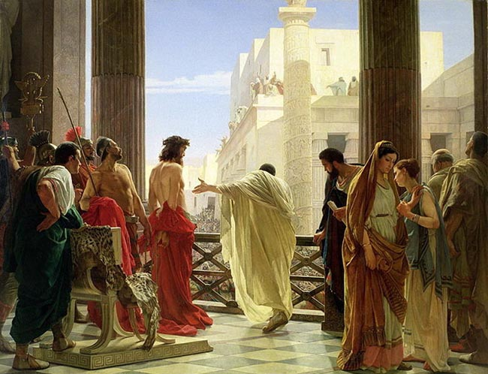
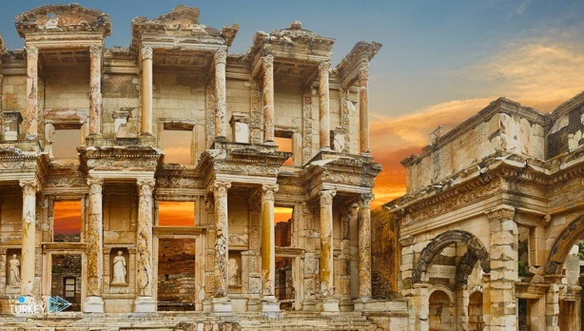
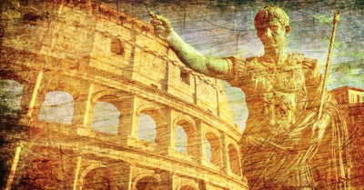
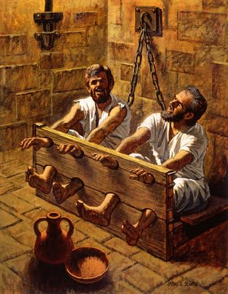
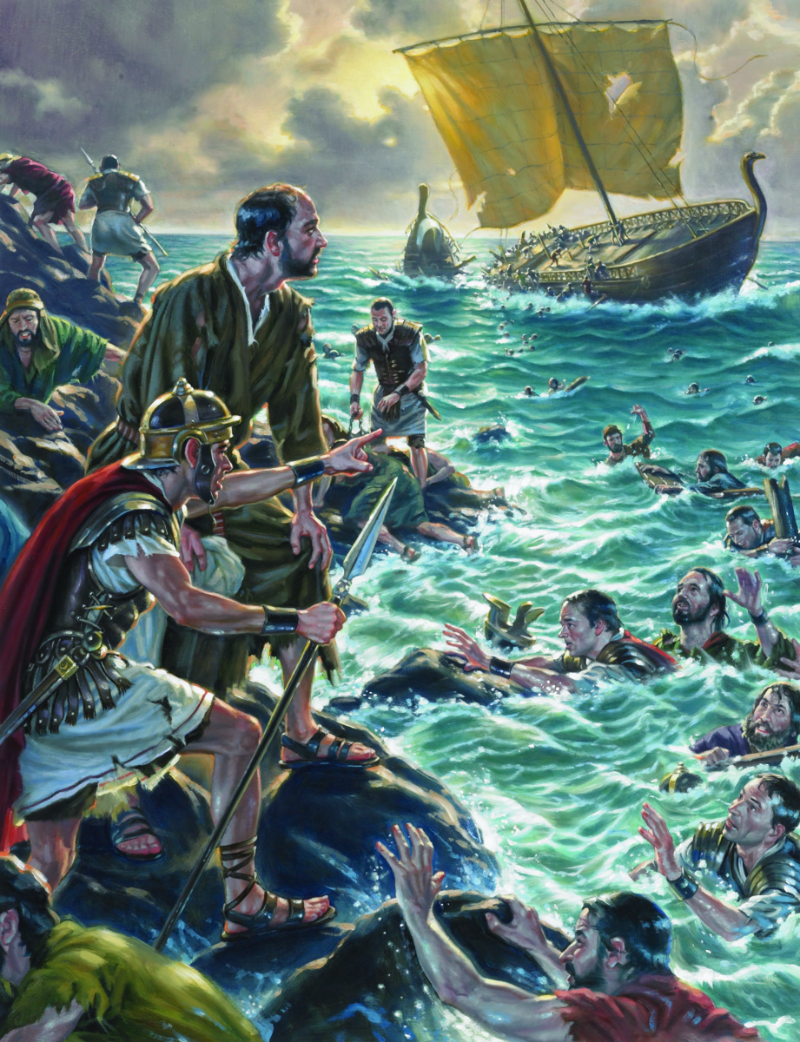
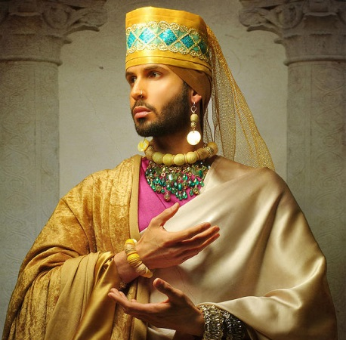
GOD IS ABLE TO OVERCOME
EVERY EVIL ATTACK AND
ANTI-CHRIST AGENDA
Jerusalem
Ephesus
Rome
Paul and Silas
Falsely Imprisoned
Paul Shipwrecked
Herod

Slide 28
GOD BROKE INTO A CITY THAT
HAD A CLOSED LOOP OF EVIL
But some of them became obstinate; they refused to believe and publicly maligned the Way. So Paul left them. He took the disciples with him and had discussions daily in the lecture hall of Tyrannus. ¹⁰ This went on for two years, so that all the Jews and Greeks who lived in the province of Asia heard the word of the Lord. Acts 19:9-10 (NIV)
When this became known to the Jews and Greeks living in Ephesus, they were all seized with fear, and the name of the Lord Jesus was held in high honor. ¹⁸ Many of those who believed now came and openly confessed their evil deeds. ¹⁹ A number who had practiced sorcery brought their scrolls together and burned them publicly. When they calculated the value of the scrolls, the total came to fifty thousand drachmas. ²⁰ In this way the word of the Lord spread widely and grew in power. Acts 19:17-20 (NIV)

Slide 29
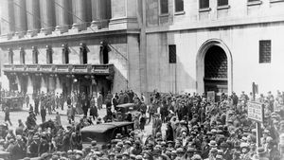
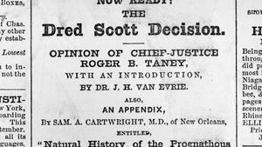
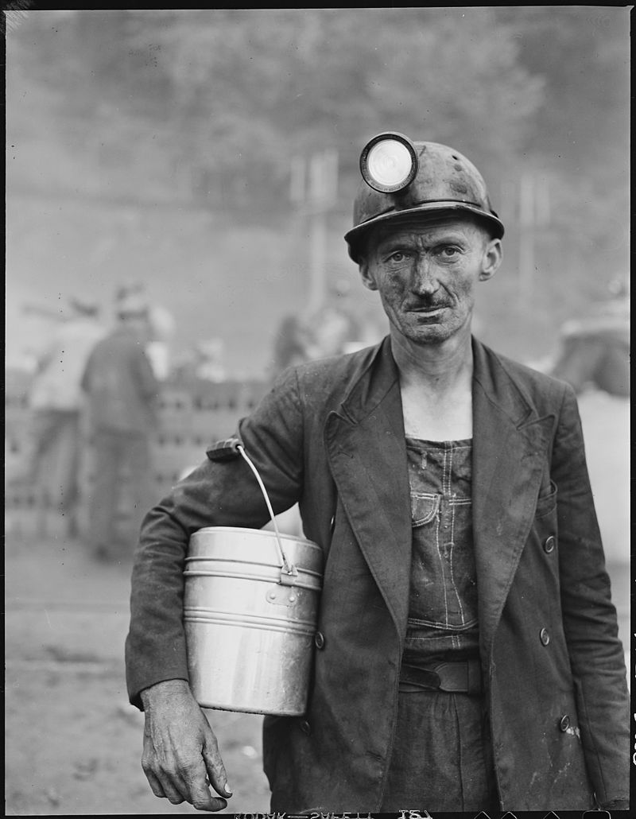
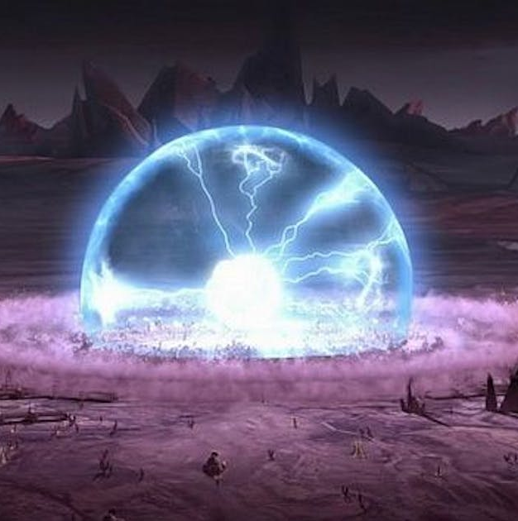
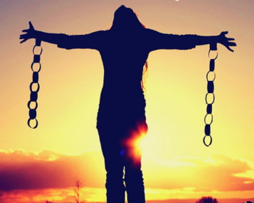
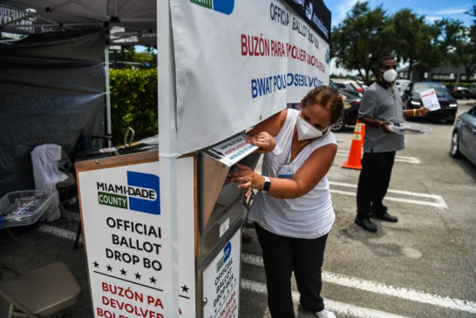
GOD IS ABLE TO OVERCOME
EVERY EVIL ATTACK AND
ANTI-CHRIST AGENDA
Financial Panic 1857
Supreme Court
Dred Scott 1857
Coal Strike
1890’s
Sexual
Colonization
Stolen Elections
Medical Tyranny
EMP Attack

Slide 30
The Arrogant Intimidation of The
Principalities Ruling Over the Closed Loop
Systems of Evil
THE CLOSED LOOP OF EVIL SAYS IT WILL NEVER ALLOW US TO CROSS OVER INTO THE PROMISES OF GOD – “WE HAVE STOLEN YOUR COUNTRY AND THE MORAL NARRATIVE AND YOU WILL NOT SUCCEED. GIVE UP ALREADY.”
THEREFORE, LORD WE CHOOSE TO ALLOW YOU TO HELP US TO CROSS THE ROARING RAGING JORDAN RIVER OF FUTILITY, FEAR, AND UNCERTAINTY – THAT SAYS WE WILL NOT SEE THE OUTPOURINGS OF THE HOLY SPIRIT THAT BRINGS ON A GENERAL AWAKENING – WE WILL ENTER IN OUR INHERITANCE AND THESE LYING SPIRITS WILL FAIL LIKE ALL THE OTHER ANTI-CHRIST AGENDAS OF THE PAST.

Slide 31
We Are Not Waiting On Something Big To Happen To Be Victorious
We are not waiting for something big to start an invasion from heaven. God has already invaded from heaven. Something big happened two thousand years ago. Yes we can underutilize the privileges, power, and authority of that first invasion by Jesus Christ and secondly when He sent the Holy Spirit at Pentecost.
But it has been proven beyond any doubt that God can pour out His extraordinary presence and convicting grace through genuine revival in the Church any time His people humble themselves and seek His face and repent of their entanglements with Jezebel, the world, and dead religion, and their own pansy flesh, and prevail in effectual prayer.

Slide 32
We Have What It Takes To Shake This Generation To The Core
Therefore, God is waiting on the Church to rise up. He is waiting for US TO RISE UP. He is waiting for a people of faith to rise up. He is waiting on intercessors to press in, contend, and decree, and receive the abundant answers. He is waiting on bold determined obedient warriors of grace to stand in the gap.
Economic collapse is not going to bring or hinder revival. War is not going to bring revival or hinder revival. An EMP or nuclear attack with no electricity is not going to bring or hinder revival. Another world-wide medical fiasco is not going to bring or hinder spiritual awakening. In short, outward circumstances do not bring breakthrough in the earth The Church obeys, LIVES ABOVE THE CHAOS and receives the promises, and HEAVEN RELEASES THE ALREADY PAID FOR VICTORY.

Slide 33
'But the court will sit, and his power will be taken away and completely destroyed forever. 27 Then the sovereignty, power and greatness of the kingdoms under the whole heaven will be handed over to the saints, the people of the Most High. His kingdom will be an everlasting kingdom, and all rulers will worship and obey him.' Daniel 7:26-27

Slide 34
Final Prayer
“Lord we pray for spontaneous and planned Holy Spirit trajectory-changing societal-impacting invasions of the Holy Spirit THIS YEAR. Lord we believe the Kingdom of God is a kingdom of intentionality (feet on the ground) but it is also a kingdom of sovereignty and of receiving that which only You can do (faith in the God of Heaven). So our faces are turned intently towards You but we are asking that You not linger for mankind (Micah 5:7) but to come with the showers of grace; the showers of intervention and salvation. We bless You in Jesus name.”

