Slide 1
THE TIME OF GOD’S FAVOR
Living in the age of the influence of the Ancient Gods (Moloch)

Slide 2
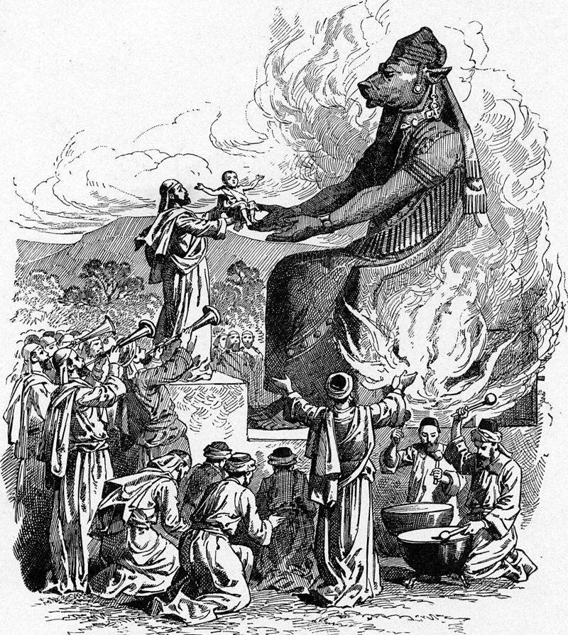

Slide 3
Who was Moloch?
Moloch- literally “Your King”, The National god of the Ammonites, to whom children were sacrificed by fire. He was their consuming and destroying and also at the same time the purifying fire.

Slide 4
“Moloch was erected On the high places of Tophet (drum) in the valley of Hinnom outside of Jerusalem, images of a bull with outstretched arms could be seen. It was made of bronze and they heated him from his lower parts; and his hands being stretched out, and mad hot, they put the child between his hands, and it was burnt, when it vehemently cried out, the priests beat a drum, that the father might no hear the voice of his son and his heart might not be moved.”
Schlomo Yitzchaki, 12 Century French Rabbi

Slide 7
Shedim- Heb. pl. n - ‘shud’ v. - to act violently, lay waste, to devastate, that which brings destruction.

Slide 8
Daimonion- Greek- a spirit, a principality, an occult entity, - a god.
Both Deut 32:17 and Psalm 106:36-37 translate Shedim as daimoniois
‘gods’ are demons!

Slide 10
1 Kings 11
“As Solomon grew old, his wives turned his heart after other gods, and his heart was not fully devoted to the Lord his God, as the heart of David his father had been. 5 He followed Ashtoreth the goddess of the Sidonians, and Molek the detestable god of the Ammonites. 6 So Solomon did evil in the eyes of the Lord; he did not follow the Lord completely, as David his father had done.”

Slide 11
2 Kings 22
Josiah was eight years old when he became king, and he reigned in Jerusalem thirty-one years. His mother’s name was Jedidah daughter of Adaiah; she was from Bozkath. 2 He did what was right in the eyes of the Lord and followed completely the ways of his father David, not turning aside to the right or to the left.

Slide 12
8 yrs old became King of Judah
16 yrs old he began to seek the God of his Father David
20 yrs old he began to purge Judah and Jerusalem of the high places
26 yrs old started purifying the land and the Temple and to repair it. 2 Chron 34

Slide 13
Josiah started making reforms, spending the necessary money to repair the temple.
22:7 “But you need not account for the money entrusted to them for they are acting faithfully.”
It was one thing to take care of the temple rebuilding process, but quite another to take care of God’s business.

Slide 14
2Kings 22:11
His Response to finding the Law:
11 When the king heard the words of the Book of the Law, he tore his robes. 12 He gave these orders to Hilkiah the priest, Ahikam son of Shaphan, Akbor son of Micaiah, Shaphan the secretary and Asaiah the king’s attendant:

Slide 15
13 “Go and inquire of the Lord for me and for the people and for all Judah about what is written in this book that has been found. Great is the Lord’s anger that burns against us because those who have gone before us have not obeyed the words of this book; they have not acted in accordance with all that is written there concerning us.”

Slide 16
How often are we doing the work we think God wants when the actual word of God is neglected.
Generation of people not walking with the LORD because the men and women who “love God” have settled for a substitute. It was the slow fade of idolatry that kept them from heeding the Truth.

Slide 17
They Found the Law in the Temple
Where else would it have been?
It was right there the whole time but the people who should have stewarded it , buried it in religion which led to idolatry.
Their idolatry was so intense and their sin so severe that they served other gods and even burned children in their sacrifices to these “gods”.

Slide 18
2 Kings 21
Josiah’s father Amon was wicked, reigned 3 yrs. 2Kings 21:19
Amon’s father Manasseh was the most wicked, reigned 55 yrs. 2 Kings 21

Slide 19
Amon: Walked in the ways his father (Manasseh) had, he worshiped the idols his father had worshiped and bowed down to them.
These “gods” promised prosperity.
“He forsook the Lord the God of his fathers, and did not walk in the way of the LORD.” v 22

Slide 20
Manasseh 2 Kings 21
Manasseh is the son of Hezekiah. “There will be peace in my lifetime” 2 Kings 20:19
“He did evil in the eyes of the Lord, following all the detestable practices of the nations the Lord had driven out before the Israelites.”

Slide 21
3 He rebuilt the high places his father Hezekiah had destroyed; he also erected altars to Baal and made an Asherah pole, as Ahab king of Israel had done. He bowed down to all the starry hosts and worshiped them.
4 He built altars in the temple of the Lord, of which the Lord had said, “In Jerusalem I will put my Name.”
5 In the two courts of the temple of the Lord, he built altars to all the starry hosts.
6 He sacrificed his own son in the fire, practiced divination, sought omens, and consulted mediums and spiritists. He did much evil in the eyes of the Lord, arousing his anger.

Slide 22
2 Kings 21
9 But the people did not listen. Manasseh led them astray, so that they did more evil than the nations the Lord had destroyed before the Israelites.

Slide 23
“He did more evil than the Amorites”
11 “Manasseh king of Judah has committed these detestable sins. He has done more evil than the Amorites who preceded him and has led Judah into sin with his idols.

Slide 24
Judgement tied to a Promise of Blessing Genesis 15:13-16
13 Then the Lord said to him, “Know for certain that for four hundred years your descendants will be strangers in a country not their own and that they will be enslaved and mistreated there.
14 But I will punish the nation they serve as slaves, and afterward they will come out with great possessions.

Slide 25
15 You, however, will go to your ancestors in peace and be buried at a good old age.
16 In the fourth generation your descendants will come back here, for the
sin of the Amorites has not yet reached its full measure.”

Slide 26
God waited over 400 years to bring judgement on a people who kept defiling the land.
“The land was defiled so I punished it for its sin, and the land vomited out its inhabitants.” Leviticus 18:25

Slide 27
At the same time, Gen 15:16 demonstrates God’s love, mercy and above all, his longsuffering and patience of sinful man.
The Amonites’ sin had not escaped God’s notice. He was keeping track of the measure of their sins and during Abraham’s time, it was “not yet full.”

Slide 28
The Amorites were warned of the coming judgment. Sihon and Og, two kings of the Amorites.
“We heard of the parting of the Red Sea, and what you did to the kings Sihon and Og.”
Joshua 2:8 Rahab, the harlot

Slide 29
11 “When we heard of it, our hearts melted in fear and everyone’s courage failed because of you, for the Lord your God is God in heaven above and on the earth below.”

Slide 30
400 years of Grace was finally full to the measure.
It was Judgment Day for the Amorites at Jericho!

Slide 31
2 Peter 2
“Their condemnation has long been hanging over them, and their destruction has not been sleeping.” v 3

Slide 32
2 Peter 2:9,10
…then the Lord knows how to rescue the godly from trials and to hold the unrighteous for punishment on the day of judgment.
10 This is especially true of those who follow the corrupt desire of the flesh[c] and despise authority.

Slide 33
2 Peter 3
8 But do not forget this one thing, dear friends: With the Lord a day is like a thousand years, and a thousand years are like a day.
9 The Lord is not slow in keeping his promise, as some understand slowness. Instead he is patient with you, not wanting anyone to perish, but everyone to come to repentance.

Slide 34
2 Peter 3
11 Since everything will be destroyed in this way, what kind of people ought you to be? You ought to live holy and godly lives 12 as you look forward to the day of God and speed its coming.
That day will bring about the destruction of the heavens by fire, and the elements will melt in the heat.
13 But in keeping with his promise we are looking forward to a new heaven and a new earth, where righteousness dwells.

Slide 35
14 So then, dear friends, since you are looking forward to this, make every effort to be found spotless, blameless and at peace with him.
15 Bear in mind that our Lord’s patience means salvation

Slide 36
2 Peter 3
17 Therefore, dear friends, since you have been forewarned, be on your guard so that you may not be carried away by the error of the lawless and fall from your secure position.
18 But grow in the grace and knowledge of our Lord and Savior Jesus Christ. To him be glory both now and forever! Amen.

Slide 37
The gods could not rule over the modern world as they had over the ancient, not in the same way.
“They came as spirits of the enlightenment, freedom and power, they came as secular gods, new gods, alternate gods, gods that granted godhood, gods that denied that they were gods, and gods that declared that there were no gods- they came as gods of the modern world”.
Jonathan Cahn The Return of the gods

Slide 38
The gods now dwell among us. They inhabit our institutions, walk the calls of our governments, cast our votes in our legislatures (and steal them in our elections) guide our corporations, gaze out from our skyscrapers, perform on our stages, and teach in our universities, They saturate our media, direct our news cycles, inspire our entertainments, and give voices to our songs. They perform on our stages,

Slide 39
in our theaters and stadiums; they light up our TV sets and computer screens, (phone screens), They incite new movements and ideologies and convert others to their ends. They instruct our children and initiate them into their ways. The incite the multitudes. They drive otherwise rational people into irrationality and some into frenzies, just as they had done in ancient times. They demand our worship, our veneration, our submission, and our sacrifices. The gods are everywhere. They have permeated our culture. They have mustered our civilization. The gods are here.

Slide 41
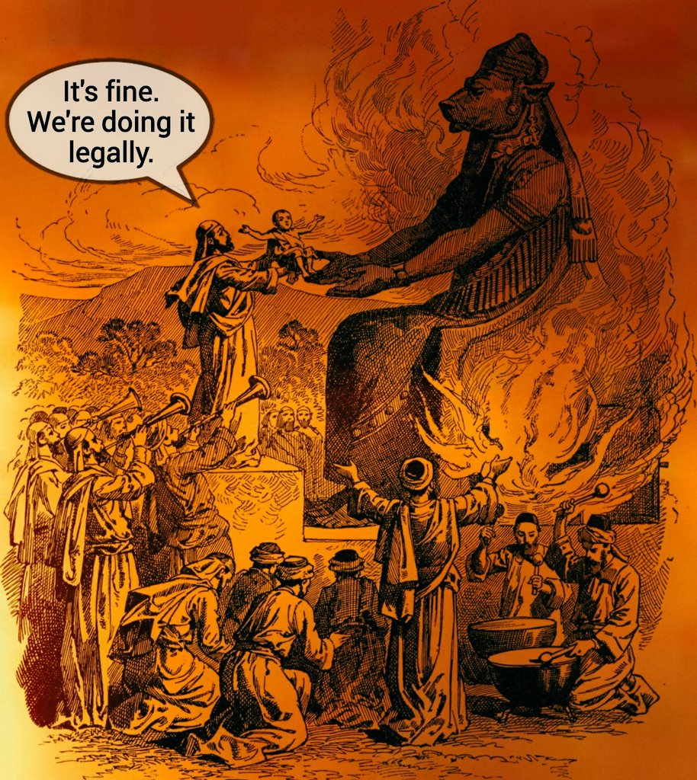
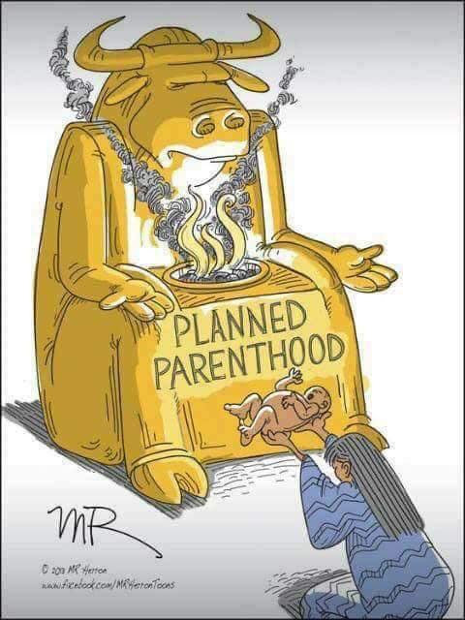

Slide 42
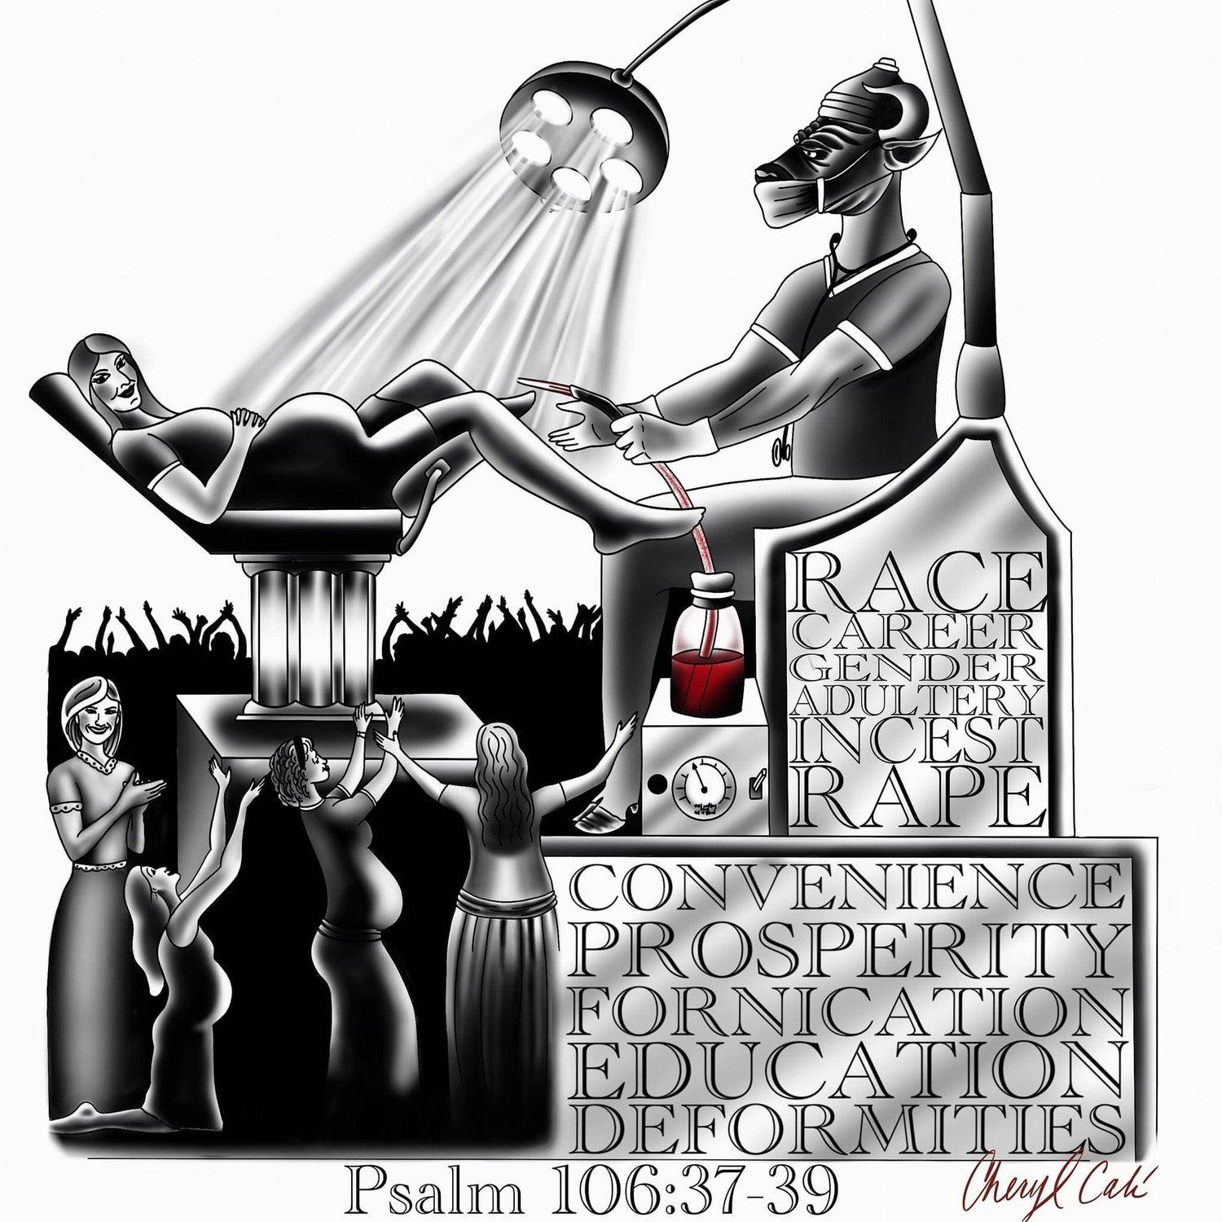

Slide 43
6 As God’s co-workers we urge you not to receive God’s grace in vain. 2 For he says,
“In the time of my favor I heard you,
and in the day of salvation I helped you.”
I tell you, now is the time of God’s favor, now is the day of salvation.

Slide 44
Our Highest Priorities:
Host the Presence of God: to create such an environment and a culture that God is attracted to it and that He doesn’t want to leave.
Create the culture in your own heart. Host Him well and get rid of anything that offends Him!

Slide 45
2. Make the House of God a House of Prayer! (Not spiritualized TED talks, concerts, conferences, community meetings, etc)
“When will my house become a house of prayer?”

Slide 46
2 Chronicles 7:14,15
14 if my people, who are called by my name, will humble themselves and pray and seek my face and turn from their wicked ways, then I will hear from heaven, and I will forgive their sin and will heal their land.
15 Now my eyes will be open and my ears attentive to the prayers offered in this place.

Slide 47
The Call of the hour is this:
“Every move of God did not did not start with good preaching or dynamic worship. Every historical revival began with a kneeling figure of one or two gathered together, repenting over their sin, becoming broken before God. Crying out for his Mercy, crying out for God to save the city.”
Todd Smith, Christ Fellowship Church, North Georgia

Slide 48
Plunder the Strong Man (Matt 12)
If you want to plunder a man’s goods, you walk into his house and you bind the strong man. You find the strength and power and you neutralize it. Then you’re able to walk in with out resistance and plunder the goods.
“That’s what the devil has done with prayer and the church. He has isolated and neutralized the prayer ministries of the churches so therefore he’s allowed us to preach, he’s allowed us to worship and there’s some kingdom demonstrations but by and large, there’s not much. If the churches began to pray and untie the strong man of prayer, the devil would not be able to walk into our youthgroups, children’s ministry, and steal and plunder our young people.”

Slide 49
Our young people would see with their own eyes that Jesus is the same today as he walked the streets of Jerusalem, still touching, still saving, still delivering, still healing. The reason young people drift from God is because Churches have become museums. They have become talking points about what God used to do. We need churches that are vibrant, on fire and believe that book from cover to cover and release Jesus to do what he did and to release the power of the Holy Spirit and quit treating the Holy Spirit like some crazy uncle that we keep him tied up in a room because we’re afraid he’ll embarrass us.
Todd Smith, Christ Fellowship Church, North Georgia

