Slide 1
Finding god in The less than ideal
LifeGate
2/4/23

Slide 2
Marriage, Family, and relationships
Focusing in on three points:
God works through less than ideal
Attachment and relational patterns
The necessity of the redemptive power of God

Slide 3
What is the Way of love? 1 Corinthians 13
13 If I speak in the tongues^{[a]} of men or of angels, but do not have love, I am only a resounding gong or a clanging cymbal. ² If I have the gift of prophecy and can fathom all mysteries and all knowledge, and if I have a faith that can move mountains, but do not have love, I am nothing. ³ If I give all I possess to the poor and give over my body to hardship that I may boast,^{[b]} but do not have love, I gain nothing.

Slide 4
What is the Way of love? 1 Corinthians 13
⁴ Love is patient, love is kind. It does not envy, it does not boast, it is not proud. ⁵ It does not dishonor others, it is not self-seeking, it is not easily angered, it keeps no record of wrongs. ⁶ Love does not delight in evil but rejoices with the truth. ⁷ It always protects, always trusts, always hopes, always perseveres. ⁸ Love never fails. But where there are prophecies, they will cease; where there are tongues, they will be stilled; where there is knowledge, it will pass away.

Slide 5
What is the Way of love? 1 Corinthians 13
⁹ For we know in part and we prophesy in part, ¹⁰ but when completeness comes, what is in part disappears. ¹¹ When I was a child, I talked like a child, I thought like a child, I reasoned like a child. When I became a man, I put the ways of childhood behind me. ¹² For now we see only a reflection as in a mirror; then we shall see face to face. Now I know in part; then I shall know fully, even as I am fully known.
¹³ And now these three remain: faith, hope and love. But the greatest of these is love.

Slide 6
1 Corinthians 13:4-7 [Message]
Love never gives up. Love cares more for others than for self. Love doesn’t want what it doesn’t have. Love doesn’t strut, Doesn’t have a swelled head, Doesn’t force itself on others, Isn’t always “me first,” Doesn’t fly off the handle,
Doesn’t keep score of the sins of others, Doesn’t revel when others grovel, Takes pleasure in the flowering of truth, Puts up with anything, Trusts God always, Always looks for the best, Never looks back, But keeps going to the end.

Slide 7
If you are looking for perfection in the natural… Good luck!
IN the flesh:
“its not fair” “this wasn’t the plan”
“It’s not worth it”
“it’s hopeless”
“I was just born this way, its who I am”
Comparisons: “the grass is greener…” (distractions and discontentment)
“They don’t understand… I wish they would just….”

Slide 8
2 Corinthians 12:8-10
⁸ Concerning this thing I pleaded with the Lord three times that it might depart from me. ⁹ And He said to me, “My grace is sufficient for you, for My strength is made perfect in weakness.” Therefore most gladly I will rather boast in my infirmities, that the power of Christ may rest upon me. ¹⁰ Therefore I take pleasure in infirmities, in reproaches, in needs, in persecutions, in distresses, for Christ’s sake. For when I am weak, then I am strong.

Slide 9
God Works in and through the less than Ideal

Slide 10
Less than Ideal
Genesis 29:28—Jacob and Rachel– work 7 years to be given the incorrect wife… a total of 14 years to earn Rachel hand in marriage
Genesis 31:41—Jacob and Leah– Leah struggled with feeling unwanted and unloved
But it was Leah, who was able to pass on the line to Jesus

Slide 11
Less than Ideal
Genesis 38:11—Judah and Tamar, his daughter in law. She tricked him. He thought she was a prostitute. He got her pregnant. He was going to have her killed until he found out who she was.
As a result, one of the twins (Perez), was used to carry the line to Jesus
2 Samuel 11-12—David and Bathsheba—Solomon was a product of a relationship that began with murder and adultery.
But it was Solomon who was able to pass on the line to Jesus

Slide 12
Less than Ideal
Mary and Joseph—It was less than Ideal to start a marriage with a women who was pregnant by someone other than her husband. Scandal? Inconvenience? Pride check? Yet through this God would bring the most important event in human history.

Slide 13
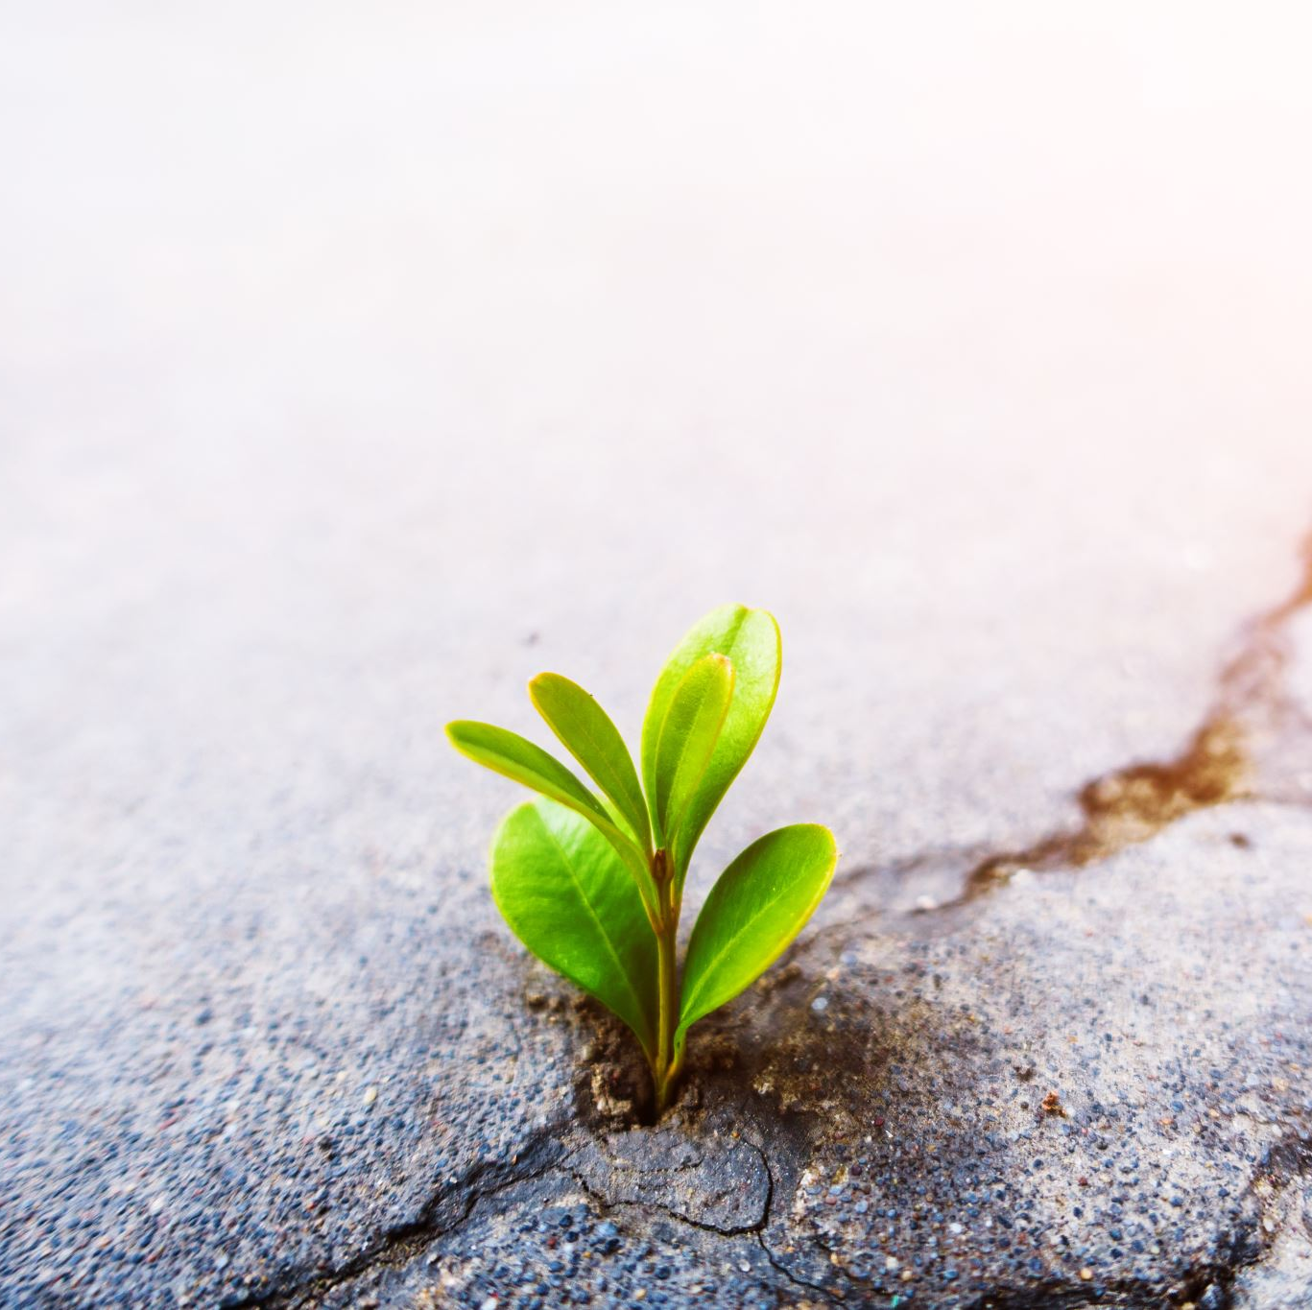
HOPE
God is able to take our mess, and make it beautiful, and give it purpose and meaning.

Slide 14
So, Where are the bible characters exemplifying a healthy relationships?
Notice how the Biblical characters (apart from the triune God), are all flawed/imperfect people. Only God shows us perfection, perfect love.
We are all in process of being perfected in Christ.
We are truly blessing to have seasoned, Godly examples among us, whose lives bare much fruit

Slide 15
Love and who we are
1 John 1:9—God is Love
Genesis 1:27—We are created in God’s image
“To be disconnected from an understanding of what love is and how to live it out is a threat to the most fundament aspect of our humanity, namely our connection to God and one another” (Sue Johnson)

Slide 16
“Created for connection”
A book by Sue Johnson (Christian author and marriage counselor)
In her book “Cradle to Grave” she highlights how God designed all of us with some predictable needs, that go with us our entire lifespan
See the still face experiment

Slide 17
What is love? 1 Corinthians 13:4-8
⁴ Love is patient, love is kind. It does not envy, it does not boast, it is not proud. ⁵ It does not dishonor others, it is not self-seeking, it is not easily angered, it keeps no record of wrongs. ⁶ Love does not delight in evil but rejoices with the truth. ⁷ It always protects, always trusts, always hopes, always perseveres. ⁸ Love never fails. But where there are prophecies, they will cease; where there are tongues, they will be stilled; where there is knowledge, it will pass away.

Slide 18
Secure vs. insecure
With out boundaries there is no security
Lack of boundaries/security leads to increased anxiety, lack of confidence/low self-esteem and other behavior issues
In Relationships: =damaged or lack of trust
In Parenting: Hebrews 12:6 “because the Lord disciplines the one he loves, and he chastens everyone he accepts as his son.”
LOVE HAS BOUNDARIES. LOVE SAYS “NO”.

Slide 19
Secure Relational Process:
Individual is Anxious
Initiates Attachment Behavior
Primary Rx Reads Cues and Comforts The Individual
Individual Experiences Reduced Anxiety

Slide 20
Lack of security in attachment will lead to frequent misinterpretation of the message and motive in what is being communicated
About 90% of all communication is everything other than the words being spoken
[body language, tone, proximity, posture, eye contact, etc]

Slide 21
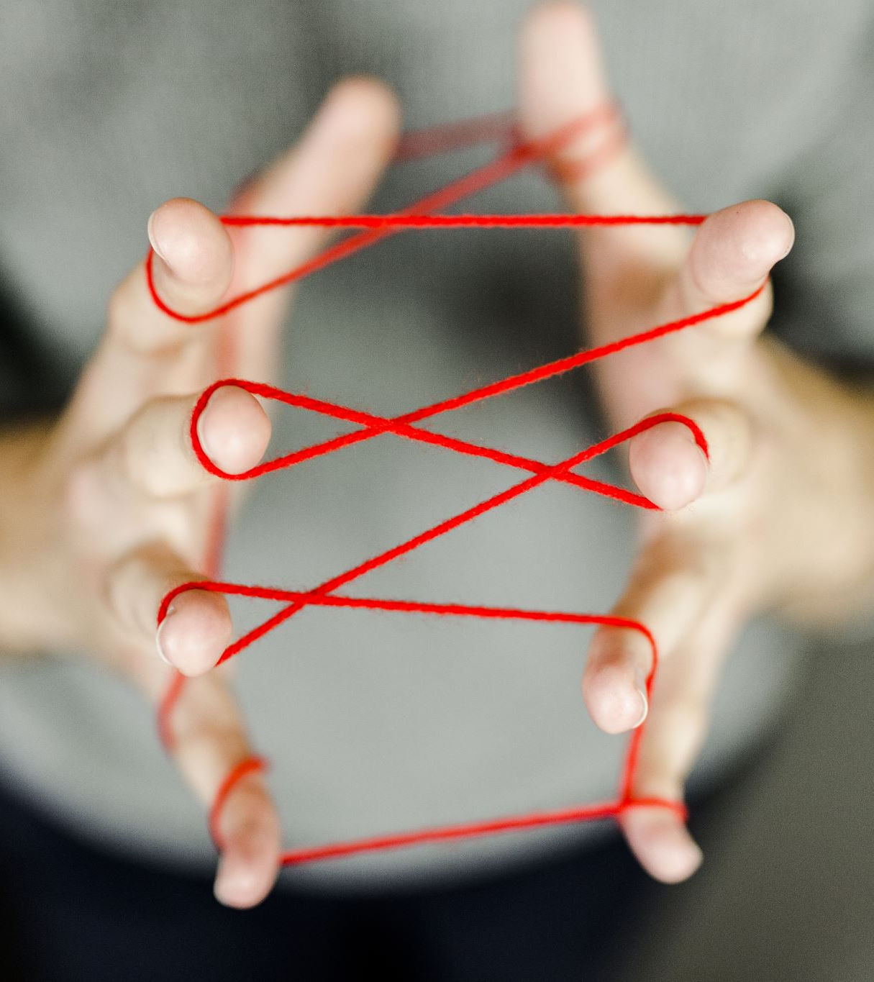
Negative Interaction Cycle (NIC)
“The Dance”
A self-sustaining relational loop
reinforcing the beliefs/internal-dilemma's that motivate the relational exchanges
Homeostasis

Slide 22
Preoccupied Relational Pattern:
Primary Rx seems distracted and distant
Individual’s anxiety spikes; draws attention to self, cries, jokes, acts angry or hurt
Primary Rx ignores or dismisses the individual
Individual escalates into aggression, threats or acts helpless
Primary Rx engages in someway
Individual is briefly reassured, anxiety decreases

Slide 23
Fearful-Avoidant Relational Pattern:
Individual experiences strong negative emotions
Individual approaches primary Rx, but acts angry & demanding
Primary Rx is triggered, either shutting down or verbally attacking the individual
Feeling more anxious and powerless, the individual escalates with aggression or running
Primary Rx either gives in or tries to defeat and control the individual

Slide 24
Dismissive-Avoidant Relational Pattern:
Individual attempts to engage primary Rx around a discrete task
Primary Rx rejects/shuts down the individual, showing anger or annoyance
The individual acts like everything is fine, and withdraws
Primary Rx ignores or makes derogatory remarks
Individual seeks relief through isolation (ie. TV, Reading gaming, phone, social media)

Slide 25
This is all to overwhelming
Change can seem impossible…
We cannot undo what happened
How our trauma impacts our ability to be emotionally present
What happened to us impacts how we give and receive love… our ability to connect and attach to others

Slide 26
There are things that can only be healed by the power of God. Things Only He can restore.

Slide 27
With God, all things are possible
Matthew 19:26 “With men this is impossible, but with God all things are possible.”
Philippians 4:13 “I can do all things through Christ who strengthens me.”

Slide 28
IN the following video, notice the fathers heart
The father’s response to the faith of a desperate child.
Father to the fatherless. [Luke 8:43-48]

Slide 29
Lets examine our heart before the lord
There are situations in life, that require the REDEMPTIVE POWWER of God in the “Less than Ideal”? Wounds that get in the way and isolate you from others?
Apart from God, left up to your own strength and/or the wisdom and strength of the world… the “less than ideal” circumstances would be hopeless.
Heart-check: ASK—are there less than ideal circumstances that desperately need the Father’s attention? Are you willing/ready to let go, and let God?
Lets Pray

