Slide 1
Part 3
“Marriage should be honored by all, and the marriage bed kept pure- Keep your lives free from the love of money and be content with what you have."
Hebrews 13:4-5 (NIV)
A SERMON FOR LIFEGATE
Sunday, February 12, 2023

Slide 2
For the LORD your God moves about in your camp to protect you and to deliver your enemies to you. Your camp must be holy, so that He will not see among you anything indecent and turn away from you. Deuteronomy 23:14

Slide 3
Quick Tutorial On Hosting The Presence of God And Not Being DRY!!
Generally: What is true with your earthly relationships is true with your relationship with GOD!!!! (I John 1 4:20)
You Have To Allow God Through The Presence of Christ, the Word of God, and the Revelation Ministry of the Holy Spirit TO GET YOU OUT OF YOUR HEAD!!
You overthink everything: (inner lawyer)
I can’t. – It won’t work. - I’m different. - God doesn’t love me! - Nothing will change.
You Have To Move from Analyzing to Affection
Affection Can only come when you VALUE someone

Slide 4
THE WORD OF GOD IS
UNAPOLOGETIC ABOUT LIFE
Marriage should be honored by all, and the marriage bed kept pure, for God will judge the adulterer and all the sexually immoral. 5 Keep your lives free from the love of money and be content with what you have, because God has said, "Never will I leave you; never will I forsake you." Hebrews 13:4-5 (NIV)
But since there is so much immorality, each man should have his own wife, and each woman her own husband. ³ The husband should fulfill his marital duty to his wife, and likewise the wife to her husband. ⁴ The wife's body does not belong to her alone but also to her husband. In the same way, the husband's body does not belong to him alone but also to his wife.
1 Corinthians 7:2-4 (NIV)

Slide 5
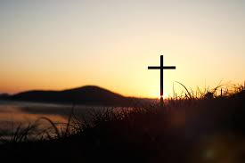
BUT PRAISE THE LORD FOR THE
FINISHED WORK OF JESUS CHRIST
But thanks be to God! He gives (Grant, deliver, bring forth) us the victory through our Lord Jesus Christ. ⁵⁸ Therefore, my dear brothers, stand firm. Let nothing move you. Always give yourselves fully to the work of the Lord, because you know that your labor in the Lord is not in vain.
1 Corinthians 15:57-58 (NIV)

Slide 7
THREE TYPES OF PEOPLE THAT REALLY CONCERN
ME AND THEIR MARRIAGES AT LIFEGATE
AND IN THE CHURCH OF AMERICA

Slide 8
To A Healthy Marriage
CONFLICT resolution and communication
EXPECTATIONS AND FRUSTRATION – Shutting down
FINANCES and stewardship – Biblical Finances
STRESS and Finding quality time
NURTURING AND AFFECTION – Biblical Sexual purity
UNITY AND VISION – common strategies for life

Slide 9
Consequently, Two Major Battlegrounds For A Healthy Marriage

Slide 10
SOME OF YOU HAVE BEEN ABUSED
– YOU EXPERIENCED THINGS THAT RUINED YOUR INNOCENCE OR YOUR CREDIT
Then they cried to the LORD in their trouble, and He saved them from their distress. 20 He sent forth His Word and healed them; He rescued them from the grave. Psalm 107:19-20 (NIV)

Slide 11
God Is Amazing At Bringing Us All Through The Less Than Ideal

Slide 12
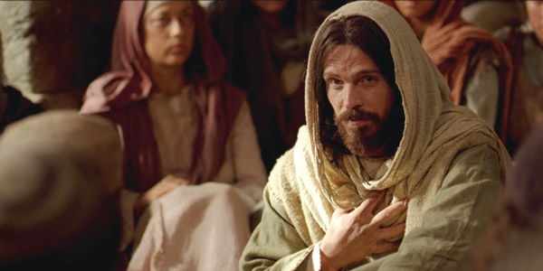
Jesus Spoke Boldly about
Finances, Sexuality, and Relationships
He went on: "What comes out of a man is what makes him 'unclean.' ²¹ For from within, out of men's hearts, come evil thoughts, sexual immorality, theft, murder, adultery, ²² greed, malice, deceit, lewdness, envy, slander, arrogance and folly. ²³ All these evils come from inside and make a man 'unclean.'" Mark 7:20-23 (NIV)

Slide 13
Scripture | Relationships | Sex | Money
Mathew 15:19 | Murder False Testimony Slander | Adultery Sexual immorality Evil thoughts | Theft
Mark 7:21-23 | Murder Malice Deceit Slander Arrogance, Folly | Sexual immorality Adultery Lewdness Evil thoughts | Theft Greed
Romans 13:12-14 | Dissension Jealousy | Sexual immorality Orgies Drunkenness Debauchery
1 Corinthians 6:9-10 | Slanderers | Sexually immoral Adulterers Male prostitutes Homosexuals | Thieves Greedy Swindlers
Galatians 5:19-21 | Hatred, discord Jealousy Fits of rage Dissentions factions | Sexual immorality Impurity Debauchery orgies | Selfish ambition envy
Ephesians 5:3-5 | Foolish talk Dirty jokes | Sexual immorality Impurity Obscenity | Greed
Colossians 3:5-9 | Anger, Rage, Malice, Slander, Filthy language, Lying | Sexual immorality, impurity, lust | Evil desires Greed

Slide 14
Jesus and Paul Didn’t Catalogue Sins
To CONDEMN us but to WARN us.
God is after our hearts – when HE HAS US – he has our stuff -

Slide 15
THE FOUR RESPONSIBILITIES OF
BIBLICAL GOD-CENTERED LOVE
THE RESPONSIBILITY OF PURE WORSHIP THAT OVERCOMES A FREE-WILL THAT IS SELF-CONSUMED (Exodus 20:3; Deuteronomy 6:5; Mark 12:30)
THE RESPONSIBILITY OF PURE PEACE THAT OVERCOMES PETTY ANGER, JEALOUSY, VIOLENCE, AND HATE. (Exodus 20:13; Matthew 5:9, James 3:18)
THE RESPONSIBILITY OF PURE PLEASURE (AND SEXUALITY) THAT OVERCOMES BEING LOVERS OF PLEASURE – ADDICTION, LUST, AND UNBIBLICAL BOUNDARYLESS SEX. (Exodus 20:14; 1 Corinthians 6:18; Colossians 3:5; 2 Timothy 3:4)
THE RESPONSIBILITY OF PURE WEALTH THAT OVERCOMES GREED, POVERTY, THEFT, AND THE LOVE OF MONEY (Exodus 20:15; Matthew 6:24; 1 Timothy 6:10; Hebrews 13:5; 1 Peter 5:2)

Slide 16
When we step out of any of God’s ordained path of obedience in these FOUR RESPONSIBILITIES we are in IDOLATRY

Slide 17
SIN IS DEEPER THAN ACTION –
IT IS A HEART ISSUE
"You have heard that it was said, 'Do not commit adultery.' 28 But I tell you that anyone who looks at a woman lustfully has already committed adultery with her in his heart.” Matthew 5:27,28

Slide 18
A POWERFUL FORCE AND GIFT
TO BE PROTECTED
THAT WHICH IS SACRED
Outside of our Freewill to CHOOSE who we love and WORSHIP – the gift of our sexuality (finances) are the most powerful force God has given us. And even WITHIN THE PROTECTIONS OF COVENANT MARRIAGE we are barely able to protect ourselves from making them into IDOLS.

Slide 19
Without SALVATION and The Holy Spirit
We would all Be
Self-Consumed
The heart is deceitful above all things and beyond cure. Who can understand it?
Jeremiah 17:9

Slide 20
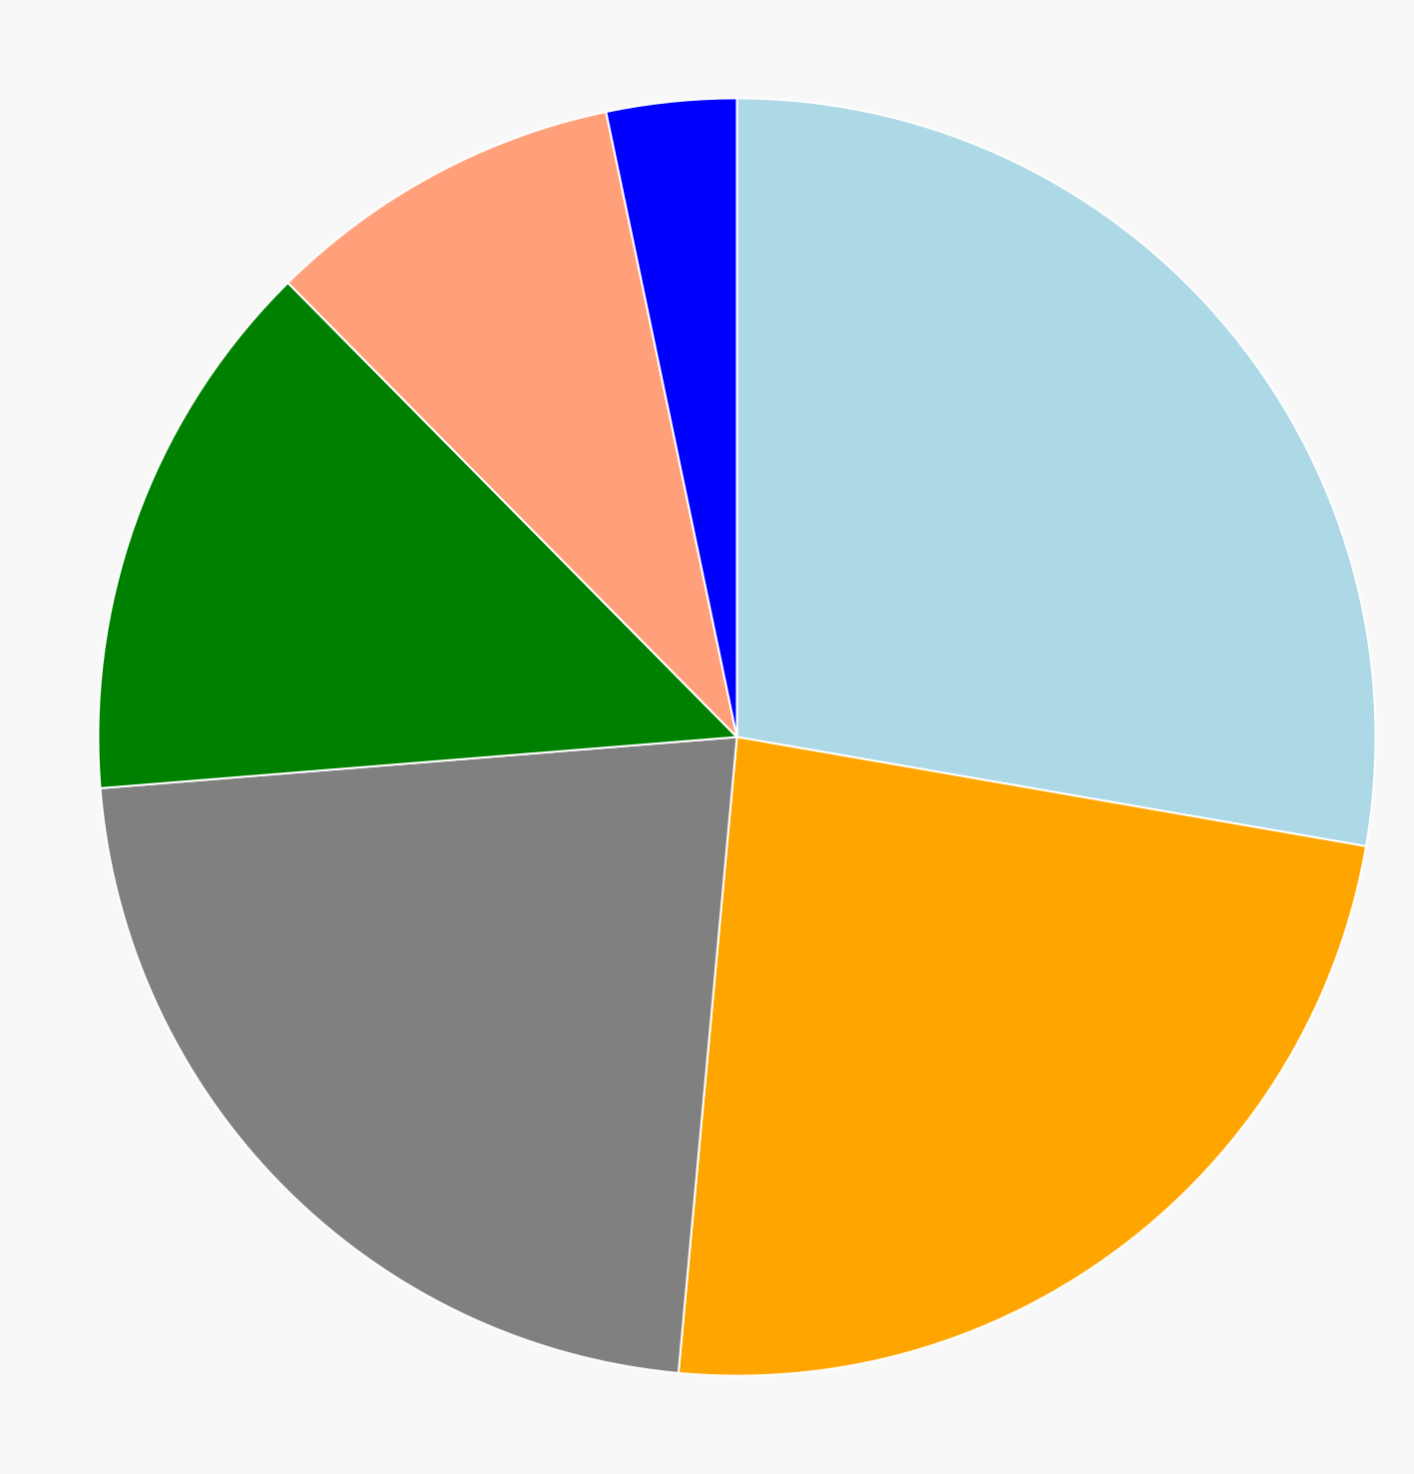
The Integrated Life
Romance
And
Sexuality
Recreation
Everyday
Life
Raising
Family
Spiritual
Life
Work and Career
Community
Involvement
Sleep

Slide 21
Without The Guidance of the
Holy Spirit and the Word of God
Everyday
Life
Romance and
Sexuality

Slide 22
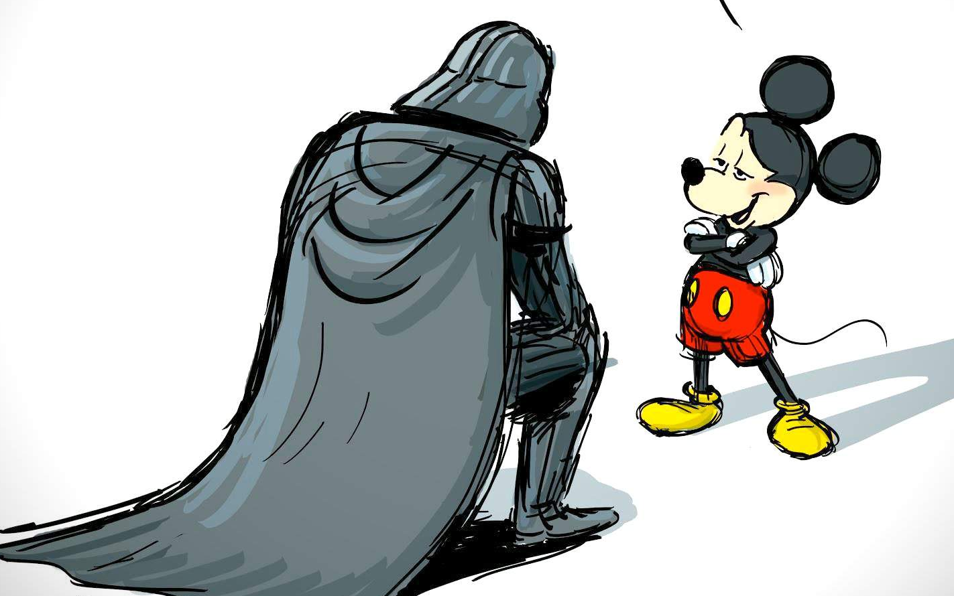
This is Us!!!!
Without The Authority That Comes
Through Christ And the Holy Spirit

Slide 23
BIBLICAL FINANCES
People who want to get rich fall into temptation and a trap and into many foolish and harmful desires that plunge men into ruin and destruction. ¹⁰ For the love of money is a root of all kinds of evil. Some people, eager for money, have wandered from the faith and pierced themselves with many griefs.
1 Timothy 6:9-10 (NIV)

Slide 24
There is treasure to be desired and oil in the dwelling of the wise; but a foolish man spends it up.
Proverbs 21:20 (KJV)
The rich rule over the poor, and the borrower is servant to the lender. ^{8A} He who sows wickedness reaps trouble. ⁹ A generous man will himself be blessed, for he shares his food with the poor. Proverbs 22:7-9 (NIV)

Slide 25
THE PRINCIPLES OF SOWING AND REAPING AND GIVING GOD HIS TITHE
Without sowing a tithe to God you are basically saying I DON’T TRUST GOD WILL TAKE CARE OF ME.
Remember this: Whoever sows sparingly will also reap sparingly, and whoever sows generously will also reap generously. ⁷ Each man should give what he has decided in his heart to give, not reluctantly or under compulsion, for God loves a cheerful giver. 2 Corinthians 9:6-7 (NIV)

Slide 26
FINANCIAL BLESSINGS
ARE A GIFT FROM GOD
We can easily forget that tithing to the Lord
is not a duty but a privilege!
"Will a man rob God? Yet you rob me. "But you ask, 'How do we rob you?' "In tithes and offerings. ⁹ You are under a curse--the whole nation of you--because you are robbing me. ¹⁰ Bring the whole tithe into the storehouse, that there may be food in my house. Test me in this," says the LORD Almighty, "and see if I will not throw open the floodgates of heaven and pour out so much blessing that you will not have room enough for it. Malachi 3:8-10 (NIV)

Slide 27
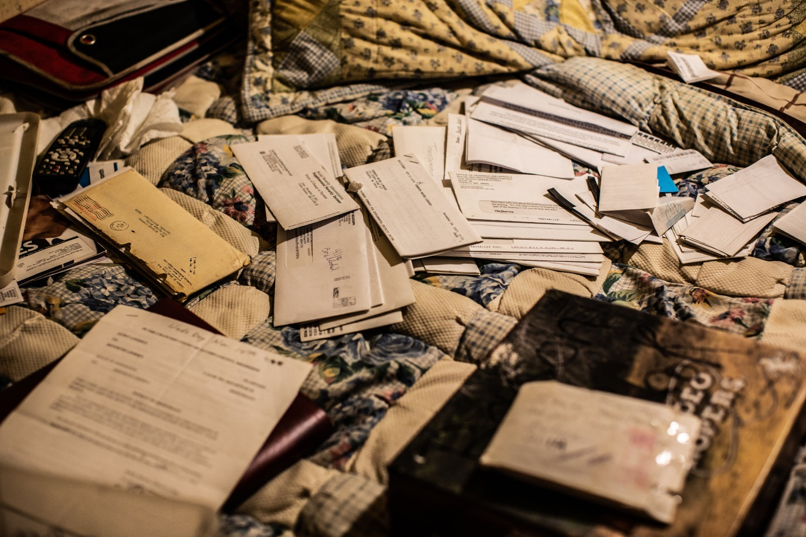
EVERY SINGLE PERSON
AND EVERY COUPLE NEEDS A BUDGET

Slide 28
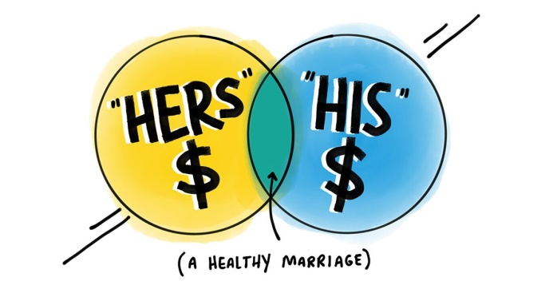
You Do Need To Come Into Unity
Concerning Finances
One of you needs to TAKE THE LEAD in running the finances and paying the bills. (It doesn’t have to be the husband.) (Prov. 31)
Share your accounts BUILD TRUST. Give each other an allowance.
Pray over your finances – agree on a BUDGET – Tithe
Ask for help if your finances are still struggling. We are here to support each other. LEARN FROM YOUR MISTAKES

Slide 29
NURTURING AND AFFECTION
NURTURE - To care for and encourage growth and to bring to life
THE EARLY CHURCH
“And yet there is something extraordinary about their lives. They live in their own countries as though they were only passing through. They play their full role as citizens, but endure the treatment as foreigners. Any country can be their homeland, but for them their homeland, wherever it may be, is not home. Like others, they marry and have children, but they do not cast them adrift. They share their meals, but not their wives.” Justin Martyr ???

Slide 30
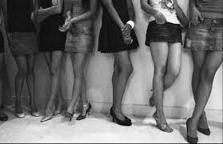
WHY IS IT CHALLENGING TO TEACH
ON BIBLICAL SEXUALITY AS A PASTOR?
Leaders have to get the victory themselves so as to lead others into the victory
We are in such an indecent and over sexualized time in history that it is almost ad nauseam to talk about this subject – yet it is a wonderful gift we must fight for.
Leaders have to be very wise in this topic because they have to thread a needle of being forthright without being graphic

Slide 31
WHY ALL THE BATTLES
WITH SEXUALITY?
Because The Enemy Hates
Godly Nurturing and Affectionate Marriages
WHY IS THE RESPONSIBILITY OF PURE PLEASURE SO RUTHLESSLY ATTACKED? –Birth control Nineteen Sixties –– 2000’s Internet – Intimidated Church struggling to overcome Jezebel herself.
WHY IS MANKIND SO PRONE TO THE SPIRIT OF IDOLATROUS SEXUALITY IN OUR DAY? Because sexuality equates with love.
CAN GOD DELIVER US FROM THE DEPRAVITY AND CORRUPTION OF BOUNDARYLESS SEXUALITY? – Yes we can live pure in an oversexualized world. BUT IT WILL REQUIRE BRUTAL HONESTY, AND ACCOUNTABILITY.
IF YOU ARE MARRIED – HOW DO YOU LIVE IN A VIBRANT HEALTHY SEXUALITY ? – NOT FRIGID – DISTANT – UN-INTERESTED IN EACH OTHER? LIVING IN A NURTURING ROMANCE AS A COUPLE IS ADDED PROTECTION – WHILE STILL FIGHTING OUR OWN CORRUPTIONS. IT IS CRITICAL TO A HEALTHY MARRIAGE THAT WE ARE FREE FROM PORNOGRAPHY AND PROTECT OUR INTIMACY AS COVENANT PARTNERS.

Slide 32
PEOPLE SEEK
INSTANT GRATIFICATION BECAUSE:
They have a wound –To medicate this pain – all forms of pleasure are sought to ESCAPE PAIN. The pain comes from many things.
There is a God-shaped hole in each soul that can only be filled with God – and this emptiness sets us up to seek fulfillment to satisfy this emptiness WITH PLEASURE.
ALLURE / PEER PRESSURE and Curiosity into unknown PLEASURE – the POTENTIAL of something very gratifying - “the woman saw that the fruit of the tree was good for food and pleasing to the eye, and also desirable for gaining wisdom.”
THE LAW OF DIMINISHING RETURN – to experience pleasure you have to increase the level of ecstasy – pleasure begins to numb you – therefore it requires more intense pleasure to satisfy.
The promise of SENSUAL REWARD - You don’t always need a WOUND – You don’t have to be chasing ways to satisfy your EMPTINESS – You don’t have to be wanting to ESCAPE your meaningless life – THE FLESH SHOWS UP and you just WANT TO GRATIFY IT. – (See 1 Timothy 5:5,6)

Slide 33
PRAY TO OVERCOME
UNGODLY MARRIAGE EXTREMES
You mean I can PRAY about
my romance with my spouse?
“Lord set me free from the ungodly models I discovered in pornographic material when I was unsaved or backslidden. Set me free from anything that does not reflect your holiness in my marriage.
“Lord activate the gift of holy nurturing sexuality in my marriage that I may bless my partner and protect our covenant.”
It is God's will that you should be sanctified: that you should avoid sexual immorality; ⁴ that each of you should learn to control his own body in a way that is holy and honorable, ⁵ not in passionate lust like the heathen, who do not know God; 1 Thessalonians 4:3-5 (NIV)
I am my lover's and my lover is mine; he browses among the lilies. Song of Songs 6:3

Slide 34
Christian Couples Should Have The Healthiest Intimacy In The World
Biblical Christians should have the healthiest most balanced righteous intimacy out of anybody in the earth. But many times they are dysfunctional, refrigerated, discouraged, or uninterested in each other and as a consequence become manipulative or vulnerable to pornography, control - frustration – and end up in punishment/reward cycles.
We need deliverance, victory, and freedom from past shame and we need to cut off all the soul ties from previous sexual encounters. Then we need to boldly call forth victory in our lives and be a blessing to our partner.
We need to allow the Holy Spirit to get us out of our own personality and our own tired, dry, cold mindset and be excited about our romance with our partner.

Slide 35
Marriage Romance
We need to get past boring romance with our spouse and stop taking things for granted. We need to stop being plateaued and selfish or in a perverted way being influenced by ungodly models we discovered in pornographic material. We need to ask God to set us free from these perverted sexual stereotypes and at the other end of the spectrum from depression, moodiness, disinterest, and manipulation.
“Well I don't have any romantic desires for my partner anymore” – Well you are in trouble and don’t act like you’re not – you have succumbed to a unimpassioned love that is dry and cognitive but not vibrant or affectionate. Ask the Holy Spirit to set you free from WHAT YOU WANT. This is a selfish unbiblical love you are attempting to express toward your spouse and you need to repent and ask God to give you a fire for Him and for your spouse.

Slide 36
Take steps to make it sacred
and special again.
Don’t let the enemy steal something God intended to be a blessing and allow him to take it away from you. Take it back.
You intended to harm me, but God intended it for good to accomplish what is now being done, the saving of many lives. Genesis 50:20 (NIV)

Slide 37
The Movie Set – Parable

Slide 38
The Miracle of God Saving Us
From Being Infatuated with the “Set”
THE GLORY OF GOD IS THAT HE CAN TAKE A SIN-SOAKED – FLESH-ADDICTED – WORLD-DAZZLED SOULS AND BRING THEM UP OUT OF THE FOG OF LIVING FOR THE MOMENT – LIVING FOR THE NEXT HIGH AND CAUSE THEM TO FALL IN LOVE WITH THEIR CREATOR! EVEN THOUGH THEY HAVE NEVER SEEN HIM – HE SO CONVINCINGLY CALLS THEM AND WITNESSES TO THEM THROUGH THE WORD, THROUGH THE SPIRIT, AND REVELATION THAT THEY COMMIT ALL THEY ARE TO HIS RIGHTEOUS PURPOSES FORSAKING IMMEDIATE GRATIFICATION FOR ETERNAL REWARD.
Though you have not seen Him, you love Him; and even though you do not see Him now, you believe in Him and are filled with an inexpressible and glorious joy, 9 for you are receiving the goal (purpose) of your faith, the salvation of your souls. 1 Peter 1:6-9 (NIV)

Slide 39
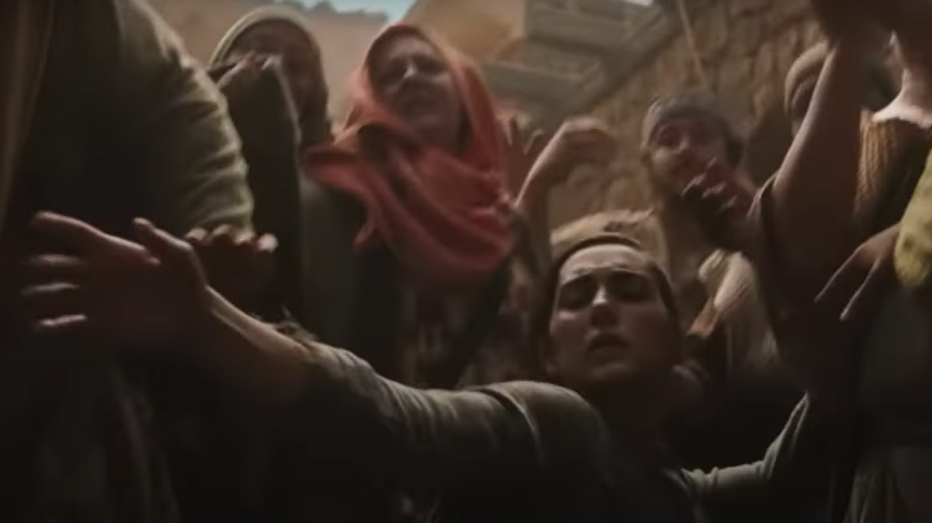
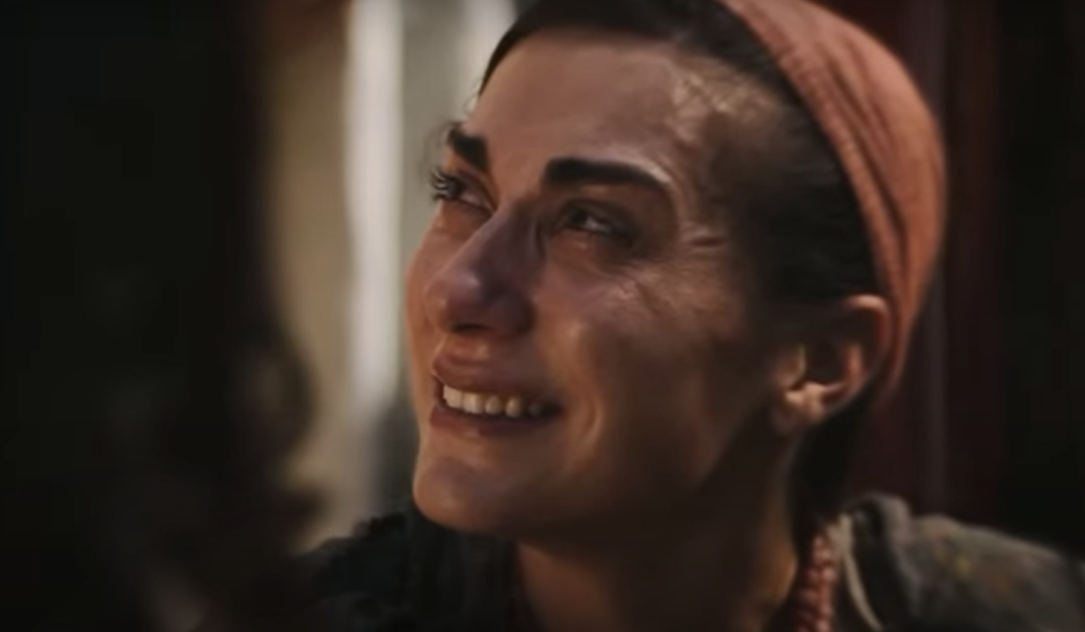
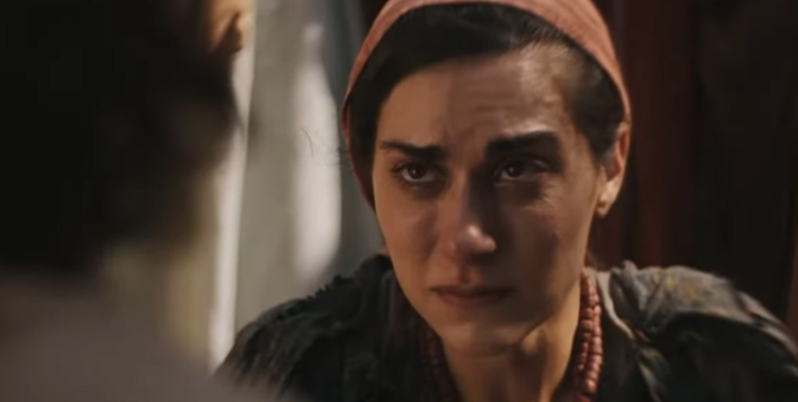
We Have To Be Desperate For Change
And Hungry To Touch Jesus

Slide 40
ASSESS WHERE YOU ARE AT TAKE ACTION STEPS TO CHANGE THE TRAJECTORY
Wisdom is a shelter as money is a shelter, but the advantage of knowledge is this: that wisdom preserves the life of its possessor.
Ecclesiastes 7:12 (NIV)

Slide 41
Relationship - Marriage Questions?
So what would be the things that God is asking you to do that you are hesitant to do – to RE-IGNITE THE SPARK?
What do you see as things that crop up in your marriage from the very beginning to now that never get resolved
THAT MAKE YOUR HEART COLD?
Can you a identify any stronghold that you think needs broken over your life and marriage – THAT IS ATTACKING YOUR SPARK FOR GOD – AND YOUR SPOUSE?
Are you willing to pay the price and believe in a radical new way that God can SPLIT YOU OPEN – AND GIVE YOU A SPARK - make your walk with God and your marriage something amazing for His glory ?

Slide 42
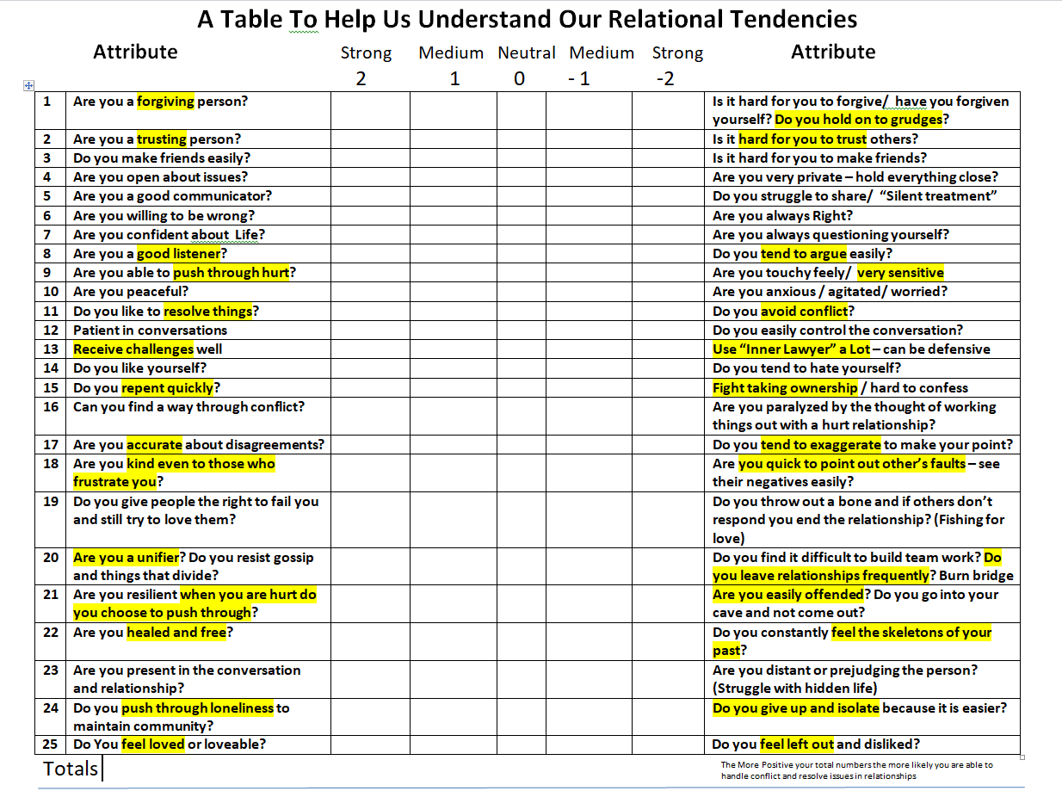

Slide 43
Finally, God does not appeal to us through our earthly nature, since it is the very thing that brings us into slavery. He has to awaken our higher spiritual nature and conscience by high level revelation, love, brokenness, and personal encounters through faith. This higher spiritual nature only comes to life through the Holy Spirit as we surrender to the person of Jesus Christ and make Him our highest priority and then appropriate His unlimited presence and strength to live out His purpose and will.

Slide 44
Emptiness will always cry out to be satisfied. This will never change. And as long as we continue to fill our emptiness with fleshly things we will only experience more emptiness and grieve the heart of God. Jesus the bondage breaker introduces a radical motive into our life that is not rooted in getting our way, escaping pain, getting a better life, or having more intense pleasure: it is not rooted in self-centeredness at all. It is rooted in God-centeredness. This motive is the motive of pure love for an all-deserving Savior. And this love chooses to “taste and see that the Lord is good.” Once we taste the Lord, our emptiness is exposed for the selfish thing that it is and we leave go of the flesh and feast on the Lord releasing for the first time true satisfaction as it begins to fill our whole life.

