Slide 1
“Likewise, husbands, dwell with (your wives) according to knowledge, giving honor unto the wife, as unto the weaker vessel, and as being heirs together of the grace of life; that your prayers be not hindered. 1 Peter 3:7 (KJV)
A SERMON FOR LIFEGATE
Sunday, March 5, 2023

Slide 2
CONCLUSION OF SERIES
IN THE MIDST OF RELATIONSHIP CONFLICTS

Slide 3
WHAT IS GOING ON 2020- 2023?
In the day of great slaughter, when the towers fall, streams of water will flow on every high mountain and every lofty hill. ²⁶ The moon will shine like the sun, and the sunlight will be seven times brighter, like the light of seven full days, when the LORD binds up the bruises of his people and heals the wounds he inflicted. Isaiah 30:25-26 (NIV)
All things rise toward crisis; whether individual matters, or those of the corporate Church or those of the affairs of the nations. And those who pray perseveringly and mightily impact the crisis in harmony with the will of God. But who are those who can powerfully prevail? They are those who are described as the ones who “draw near to God.” George Lang

Slide 4
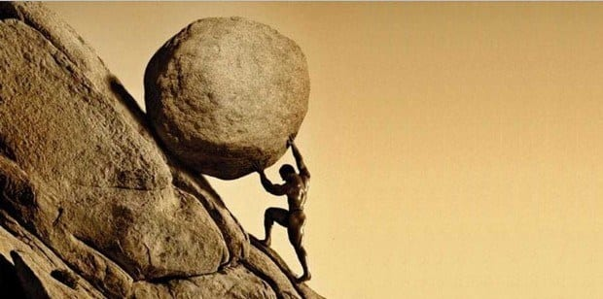
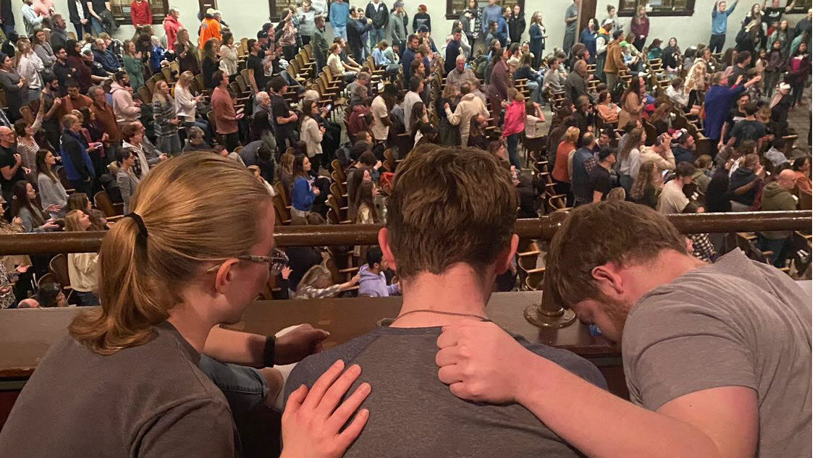
WHAT IS GOING ON 2020- 2023?
THE ULTIMATE FUTILITY OF MAN

Slide 5
WHAT IS GOING ON 2020- 2023?
MEDICAL MOUNTAIN
Support Godly shows and movies | Support our local businesses Start a new business | Awakening Evangelism Discipleship Healing | Engage Public Education Resist indoctrination | Marriages Youth Ministry CPOW | Writing Podcasts Live Stream | Engage for Godly Leaders Work for the Freedom of our nation

Slide 6
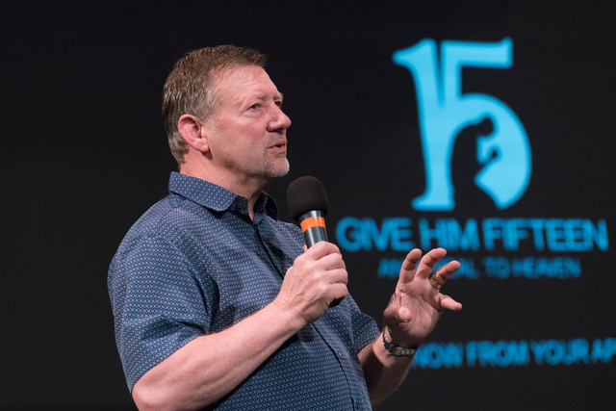
Churches
Need To Get Ready
Churches and leaders should be preparing their people to lead others to Christ. Make sure they know how to do this. Create entry points in the life of your congregation for unbelievers to enter. Begin discussions with your people and leaders on how you will handle challenging and delicate situations. How will you treat the same-sex couple, the prostitute, the drug dealer, the smelly homeless person, the gang member, etc., who enter your congregation looking for hope? How will you protect the innocent and the children, discerning the predators, without rejecting the true seekers? How will you feed and clothe the poor? Revival can and will be challenging. We must prepare.
Dutch Sheets

Slide 7
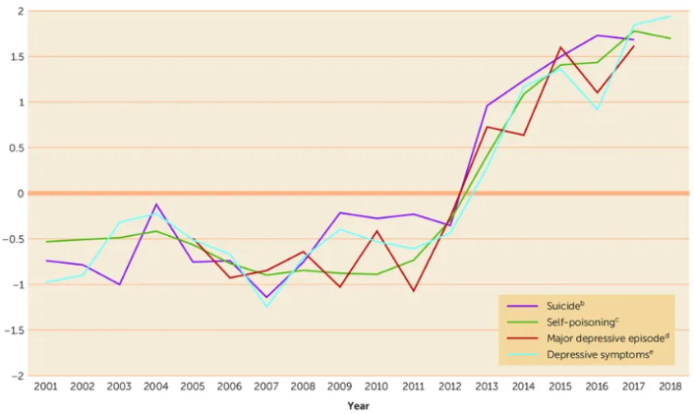
Does Technology and
Social Media Impact us?
I Phone
Invented 2007

Slide 8
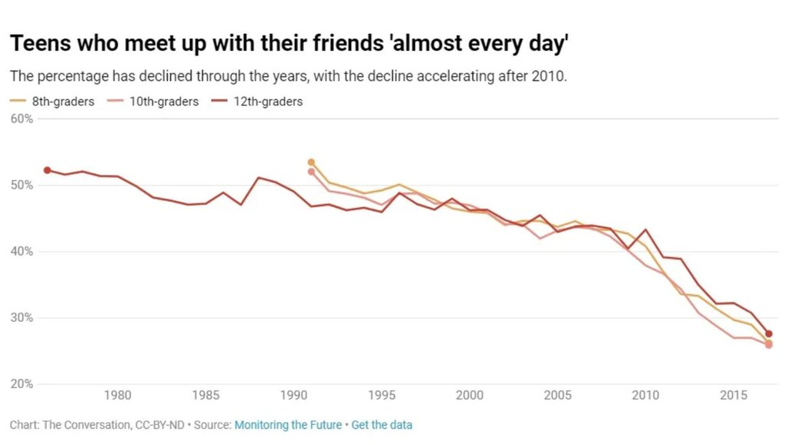
Does Technology and
Social Media Impact us?
I Phone
Invented 2007

Slide 9
GUARD YOUR MIND
AND DON’T WASTE YOUR TIME
There is a cleansing in the Prophetic voices
And In the News of the day JUNKIES
As I urged you - stay there in Ephesus so that you may command certain men not to teach false doctrines any longer nor to devote themselves to myths and endless genealogies. These promote controversies (LITERAL – QUESTIONS) rather than God's work--which is by faith. 1 Timothy 1:3-4 (NIV)

Slide 10
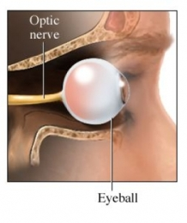
Jesus Wants You To Have People Push back from their chair and say – “I’ve never seen this before.”
Sheila Burke
The Healing Of Relationships
Clarence and Lisa Robbins

Slide 11
This will Make People Notice
This is the case with our community. The grace of God is visible in its effects in producing light and knowledge, prayer and praise, attendance to corporate means of grace, holiness of life, and reformation of culture. Great gladness has been obtained by hundreds who have come to the enjoyment of pardon and peace, and are now rejoicing in the Lord. Great joy has been introduced into families. Men that were coarse and savage, and a source of untold misery to their wives, are now altered, mild, pleasant, so God-like, that the change in their domestic happiness is like heaven on the earth. The sounds of joy and gladness is now heard in many families throughout this privileged season. (Ireland 1859)

Slide 12
THE FOUR RESPONSIBILITIES OF
BIBLICAL GOD-CENTERED LOVE
THE RESPONSIBILITY OF PURE WORSHIP THAT OVERCOMES A FREE-WILL THAT IS SELF-CONSUMED (Exodus 20:3; Deuteronomy 6:5; Mark 12:30)
THE RESPONSIBILITY OF PURE PEACE THAT OVERCOMES PETTY ANGER, JEALOUSY, VIOLENCE, AND HATE. (Exodus 20:13; Matthew 5:9, James 3:18)
THE RESPONSIBILITY OF PURE PLEASURE (AND SEXUALITY) THAT OVERCOMES BEING LOVERS OF PLEASURE – ADDICTION, LUST, AND UNBIBLICAL BOUNDARYLESS SEX. (Exodus 20:14; 1 Corinthians 6:18; Colossians 3:5; 2 Timothy 3:4)
THE RESPONSIBILITY OF PURE WEALTH THAT OVERCOMES GREED, POVERTY, THEFT, AND THE LOVE OF MONEY (Exodus 20:15; Matthew 6:24; 1 Timothy 6:10; Hebrews 13:5; 1 Peter 5:2)

Slide 13
When we step out of any of God’s ordained path of obedience in ANY these FOUR RESPONSIBILITIES we are in IDOLATRY
Your Emotions Can Become IDOLATRY you can worship Anger

Slide 14
To A Healthy Marriage
CONFLICT RESOLUTION and communication
EXPECTATIONS AND FRUSTRATION – Shutting down
FINANCES and stewardship – Biblical Finances
STRESS and Finding quality time
NURTURING AND AFFECTION – Biblical Sexual purity
UNITY AND VISION – common strategies for life

Slide 15
Conflicts Almost always Involve Our Feelings
Having Our Emotions Sanctified Is Critical
REMEMBER : - impact the crisis in harmony with the will of God. (GIVE ME SOMETHING TO WORK WITH)
Be joyful always; ¹⁷ pray continually; ¹⁸ give thanks in all circumstances, for this is God's will for you in Christ Jesus. ¹⁹ Do not put out the Spirit's fire; ²⁰ do not treat prophecies with contempt. ²¹ Test everything. Hold on to the good. ²² Avoid every kind of evil. ²³ May God Himself, the God of peace, sanctify you through and through. May your whole spirit, soul and body be kept blameless at the coming of our Lord Jesus Christ. ²⁴ The One who calls you is faithful and He will do it.
1 Thessalonians 5:16-24 (NIV)

Slide 16
Having Our Emotions Sanctified
Who is wise and understanding among you? Let him show it by his good life, by deeds done in the humility that comes from wisdom. 14 But if you harbor bitter envy and selfish ambition in your hearts, do not boast about it or deny the truth. 15 Such "wisdom" does not come down from heaven but is earthly, unspiritual, of the devil. 16 For where you have envy and selfish ambition, there you find disorder and every evil practice. (CONFLICT) 17 But the wisdom that comes from heaven is first of all pure; then peace-loving, considerate, submissive (easily entreated), full of mercy and good fruit, impartial and sincere. 18 Peacemakers who sow in peace raise a harvest of righteousness. James 3:13-18 (NIV)
A generous person will prosper; whoever refreshes
others will be refreshed. Proverbs 11:25

Slide 17
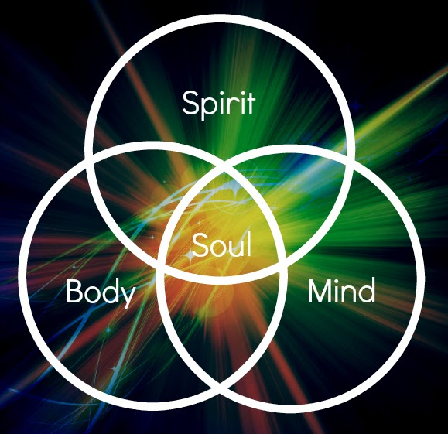
How We Are Created
(No body can really agree on
how to Diagram this)
Body
Mind/ Heart/ Soul
Spirit
HAS
AFFECTIONS
Love the LORD your God with all your heart and with all your soul and with all your strength. Deuteronomy 6:5
Emotions
Heart
WILL
Flesh
For where your treasure is, there your heart will be also. Matthew 6:21 (NIV)
TIES TO WHAT THE HEART LOVES
INFORMS

Slide 18
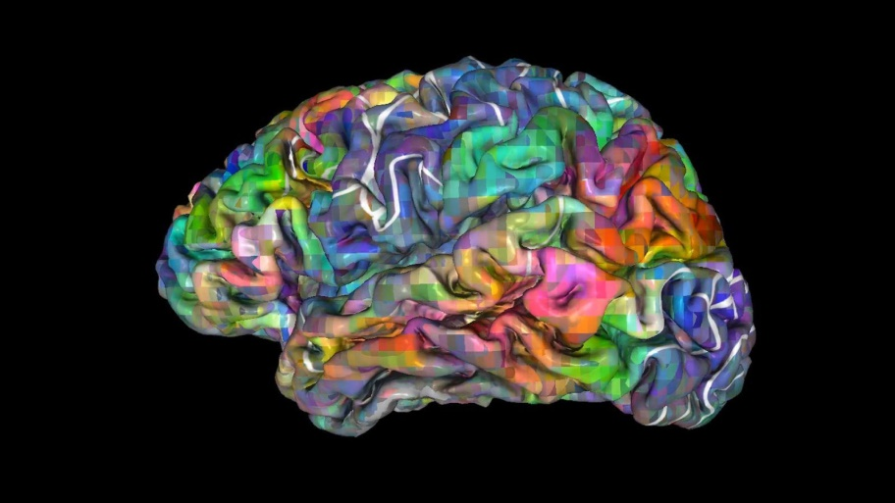
Critical Functions of The Mind/Heart
The Heart chooses - consents or rejects to the facts and goes out after the desired object (treasure) with AFFECTIONS -presented by the MIND – The heart loves or despises based on this information
The Mind - INFORMS - Gather’s
Facts/ truths – receives information – Categorizes the importance and needs and impact of these
Facts/truths
The Emotions
Have Feelings about these facts/truths
BUT THEY ARE NOT FAITH OR VIRTUOUS
For as he thinks in his heart, so is he. Proverbs 23:7

Slide 19
CONFLICT RESOLUTION
INVOLVES THE HEART – BUT ALSO THE MOUTH BEING SANCTIFIED
That if you confess with your mouth (ACTIVATED FAITH), "Jesus is Lord," and believe in your heart that God raised Him from the dead, you will be saved. ¹⁰ For it is with your heart that you believe (unto love) and are justified, and it is with your mouth that you confess and are saved. (revealing the fruit of your faith and love) ¹¹ As the Scripture says, "Anyone who trusts in Him will never be put to shame." Romans 10:9-11 (NIV)

Slide 20
One of the Biggest Hindrances
To Breakthrough in Relationships
“What did you expect? Of course they rejected you. That’s what happens every time. Why did you expect anything different?” Do you ever hear that voice when you’re rejected? The funny thing is, that voice is YOU (backed up by the enemy).” ( Website - the answer AZ)
Something real – that
Hits the core of your heart and makes you feel
Rejected unworthy and
Never GOOD ENOUGH.
What, then, shall we say in response to this? If God is for us, who can be against us? ³² He who did not spare His own Son, but gave Him up for us all--how will He not also, along with Him (Jesus) , graciously give us all things?
Romans 8:31-32 (NIV)

Slide 21
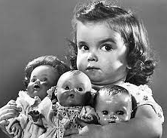
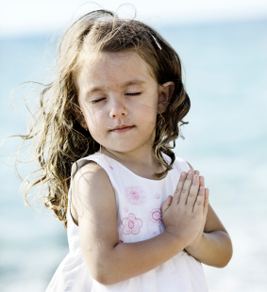
THE WORK OF JESUS CHRIST HAS THE
ONLY POWER TO REVERSE THE POLARITY
OF OUR SELFISH HEART
-
+
Selfish
Loving

Slide 22
THE SIX BASIC PERSONALITIES
And their Strengths and Weaknesses
Pioneers --- They lead the way and don’t care if anyone follows – they press through – they are free-spirited - but left to themselves they become fiercely independent and don’t always finish the details of what they are working on.
Survivors – They will protect themselves and become controllers of their world and do not trust others very well.
Fighters - They have something to prove – and never feel accepted. Are strong in faith but are often susceptible to rejection and low self esteem and thrive (too much) in conflict.

Slide 23
THE SIX BASIC PERSONALITIES
Care-givers - They love everyone deeply – and cannot confront those they love – they are the ultimate “people person” - but they become enablers and are hard at setting boundaries.
Victims – They always have something to blame for their pain and failures other than themselves - they become passive through excuses and struggle with comparing themselves with others.
Loners - They always stay away from others to protect their fears and insecurities – unseen – they tend to sabotage potential relationships with landmines of distrust and over-analyzing.

Slide 24
Relationship-Busters
Perfume and incense bring joy to the heart, and the pleasantness of one's friend springs from their earnest counsel. Proverbs 27:9 (NIV)
Wounds from a friend can be
trusted, but an enemy multiplies kisses. Proverbs 27:6 (NIV)
The Five
Anger
Anxiety
Distrust
Isolation/ irritation
Hopelessness – Depression
Peacemakers who sow in peace raise a harvest of righteousness. James 3:18 (NIV)

Slide 25
THE PHILIPPIANS 1 GIFT OF BIBLICAL SELF DIAGNOSIS
THE ABILITY TO UNDERSTAND OUR PERSONALITY HELPS YOU TO DISCERN WHAT BATTLE
IS GOING ON FOR OUR SOUL.
And it is my prayer that your love may be more and more accompanied by clear knowledge and keen perception, for testing things that differ, so that you may be men of transparent character, and may be blameless, in preparation for the day of Christ,
being filled with these fruits of righteousness which come through Jesus Christ— to the glory and praise of God. Philippians 1:9-11 (WEY)

Slide 26
Changing the Trajectory of Conflict
Holy Spirit Conflict Resolution Therapy
"Therefore, if you are offering your gift at the altar and there remember that your brother has something against you, ²⁴ leave your gift there in front of the altar. First go and be reconciled to your brother; then come and offer your gift. Matthew 5:23-24 (NIV)
1 – Admit your own faults and take the high-road of being loving – forgiving, and willing to change.
2 – Find a common point of agreement – Don’t always be right
3 – Repent of negative communication patterns, and pray for effective “dialoguing” skills. With the Spirit’s enabling power you will learn how to avoid emotional detours.

Slide 27
THE COMMITMENT TO
HEALTHY DIALOGUE
I will express my disagreements with my friends or spouse without insulting, mocking, or slandering them personally. (Matthew 5:22)
I will not exaggerate the others' positions nor make unfounded assumptions. I will always extend the benefit of the doubt. (Ephesians 4:29)
Do not let any unwholesome talk come out of your mouths, but only what is helpful for building others up according to their needs, that it may benefit those who listen. Ephesians 4:29 (NIV)

Slide 28
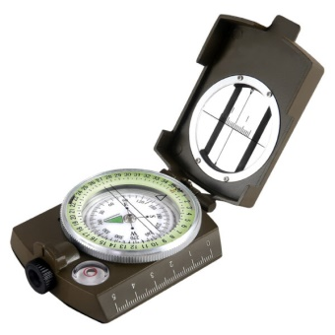
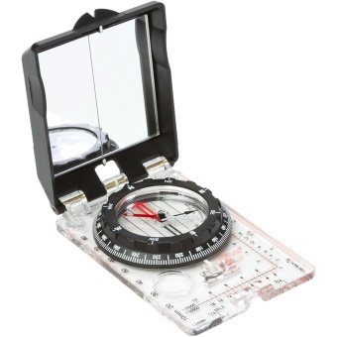
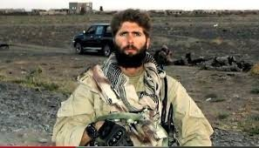
Lensatic
Silva
In the SEAL Teams we use the Silva Ranger compass for our land navigation. The army uses the Lensatic compass.
Fails an
Over-watch mission
Afghanistan

Slide 29
Jesus Is the Greatest Leader Ever
He leads His Team Well
We simply Need to Execute His Plans
SINE PARI – WITHOUT EQUAL
My lover is radiant - outstanding among ten thousand. Song of Songs 5:10 (NIV)
“Vince Peterson was the greatest natural leader I’ve ever known. He had a knack of expressing where the team needed to go with just a few words. He’d plant the seeds, let his men take ownership of the plan, then watch as everything went forward. When the plan succeeded, and it almost always did, he never took the credit. He gave it to everyone else.”

Slide 30
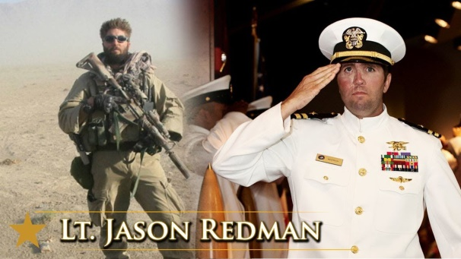
The Breakthrough
Moment
For a second I stood on a mental precipice, looking down at that void that I’d fallen into after my last mission in Afghanistan. No. I refuse to go there. Not this time. What’s the takeaway? How can I fix this?
“Don’t let the reaction to the mistake destroy your relationship with your teammates.” I let one of my own weaknesses beat me again.
. “Look, Red, you’re doing a great job but you suck at taking criticism. Someone offers you advice after you make a mistake and you take it personally. We’re trying to help you grow, make you a better leader. You got this. We all mess up. Just happens. Learn to absorb the lessons, take the heat, and move on.”

Slide 31
THE Joe Hari Tool

Slide 32
True Friends Open Up
And Share With Each Other
Shallow access to heart – I’ll let you share your thoughts with me in “friend-to-friend” respect, but I don’t want to deal with what you are sharing or let you know why I’m not going to listen to you.
Strategic access to heart – I want you to share anything useful to help me to become more like Jesus – and along the way when I become defensive please be patient with me – but keep speaking the TRUTH into my heart until I see the issues and am set free in that area.

Slide 33
Everything Comes by Activated FAITH
Character Breakthroughs: These
Release greater
Missional opportunities
As the Lord releases
Greater anointings
because your faith
produces
the character
of Jesus.
Receive Corporate
Visitations of God’s
Presence in church
And community:
You link your
Faith with others
For community
Outpourings.
Deeper Fillings of
The Holy Spirit: You sense your deep weakness And
appropriate the
promised infillings of
His effective power.
Salvation: You
believe Jesus
died for you and rose
again and receive forgiveness by faith and
Confess it with your mouth.

Slide 34
Relationship - Marriage Questions?
So what would be the things that God is asking you to do that you are hesitant to do – to HEAL RELATIONSHIPS?
What do you see as things that crop up in your marriage or relationships that never get resolved
WHAT MAKES YOUR HEART COLD?
Can you a identify any stronghold that you think needs broken over your life and marriage – THAT IS ATTACKING YOUR SPARK FOR GOD – AND YOUR RELATIONSHIPS? A PAST WOUND? UNRESOLVED?
Are you willing to pay the price and believe in a radical new way that God can SPLIT YOU OPEN – AND GIVE YOU A NEW HEART - make your walk with God and your marriage something amazing for His glory ?

Slide 35
