Slide 1
Being Captured
By God
A SERMON FOR LIFEGATE
Sunday, March 26, 2023

Slide 3
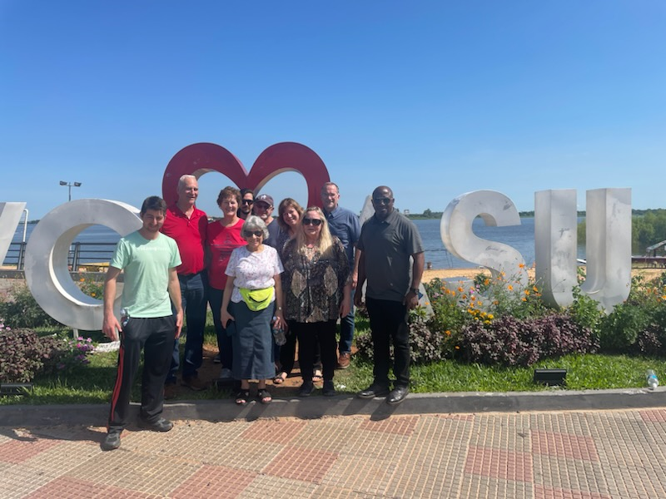

Slide 4
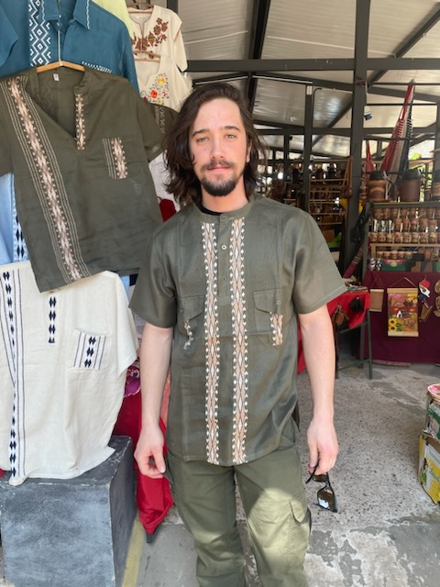

Slide 5
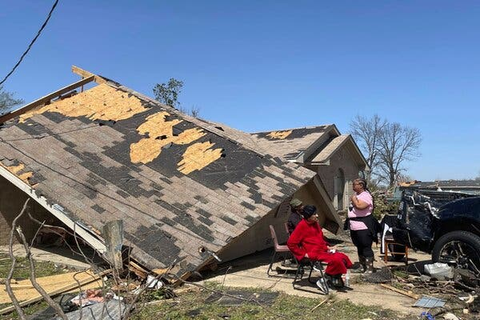
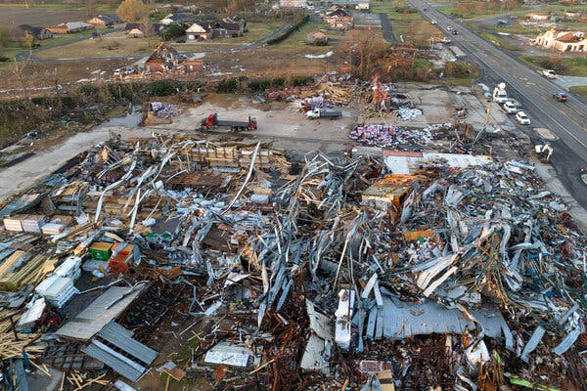
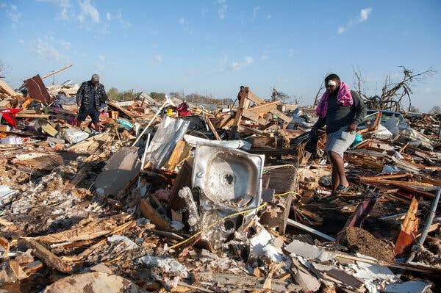
Praying For America
Especially Rolling Fork Mississippi

Slide 6
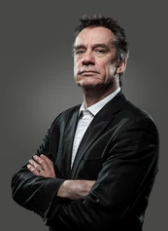
Opening Random Thoughts
The sad thing is you can be a nice winsome charming bubbly person and still not have a saving faith in Jesus Christ and be living inwardly for the flesh and lose your soul to eternal separation from God. ¹¹ "But when the king came in to see the guests, he noticed a man there who was not wearing wedding clothes. ¹² 'Friend,' he asked, 'how did you get in here without wedding clothes?' The man was speechless. ¹³ "Then the king told the attendants, “Throw him outside, into the darkness, where there will be weeping and gnashing of teeth.' ¹⁴ "For many are invited, but few are chosen." Matthew 22:11-14 (NIV)
Or you can be a stern uninviting person and have a personal baby faith in Christ for salvation but miss the higher works of His grace and Spirit but barely go to heaven. He himself will be saved, but only as one escaping through the flames. 1 Corinthians 3:15 (NIV)

Slide 7
THE LORD IS EXPOSING EVERYTHING IN ALL OF US – HE IS PREPARING TO GIVE US VERY RICH BLESSINGS IN THESE LAST DAYS - AND HE CAN’T TAKE THE CHANCE THAT WE WILL SQUANDER THEM WITH SELFISH CHOICES.
"Whenever I would restore the fortunes of my people, whenever I would heal Israel, the sins of Ephraim are exposed and the crimes of Samaria revealed. Hosea 7:1
Personal Purifying
Marriages aligned
Finances evaluated
Motives searched
Attitudes challenged

Slide 8
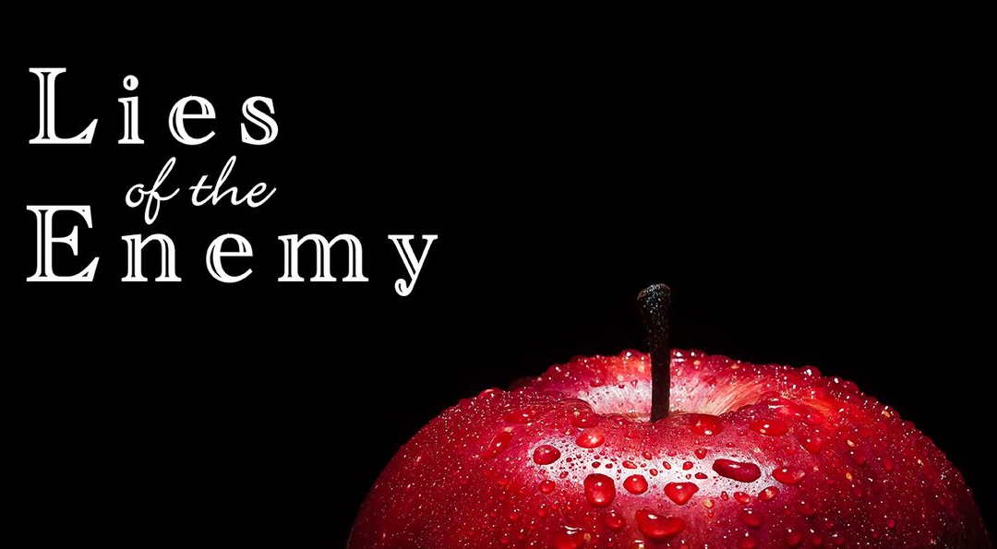
UNWRAPPING

Slide 9
THE SEARCHING OF THE LORD
Lord forgive me for getting used to areas of diminishing sensitivity toward You and others around me because I’m tired or worn out. Give me fresh faith – fresh love – fresh grace – fresh oil.
Lord help me to constantly allow the Holy Spirit to deepen my Christ-like attitudes. To deepen our sensitivity to Your works of grace. Lord I need Your glory to refine me. The burning of Your Holiness in me. Not of human origin but of the Holy Spirit.

Slide 10
DURING TIMES OF GREAT SEARCHING WE CAN GET ON EACH OTHER’S NERVES
And do not grieve the Holy Spirit of God, with whom you were sealed for the day of redemption. ³¹ Get rid of all bitterness, rage and anger, brawling and slander, along with every form of malice. ³² Be kind and compassionate to one another, forgiving each other, just as in Christ God forgave you. Ephesians 4:30-32 (NIV)
“Oh! It is grand to be absolutely conquered by the Holy Spirit, and swing out a thousand miles from everybody and everything into the ocean of God’s presence and leading, and work with Him in humility without stumbling over others, without spiritual pride, and bend to every plan God has for us.” G. D. Watson

Slide 11
God is revealing each of our
personal “echo chambers”
THE LORD IS REVEALING THIS GENERATIONS IDOLATROUS ECHO CHAMBERS – WHERE THE VOICES REINFORCE A STRONGHOLD THAT HAS GRIPPED THEM FOR YEARS.
PARENTS, AND SPIRITUAL LEADERS MUST STAND FOR THE TRUTH – EVEN WHEN THE TRAJECTORY OF THOSE PULLING ON OUR HEARTS FOR COUNSEL WANT US TO APPROVE THEIR IDOLATRY.

Slide 12
CRAZY HUMAN WEAKNESS
THERE IS THIS CRAZY WEAKNESS IN HUMAN NATURE WHERE “IF I’M NOT THE ONE WHO IS PERPETRATING THE WRONG IN A PARTICULAR SITUATION DIRECTLY” THEN I DON’T FEEL ANY OBLIGATION TO GET INVOLVED DIRECTLY IN EXPOSING OR RESISTING THE SUBTLE AGENDAS OF THE FALSE MOVEMENTS.

Slide 13
Just Because The Holy Spirit Works
In Mysterious Ways – Does Not Make
Him Ineffective
LORD HOLY SPIRIT YOU ARE THE MOST MYSTERIOUS OF THE GLORIOUS GODHEAD – YET YOU ARE SO ESSENTIAL TO ALL OF OUR LIVES – TO LIVE IN VICTORY – TO LIVE IN EFFECTUAL GRACE AND IMPACT
HOLY SPIRIT I REPENT! (BECAUSE WHEN VIEWING YOUR MYSTERIOUS WAYS) I THINK YOU ARE SO SENSITIVE THAT I TREAT YOU AS INEFFECTIVE – YOU ARE NOT DIFFICULT TO PARTNER WITH – BUT I NEED TO CHANGE – I NEED TO GET OUT OF THE RELIGIOUS FLESH AND INTO THE SPIRIT MORE. I PRAISE YOU HOLY SPIRIT THAT YOU ARE EFFECTIVE – YOU ARE IMPACTFUL – YOU DO ALL THINGS WELL.

Slide 14
What Is About To Happen

Slide 15
God Did Not Give Up On His Original Plan

Slide 16
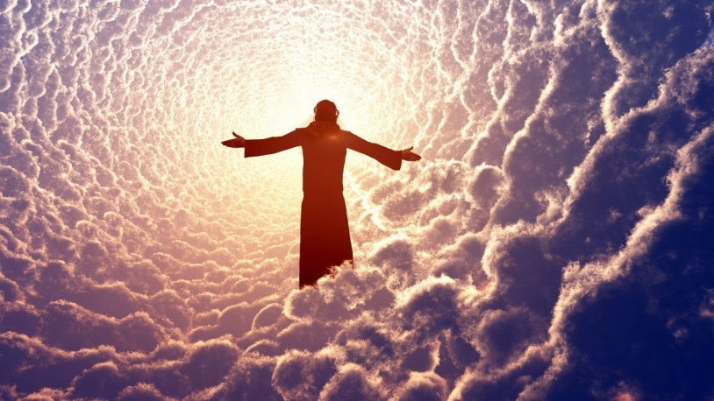
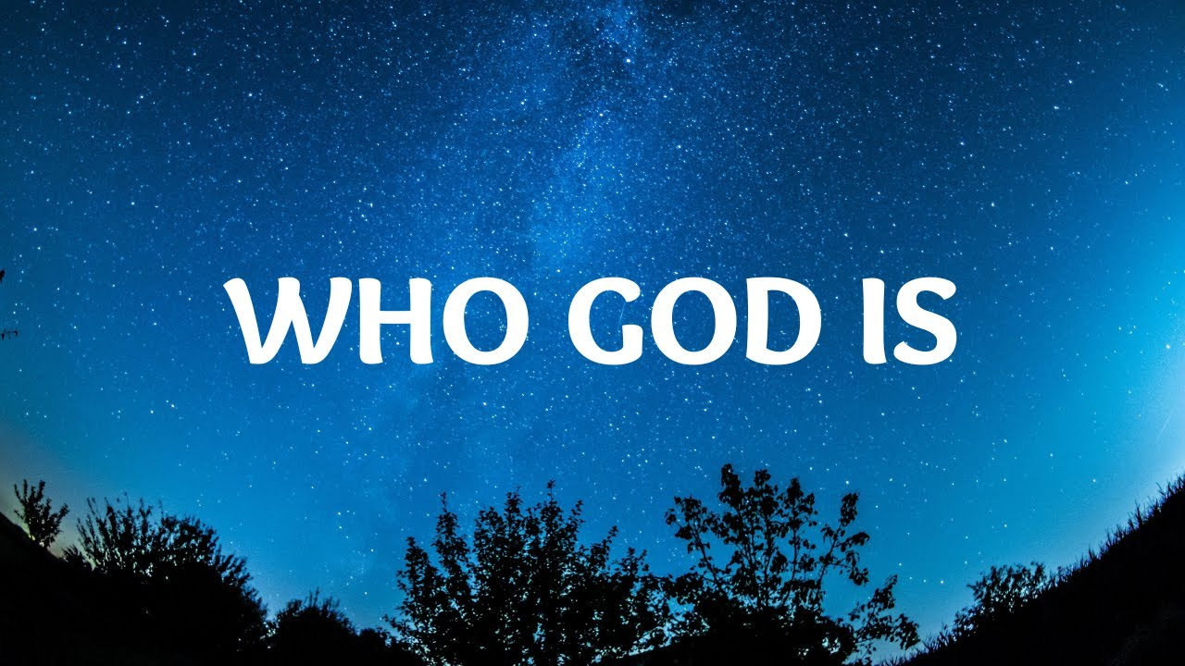
THE GLORY OF OUR HOLY GOD
WHAT HE DOES

Slide 17
This Is The Majesty Of Our God
Oh, the depth of the riches of the wisdom and knowledge of God! How unsearchable His judgments, and His paths beyond tracing out! "Who has known the mind of the Lord? Or who has been His counselor?" "Who has ever given to God, that God should repay him?" For from Him and through Him and to Him are all things. To Him be the glory forever! Amen. He is before all things, and in Him all things hold together. And He is the Head of the Body, the Church; He is the beginning and the firstborn from among the dead, so that in everything He might have the supremacy.

Slide 18
"Our method of proclaiming salvation is this: to point out to every heart the loving Lamb, who died for us, and although He was the Son of God, offered Himself for our sins ... by preaching His innocent blood, and His love unto death, even the death on the cross, never, either in discourse or in argument, to digress for even fifteen minutes from the loving Lamb:

Slide 19
To name no virtue except in Jesus, to preach no commandment except faith in Him; no pardon except that He atoned for us; no sanctification but the privilege to sin no more; no other happiness but to be near Him and know Him and do His pleasure; no self denial but to be deprived of Him and His blessings; no calamity but to displease Him; no other life but in Him."
- Count Zinzendorf

Slide 20
Isaiah Chapter 61

Slide 21
Isaiah Chapter 61 Part 2

Slide 22
Colossians Chapter 1

Slide 23
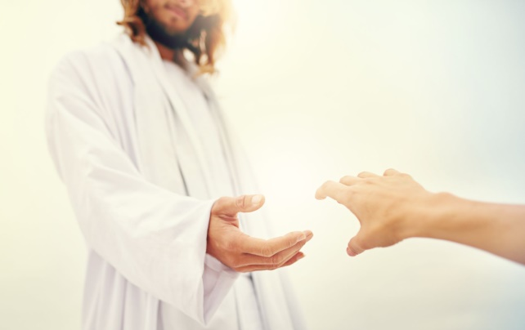
An Intensified Filling of the Holy Spirit
Will Only Give You More Revelation of Jesus
The primary work of Grace you receive in the filling of the Holy Spirit is a greater revelation of Jesus
Gifts
Anointing
Power
Hope
I consider everything a loss compared to the surpassing greatness of knowing Christ Jesus my Lord, for whose sake I have lost all things. I consider them rubbish, that I may gain Christ ⁹ and be found in him, not having a righteousness of my own that comes from the law, but that which is through faith in Christ--the righteousness that comes from God and is by faith. ¹⁰ I want to know Christ and the power of his resurrection and the fellowship of sharing in his sufferings, becoming like him in his death, Philippians 3:8-10 (NIV)

Slide 24
So How Do We Posture Our Selves To Receive More Intensified Fillings Of The Spirit ?
All Judah rejoiced about the oath because they had sworn it wholeheartedly. They sought God eagerly, and He was found by them. So the LORD gave them rest on every side. 2 Chronicles 15:15 (NIV)
Seek the LORD while he may be found; call on him while He is near. ⁷ Let the wicked forsake his way and the evil man his thoughts. Let him turn to the LORD, and he will have mercy on him, and to our God, for he will freely pardon. Isaiah 55:6-7 (NIV)
After they prayed, the place where they were meeting was shaken. And they were all filled with the Holy Spirit and spoke the word of God boldly. Acts 4:31 (NIV)

Slide 25
The Power Of Hope
May the God of hope fill you with all joy and peace as you trust in him, so that you may overflow with hope by the power of the Holy Spirit. Romans 15:13 (NIV)

Slide 26
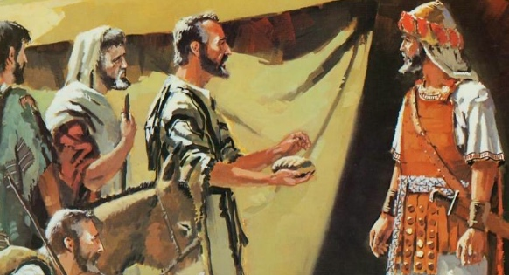
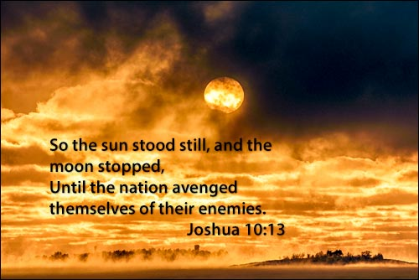
Some Of The Greatest Blessings
Can Come Even After We have Messed Up
Joshua and the Gibeonites

Slide 27
THE GLORY IS THAT EVERYTHING THAT COMES TO US IS A GIFT – IT IS BY GRACE – WE CANNOT EARN IT –
IT IS THROUGH THE SACRIFICE OF JESUS – IT IS BY MERCY.
AND YET – WE ARE INVITED TO CONTEND FOR THOSE GIFTS IF THEY ARE DELAYED – IF THEY ARE RESISTED.

Slide 28
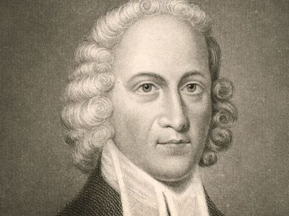
Jonathan Edwards
As I rode out into the woods for my health, in 1737, having left my horse in a retired place, I had a revelation, that was for me extraordinary, of the glory of the Son of God as Mediator between God and man and of His wonderful, great, full, pure, and sweet grace and love, and meek and gentle condescension. The grace that appeared so calm and sweet appeared also great above the heavens, the Person of Christ appeared indescribably excellent and a beauty great enough to swallow up all thoughts and conceptions, this continued, as near as I can judge, for about an hour, which kept me a greater part of the time in a flood of tears and weeping out loud. I felt an determination of my soul to be what I know not otherwise how to say except, emptied and annihilated, to lie in the dust and to be full of Christ alone, to love Him with a holy and a pure love, to trust in Him, to depend upon Him, to serve Him, and to be perfectly sanctified and made pure with a Divine and heavenly purity.

Slide 29
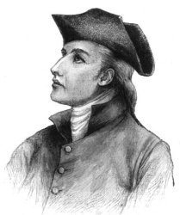
David Brainerd
“Out of the “blue” an unspeakable glory seemed to open up to me. It was an inward revelation or view that I had of God, such as I had never had before or anything comparable to it. For the excellency and beauty of it was way beyond anything I had ever received. I had no particular revelation of the Father, Son or Spirit – but They all appeared to me to be the Divine Glory. My soul rejoiced with joy unspeakable, to see such our glorious God. I was inwardly pleased and satisfied that He should be God forever and ever. My soul was so captivated and delighted in His excellencies, loveliness, greatness, and other perfections that I was swallowed up in Him. July 12, 1739

Slide 30
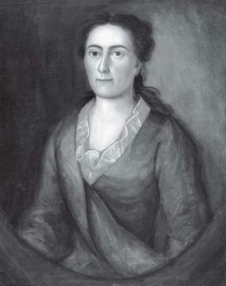
Sarah Edwards
That night, which was Thursday night, January 28, was the sweetest night I ever had in my life. All night I continued in a constant, clear, and powerful sense of the heavenly sweetness of Christ’s excellent and transcendent love, of His nearness to me, and of my dearness to Him; with an inexpressibly sweet calmness of soul and an entire rest in Him.
I seemed to myself to perceive a glow of Divine love come down from the heart of Christ in heaven, into my heart, in a constant stream, like a stream of sweet light. At the same time, my heart and soul all flowed out in love to Christ; so that there seemed to be a constant flowing and re-flowing of heavenly and Divine love, from Christ’s heart to mine; and I appeared to float or swim, in these bright, sweet beams of the love of Christ, like the motes swimming in the beams of the bright sunlight.

Slide 31
APPLICATION?
Are you willing to be emptied of YOURSELF?
Are you HUNGRY FOR GOD and HIS PRESENCE in your life?
Can you a identify any stronghold that puts you in your own echo chamber of making excuses and not CHANGING.
Are you willing to pay the price and POSTURE YOURSELF for more FILLINGS OF THE HOLY SPIRIT?

