Slide 1

Hosting the Presence of the Spirt:
Helping the Body of Christ learn what the value and place of God’s Glory plays in
Defeating the enemy and bringing a great harvest of souls and fruit to our region.

Slide 2
Personal Reflection -
A revival in 1989
Three weeks ago - large job get’s canceled
Visit to Asbury
In a season of refinement – God is weeding things
out of me.

Slide 3
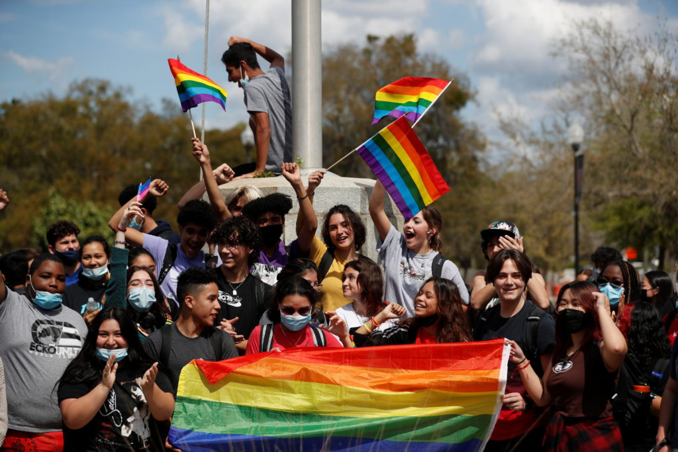
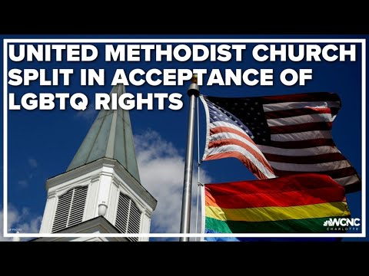
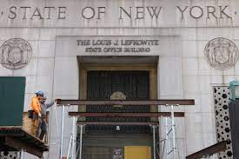
Historical Moment

Slide 4
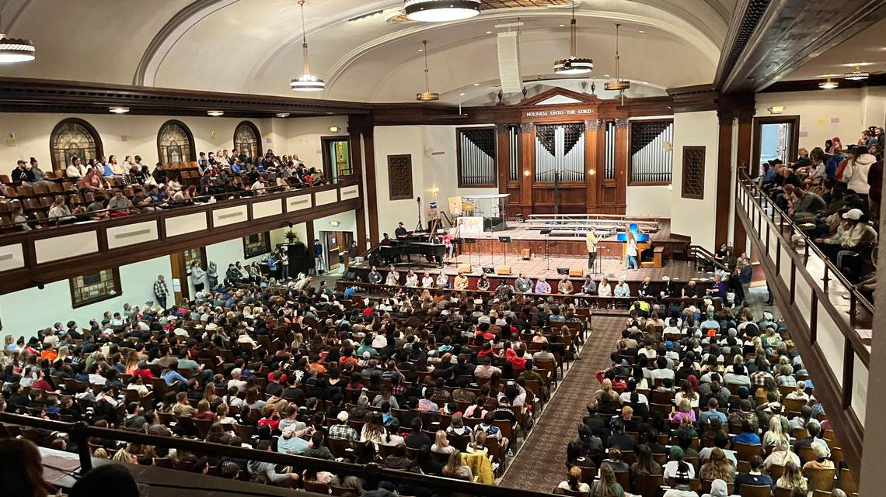
Revival is being poured out 2023

Slide 5

The Fear of God

Slide 6

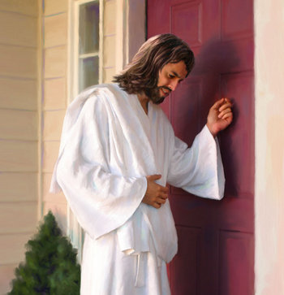
Recognizing the Door Bell of Spirit

Slide 7

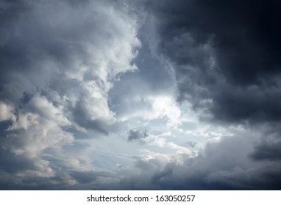
Three atmospheres that we can work under:
Open Heavens
- Anointing and power in ministry
People are seeking God/ turning their lives over
His presence fills the market place
Power and efficiency - no spinning
wheels wasting time
Satan’s lies and decent are exposed
Jesus is the talk of the town
Intermittent break throughs
People see kisses of heaven and the glory shows up for brief periods
Sense of greater things about to happen in the land
People are praying and believing for break throughs.
Deeper hunger and longing in the church

Slide 8

Closed Heavens:
Churches are closing
Liberal theology has taken over most denominations
People are lost and don’t seem care
Society is in deep moral decline
Satan is the talk of the town
Evil is celebrated and people have no hope for the future.
Example of transformational times: Welsh revival 1905

Slide 9
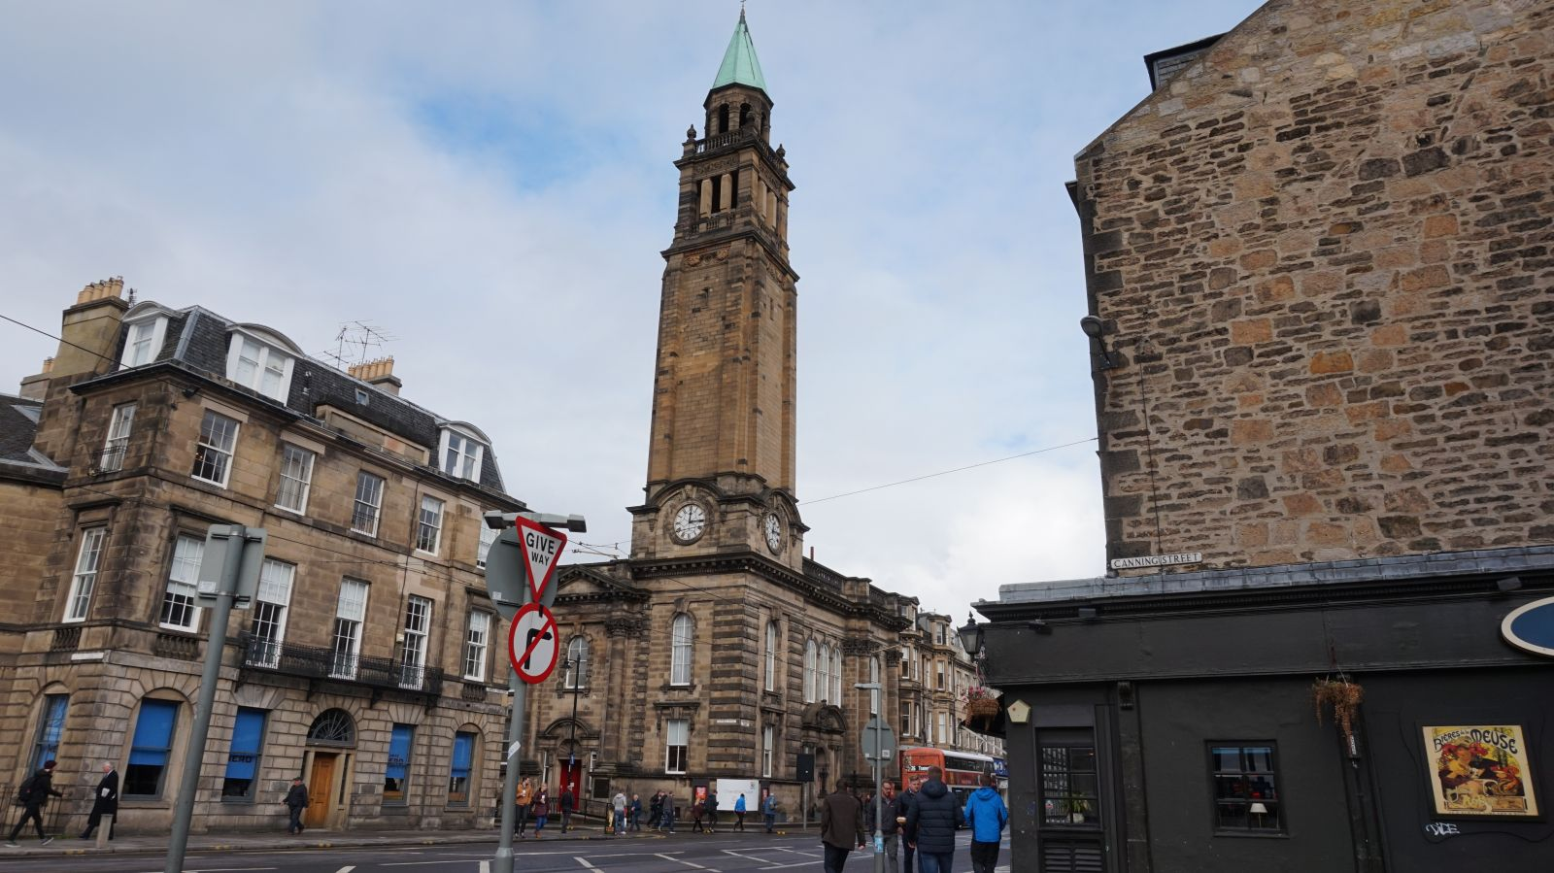
Charlotte Chapel 1905 - 1915

Slide 10
Points made by Joseph Kemp in early 1900’s
There needs to be a revelation that God is the only One Who can fix the current crisis!!
- The decline in the church life is alerting us to the need….
- The decline in society is bringing us to our knees
- The church is feverously laboring away and accomplishing little
- The world is laughing at the church and mocking her efforts
- When we get the end of our human efforts, revival is waiting
A return to the heartfelt need and exercise of prayer
  - Without faith filled prayers for God’s power to open the Heavens there can be no victory!
  - All our activities and countless programs have accidentally pushed out prayer
  - When everything dominates the time needed for prayer, something has to be given up in order to get back into the flow of intercession.
  - When church member get to busy for prayer meetings, the prayer meetings will become non-essential and the consequences will be no spiritual power of authority.
  - It is suicidal to imagine you can affect your world and make an eternal difference without getting prayer gathering fanned back into flame.
  - It is also important to note, that even after getting people to start attending again, these meetings must be : Focused on Specific areas of life, (Salvations, healings, government needs, marriages, youth)
  Prayer must also be earnest: not just going through the motions.
  Intercessor must display faith and confidence in the Lord to answer them.

Slide 11
3) Willingness to Obey the conviction of the Holy Spirit and deal with sin:
- We must be in a clear relationship with the Lord in order to have victory.
- Put aside every weight and entanglement that comes between us and the Lord
- Through the fresh revelation of the Holy Spirit, you can be made aware of things you have held onto for years that God no longer wants you to be a part of. Going into the season of exposure, you will quickly come to the conclusion that there is nothing worth clinging on too. Yur priority will be to not grieve the Spirit and cause the Lord’s presence to subside.
- For sure the exposure of the subtle sense of pride coming into our hearts -
- I’ve preached a great messages/ Leading in wonderful worship
- Serving in many capacities / Tithing to the Lord
All of this needs to be exposed if it’s tainted with pride.
4) Restoration of the Scriptures as the foundation of our preaching/ teaching:
- Telling people that God loves them, without revealing the depth of our own
rebellion and depravity is half truth.
- Conviction is most effective when speaking the words of God.
- If people leave your services and have not heard the word of God, you have failed.
- The world is waiting for preachers who deliver the truth of God’s word that is accompanied by the presence of the Holy Spirit.
5) The Outpouring of the Holy Spirit:
- This is the most important aspect of effective ministry
- The essential piece of Church’s fruitfulness upon a community, will be to what degree a general revival is sweeping our land.
- Whatever obstacles we can discover and remove, to allow this blessing to flow in our streets, will be worth it all. It will be the most important effort of a life time.

Slide 12
Story of 2 Chronicle 20
Great battle was about take place
King called for prayer and Fasting
God rang the door bell of an ordinary citizen
Brought a great victory

Slide 13

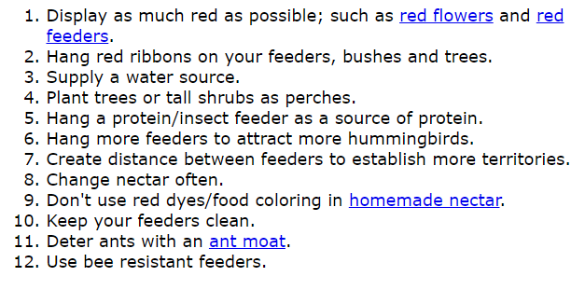
How do we attract Holy Spirit to
Come to Elizabethtown

Slide 14
Welcome Mat for the Holy Spirit
Reverence and fear of the Lord
Walk in Humility
Awareness of our weaknesses
Prompt Obedience to the Holy Spirit
Dig into the word of God – Claim Promises
Resist the idea you don’t qualify
Stand against the notions that your wierd and
  People will think your crazy

Slide 15
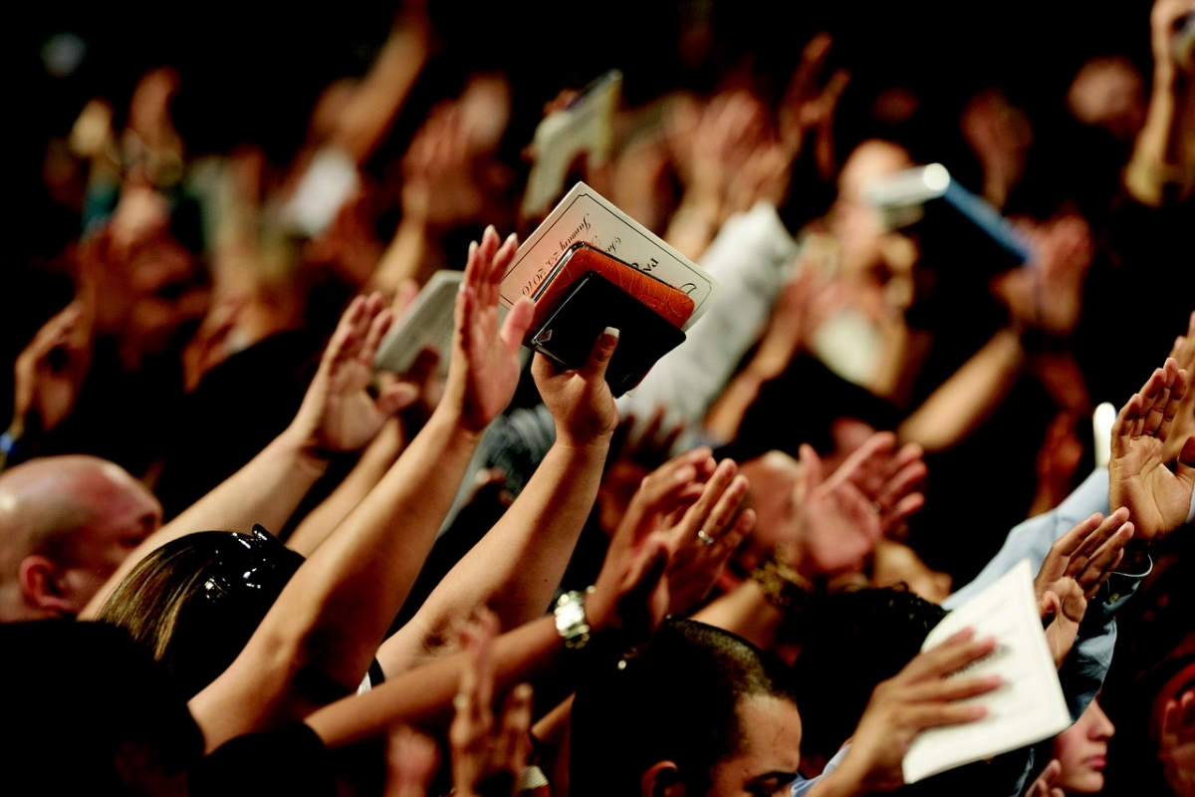
The season for Corporate
Get into the habit of gathering as many beleivers together for prayer and worship when God calls us.

