Slide 1
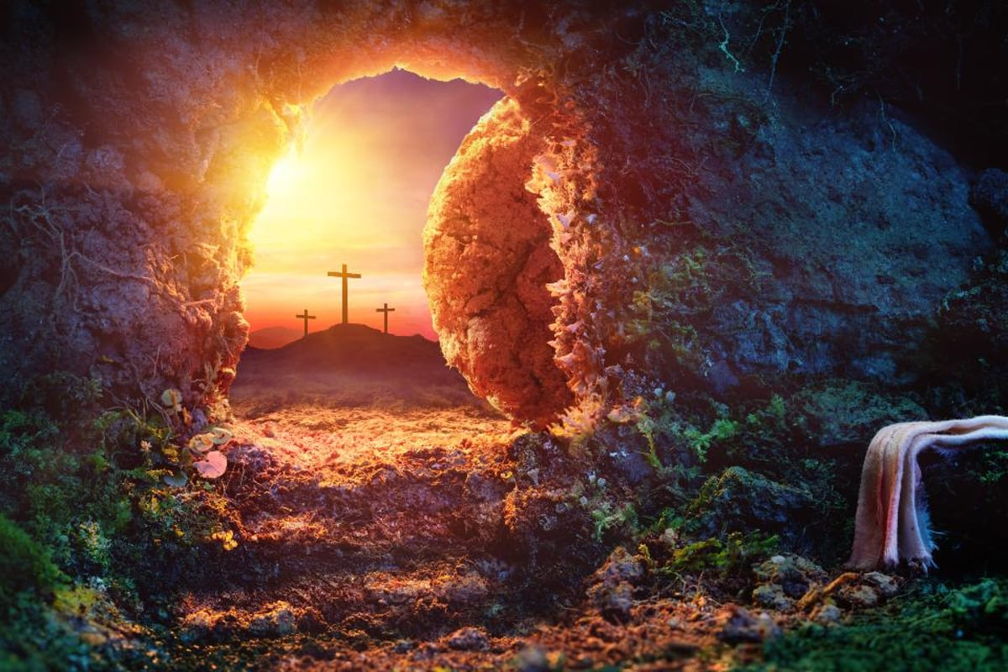
The Resurrection Vindicates
The Sinless Life Of Jesus Christ
Easter Sermon For LifeGate
Sunday, April 9, 2023

Slide 2
Opening Scriptures
"Men of Israel, listen to this: Jesus of Nazareth was a man accredited by God to you by miracles, wonders and signs, which God did among you through him, as you yourselves know. ²³ This man was handed over to you by God's set purpose and foreknowledge; and you, with the help of wicked men, put him to death by nailing him to the cross. ²⁴ But God raised him from the dead, freeing him from the agony of death, because it was impossible for death to keep its hold (Retained) on him. Acts 2:22-24 (NIV)
Seeing what was ahead, he (David) spoke of the resurrection of the Christ, that He was not abandoned to the grave, nor did His body see decay. ³² God has raised this Jesus to life, and we are all witnesses of the fact. Acts 2:31-32 (NIV)

Slide 3
Opening Scriptures
Beyond all question, the mystery of godliness is great: He appeared in a body, was vindicated by the Spirit, was seen by angels, was preached among the nations, was believed on in the world, was taken up in glory. 1 Timothy 3:16 (NIV)

Slide 4
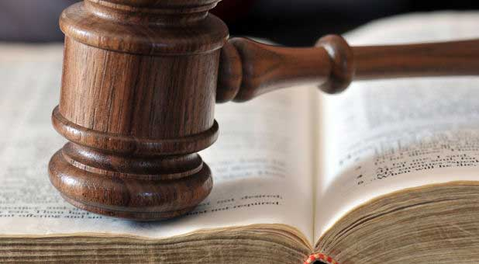
VINDICATE: to clear (someone) of blame or suspicion. - show or prove to be right

Slide 5
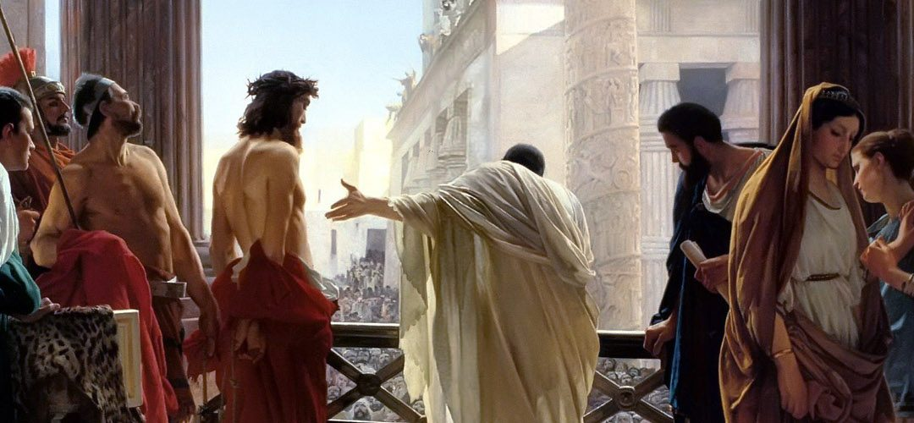
The Dangers Of The Speed of Drama

Slide 6
The Players in The Drama
PILATE – Saw someone that should be exonerated but ultimately caved and washed his hands
THE CROWD - Those – caught up in the spirit of the age –
PILATE’S WIFE – Don’t get involved
SOLDIERS – JUST doing what they were told
LEADING TEACHERS – Caiaphas - ELDERS AND PHARISEES – Missed the Messiah because of their blind ambition and unbelief

Slide 7
The Players in The Drama
HEROD – I just want to see some miracles
BARABBAS – The unjust man set free because of the sacrifice of Jesus in his place
SIMON of CYRENE – Called into the spectacle because he was available –
TWO THIEVES ON EITHER SIDE OF JESUS – one joins the rest and mocks – the other sees something deeper going on and recognizes Jesus as the Messiah
PETRIFIED AND STUNNED DISCIPLES INCLUDING PETER

Slide 8
Back Up A
Minute
What is your Source?
If God created the Universe He is super super intelligent
God is a Precise Communicator (He means what He says)
God chose to speak to His creation his thoughts and principles and expectations
He made mankind capable of processing languages and to fashion that language into a written organized structure
God used language to communicate through HIS PROPHETS Who He is – and called this the TORAH (Law) – Logos – Written word – Rhema – Spoken Word - All scripture is given by inspiration of God, and is profitable for doctrine, for reproof, for correction, for instruction in righteousness: 2 Timothy 3:16 (KJV)

Slide 9
A Simplified Poll
That Defines A Biblical Worldview
Only 33%
Of Pastors
Believe these
Do absolute moral truths exist?
Is absolute truth defined by the Bible?
Did Jesus Christ live a sinless life?
Is God the all-powerful and all-knowing Creator of the universe, and does He still rule it today?
Is salvation a gift from God that cannot be earned?
Is Satan real?
Does a Christian have a responsibility to share his or her faith in Christ with other people?
Is the Bible accurate in all of its teachings?

Slide 10
According To Scriptures
¹ Now, brothers, I want to remind you of the Gospel I preached to you, - For what I received I passed on to you as of first importance: that Christ died for our sins according to the Scriptures, ⁴ that He was buried, that He was raised on the third day according to the Scriptures, ⁵ and that He appeared to Peter, and then to the Twelve. ⁶ After that, He appeared to more than five hundred of the brothers at the same time, most of whom are still living, though some have fallen asleep. ⁷ Then He appeared to James, then to all the apostles, ⁸ and last of all He appeared to me also, as to one abnormally born. 1 Corinthians 15:1, 3-8 (NIV)

Slide 11
THE UNSPEAKABLE GLORY
OF THE SUFFERING SAVIOR
Surely he took up our infirmities and carried our sorrows, yet we considered him stricken by God, smitten by him, and afflicted. 5 But he was pierced for our transgressions, he was crushed for our iniquities; the punishment that brought us peace was upon him, and by his wounds we are healed. 6 We all, like sheep, have gone astray, each of us has turned to his own way; and the LORD has laid on him the iniquity of us all. 7 He was oppressed and afflicted, yet he did not open his mouth; he was led like a lamb to the slaughter, and as a sheep before her shearers is silent, so he did not open his mouth. Isaiah 53:4-7 (NIV)

Slide 12
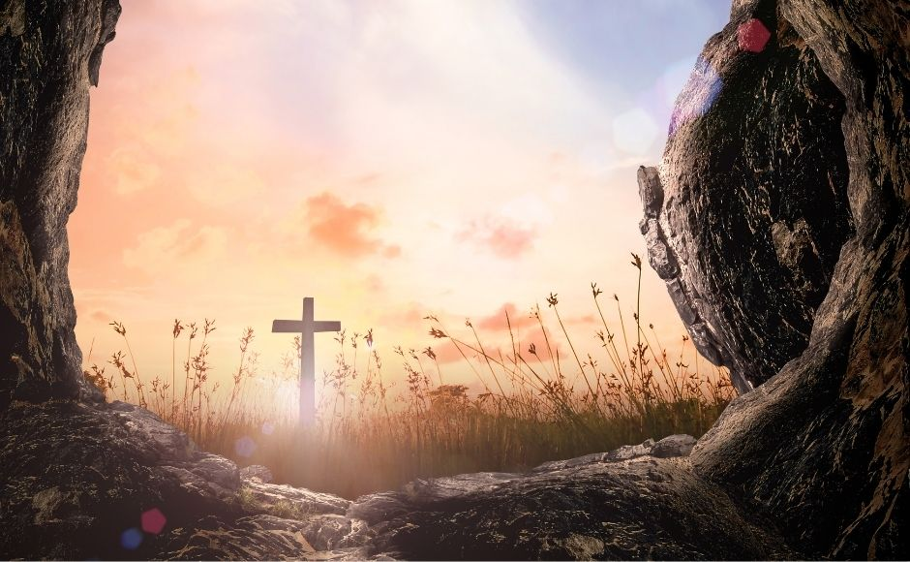
Colossians Chapter 1
The Greatest
Turn of Events

Slide 13
The Resurrection
Vindicated His Obedience
He was assigned a grave with the wicked, and with the rich in his death, though he had done no violence, nor was any deceit in his mouth. Isaiah 53:9 (NIV)
Yet it was the LORD's will to crush him and cause him to suffer, and though the LORD makes his life a guilt offering, He will see His offspring and prolong His days, and the will of the LORD will prosper in His hand. 11 After the suffering of His soul, He will see the light [of life] and be satisfied; by his knowledge my righteous servant will justify many, and he will bear their iniquities. Isaiah 53:10-11 (NIV)

Slide 14
The Holiness of God
Required The Cross
Caught in the grip of this rapid cultural change, the last one hundred years of Church history has seen an accelerated drift toward a Gospel that declares almost exclusively the love and grace of God and the non-confrontive elements of the Gospel. Undoubtedly, the strongest currents of the Gospel are anchored in the love of God and these become the underpinning for everyone who yields their life to God. But, is it possible to have soaked so long in this singular vein of teaching that we have lost our spiritual equilibrium? Is it possible we no longer have the faintest idea how uncompromising the final judgment of our Holy God will be for everyone?

Slide 15
We Can Receive His Victory
The Cross and resurrection of Jesus Christ answers this question. The Cross of Christ shows us what was coming for each of us. A justified judgment for our sins. But He took that curse for our sake. The Resurrection shows us that He has won, He has conquered and we are invited into His victory. Because our sentence is commuted and we are resurrected in Him we have both an appreciation of the judgment of God and the mercy of His grace.

Slide 16
Faith is the Key That Unlocks His Victory For Us
And without faith it is impossible to please God, because anyone who comes to him must believe that he exists and that he rewards those who earnestly seek him. Hebrews 11:6 (NIV)

Slide 17
THE WEST LOVES VAGUE SPIRITUALITY
INDEFINITE MYSTICISM
Five
Natural faith – seeing is believing
Science faith – Man and science is the answer to mankind’s problems.
Fear faith – the thing I fear must be real
Delusional faith – ultimately believing a lie
God faith – Word inspired and Spirit-activated ends up putting trust in the Lord.

Slide 18
What is Faith?
Now faith is the substance of things hoped for, the evidence of things not seen. Hebrews 11:1 (KJV) -
FAITH – is a persuasion of the Mind and heart to fully TRUST in the revelation of God revealed in the Scriptures by the Work of the Holy Spirit.

Slide 19
The Resurrection Vindicates God
THE RESURRECTION VINDICATES THE SINLESS LIFE OF JESUS
THE RESURRECTION VINDICATES THE SACRIFICE OF THE FATHER
That he might make atonement for the sins of the people. 18 Because He himself suffered when He was tempted, He is able to help those who are being tempted. Hebrews 2:17-18 (NIV)
THE RESURRECTION VINDICATES THE GLORIOUS POWER OF THE HOLY SPIRIT
Just as Christ was raised from the dead through the glory of the Father, we too may live a new life. Romans 6:4 (NIV)

Slide 20
The Glory of Jesus
So when God came down, He chose the first-person hard way; He chose the gritty way; He chose the bloody way; He chose the suffering way; He chose a deeply humbling and excruciating way to save us. He does expect us to receive this grace – He does expect us to take Him up on the offer of Him paying our fine and that we would turn to Him and obey Him the rest of our life.
In conclusion, God’s costly intervention, makes us look at the world around us in its suffering and pain and say OK it doesn't make sense to me and I don't understand it all. But I know this one thing. My God went deeper than all the suffering that's going on around me. My God experienced more injustice than all of the injustice in our world and He was totally pure innocent HOLY GOD (Not a sinful jerk like me).

Slide 21
Some Of The Greatest Blessings
Can Come Even After We have Messed Up
My God endured more wrong against Himself than we have experienced towards ourselves. My God who could have set a nice little picnic table in heaven and watched the world implode or could have sent His angels down to earth while He sat in a white suit pushing buttons from His office. Instead, chose to get dirtier than the dirtiest situation we're facing. He became totally engaged and suffered; He didn't take the easy way out.
Our God set the standard. Our God went the 10,000th mile. Our God went far beyond just fixing a problem. He did it with His own suffering; He did it with His own willingness to cross over into weakness and take up our infirmities upon Himself. So that when He finished His work – and was resurrected - He would be the most exalted, most glorious Savior of all and would be able to save us to the uttermost.(Hebrews 7:25)

Slide 22
God is raising up a generation that will
Humbly walk with God
For this is what the high and lofty One says-- He who lives forever, whose name is holy: "I live in a high and holy place, but also with him who is contrite and lowly in spirit, to revive the spirit of the lowly and to revive the heart of the contrite.
Isaiah 57:15 (NIV)

Slide 23
Where Are We – Easter 2023
I want to know Christ and the power of his resurrection and the fellowship of sharing in his sufferings, becoming like him in his death, ¹¹ and so, somehow, to attain to the resurrection from the dead. ¹² Not that I have already obtained all this, or have already been made perfect, but I press on to take hold of that for which Christ Jesus took hold of me. ¹³ Brothers, I do not consider myself yet to have taken hold of it. But one thing I do: Forgetting what is behind and straining toward what is ahead, ¹⁴ I press on toward the goal to win the prize for which God has called me heavenward in Christ Jesus. Philippians 3:10-14 (NIV) (62 A.D.)

