Slide 1
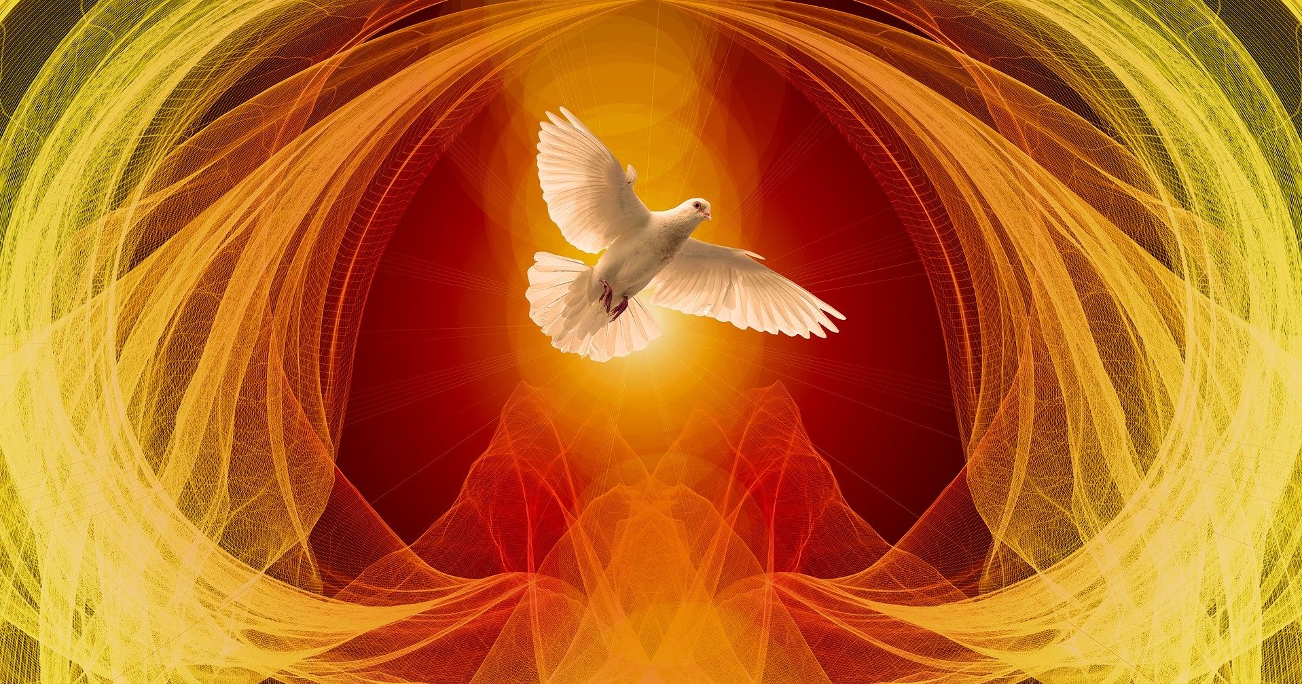
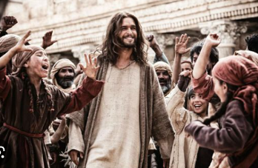
Hosting the Presence of the Spirt: II
Helping the Body of Christ learn what the value and place of God’s Glory plays in
Defeating the enemy and bringing a great harvest of souls and fruit to our region.
Palm Sunday Awakening

Slide 2
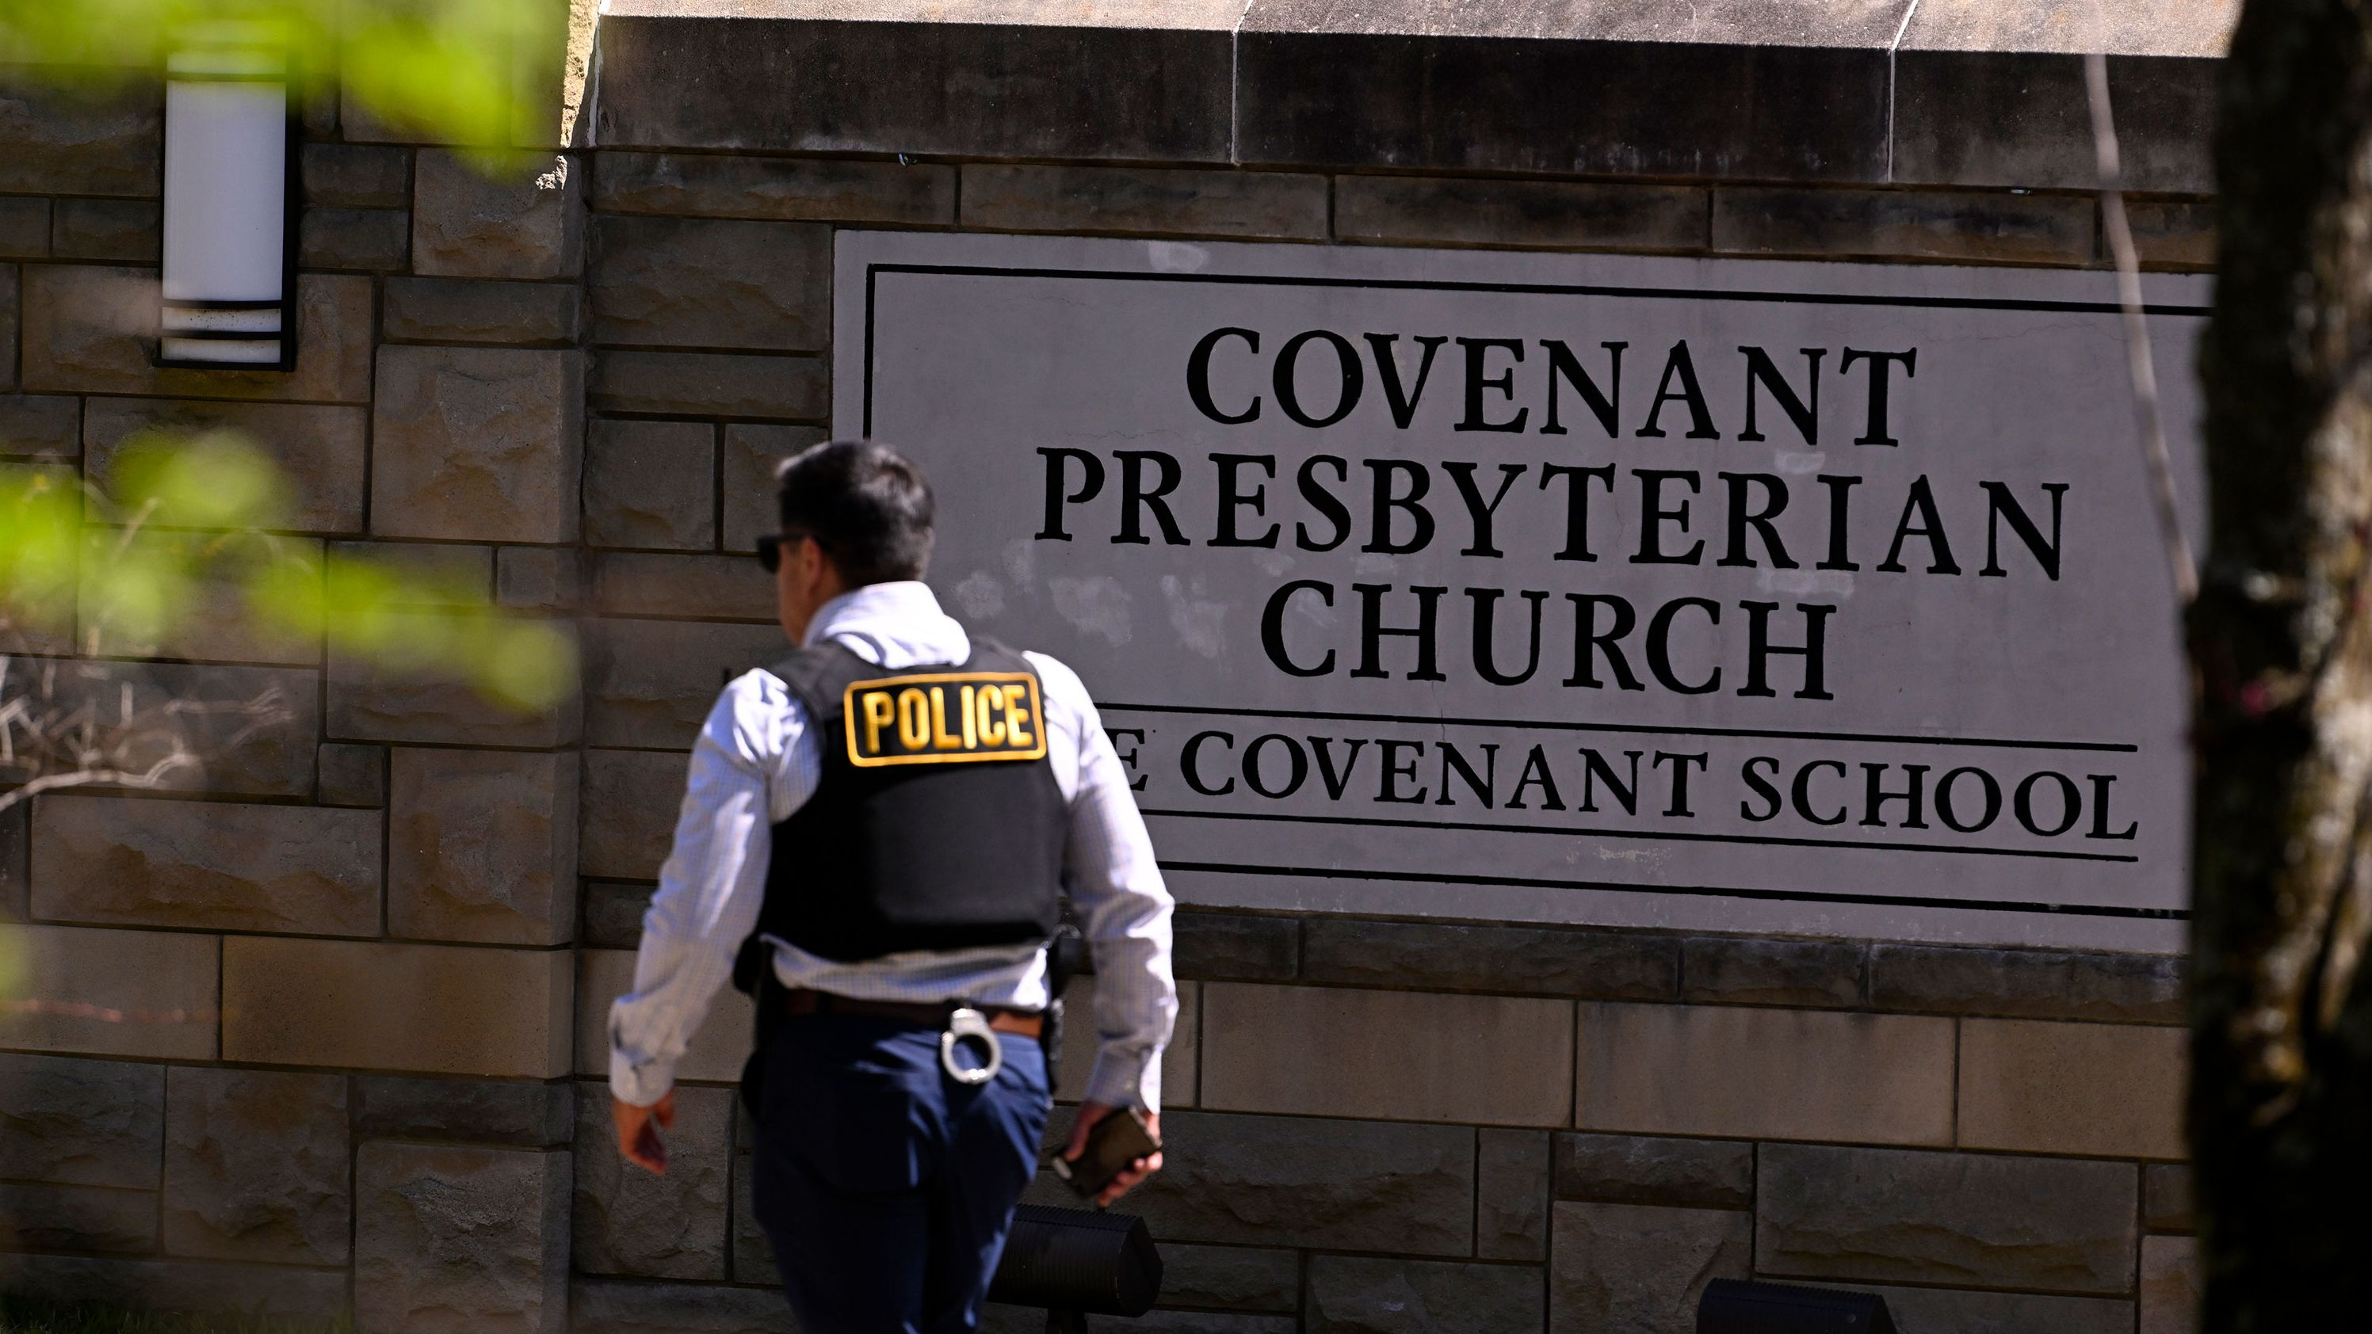
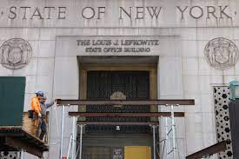
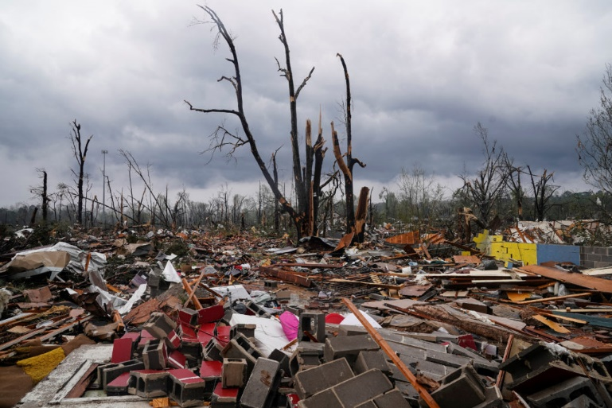
Historical Moment: What’s happening?

Slide 3
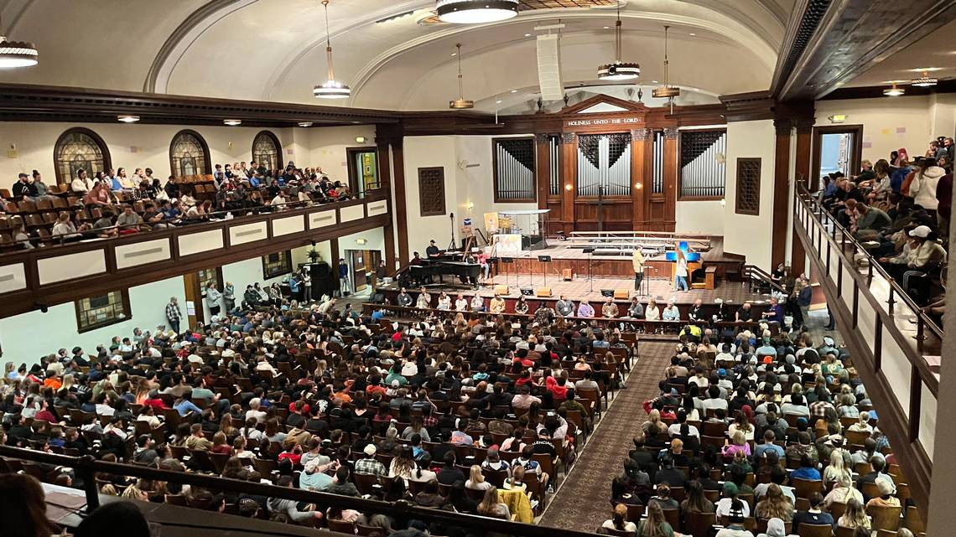
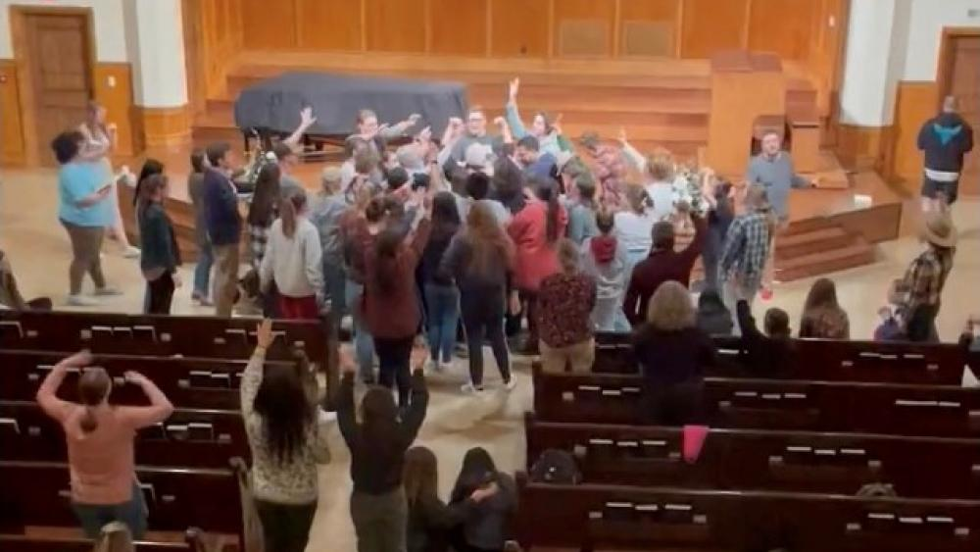
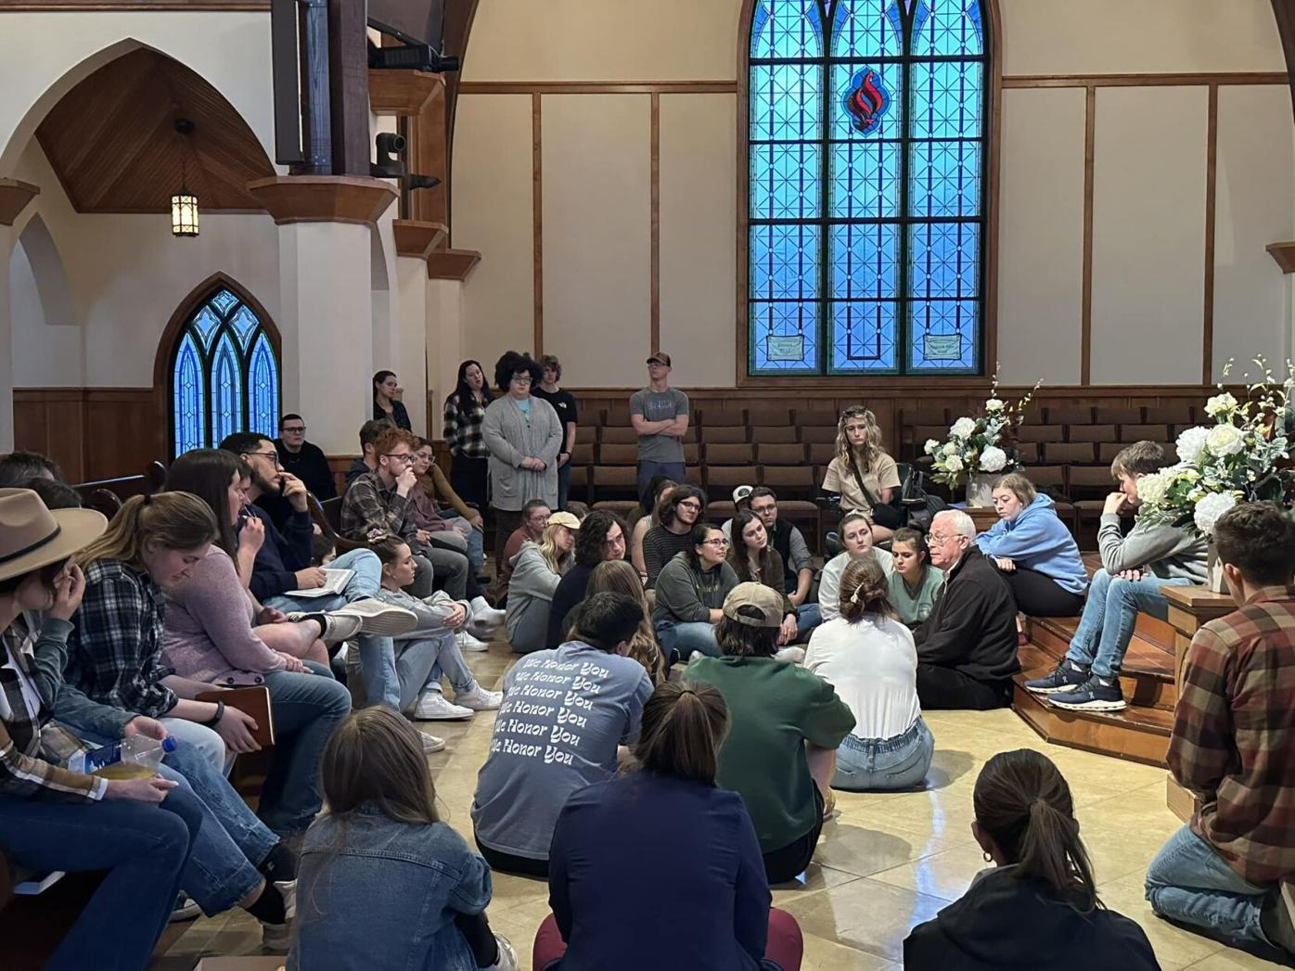
Revival is being poured out 2023

Slide 4
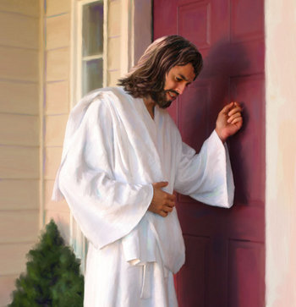
Recognizing the Door Bell of Spirit
HOLY ALARM

Slide 5
Seeking the presence of the Spirit - Is not idolizing revival
Seeing young people getting revived is heart of God
Seeing broken relationship that haven’t been healed in 20 years restored – is heart of God
Seeing churches working in unity and carrying the torch of revival – is the heart of God
Seeing individuals set free from bondage, depression, suicidal thoughts, anger – is heart God
Seeing schools impacted with righteousness
- Is the heart of God!

Slide 6
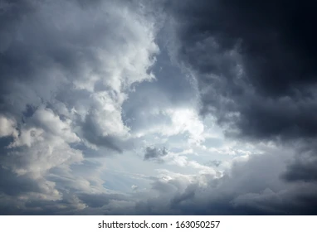
Three atmospheres that we can work under:
Open Heavens
- Anointing and power in ministry
People are seeking God/ turning their lives over
His presence fills the market place
Power and efficiency - no spinning
wheels wasting time
Satan’s lies and decent are exposed
Jesus is the talk of the town
Intermittent break throughs
People see kisses of heaven and the glory shows up for brief periods
Sense of greater things about to happen in the land
People are praying and believing for break throughs.
Deeper hunger and longing in the church

Slide 7
Closed Heavens:
Churches are closing
Liberal theology has taken over most denominations
People are lost and don’t seem care
Society is in deep moral decline
Satan is the talk of the town
Evil is celebrated and people have no hope for the future.
Our job in 2023 is to assist in seeing wider opening in Heavens
Corporate response – act collectively to seek God’s Favor - 2 Chron. 7:14
Personal response - empty ourselves of things that hinder – Heb. 12:

Slide 8
Story of 2 Chronicle 20
Great battle was about take place
King called for prayer and Fasting
God rang the door bell of an ordinary citizen
Brought a great victory

Slide 9
How do we attract Holy Spirit to Come to Elizabethtown (Corporately)
Thank the Lord that He has a solution for our troubled nation and communities
Remind Him that He’s done it before, he can do it again!
Make adjustments for His instructions/ direction/ impartations of assignments.
Pray/ Pray/ Pray/ Pray - alone in secret place/ family/
and corporately
Talk to the Gen “z” and encourage them to listen closely because they are the Gideon’s of the hour!

Slide 10
Welcome Mat for the Holy Spirit ( Personal Level)
Reverence and fear of the Lord
Walk in Humility
Awareness of our weaknesses
Prompt Obedience to the Holy Spirit
Dig into the word of God – Claim Promises
Resist the idea you don’t qualify
Stand against the notions that your weird and
People will think your crazy

Slide 11
What are the characteristics of this current revival? (DNA)

Slide 12
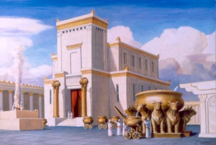
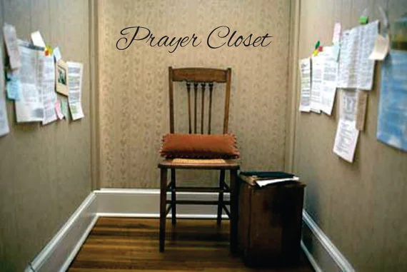
Entering into God’s presence -

Slide 13
He is Worthy of all our Praise

Slide 14
Getting set free from Default Mode

Slide 15
PALM SUNDAY – Waving the branches of our hearts to welcome the Lord in!
LORD COME INTO MY MIND!!

