Slide 1
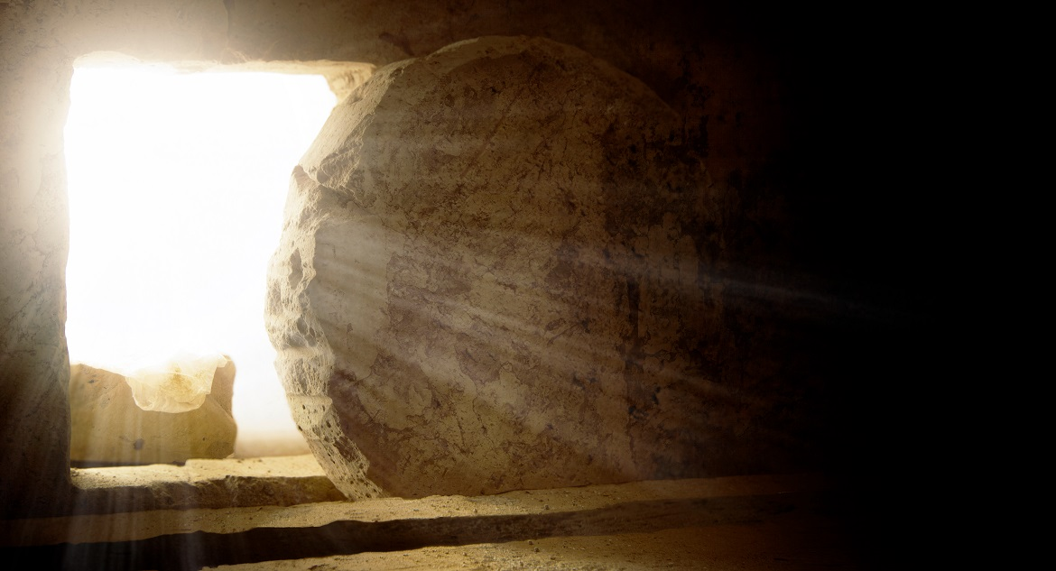
The Resurrection Power

Slide 2
Acts 4:33 And with great power the apostles were giving testimony to the resurrection of the Lord Jesus, and abundant grace was upon them all.

Slide 3
23 this Man, delivered over by the predetermined plan and foreknowledge of God, you nailed to a cross by the hands of godless men and put Him to death.
24 “But God raised Him up again, putting an end to the agony of death, since it was impossible for Him to be held ³in its power.
Acts 2:23,24

Slide 4
1 Cor. 15:3,4
3 For I delivered to you as of first importance what I also received, that Christ died for our sins according to the Scriptures,
4 and that He was buried, and that
He was raised on the third day according to the Scriptures,

Slide 5
The Believer’s Power
Ephesians 1
18 I ask that the eyes of your heart may be enlightened, so that you may know the hope of His calling, the riches of His glorious inheritance in the saints, 19 and the surpassing greatness of His power to us who believe. These are in accordance with the working of His mighty strength, 20 which He exerted in Christ when He raised Him from the dead and seated Him at His right hand in the heavenly realms,…

Slide 6
Ephesians 3:7
I became a servant of this gospel by the gift of God's grace, given me through the working of His power.

Slide 7
Ephesians 6:10
Finally, be strong in the Lord and in His mighty power.

Slide 8
Colossians 1:29
To this end I also labor, striving with all His energy working powerfully within me.

Slide 9
If anyone speaks, he should speak as one conveying the words of God. If anyone serves, he should serve with the strength God provides, so that in all things God may be glorified through Jesus Christ, to whom be the glory and the power forever and ever. Amen.
1 Peter 4:11

Slide 10
Living the Resurrected Life Every Day

Slide 11
BEING FILLED WITH THE HOLY SPIRIT
Eph 5:18 “And don’t get drunk with wine, which is rebellion, instead be filled with the fullness of the Holy Spirit.” (TPT)

Slide 12
Eph 5:19-21 ¹⁹ And your hearts will overflow with a joyful song to the Lord.
Keep speaking to each other with words of Scripture, singing the Psalms with praises and spontaneous songs given by the Spirit!

Slide 13
²⁰ Always give thanks to Father God for every person he brings into your life in the name of our Lord Jesus Christ.
²¹ And out of your reverence for Christ be supportive of each other in love.

Slide 14
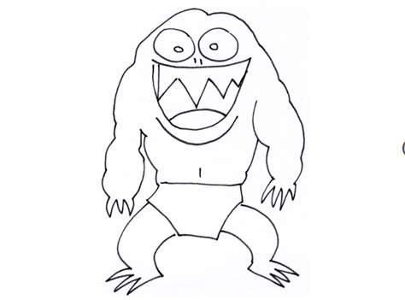
Flesh represents the sinful, corrupted desires of our heart, Mind, Will and Emotions
Flesh

Slide 15
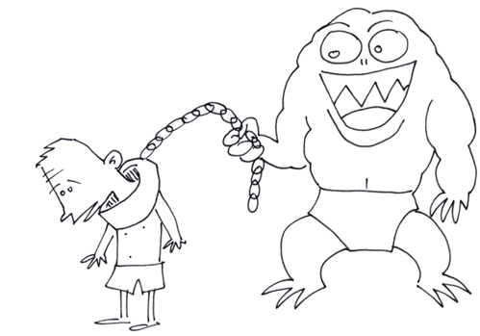
The Bible says that we are slaves to our sinful desires

Slide 16
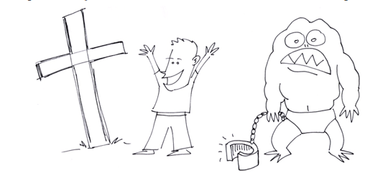
Our spirit is made alive when we come to Christ and are no longer slaves of sin.

Slide 17
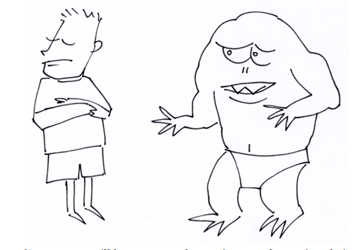
Our Flesh no longer has full control

Slide 18
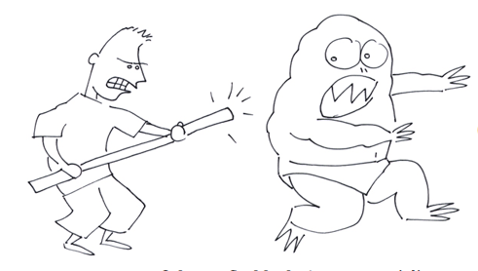
²⁷ but I train like a champion athlete. I subdue my body and get it under my control… 1 Corinthians 9:27

Slide 19
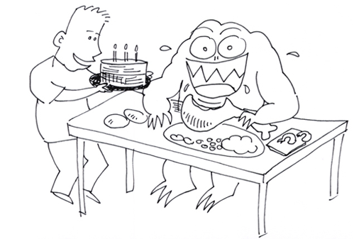
When we feed the flesh…

Slide 20
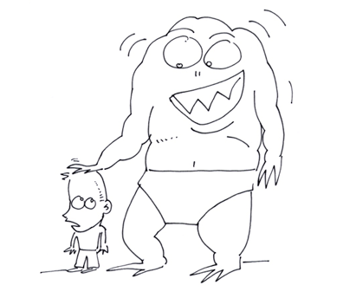
Our Flesh grows stronger than your spirit.

Slide 21
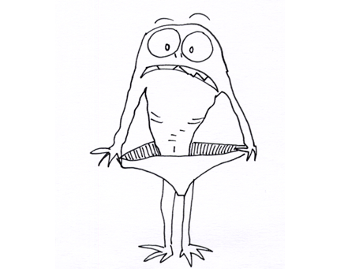
When you are filled with the Holy Spirit, you will not gratify the desires of the flesh.

Slide 22
11 And do this, understanding the present time: The hour has already come for you to wake up from your slumber, because our salvation is nearer now than when we first believed.
Romans 13:11-14

Slide 23
12 The night is nearly over; the day is almost here. So let us put aside the deeds of darkness and put on the armor of light.
13 Let us behave decently, as in the daytime, not in carousing and drunkenness, not in sexual immorality and debauchery, not in dissension and jealousy.

Slide 24
¹⁴ Instead fully immerse yourselves into the Lord Jesus, the Anointed One, and don’t waste even a moment’s thought on your former identity to awaken its selfish desires.
Romans 13:11-14

Slide 26
1 Peter1:3,4
v.3 His divine power has given us everything we need for life and godliness through our knowledge of him who called us by his own glory and goodness.
v4. Through these he has given us his very great and precious promises, so that through them you may participate in the divine nature and escape the corruption in the world caused by evil desires.

Slide 27
1 Peter 1:4
v4. Through these he has given us his very great and precious promises, so that through them you may participate in the divine nature and escape the corruption in the world caused by evil desires.

Slide 28
What are “these” very great and precious promises?

Slide 29
1 Peter 1:5,6
“For this reason, make every effort to add to your faith goodness; and to goodness, knowledge; and to knowledge, self-control; and to self-control, perseverance; and to perseverance, godliness; and to godliness, brotherly kindness; and to brotherly kindness, love.”

Slide 30
σπουδὴν (grk- spoudēn)
“haste, diligence”

Slide 31
Now What? Do some Addition!
Faith
Goodness ss
Knowledge
Godliness
Perseverance
Self -Control
Brotherly Kindness
Love

Slide 32
v8 For if you possess these qualities in increasing measure, they will keep you from being ineffective and unproductive in your knowledge of our Lord Jesus Christ.

Slide 33
V9 But if anyone does not have them, he is nearsighted and blind, and has forgotten that he has been cleansed from his past sins.

Slide 34
10 Therefore, my brothers, be all the more eager to make your calling and election sure. For if you do these things, you will never fall, 11 and you will receive a rich welcome into the eternal kingdom of our Lord and Savior Jesus Christ.

Slide 35
σπουδὴν (grk- spoudēn)
“haste, diligence”
Eagerness

Slide 36
20 For no matter how many promises God has made, they are “Yes” in Christ. And so through him the “Amen” is spoken by us to the glory of God. 21 Now it is God who makes both us and you stand firm in Christ. He anointed us, 22 set his seal of ownership on us, and put his Spirit in our hearts as a deposit, guaranteeing what is to come.

Slide 37
John 14:12
Very truly I tell you, whoever believes in me will do the works I have been doing, and they will do even greater things than these, because I am going to the Father.

Slide 38
Hebrews 6:11,12
We want each of you to show this same diligence to the very end, so that what you hope for may be fully realized.
12 We do not want you to become lazy, but to imitate those who through faith and patience inherit what has been promised.

Slide 39
The bible commands us to “hold fast the confession of our hope without wavering, for He who promised is faithful”.
Hebrews 10:23

Slide 40
And that we should
“not cast away our confidence, which has great reward. For we have need of endurance, so that after we have done the will of God, we may receive the promise”
(Heb. 10:35-36).

Slide 41
Hebrews 6:16
People swear by someone greater than themselves, and the oath confirms what is said and puts an end to all argument.
17 Because God wanted to make the unchanging nature of his purpose very clear to the heirs of what was promised, he confirmed it with an oath.

Slide 42
18 God did this so that, by two unchangeable things in which it is impossible for God to lie, we who have fled to take hold of the hope set before us may be greatly encouraged.
19 We have this hope as an anchor for the soul, firm and secure. It enters the inner sanctuary behind the curtain,
20 where our forerunner, Jesus, has entered on our behalf.

Slide 43
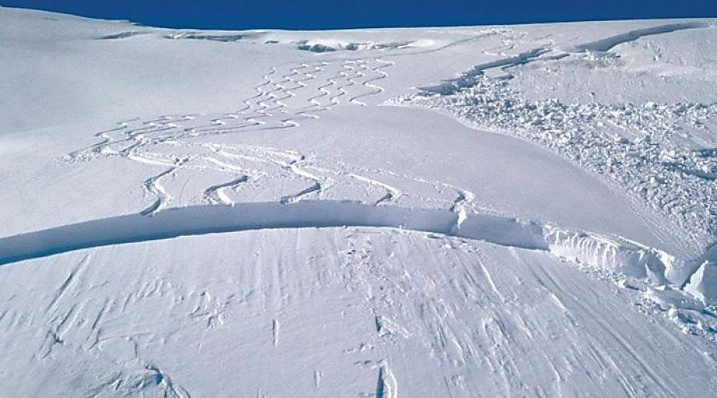
https://youtu.be/qq-olkZrPDE
A Controlled Avalanche is Coming

Slide 44
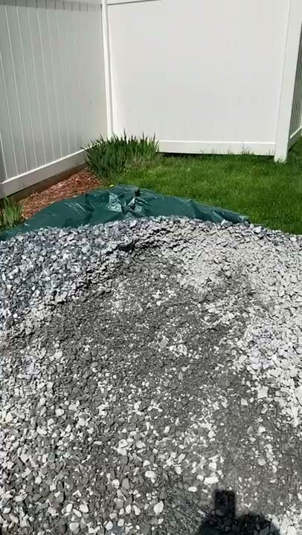

Slide 45
Revelation 14:14-16 I looked, and there before me was a white cloud, and seated on the cloud was one like a son of man with a crown of gold on his head and a sharp sickle in his hand.
15 Then another angel came out of the temple and called in a loud voice to him who was sitting on the cloud, “Take your sickle and reap, because the time to reap has come, for the harvest of the earth is ripe.”
16 So he who was seated on the cloud swung his sickle over the earth, and the earth was harvested.

Slide 46
Revelation 14:17-20 Another angel came out of the temple in heaven, and he too had a sharp sickle. 18 Still another angel, who had charge of the fire, came from the altar and called in a loud voice to him who had the sharp sickle, “Take your sharp sickle and gather the clusters of grapes from the earth’s vine, because its grapes are ripe.”
19 The angel swung his sickle on the earth, gathered its grapes and threw them into the great winepress of God’s wrath. 20 They were trampled in the winepress outside the city, and blood flowed out of the press, rising as high as the horses’ bridles for a distance of 1,600 stadia.

