Slide 1
Sermon For LifeGate
Sunday, May 14, 2023

Slide 2
Opening Scriptures
My son, hear the instruction of your father, and forsake not the law of your mother: Proverbs 1:8 (KJV)
May your father and mother be glad; may she who gave you birth rejoice!
Proverbs 23:25 (NIV)

Slide 3
Opening Statement
Mother’s You Have Way More Authority Than You Think You Have To Mark Your Children For Holiness, Peace, Joy, and Freedom
Then (Elisha) said, "Take the arrows," and the king took them. Elisha told him, "Strike the ground." He struck it three times and stopped. ¹⁹ The man of God was angry with him and said, "You should have struck the ground five or six times; then you would have defeated Aram and completely destroyed it. But now you will defeat it only three times." 2 Kings 13:18-19 (NIV)

Slide 4
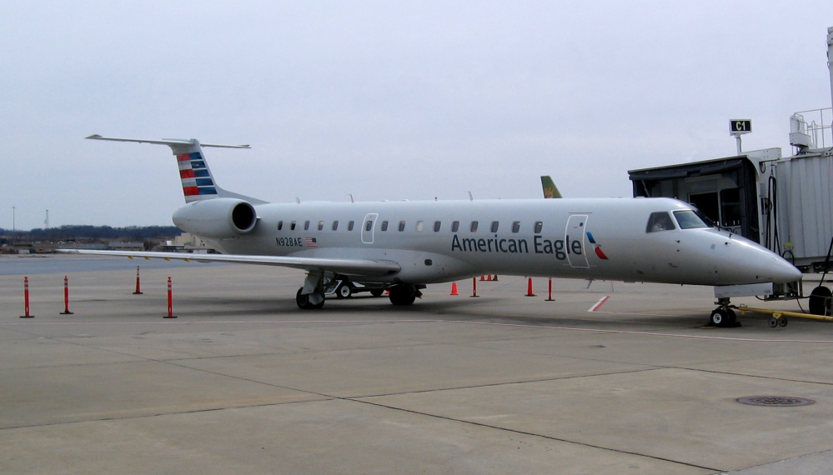
DON’S JOURNAL - OCTOBER 19, 2018 was a very humbling day – I desperately need the Lord. Lord there is a suffocating helplessness in every direction. I feel hemmed in.
LORD FORGIVE ME FOR:
1. OPERATING OUT OF MY EMOTIONS
2. OPERATING OUT OF MY DISAPPOINTMENTS
3. OPERATING OUT OF MY FLESH
4. OPERATING OUT OF MY NEGATIVE ATTITUDE
I was operating out of an old wound from my child-hood - when my Dad felt yelling was the best method of discipline

Slide 5
BUT GOD
CHANGES EVERYTHING

Slide 6
LIFE THROWS CURVE BALLS
Consider what God has done: Who can straighten what He has made crooked? ¹⁴ When times are good, be happy; but when times are bad, consider: God has made the one as well as the other. Ecclesiastes 7:13-14 (NIV)
Jesus said to his disciples: "Things that cause people to sin are bound to come, but woe to that person through whom they come. Luke 17:1 (NIV)

Slide 7
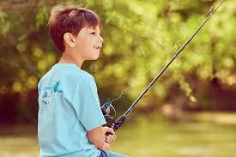
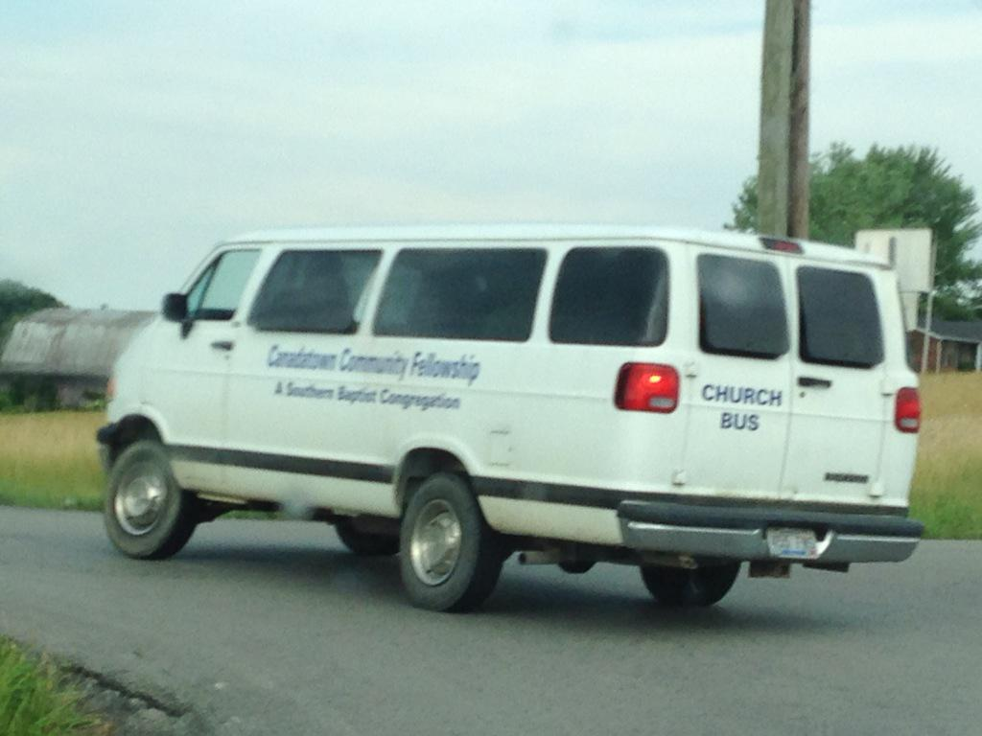
Well That Left of Mark

Slide 8
Joseph Was Marked By A Tragic Childhood
Now Israel loved Joseph more than any of his other sons, because he had been born to him in his old age; and he made a richly ornamented robe for him. ⁴ When his brothers saw that their father loved him more than any of them, they hated him and could not speak a kind word to him. Genesis 37:3-4 (NIV)

Slide 9
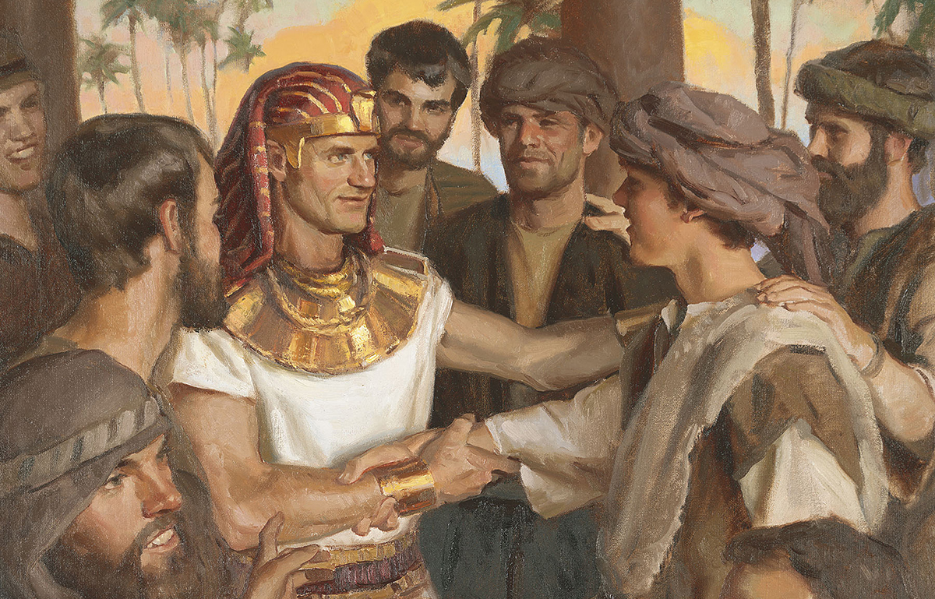
God Overcame the Etchings
Of Hurt and Sin
As for you, you thought evil against me, but God meant it for good, to bring about that many people should be kept alive, as they are this day. Genesis 50:20 (AMP)

Slide 10
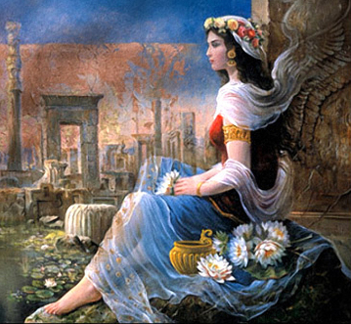
Esther was born to older parents and orphaned at a young age
Mordecai had a cousin named Hadassah, whom he had brought up because she had neither father nor mother. This girl, who was also known as Esther, was lovely in form and features, and Mordecai had taken her as his own daughter when her father and mother died. Esther 2:7 (NIV)

Slide 11
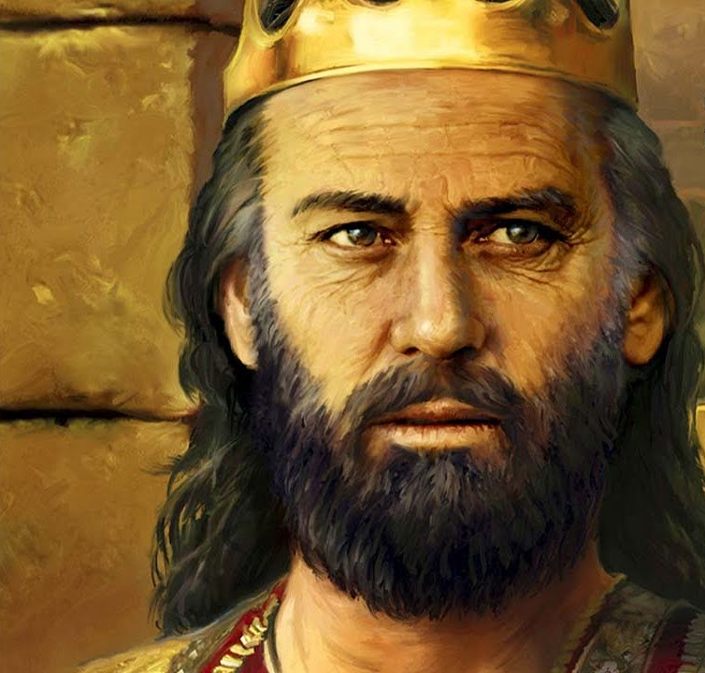
Setting Up With Many Blessings
Doesn’t Always End Well
As Solomon grew old, his wives turned his heart after other gods, and his heart was not fully devoted to the LORD his God, as the heart of David his father had been.
1 Kings 11:4 (NIV)

Slide 12
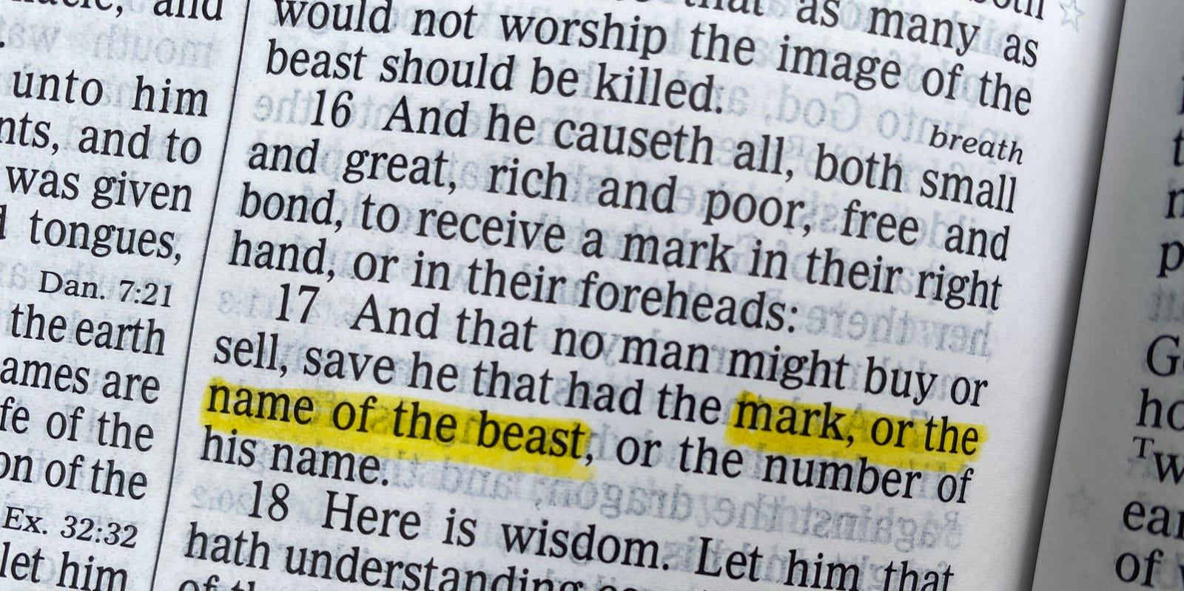
Satan Marks People by Taking Away
Etching – gouging out life
And that no man might buy or sell, save he that had the mark, or the name of the beast, or the number of his name.
Revelation 13:17 (KJV)
GREEK - CHARAGMA - a scratch or etching, or sculptured figure (statue) :- graven, mark

Slide 13
The Five Major Things The Enemy Takes
THE ENEMY TAKES OUR INNOCENCE
THE ENEMY TAKES OUR VISION
THE ENEMY TAKES OUR FUTURE
THE ENEMY TAKES OUR HOPE
THE ENEMY TAKES OUR AFFECTIONS

Slide 14
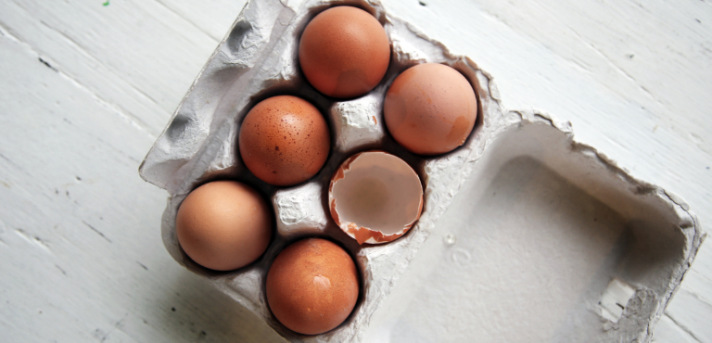
THE ENEMY – WHO WAS IN ON ATTACKING YOUR INNOCENCE
Says – You Are
Damaged Goods

Slide 15
WITHOUT HOPE
WE ARE IN DANGER
ONCE THE ENEMY CONVINCES US WE ARE DAMAGED – WE HAVE NO MOTIVATION TO RESIST HIS LIES

Slide 16
THE ENEMY DOESN’T CARE HOW HE TAKES AWAY OUR DESTINY – EVEN IN THE GUISE OF LOVE AND COMPASSION
THE ENEMY
REMOVES THE
FOUNDATIONS OF TRUTH IN THE FAÇADE OF HELPING HUMANITY LOVE EACH OTHER BETTER
OPEN BORDERS
ARE COMPASSIONATE
WAYS TO HELP THE POOR
HELPING YOUTH
BE SEXUALLY
MUTILATED WILL HELP THEM EMOTIONALLY

Slide 17
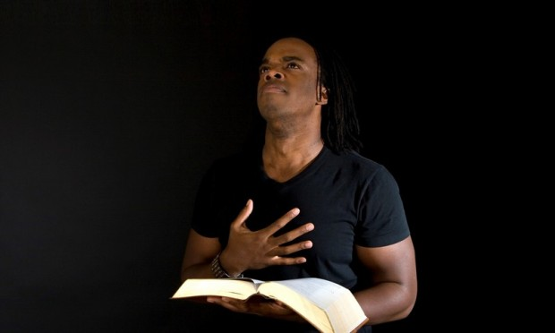
God Writes On Us
He Adds To Us – HE GIVES
"This is the covenant I will make with the house of Israel after that time," declares the LORD. "I will put my law in their minds and write it on their hearts. I will be their God, and they will be my people. Jeremiah 31:33

Slide 18
He puts His Indelible ink on our
Hearts and Adds PEACE and JOY
I will write on him the name of my God and the name of the city of my God, the new Jerusalem, which is coming down out of heaven from my God; and I will also write on him my new name.
GREEK - GRAPHO – TO WRITE
write;
"God opposes the proud but gives grace to the humble." 1 Peter 5:5 (NIV)

Slide 19
GOD OVERCOMES
The Enemy’s Plans
IN THE VERY BOOK THAT DESCRIBES SATAN MARKING PEOPLE FOR DESTRUCTION – GOD IS SHOWING THAT HE WILL WRITE BLESSINGS ON HIS PEOPLE AT MULTIPLE LEVELS
Him who overcomes I will make a pillar in the temple of my God. Never again will he leave it. I will write on him the name of my God and the name of the city of my God, the new Jerusalem, which is coming down out of heaven from my God; and I will also write on him my new name. 13 He who has an ear, let him hear what the Spirit says to the churches. Revelation 3:12-13 (NIV)

Slide 20
God writes On Us
The mind of sinful man is death, but the mind controlled by the Spirit is life and peace; Romans 8:6 (NIV)
The Lord writes on us:
Forgiveness/ Pardon/ Cleansed/ Holiness
Adopted/ Son/ Daughter
Transformed/ Set free
Washed/ renewed
Life/ peace
Hope/ Destiny/ Joy
But if anyone does not have them, he is nearsighted and blind, and has forgotten that he has been cleansed from his past sins. 2 Peter 1:9 (NIV)

Slide 21
But we aren’t virgins
Unmarried Couples – who were previously married
Don’t be living together – GET MARRIED

Slide 22
The Impossible Becomes Possible
These are they which were not defiled with women; for they are virgins. These are they which follow the Lamb whithersoever he goes. These were redeemed from among men, being the firstfruits unto God and to the Lamb. ⁵ And in their mouth was found no guile: for they are without fault before the throne of God. Revelation 14:4-5 (KJV)

Slide 23
Christianity (through the Gospel and the power of the Holy Spirit) served as a revitalization of these Greco-Roman cities. It was a movement of hope in the midst of misery, chaos, fear, and brutality of life in a Urban Greco-Roman world. It brought revitalization and revival in many ways. Rodney Stark

Slide 24
Doubtless, this was exactly what was happening in the New Testament in the Early Church. Many a male or female slave in Roman households, who were vulnerable and without escape, or redress, to any outrage that a cruel Roman master chose to do to them, was able by living in the power of the Gospel and the communion of the Holy Spirit, to be more than a “conqueror” in Christ and to defeat the evil temptations in the region of their own spirit, remaining pure in heart, loving, patient, Christ-like, no matter how Satan might appear to have triumphed in their outward circumstances.
Such disciples, because of the Spirit of God, and because of being channels of His energy and grace, create their own atmosphere, carry it with them, shed it abroad, and are superior to satanic influence by driving his forces away. George Lang

Slide 25
MOTHER’S BE BOLD
AND LOVING
You have the awesome privilege to have God rewrite Your heart – so that you CAN MARK YOUR CHILDREN with what God has marked you. –
WOUNDS CAN BE HEALED
MISTAKES CAN BE OVERCOME
HURTS CAN BE HEALED
PERSONALITY FLAWS CAN BE SMOOTHED
GENERATIONAL CURSES CAN BE BROKEN

Slide 26
DISCIPLE YOUR CHILDREN
TO BE GOOD AT RELATIONSHIPS
LIVING AT PEACE IS A HUGE PART OF COMING INTO MATURITY AND BEING SANCTIFIED – JOE SWEET
BEING UNOFFENDED – IS AN EVIDENCE OF BEING SANCTIFIED
They will be called the Holy People, the Redeemed of the LORD; and you will be called Sought After, the City No Longer Deserted. Isaiah 62:12 (NIV)

Slide 27
God is raising up a generation that will
BE MARKED BY GOD
I AM CONVINCED AT THE END OF THE DAY – THERE IS SOMETHING OF GOD’S FOREKNOWLEDGE THAT ALLOWED THIS HUGE – DIVERSION TO TAKE PLACE (WHERE SATAN DUPED MANKIND AND ETCHED THE KNOWLEDGE OF GOOD AND EVIL ON OUR HEARTS - – MANKIND WAS NEVER INTENDED TO SIN – TO DIE – TO SUFFER – TO FIGHT – TO KILL – TO WORSHIP PLEASURE – TO HATE GOD
BUT AT THE END OF THE DAY – GOD WILL GET SOMETHING MORE GLORIOUS OUT OF IT THAN IF IT NEVER HAPPENED.

Slide 28
APPLICATION?
Mother’s You are given the PRIVILEGE to mark your children all of your life – not just when they are at home
You have the grace to have the WRITING of the LORD on your side – it has greater power than the gouging/etching of the enemy
Ask for greater anointing to lead your children into TRUTH – PURITY – PEACE AND JOY – all operating in LOVE.
EXPECT THE IMPOSSIBLE

