Slide 1
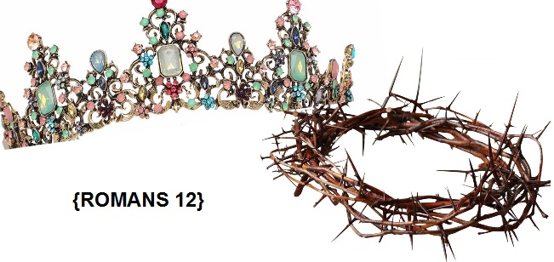
“How to be a Christian”

Slide 2
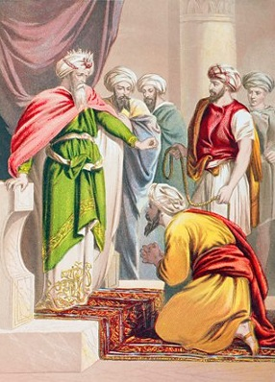
“Mercies”
Verse 1: Beloved friends, what should be our proper response to God’s marvelous mercies?
https://youtu.be/DEo2S56-cTA
n. Compassionate treatment, especially of those under one's power; clemency. n. Disposition to be kind and forgiving.
Q.) What mercies do we experience?

Slide 3
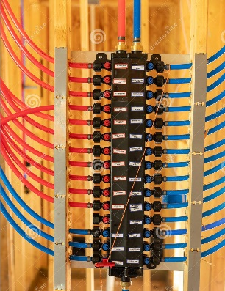
“Manifold”
The Lord is gracious, and full of compassion; slow to anger, and of great mercy. The Lord is good to all: and his tender mercies are over all his works. Psalm 145:8-9 KJV
The Lord is merciful and gracious, slow to anger, and plenteous in mercy. Psalm 103:8 KJV
Adj. plentious: (manifold) many times or multiplied quantity, complicated, or marked by diversity.

Slide 4
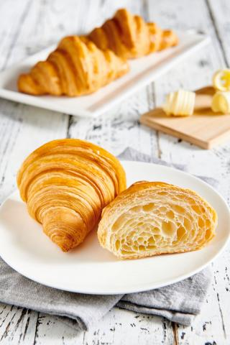
Butter is what makes a croissant taste good. Butter represents the invisible Spirit of God put into us by Jesus's mercies as he folds us over and over in his forgiveness, kindness, patience many, many times. When we are done we will taste delicious like Jesus(body&blood) by the power of the Holy Spirit. Oil in the bible was used to anoint someone with power and authority. We are anointed as children of God.
Q.) Where did the butter go?
(NO Volume) 1.5 speed 1:00 to 4:10
Manifolded Croissant Dough

Slide 5
“Living Sacrifice”
“Surrender yourselves to God to be his sacred, living sacrifices.”
LIVING SACRIFICE | DEAD SACRIFICE
Ongoing, daily | One time only
Christ like, biblical | Pheraseical, religious, the law
Intimate, involved | Distant, disconnected
On fire | Cold, lifeless
Useful for warmth, inviting | Useless, stinky, disgusting

Slide 6
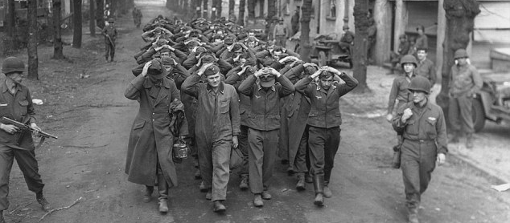
“Surrender; Prisoner of Christ”
Surrender: (verb)To relinquish control over a territory, combatants or fortifications. It is a military tactic to stay alive. You submit to the terms! Do what they say or else!
You can go peaceably as a prisoner of Christ OR through defeat, struggling to master yourself as a prisoner of Satan.

Slide 7
“deLight His Heart”
“And live in holiness,experiencing all that delights his heart. For this becomes your genuine expression of worship.”
Your heart becomes light when he carries your load and his heart lights up with joy when you follow his example of living a surrendered life.

Slide 8
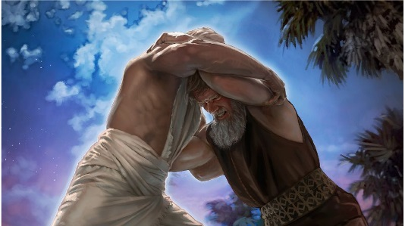
“Tap Out”
Who invented wrestling? God did! Are you wrestling against God's system of becoming a living sacrifice? It's time to “tap out.” Surrender to Him!

Slide 9
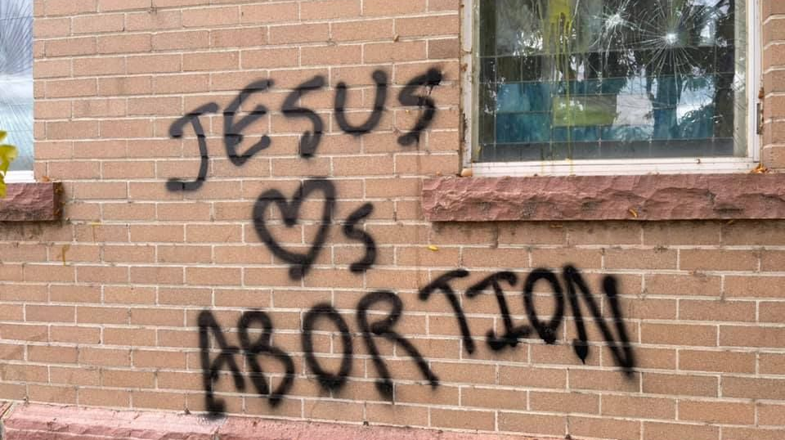
“Counter Cult-ure”
2 Stop imitating the ideals and opinions of the culture around you
One thing to surrender: “opinions and ideals,” that is really what culture is made up of, right?
If we imitate the opinions and ideals of the world we will turn into the world.
What cult-ture opinions and ideals should we reject?

Slide 10
“HOW TO BE A CHRISTIAN” Step 1: Accept God's Plan For You Mercies, Manifold, Living Sacrifice, deLight His Heart, Tap Out,

Slide 11
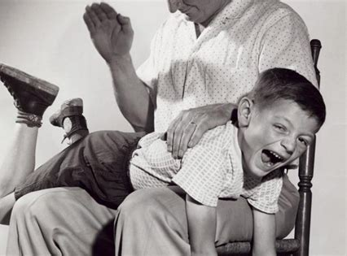
“Reformation”
2 “but be inwardly transformed by the Holy Spirit through a total reformation of how you think.”
REFORMATION – verb:The act of reforming; correction or amendment of life, manners, or of any thing corrupt; as the reformation of manners.
We use discipline to reform a child. The tool may be a paddle! The tool he uses for our reformation is the Word.
Q.) How does God reform you with his word logos or rhema?

Slide 12
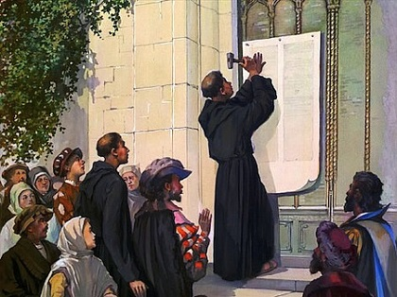
“Reformation”
What was the Reformation? Think: Martin Luther. October 31, 1517 nails his 95 theses on the wooden doors of the Hofkirche in Wittenberg. He nailed the demands or needed changes in public to communicate (through written word) what the Spirit had revealed to him.
Reformation happens when you let Jesus nail or bind you to the Word/Himself/Spirit (Remember John 1:1 The Word = God)

Slide 13
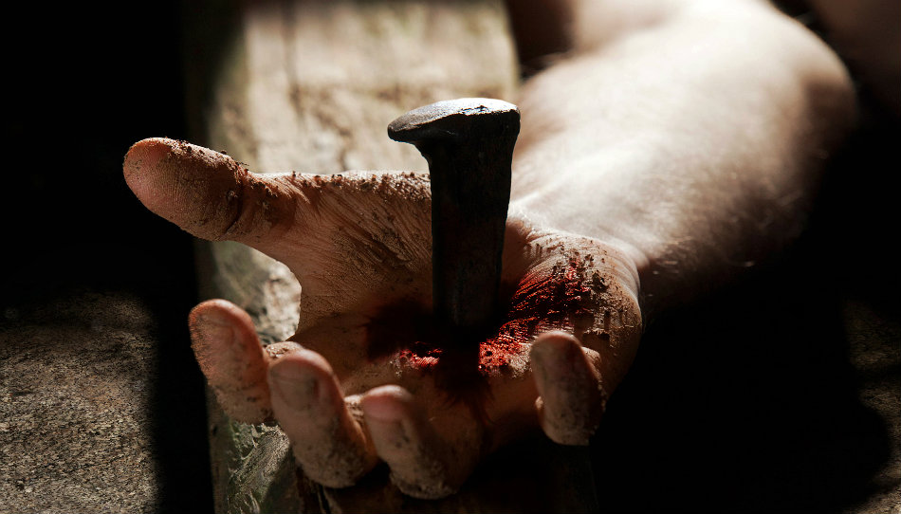
“Piercing”
Hebrews 4:12
For the word of God is living and powerful, and sharper than any two-edged sword, piercing (like a nail) even to the division of soul and spirit, and of joints and marrow, and is a discerner of the thoughts and intents of the heart.

Slide 14
“Bind”
"to attach," "to fasten," or “to form an agreement with by your words”; making an oath.
Proverbs 3:3-4 NKJV Let not mercy and truth forsake you; bind them around your neck,write them on the tablet of your heart, and so find favor and high esteem in the sight of God and man. | Proverbs 6:20-21 NKJV My son, keep your father’s command, and do not forsake the law of your mother. Bind them continually upon your heart; Tie them around your neck.
Proverbs 7:2-3 NKJV Keep my commands and live, and my law as the apple of your eye.Bind them on your fingers; write them on the tablet of your heart.

Slide 15
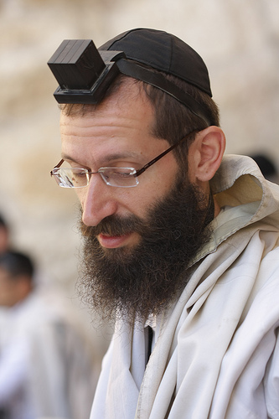
Q: Is this what God wanted us to do?
What did he mean by Deut. 6:5-8 Love the Lord your God with all your heart, with all your soul, and with all your strength. These words that I am giving you today are to be in your heart. Repeat them to your children. Talk about them when you sit in your house and when you walk along the road, when you lie down and when you get up. Bind them as a sign on your hand and let them be a symbol on your forehead. Write them on the doorposts of your house and on your city gates.

Slide 16
“Mind = heart, neck, forehead”
Body Parts Have Meaning! All these body parts are manifest in the term “mind” that we see in most translations today!
HEART: (Hebrew) stands for the inner part of a person and refers to our will, mind, consciousness, emotions and understanding. It also refers to a person’s moral character and determination.
HEART: (Greek) stands for the origin of our spiritual life and includes the emotions we experience, the thoughts we have and our will in life. It also describes the center of our longings, desires and feelings.
NECK: our will and conscience.

Slide 17
FOREHEAD: corresponds to His love, in love to the Lord, by which is signified that they are under the Lord's protection, because they are in His love, as in the following passages:
Jehovah said, Go through the midst of Jerusalem, and set a mark upon the foreheads of the men that groan and sigh for all the abominations that are done in the midst thereof; and smite; let not your eye spare; but come not near against any man upon whom is the mark (Ezek. 9:4-6).
Behold the Lamb standing on the Mount Zion, and with Him a hundred and forty-four thousand, having the name of His Father written on their foreheads (Rev. 14:1).
They shall see the faces of God and of the Lamb, and His name shall be on their foreheads (Rev. 22:4).
https://www.biblemeanings.info

Slide 18
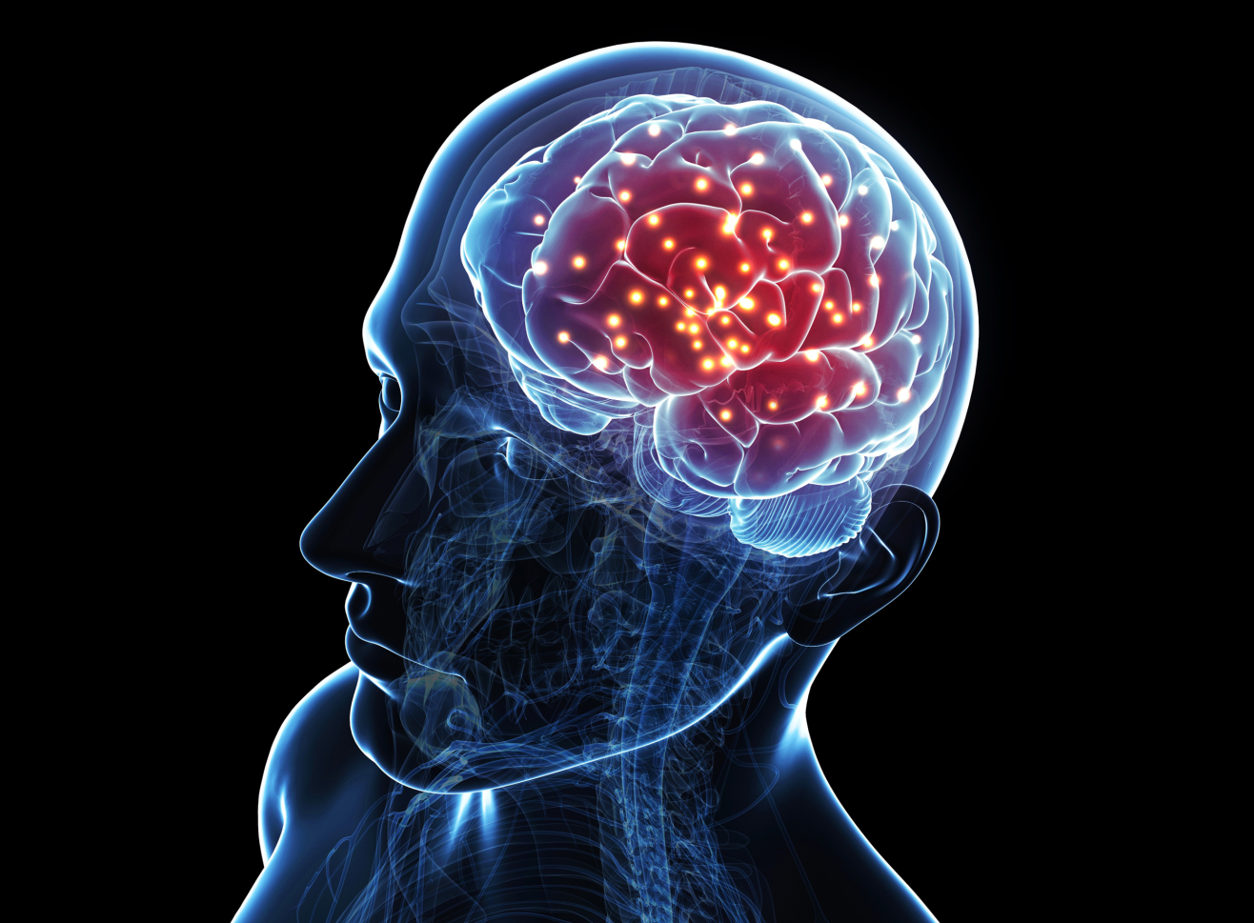
“Reform Your Mind”
Kris V "change your mind"
How Biblical Meditation Transforms Your Mind
Dr Caroline Leaf
“Detoxing Your Mind” 5:55 -17:14 (speed:1.25)

Slide 19
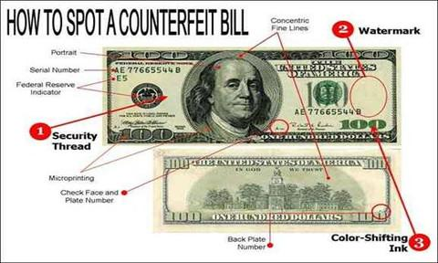
“Discern”
Romans 12:2 This will empower you to discern God’s will as you live a beautiful life, satisfying and perfect in his eyes. DISCERNMENT: To be able to distinguish the differences between or similarity to the genuine from the counterfeit.

Slide 20
“Two Wills”
Discerning the Will of God, John Piper
1. God’s Sovereign Will (This is the will we can influence by requesting, and being open to opportunities)
2. God’s Command Will (this is the one we should focus on discerning) His will is what he commands us to do. This is the will of God we fail to do and choose to disobey.
Q. When did you obey God's Will (commands) and reap the benefits?
Q. When did you open yourself to God's sovereign will with a yes in a moment of opportunity?

Slide 21
“True Value”
3 “God has given me grace to speak a warning about pride. I would ask each of you to be emptied of self-promotion and not create a false image of your importance. Instead, honestly assess your worth by using your God-given faith as the standard of measurement, and then you will see your true value with an appropriate self-esteem.”
>>Q. Examples of pride? >>Q. Examples of self hatred?
Find your “TRUE VALUE” by placing your plank of faith on the Rock of Jesus and you will find your worth is right at the fulcrum, not prideful and not self loathing.

Slide 22
“HOW TO BE A CHRISTIAN” Step 1: Accept God's Plan For You Mercies, Manifold, Living Sacrifice, deLight His Heart, Tap Out, Step 2: Take Action Counter Cult-ure, Reformation, Reform Your Mind, Piercing, Bind The Word to Your H+F+N, Discern,Two Wills,True Value,

Slide 23
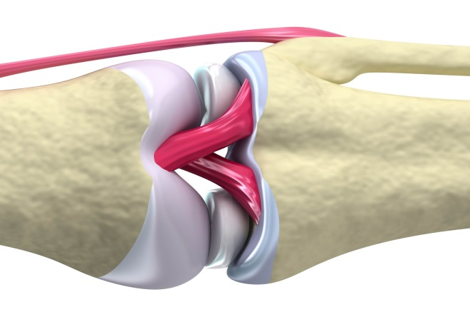
“Vitally Joined”
4 “In the human body there are many parts and organs, each with a unique function. 5 And so it is in the body of Christ. For though we are many, we’ve all been mingled into one body in Christ. This means that we are all vitally joined to one another, with each contributing to the others.”
VITAL, adjective
2. Contributing to life; necessary to life; as vital air; vital blood.
5. Very necessary; highly important; essential. Religion is a business of vital concern.
JOIN, verb
1. To set or bring one thing in contiguity with another.
(actual contact, being in contact or within touching distance)
2. To couple; to connect; to combine; as, to join ideas.

Slide 24
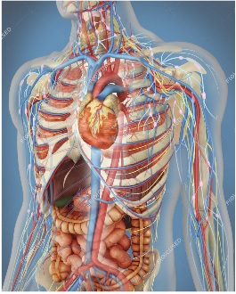
“Unique Function”
Doctors say that the gallbladder is not necessary so they remove it! Look what happens when you remove one organ!
1. Cholesterol imbalance
2. Inefficient toxin removal
3. Constipation
4. Thyroid imbalance
5. Fatty Liver
6 Fat Soluble Vitamins Deficiency
7. Inability to absorb omega 3 fatty acids
We cannot cut one member out of our church body! 2 Peter 17 “Recognize the value of every person and continually show love to every believer.”

Slide 25
“Varying Gifts”
Verse 6 God’s marvelous grace imparts to each one of us varying gifts.
Prophecy | activate your gift by using the proportion of faith you have to prophesy
Serving | thrive in serving others well
Teaching | be actively teaching and training others
Encouragement | encourage others often
Giving to Help | prosper in your generosity without any fanfare
Leadership | be passionate about your leadership
Compassion | then flourish in your cheerful display of compassion.

Slide 26
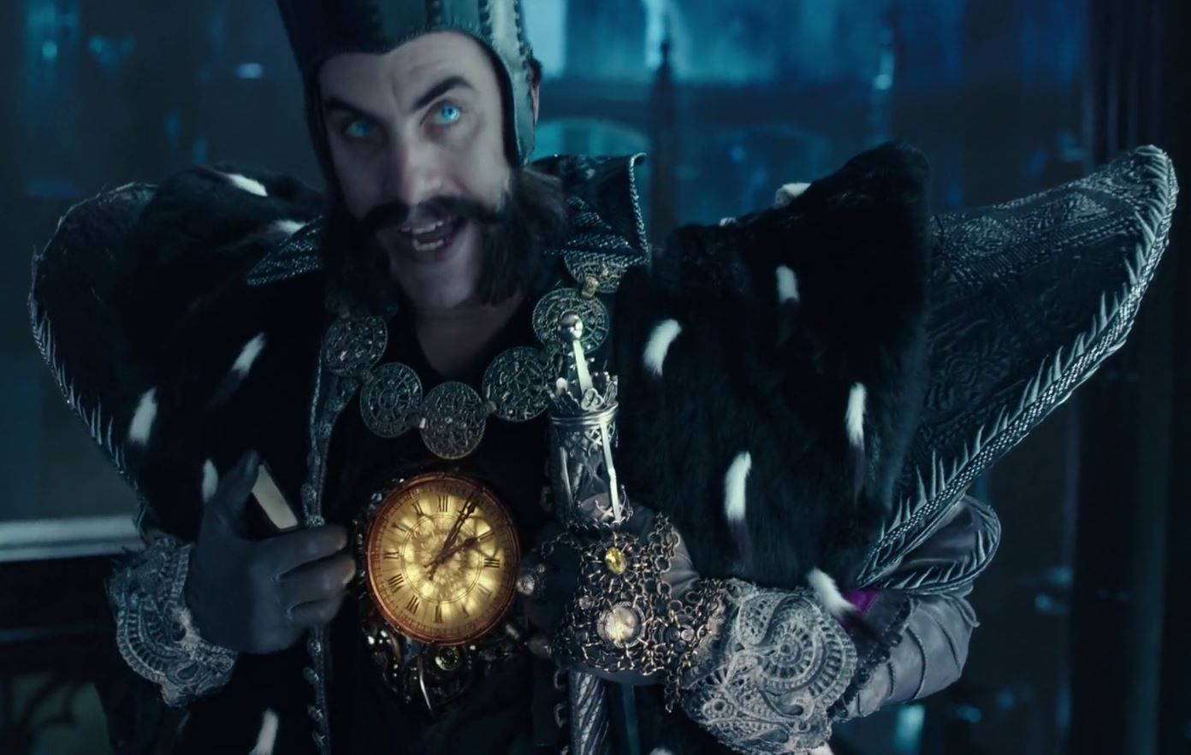
“Inner Movement”
9 “Let the inner movement of your heart always be to love one another...”
This is TIME from the “Through the Looking Glass” Time is a person; just like Jesus is Love. He is inseparable from his identity as time. It is part of him, in his heart and mind. It is what he runs on and how he functions.

Slide 27
“Love Operates”
Do we operate in Love? Is it hardwired into us, like an operating system...
Operate: To control the functioning of; to run
Q. At the end of the day, has Love controlled, or run your interactions with
Your neighbor?
your friend?
your family?
your enemy? Yourself?

Slide 28
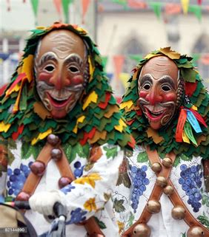
“Never Wear a Mask”
“and never play the role of an actor wearing a mask. Despise evil and embrace everything that is good and virtuous.”
“Don't hide your identity as a Christian, as an individual that God created and given grace-gifts.
Don't pretend to love people. Genuinely love them by asking God to show you how to love them.”

Slide 29
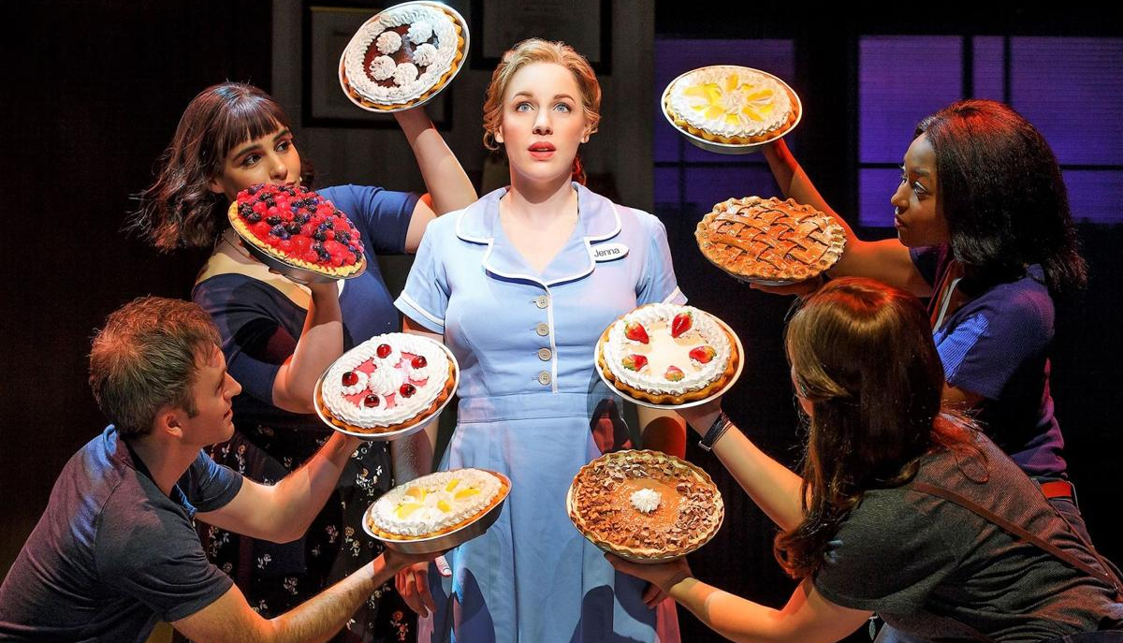
“Outdo yourselves in Honor”
“10 Be devoted to tenderly loving your fellow believers as members of one family. Try to outdo yourselves in respect and honor of one another.”

Slide 30
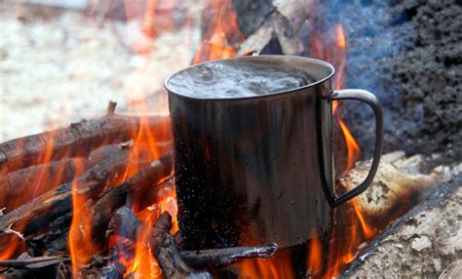
“Boil & Radiate”
“11 Be enthusiastic to serve the Lord, keeping your passion toward him boiling hot! Radiate with the glow of the Holy Spirit and let him fill you with excitement as you serve him.”
Q. What does boiling/burning do scientifically speaking? (- - - - - -)
Q. What does God Day about lukewarm? Rev 3:15-17
Q. What does water/fire represent in the Bible? (- - - - - - - - - -)
Q. What causes nations to bow down? Isa 64:2
Q. Who are we like when we radiate a glow? Ps 96:6

Slide 31
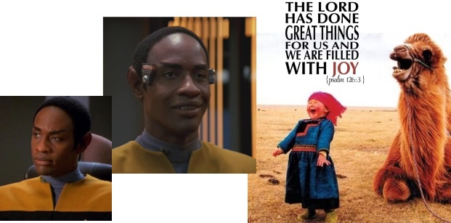
“Release Continual Joy”
“12 Let this hope burst forth within you, releasing a continual joy. ”

Slide 32
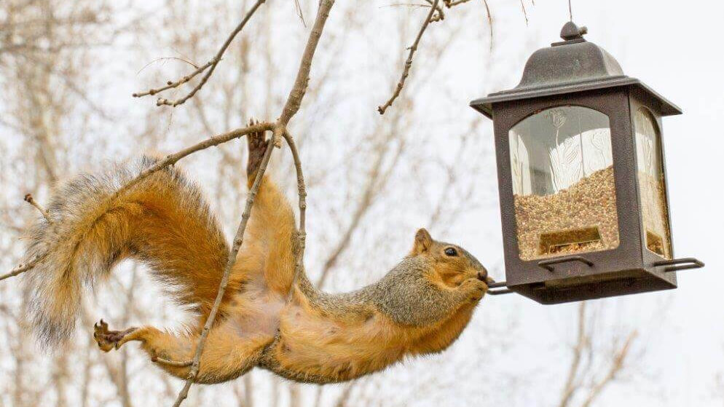
“Don't Give Up”
“...Don’t give up in a time of trouble...
Aramaic can be translated “Bear your afflictions bravely.”
Squirrels That Dont Give up Play :15- 1:44

Slide 33
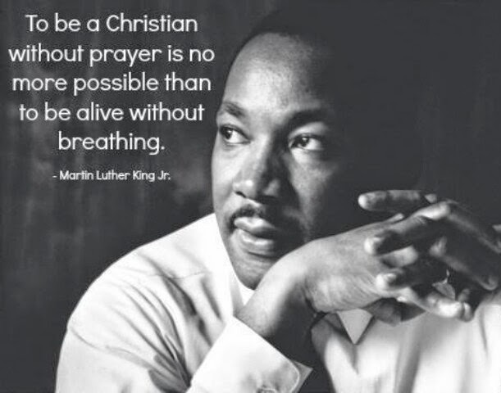
“Commune”
A Commune is a place where people live together as one!
Psalm 4:4-5
KJV: But know that the Lord hath set apart him that is godly for himself: the Lord will hear when I call unto him. Stand in awe, and sin not: commune with your own heart upon your bed, and be still.
The Message: Complain if you must, but don’t lash out. Keep your mouth shut, and let your heart do the talking. Build your case before God and wait for his verdict.
“...but commune with God at all times.”

Slide 34
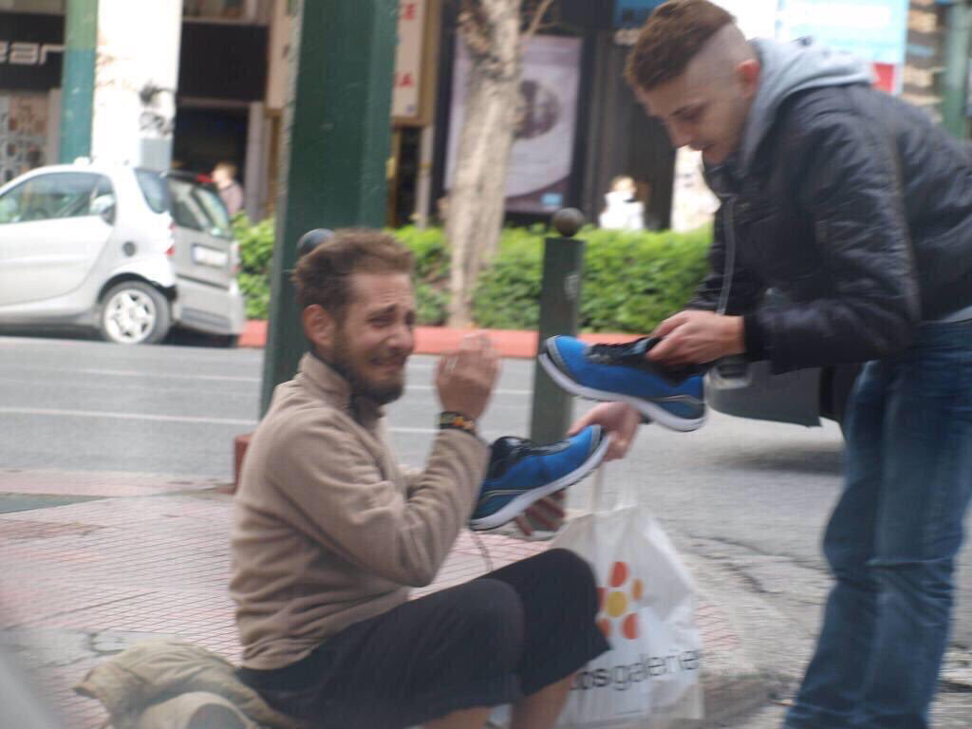
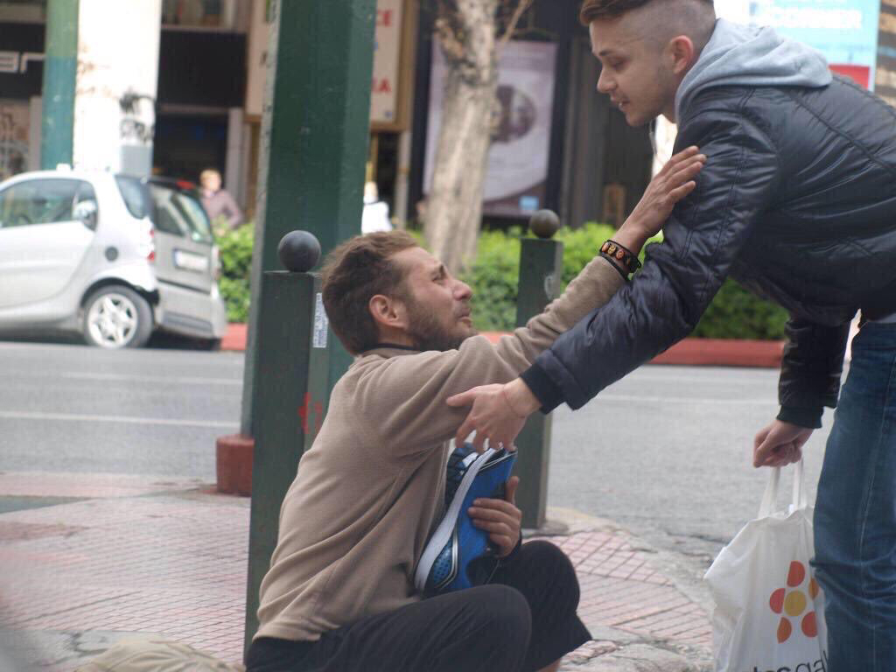
“Take Interest”
“13 Take a constant interest in the needs of God’s beloved people and respond by helping them.”
Interest: To concern; to affect; to excite emotion or passion
Interest: To have a share of $
Q. Who are God's beloved people?

Slide 35
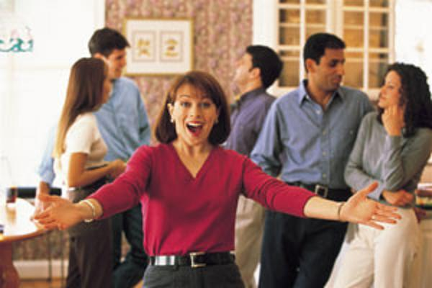
“Eagerly Welcome”
“And eagerly welcome people as guests into your home.”
Psalm 5:7 But I know that you will welcome me into your house, for I am covered by your covenant of mercy and love. So I come to your sanctuary with deepest awe to bow in worship and adore you.
Genesis 33:15 Esau said, “Let me at least lend you some of my men.” “There’s no need,” said Jacob. “Your generous welcome is all I need or want.”
Proverbs 25:17Don’t wear out your welcome by staying too long at the home of your friends, or they may get fed up with always having you there and wish you hadn’t come.

Slide 36
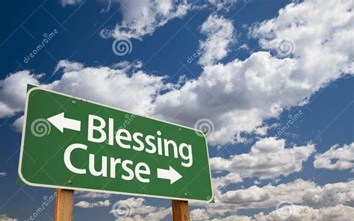
“Speak Blessing”
“14 Speak blessing, not cursing, over those who reject and persecute (oppress or harass with ill-treatment) you.”

Slide 37
“Celebrate and Weep”
“15 Celebrate with those who celebrate, and weep with those who grieve.”
Experience the full range of emotions with believers.
Q. What are some ways to celebrate with someone?
Q. When have you wept with someone who is grieving?
Q. These emotions are quite opposite, why are they in the same verse?

Slide 38
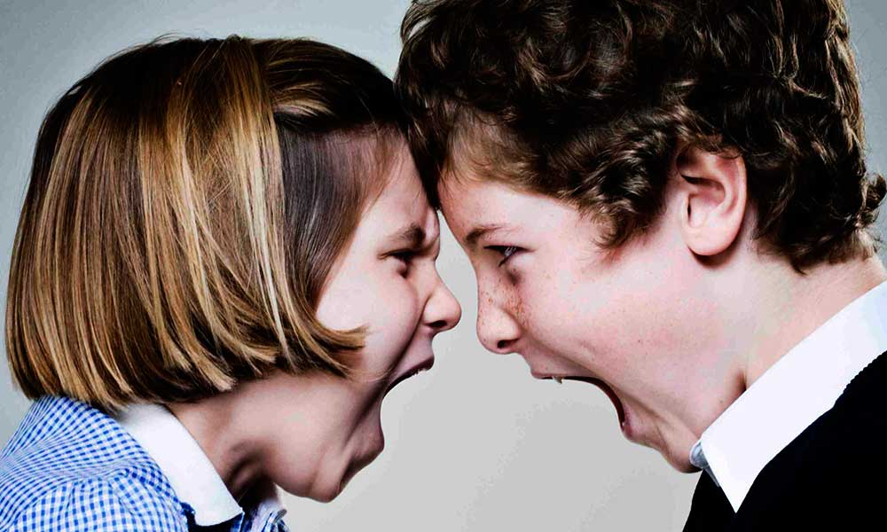
“Spirit of Harmony”
“16 Live happily together in a spirit of harmony,” Q. Is this harmony?
PTX - How to harmonize
(up to 31 seconds)
a. An orderly or pleasing
combination of elements in a whole
b. A relationship in which various
components exist together without destroying one another
c. A relationship characterized
by a lack of conflict
Q. What is the benefit of living in harmony?
“Do all things without grumbling or disputing, that you may be blameless and innocent, children of God without blemish in the midst of a crooked and twisted generation, among whom you shine as lights in the world... Philippians 2:14-15

Slide 39
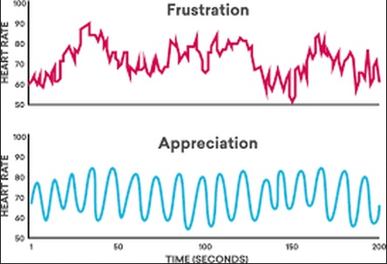
Harmony VS Disharmony effects on the heart rate

Slide 40
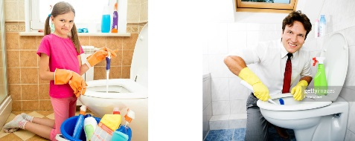
“Too Important?”
and be as mindful of one another's worth as you are your own. Don’t live with a lofty mind-set, thinking you are too important to serve others but be willing to do menial tasks and identify with those who are humble minded...” Philippians 2:14-16

Slide 41
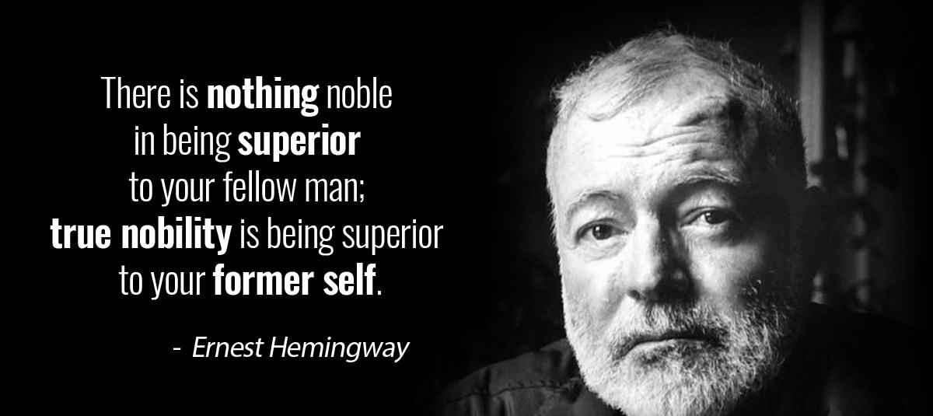
“Don't Be Smug”
Don’t be smug or even think for a moment that you know it all..”
Exhibiting or feeling great or offensive satisfaction with oneself or with one's situation; self-righteously complacent

Slide 42
“HOW TO BE A CHRISTIAN” Step 1: Accept God's Plan For You Mercies, Manifold, Living Sacrifice, deLight His Heart, Tap Out, Step 2: Take Action Counter Cult-ure, Reformation, Reform Your Mind, Piercing, Bind The Word to Your H+F+N, Discern,Two Wills,True Value, Step 3: Facilitate His Plan For The Church By Doing Your Part Vitally Joined, Unique Function, Varying Gifts, Inner Movement, Love Operates, Never Wear A Mask, Outdo Yourselves in Honor, Boil & Radiate, Release Continual Joy, Don't Give Up, Commune, Take Interest, Eagerly Welcome, Speak Blessing, Celebrate & Weep, Spirit of Harmony, Too Important?, Don't be Smug,

Slide 43
“Noble Benefactor”
“17-18 Never hold a grudge or try to get even, but plan your life around the noblest way to benefit others. Do your best to live as everybody’s friend.”
Q. Who was a benefactor in the Bible?
Q. What does a benefactor do?
Q. What is noble?
Q. Where does nobility come from?

Slide 44
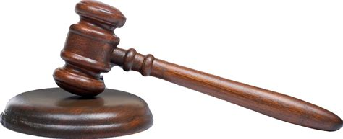
“Vengeance & Recompense”
“19 Beloved, don’t be obsessed with taking revenge, but leave that to God’s righteous justice. For the Scriptures say: “Vengeance is mine, and I will repay,” says the Lord.”
“To me belongeth vengeance and recompense” KJV
Deut 32:35 “Don’t you realize that I have my shelves well stocked, locked behind iron doors? I’m in charge of vengeance and payback, just waiting for them to slip up; And the day of their doom is just around the corner, sudden and swift and sure.

Slide 45
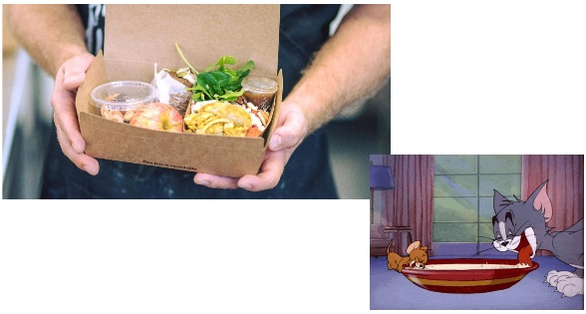
“Win With Kindness”
“20 And:If your enemy is hungry, buy him lunch! Win him over with kindness.

Slide 46
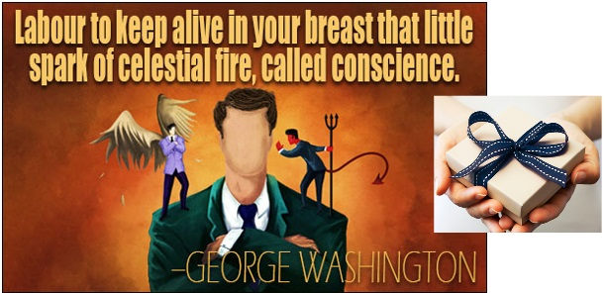
“Awaken Conscience”
“For your surprising generosity will awaken his conscience, and God will reward you with favor.”

Slide 47
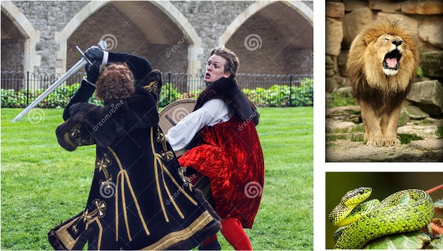
“deFeet Evil with Good”
“21 Never let evil defeat you, but defeat evil with good.”

Slide 48
“HOW TO BE A CHRISTIAN; In One Slide” Step 1: Accept God's Plan For You Mercies, Manifold, Living Sacrifice, deLight His Heart, Tap Out, Step 2: Take Action Counter Cult-ure, Reformation, Reform Your Mind, Piercing, Bind The Word to Your H+F+N, Discern,Two Wills,True Value, Step 3: Facilitate His Plan For The Church By Doing Your Part Vitally Joined, Unique Function, Varying Gifts, Inner Movement, Love Operates, Never Wear A Mask, Outdo Yourselves in Honor, Boil & Radiate, Release Continual Joy, Don't Give Up, Commune, Take Interest, Eagerly Welcome, Speak Blessing, Celebrate & Weep, Spirit of Harmony, Too Important? Don't be Smug, Step 4: Win With God Noble Benefactor, Vengance & Recompence, Win With Kindness, Awaken Conscience, deFeet Evil with Good

