Slide 1
The Father Is Good
Lifegate 6/18/23—Father’s Day

Slide 2
Summary:
Key passages—A familiar story from a less emphasized vantage
Addressing wounds that isolate us and distort our perception
“Jesus loves me. This I know, for the Bible tells me so”

Slide 3
Key Passages: Matt 14:24-33, Mark 6:47-51 (v.48)

Slide 4
First some about Mark (aka John Mark):
-Thought to be much younger than the other disciples
-His mother was Mary who had a house in Jerusalem that served as a meeting place for believers.
-No mention of his father, other than Peter referring to him as his son (Peter 5:13—this was likely spiritual rather than literal/biological. Like Paul, when he called Timothy his son in 1 Cor 4:17)
-Mark is possibly referring to himself, in the account of the young boy mentioned wearing a linen shirt at the time of Jesus arrest (Mark 14:51,52)
-Recorded falling out between him and Paul and Barnabas, when Mark deserted/abandoned them (Acts 13:4)possibly a maturity issue. Why would Paul be so adamant about not accepting him back on the team (Acts15:37-39), —resulting in Paul and Barnabas going separate ways.

Slide 5
Matt 14:24-33
²⁴ and the boat was already a considerable distance from land, buffeted by the waves because the wind was against it.
²⁵ Shortly before dawn Jesus went out to them, walking on the lake. ²⁶ When the disciples saw him walking on the lake, they were terrified. “It’s a ghost,” they said, and cried out in fear.
²⁷ But Jesus immediately said to them: “Take courage! It is I. Don’t be afraid.”
²⁸ “Lord, if it’s you,” Peter replied, “tell me to come to you on the water.”

Slide 6
Matt 14:24-33
²⁹ “Come,” he said.
Then Peter got down out of the boat, walked on the water and came toward Jesus. ³⁰ But when he saw the wind, he was afraid and, beginning to sink, cried out, “Lord, save me!”
³¹ Immediately Jesus reached out his hand and caught him. “You of little faith,” he said, “why did you doubt?”
³² And when they climbed into the boat, the wind died down. ³³ Then those who were in the boat worshiped him, saying, “Truly you are the Son of God.”

Slide 7
Compare with Mark’s account: Mark 6:47-51 (v.48)
⁴⁷ Late that night, the disciples were in their boat in the middle of the lake, and Jesus was alone on land. ⁴⁸ He saw that they were in serious trouble, rowing hard and struggling against the wind and waves. About three o’clock in the morning^{[a]} Jesus came toward them, walking on the water. He intended to go past them, ⁴⁹ but when they saw him walking on the water, they cried out in terror, thinking he was a ghost. ⁵⁰ They were all terrified when they saw him.
But Jesus spoke to them at once. “Don’t be afraid,” he said. “Take courage! I am here!^{[b]}” ⁵¹ Then he climbed into the boat, and the wind stopped. They were totally amazed,

Slide 8
Mark 6:48
⁴⁸ He saw that they were in serious trouble, rowing hard and struggling against the wind and waves. About three o’clock in the morning^{[a]} Jesus came toward them, walking on the water. He intended to go past them,

Slide 9
HE SEES YOU IN YOUR STRUGGLE

Slide 10
Mark 6:48
⁴⁸ He saw that they were in serious trouble, rowing hard and struggling against the wind and waves. About three o’clock in the morning^{[a]} Jesus came toward them, walking on the water. He intended to go past them,

Slide 11
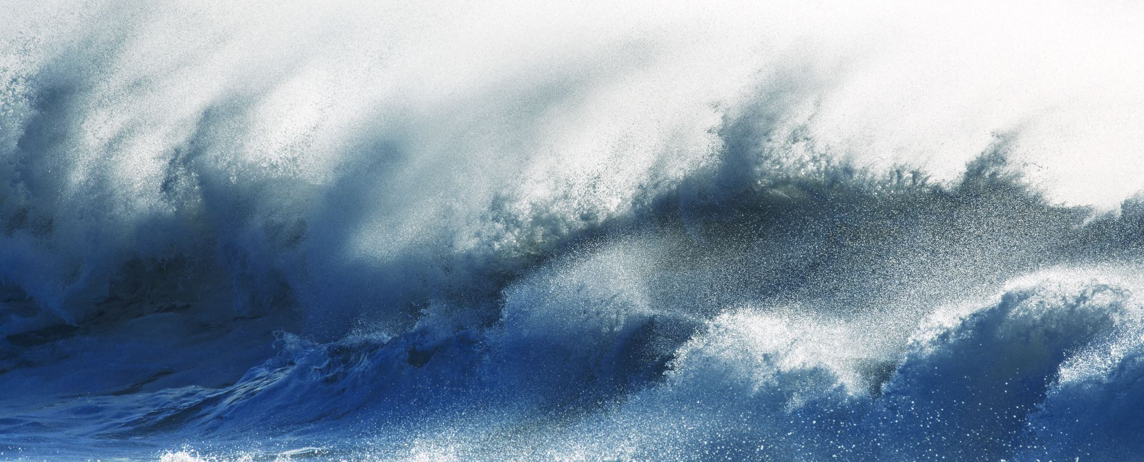
WAS it the wind and the waves taking his focus of Jesus, impacting his faith?

Slide 12
Mark 6:48 This verse starts with hopeful reassurance and ends with doubtful insecurity.
Similar yet less tangible than the wind and waves, past hurt becomes a filter or a lens through which we interpret relationships
We can project our past experiences onto other people around us, as we anticipate being let down again, and try to protect ourselves from further hurt.
In our hurt, we can push away the love that we desperately need.

Slide 13
There is often something much bigger happening throughout our struggles
[Interestingly, Mark doesn’t even mention Peter stepping out of the boat? Did he miss that part?]
Think big picture/what was God up to???:
Was God/Jesus actually going to let a storm hinder his ministry? NO WAY!!!
He got them to the other side safely.
He addressed their fear and doubts, giving them experiences to increase their faith—He called Peter out of the boat, and then supported him.
The waves calmed as he entered the boat. They experienced yet another miracle.
Perhaps he was teaching them turn to him for help. He wants you to reach out.

Slide 14
Father wounds are often projected onto God.
This can impact how we see God:
“He doesn’t have time”
“He’s harsh/I’m afraid to go to Him”
He feels distant/uninvolved”
“I’m a bother when I need to go to him for help. I can’t ask Him for this…”
“He doesn’t care”
“He’ll just leave, and I’ll feel alone again”
Testimony of a son

Slide 15
Did any of those reflect your experience with your earthly father?
What is the impact on how you perceive Heavenly father?

Slide 16
Who is our Heavenly Father?
Hebrew 6:18-19 ”So God has given both his promise and his oath. These two things are unchangeable because it is impossible for God to lie. Therefore, we who have fled to him for refuge can have great confidence as we hold to the hope that lies before us. ¹⁹ This hope is a strong and trustworthy anchor for our souls. It leads us through the curtain into God’s inner sanctuary. ”
Numbers 23:19 “God is not human, that he should lie, not a human being, that he should change his mind. Does he speak and then not act? Does he promise and not fulfill?”

Slide 17
Our Heavenly Father:
Matthew 7:11 “So if you sinful people know how to give good gifts to your children, how much more will your heavenly Father give good gifts to those who ask him.”
1 John 3:1 “See how very much our Father loves us, for he calls us his children, and that is what we are! But the people who belong to this world don’t recognize that we are God’s children because they don’t know him.”
James 1:17 “ Whatever is good and perfect is a gift coming down to us from God our Father, who created all the lights in the heavens.^{[a]} He never changes or casts a shifting shadow.^{[b]}

Slide 18
His love changes our hearts
Romans 2:4 “Don’t you see how wonderfully kind, tolerant, and patient God is with you? Does this mean nothing to you? Can’t you see that his kindness is intended to turn you from your sin?”
Romans 5:8 ”But God showed his great love for us by sending Christ to die for us while we were still sinners.”
1 John 4:19 “we love each other^{[a]} because he loved us first.”
Romans 8:28-29 “And we know that God causes everything to work together^{[a]} for the good of those who love God and are called according to his purpose for them. ²⁹ For God knew his people in advance, and he chose them to become like his Son, so that his Son would be the firstborn^{[b]} among many brothers and sisters.”

Slide 19
The Love of the Father
Romans 8:38 “And I am convinced that nothing can ever separate us from God’s love. Neither death nor life, neither angels nor demons,^{[a]} neither our fears for today nor our worries about tomorrow—not even the powers of hell can separate us from God’s love.”
1 John 4:16 “¹⁶ We know how much God loves us, and we have put our trust in his love. God is love, and all who live in love live in God, and God lives in them.”
John 3:16 “For this is how God loved the world: He gave^{[a]} his one and only Son, so that everyone who believes in him will not perish but have eternal life.”

Slide 20
The Love of the Father
1 John 9:9 “God showed how much he loved us by sending his one and only Son into the world so that we might have eternal life through him.”
John 15:9 “I have loved you even as the Father has loved me. Remain in my love.”
Isaiah 41:13 “For I hold you by your right hand—I, the Lord your God. And I say to you, ‘Don’t be afraid. I am here to help you.”

