Slide 1
For Our Time Of Crisis
Sermon For LifeGate
Sunday, June 4th, 2023

Slide 2
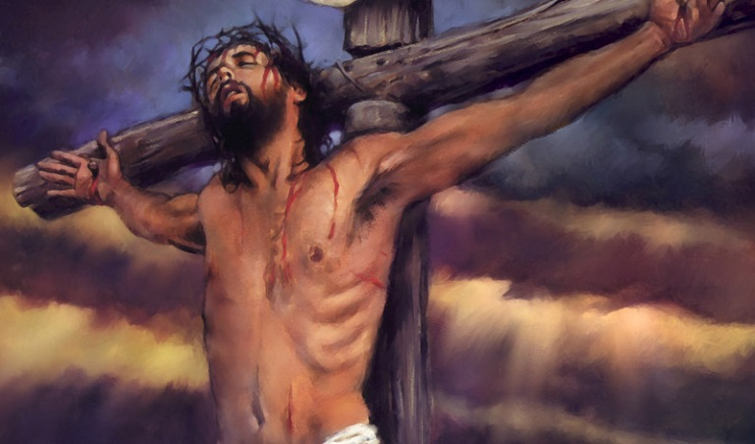
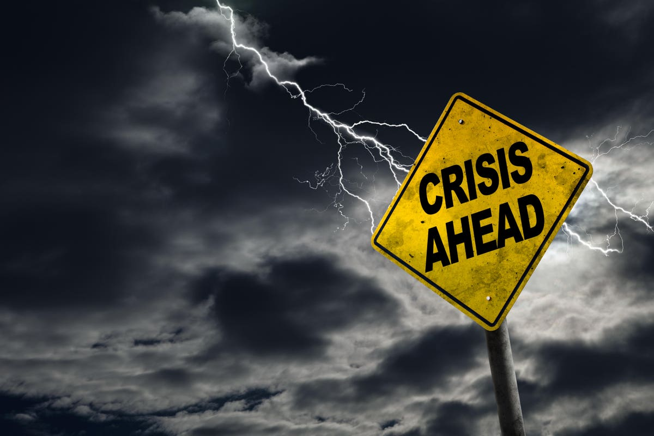
SOME OF THE MOST CRITICAL WORDS OF JESUS – IN A TIME OF ACCELERATION
And I, if I be lifted up from the earth, will draw all men unto me. John 12:32 (KJV)
Literal Meaning
Daily Application

Slide 3
As Watchman on the Wall
WE ARE NOT CALLED TO OPERATE IN A WAY SO AS TO DEVELOP STREET CRED WITH OUR CULTURE BECAUSE WE COME UP WITH A VIBE EITHER CONSERVATIVE OR LIBERAL THAT MAKES EVERYONE LIKE US. WE ARE STANDING IN THE GAP AND SOMETIMES OUR POSITIONS ARE HOSTILE TO THE LIES THAT HAVE BECOME COMMON PLACE. IN ADDITION, WE ARE NOT GOING TO SCRIPTURE WHIP PEOPLE INTO A JUDEA CHRISTIAN WORLD VIEW. WE ARE GOING TO HAVE TO BE DRENCHED IN THE BOLDNESS OF THE HOLY SPIRIT AND WILLING TO ALSO LISTEN TO THOSE WITH MERCY AND WISDOM THAT HAVE GONE INTO THE LIONS DEN AND COME OUT WITH SCARS IN SOME OF THE MOST CHALLENGING SITUATIONS YET ARE NOT GIVING THE WICKED A FREE PASS. THIS WILL TAKE BOLD GOSPEL LIVING AND BOLD GOSPEL INTERCESSION TO WIN THE DAY - DON LAMB

Slide 4
LET’S ADMIT IT – WE GREW UP IN THE
SHALLOW END OF THE POOL
We like to get big blessings without pain – We want breakthroughs without costly transformational prayer and engaging the culture around us.
We lean toward a “Spiritual evolution” if given enough time – the harvest will eventually come in – revival will come eventually – even if we fail.”

Slide 5
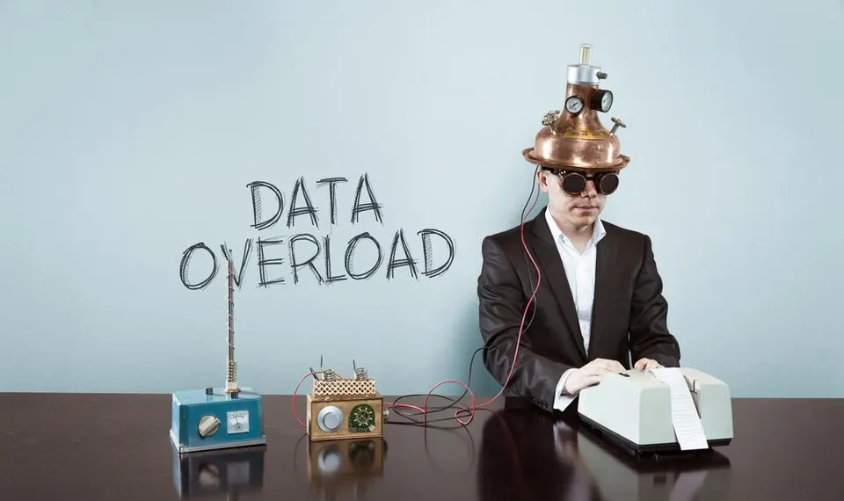
COUPLED WITH A 24 MINUTE
NEWS CYLCE AND INFORMATION OVERLOAD

Slide 6
The Glory of God To Raise Up A praying People
⁹ They will come with weeping; they will pray as I bring them back. I will lead them beside streams of water on a level path where they will not stumble, because I am Israel's Father, and Ephraim is my firstborn son. Jeremiah 31:9 (NIV)
I had this Pollyanna View Of God And His Promises
2 Kings 24:2
Isaiah 55:11 Glory
All Glorious Godhead
Declares a Powerful
Promise Of What He WILL DO AND ACCOMPLISH
Trajectory of Power and Fulfillment
GOD WILL HAVE HIS PROMISES FULFILLED
The Word Is
Almost Like Inevitable
It’s going to work
No matter what I do
Because God Promised
But He Will need to raise up multiple generations that will receive these promises as their OWN for their time and situation
All of the sudden things
Are powerfully happening on the Earth - Because The Promises Are being fulfilled

Slide 7
The Exciting Reality Of God
Successfully Achieving Breakthrough
HERE IS WHAT IS SO ENCOURAGING ABOUT THIS REVELATION. GOD IS DECLARING HE WILL HAVE A PEOPLE WHO WILL PARTNER WITH HIM. HE IS DECLARING THAT THE PROMISES WILL BE FULFILLED – IT IS A DECLARATION OF HIM SUCCESSFULLY HAVING A FAITH-FILLED PEOPLE WHO WILL COOPERATE WITH HIM.

Slide 8
FOUR HOLY SPIRIT
TRAJECTORIES
SEEK – The Face of God
SHOW – The Love of God
SPEAK – The Word of God
STEWARD – The Move of God

Slide 9
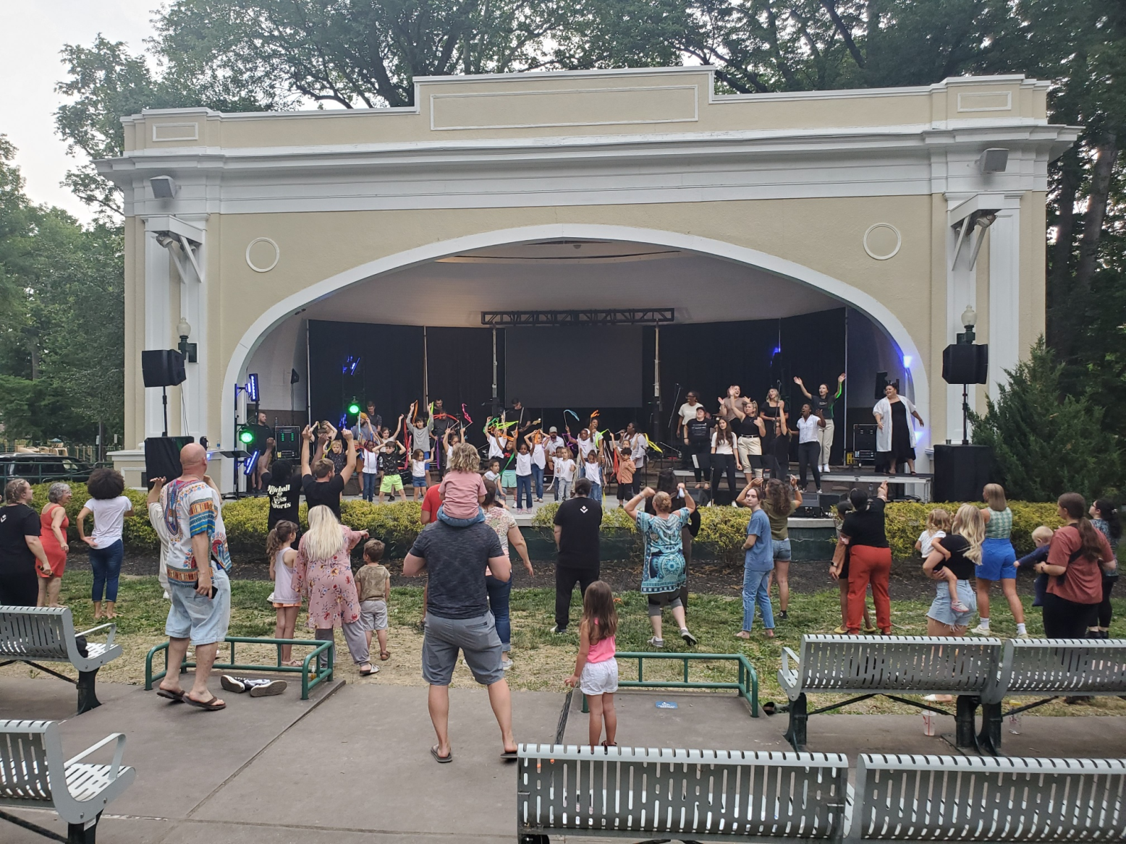
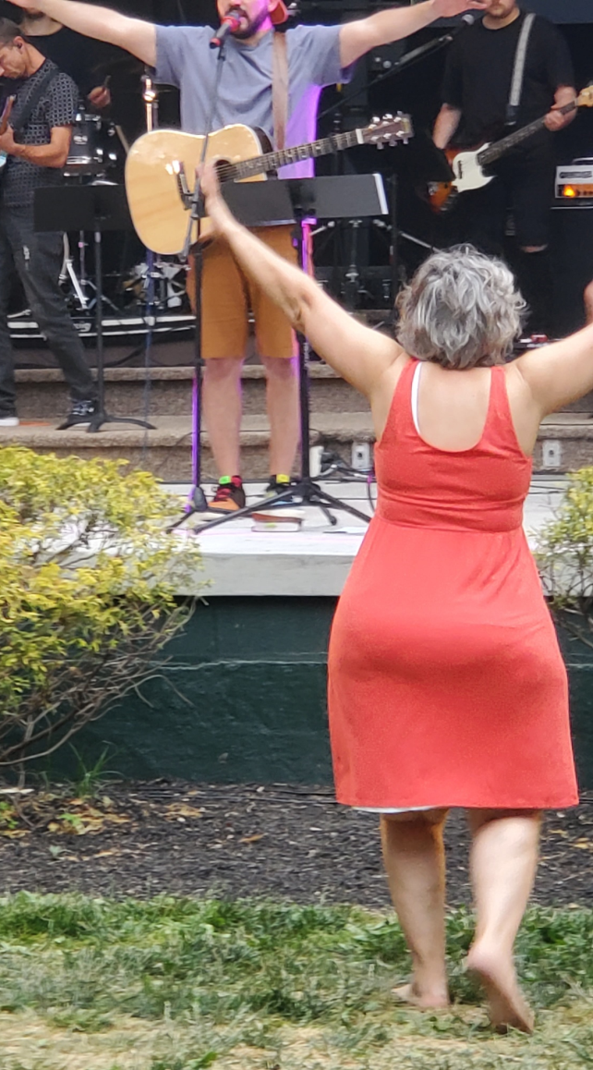
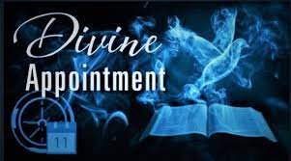
A DAY OF GUT-WRENCHING
AND BLESSING AND OPPORTUNITY

Slide 10
This Wednesday
At LifeGate
“WE REALLY BELIEVE THAT GOD CAN DO THE IMPOSSIBLE – NOT ONLY THEORETICALLY BUT PRACTICALLY – WHERE WE ARE – NOT SOMEWHERE ELSE – NOT IN ANOTHER PART OF THE WORLD – BUT RIGHT HERE WHERE WE ARE.”
Lonnie Riley

Slide 11
GOD IS GOING TO REDEEM
THIS CRAZINESS SOMEHOW
I AM CONVINCED - AT THE END OF THE DAY – THERE IS SOMETHING OF GOD’S FOREKNOWLEDGE THAT ALLOWED THIS HUGE 10,000 YEAR DIVERSION TO TAKE PLACE (WHERE SATAN DUPED MANKIND AND ETCHED THE KNOWLEDGE OF EVIL ON THEIR HEARTS – MANKIND WAS NEVER INTENDED TO SIN – TO REBEL - TO DIE – TO SUFFER – TO FIGHT – TO GET SICK – TO KILL – TO WORSHIP PLEASURE –
TO HATE GOD

Slide 12
GOD IS GOING TO REDEEM
THIS CRAZINESS SOMEHOW
BUT, IN THE MOST PROFOUND REVERSAL, THROUGH THE CROSS – THROUGH THE PERFORMATIVE WORD OF TRUTH – THROUGH THE POWER OF THE HOLY SPIRIT TO ERASE THOSE ETCHINGS OF WICKEDNESS - THROUGH THE BLOOD OF JESUS AND GOSPEL REPENTANCE AND THE WRITING OF GOD’S LOVE ON OUR HEARTS – GOD KNEW HE WOULD OVERCOME THIS SAVAGE SETBACK AND GET SOMETHING MORE GLORIOUS OUT OF IT THAN IF IT HAD NEVER HAPPENED IN THE FIRST PLACE.

Slide 13
GOD IS SEEING WHAT
WE ARE MADE OF
THE CHURCH IS BEING EVALUATED
GOD IS LOOKING FOR A REPENTANT CHURCH AND A FAITH-ACTIVATED CHURCH
GOD IS USING THE DEPRAVITY OF CULTURE TO CREATE AN EXTREME CONTRAST BETWEEN WORLDVIEWS
(TO MAKE PEOPLE STOP HALTING BETWEEN TWO OPINIONS) - Lance Wallnau

Slide 14
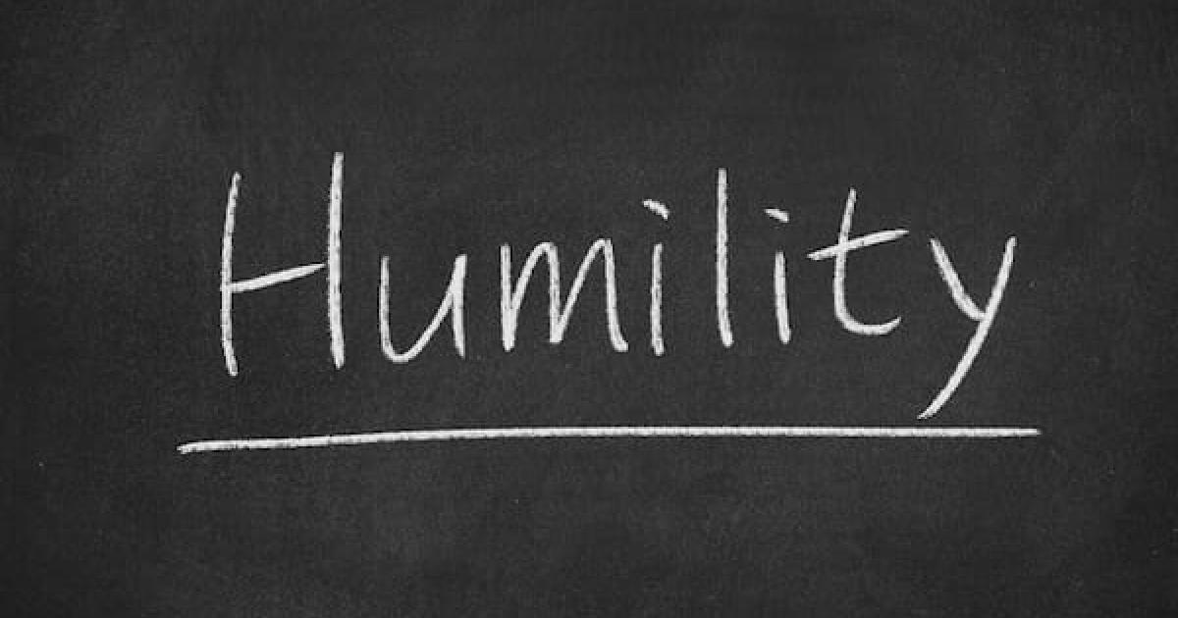
LifeGate Declares
Month

Slide 15
The Very First Time In Scripture The Word Humble Shows Up
And you shall remember all the way which the LORD your God led you these forty years in the wilderness, to humble you, and to prove you, to know what was in your heart, whether you would keep His commandments, or not. Deuteronomy 8:2 (NKJV)

Slide 16
The Apostle John Sums It Up
This is how we know what love is: Jesus Christ laid down his life for us. (SHOW) And we ought to lay down our lives for our brothers. 17 If anyone has material possessions and sees his brother in need but has no pity on him, how can the love of God be in him? (SHOW) 18 Dear children, let us not love with words or tongue (SPEAK) but with actions and in truth. (SHOW) 19 --- 21 Dear friends, if our hearts do not condemn us, we have confidence before God 22 and receive from Him anything we ask, (SEEK) because we obey His commands and do what pleases Him. (STEWARD) 23 And this is his command: to believe in the name of His Son, Jesus Christ, and to love one another as He commanded us. 24 Those who obey His commands live in him, and he in them. (STEWARD) And this is how we know that he lives in us: We know it by the Spirit he gave us.
1 John 3:16-24 (NIV)

Slide 17
SOME OF THE MOST CRITICAL WORDS OF JESUS
And I, if I be lifted up from the earth, will draw all men unto me. John 12:32 (KJV)
Literal Meaning
Daily Application

Slide 18
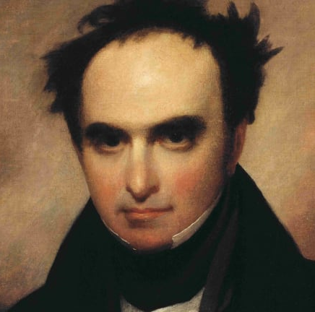
The Miracle Of America
Daniel Webster
“Hold on, my friends, to the Constitution and to the Republic for which it stands. Miracles sometimes do not cluster and what has happened once in 6,000 years may not happen again. Hold on to the Constitution, for if the American Constitution should fail, there will be anarchy throughout the world.” Daniel Webster (early 1800’s)

Slide 19
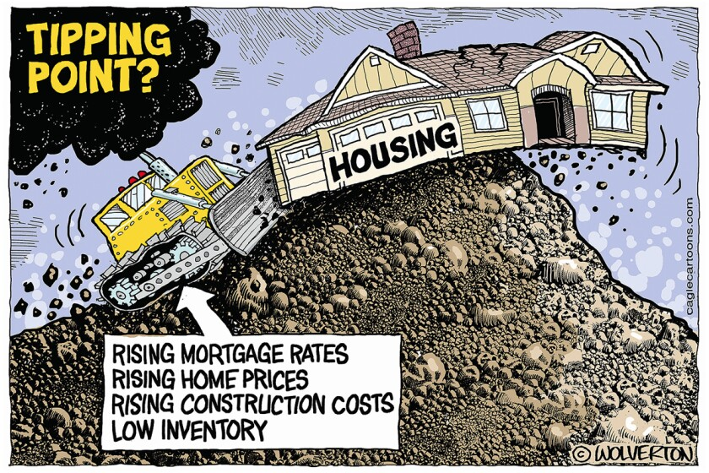
IT DOESN’T MEAN WE CAN’T TALK ABOUT THE ISSUES OF THE DAY

Slide 20
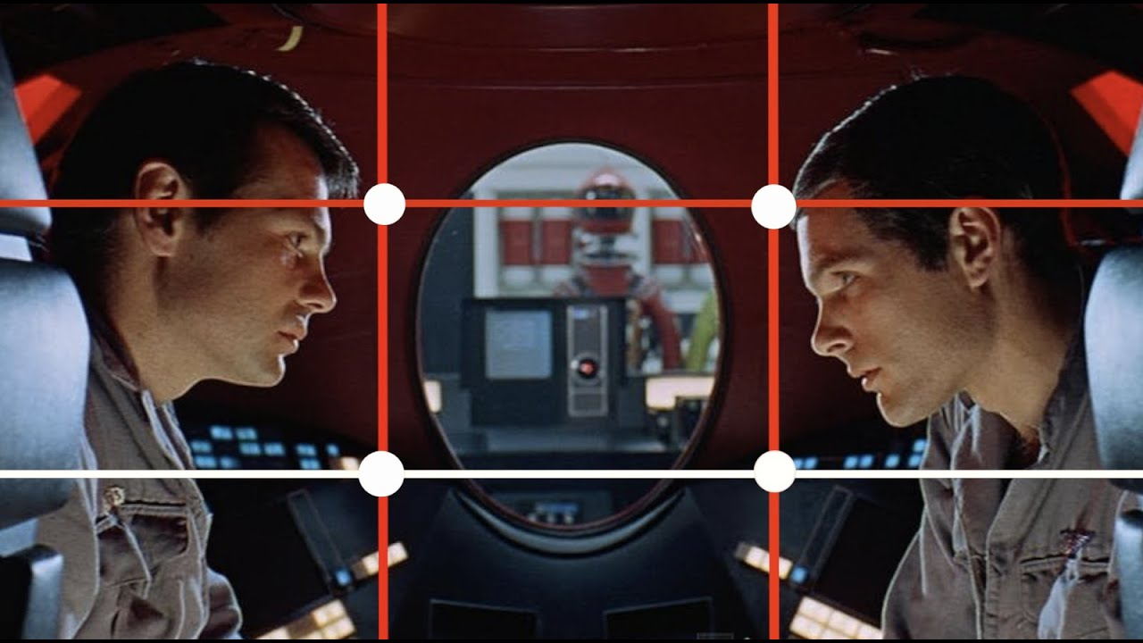
There’s a rule in Photography
Called the THIRDS – rule

Slide 21
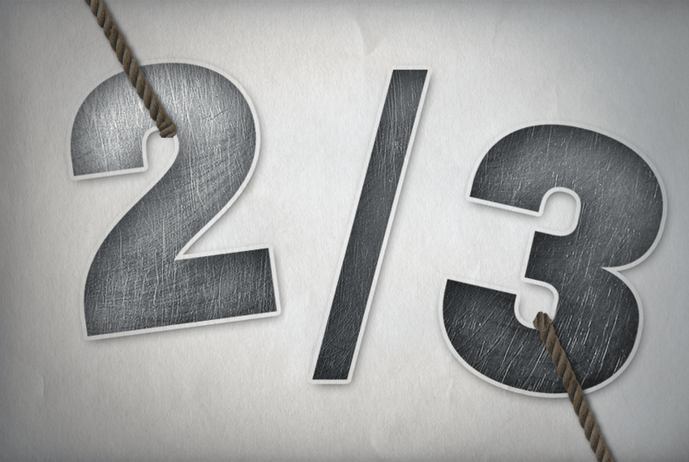
BUT WE NEED TO USE ONE THIRD OF OUR TIME WITH THE CRISIS AND TWO THIRDS WITH THE LORD RISING ABOVE THE CRISIS
Then he said to them all: "If anyone would come after me, he must deny himself and take up his cross daily and follow me. Luke 9:23 (NIV)
RULE

Slide 22
HOW DO WE LIFT JESUS ABOVE THE SITUATIONS WE FACE?
OR BRING HIM INTO THE CRISIS WE ARE ENGAGING?
Keeping Jesus The Center means we do not allow the CRISIS to become more intimidating or important that He is – As LORD – As PROVIDER – As JUDGE – As JEALOUS over His people and His Kingdom -
Never be lacking in zeal, but keep your spiritual fervor, serving the Lord. Romans 12:11 (NIV)
Since we live by the Spirit, let us keep in step with the Spirit. Galatians 5:25 (NIV)
Make every effort to keep the unity of the Spirit through the bond of peace. Ephesians 4:3 (NIV)

Slide 23
HOW DO WE LIFT JESUS ABOVE THE SITUATIONS WE FACE?
Pray in the Spirit on all occasions with all kinds of prayers and requests. With this in mind, be alert and always keep on praying for all the saints. Ephesians 6:18 (NIV)
Keep away from every brother who is idle and does not live according to the teaching you received from us.
2 Thessalonians 3:6 (NIV)
Do not share in the sins of others. Keep yourself pure.
1 Timothy 5:22 (NIV)
Keep your head in all situations, endure hardship, do the work of an evangelist, discharge all the duties of your ministry.
2 Timothy 4:5 (NIV)

Slide 24
THE WORDS OF JESUS TO
A CHURCH IN CRISIS
¹² While Jesus was in one of the towns, a man came along who was covered with leprosy. When he saw Jesus, he fell with his face to the ground and begged him, "Lord, if you are willing, you can make me clean." ¹³ Jesus reached out his hand and touched the man. "I am willing," He said. "Be clean!" And immediately the leprosy left him. Luke 5:12-13 (NIV)

Slide 25
THE WORDS OF JESUS TO
THE CHURCH IN CRISIS
As Jesus went on from there, two blind men followed him, calling out, "Have mercy on us, Son of David!" ²⁸ When he had gone indoors, the blind men came to him, and he asked them, "Do you believe that I am able to do this?" "Yes, Lord," they replied. ²⁹ Then he touched their eyes and said, "According to your faith will it be done to you"; Matthew 9:27-29 (NIV)

Slide 26
THE WORDS OF JESUS TO
THE CHURCH IN CRISIS
Jesus answered and said unto them, Verily I say unto you, If you have faith, and doubt not, you shall not only do this which is done to the fig tree, but also if you will say unto this mountain, Be thou removed, and be thou cast into the sea; it shall be done. ²² And all things, whatsoever you shall ask in prayer, believing, you shall receive. Matthew 21:21-22 (KJV)

Slide 27
We Must Foster The Spirit
Of Faith and Expectancy
My soul, wait thou only upon God; for my expectation is from Him. 6 He only is my rock and my salvation: he is my defense; I shall not be moved. 7 In God is my salvation and my glory: the rock of my strength, and my refuge, is in God. Psalm 62:5-7 (KJV)

Slide 28
APPLICATION?
Take to heart the privilege to be one who brings GOOD NEWS – God is not at war with us – but we are with Him and we can SURRENDER IMMEDIATELY and be saved and reconciled
You don’t have to put up with being bullied by your flesh and the culture and your problems – LIFT JESUS UP IN YOUR HEART – and over your problems.
Step into the river of SEEK – The Face of God SHOW – The Love of God - SPEAK – The Word of God STEWARD – The Move of God

