Slide 1
For Our Time Of Crisis
Sermon For LifeGate
Sunday, June 11th, 2023

Slide 2
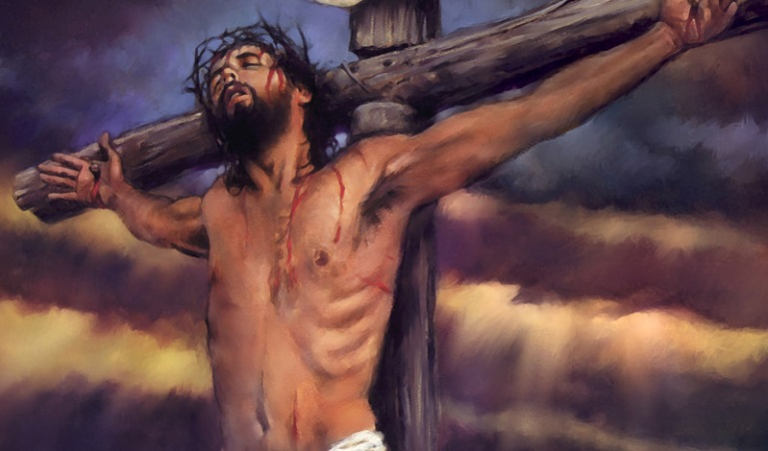
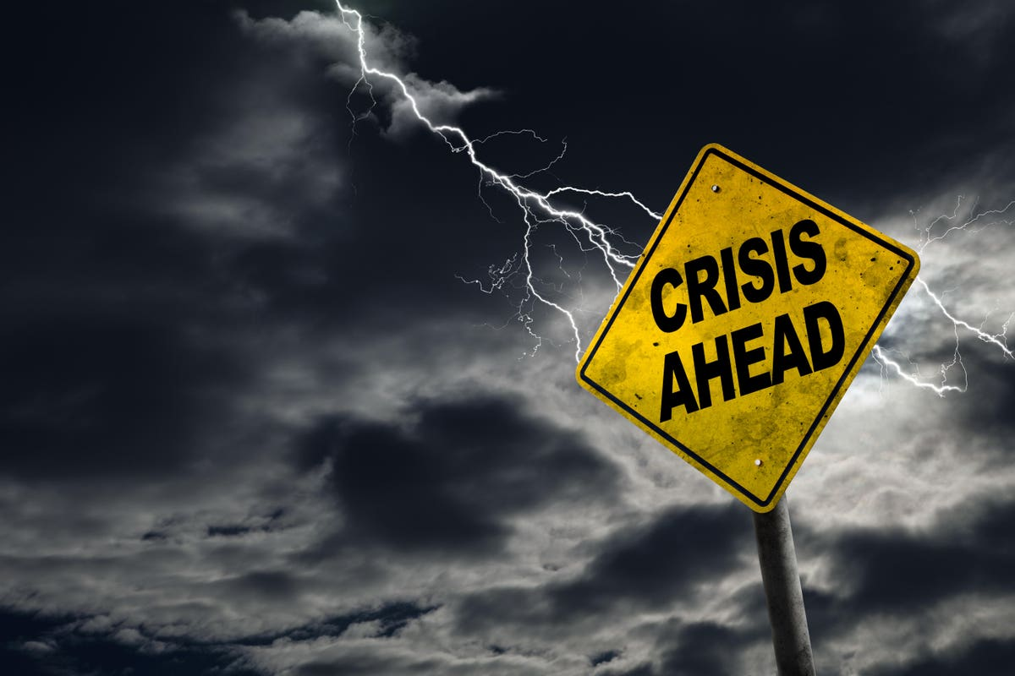
SOME OF THE MOST CRITICAL WORDS OF JESUS – IN A TIME OF ACCELERATION
And I, if I be lifted up from the earth, will draw all men unto me. John 12:32 (KJV)
Literal Meaning
Daily Application

Slide 3
FOUR HOLY SPIRIT
TRAJECTORIES
SEEK – The Face of God
SHOW – The Love of God
SPEAK – The Word of God
STEWARD – The Move of God

Slide 4
The Book Of Daniel Unleashed
⁴ But you, O Daniel, shut up the words, and seal the book, even to the time of the end: many shall run to and fro, and knowledge shall be increased. Daniel 12:4 (KJV)
And they shall pollute the sanctuary of strength, and shall take away the daily sacrifice, and they shall place the abomination that maketh desolate. (Antiochus Epiphanes (175 BC -164BC), And such as do wickedly against the covenant shall he corrupt by flatteries: but the people that do know their God shall be strong, and do exploits. Daniel 11:31-32 (KJV)
And he shall speak great words against the most High, and shall wear out the saints of the most High, and think to change times and laws: and they shall be given into his hand until a time and times and the dividing of time. Daniel 7:25 (KJV)

Slide 5
We Are In This Psalm 64 Moment
Hear me, O God, as I voice my complaint; protect my life from the threat of the enemy. ² Hide me from the conspiracy of the wicked, from that noisy crowd of evildoers. ³ They sharpen their tongues like swords and aim their words like deadly arrows. ⁴ They shoot from ambush at the innocent man; they shoot at him suddenly, without fear. ⁵ They encourage each other in evil plans, they talk about hiding their snares; they say, "Who will see them?" ⁶ They plot injustice and say, "We have devised a perfect plan!" Surely the mind and heart of man are cunning. ⁷ But God will shoot them with arrows; suddenly they will be struck down. ⁸ He will turn their own tongues against them and bring them to ruin; all who see them will shake their heads in scorn. ⁹ All mankind will fear; they will proclaim the works of God and ponder what he has done. ¹⁰ Let the righteous rejoice in the LORD and take refuge in him; let all the upright in heart praise him! Psalm 64:1-10 (NIV)

Slide 6
The Message Translation
The God of the Arrow shoots (His enemies)! They double up in pain, ⁸ Fall flat on their faces in full view of the grinning crowd. ⁹ Everyone sees it. God's work is the talk of the town. ¹⁰ Be glad, good people! Fly to GOD! Good-hearted people, make praise your habit. Psalm 64:7-10 (MSG)

Slide 7
We Are In The Time Of Digging Holes in the Wall of Culture and the Church Finding Out – “How far gone we are.”
Busy but prayerless and powerless Church
Tired over-extended Believers
Deep State – Real Movement To Control World
Political, Medical, Financial tyranny and insanity
Then he said to me, "Son of man, look toward the north." So I looked, and in the entrance north of the gate of the altar I saw this idol of jealousy. ⁶ And he said to me, "Son of man, do you see what they are doing--the utterly detestable things the house of Israel is doing here, things that will drive me far from my sanctuary? But you will see things that are even more detestable." ⁷ Then he brought me to the entrance to the court. I looked, and I saw a hole in the wall. ⁸ He said to me, "Son of man, now dig into the wall." So I dug into the wall and saw a doorway there. ⁹ And he said to me, "Go in and see the wicked and detestable things they are doing here." Ezekiel 8:5-9 (NIV)

Slide 8
Help Our Hearts Not Be Jaded
By All The Drama
Nation will rise against nation, and kingdom against kingdom. There will be famines and earthquakes in various places. ⁸ All these are the beginning of birth pains. ⁹ "Then you will be handed over to be persecuted and put to death, and you will be hated by all nations because of me. ¹⁰ At that time many will turn away from the faith and will betray and hate each other, ¹¹ and many false prophets will appear and deceive many people. ¹² Because of the increase of wickedness, the love of most will grow cold, ¹³ but he who stands firm to the end will be saved. ¹⁴ And this gospel of the kingdom will be preached in the whole world as a testimony to all nations, and then the end will come. Matthew 24:7-14 (NIV)

Slide 9
The Presence Of The Lord Must Be Carried On The Shoulders of The Saints
We had reached a place where we dared not go forward without God's presence.
Very earnestly, we poured out our prayers before Lord, searching our hearts and seeking to meet the conditions. God heard us and gave us a visitation showing us what was to come. The Spirit showed us plainly that the way of victory for us would be a way of radical faith, confession, of broken hearts, and bitter tears." 1906
At that time the LORD set apart the tribe of Levi to carry the ark of the covenant of the LORD, to stand before the LORD to minister and to pronounce blessings in His name, as they still do today ⁻ the LORD is their inheritance, as the LORD your God told them.) Deuteronomy 10:8-9

Slide 10
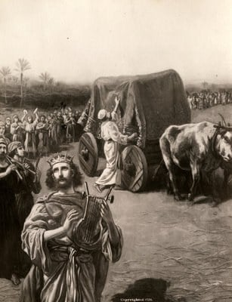
We Cannot Ad-Lib The Will of God
And Expect Things To Go Right
¹ After David had constructed buildings for himself in the City of David, he prepared a place for the ark of God and pitched a tent for it. ² Then David said, "No one but the Levites may carry the ark of God, because the LORD chose them to carry the ark of the LORD and to minister before him forever." 1 Chronicles 15:1-2 (NIV)
⁹ When they came to the threshing floor of Kidon, Uzzah reached out his hand to steady the ark, because the oxen stumbled. ¹⁰ The LORD's anger burned against Uzzah, and he struck him down because he had put his hand on the ark. So he died there before God. 1 Chronicles 13:9-10 (NIV)

Slide 11
The Trajectory Of Our Time Of Battle
"I tell you the truth, this generation will certainly not pass away until all these things have happened. ³³ Heaven and earth will pass away, but my words will never pass away. ³⁴ "Be careful, or your hearts will be weighed down with dissipation, drunkenness and the anxieties of life, and that day will close on you unexpectedly like a trap. ³⁵ For it will come upon all those who live on the face of the whole earth. ³⁶ Be always on the watch, and pray that you may be able to escape (Flee) all that is about to happen, and that you may be able to stand before the Son of Man." Luke 21:32-36 (NIV)

Slide 12
The Fact That God Gets Everyone’s Attention Through Judgment Yet Promises To Heal Them
Through the Holy Spirit and the Gospel
In the day of great slaughter, when the towers fall, streams of water will flow on every high mountain and every lofty hill. ²⁶ The moon will shine like the sun, and the sunlight will be seven times brighter, like the light of seven full days, when the LORD binds up the bruises of His people and heals the wounds He inflicted. Isaiah 30:25-26 (NIV)

Slide 13
You Are Salt and Light
"You are the salt of the earth. But if the salt loses its saltiness, how can it be made salty again? It is no longer good for anything, except to be thrown out and trampled by men. 14 "You are the light of the world. A city on a hill cannot be hidden. 15 Neither do people light a lamp and put it under a bowl. Instead they put it on its stand, and it gives light to everyone in the house. 16 In the same way, let your light shine before men, that they may see your good deeds and praise your Father in heaven. Matthew 5:13-16 (NIV)
Dear friends, I urge you, as aliens and strangers in the world, to abstain from sinful desires, which war against your soul. ¹² Live such good lives among the pagans that, though they accuse you of doing wrong, they may see your good deeds and glorify God on the day he visits us. 1 Peter 2:11-12 (NIV)

Slide 14
The Spirit of This Age
Will Try To Snuff You Out
You have profaned me among my people for a few handfuls of barley and scraps of bread. By lying to my people, who listen to lies, you have killed those who should not have died and have spared those who should not live. ²⁰ "'Therefore this is what the Sovereign LORD says: I am against your magic charms with which you ensnare people like birds and I will tear them from your arms; I will set free the people that you ensnare like birds. ²¹ I will tear off your veils and save my people from your hands, and they will no longer fall prey to your power. Then you will know that I am the LORD. ²² Because you disheartened the righteous with your lies, when I had brought them no grief, and because you encouraged the wicked not to turn from their evil ways and so save their lives, ²³ therefore you will no longer see false visions or practice divination. I will save my people from your hands. And then you will know that I am the LORD.'" Ezekiel 13:19-23 (NIV)

Slide 15
But It Must be Matched With The Glorious Revelation That Jesus Is Still Working
Keep your lives free from the love of money and be content with what you have, because God has said, "Never will I leave you; never will I forsake you." ⁶ So we say with confidence, "The Lord is my Helper; I will not be afraid. What can man do to me?" ⁷ Remember your leaders, who spoke the Word of God to you. Consider the outcome of their way of life and imitate their faith. ⁸ Jesus Christ is the same yesterday, and today, and forever.
Hebrews 13:5-10 (NIV)

Slide 16
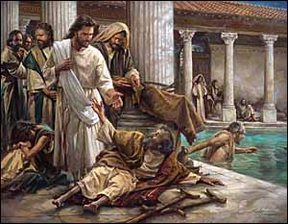
Jesus And The Rules Of Man
And The Hopeless Man
⁵ One who was there had been an invalid for thirty-eight years. ⁶ When Jesus saw him lying there and learned that he had been in this condition for a long time, he asked him, "Do you want to get well?" ⁷ "Sir," the invalid replied, "I have no one to help me into the pool when the water is stirred. While I am trying to get in, someone else goes down ahead of me." ⁸ Then Jesus said to him, "Get up! Pick up your mat and walk." ⁹ At once the man was cured; he picked up his mat and walked. The day on which this took place was a Sabbath, ¹⁰ and so the Jews said to the man who had been healed, "It is the Sabbath; the law forbids you to carry your mat." ¹¹ But he replied, "The man who made me well said to me, 'Pick up your mat and walk.'" John 5:5-11 (NIV)

Slide 17
Jesus And The Father
Are Always Working
So, because Jesus was doing these things on the Sabbath, the Jews persecuted him. ¹⁷ Jesus said to them, "My Father is always at His work (to engage, labor) to this very day, and I, too, am working." ¹⁸ For this reason the Jews tried all the harder to kill him; not only was he breaking the Sabbath, but he was even calling God his own Father, making himself equal with God. ¹⁹ Jesus gave them this answer: "I tell you the truth, the Son can do nothing by himself; he can do only what he sees his Father doing, because whatever the Father does the Son also does. John 5:16-19 (NIV)

Slide 18
You Can’t Do That!!!
Man’s Rules Say So
You can’t have revival in these days of apostasy
There are no eleventh hour deliverances it is only judgment and then RAPTURE
Your efforts are futile the deep state has won we are under judgment just follow Jesus and don’t put forth any effort to steward your city of nation
You can’t heal in this atmosphere of medical dysfunction
That marriage can’t be saved they are too far gone – they have “marriage disorder syndrome.”

Slide 19
I Am Blessed By The Revelation of Jesus – But I Want Him To Be Astonished At My Faith
The centurion replied, "Lord, I do not deserve to have you come under my roof. But just say the word, and my servant will be healed. 9 For I myself am a man under authority, with soldiers under me. I tell this one, 'Go,' and he goes; and that one, 'Come,' and he comes. I say to my servant, 'Do this,' and he does it." 10 When Jesus heard this, he was astonished and said to those following him, "I tell you the truth, I have not found anyone in Israel with such great faith. - 13 Then Jesus said to the centurion, "Go! It will be done just as you believed it would." And his servant was healed at that very hour. Matthew 8:8-13 (NIV)

Slide 20
We Must Foster The Spirit
Of Faith and Expectancy
¹⁶ Therefore, the promise comes by faith, so that it may be by grace -- As it is written: "I have made you a father of many nations." He is our father in the sight of God, in whom he believed--the God who gives life to the dead and calls things that are not as though they were. ¹⁸ Against all hope, Abraham in hope believed and so became the father of many nations, just as it had been said to him, "So shall your offspring be." Romans 4:16-18 (NIV)
²⁵ For the foolishness of God is wiser than man's wisdom, and the weakness of God is stronger than man's strength. ²⁶ Brothers, think of what you were when you were called. Not many of you were wise by human standards; not many were influential; not many were of noble birth. ²⁷ But God chose the foolish things of the world to shame the wise; God chose the weak things of the world to shame the strong. ²⁸ He chose the lowly things of this world and the despised things--and the things that are not--to nullify the things that are, ²⁹ so that no one may boast before him. 1 Corinthians 1:25-29 (NIV)

Slide 21
APPLICATION?
Prepare to SWIM AGAINST THE CURRENT – Be carried by the “Gulfstream” of the Holy Spirit.
Prepare for rough times – but prepare your faith more than your pantry
Get motivated to ASTONISH Jesus with your expectancy and holy rebellious declarations of faith against all the forces of hell.
Step into the river of SEEK – The Face of God SHOW – The Love of God - SPEAK – The Word of God STEWARD – The Move of God

