Slide 2
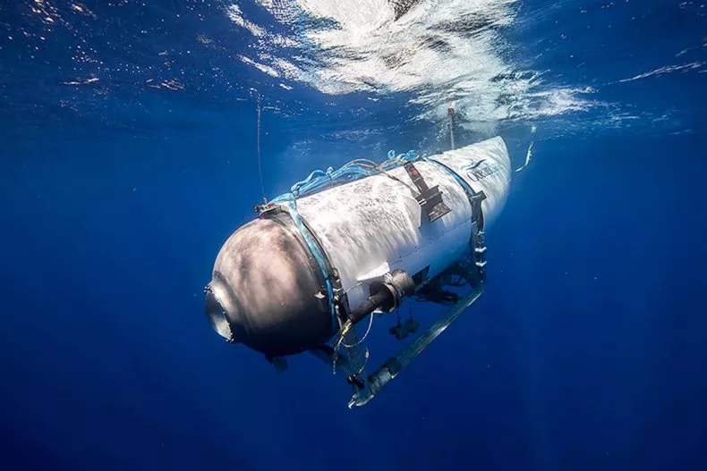
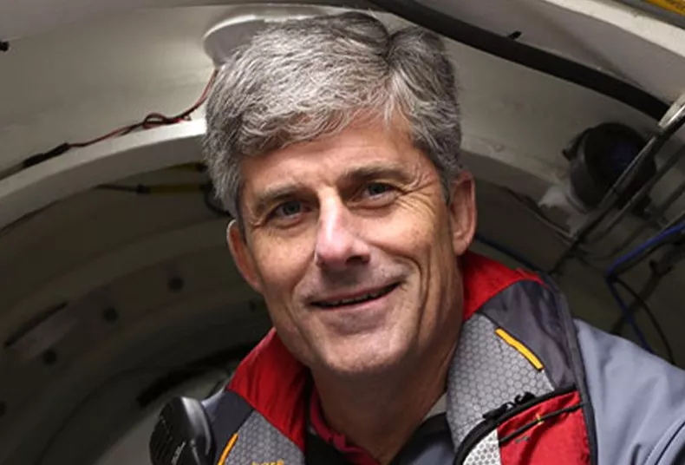
In 2017, "By the time we're done testing it, I believe [Titan is] pretty much invulnerable."
Stockton Rush, CEO OceanGate

Slide 3
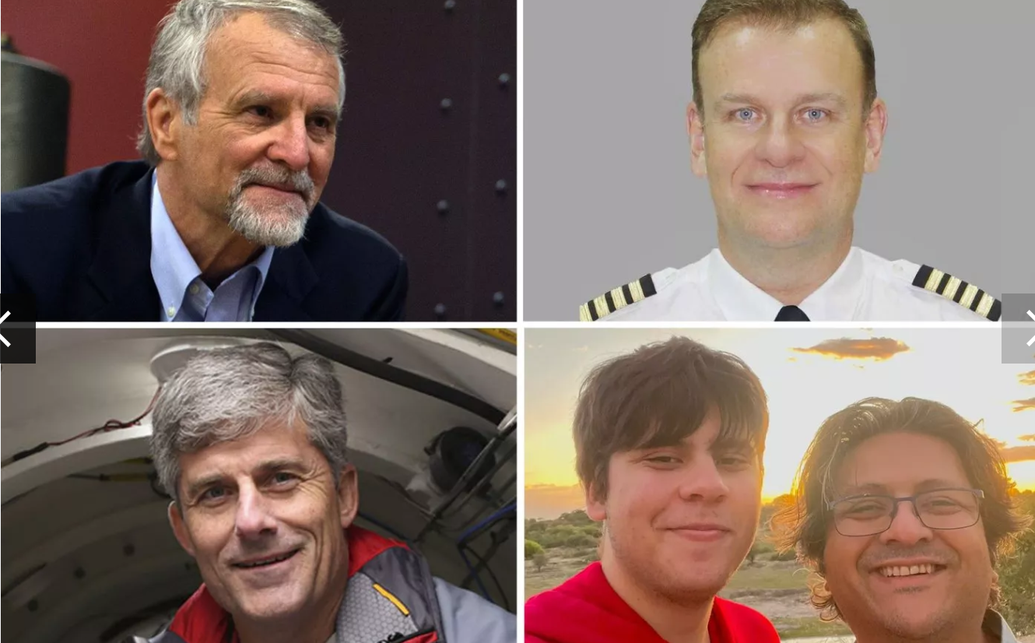

Slide 4
"You know, at some point, safety just is pure waste," said Rush. "I mean, if you just want to be safe, don't get out of bed. Don't get in your car. Don't do anything. At some point, you're going to take some risk, and it really is a risk/reward question. I think I can do this just as safely by breaking the rules.”rules."

Slide 5
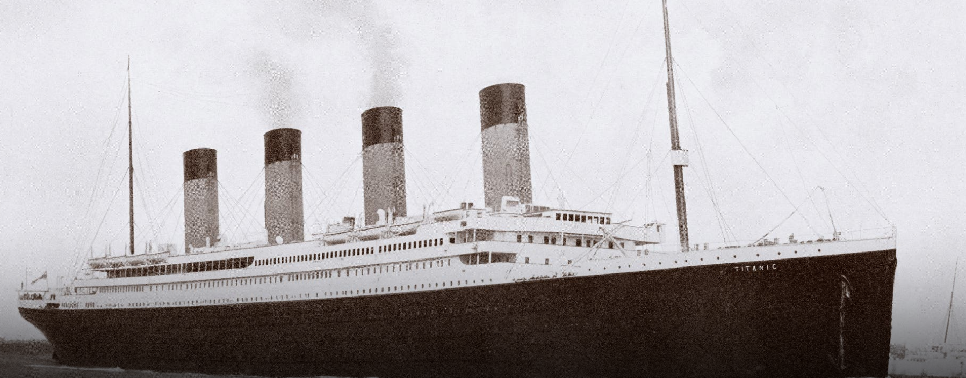
The “Unsinkable” Titanic

Slide 6
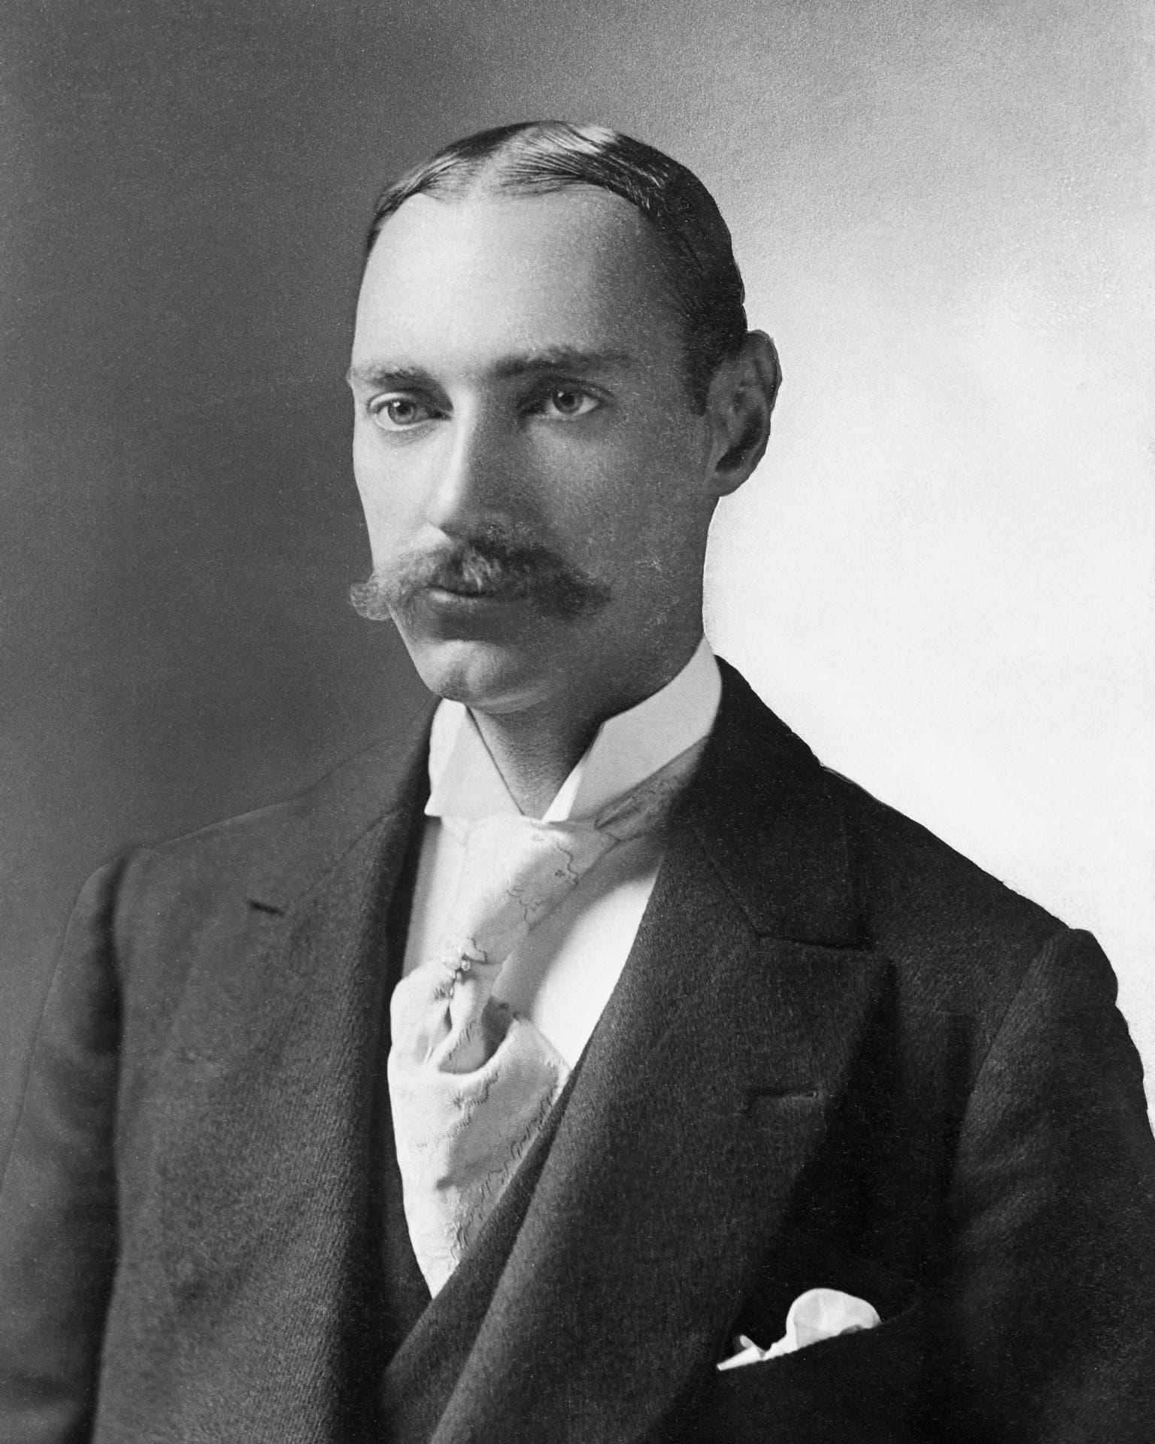
Number of people who died: 1,517
Number that survived: 709
Lifeboats Equipped to carry: 64
Actually carried: 20
JJ Astor, the riches passenger
Worth $87 mil.= $2.2 bil today.

Slide 7
On April 14, 1912, the day of the disaster, Titanic received seven iceberg warnings. One of these messages was transmitted from the SS Amerika via the Titanic to the Hydrographic Office in Washington, D.C. The message reported ice along Titanic's route.
Because of fog and icebergs, the Californian's captain, Stanley Lord, had halted his ship north of the Titanic, and his radio operator had broadcast a warning. The Titanic's radio operator, John George Phillips, told the Californian: ''Shut up, shut up! I am busy!

Slide 8
hubris-Greek hybris, in ancient Athens, the intentional use of violence to humiliate or degrade.
The word's connotation changed over time, and hubris came to be defined as overweening presumption that leads a person to disregard the divinely fixed limits on human action in an ordered cosmos.

Slide 9
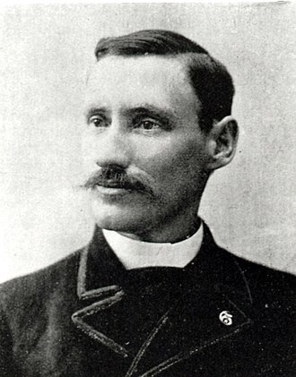
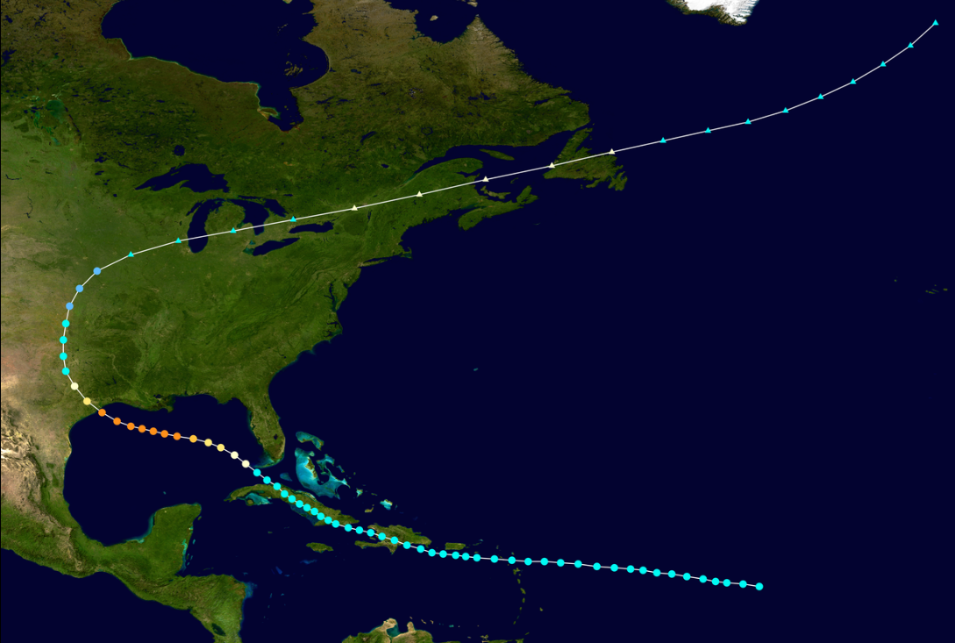
Isaac Cline- meteorologist 1861-1955

Slide 10
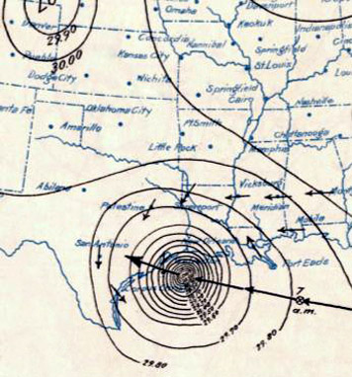
The Great Galveston Hurricane of 1900
1900 Storm, is the deadliest natural disaster in United States history.
12,000 fatalities
7,000 buildings
3,636 demolished homes
Category 4 hurricane with maximum sustained winds of 145 mph

Slide 11
Rapture and Resurrection

Slide 12
Matthew 24
1 Jesus left the temple and was walking away when his disciples came up to him to call his attention to its buildings. 2 “Do you see all these things?” he asked. “Truly I tell you, not one stone here will be left on another; everyone will be thrown down.”
3 As Jesus was sitting on the Mount of Olives, the disciples came to him privately. “Tell us,” they said, “when will this happen, and what will be the sign of your coming and of the end of the age?”
4 Jesus answered: “Watch out that no one deceives you. 5 For many will come in my name, claiming, ‘I am the Messiah,’ and will deceive many. 6 You will hear of wars and rumors of wars, but see to it that you are not alarmed. Such things must happen, but the end is still to come.

Slide 13
7 Nation will rise against nation, and kingdom against kingdom. There will be famines and earthquakes in various places. 8 All these are the beginning of birth pains.
9 “Then you will be handed over to be persecuted and put to death, and you will be hated by all nations because of me. 10 At that time many will turn away from the faith and will betray and hate each other, 11 and many false prophets will appear and deceive many people. 12 Because of the increase of wickedness, the love of most will grow cold, 13 but the one who stands firm to the end will be saved. 14 And this gospel of the kingdom will be preached in the whole world as a testimony to all nations, and then the end will come.

Slide 14
15 “So when you see standing in the holy place ‘the abomination that causes desolation,’ spoken of through the prophet Daniel—let the reader understand— 16 then let those who are in Judea flee to the mountains. 17 Let no one on the housetop go down to take anything out of the house. 18 Let no one in the field go back to get their cloak. 19 How dreadful it will be in those days for pregnant women and nursing mothers! 20 Pray that your flight will not take place in winter or on the Sabbath. 21 For then there will be great distress, unequaled from the beginning of the world until now—and never to be equaled again.

Slide 15
22 “If those days had not been cut short, no one would survive, but for the sake of the elect those days will be shortened. 23 At that time if anyone says to you, ‘Look, here is the Messiah!’ or, ‘There he is!’ do not believe it. 24 For false messiahs and false prophets will appear and perform great signs and wonders to deceive, if possible, even the elect. 25 See, I have told you ahead of time.
26 “So if anyone tells you, ‘There he is, out in the wilderness,’ do not go out; or, ‘Here he is, in the inner rooms,’ do not believe it. 27 For as lightning that comes from the east is visible even in the west, so will be the coming of the Son of Man. 28 Wherever there is a carcass, there the vultures will gather.

Slide 16
29 “Immediately after the distress of those days
Up til this point, no Rapture has taken place.
Then a Cosmic Disturbance takes place!

Slide 17
“‘the sun will be darkened, and the moon will not give its light; the stars will fall from the sky, and the heavenly bodies will be shaken.’

Slide 18
Isaiah 13:9,10
9 See, the day of the Lord is coming
—a cruel day, with wrath and fierce anger—
to make the land desolate
and destroy the sinners within it.
10
The stars of heaven and their constellations
will not show their light.
The rising sun will be darkened
and the moon will not give its light.

Slide 19
Day of the LORD = Christ’s Return

Slide 20
The Impact on National Israel and the World

Slide 21
30 “Then will appear the sign of the Son of Man in heaven. And then all the peoples of the earth will mourn when they see the Son of Man coming on the clouds of heaven, with power and great glory.

Slide 22
The Tribulation Comes First
Then a Cosmic Disturbance
Then the 2nd Coming “They will see him in the Sky”
He will send His Angels with a loud trumpet call

Slide 23
31 And he will send his angels with a loud trumpet call, and they will gather his elect from the four winds, from one end of the heavens to the other.
This is the only time Jesus mentions the gathering of the elect. And it happens after the tribulation.
These are the words of Jesus

Slide 24
“Gathering of the Elect” happens by Resurrection of the Dead and by Catching up those who are alive.

Slide 25
If you’re resurrected, you’re dead first
If you’re raptured, you’re alive

Slide 26
2 Thessalonians 2:1
“Concerning the coming of our Lord Jesus Christ and our being gathered to him,..”
Tribulation of those days
He comes
He takes us with him
This is the story-line in the Gospels

Slide 27
Paul says “concerning the Day of the LORD Jesus and our being gathered to him, v.1
“don’t become easily unsettled by a letter of prophecy supposed to have come from us saying that the Day of the Lord has come.” 2 Thess 2:2

Slide 28
“ v.3 Don’t let anyone deceive you in any way, for that day will not come…”
What Day? The Day of the LORD when he comes to take us.
“Until……

Slide 29
..the Rebellion (falling away) occurs and the man of lawlessness is revealed. The man doomed to destruction.

Slide 30
apostasia- “a departure, divorce or. dismissal of a woman from her husband, the deed or instrument of such divorce,” and is a. derivative of the verb, aphistemi, meaning, “to depart or stand away from, to fall away.”
It is this one word that bible teachers have used to validate the pre-tribulation rapture

Slide 31
4 “He will oppose and will exalt himself over everything that is called God or is worshiped, so that he sets himself up in God’s temple, proclaiming himself to be God.
5 Don’t you remember that when I was with you I used to tell you these things?” 2 Thess 4,5

Slide 32
2 Thessalonian 4:
13 Brothers and sisters, we do not want you to be uninformed about those who sleep in death, so that you do not grieve like the rest of mankind, who have no hope.
14 For we believe that Jesus died and rose again, and so we believe that God will bring with Jesus those who have fallen asleep in him.
15 According to the Lord’s word, we tell you that we who are still alive, who are left until the coming of the Lord, will certainly not precede those who have fallen asleep.

Slide 33
16 For the Lord himself will come down from heaven, with a loud command, with the voice of the archangel and with the trumpet call of God, and the dead in Christ will rise first.
17 After that, we who are still alive and are left will be caught up together with them in the clouds to meet the Lord in the air. And so we will be with the Lord forever.
18 Therefore encourage one another with these words.

Slide 34
Paul closes the argument by saying “that day will not come until…”

Slide 35
..the Rebellion (falling away) occurs and the man of lawlessness is revealed. The man doomed to destruction.

Slide 36
Day of the LORD = Christ’s Return and the gathering of us to Him.
but first the rebellion (falling away), then the man of lawlessness is revealed.

Slide 37
2 Thessalonians 2:
6 And now you know what is holding him back, so that he may be revealed at the proper time.
7 For the secret power of lawlessness is already at work; but the one who now holds it back will continue to do so till he is taken out of the way.
8 And then the lawless one will be revealed, whom the Lord Jesus will overthrow with the breath of his mouth and destroy by the splendor of his coming.

Slide 38
9 The coming of the lawless one will be in accordance with how Satan works. He will use all sorts of displays of power through signs and wonders that serve the lie, 10 and all the ways that wickedness deceives those who are perishing. They perish because they refused to love the truth and so be saved. 11 For this reason God sends them a powerful delusion so that they will believe the lie
12 and so that all will be condemned who have not believed the truth but have delighted in wickedness.

Slide 40
This is the Satanic Fake, counterfeit gospel story:
A revealing of the lawless one
By the work of Satan
Displaying all sorts of power and miracles
Delivering Lies
Deceiving those who are perishing

Slide 41
Who wants to restrain the revealing of the Anti-Christ in the beginning of the Great Tribulation more than anyone?
Who wants to delay that?
The one who is restraining the revealing of the Anti-Christ is the one who works lawlessness. The one who is energizing his tyrannical reign is Satan himself.

Slide 42
The removal of Satan from his position of governmental position and even a privilege in the unseen realm (acc. to Ephesians 6:12), the removal of Satan is what sets in motion the wrath of Satan on the earth and the Great Tribulation commencing.

Slide 43
Mystery of Lawlessness
Mystery of Godliness
1 Timothy 3:16
Lawlessness increased
Satan cast out of Heaven
Tribulation Begins
Man of lawlessness revealed
Possesses the Man of Sin
Deceives those who are perishing
The activity of Satan in the bodily form of a man incarnate.
God was manifested in the Flesh (Jesus)
Vindicated by the Spirit
Seen by Angels,
Preached among the nations,
Was believed on in the world,
Was taken up in glory.

Slide 44
The hope of the New Testament is Resurrection, not Rapture
1 Corinthians 15
50 I declare to you, brothers and sisters, that flesh and blood cannot inherit the kingdom of God, nor does the perishable inherit the imperishable. 51 Listen, I tell you a mystery: We will not all sleep, but we will all be changed— 52 in a flash, in the twinkling of an eye, at the last trumpet. For the trumpet will sound, the dead will be raised imperishable, and we will be changed.

Slide 45
53 For the perishable must clothe itself with the imperishable, and the mortal with immortality. 54 When the perishable has been clothed with the imperishable, and the mortal with immortality, then the saying that is written will come true: “Death has been swallowed up in victory.”[h]
55
“Where, O death, is your victory? Where, O death, is your sting?”[i]
56 The sting of death is sin, and the power of sin is the law. 57 But thanks be to God! He gives us the victory through our Lord Jesus Christ.
58 Therefore, my dear brothers and sisters, stand firm. Let nothing move you. Always give yourselves fully to the work of the Lord, because you know that your labor in the Lord is not in vain.

Slide 46
Revelation 12
1 A great sign appeared in heaven: a woman clothed with the sun, with the moon under her feet and a crown of twelve stars on her head. 2 She was pregnant and cried out in pain as she was about to give birth. 3 Then another sign appeared in heaven: an enormous red dragon with seven heads and ten horns and seven crowns on its heads. 4 Its tail swept a third of the stars out of the sky and flung them to the earth. The dragon stood in front of the woman who was about to give birth, so that it might devour her child the moment he was born.

Slide 47
5 She gave birth to a son, a male child, who “will rule all the nations with an iron scepter.” And her child was snatched up to God and to his throne. 6 The woman fled into the wilderness to a place prepared for her by God, where she might be taken care of for 1,260 days.

Slide 48
7 Then war broke out in heaven. Michael and his angels fought against the dragon, and the dragon and his angels fought back. 8 But he was not strong enough, and they lost their place in heaven. 9 The great dragon was hurled down—that ancient serpent called the devil, or Satan, who leads the whole world astray. He was hurled to the earth, and his angels with him.

Slide 49
10 Then I heard a loud voice in heaven say:
“Now have come the salvation and the power and the kingdom of our God, and the authority of his Messiah. For the accuser of our brothers and sisters, who accuses them before our God day and night, has been hurled down.
11 They triumphed over him by the blood of the Lamb and by the word of their testimony; they did not love their lives so much as to shrink from death.

Slide 50
12
Therefore rejoice, you heavens and you who dwell in them! But woe to the earth and the sea, because the devil has gone down to you! He is filled with fury, because he knows that his time is short.”

Slide 51
13 When the dragon saw that he had been hurled to the earth, he pursued the woman who had given birth to the male child.
14 The woman was given the two wings of a great eagle, so that she might fly to the place prepared for her in the wilderness, where she would be taken care of for a time, times and half a time, out of the serpent’s reach.

Slide 52
What happens at the sounding of the Last Trumpet?
Resurrection, Rapture of the Church,, Second Coming of Christ, The destruction of the Antichrist and his reign, and Death itself will be swallowed up in victory!

Slide 53
The Seventh Trumpet
15 The seventh angel sounded his trumpet, and there were loud voices in heaven, which said:
“The kingdom of the world has become the kingdom of our Lord and of his Messiah, and he will reign for ever and ever.”
16 And the twenty-four elders, who were seated on their thrones before God, fell on their faces and worshiped God, 17 saying:
“We give thanks to you, Lord God Almighty, the One who is and who was, because you have taken your great power and have begun to reign.

Slide 54
18
The nations were angry, and your wrath has come. The time has come for judging the dead, and for rewarding your servants the prophets and your people who revere your name, both great and small— and for destroying those who destroy the earth.”
19 Then God’s temple in heaven was opened, and within his temple was seen the ark of his covenant. And there came flashes of lightning, rumblings, peals of thunder, an earthquake and a severe hailstorm.

Slide 55
15 Then from his mouth the serpent spewed water like a river, to overtake the woman and sweep her away with the torrent.
16 But the earth helped the woman by opening its mouth and swallowing the river that the dragon had spewed out of his mouth.
17 Then the dragon was enraged at the woman and went off to wage war against the rest of her offspring—those who keep God’s commands and hold fast their testimony about Jesus.

Slide 56
Matthew 24:
32 “Now learn this lesson from the fig tree: As soon as its twigs get tender and its leaves come out, you know that summer is near. 33 Even so, when you see all these things, you know that it is near, right at the door. 34 Truly I tell you, this generation will certainly not pass away until all these things have happened. 35 Heaven and earth will pass away, but my words will never pass away.

Slide 57
36 “But about that day or hour no one knows, not even the angels in heaven, nor the Son,[f] but only the Father. 37 As it was in the days of Noah, so it will be at the coming of the Son of Man. 38 For in the days before the flood, people were eating and drinking, marrying and giving in marriage, up to the day Noah entered the ark;

Slide 58
39 and they knew nothing about what would happen until the flood came and took them all away. That is how it will be at the coming of the Son of Man. 40 Two men will be in the field; one will be taken and the other left. 41 Two women will be grinding with a hand mill; one will be taken and the other left.

Slide 59
42 “Therefore keep watch, because you do not know on what day your Lord will come. 43 But understand this: If the owner of the house had known at what time of night the thief was coming, he would have kept watch and would not have let his house be broken into. 44 So you also must be ready, because the Son of Man will come at an hour when you do not expect him.

Slide 60
45 “Who then is the faithful and wise servant, whom the master has put in charge of the servants in his household to give them their food at the proper time? 46 It will be good for that servant whose master finds him doing so when he returns. 47 Truly I tell you, he will put him in charge of all his possessions.

Slide 61
48 But suppose that servant is wicked and says to himself, ‘My master is staying away a long time,’ 49 and he then begins to beat his fellow servants and to eat and drink with drunkards. 50 The master of that servant will come on a day when he does not expect him and at an hour he is not aware of. 51 He will cut him to pieces and assign him a place with the hypocrites, where there will be weeping and gnashing of teeth.

Slide 63
Take Aways:
Don’t become easily deceived or Unsettled 2Thess2:2,3
Love the Truth 2Thess 2:10
Encourage one another with these words
Stand Firm 2 Thess2:15
Look forward to Resurrection, Not the Rapture
Wholesome thinking 2 Peter 3:1
Live Holy and Godly lives as you
Look Forward to the Day of God and speed its coming. 1Pet3:11,12
God’s Patience=salvation for others 2 Peter 3:15
Be found spotless, blameless and at peace with him. 2Peter 3:14

