Slide 1
For Our Time Of Crisis
Sermon For LifeGate
Sunday, July 2nd, 2023
Matthew Chapter 11

Slide 2
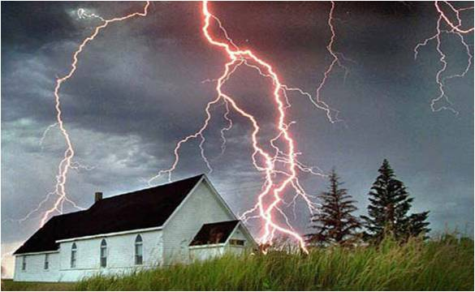
The Awakening
Will Match and Exceed
The Shaking

Slide 3
SOME OF THE MOST CRITICAL WORDS OF JESUS – IN A TIME OF ACCELERATION
“THERE IS ONLY ONE WAY TO GO THROUGH THIS CRUCIBLE MOMENT AS FOLLOWERS OF JESUS CHRIST – AND IT IS TO COMMIT OUR ALL TO HIM WHO SITS ON THE THRONE AND UNTO THE LAMB – AND BE POWERFULLY FILLED CONTINUOUSLY WITH
THE HOLY SPIRIT.” Don Lamb
They will be my people, and I will be their God. I will give them singleness of heart and action, so that they will always fear me for their own good and the good of their children after them. Jeremiah 32:38-39 (NIV)

Slide 4
The Atmosphere of Challenge
Is Not Something New
And from the days of John the Baptist until now the kingdom of heaven suffers violence, and the violent take it by force. Matthew 11:12 (KJV)

Slide 5
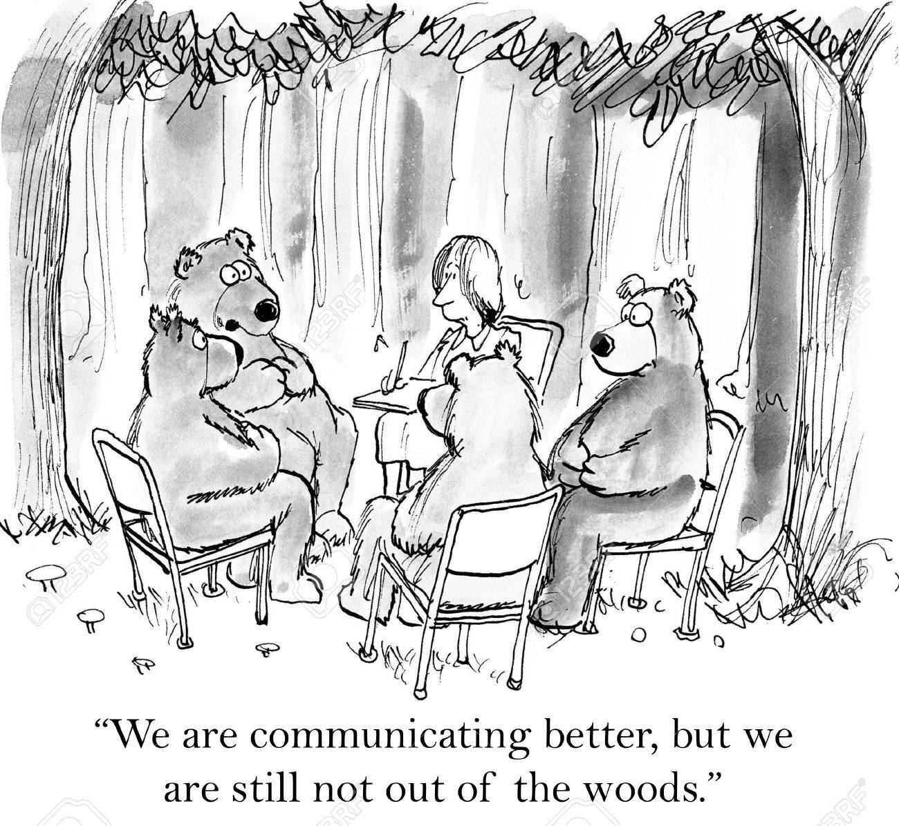
There Are Positive Things Happening
But We are Not Out Of The Woods

Slide 6
LET NO ONE TAKE YOUR CROWN
Since you have kept my command to endure patiently, I will also keep you from the hour of trial that is going to come upon the whole world to test those who live on the earth. ¹¹ I am coming soon. Hold on to what you have, so that no one will take your crown. Revelation 3:10-11 (NIV)

Slide 7
FOUR HOLY SPIRIT
TRAJECTORIES
SEEK – The Face of God
SHOW – The Love of God
SPEAK – The Word of God
STEWARD – The Move of God

Slide 8
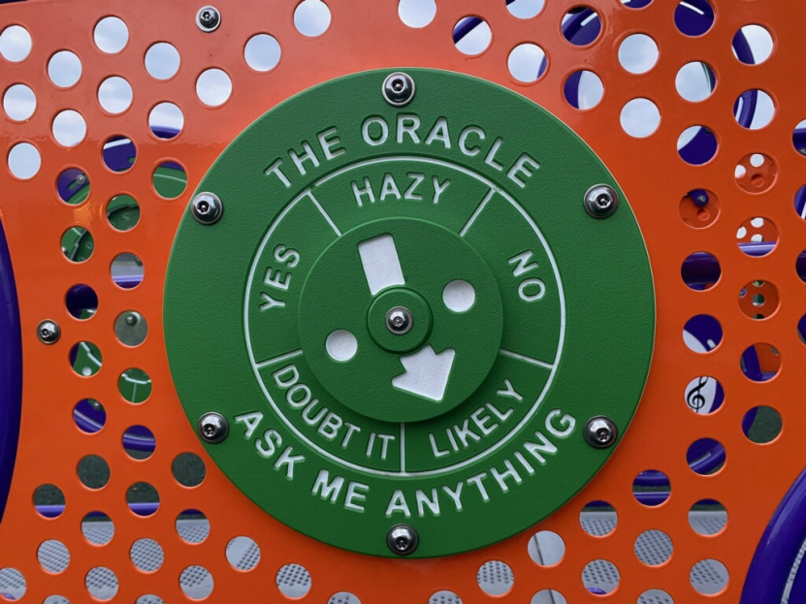
There is No Innocent Evil
It was the Communist revolutionary Lenin who said, "Give me one generation of youth, and I will transform the entire world." Now an entire generation of youth has been given to a woman named J.K. Rowling and her books on witchcraft, known as the Harry Potter Series. “As a former witch, I can speak with authority when I say that I have examined the works of Rowling and that the Harry Potter books are training manuals for the occult. Untold millions of young people are being taught to think, speak, dress and act like witches by filling their heads with the contents of these books. Children are obsessed with the Harry Potter books that they have left television and video games to read these witchcraft manuals. Our children by reading the Harry Potter books are learning a new vocabulary, including words such as "Azkaban", "Circe", "Draco", "Erised", "Hermes", and "Slytherin"; all of which are names of real devils or demons. These are not characters of fiction!”
Young readers today, more than any other time in history, have an abundance of occult resources easily available to them. The Harry Potter series clearly teaches young children how to become witches and warlocks and brings them into the new age occult world, and schools them in the devil's occult craft.

Slide 9
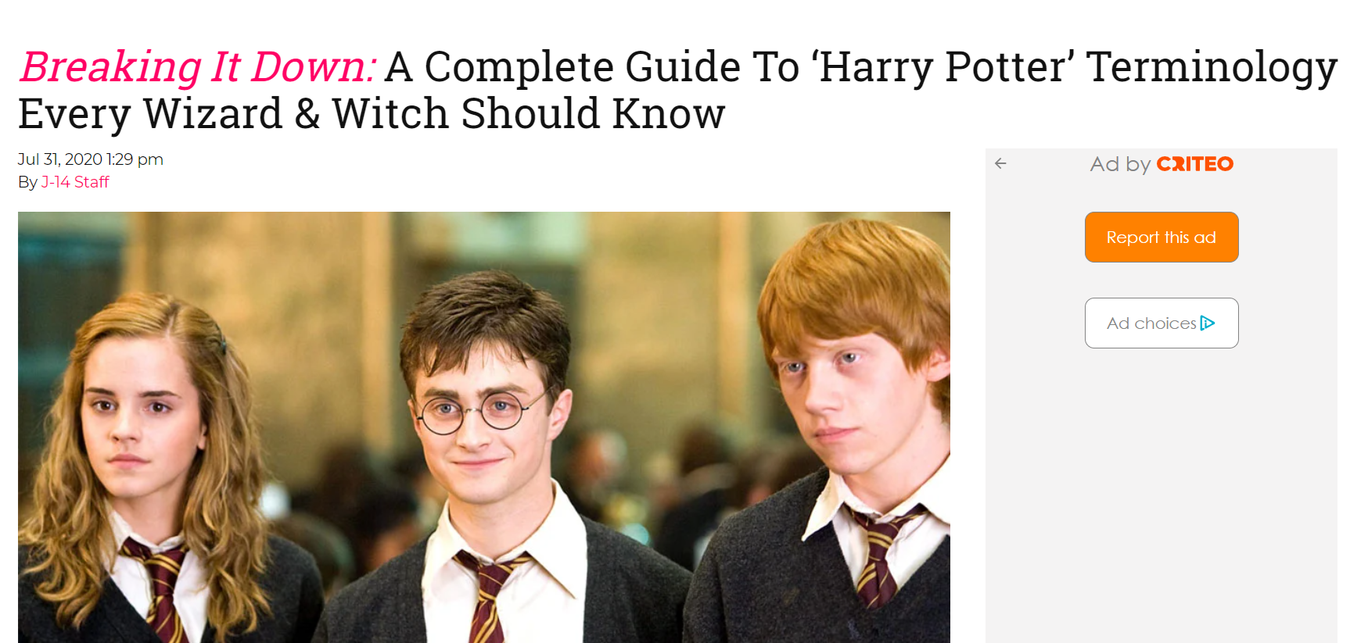
Just In Case You Think I’m Over-reacting

Slide 10
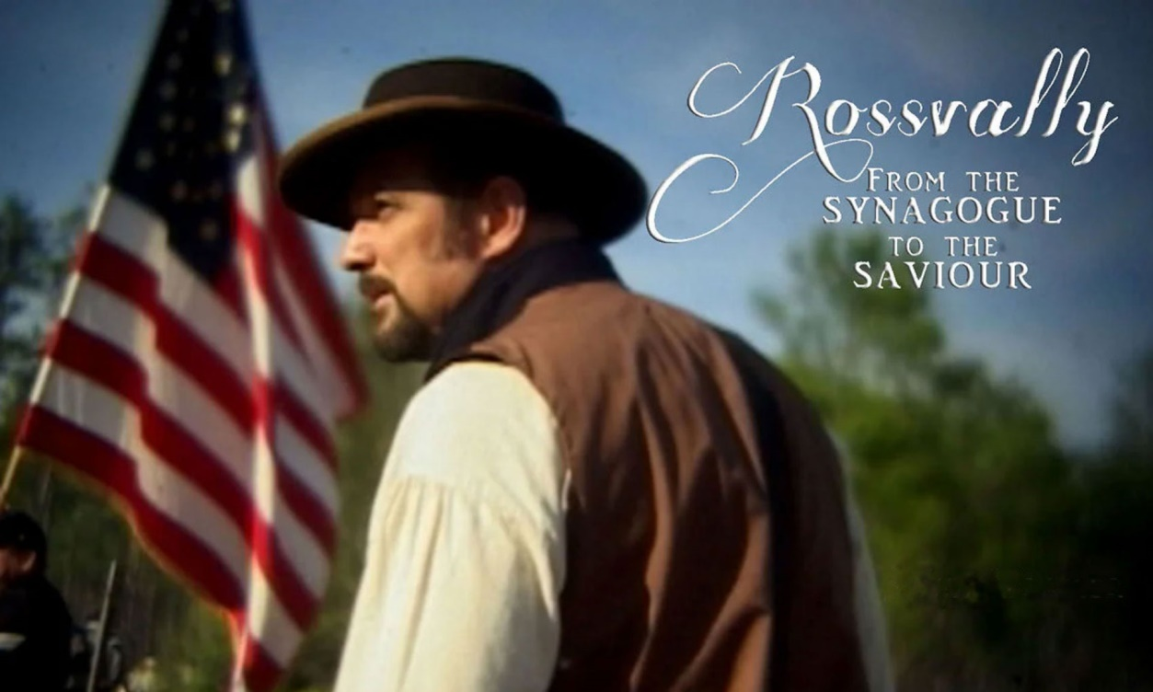
A Moving Story From
The Battle Of Gettysburg
Doctor M. L Rossvalley
Two or three times in my life God in His mercy touched my heart, and twice before my conversion I was under deep conviction.

Slide 11
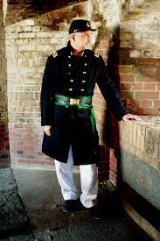
Here was an elite Doctor in the Union Army – and Officer in the Medical Corp.
But he carried the yoke of ORTHODOX JEWISH heritage and did not know the salvation, freedom and liberty and joy and Jesus’ yoke – that His burden is light

Slide 12
The Enemy Is Always Fighting These
Four Realms
REDEMPTION
RELATIONSHIPS
RESOURCES
REFORMATION

Slide 13
The Four Phases Of Personal
And Corporate Revival/ Awakening
1 – Stimulation phase – exciting – everything begins to shift
2 – Sanctification phase – people decide whether to stay
3 – Shock and awe phase – God releases even more of His interventions Joshua 3:5
4 – Service – stewarding – Reformation

Slide 14
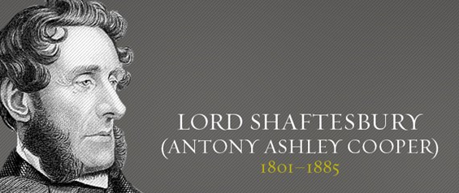
God Uses the Gospel to Bring Reformation Whenever There Were Leaders Bold Enough To Stand In The Gap
Ordinances, imposed on them until the time of reformation.
Hebrews 9:10 (KJV)
The Industrial Revolution was a Blessing and a Curse
Lord Shaftesbury saw faith in Christ’s finished work on the Cross as the “Keystone of reformation.” He saw good works as evidence of personal faith. Life and property were given to us to steward by God’s goodness. His aim was to honor God and promote human dignity.
“What is morally right should never be politically wrong and what is politically wrong could never be morally right.” Lord Shaftesbury 1844 Speech to House of Commons

Slide 15
So If A Billionaire Became
A Solid Christian – Why would They Pray
Bill Gates
Warren Buffett
Because They Owe It All To Him
It’s Not About Us – Be Humble

Slide 16
Jesus Will Allow Things
To Happen That Will Ruffle Your Feathers
After Jesus had finished instructing his twelve disciples, he went on from there to teach and preach in the towns of Galilee. ² When John heard in prison what Christ was doing, he sent his disciples ³ to ask him, "Are you the one who was to come, or should we expect someone else?" ⁴ Jesus replied, "Go back and report to John what you hear and see: ⁵ The blind receive sight, the lame walk, those who have leprosy are cured, the deaf hear, the dead are raised, and the good news is preached to the poor. ⁶ Blessed is the man who does not fall away on account of me." Matthew 11:1-6 (NIV)

Slide 17
But Jesus Did Show us He
Could Break Off Generational Yokes
"Come to me, all you who are weary and burdened, and I will give you rest. ²⁹ Take my yoke upon you and learn from me, for I am gentle and humble in heart, and you will find rest for your souls. ³⁰ For my yoke is easy (useful, BETTER, good) and my burden is light."
Matthew 11:28-30 (NIV)

Slide 18
The Generational Yokes That We Carry
In Our Families Need Broken
WE ARE IMPATIENT
WE ARE DISTRACTED
WE ARE GRUMPY
WE ARE LUSTFUL
WE ARE VICTIMS
WE ARE NEGATIVE
WE ARE DEPRESSED
WE ARE SELF-ABSORBED
WE ARE DOUBTING
WE ARE FINANCIALLY UNDISCIPLINED
WE ARE ARGUMENTATIVE AND PASSIVE/ AGGRESSIVE

Slide 19
The Fatigue Of Carrying Unholy Yokes
LORD BREAK THE GENERATIONAL YOKES OFF OF OUR LIVES AND FAMILIES AND MARRIAGES
LORD FORGIVE US - WE DEVELOP PATHS – WE DEVELOP TENDENCIES AND PROPENSITIES THAT GIVE US STRENGTHS AND WEAKNESSES AND THEY NEED TO BE CORRECTED AND SHAPED AND REMOVED AT TIMES BY YOUR CLEANSING GRACE

Slide 20
The Glory of God Is That He Sends His Son
To Get Into The Trenches With Us
Jesus comes to break off generational and personal YOKES – that burden us – distort us and bring dishonor to the Lord. Then He LINKS UP WITH US – and Helps carry our load for us with supernatural grace and fortitude.
Surely he took up our infirmities and carried our sorrows, yet we considered him stricken by God, smitten by him, and afflicted. ⁵ But he was pierced for our transgressions, he was crushed for our iniquities; the punishment that brought us peace was upon him, and by his wounds we are healed. Isaiah 53:4-5 (NIV)
For we are fellow workmen (joint promoters, laborers together) with and for God; you are God's garden and vineyard and field under cultivation, [you are] God's building. 1 Corinthians 3:9 (AMP)
As God's fellow workers we urge you not to receive God's grace in vain. 2 Corinthians 6:1 (NIV)

Slide 21
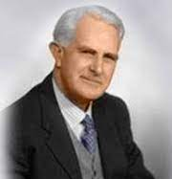
Breaking The Yoke
of Limitation
T. Austin Sparks
Throughout the last 2,000 years many things have contributed to an unenlightened condition that persists in God's people. We all know that structured or organized religion has limited the spiritual growth of many and has kept the majority of Christianity in an unenlightened and unempowered condition and also hindered their pursuit of a greater revelation of Jesus Christ. Then others left traditional Christianity for deeper waters. But even some of these have contributed to the limitation by believing that they exclusively have the full truth and live it out in their small communities.

Slide 22
Breaking The Yoke
of Limitation
Consequently, over these generations the Church has suffered great loss on both accounts. On the one hand the Church has remained unenlightened as to the fullness of Christ their Savior and what they have been given through the finished work of the Cross while on the other hand small Spirit-filled communities can become exclusive and keep the enlightenment needed for everyone to themselves and on this account the majority of Christianity has had little impact upon the forces of Darkness.

Slide 23
Breaking The Yoke
of Limitation
But let us not despair. Let us remember that as the Body of Christ begins to move in that which God has revealed through the Word and by the Holy Spirit that the heavenly host of God are being instructed as their role to support the Church. Let us remember that we are in the middle of a battle against spiritual wickedness in heavenly places against principalities against powers and against the world rulers in this present darkness. And it is the sword of the Spirit which is the Word of God accompanied by Spirit-filled prayer in the church that these heavenly hosts get their assignments and become the effective weapons in the unseen realm leveraged to bring victory as the Church moves in the power of God's Word and the enemies of God are being instructed as to their place, however unwillingly, they are under Christ's feet.

Slide 24
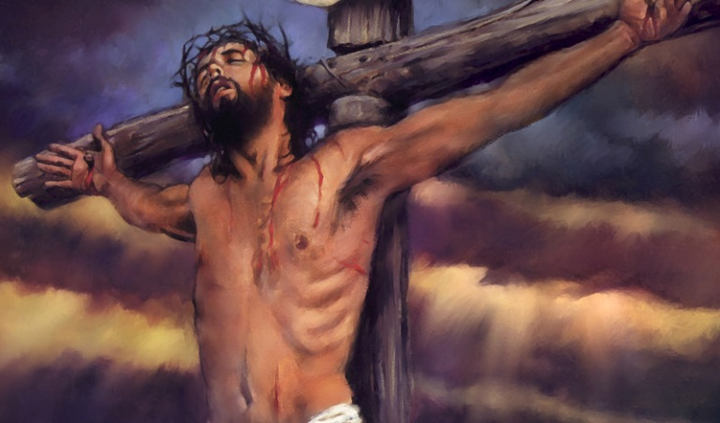
SOME OF THE MOST CRITICAL WORDS OF JESUS – IN A TIME OF ACCELERATION
And I, if I be lifted up from the earth, will draw all men unto me. John 12:32 (KJV)
Literal Meaning
Daily Application

Slide 25
Jesus And The Father
Are Always Working
Jesus said to them, "My Father is always at His work (to engage, labor) to this very day, and I, too, am working." ⁻⁻⁻ "I tell you the truth, the Son can do nothing by himself; he can do only what he sees his Father doing, because whatever the Father does the Son also does. John 5:16-19 (NIV)
FORGIVE US FOR THINKING THAT YOU ARE NOT ACTIVE YOU ARE NOT WORKING – THAT SOMEHOW EVEN THOUGH YOU ARE ALLOWING WICKEDNESS TO RUN AMOK AND TO BE EXPOSED – YOU ARE NOT LESS ACTIVE AND DISENGAGED

Slide 26
Where Did Jesus
Show Us How He Could Break Off
Generational Yokes
"Come to me, all you who are weary and burdened, and I will give you rest. ²⁹ Take my yoke upon you and learn from me, for I am gentle and humble in heart, and you will find rest for your souls. ³⁰ For my yoke is easy (useful, BETTER, good) and my burden is light."
Matthew 11:28-30 (NIV)

Slide 27
HOW DO WE MAKE THIS PERSONAL?
1. You still have an assignment – find out what it is – DO NOT LET ANYONE TAKE YOUR CROWN.
2 . Pray without ceasing for fresh fillings of the Holy Spirit
3. Do not get into the flesh – if you are resisted – STAY ABOVE THE FLESH through the Holy Spirit.
4. Expect God to come through in your battles.
5. TAKE ON THE LINKED UP PARTNERSHIP OF JESUS AND HIS YOKE Get freedom from hindering personality traits – negative childhood shaping – cultural bondage through the Supernatural working of the Holy Spirit’s internal encountering glory that will CARRY YOU THROUGH into purity, freedom, purpose, hope, and endurance.

