Slide 1
For Our Time Of Crisis
Sermon For LifeGate
Sunday, July 16th, 2023

Slide 2
Verse of the Week
From the end of the earth will I cry unto thee, when my heart is overwhelmed: lead me to the Rock (boulder place of refuge) that is higher than I. Psalm 61:2

Slide 3
The Duel-Edged Sword
Unfettered Access Can Make Us Either
Courageous or Complacent
Therefore he is able to save completely those who come to God through Him, because He always lives to intercede for them. Hebrews 7:25 (NIV)
Therefore, brothers, since we have confidence to enter the Most Holy Place by the blood of Jesus, ²⁰ by a new and living way opened for us through the curtain, that is, his body, ²¹ and since we have a great priest over the house of God, ²² let us draw near to God with a sincere heart in full assurance of faith, having our hearts sprinkled to cleanse us from a guilty conscience and having our bodies washed with pure water. ²³ Let us hold unswervingly to the hope we profess, for he who promised is faithful. Hebrews 10:19-23

Slide 4
“Tough Love” Is Still Love
THOSE WHO ARE SENSITIVE WILL RARELY CONFRONT – BECAUSE IT GOES AGAINST THEIR NATURE AND THEY PERCEIVE LOVE AS NEVER JOSTLING SOMEONE OUT OF THEIR HARDENED LIFESTYLE OF RELIGIOSITY OR CARNAL IDOLATRY THROUGH TOUGH LOVE.
THOSE WHO KNOW THE TRUTH AND ARE BOLD – CAN BECOME HARSH AND SEVERE AND NOT LOVE THE PEOPLE WITH THE SPIRIT OF CHRIST – AND CAN BECOME JUDGMENTAL.

Slide 5
FOUR HOLY SPIRIT
TRAJECTORIES
SEEK – The Face of God
SHOW – The Love of God
SPEAK – The Word of God
STEWARD – The Move of God

Slide 6
Jesus Told us – The World Was
Supernaturally CREATED – Not EVOLVED
Because those will be days of distress unequaled from the beginning, when God created the world, until now--and never to be equaled again. Mark 13:19 (NIV)
"It was because your hearts were hard that Moses wrote you this law," Jesus replied. ⁶ "But at the beginning of creation God 'made them male and female.' ⁷ 'For this reason a man will leave his father and mother and be united to his wife, ⁸ and the two will become one flesh.' So they are no longer two, but one. ⁹ Therefore what God has joined together, let man not separate." Mark 10:5-9 (NIV)

Slide 7
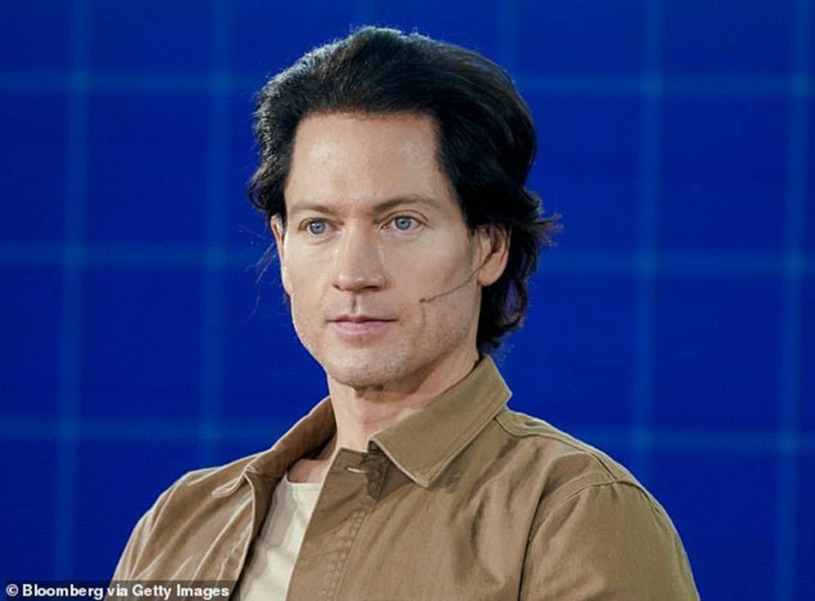
Ceo Tech Bryan Johnson

Slide 8
Even Spiritual Leaders Begin to Think
Goofy and explain away the Supernatural
Then the Sadducees, who say there is no resurrection, came to him with a question. ¹⁹ "Teacher," they said, "Moses wrote for us that if a man's brother dies and leaves a wife but no children, the man must marry the widow and have children for his brother-- ²² In fact, none of the seven left any children. Last of all, the woman died too. ²³ At the resurrection whose wife will she be, since the seven were married to her?" ²⁴ Jesus replied, "Are you not in error because you do not know the Scriptures or the power of God? ²⁵ When the dead rise, they will neither marry nor be given in marriage; they will be like the angels in heaven. ²⁶ Now about the dead rising--have you not read in the book of Moses, in the account of the bush, how God said to him, 'I am the God of Abraham, the God of Isaac, and the God of Jacob'? ²⁷ He is not the God of the dead, but of the living. You are badly mistaken!" Mark 12:18-27 (NIV)

Slide 9
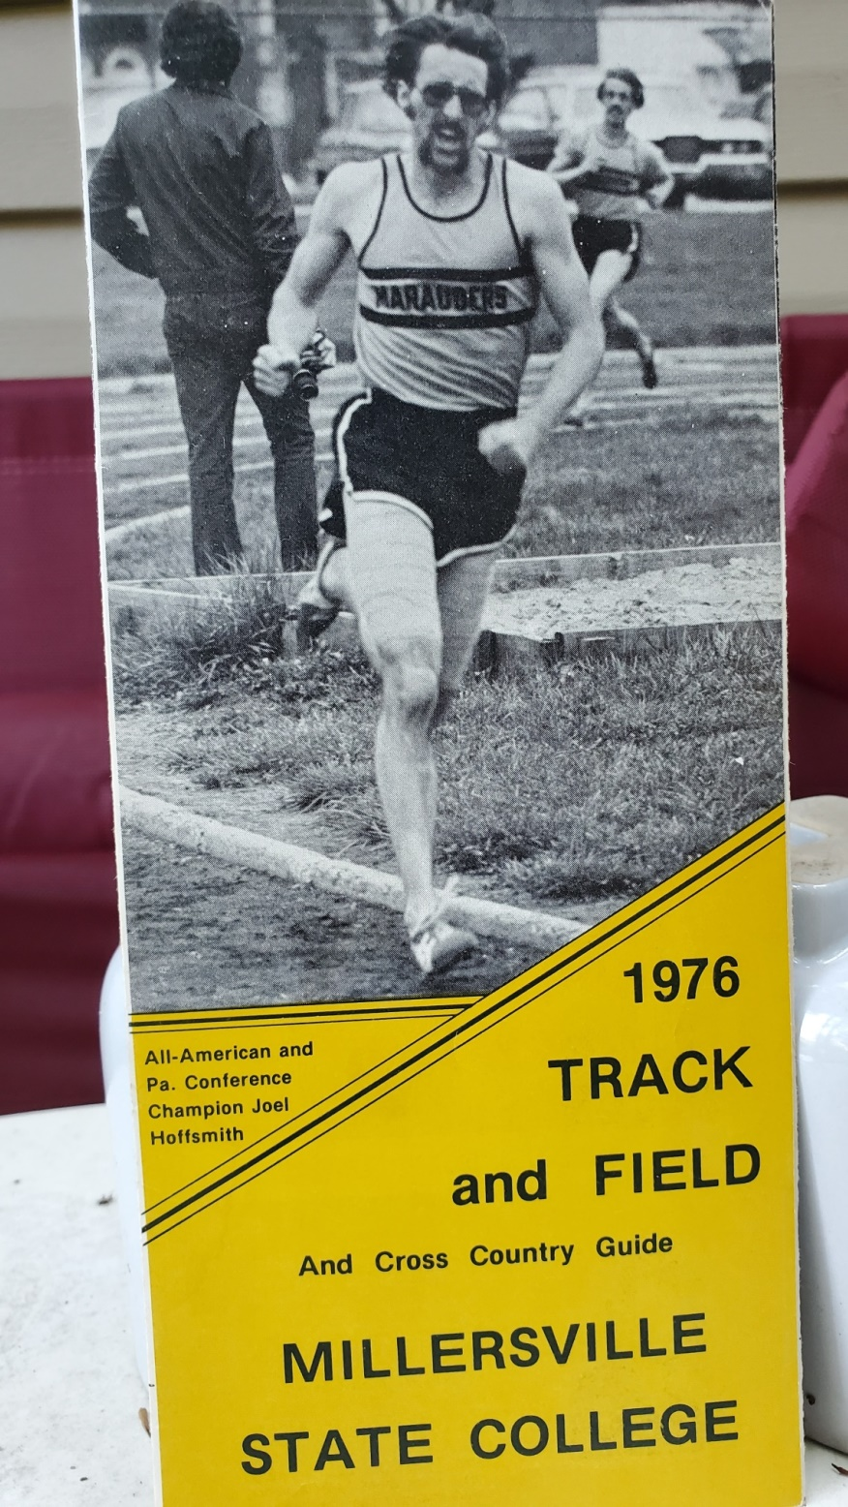
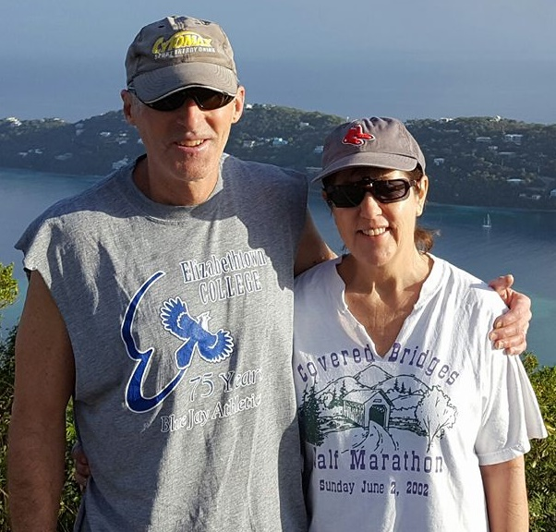
Honoring
The Life Work
Joel Hoffsmith – 1977 - 2023

Slide 10
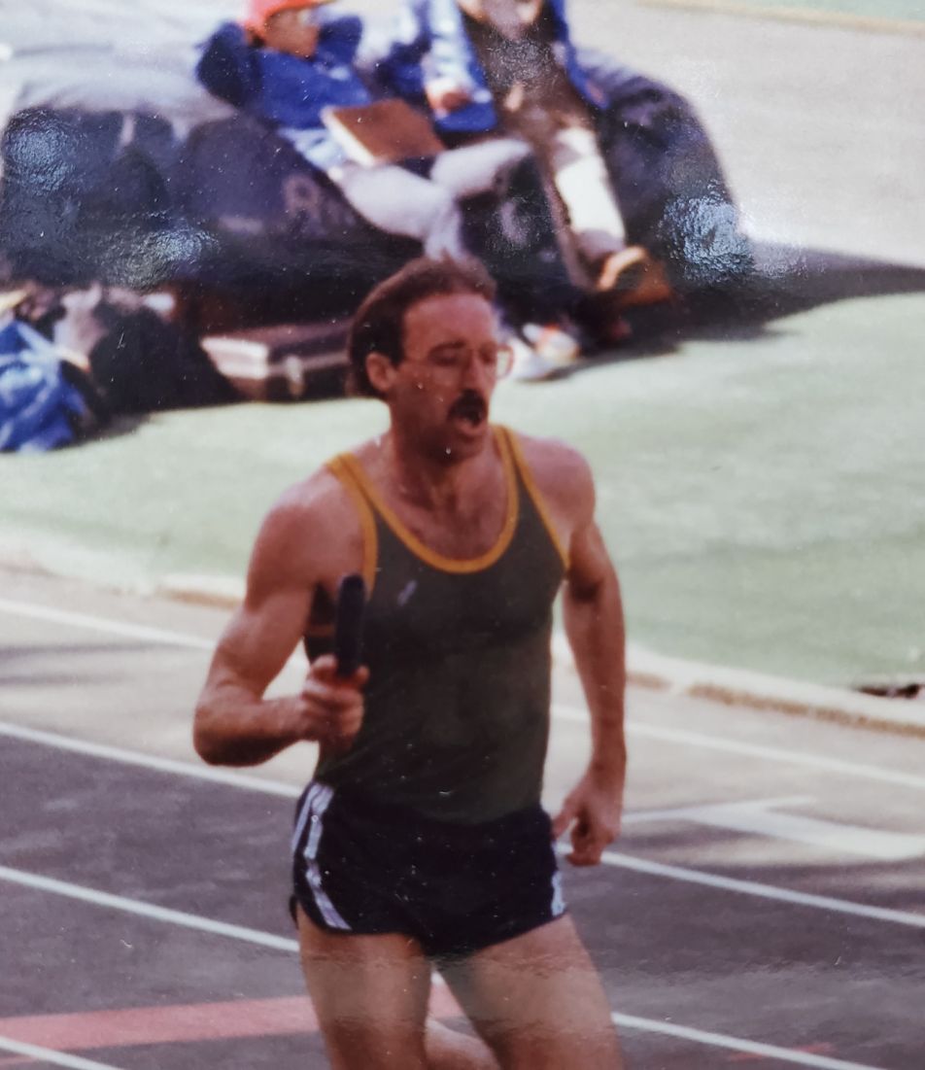
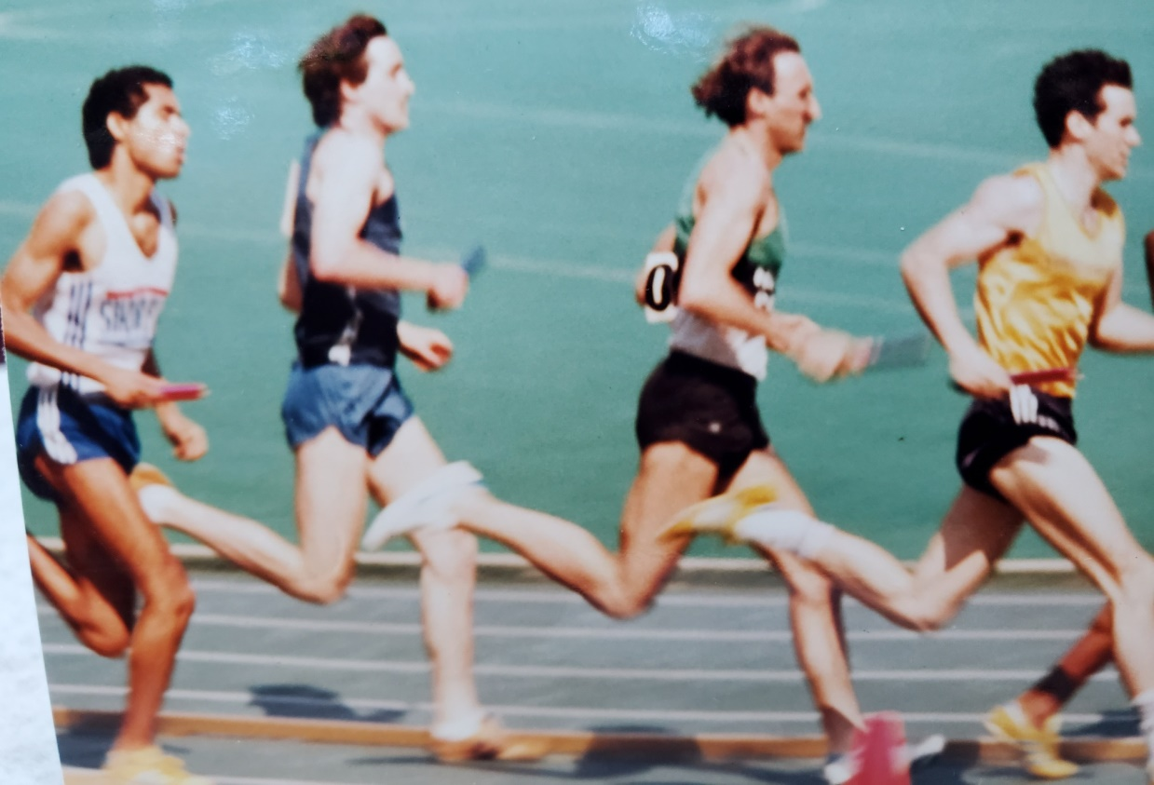

Slide 11
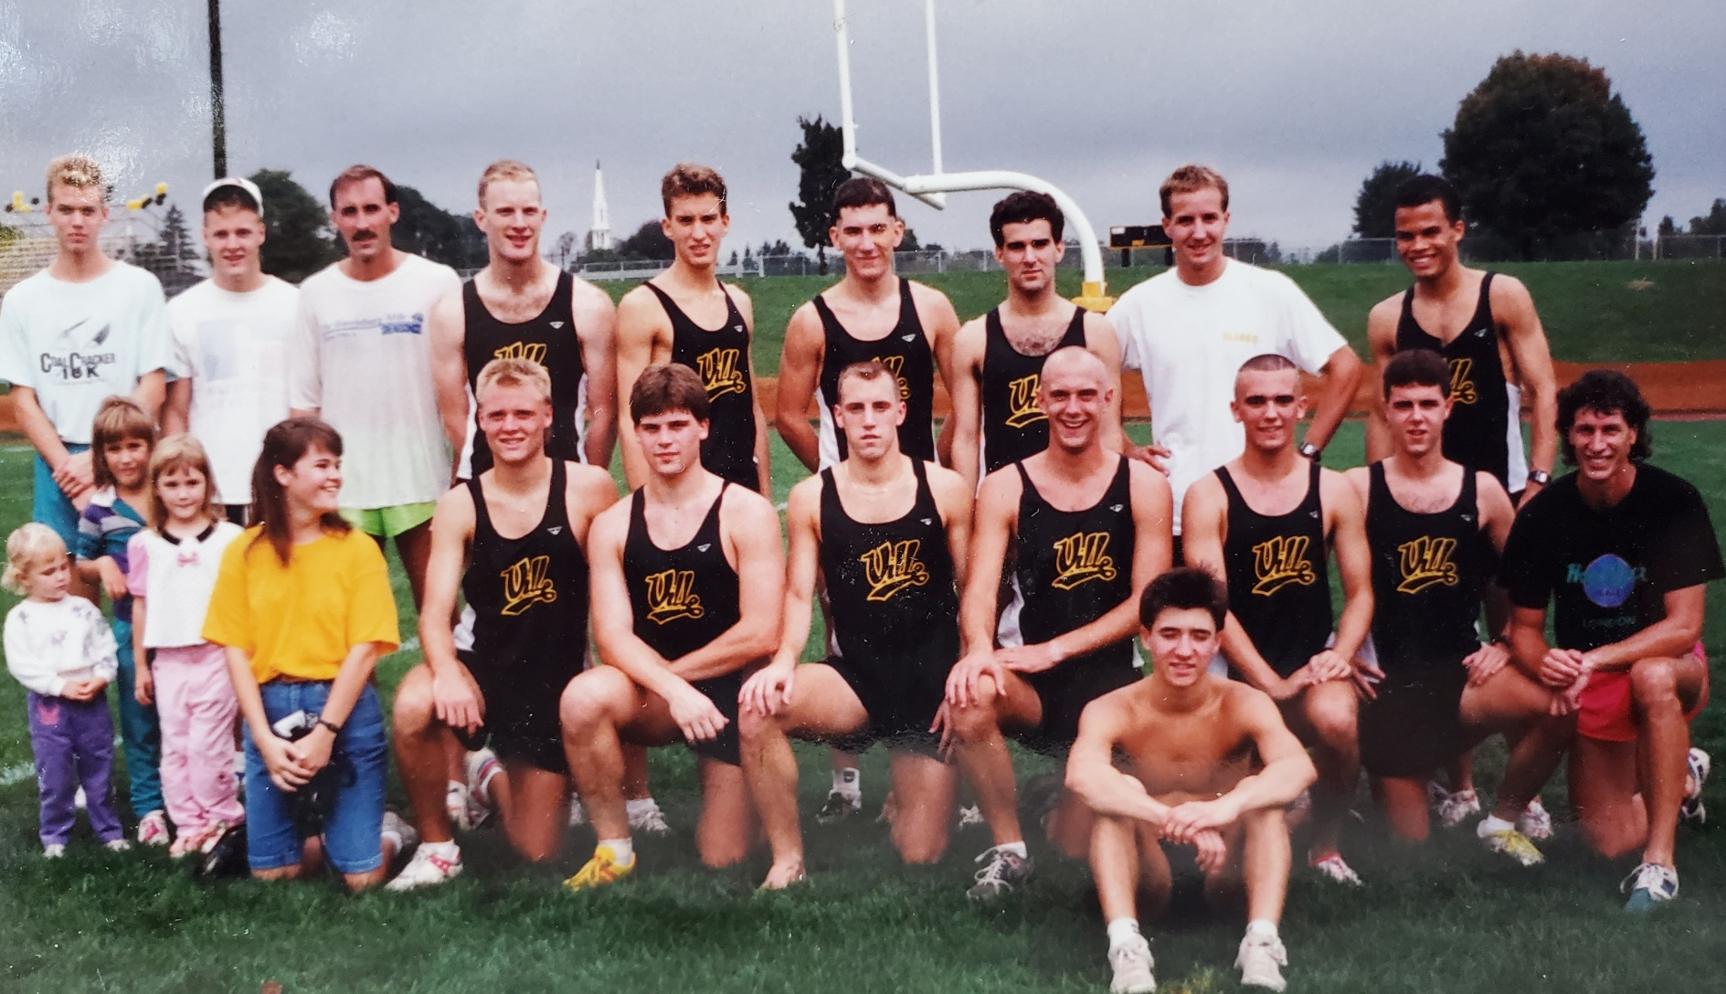

Slide 12
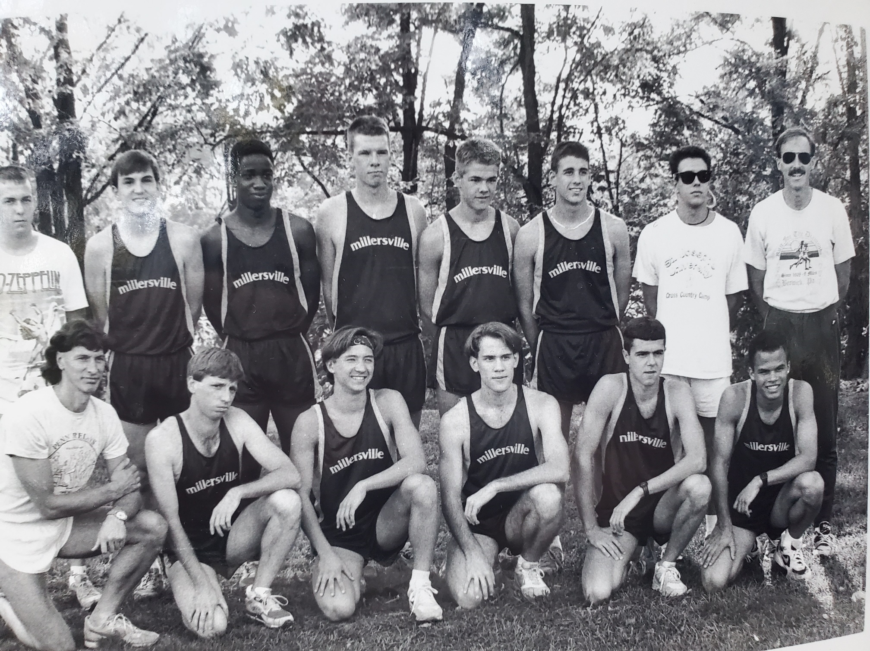

Slide 13
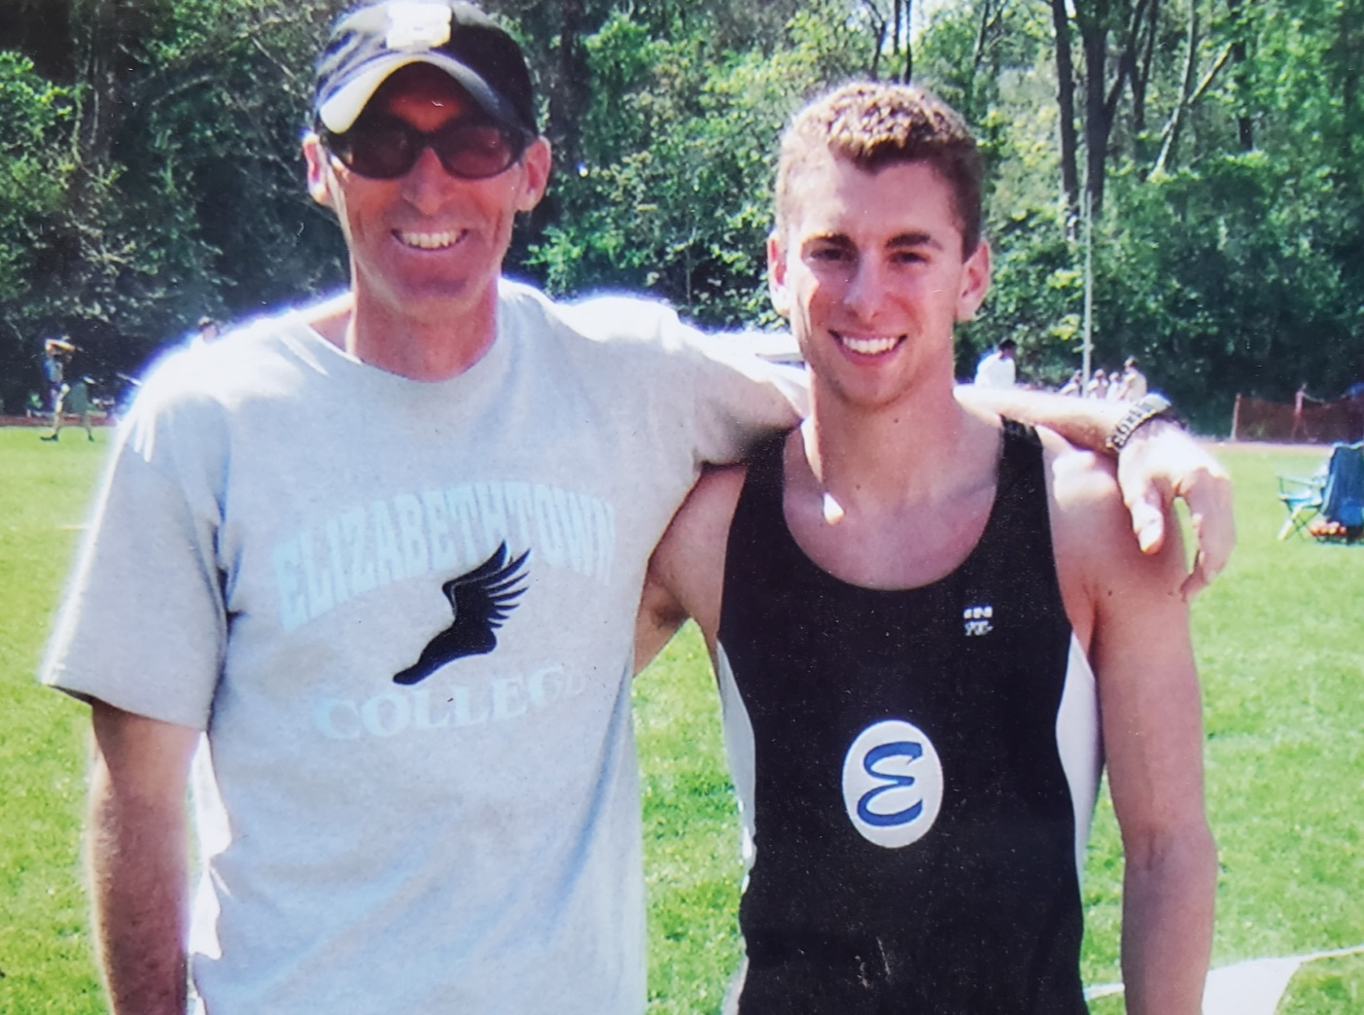

Slide 14
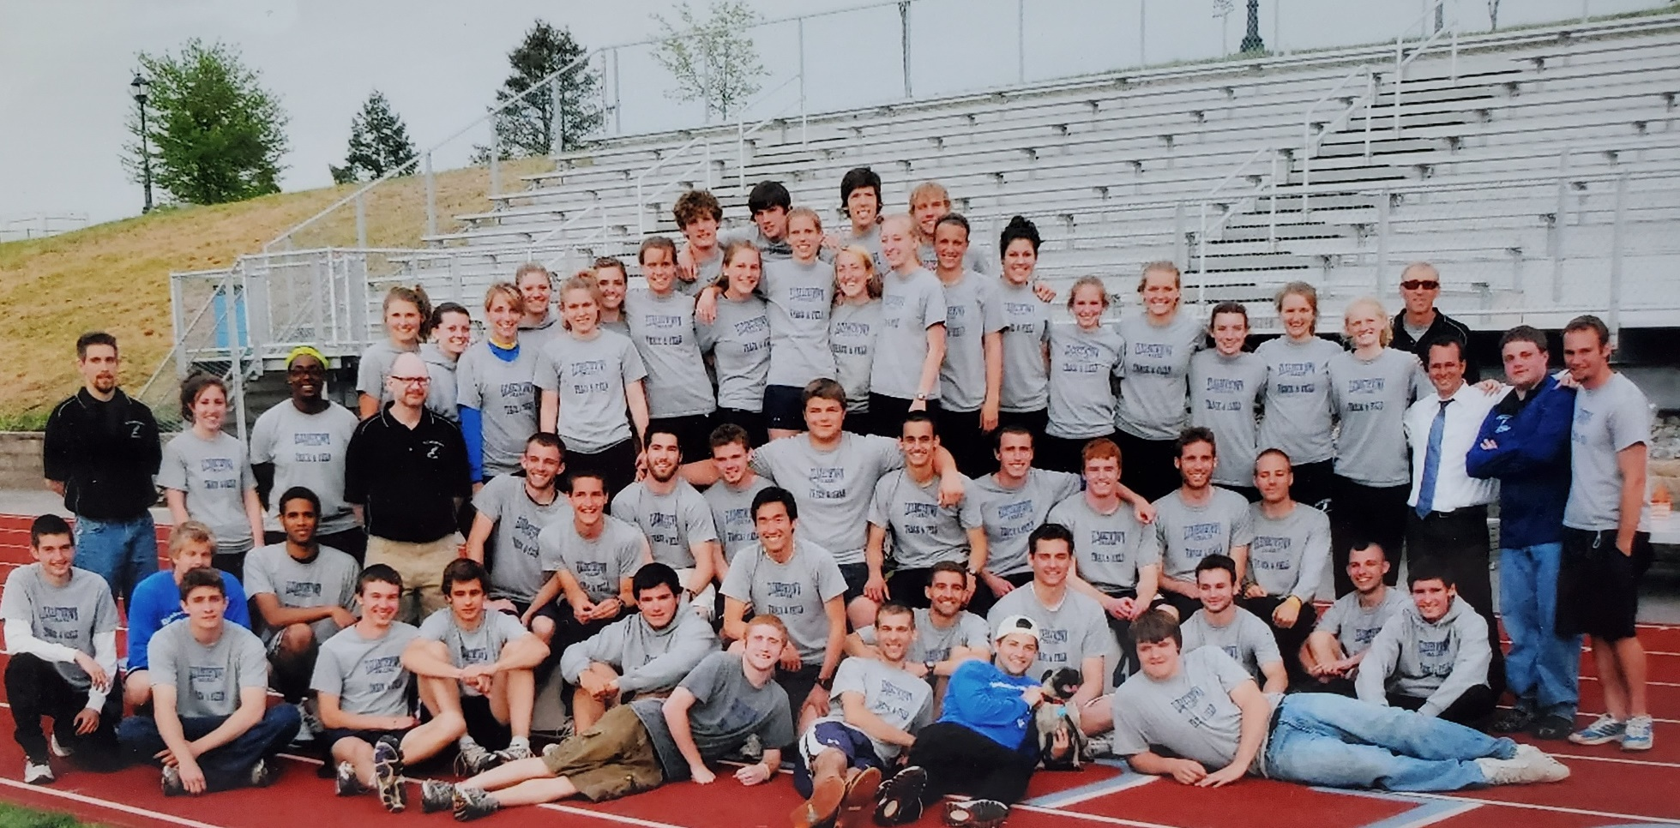
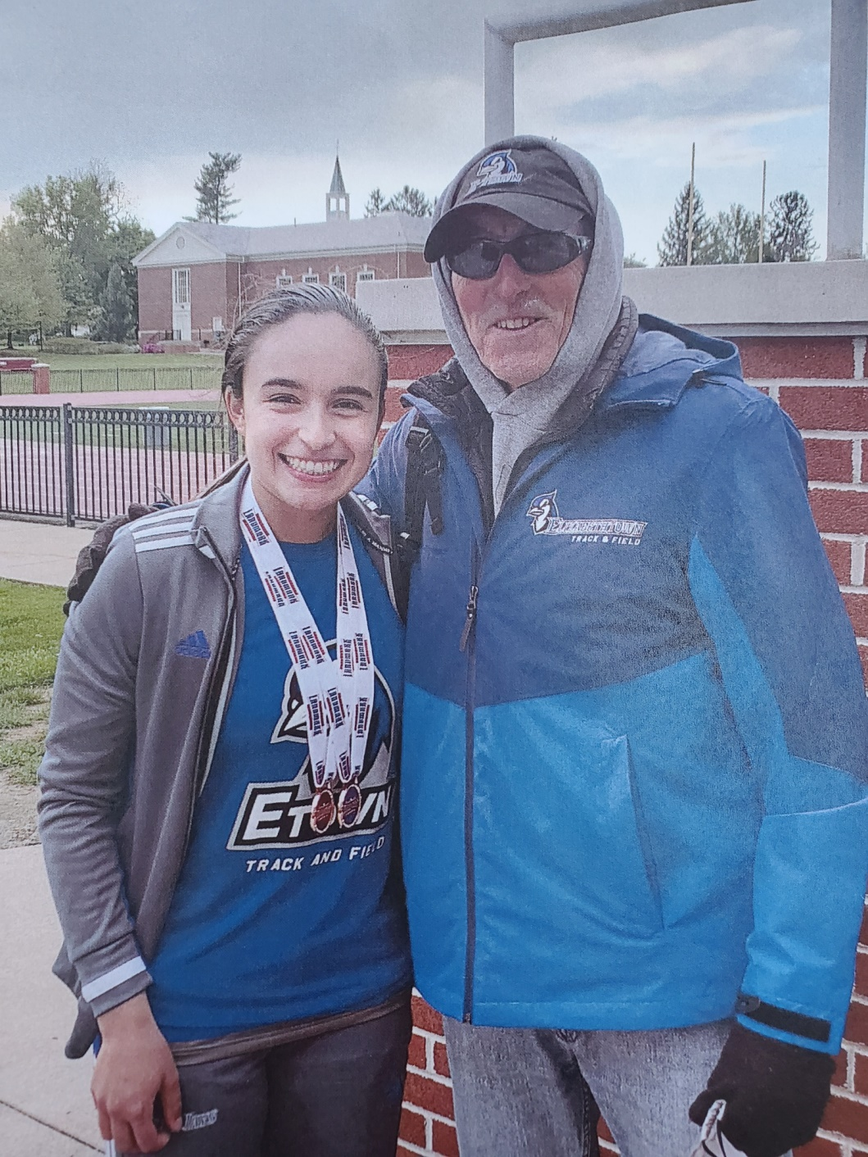

Slide 15
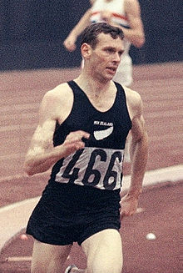
A Running Trivia Question
Who was Peter Snell?
Who was Arthur Lydiard?
How many miles did coach Lydiard
Make Peter Snell run a week?

Slide 16
A GREAT Coach Will:
Give you the tools you need to succeed
Take you from where you are and build on your strengths and help you overcome your weaknesses
Push you beyond what you think you can do
Identify when you are making “excuses” and hold you to a higher standard
Encourage you when you are struggling
Celebrate with you in your victories

Slide 17
Jesus The Ultimate
Supernatural Coach
As Jesus walked beside the Sea of Galilee, he saw Simon and his brother Andrew casting a net into the lake, for they were fishermen. ¹⁷ "Come, follow me," Jesus said, "and I will make you fishers of men." ¹⁸ At once they left their nets and followed him. Mark 1:16-18 (NIV)
MAKE YOU FISHERS OF MEN - to make - to bring (forth), to ordain, to raise up, to secure, to show

Slide 18
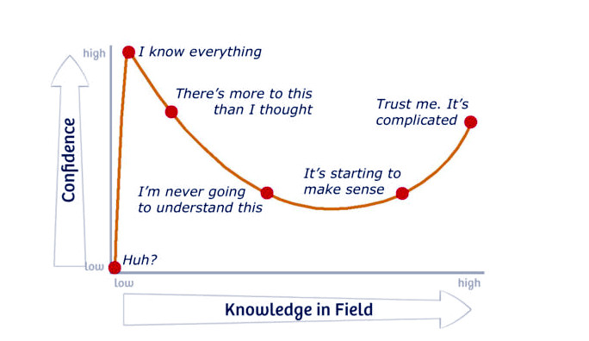
Jesus - The Ultimate Coach
The Hardest people to work with are the ones who KNOW IT ALL

Slide 19
“The GREATEST DANGER to good coaching having strategic IMPACT is that the student doesn’t go deep enough. The challenges to grow do not go to the root – only surface changes are made and hidden issues remain.”

Slide 20
Satan Doesn’t Want a Supernatural
Savior/ Coach To Be Presented To The world
Satan is ever present among the sons of God. He seeks to destroy this work first by ridicule and second by duplicating it. "If Satan cannot caricature the work of God out of countenance, he will duplicate it as nearly as possible for purposes of deception. Observing how the work of Christ improves personal and social life, increases culture and multiplies physical comforts, Satan needs to secure the same results up to the point of accepting regeneration or salvation, but not that.
"In other words, Christ and Satan work in exactly the opposite directions. Christ creates a changed life first and then works toward human betterment in all things. Satan begins with human betterment and seeks as much physical comfort and mental achievement in social improvement as possible, provided there will be no regeneration, no salvation of the soul."

Slide 21
The Disciples Were Discipled By
A Supernatural Coach
And with great power gave the apostles witness of the resurrection of the Lord Jesus: and great grace was upon them all. Acts 4:33 (KJV)

Slide 22
For the word of God is living and active. Sharper than any double-edged sword, it penetrates even to dividing soul and spirit, joints and marrow; it judges the thoughts and attitudes of the heart. ¹³ Nothing in all creation is hidden from God's sight. Everything is uncovered and laid bare before the eyes of him to whom we must give account. Hebrews 4:12-13 (NIV)

Slide 23
Being Fisher’s of Men
Level of Friendship | Description of Interactions | Key Kingdom Chemistry Approach
Enemies | Could be rare – or often depending on each situation | “Kill them with kindness” – take food – build bridges – ask them can /I pray for you – Stand in the gap – bless them – and seek God’s restraining grace
Strangers | Once-Upon – A - Time encounter | Word of Knowledge – servant heart – “can I pray for you?”
Acquaintances | Very rarely interact (twice a year) | Word of Knowledge – servant heart – “can I pray for you?”
Friends/ Neighbors | Loose bonds – keep in touch – see more often | “Kill them with kindness” – take food – build bridges – ask them can /I pray for you
Close Fiends | Engaged a lot – close knit – kindred spirit | Speak the truth in love – serve – stand in the gap
Covenant/ Destiny Partners/ Children | Intensified connection and commitment | Accountability and appreciation
Spouse | Lifetime allegiance/ unbreakable bond | Mutual admiration respect support and appreciation with a servant heart

Slide 24
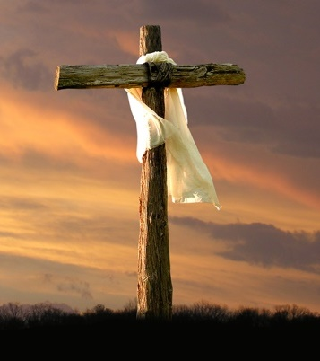
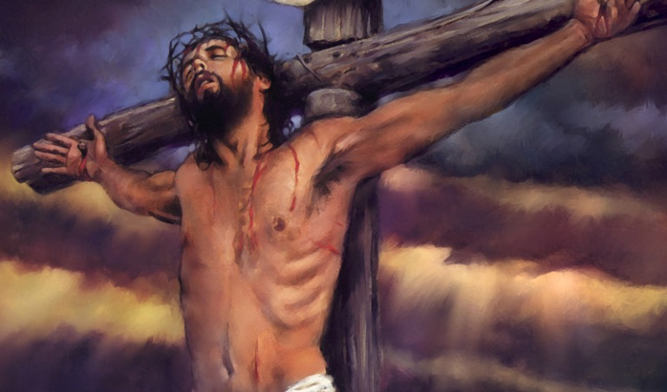
SOME OF THE MOST CRITICAL WORDS OF JESUS – IN A TIME OF ACCELERATION
And I, if I be lifted up from the earth, will draw all men unto me. John 12:32 (KJV)
Literal Meaning
Daily Application

Slide 25
Jesus And The Father
Are Always Working
Jesus said to them, "My Father is always at His work (to engage, labor) to this very day, and I, too, am working." ⁻⁻⁻ "I tell you the truth, the Son can do nothing by himself; he can do only what he sees his Father doing, because whatever the Father does the Son also does. John 5:16-19 (NIV)
FORGIVE US FOR THINKING THAT YOU ARE NOT ACTIVE YOU ARE NOT WORKING – THAT SOMEHOW EVEN THOUGH YOU ARE ALLOWING WICKEDNESS TO RUN AMOK AND TO BE EXPOSED – YOU ARE NOT LESS ACTIVE AND DISENGAGED

Slide 26
Jesus Calls Us To Allow
Him To Break Off
Generational Yokes
"Come to me, all you who are weary and burdened, and I will give you rest. ²⁹ Take my yoke upon you and learn from me, for I am gentle and humble in heart, and you will find rest for your souls. ³⁰ For my yoke is easy (useful, BETTER, good) and my burden is light."
Matthew 11:28-30 (NIV)

Slide 27
Jesus Will Coach Us
Into His Effectual Working and Power
"Come, follow me," Jesus said, "and I will make you fishers of men." ¹⁸ At once they left their nets and followed him. Mark 1:17 (NIV)

Slide 28
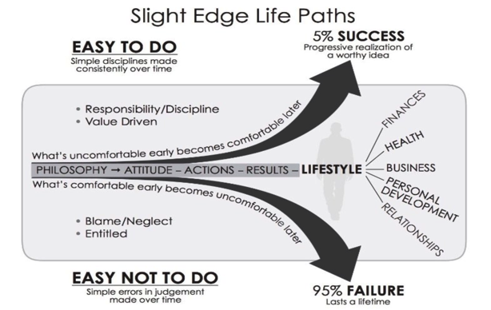
Jesus - The Ultimate Coach
Challenging To Do
Repentance is Required
No discipline seems pleasant at the time, but painful. Later on, however, it produces a harvest of righteousness and peace for those who have been trained by it. Hebrews 12:11 (NIV)
Endurance
Peace/ Joy
Victory
Spiritual
Breakthrough
Core Convictions
Faith
Bondage
Addiction
Frustration
Anger/ Bitterness
Flesh is in Charge
The way of a fool seems right to him, but a wise man listens to advice. Proverbs 12:15 (NIV)
Because the Lord disciplines those He loves, and He punishes everyone He accepts as a son." ⁷ Endure hardship as discipline CHASTEN (Pie-deah - tutor, i.e. educate or train, and correct) God is treating you as sons. Hebrews 12:6-7a (NIV)

Slide 29
HOW DO WE MAKE THIS PERSONAL?
1. Lord Jesus I receive You as my LIFE COACH.
2 . Lord Jesus I repent of allowing my flesh to make excuses and not following Your instructions to be worked out victoriously in my life as Your disciple.
3. Lord Jesus I willingly give You access to those areas of my life that I struggle with and don’t want to change.
4. Lord Jesus thank You for being a persistent and challenging coach Who doesn’t baby me but works all things for my good and for Your glory.
5. Lord Jesus push me past the place of being stuck in my own head and living in the past or disconnected from Your Holy Spirit and glorious presence. .
6. Lord Jesus I depend on Your strength to help me finish this race well.

