Slide 1
In Our Time Of Crisis
Sermon For LifeGate
Sunday, August 6th, 2023

Slide 2
Getting Closer To The Finish Line

Slide 3
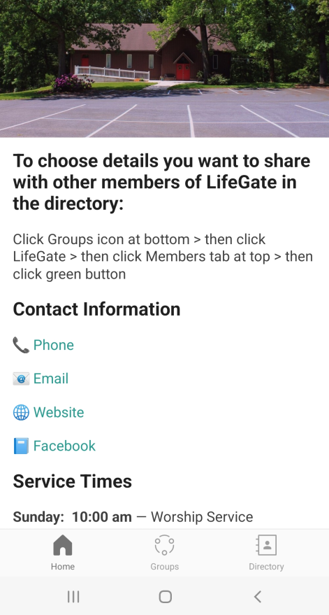
Tutorial On LifeGate App
Open and
Authenticate
Choose
LifeGate as Church
Go to your App Store
Choose Church Center App

Slide 5
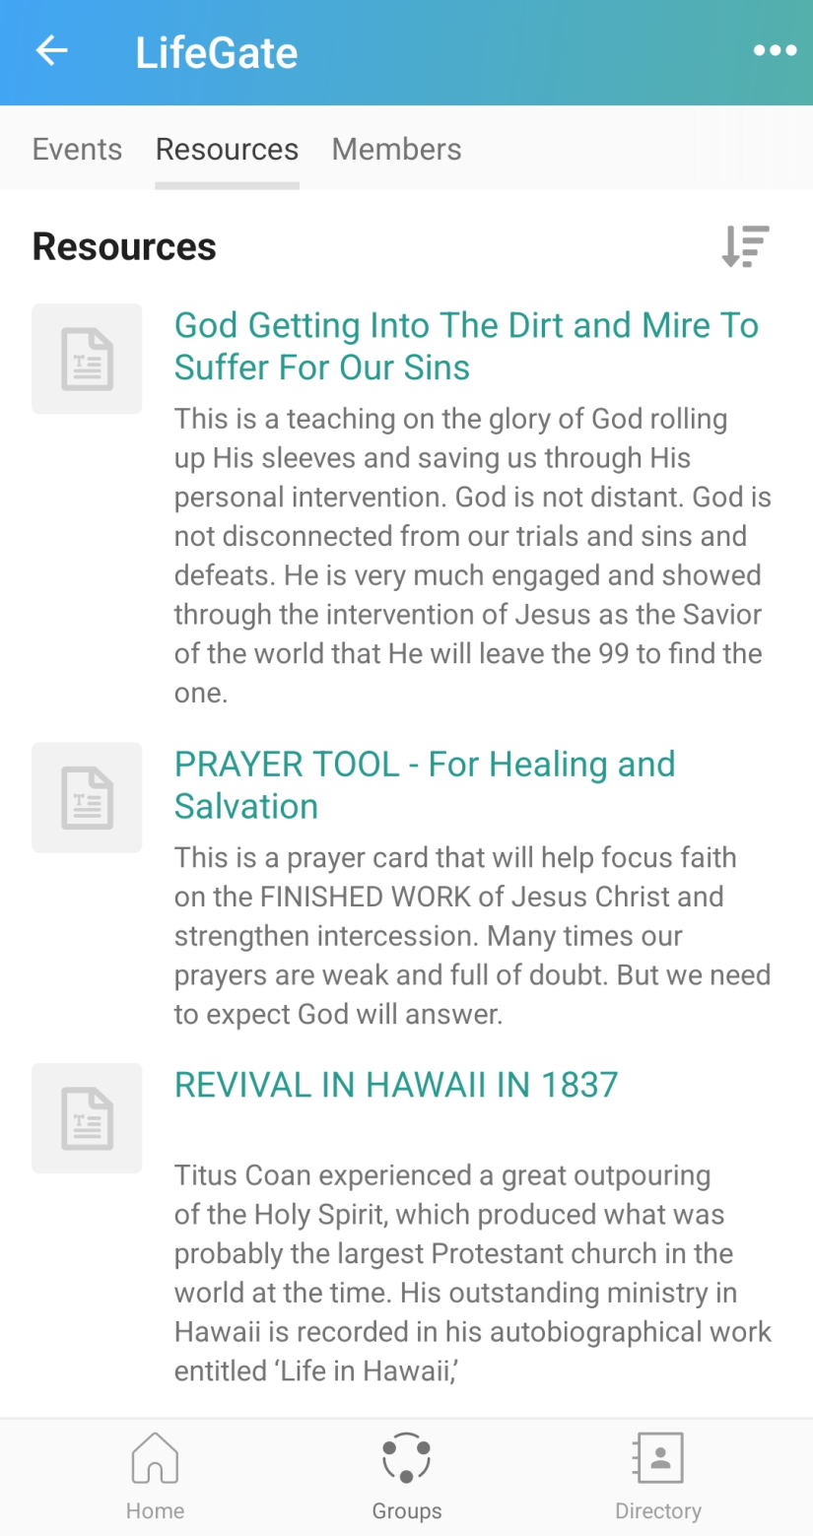

Slide 6
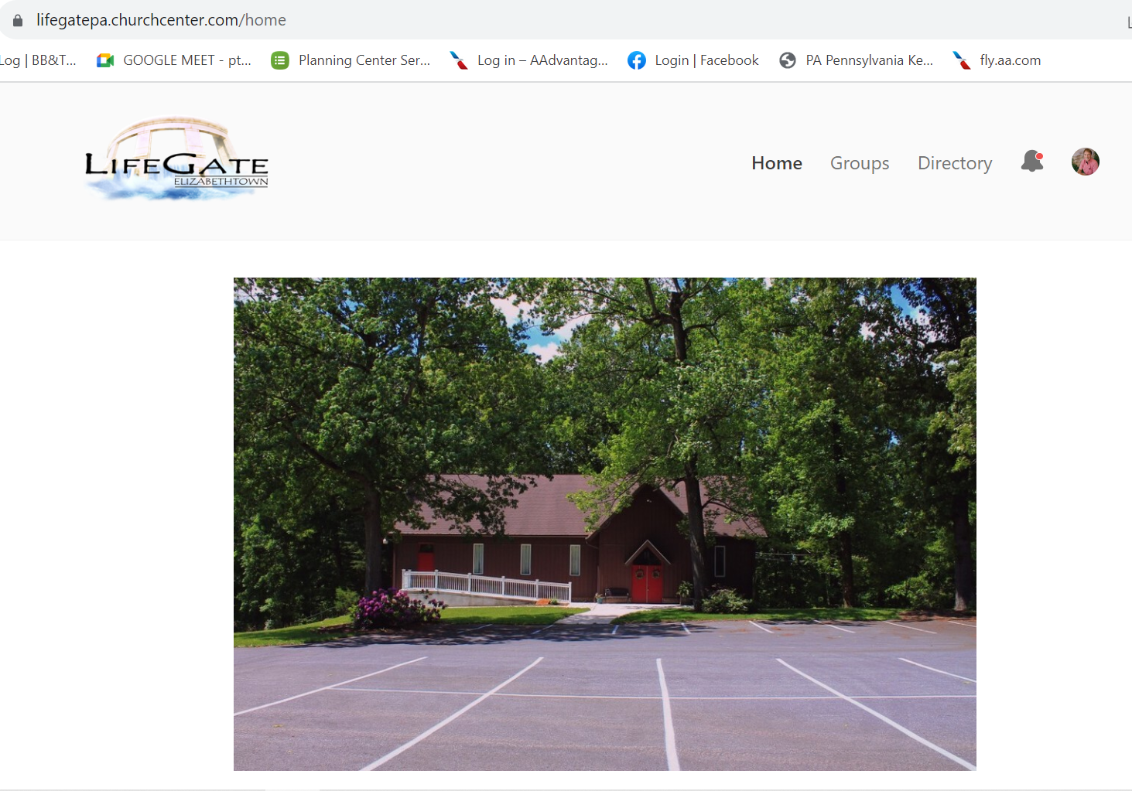

Slide 7
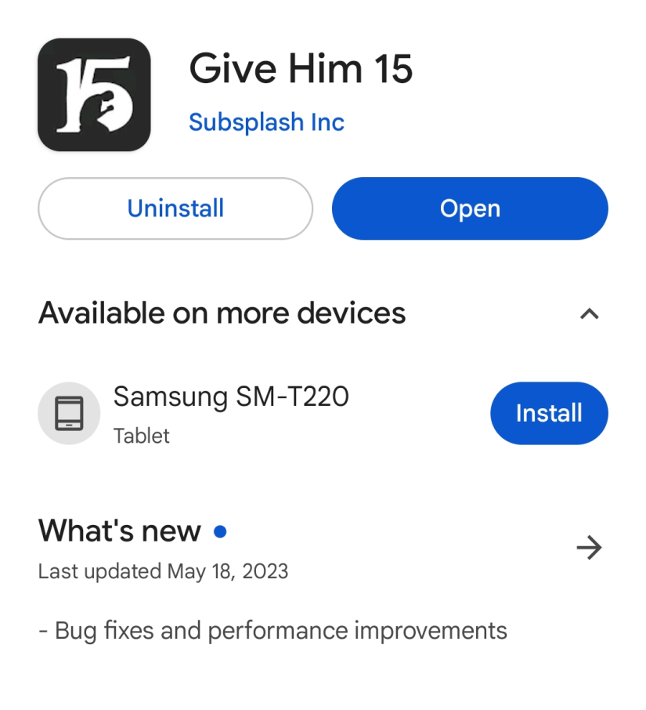
Dutch Sheets and Give Him 15

Slide 8
Being Grieved Over the Affairs
Of Our Nation Does NOT Mean We Are Operating In Political Idolatry
"Bible-believing American Christians: the end of human civilization as we know it is revealed in the book of Revelation, it is not a conservative American utopia. Beware of political idolatry disguised and perfumed as patriotism. Repent of political idolatry. Pry your eyes away from political saviors.” Author is a good brother in the Lord
This Statement is partially true yet INCOMPLETE
Partial Fulfillment – Intermediate Fulfillment – ULTIMATE fulfillment
When the righteous are in authority, the people rejoice: but when the wicked rule, the people mourn. Proverbs 29:2 (KJV)
The Anti-Christ Spirit is working overtime to CODIFY it’s narrative by saying “evil is good” – and intimidating and taking to COURT anyone who questions their LIES or interrupts their POWER.

Slide 9
The Anti-Christ Spirit Will Try To Silence You
With Intimidation and Fear In Three Gates Of Influence
But Paul said to the officers: "They beat us publicly without a trial, even though we are Roman citizens, and threw us into prison. And now do they want to get rid of us quietly? No! Let them come themselves and escort us out." Acts 16:37 (NIV)
Political Gate
Of Influence
Nobody has ever heard of opening the eyes of a man born blind. 33 If this man were not from God, He could do nothing." 34 To this they replied, "You were steeped in sin at birth; how dare you lecture us!" And they threw him out. John 9:30-34 (NIV)
Religious Gate
Of Influence
“Lot went outside to meet them and shut the door behind him and said, "No, my friends. Don't do this wicked thing. - don't do anything to these men, for they have come under the protection of my roof." 9 "Get out of our way," they replied. And they said, "This fellow came here as an alien, and now he wants to play the judge! We'll treat you worse than them. Genesis 19:6-9 (NIV)
Sexual Gate
Of Influence

Slide 10
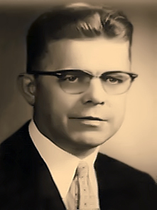
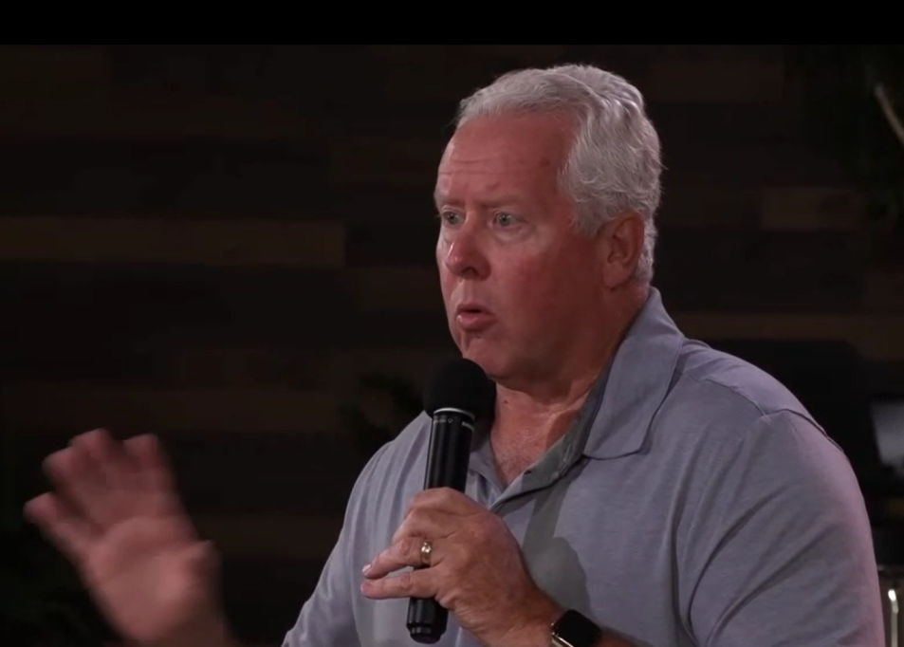
God Encounters His People Beyond
Normal Experiences – But It Must Align With The WORD OF GOD
Walter Beuttler
Instant Obedience/ Host the Presence of the Lord
John Fenn
God designed and imagined you and prepared a specific GRACE for you before you were born – so that you would find God and succeed in your life and mission
“Fly to Amsterdam New Years Day in the Afternoon.”

Slide 11
Give Me The Scripture To Prove
This Man’s Encounter
"The God who made the world and everything in it is the Lord of heaven and earth and does not live in temples built by hands. ²⁵ And He is not served by human hands, as if He needed anything, because He himself gives all men life and breath and everything else. ²⁶ From one man He made every nation of men, that they should inhabit the whole earth; and He determined the times set for them and the exact places where they should live. ²⁷ God did this so that men would seek Him and perhaps reach out for Him and find Him, though He is not far from each one of us. ²⁸ 'For in him we live and move and have our being.' Acts 17:24-28 (NIV)

Slide 12
The John Chapter Nine Miracle
As He went along, He saw a man blind from birth. ² His disciples asked him, "Rabbi, who sinned, this man or his parents, that he was born blind?" ³ "Neither this man nor his parents sinned," said Jesus, "but this happened so that the work of God might be displayed in his life. ⁴ As long as it is day, we must do the work of Him who sent me. Night is coming, when no one can work. John 9:1-4 (NIV)

Slide 13
Each One Is Given The Grace
To Succeed with What They Face
But by the grace of God I am what I am, and his grace to me was not without effect. No, I worked harder than all of them--yet not I, but the grace of God that was with me. 1 Corinthians 15:10 (NIV)
But to each one of us grace has been given as Christ apportioned it. Ephesians 4:7 (NIV)
No temptation has seized you except what is common to man. And God is faithful; He will not let you be tempted beyond what you can bear. But when you are tempted, He will also provide a way out so that you can stand up under it. 1 Corinthians 10:13 (NIV)
And God is able to make all grace abound to you, so that in all things at all times, having all that you need, you will abound in every good work. 2 Corinthians 9:8 (NIV)

Slide 14
Jesus Told us – We Were Brought Into
This World To Display His Glory
And He Gave Us Sufficient Grace
But he said to me, "My grace is sufficient (avails) for you, for my power is made perfect in weakness." Therefore I will boast all the more gladly about my weaknesses, so that Christ's power may rest on me. ¹⁰ That is why, for Christ's sake, I delight in weaknesses, in insults, in hardships, in persecutions, in difficulties. For when I am weak, then I am strong. 2 Corinthians 12:9-10
Sufficient (GREEK) - Arkeh-oe – Yes it is ENOUGH – but it literally means a raising of a barrier to defend and protect – being in a fort - THE SPIRITUAL BULWARK OF GOD’S GRACE - ESTABLISHES A BARRIER AGAINST THE ENEMY AND AGAINST OUR FLESH AND AGAINST DISCOURAGEMENT AND DEFEAT.
Do not be carried away by all kinds of strange teachings. It is good for our hearts to be strengthened by grace, Hebrews 13:9 (NIV)

Slide 15
Let’s Review This Amazing Grace
Before the Creation of the world - God knew who was going to come into the Earth.
Grace is not only RECEIVING SOMETHING I DON’T DESERVE (salvation – Filling of the Holy Spirit – Forgiveness – Wisdom – Gifts of the Spirit) – But it is the empowerment – strengthening and enabling to live out the WILL OF GOD in JOY and VICTORY – and bring all the glory back to God.
When – How – Where – Who – they were going to be – their family. The color of hair/ eyes/ skin – nation they would be born in – what time period they would live in.
God Allocated His grace to be SUFFICIENT for that person to succeed in life – in finding God – and in being an obedient Son or Daughter to the King of kings.
We beg of you not to receive the grace of God in vain [that merciful kindness by which God exerts His holy influence on souls and turns them to Christ, keeping and strengthening them—[ do not receive it to no purpose]. 2 Corinthians 6:1 (AMP)

Slide 16
When We Stand Before the Lord
The wrath of God is being revealed from heaven against all the godlessness and wickedness of men who suppress the truth by their wickedness, ¹⁹ since what may be known about God is plain to them, because God has made it plain to them. ²⁰ For since the creation of the world God's invisible qualities--His eternal power and divine nature--have been clearly seen, being understood from what has been made, so that men are without excuse. Romans 1:18-20 (NIV)
For the grace of God that brings salvation has appeared to all men. ¹² It teaches us to say "No" to ungodliness and worldly passions, and to live self-controlled, upright and godly lives in this present age, Titus 2:11-12 (NIV)

Slide 17
The Greatest Danger Is That We Will
Turn Away In the Flesh and Miss His Grace
Make every effort to live in peace with all men and to be holy; without holiness no one will see the Lord. ¹⁵ See to it that no one misses the grace of God and that no bitter root grows up to cause trouble and defile many. Hebrews 12:14-15 (NIV)
Grace is not simply God's perpetual tolerance of our sins or immaturities. It is His patience and direct help (and intervention) in the transformation process. Junior DeSouza

Slide 18
Lord Reach Our City – Reach Our Nation
Through Our Prayers and Obedience
“BRING BACK TO PEOPLE WHAT THE ENEMY HAS STOLEN – THEIR PURPOSE – SALVATION – VISION – HOPE.”
God awakens sinners; to make them sensible of the danger of missing the day of grace and to stir them up to improve the time while their day lasts. God has said that His Spirit will not always strive with men. [See]Genesis 6:3. Jonathan Edwards

Slide 19
One Of The Greatest Evidences That We Are Co-Operating With The Grace of God
Is A Broken and Contrite (Humble) Heart
The LORD is nigh unto them that are of a broken heart; and saves such as be of a contrite spirit. Psalm 34:18 (KJV)
The sacrifices of God are a broken spirit; a broken and contrite heart, O God, you will not despise. Psalm 51:17 (NIV)
For this is what the high and lofty One says-- he who lives forever, whose name is holy: "I live in a high and holy place, but also with him who is contrite and lowly in spirit, to revive the spirit of the lowly and to revive the heart of the contrite. Isaiah 57:15 (NIV)
² Has not my hand made all these things, and so they came into being?" declares the LORD. "This is the one I esteem: he who is humble and contrite in spirit, and trembles at my word. Isaiah 66:2 (NIV)

Slide 20
God’s Eternal Grace Produces Humble Hearts
He(God) mocks proud mockers but gives grace to the humble. Proverbs 3:34 (NIV)
But he gives us more grace. That is why Scripture says: "God opposes the proud but gives grace to the humble." ⁷ Submit yourselves, then, to God. Resist the devil, and he will flee from you. ⁸ Come near to God and he will come near to you.
James 4:6-8 (NIV)
All of you, clothe yourselves with humility toward one another, because, "God opposes the proud but gives grace to the humble." ⁶ Humble yourselves, therefore, under God's mighty hand, that He may lift you up in due time. ⁷ Cast all your anxiety on Him because He cares for you. 1 Peter 5:6-7 (NIV)

Slide 21
This Eternal Grace Changes Us
From the Inside Out
THE GREATEST GIFT GOD GIVES US IN SALVATION IS A RELATIONSHIP WITH HIMSELF. FURTHERMORE, IN THIS PRICELESS GIFT IS ALSO THE GIFT OF A CHANGE OF HEART BY THE COSTLY GRACE OF GOD– WHICH CHANGES OUR HIGHEST MOTIVE FROM BEING SELF-CENTERED TO BEING GOD-CENTERED.
“God introduces a radical new motive into our life that is not rooted in getting our own way, escaping pain, getting a better life, having financial blessings, or experiencing more pleasure: It is rooted in God-centered living. Out of this grace we are given the power to be anchored in a friendship with God that prevails over our own selfishness and roots of addiction.” Don Lamb

Slide 22
HOW DO WE MAKE THIS PERSONAL?
1. ACKNOWLEDGE the Lord has given you the grace that is sufficient to FIND HIM and LIVE FOR HIM on mission with great joy and success.
2 . LEVERAGE the grace that has been given you.
3. FORSAKE EVERYTHING that tends to make you despise or misuse or TAKE FOR GRANTED the grace of God in your life.
4. PUSH THROUGH the gates of intimidation that want to silence you and make you go away “silently in the night.”
5. PUSH IN WITH LIFEGATE and others to see our DAY OF GRACE come in power and set the captives free.
6. SHARE THE GOSPEL with greater freedom and liberty – God does have a plan for everyone – the enemy has come to steal kill and destroy – Jesus has come to give life abundantly (John 10:10) – and yet in that process of mercy WARN people to not MISS THE GRACE OF GOD.

