Slide 1
You and I were Made to Deliver

Slide 2
1 Samuel 9:1-2
There was a Benjamite, a man of standing, whose name was Kish son of Abiel, the son of Zeror, the son of Bekorath, the son of Aphiah of Benjamin.

Slide 3
“A Benjamite, a mighty man of power.” NKJV
“valiant mighty man.” NASB
“Man of wealth and power” RSV
“a Benjaminite of stalwart character.” MSG

Slide 4
1Sam 9:2
Kish had a son named Saul, as handsome a young man as could be found anywhere in Israel, and he was a head taller than anyone else.

Slide 5
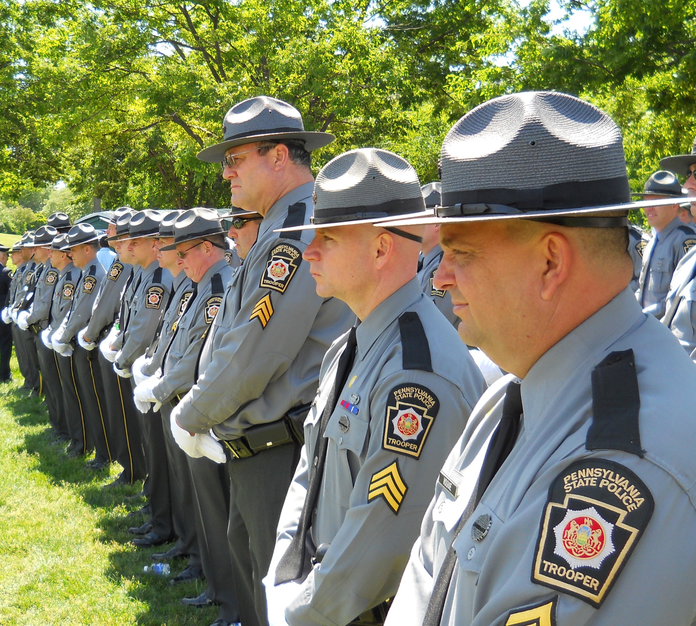

Slide 6
Now the donkeys belonging to Saul’s father Kish were lost, and Kish said to his son Saul, “Take one of the servants with you and go and look for the donkeys.”
1 Samuel 9:3

Slide 7
Saul (Heb.) “Asked for”, “Prayed for”

Slide 8
Samuel judged Israel and throughout his life, all the cities and territories stolen from the Amorites were restored to them and Israel delivered the neighboring territories from the power of the Philistines. They had peace with the Amorites.

Slide 9
Then they asked for a King. 1 Sam 8
5 They said to him, “You are old, and your sons do not follow your ways; now appoint a king to lead us, such as all the other nations have.”

Slide 10
22 The Lord answered, “Listen to them and give them a king.”

Slide 12
God Says
16 “About this time tomorrow I will send you a man from the land of Benjamin. Anoint him ruler over my people Israel; he will deliver them from the hand of the Philistines. I have looked on my people, for their cry has reached me.”
1 Samuel 9:

Slide 13
17 When Samuel caught sight of Saul, the Lord said to him, “This is the man I spoke to you about; he will govern my people.”

Slide 14
20 As for the donkeys you lost three days ago, do not worry about them; they have been found. And to whom is all the desire of Israel turned, if not to you and your whole family line?”

Slide 15
“A Benjamite, a mighty man of power.” NKJV
“valiant mighty man.” NASB
“Man of wealth and power” RSV
“a Benjaminite of stalwart character.” MSG

Slide 16
Romans 4:16 Therefore, the promise comes by faith, so that it may be by grace and may be guaranteed to all Abraham’s offspring—not only to those who are of the law but also to those who have the faith of Abraham. He is the father of us all. 17 As it is written: “I have made you a father of many nations.” He is our father in the sight of God, in whom he believed—the God who gives life to the dead and calls into being things that were not.

Slide 17
1 Samuel 9
21 Saul answered, “But am I not a Benjamite, from the smallest tribe of Israel, and is not my clan the least of all the clans of the tribe of Benjamin? Why do you say such a thing to me?”

Slide 18
1 Then Samuel took a flask of olive oil and poured it on Saul’s head and kissed him, saying, “Has not the Lord anointed you ruler over his inheritance?”
1 Samuel 10

Slide 19
Septuagint and Vulgate “Has not the Lord anointed over his people Israel? You will reign over the Lord’s people and save them from the power of their enemies round about. And this will be a sign to you that the Lord has anointed you ruler over his inheritance:

Slide 20
The Lord gives Saul several signs to confirm that He is ready and willing to use him to accomplish the deliverance of Israel from their enemies.

Slide 21
2 “When you leave me today, you will meet two men near Rachel’s tomb, at Zelzah on the border of Benjamin.
First Sign

Slide 22
Zelzah- “Shade, protection from the dazzling brightness”.

Slide 23
Who is God bringing up in His memory related to Saul and raising him up to be the delivering King?
Rachel

Slide 24
1000 years had passed from Rachel to Saul.
Who is Rachel remembered for?
Joseph and Benjamin

Slide 25
God says to Saul: “Meet Me at Rachel’s Tomb in the Shade”
God anticipates a deliverer like Joseph was to Israel!

Slide 26
3 “Then you will go on from there until you reach the great tree of Tabor. Three men going up to worship God at Bethel will meet you there. One will be carrying three young goats, another three loaves of bread, and another a skin of wine. 4 They will greet you and offer you two loaves of bread, which you will accept from them.

Slide 27
“Mount Tabor”
“Bethel”
“Three Men”
“Three loaves of bread”
“Three young goats”
“Skin of wine”

Slide 28
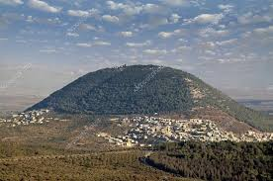
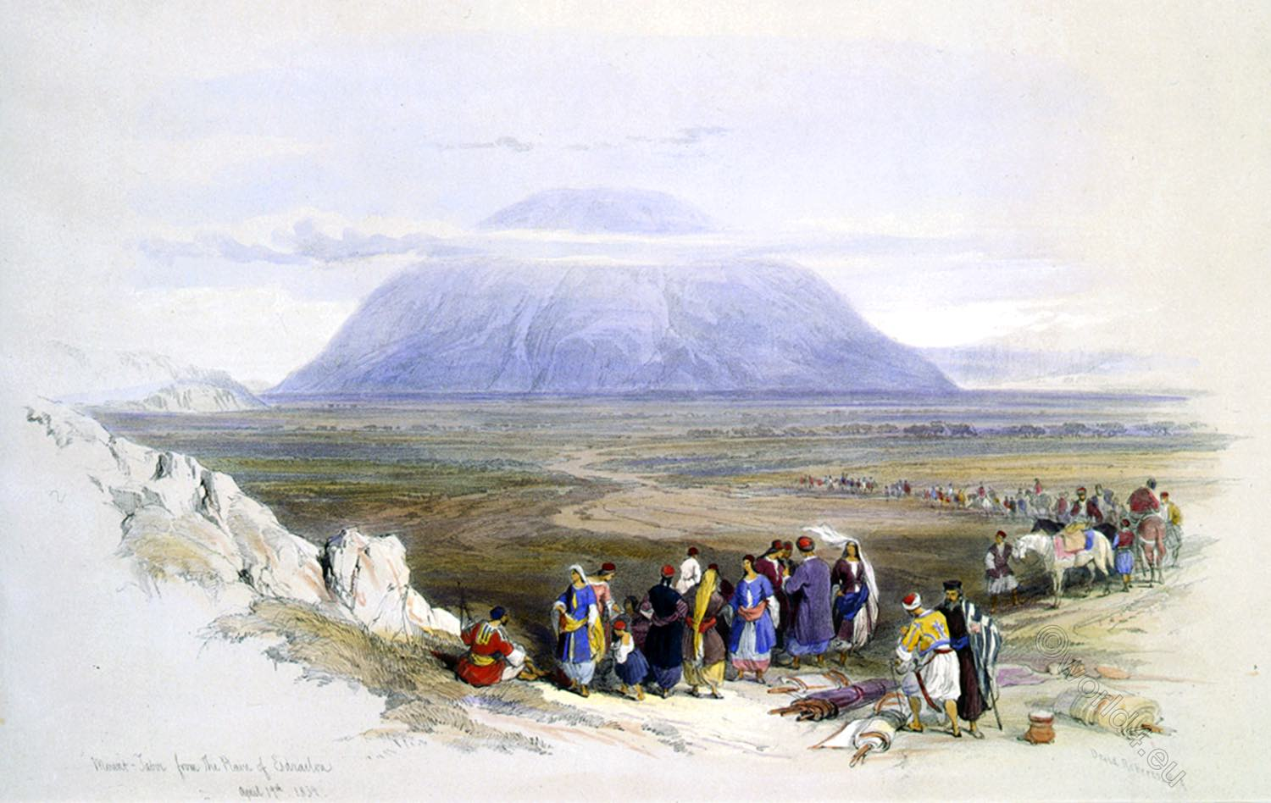
Tabor-verb ברר (barar), to purify or clarify
Also a town given to the Levites in 1 Chron 6:77.

Slide 29
-Beth El- (Heb.) “House of God”
-Jacob built an altar in Genesis 35
-Jacob’s ladder representing Jesus
-“Kings would come from you”
-Also the birthplace of the King of Kings! Bethlehem

Slide 30
“Mount Tabor”
“Bethel”
“Three Men”
“Three young goats”
“Three loaves of bread”
“Skin of wine”
Transfiguration, Levitical town
Clarification, Purification,
House of God, Jacob’s Ladder, First King and the Birthplace of Jesus
Three Magi, Three Men who meet Abraham, Father Son, Holy Spirit
Burnt offerings
Bread and Blood of the Passover

Slide 31
God, who stands outside of time was ready and willing to invest all that was needed to joining his man, who is Prophet, priest and King over all Israel to bring deliverance if he would engage it by obedience and faith.

Slide 32
1 Sam 10:5-7
“After that you will go to Gibeah of God, where there is a Philistine outpost. As you approach the town, you will meet a procession of prophets coming down from the high place with lyres, timbrels, pipes and harps being played before them, and they will be prophesying. 6 The Spirit of the Lord will come powerfully upon you, and you will prophesy with them; and you will be changed into a different person. 7 Once these signs are fulfilled, do whatever your hand finds to do, for God is with you.

Slide 33
Question for the Church:
If you knew that God was with you to accomplish whatever your hands find to do, and you couldn’t fail, What would you attempt and accomplish by faith in that promise?

Slide 34
Are you hiding among the baggage, when a King is in you?
Vs.22
Is Fear keeping you from walking in obedience to your royal authority?

Slide 35
1 Sam 13:5-10 “When the men of Israel saw that their situation was critical and that their army was hard pressed, they hid in caves and thickets, among the rocks and in pits and cisterns.

Slide 36
The progression of the demise of Saul’s rule can be seen in his tendency to be afraid, to act on his emotions and what he sees rather than obey the word of God.

Slide 37
Saul remained at Gilgal, and all the troops with him were quaking with fear. 8 He waited seven days, the time set by Samuel; but Samuel did not come to Gilgal, and Saul’s men began to scatter. 9 So he said, “Bring me the burnt offering and the fellowship offerings.” And Saul offered up the burnt offering. 10 Just as he finished making the offering, Samuel arrived, and Saul went out to greet him.

Slide 38
11 “What have you done?” asked Samuel.
Saul replied, “When I saw that the men were scattering, and that you did not come at the set time, and that the Philistines were assembling at Mikmash, 12 I thought, ‘Now the Philistines will come down against me at Gilgal, and I have not sought the Lord’s favor.’ So I felt compelled to offer the burnt offering.”

Slide 39
13 “You have done a foolish thing,” Samuel said. “You have not kept the command the Lord your God gave you; if you had, he would have established your kingdom over Israel for all time. 14 But now your kingdom will not endure; the Lord has sought out a man after his own heart and appointed him ruler of his people, because you have not kept the Lord’s command.”

Slide 40
The final straw:
1 Sam 15: Rejection of Saul as King
Sparing of Agag the Amalekite.

Slide 41
3 Now go, attack the Amalekites and totally destroy all that belongs to them. Do not spare them; put to death men and women, children and infants, cattle and sheep, camels and donkeys.’”

Slide 42
17 Samuel said, “Although you were once small in your own eyes, did you not become the head of the tribes of Israel? The Lord anointed you king over Israel. 18 And he sent you on a mission, saying, ‘Go and completely destroy those wicked people, the Amalekites; wage war against them until you have wiped them out.’
19 Why did you not obey the Lord? Why did you pounce on the plunder and do evil in the eyes of the Lord?”

Slide 43
20 “But I did obey the Lord,” Saul said. “I went on the mission the Lord assigned me. I completely destroyed the Amalekites and brought back Agag their king. 21 The soldiers took sheep and cattle from the plunder, the best of what was devoted to God, in order to sacrifice them to the Lord your God at Gilgal.”

Slide 44
22 But Samuel replied:
“Does the Lord delight in burnt offerings and sacrifices as much as in obeying the Lord? To obey is better than sacrifice, and to heed is better than the fat of rams.

Slide 45
23 For rebellion is like the sin of divination, and arrogance like the evil of idolatry. Because you have rejected the word of the Lord, he has rejected you as king.”

Slide 46
24 Then Saul said to Samuel, “I have sinned. I violated the Lord’s command and your instructions. I was afraid of the men and so I gave in to them. 25 Now I beg you, forgive my sin and come back with me, so that I may worship the Lord.”

Slide 47
Whatever is not Transformed by God will be transferred to the next generation.
Ex 20:5
Prov 3:33
2 Timothy 1:5-7

Slide 48
Proverbs 3:33
The Lord’s curse is on the house of the wicked,
but he blesses the home of the righteous.

Slide 49
2 Tim 1:5 I am reminded of your sincere faith, which first lived in your grandmother Lois and in your mother Eunice and, I am persuaded, now lives in you also.
6 For this reason I remind you to fan into flame the gift of God, which is in you through the laying on of my hands. 7 For the Spirit God gave us does not make us timid, but gives us power, love and self-discipline. 8 So do not be ashamed of the testimony about our Lord or of me his prisoner. Rather, join with me in suffering for the gospel, by the power of God.

Slide 50
Esther 2:5
Now there was in the citadel of Susa a Jew of the tribe of Benjamin, named Mordecai son of Jair, the son of Shimei, the son of Kish

Slide 51
3 After these events, King Xerxes honored Haman son of Hammedatha, the Agagite, elevating him and giving him a seat of honor higher than that of all the other nobles.
2 All the royal officials at the king’s gate knelt down and paid honor to Haman, for the king had commanded this concerning him. But Mordecai would not kneel down or pay him honor.

Slide 52
Esther 4 13-14
13“Do not think that because you are in the king’s house you alone of all the Jews will escape.
14 For if you remain silent at this time, relief and deliverance for the Jews will arise from another place, but you and your father’s family will perish. And who knows but that you have come to your royal position for such a time as this?”

Slide 53
Don’t allow the enemy to keep you from the destiny God has for you!

Slide 54
Don’t approach a spiritual problem with a natural or human solution.

Slide 55
15 Then Esther sent this reply to Mordecai: 16 “Go, gather together all the Jews who are in Susa, and fast for me. Do not eat or drink for three days, night or day. I and my attendants will fast as you do. When this is done, I will go to the king, even though it is against the law. And if I perish, I perish.”

Slide 56
When your problems are spiritual, you can’t legislate them, medicate, psychoanalyze them, positive mind them away.
Spider web vs spider, snakes need ground vs. eagle. Fasting brings the snake into the air.

Slide 57
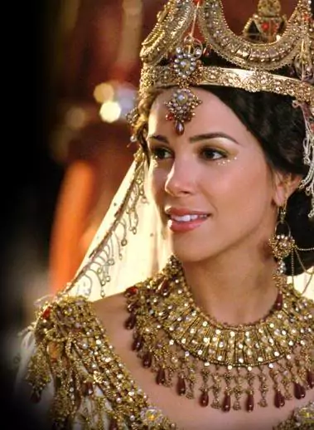
Dress up in Royalty, not dress down in Rags.

Slide 58
5 On the third day Esther put on her royal robes and stood in the inner court of the palace, in front of the king’s hall. The king was sitting on his royal throne in the hall, facing the entrance. 2 When he saw Queen Esther standing in the court, he was pleased with her and held out to her the gold scepter that was in his hand. So Esther approached and touched the tip of the scepter.

Slide 59
Haman had access to the King .
Esther had Authority!!!

Slide 60
You need to eat in the presence of your enemy (Psalm 23:5)
Don’t use God as a means to a goal. Make him your goal!

Slide 61
Whatever God hasn’t removed, he has empowered you to resist!
Esther 8:11

Slide 62
8:11 The king’s edict granted the Jews in every city the right to assemble and protect themselves; to destroy, kill and annihilate the armed men of any nationality or province who might attack them and their women and children,[b] and to plunder the property of their enemies.

Slide 63
Warfare is fought with the word and worship.
Psalm 149:5-9

Slide 64
What is it that the LORD is telling you to do today that you have not been willing to obey?
Who do you fear and want to please more? Man or God?

Slide 65
What are the things that have been excused by you as “passed down to me from my parents”?

Slide 66
Proverbs 6
My son, if you have put up security for your neighbor,
if you have shaken hands in pledge for a stranger,
2
you have been trapped by what you said,
ensnared by the words of your mouth.

Slide 67
3
So do this, my son, to free yourself,
since you have fallen into your neighbor’s hands:
Go—to the point of exhaustion—
and give your neighbor no rest!

Slide 68
4
Allow no sleep to your eyes,
no slumber to your eyelids.
5
Free yourself, like a gazelle from the hand of the hunter,
like a bird from the snare of the fowler.

Slide 69
Proverbs 29:25
Fear of man will prove to be a snare,
but whoever trusts in the Lord is kept safe.

