Slide 1
Modern Day Myths in the Church (Excerpts from 2 Timothy)
¹⁴ Keep reminding God’s people of these things. Warn them before God against quarreling about words; it is of no value, and only ruins those who listen. ¹⁵ Do your best to present yourself to God as one approved, a worker who does not need to be ashamed and who correctly handles the word of truth. ¹⁶ Avoid godless chatter, because those who indulge in it will become more and more ungodly. ¹⁷ Their teaching will spread like gangrene. Among them are Hymenaeus and Philetus, ¹⁸ who have departed from the truth. They say that the resurrection has already taken place, and they destroy the faith of some. ¹⁹ Nevertheless, God’s solid foundation stands firm, sealed with this inscription: “The Lord knows those who are his,” and, “Everyone who confesses the name of the Lord must turn away from wickedness.” (2 Tim. 2)

Slide 2
²² Flee the evil desires of youth and pursue righteousness, faith, love and peace, along with those who call on the Lord out of a pure heart. ²³ Don’t have anything to do with foolish and stupid arguments, because you know they produce quarrels. ²⁴ And the Lord’s servant must not be quarrelsome but must be kind to everyone, able to teach, not resentful. ²⁵ Opponents must be gently instructed, in the hope that God will grant them repentance leading them to a knowledge of the truth, ²⁶ and that they will come to their senses and escape from the trap of the devil, who has taken them captive to do his will. (2 Tim. 2)
3 But mark this: There will be terrible times in the last days. ² People will be lovers of themselves, lovers of money, boastful, proud, abusive, disobedient to their parents, ungrateful, unholy, ³ without love, unforgiving, slanderous, without self-control, brutal, not lovers of the good, ⁴ treacherous, rash, conceited, lovers of pleasure rather than lovers of God— ⁵ having a form of godliness but denying its power. Have nothing to do with such people.

Slide 3
¹⁰ You, however, know all about my teaching, my way of life, my purpose, faith, patience, love, endurance, ¹¹ persecutions, sufferings—what kinds of things happened to me in Antioch, Iconium and Lystra, the persecutions I endured. Yet the Lord rescued me from all of them. ¹² In fact, everyone who wants to live a godly life in Christ Jesus will be persecuted, ¹³ while evildoers and impostors will go from bad to worse, deceiving and being deceived. ¹⁴ But as for you, continue in what you have learned and have become convinced of, because you know those from whom you learned it, ¹⁵ and how from infancy you have known the Holy Scriptures, which are able to make you wise for salvation through faith in Christ Jesus. ¹⁶ All Scripture is God-breathed and is useful for teaching, rebuking, correcting and training in righteousness, ¹⁷ so that the servant of God^{[a]} may be thoroughly equipped for every good work. (2 Tim. 3)

Slide 4
4 In the presence of God and of Christ Jesus, who will judge the living and the dead, and in view of his appearing and his kingdom, I give you this charge: ² Preach the word; be prepared in season and out of season; correct, rebuke and encourage—with great patience and careful instruction. ³ For the time will come when people will not put up with sound doctrine. Instead, to suit their own desires, they will gather around them a great number of teachers to say what their itching ears want to hear. ⁴ They will turn their ears away from the truth and turn aside to myths. ⁵ But you, keep your head in all situations, endure hardship, do the work of an evangelist, discharge all the duties of your ministry.
¹⁸ The Lord will rescue me from every evil attack and will bring me safely to his heavenly kingdom. To him be glory for ever and ever. Amen.

Slide 5
Avoid godless chatter, because those who indulge in it will become more and more ungodly. Their teaching will spread like gangrene. (2:16-17)
Our world / nation is a very different place than it was 15 years ago!
Social media has given everyone a voice.
It’s easy to get drawn into godless chatter and to be very rude.
I started a Facebook account in 2020 (out of sheer boredom).
We need to be aware of how our comments and posts effect our Christian witness.
Does anyone know what “gangrene” is / how it starts?
Make sure your teaching and words are not destructive.
“Everyone who confesses the name of the Lord must turn away from wickedness.” (God and sin don’t mix!)

Slide 6
Don’t have anything to do with foolish and stupid arguments, because you know they produce quarrels. (2:23)
Getting into a Facebook comment battle with someone can be very time consuming and very draining!
Like what you like and skim over the “foolish & stupid arguments.”
This doesn’t mean that we don’t defend the things of God, but in most cases, were not going to convince others to change their POV.
It becomes an exercise in futility! Amen?
“Opponents must be gently instructed…” (Read 2:25-26)
What are some of the key words/ phrases that you hear?
God plays an awfully BIG role in what we are “gently” trying to do!
God’s strong arm (man’s will) vs. God’s finger work (Creation).

Slide 7
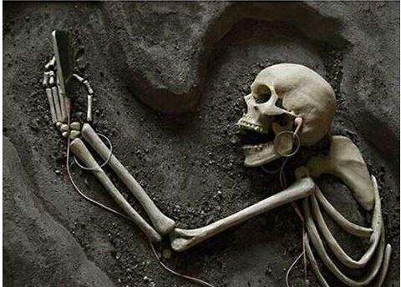
There will be terrible times in the last days. (3:1-5)

Slide 8
“…having a form of godliness but denying its power. Have nothing to do with such people.” (3:5)
Humanity is created in the image and likeness of God. (Genesis)
Humanity has a conscience, but it becomes seared & ineffective.
(See Romans 2:12-15).
Obedience is more important than intellectual agreement!
Calling oneself a Christian is easier than being one.
Tough language!
Paul tells the Corinthians to expel the immoral brother!
(See 1 Cor. 5:1-5)

Slide 9
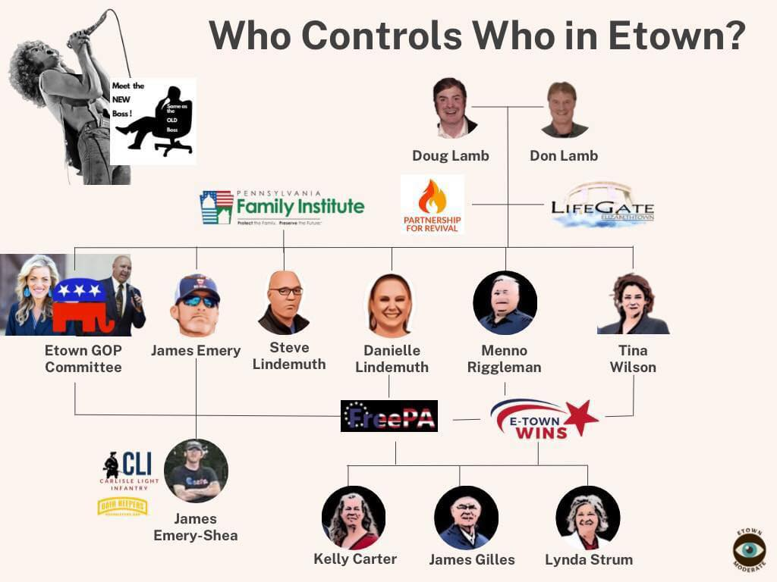
…everyone who wants to live a godly life in Christ Jesus will be persecuted, while evildoers and imposters will go from bad to worse, deceiving and being deceived.” (3:12-13)

Slide 10
But as for you, continue in what you have learned and have become convinced of, because you know those from whom you learned it, and how from infancy you have known the Holy Scriptures… (3:14-15)
Would Mom Lamb have led you astray?
Would Paul or E. Daniel?
I’ve been studying and learning the Bible for 40 years or more.
(Methodist / Church of God / Lifegate???)
I had many spiritual parents & grandparents at Landisville, many of whom are no longer with us.
I trusted their teaching and discipling!
“All Scripture is God-breathed and is useful for teaching, rebuking, correcting and training in righteousness so that the servant of God may be thoroughly equipped for every good work.” (3:16-17)

Slide 11
4 In the presence of God and of Christ Jesus, who will judge the living and the dead, and in view of his appearing and his kingdom, I give you this charge: ² Preach the word; be prepared in season and out of season; correct, rebuke and encourage—with great patience and careful instruction. ³ For the time will come when people will not put up with sound doctrine. Instead, to suit their own desires, they will gather around them a great number of teachers to say what their itching ears want to hear. ⁴ They will turn their ears away from the truth and turn aside to myths. ⁵ But you, keep your head in all situations, endure hardship, do the work of an evangelist, discharge all the duties of your ministry.
This past Sunday’s experience at an unnamed church in Etown.
I believe the church brought in a speaker who told them what “their itching ears wanted to hear.”
Some of the “myths” we hear today in church circles need to be addressed.

Slide 12
Myth #1

Slide 13
AKA: Tolerance is King!
Well, “Jesus ate with tax collectors and sinners…”
Response: Jesus ate with tax collectors, sinners, prostitutes, and others, not for the sake of tolerance, but because he was calling them to repentance and a changed life having met Himself.
¹¹ When the Pharisees saw this, they asked his disciples, “Why does your teacher eat with tax collectors and sinners?” ¹² On hearing this, Jesus said, “It is not the healthy who need a doctor, but the sick. ¹³ But go and learn what this means: ‘I desire mercy, not sacrifice.’ For I have not come to call the righteous, but sinners.” (Matthew 9)
Sinners can be fun to hang out with!
It doesn’t mean we condone their lifestyle or personal choices.
We need to avoid the extremes in most things (bar, movies, casino).

Slide 14
“Cheap Grace” – acc. to Dietrich Bonhoeffer
Cheap grace is grace without price; grace without cost!”
Cheap grace is grace as doctrine…a system.
Cheap grace means justification of sin w/o justification of the sinner.
It is preaching forgiveness w/o requiring repentance.
It is baptism w/o discipline; it is communion w/o confession.
It is Grace w/o discipleship, w/o the cross, w/o Jesus.
This cheap grace rather than having been given by God, is the grace we give ourselves.
He believed it was the chief enemy of the Church!

Slide 15
Streams of Living Water – Richard Foster
The Contemplative Tradition: the Prayer-filled Life
The Holiness Tradition: the Virtuous Life
The Charismatic Tradition: the Spirit-Empowered Life
The Evangelical Tradition: the Word-Centered Life
The Incarnational Tradition: the Sacramental Life
The Social Justice Tradition: the Compassionate Life
He argues that many churches are good at one of these traditions, but that to be an effective church, we should be mixing together some of all six streams.
An over-emphasis on any one stream can become prone to error!

Slide 16
Myth #2 – The Church should take care of everyone.

Slide 17
This is an over-emphasis on the Social Justice stream.
Feeding & clothing the poor is good enough for a ministry.
It can become the Compassionate stream run-amuck.
It starts to look like our Southern border!
⁷ “Leave her alone,” Jesus replied. “It was intended that she should save this perfume for the day of my burial. ⁸ You will always have the poor among you, but you will not always have me.” (John 12)
Mary, once again, chose what was best (being at the feet of Jesus).
We need to spend time worshipping at the feet of Jesus.
Tending to people’s spiritual needs, not simply their physical needs.
A meal and even a shirt only last a short while.

Slide 18
Myth #3 - Preaching the hard truth is hate speech!

Slide 19
Old adage – “If you don’t like your toes being stepped on, get out of the isle.”
Sometimes tough love is necessary.
Hearing what you don’t want to hear, can be the best thing for you.
If you don’t like the message, then turn it off.
Conviction isn’t comfortable! It’s a Holy Spirit thing.
Nowadays people are “offended” by everything.
Our society has to adjust in order to make everyone comfortable.
Even the church can play this game at times (seeker sensitivity).
“God created Adam and Eve, not Adam and Steve.”

Slide 20
Myth #4 – If you love God and Country you’re a White Christian Nationalist.

Slide 21
“It is impossible to rightly govern a nation without God and the Bible.” (G W)
“Our Constitution was made only for a moral and religious people. It is wholly inadequate to the government of any other.” (J A)
“Human law must rest its authority ultimately upon the authority of that law which is divine. Far from being rivals or enemies, religion and law are twin sisters, friends, and mutual assistants. Indeed, these two sciences run into each other.” (J W)
“Without God there could be no American form of government, nor an American way of life.” (D E)
It’s pretty clear that a love for God and for Country is a good thing!
It is good to control your zeal and to use wise judgment.
Not everyone used good judgment on J6, but not every white person is a racist, either. Most are not.

Slide 22
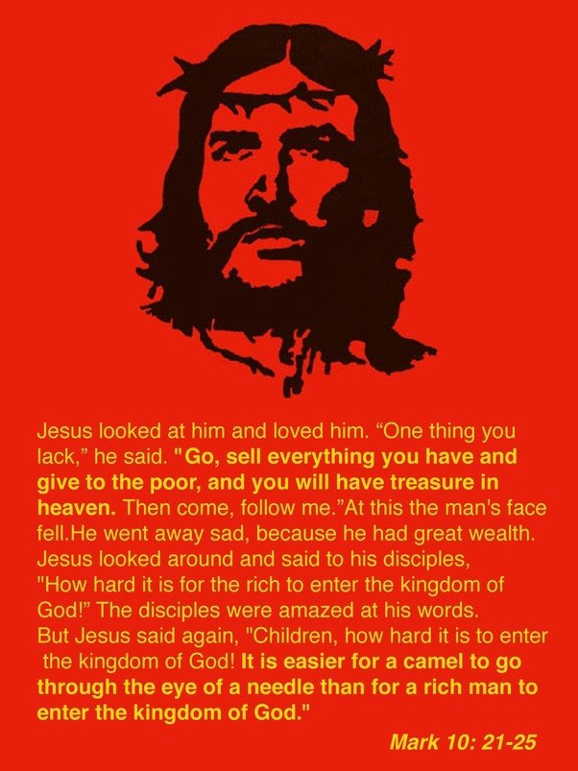
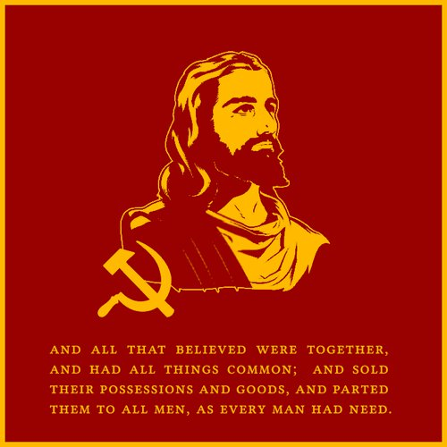
Myth #5 – Jesus was a Socialist / Communist

Slide 23
This myth puts an over-emphasis on Acts 2:44-45.
We are expected / instructed to be a “charitable” people.
However, that charity is to be voluntary, not compulsory!
From the heart, not from dictate.
Problem with Mark 10:21-25 is:
“What must I do to inherit eternal life?” (vs. 17)
Jesus is a very personal Savior.
He gave this man a very personal, intimate answer suited to him.
Jesus was not speaking in universal truths here.
The issue and the answer could be different for everyone.
Fill in the blank, what is it for you?

Slide 24
The Bible has a lot to say about private property.
The 10 Commandments
Thou shalt not steal.
Thou shalt not covet thy neighbor’s... Stuff
Proverbs 3:9-10
“Honor the Lord with your wealth, with the firstfruits of all your crops; then your barns will be filled to overflowing, and your vats will brim over with new wine.”
Jesus taught often concerning private property in Parables
“A man planted a vineyard. He put a wall around it, dug a pit for the winepress and built a watchtower.” (Mark 12:1)
Why would he need a wall & watchtower if he didn’t own it?

Slide 25
We need to work for a living!
Working is a result of the Curse (Gen. 3:17-19)
“Do not defraud or rob your neighbor. Do not hold back the wages of a hired worker overnight.” (Lev. 19:13)
“for the worker deserves his wages” (Luke 10:7)
¹¹ and to make it your ambition to lead a quiet life: You should mind your own business and work with your hands, just as we told you, ¹² so that your daily life may win the respect of outsiders and so that you will not be dependent on anybody. (1 Thess.)
¹⁰ For even when we were with you, we gave you this rule: “The one who is unwilling to work shall not eat. ¹¹ We hear that some among you are idle and disruptive. They are not busy; they are busybodies.”
(2 Thess.)

Slide 26
So what?
Never be ashamed of the Gospel.
¹⁶ For I am not ashamed of the gospel, because it is the power of God that brings salvation to everyone who believes: first to the Jew, then to the Gentile. ¹⁷ For in the gospel the righteousness of God is revealed—a righteousness that is by faith from first to last… (Romans)
Never apologize for the Word of God.
¹⁶ All Scripture is God-breathed and is useful for teaching, rebuking, correcting and training in righteousness, ¹⁷ so that the servant of God may be thoroughly equipped for every good work. (2 Timothy)
People have the right to be offended.
That’s not your concern. Your job is to be gently faithful.
Read the account from The Name, by Franklin Graham (pp 18-19).

Slide 27
¹⁶ Watch your life and doctrine closely. Persevere in them, because if you do, you will save both yourself and your hearers. (1 Timothy 4)
⁵ But you, keep your head in all situations, endure hardship, do the work of an evangelist, discharge all the duties of your ministry.
¹⁸ The Lord will rescue me (you) from every evil attack and will bring me (you) safely to his heavenly kingdom. To him be glory for ever and ever. Amen.

