Slide 1
For Our Time Of Crisis
Sermon For LifeGate
Sunday, September 3, 2023
Matthew Chapter 11

Slide 2
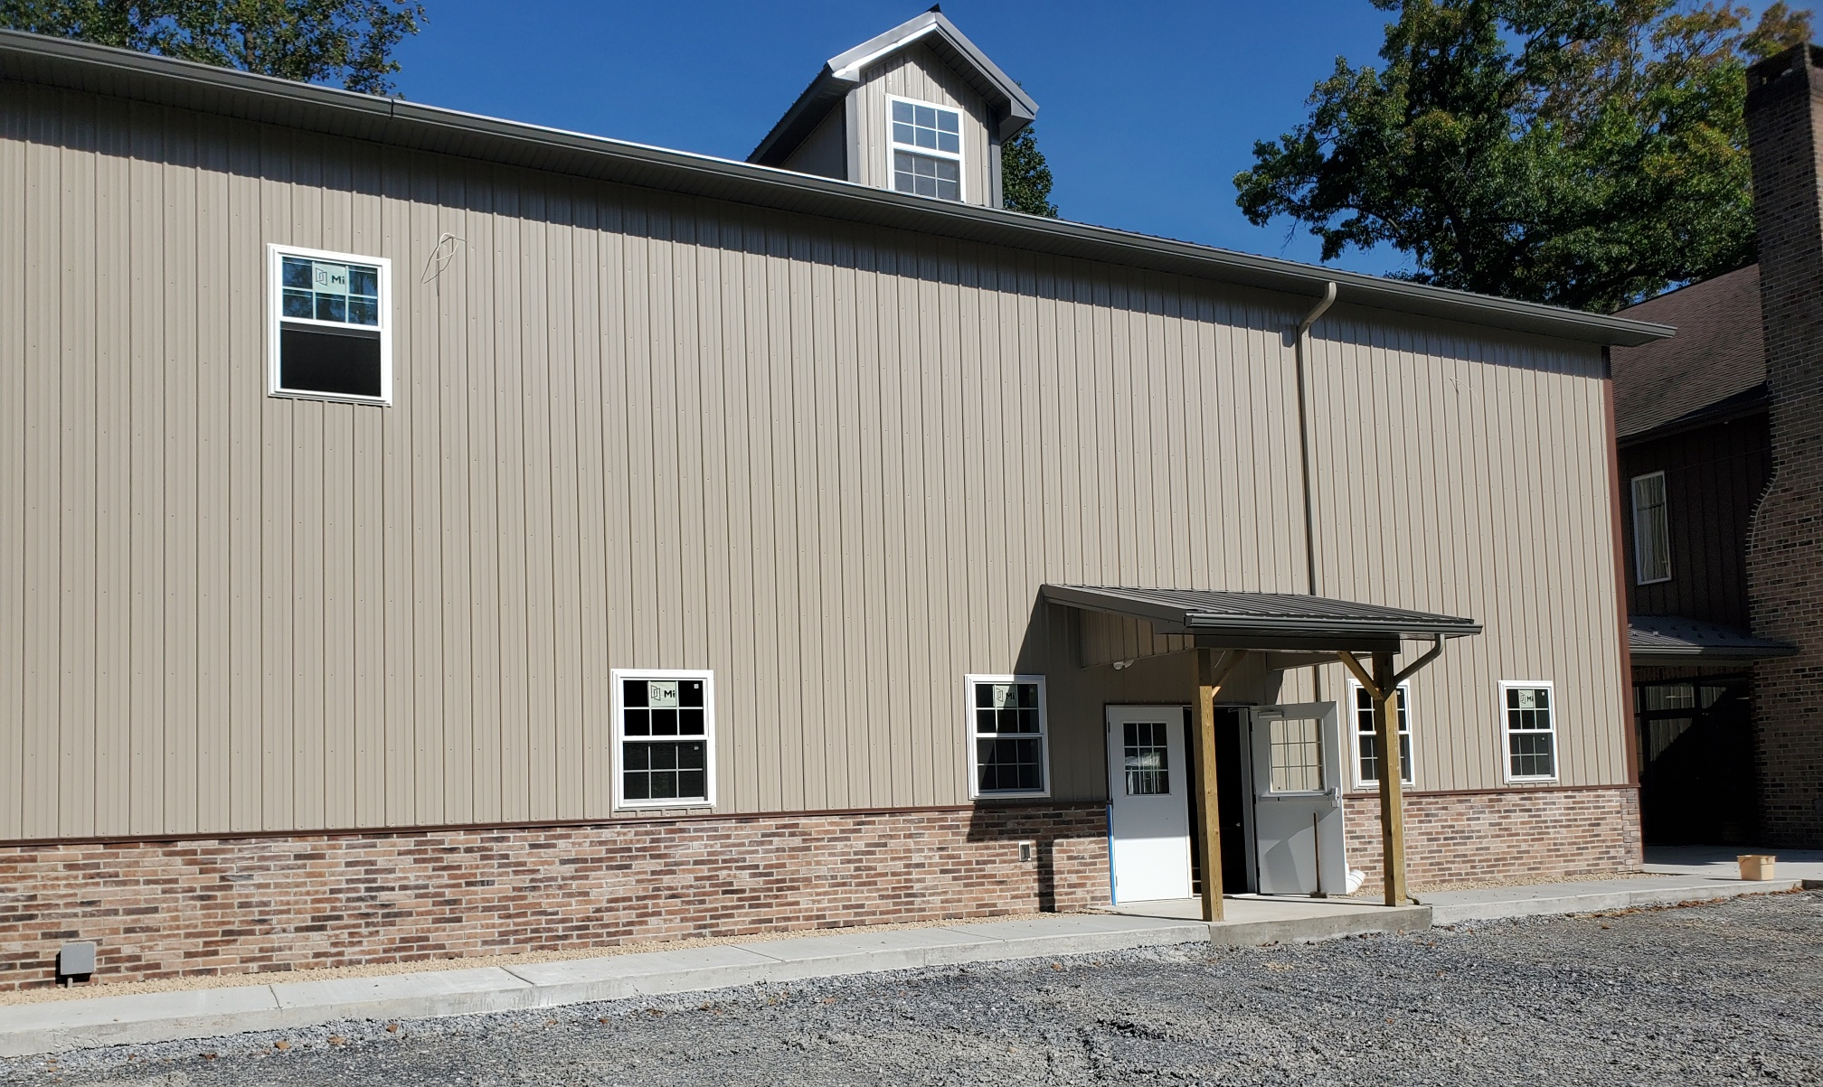
Getting Closer To The Finish Line

Slide 3
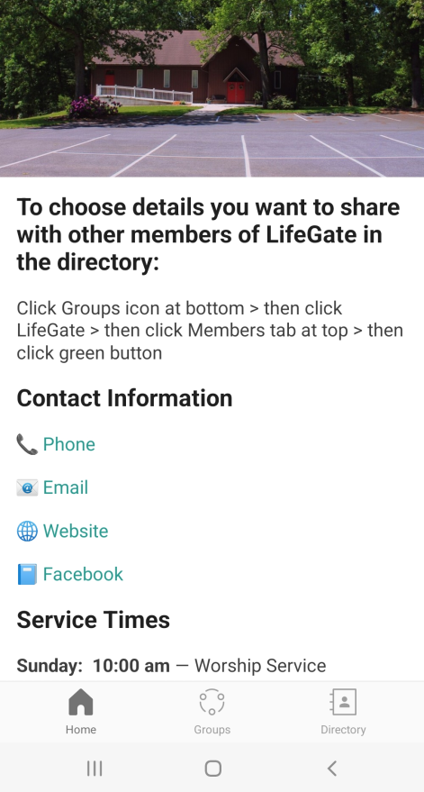
Tutorial On LifeGate App
Open and
Authenticate
Choose
LifeGate as Church
Go to your App Store
Choose Church Center App

Slide 4
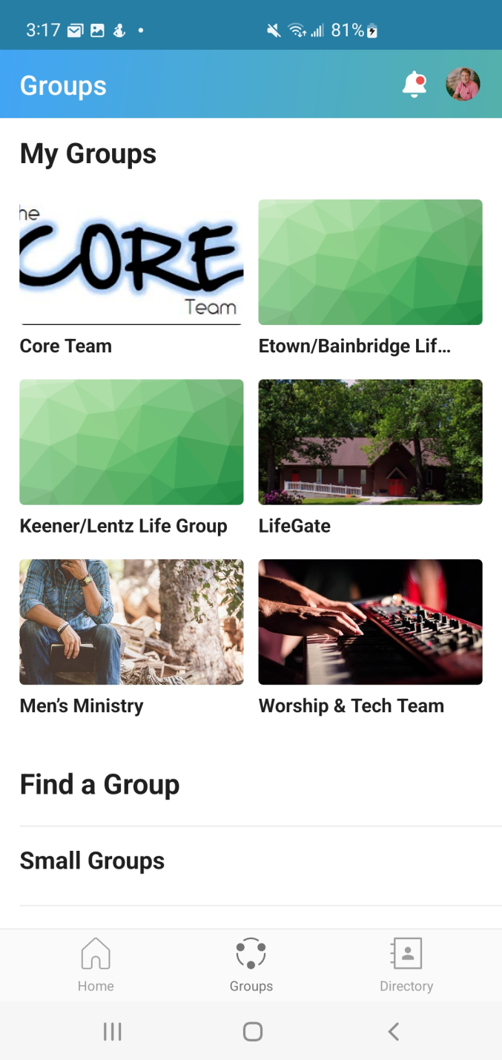

Slide 5
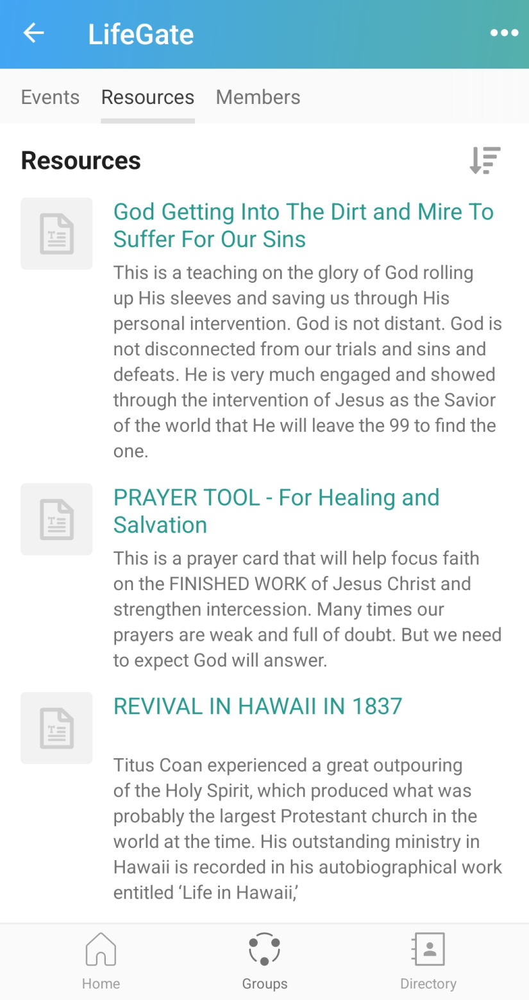

Slide 6
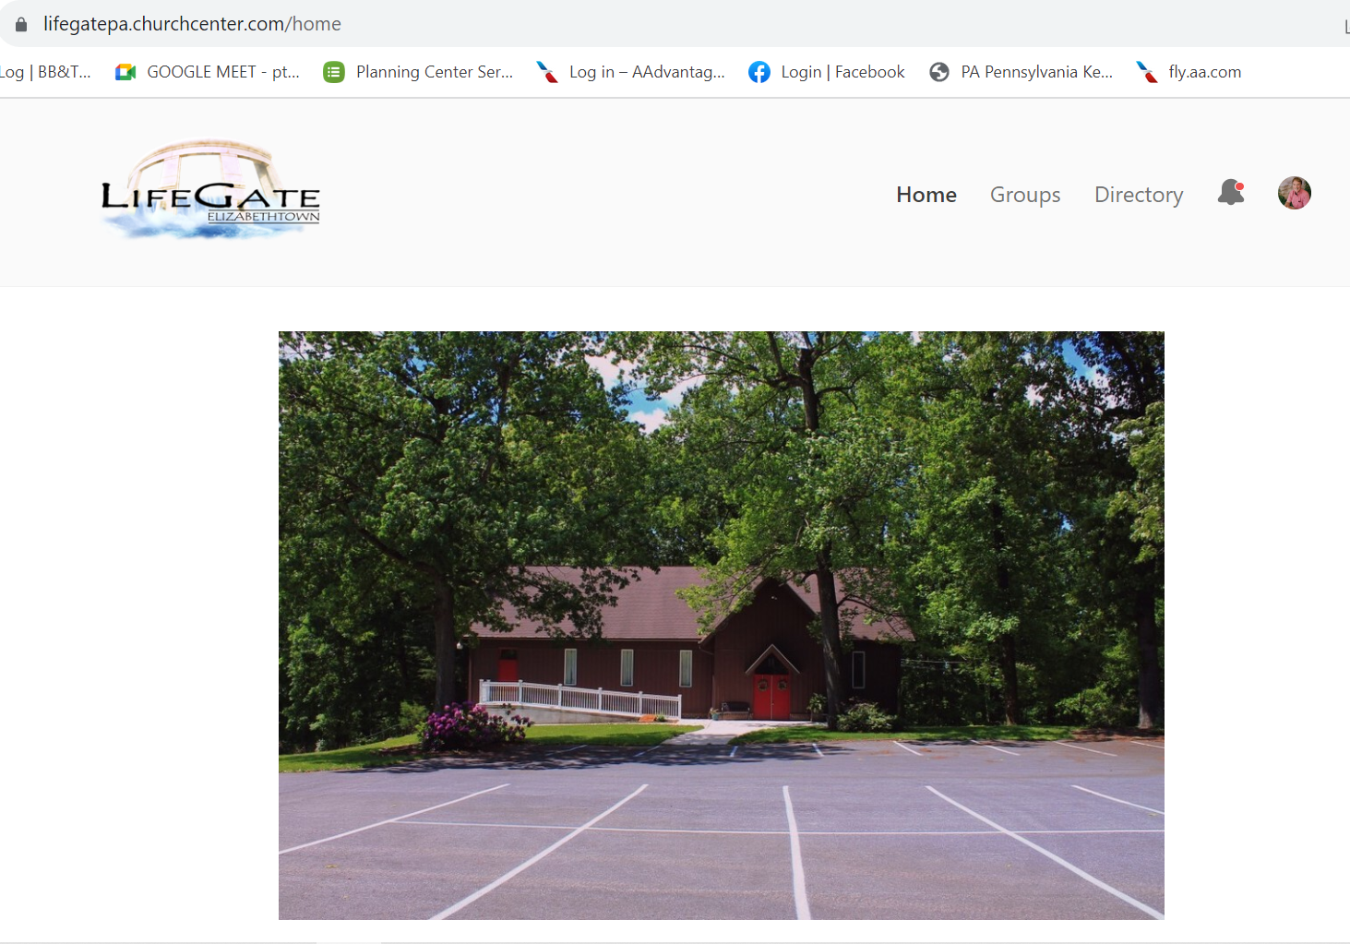

Slide 7
THIS MESSAGE IS NOT A GUILT TRIP
OR A VENTING SESSION – WHERE I AM FRUSTRATED
CHRISTIANS ARE WILLING TO GIVE UP THEIR SIN
BUT THEY ARE NOT WILLING TO GIVE UP COMFORT Pete Ogilvie

Slide 8
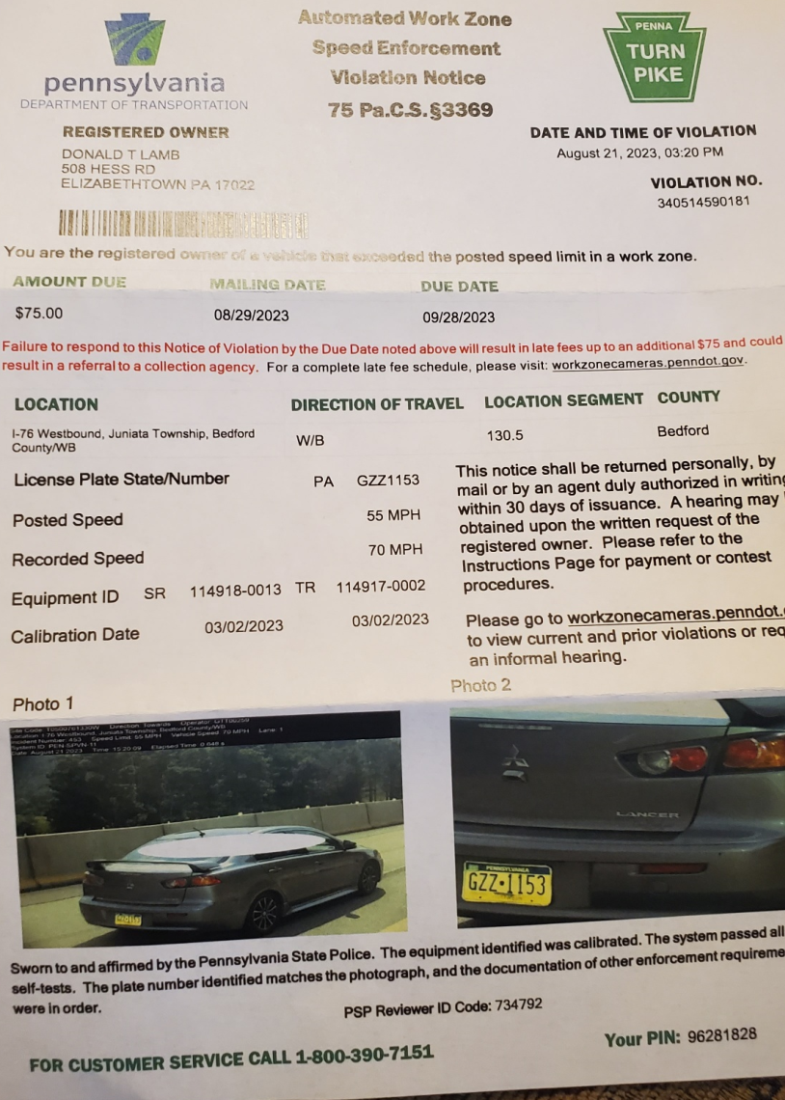
Opening Thoughts
Swimming Against The Current
The people that do know their God shall be strong, and do exploits. Daniel 11:32b (KJV)
Some of the wise will stumble, so that they may be 1/refined, 2/purified and 3/made spotless until the time of the end, for it will still come at the appointed time. Daniel 11:34-35 (NIV)

Slide 9
“GOD IS ROUSING THE WESTERN CHURCH OUT OF HER WORLDLY INDUCED SLUMBERING INTO AN ENGAGED SPIRIT-FILLED GLORY THAT MAKES HER THE PRIMARY INSTRUMENT OF REFORMATION IN THE EARTH.”
Nations will come to your light, and kings to the brightness of your dawn. Isaiah 60:3 (NIV)

Slide 10
This Summer Showed Us Areas God
Is Refining In Each Of Us – It will require Humility And Standing Together As Destiny Partners
Be kind and compassionate to one another, forgiving each other, just as in Christ God forgave you. Ephesians 4:32 (NIV)
STEP THROUGH (BY GRACE) THE PERSONALITY CONFLICTS – THE WEARINESS OF
DIFFERENCES – Personal – family – marriage - regional
THEREFORE - WE SEEK AS A COMMUNITY TO OVERCOME BY GROWING IN GRACE
⁶ And David was greatly distressed; because the soul of all the people was grieved, every man for his sons and for his daughters: but David encouraged himself in the LORD his God. 1 Samuel 30:6 (KJV)
And Saul's son Jonathan went to David at Horesh and helped him find strength in God. 1 Samuel 23:16 (NIV)

Slide 11
God’s Finger Made the Universe
But It Takes The Arm of God To Change Hearts
When I consider your heavens, the work of your fingers, the moon and the stars, which you have set in place, what is man that you are mindful of him, the Son of man that you care for Him? Psalm 8:3-4 (NIV)
The heart is deceitful above all things and beyond cure. Who can understand it? ¹⁰ "I the LORD search the heart and examine the mind, to reward a man according to his conduct, according to what his deeds deserve." Jeremiah 17:9-10 (NIV)
I will heal their backsliding, I will love them freely: for mine anger is turned away from him. Hosea 14:4 (KJV)
Some of the wise will stumble, so that they may be 1/refined, 2/purified and 3/made spotless until the time of the end, for it will still come at the appointed time. Daniel 11:34-35 (NIV)

Slide 12
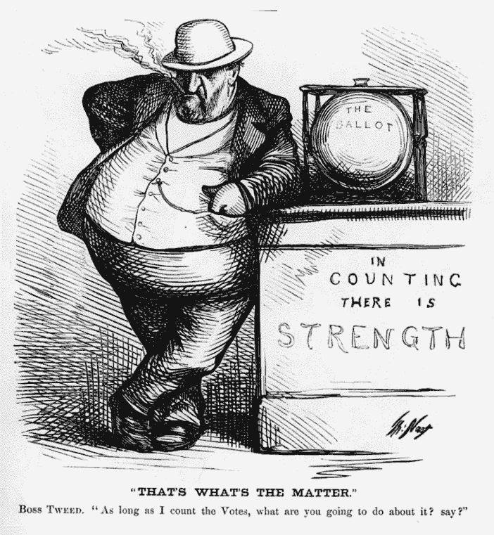
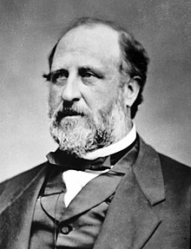
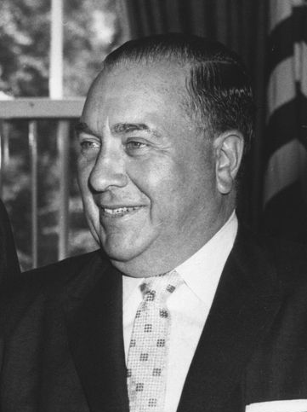
The Difference Between Tyrants and Leaders
Tyrants Build Machines
Leaders Build Influence
William (Boss) Tweed
Mayor Richard Daley
“The “anti-authoritarian spirit that was part of the hippie movement was a threat to machine politics which was built on the foundation of blind obedience [to a system]. Richard Daley understood that when power shifted to the grass-roots level into the streets political bosses like him would suffer.”

Slide 13
God does not make us MACHINES
God INFLUENCES us to be
transformed by His Love and truth
For Christ's LOVE compels us, because we are convinced that One died for all, and therefore all died. ¹⁵ And He died for all, that those who live should no longer live for themselves but for Him who died for them and was raised again. ¹⁶ So from now on we regard no one from a worldly point of view. Though we once regarded Christ in this way, we do so no longer. ¹⁷ Therefore, if anyone is in Christ, he is a new creation; the old has gone, the new has come!
2 Corinthians 5:14-17 (NIV)

Slide 14
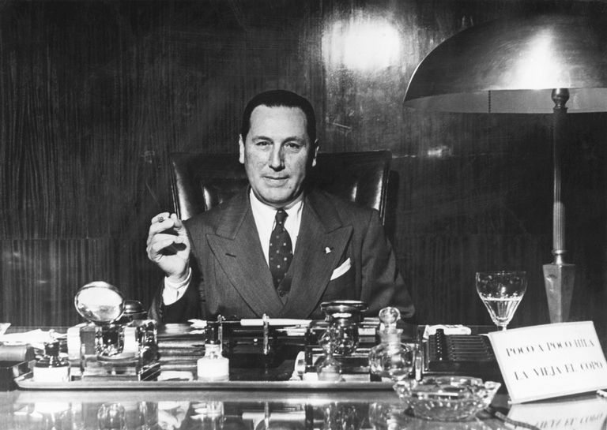
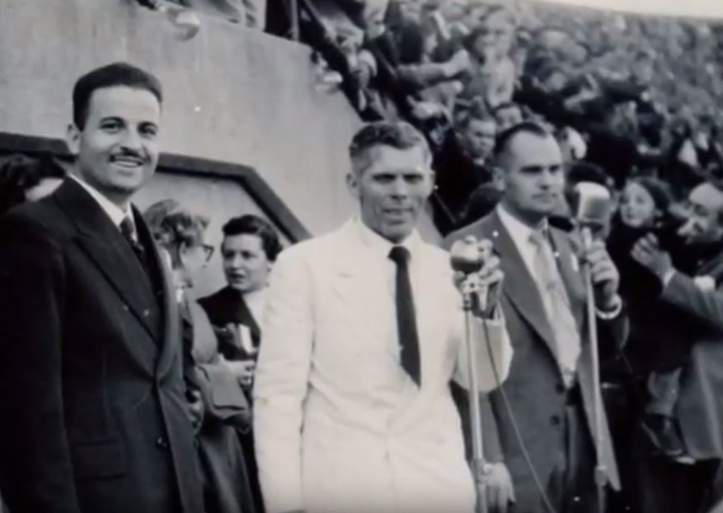
In A Time of Tyranny – 1954
Revival In Argentina
For two snows will not pass over the earth until thou shalt go to this land, for thou shalt not go by boat nor by land, but as a bird, flying through the air shalt thou go.
Argentina Dictator
Juan Peron
American Evangelist
Tommy Hicks 1954

Slide 15
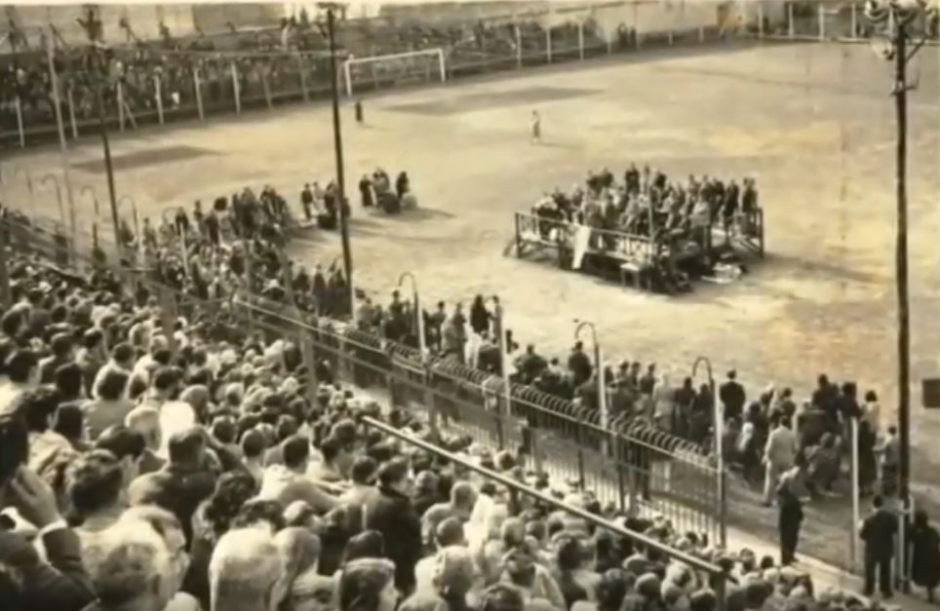
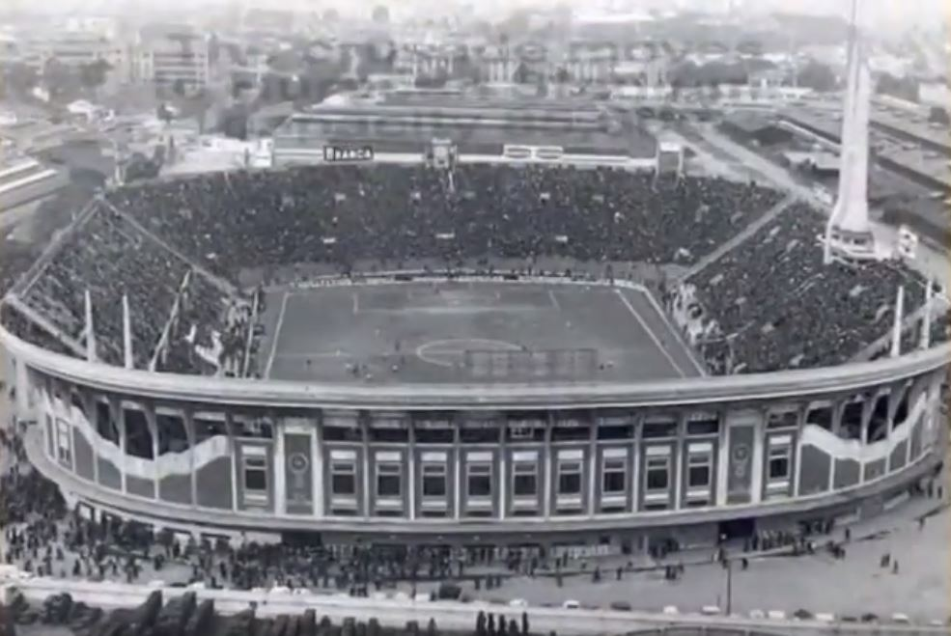
Lasted 52 Days – over three million attended

Slide 16
Don’t Discount Yourself – God is Strongly Urging And Calling
Everyone to Himself – The Prodigals – The Backsliders – The Weak – The Strong … Everyone
¹ "Come, all you who are thirsty, come to the waters; and you who have no money, come, buy and eat! Come, buy wine and milk without money and without cost. ² Why spend money on what is not bread, and your labor on what does not satisfy? Listen, listen to me, and eat what is good, and your soul will delight in the richest of fare. Isaiah 55:1-2 (NIV)
Seek the LORD while He may be found; call on Him while He is near. ⁷ Let the wicked forsake his way and the evil man his thoughts. Let him turn to the LORD, and He will have mercy on him, and to our God, for He will freely pardon. Isaiah 55:6-7
¹⁵ For this is what the high and lofty One says-- He who lives forever, whose Name is holy: "I live in a high and holy place, but also with him who is contrite and lowly in spirit, to revive the spirit of the lowly and to revive the heart of the contrite. ¹⁶ I will not accuse forever, nor will I always be angry, for then the spirit of man would grow faint before Me-- the breath of man that I have created. ¹⁷ I was enraged by his sinful greed; I punished him, and hid my face in anger, yet he kept on in his willful ways. ¹⁸ I have seen his ways, but I will heal him; I will guide him and restore comfort to him, ¹⁹ creating praise on the lips of the mourners in Israel. Peace, peace, to those far and near," says the LORD. "And I will heal them." Isaiah 57:15-19 (NIV)

Slide 17
God Is Raising Up A Last Days Army – Jesus-Centered
Full Of The Holy Spirit That Will Not Quit Or Discount Itself
But Be Spirit-led - Full Of Integrity, Prayer, and Self-starters
So I prophesied as He commanded me, and breath entered them; they came to life and stood up on their feet--a vast army. Ezekiel 37:10 (NIV)
The people that do know their God shall be strong, and do exploits. Daniel 11:32b (KJV)
"On that day I will make the leaders of Judah like a firepot in a woodpile, like a flaming torch among sheaves. They will consume right and left all the surrounding peoples, ⁸ On that day the feeblest among them will be like David, and the house of David will be like God, like the Angel of the LORD going before them. Zechariah 12:6,8 (NIV)
Out of the mouths of babes and infants You have established strength because of Your foes, that You might silence the enemy and the avenger. Psalm 8:2 (AMP)
"And I will pour out on the house of David and the inhabitants of Jerusalem a spirit of grace and supplication. Zechariah 12:10 (NIV)

Slide 18
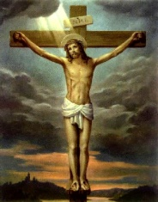
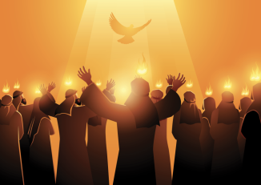
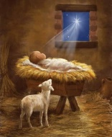
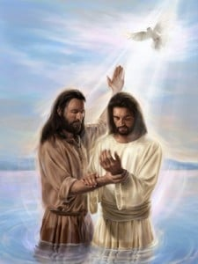
Jesus Increased His Teaching and Revelations on The Holy Spirit The Closer He Came To The End of His Ministry
Birth
Baptism
Cross
Pentecost
The Life Of Jesus and His Teaching On The Holy Spirit
Jesus teaches on the Holy Spirit approximately 12 times in his early and middle ministry but 11 times in the last week and post resurrection
Holy Spirit Activity
Jesus Teaching On the Holy Spirit

Slide 19
The Last Words Of Jesus
But I tell you the truth: It is for your good that I am going away. Unless I go away, the Counselor will not come to you; but if I go, I will send Him to you. ⁸ When He comes, He will convict the world of guilt in regard to sin and righteousness and judgment: John 16:7-8

Slide 20
The Last Words Of Jesus
On one occasion, while He was eating with them, He gave them this command: "Do not leave Jerusalem, but wait for the Gift my Father promised, which you have heard Me speak about. ⁵ For John baptized with water, but in a few days you will be baptized with the Holy Spirit." Acts 1:4-5
But you will receive power when the Holy Spirit comes on you; and you will be My witnesses in Jerusalem, and in all Judea and Samaria, and to the ends of the earth." Acts 1:8 (NIV)

Slide 21
What Is Jesus Emphasizing by bringing this crescendo of teaching on the Holy Spirit right before He leaves the Disciples.
He was emphasizing the full blessing and provision of the extreme intervention He was about to provide at the CROSS would culminate in a GREAT GIFT called the filling and baptism of the Holy Spirit FOR ALL HIS DISCIPLES.
BY DEFAULT - He was emphasizing that they could not reasonably expect effective LIVING or MINISTRY without tapping into this free gift by faith – intercession – and obedience to the coming Holy Spirit.
Finally, His insistence that they TARRY in Jerusalem and not “hit the ground running” – meant the Holy Spirit is a gift sought after even after we have Him – we need to ASK – SEEK – KNOCK – nothing is AUTOMATIC – God requires that we HOST HIS PRESENCE and wait on Him for His greater enduement of power in each season.

Slide 22
DO NOT WAIT FOR OTHER’S
TO ASSIGN YOUR PLACE IN MINISTRY
THEREFORE, GOD IS RAISING UP HOLY SPIRIT LED SELF-STARTERS – MEANING – THEY ARE NOT WAITING ON OTHERS TO MAKE A PLACE FOR THEM – GOD HAS GIFTED THEM AND THEY ARE STEPPING INTO HIS PREPARED PLACES OF SERVICE AND BLESSING
For we are God's workmanship, created in Christ Jesus to do good works, which God prepared in advance for us to do. Ephesians 2:10 (NIV)
A man's gift makes room for him, and brings
him before great men. Proverbs 18:16

Slide 23
The Key Motivation of this Army is not
GUILT – But LOVE And CONVICTION
You cannot sustain a movement by being guilt-driven
⁴² They devoted themselves to the apostles' teaching and to the fellowship, to the breaking of bread and to prayer. ⁴³ Everyone was filled with awe, and many wonders and miraculous signs were done by the apostles. ⁴⁴ All the believers were together and had everything in common. (CORPORATE PURPOSE) ⁴⁵ Selling their possessions and goods, they gave to anyone as he had need (FINANCES). ⁴⁶ Every day they continued to meet together in the temple courts. (TIME) They broke bread in their homes and ate together with glad and sincere hearts (RELATIONSHIPS) , ⁴⁷ praising God and enjoying the favor of all the people. And the Lord added to their number daily those who were being saved. Acts 2:42-47 (NIV)
³² All the believers were one in heart and mind. No one claimed that any of his possessions was his own, but they shared everything they had. ³³ With great power the apostles continued to testify to the resurrection of the Lord Jesus, and much grace was upon them all. Acts 4:32-33 (NIV)

Slide 24
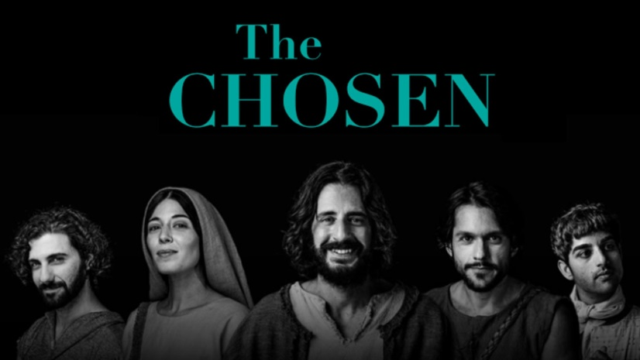
HELP THE INDIVIDUAL BELIEVERS
CORPORATE VISION AND PARTICIPATION
NOT TO BE THEIR LAST PRIORITY

Slide 25
GET INVOLVED IN THE RIVER OF
CHANGE – NOT JUST CIVILIAN AFFAIRS
No one serving as a soldier gets involved in civilian affairs--he wants to please his commanding officer.
2 Timothy 2:4 (NIV)
Corporate Intercession
Hosting The Presence of the Lord
LifeGroups
Leading A Bible Study
Children’s Ministry
Serving At a Gate of Influence
Youth Ministry
Sound/ Video
Women’s Ministry
Men’s Ministry
Social Media / Radio TV

Slide 26
We’re Not Going To Allow The Enemy or the Culture
Or the Problem To Steal Our Families Destiny
The thief comes only to steal and kill and destroy; I have come that they may have life, and have it to the full. John 10:10 (NIV)
²⁶ My flesh and my heart may fail, but God is the strength of my heart and my portion forever. Psalm 73:26 (NIV)

Slide 27
Consequently, LifeGate is determined to break the religious limitation off of our church and region by Hosting God’s Presence and Obeying His leading as we stand at the gates of influence and love each other through the battles.
Here’s Our Negatives
WE ARE EXPECTATION-CHALLENGED
The culture we have to overcome is one where we have all been born and bread on tiny tired prayer meetings – that do not expect Heaven’s immediate intervention - Good can some times happen but not the BEST.
WE ARE PRIORITY-CHALLENGED
Our Corporate Church engagement is like – “Yeah I’ll do that if I get the time or my calendar opens up – my family is too important and busy- I’m exhausted.

Slide 28
Consequently, LifeGate is determined to break the religious limitation off of our church and region by Hosting God’s Presence and Obeying His leading as we stand at the gates of influence and love each other through the battles.
Here’s Our Positives
WE ARE FREE TO CHART
OUR OWN COURSE
No one is holding LifeGate back we have been given a clean slate – we can develop our own culture of a Jesus –centered Revival and no one can tell us
YOU CAN’T DO THAT
WE ARE YOUNG ENOUGH TO LEARN FROM OUR MISTAKES THROUGH HUMILITY
We already have many Spirit-filled self-starters yet as we step into the unknown and learn as we go and stay humble and teachable WE HAVE NO VESTED INTEREST TO PROTECT THE
MACHINE OF RELIGION

Slide 29
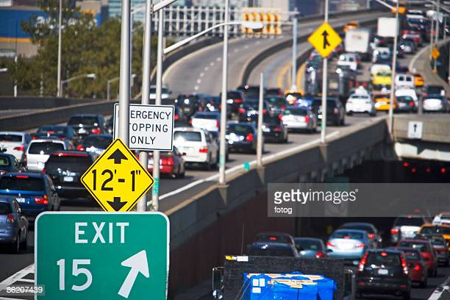
The Exit Ramp For us (FROM ALL THE BUSYNESS AND DRAMA) Personally and Corporately – Is The Manifest Presence and Invasion Of The Holy Spirit
Invasion of Heaven
Without Deep Conviction and Spirit Moving we go around endless seasons of changing the furniture on a sinking ship

Slide 30
HELP THE INDIVIDUAL BELIEVERS
CORPORATE VISION AND PARTICIPATION
NOT TO BE THEIR LAST PRIORITY

Slide 31
Here Is The Scary Part
Of This Kingdom Shift We Are In
Your Friends and Family will tell you “You are part of a cult. This Jesus Kingdom – Holy Spirit revival stuff is way to serious to you and takes up too much of your life.”

Slide 32
God Is Raising Up A Last Days Army – Jesus-Centered
Full Of The Holy Spirit That Will Not Quit Or Discount Itself
But Be Spirit-led - Full Of Integrity, Prayer, and Self-starters
So I prophesied as He commanded me, and breath entered them; they came to life and stood up on their feet--a vast army. Ezekiel 37:10 (NIV)
The people that do know their God shall be strong, and do exploits. Daniel 11:32b (KJV)
"On that day I will make the leaders of Judah like a firepot in a woodpile, like a flaming torch among sheaves. They will consume right and left all the surrounding peoples, ⁸ On that day the feeblest among them will be like David, and the house of David will be like God, like the Angel of the LORD going before them. Zechariah 12:6,8 (NIV)
Out of the mouths of babes and infants You have established strength because of Your foes, that You might silence the enemy and the avenger. Psalm 8:2 (AMP)
"And I will pour out on the house of David and the inhabitants of Jerusalem a spirit of grace and supplication. Zechariah 12:10 (NIV)

Slide 33
Persistence, resistance, insistence
But let us not despair. Let us remember that as the Body of Christ begins to move in that which God has revealed through the Word and by the Holy Spirit that the heavenly host of God are being instructed as their role to support the Church. Let us remember that we are in the middle of a battle against spiritual wickedness in heavenly places against principalities against powers and against the world rulers in this present darkness. And it is the Sword of the Spirit, which is the Word of God, accompanied by Spirit-filled prayer in the church that these heavenly hosts get their assignments and become the effective weapons in the unseen realm leveraged to bring victory as the Church moves in the power of God's Word and the enemies of God are being instructed as to their place, however unwillingly, they are under Christ's feet. T. Austin Sparks

Slide 34
HOW DO WE MAKE THIS PERSONAL?
1. You are in a great SHIFT – be aware how God is refining your heart and changing the CULTURE of LifeGate and the American Church.
2 . Pray without ceasing for fresh fillings of the Holy Spirit
3. Do not get into the flesh – if you are offended– STAY ABOVE THE FLESH through the Holy Spirit.
4. Expect God to come through in your battles. (Positive confession of faith)
5. SUBMIT YOUR PERSONAL CALENDAR and cultural bondage to the Holy Spirit’s glory and let Him burn up the dross – preparing you to host His presence with the Body of Christ
6. Look for Destiny partners who will stand with you in the battle.

