Slide 1
Sermon For LifeGate
Sunday, September 24, 2023

Slide 3
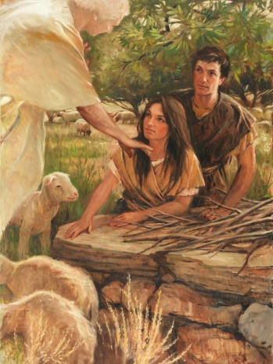
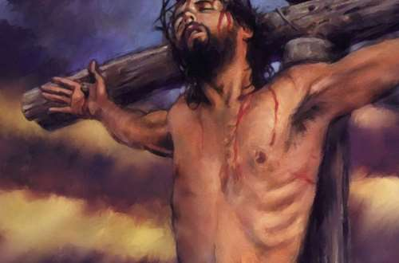
Today Is The Day Of Atonement
²⁶ The LORD said to Moses, ²⁷ "The tenth day of this seventh month is the Day of Atonement. (KIPPOOR – to cover – remove – cancel) Hold a sacred assembly and deny yourselves, and present an offering made to the LORD by fire. Leviticus 23:26-27 (NIV)
First Day Of Atonement
Genesis 3
Adam and Eve
Instituted in Israel in 1300 B.C.
Ultimate Fulfillment 33 A.D.
When he had received the drink, Jesus said, "It is finished." With that, he bowed his head and gave up his spirit. John 19:30 (NIV)
I write this to you so that you will not sin. But if anybody does sin, we have one who speaks to the Father in our defense--Jesus Christ, the Righteous One. ² He is the atoning sacrifice for our sins, and not only for ours but also for the sins of the whole world. 1 John 2:1-2 (NIV)

Slide 4
The Preciseness Of Grace
It is not Sloppy “Agape”
“Your sins are forgiven past present and future.”
“Your sins are forgiven in the past if you have turned from them and turned to God in obedience and any you would commit in the present or future are paid for.”
Repent, then, and turn to God, so that your sins may be wiped out, that times of refreshing may come from the Lord, Acts 3:19 (NIV)
For certain men whose condemnation was written about long ago have secretly slipped in among you. They are godless men, who change the grace of our God into a license for immorality and deny Jesus Christ our only Sovereign and Lord. Jude 1:4 (NIV)

Slide 5
The Verse of The Month
Your rigging hangs loose: The mast is not held secure, the sail is not spread. Then an abundance of spoils will be divided and even the lame will carry off plunder. ²⁴ No one living in Zion will say, "I am sick"; and the sins of those who dwell there will be forgiven. Isaiah 33:23-24 (NIV)

Slide 6
The Body – Mind Connection Cannot
Be Overstated
Get The Junk and Gunk Off Your Sacrifice
Therefore, I urge you, brothers, in view of God's mercy, to offer your bodies as living sacrifices, holy and pleasing to God--this is your spiritual act of worship. ² Do not conform any longer to the pattern of this world, but be transformed by the renewing of your mind. Then you will be able to test and approve what God's will is--his good, pleasing and perfect will.
Romans 12:1-2 (NIV)
Mike Obrien 1977

Slide 7
Two Core Kingdom Revelations From
The Book of Habakkuk (We are Going To Pray )
God is after Faith that will overcome The
Unbelief of godless living
DOUBT
"See, he is puffed up; his desires are not upright-- but the righteous will live by his faith-- ⁵ indeed, wine betrays him; he is arrogant
and never at rest. Habakkuk 2:4-5 (NIV)
God is after a people who are overwhelmed by His Glory and live
Holy lives
DESIRE
Has not the LORD Almighty determined that the people's labor is only fuel for the fire, that the nations exhaust themselves for nothing? ¹⁴ For the earth will be filled with the knowledge of the glory of the LORD, as the waters cover the sea. ¹⁵ "Woe to him who gives drink to his neighbors, pouring it from the wineskin till they are drunk, so that he can gaze on their naked bodies. Habakkuk 2:13-15 (NIV)

Slide 8
We Are Praying Like We Have Thirty Years To See Harvest – But We Labor Like We Have Three
May the God of peace, .. ²¹ equip you with everything good for doing his will, and may he work in us what is pleasing to him, through Jesus Christ, to whom be glory for ever and ever. Amen. Hebrews 13:20-21 (NIV)
⁵⁸ Therefore, my beloved brethren, be steadfast, immoveable, always abounding in the work of the Lord, forasmuch as ye know that your labor is not in vain in the Lord. 1 Corinthians 15:58 (KJV)

Slide 9
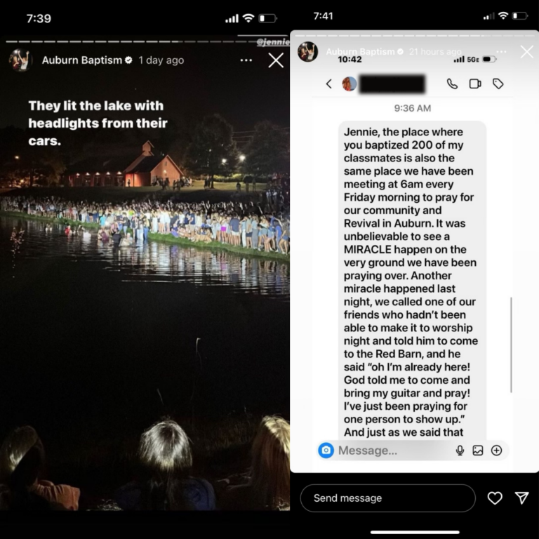

Slide 10
Covenant Protects Us
For wisdom will enter your heart, and knowledge will be
pleasant to your soul. 11 Discretion will protect you, and understanding will guard you. Proverbs 2:7-11

Slide 11
Two Major Things God Is Desiring To Strengthen At LifeGate This Fall
Strengthen Our Vertical With God
Pioneer new levels of Breakthrough Intercession
Strengthen A Culture of Hosting The Presence of The Lord Through Fervent Prayer and Worship
Your rigging hangs loose: The mast is not held secure, the sail is not spread.
Tighten Our Ship
Build stronger “intentional ministry”
Create A Culture of Honoring The Corporate Gathering of The Saints and “Respecting” the Property and Building He Has blessed us with

Slide 12
Consequently, LifeGate is determined to break the religious limitation off of our congregation and region by Hosting God’s Presence and Obeying His leading as we stand at the gates of influence and love each other through the battles.
Here’s Our Negatives
WE ARE EXPECTATION-CHALLENGED
WE ARE PRIORITY-CHALLENGED

Slide 13
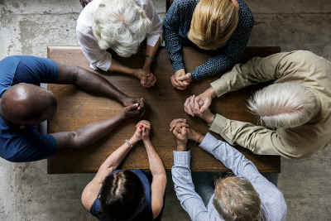
Consequently, LifeGate is determined to break the religious limitation off of our church and region by Hosting God’s Presence and Obeying His leading as we stand at the gates of influence and love each other through the battles.
Here’s Our Positives
WE ARE FREE TO CHART
OUR OWN COURSE
WE ARE YOUNG ENOUGH TO LEARN FROM OUR MISTAKES THROUGH HUMILITY

Slide 14
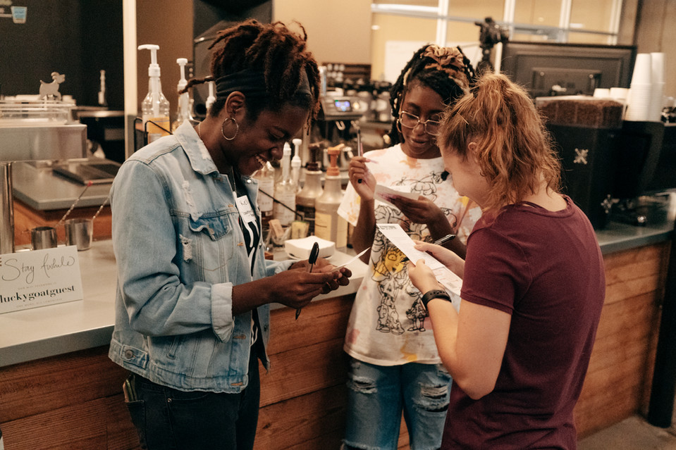
We Are In A Paradigm Shift
It Requires All Hands On Deck
It’s The Saints
Engaged In The Earth That Are Going To Make The Difference
I said to the LORD, "You are my Lord; apart from you I have no good thing." ³ As for the saints who are in the land, they are the glorious ones in whom is all my delight. Psalm 16:2-3

Slide 15
Make The Vision Clear
Then the LORD replied: "Write down the revelation and make it plain on tablets so that a herald may run with it. Habakkuk 2:2 (NIV)

Slide 16
Discipling LifeGate Into Future HARVEST
And Into An Intentional Healthy Culture
Culture of Hosting The Presence of The Lord Through Prayer and Worship
Culture of Putting Christ In The Center of Everything
Culture of Boldly Proclaiming The Eternal Word Of God
Culture of Discipleship and Growth In Grace
Culture of Honor – God – WORD - Time – His House
Culture of Harmony Between Spirit-Led and Intentional Practical Strategies For Keeping Our House In Order
Culture of Family-Centered Ministry
That touches the Gates of Influence

Slide 18
Where We Are Going Requires A Shift
Of INTENTIONALITY
Here’s How It Works To Accomplish A Mission
Set Forth A CLEAR Vision – and goal to victory
Celebrate the victories and learn from the mistakes
Family
Home-schooling
Church ministry
Business
Give A Strong Direction and Set Minimal Boundaries and goals to get to the target
Re-inforce and hold accountable those on the mission

Slide 19
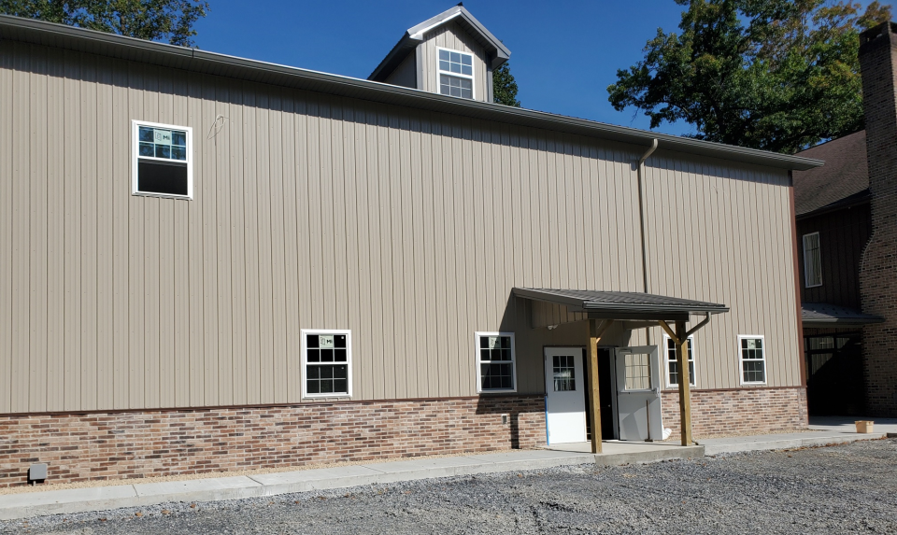
We Are About To Double Our Size
Of Building
We can double our chaos
Or we can double our blessing
We can double our places to run and play and have fun
Or we can double our ability to make warriors our of our children and youth
And we can double our prayer army in hosting the presence of the Lord and bringing His glory into our region

Slide 20
Where We Are Going Requires A Shift
Of INTENTIONALITY FOR PRAYER
Specifically For LifeGate
We Will continue to
Lay out the vision and invite everyone of you into the INTERCESSORY MOVEMENT That will host the Presence of the Lord and Shake the darkness off our land
Celebrate the victories and learn from the mistakes
More prayer warriors are needed –
Sacrifice to get into the Presence of the Lord corporately – change your schedule
Become a GOD-CHASER with us
Re-inforce and hold each other accountable to
This shift

Slide 21
Where We Are Going Requires A Shift
Of INTENTIONALITY FOR MINISTRY
Specifically For LifeGate
Family-Centered
Children’s and Youth Ministry
That is dynamic
Spirit-filled and
Life-giving
Celebrate the victories and learn from the mistakes
More Laborers needed –
Increased honor and respect from
Children – tools to help teachers and leaders – be dynamic
And scalable
Re-inforce and hold accountable that our culture
Is changing

Slide 22
GET INVOLVED IN THE RIVER OF
CHANGE – NOT JUST CIVILIAN AFFAIRS
No one serving as a soldier gets involved in civilian affairs--he wants to please his commanding officer.
2 Timothy 2:4 (NIV)
Corporate Intercession
Hosting The Presence of the Lord
LifeGroups
Leading A Bible Study
Children’s Ministry
Serving At a Gate of Influence
Youth Ministry
Sound/ Video
Women’s Ministry
Men’s Ministry
Social Media / Radio TV

Slide 23
Don’t Discount Yourself – God is Strongly Urging And Calling
Everyone to Himself – The Prodigals – The Backsliders – The Weak – The Strong … Everyone
Next Sunday – October 1st
Preach A powerful sermon To the Youth And Children
Sign-up sheet for Youth Ministry (Wednesday nights)
Sign-up sheet for Children’s ministry (Sunday Mornings)
Sign-up sheet for Play ground helper
Sign-up sheet for Hall Monitors
Sign-up sheet for Coffee-Time helpers – Once a month Coffee time from 9:30 AM – 9:50 AM
Sign-up sheet for Ushers to help seat people

