Slide 1
“the earth will be full of the knowledge of the LORD as the waters cover the sea.”
Isaiah 11:9

Slide 2
This Photo by Unknown Author is licensed under CC BY

Slide 3
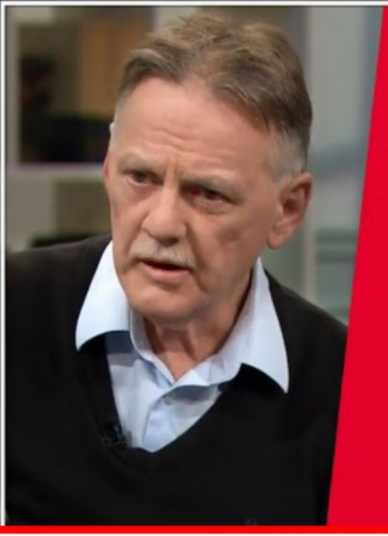
Mike O’brien
100Huntley - YouTube

Slide 4
“The heavens declare the glory of God; the skies proclaim the work of his hands.
Day after day they pour forth speech; night after night they reveal knowledge.”
Psalm 19:1-2

Slide 6
I. The Lord wants to restore the JOY of the knowledge of Him.
The word “JOY” appears over 200 times in scripture; “rejoice” appears over 200 times
Joy is one of the nine fruits of the Spirit, cultivated in the Christian’s life through the Holy Ghost

Slide 9
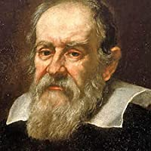
“Mathematics is the language in which God has written the universe”
― Galileo Galilei
https://www.youtube.com/watch?v=nt2OlMAJj6o

Slide 10
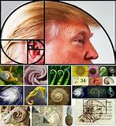
Places You Won't Believe The Golden Ratio & Fibonacci Sequence Appears
BE AMAZED

Slide 11
II. The Lord desires righteous self-government
Knowledge of the Lord brings about inner peace and the ability to live peacefully with others. (Romans 14:17)

Slide 12
“Whoever is slow to anger is better than the mighty, and he who rules his spirit better than he who takes a city.” (Proverbs 16:32 )

Slide 14
III. The Lord wants us not to be deceived

Slide 15
”Let no one deceive you in any way. For that day will not come, unless the rebellion comes first, and the man of lawlessness^{[b]} is revealed, the son of destruction,^{[c]} ⁴ who opposes and exalts himself against every so-called god or object of worship, so that he takes his seat in the temple of God, proclaiming himself to be God…”
(2 Thessalonians 2:3-5)

Slide 16
“And then the lawless one will be revealed, whom the Lord Jesus will kill with the breath of his mouth and bring to nothing by the appearance of his coming. ⁹ The coming of the lawless one is by the activity of Satan with all power and false signs and wonders, ¹⁰ and with all wicked deception for those who are perishing, because they refused to love the truth and so be saved. ¹¹ Therefore God sends them a strong delusion, so that they may believe what is false, ¹² in order that all may be condemned who did not believe the truth but had pleasure in unrighteousness. (2 Thessalonians 2:8-12)

Slide 18
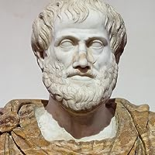
“It is the mark of an educated mind to be able to entertain a thought without accepting it.”
― Aristotle, Metaphysics

Slide 19
“The first to state his case seems right until another comes and cross-examines him.” (Proverbs 18:17)

Slide 20
“Has it ever struck you as odd, or unfortunate, that today, when the proportion of literacy is higher than it has ever been, people should have become susceptible to the influence of advertisement and mass propaganda to an extent hitherto unheard of and unimagined?”
-Dorothy Sayers, 1947

Slide 21
“For we let our young men and women go out unarmed, in a day when armour was never so necessary. By teaching them all to read, we have left them at the mercy of the printed word. By the invention of the film and the radio, we have made certain that no aversion to reading shall secure them from the incessant battery of words, words, words. They do not know what the words mean; they do not know how to ward them off or blunt their edge or fling them back; they are a prey to words in their emotions instead of being the masters of them in their intellects.”
-Dorothy Sayers, 1947 speech at Oxford University

Slide 22
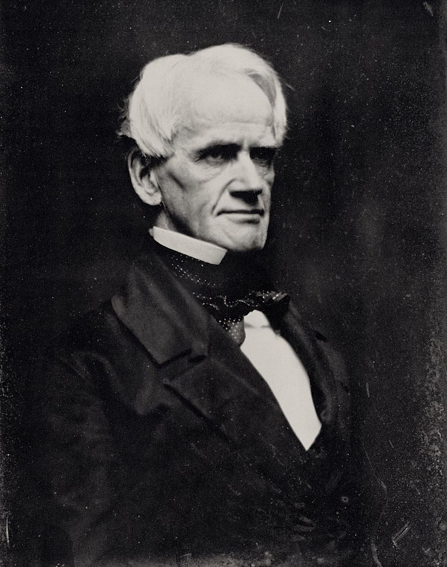
A group of Boston Unitarians led by Horace Mann traveled to Europe and brought back a system of education to the United States, modeled after the Prussian military.

Slide 23
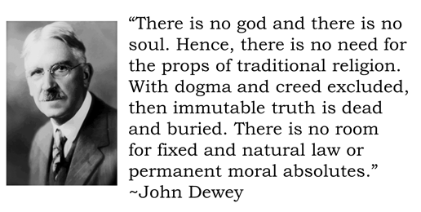
“Here are all the elements for a religious faith that shall not be confined to sect, class, or race. Such a faith has always been the common faith of mankind. It remains for us to make it explicit and militant”
– John Dewey, on Secular Humanism

Slide 24
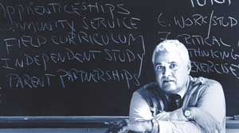
“Slowly I began to realize that the bells and the confinement, the crazy sequences, the age-segregation, the lack of privacy, the constant surveillance, and all the rest of the national curriculum of schooling were designed exactly as if someone had set out to prevent children from learning how to think and act, to coax them into addiction and dependent behavior.”
John Taylor Gatto, three-time Teacher of the Year Award recipient of NYC public schools; 1991 New York State Teacher of the Year Award

Slide 25
“One of the first things a family tries to teach its children is the difference between good and evil, right and wrong. One of the first things our schools do is destroy that distinction.”
John Taylor Gatto
Although teachers do care and do work very, very hard, the institution is psychopathic-it has no conscience. It rings a bell and the young man in the middle of writing a poem must close his notebook and move to a different cell where he must memorize that humans and monkeys derive from a common ancestor.
John Taylor Gatto

Slide 26
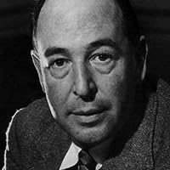
“I was at this time living, like so many Atheists or Antitheists, in a whirl of contradictions. I maintained that God did not exist. I was also very angry with God for not existing. I was equally angry with Him for creating a world.”
― C.S. Lewis

Slide 27
IV. The Lord wants us to be mature in our thinking and prosper in wisdom and character and liberty

Slide 28
Buy truth, and do not sell it, Get wisdom, instruction, and understanding. (Proverbs 23:23)
“You shall know the truth and the truth shall set you free” (John 8:32)
“Where the Spirit of the Lord is there is liberty” (2 Corinthians 3:17

Slide 29
“We declare God’s wisdom, a mystery that has been hidden and that God destined for our glory before time began. ⁸ None of the rulers of this age understood it, for if they had, they would not have crucified the Lord of glory. ⁹ However, as it is written:
“What no eye has seen, what no ear has heard, and what no human mind has conceived”^{[b]}— the things God has prepared for those who love him—
¹⁰ these are the things God has revealed to us by his Spirit.
The Spirit searches all things, even the deep things of God.”
(1 Corinthians 2:7-10)

Slide 30
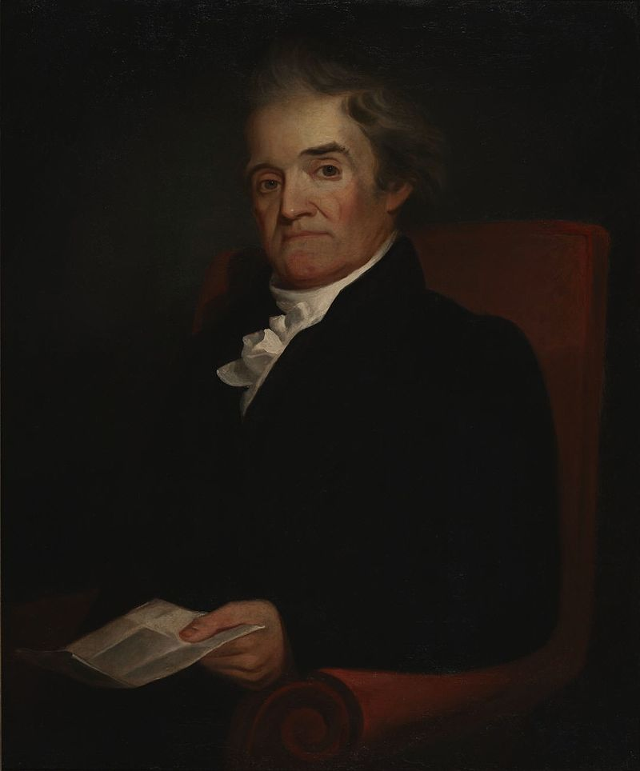
“Any system of education...which limits instruction to the arts and sciences and rejects the aids of religion in forming the character of citizens, is essentially defective.” Noah Webster

Slide 31
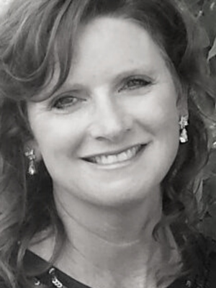
“Education that aims to cultivate a soul includes intentional lessons and methodology that will guide the student increasingly down the path of virtue.” (Shelly Stockton, Classical Educator and award-winning Composer)

Slide 32
Virtue: goodness, power, from the Latin virtus, manliness, worth; general: moral excellence, right action and thinking (Webster’s New World Dictionary, 1962)

Slide 34
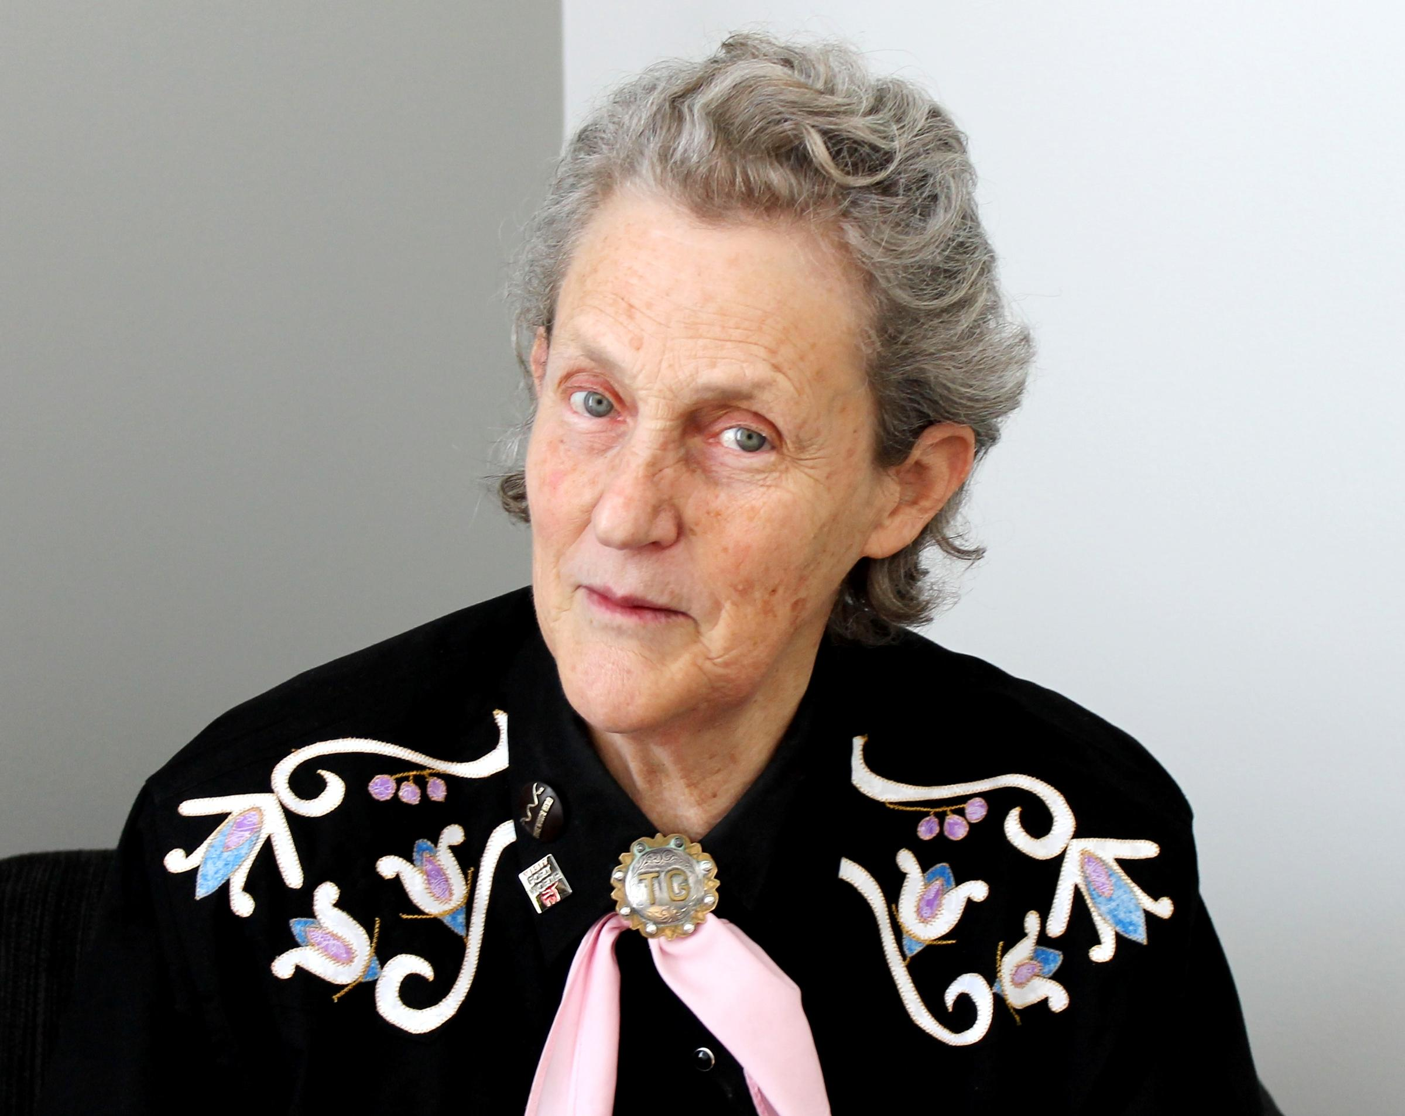
Dr. Temple Grandin

Slide 36
V. Action Steps
A. Set goals
B. Ask for the Holy Spirit’s help and illumination
C. Give yourself – and others – grace to change your/their mind(s)
D. (Homework!)

Slide 37
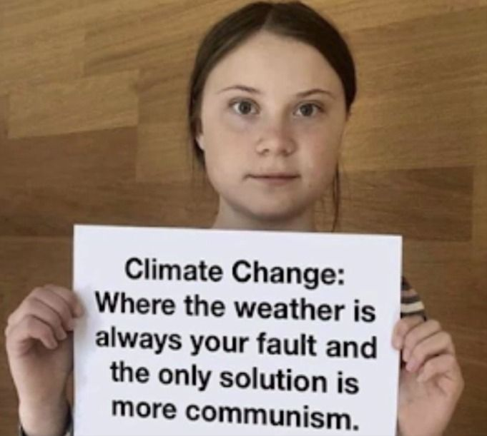

Slide 38
Homework
sequere pecuniam and cui bono?
What does the Bible say about climate change?
Where is land pollution mentioned in the Bible and what causes it?
What are the spiritual powers (i.e. Ephesians 5) behind Climate Change? (hint: Gaia)
Which countries are the worst offenders when it comes to pollution? Are they part of the International Climate Summit?

Slide 39
Who or what entities does climate change benefit? (Cui Bono?)
Who is funding climate research?
In which decade was the phrase “global cooling” coined?
What is weather manipulation and is it affecting climate change? Which state(s) can you apply for a permit to modify the weather?

