Slide 1
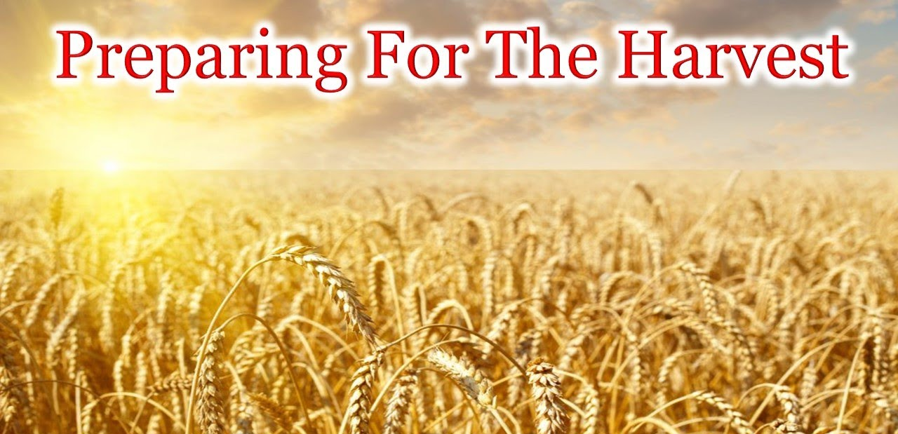
Sermon For LifeGate
Sunday, September 24, 2023

Slide 2
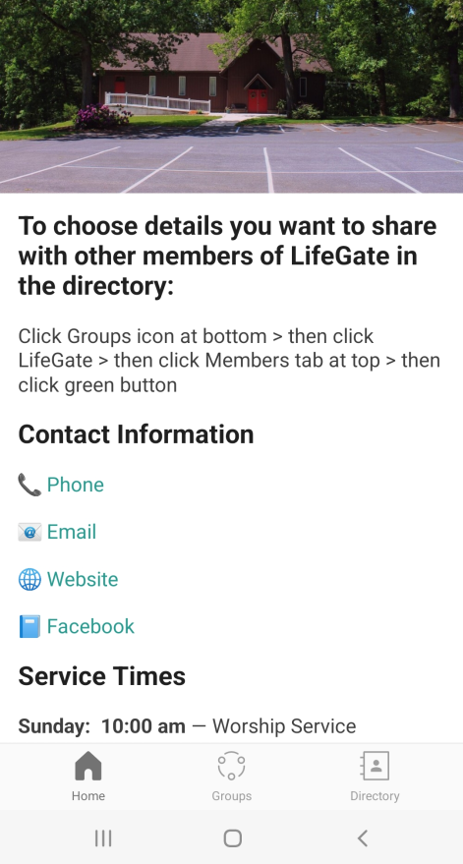
Tutorial On LifeGate App
Open and
Authenticate
Choose
LifeGate as Church
Go to your App Store
Choose Church Center App

Slide 3
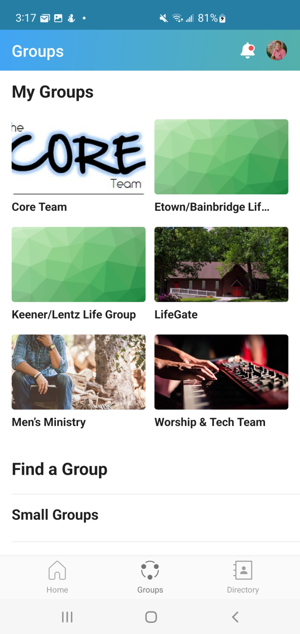

Slide 4
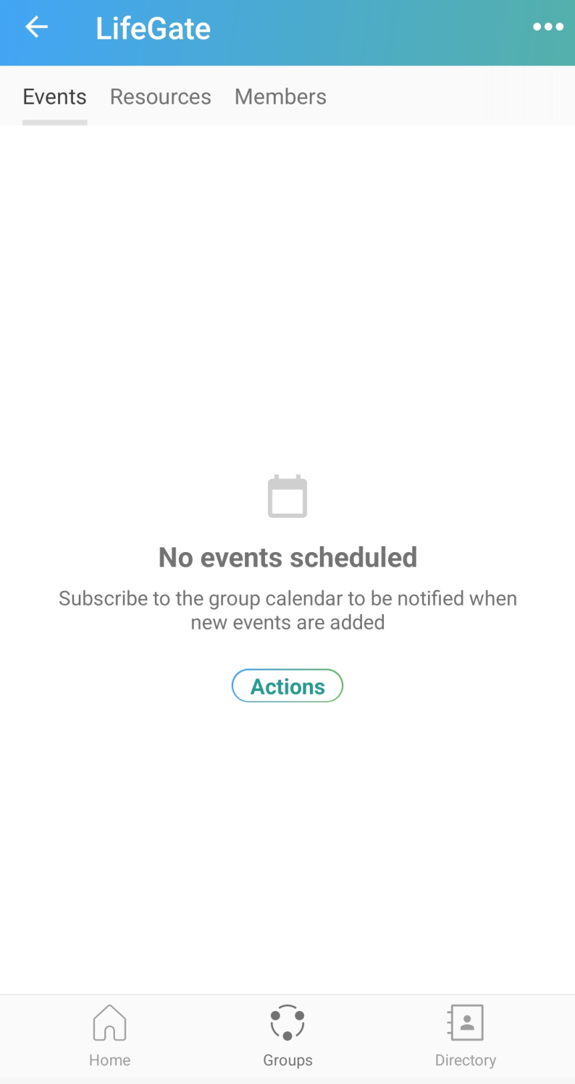
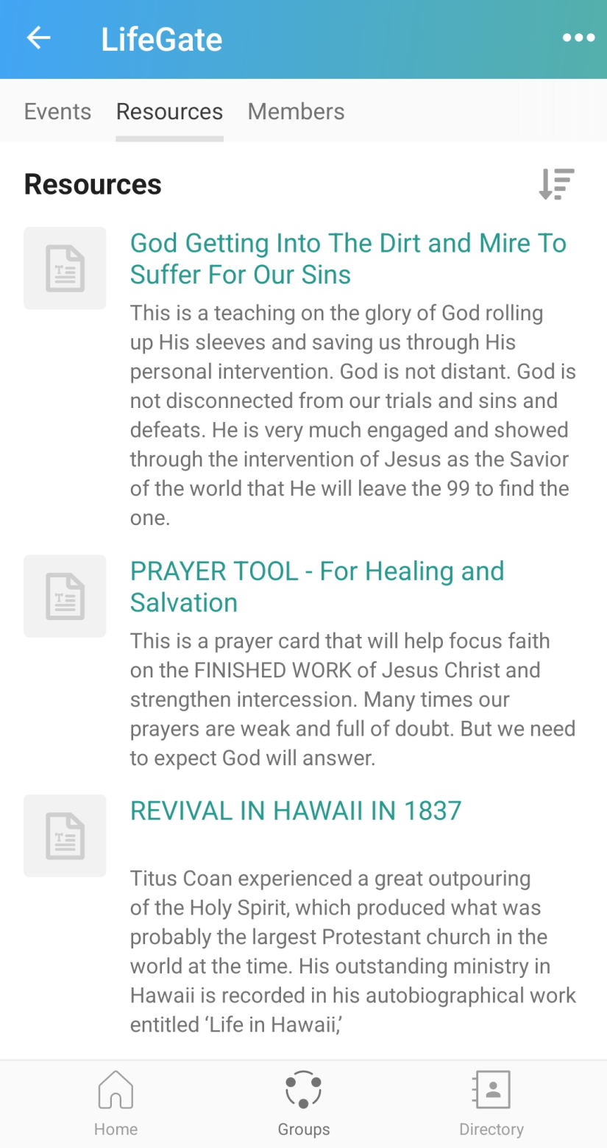

Slide 5
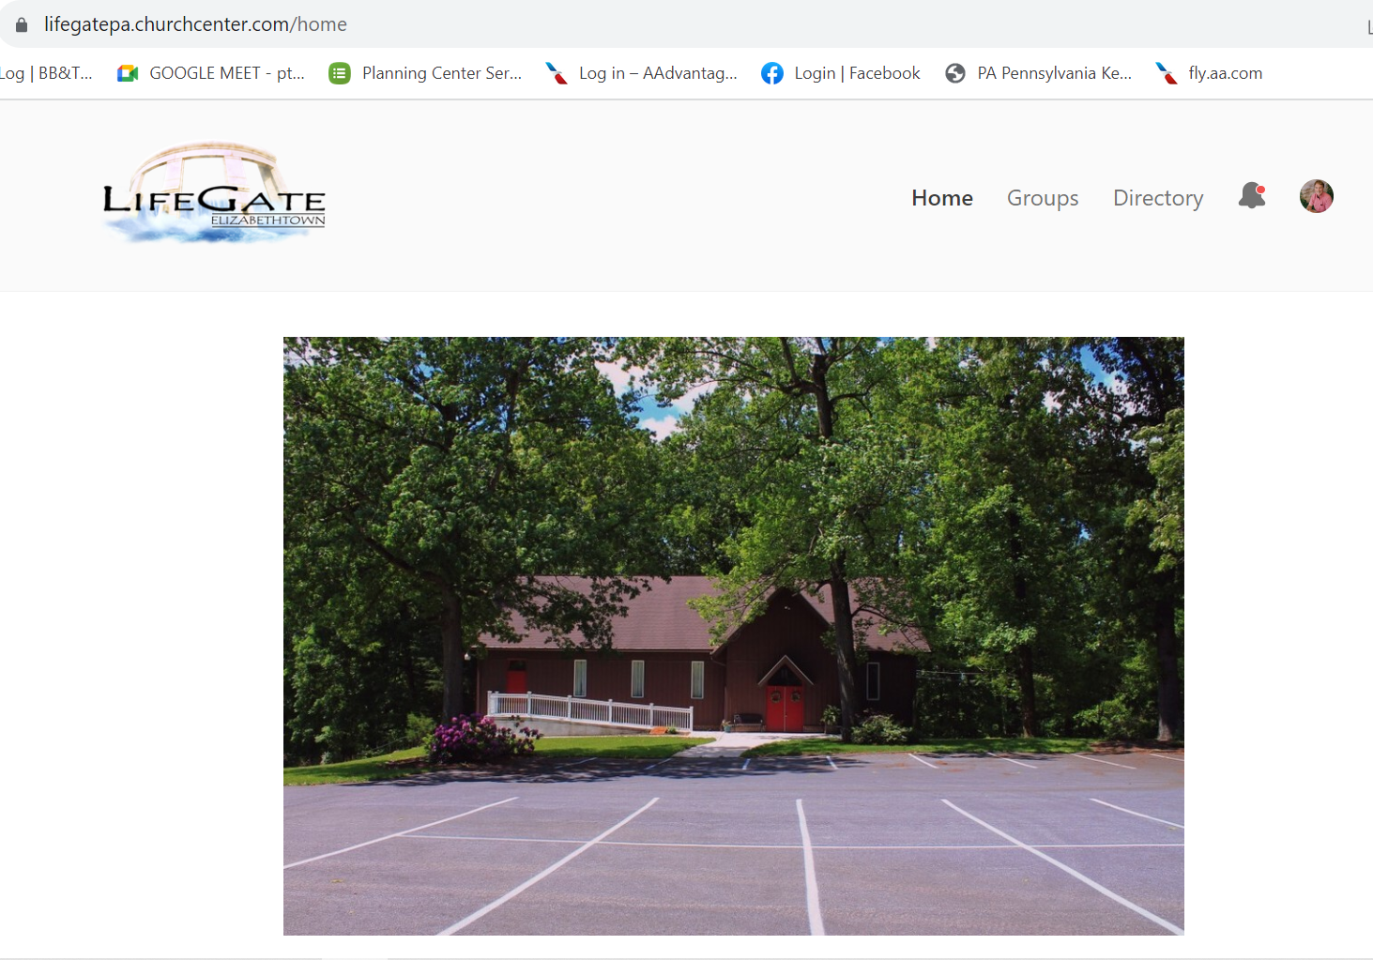

Slide 6
We Are Praying Like We Have Thirty Years To See Harvest – But We Labor Like We Have Three
Wells Dug by Man and primed by Man
May the God of peace, .. ²¹ equip you with everything good for doing his will, and may he work in us what is pleasing to Him, through Jesus Christ, to whom be glory for ever and ever. Amen. Hebrews 13:20-21 (NIV)
Steadfast, Immovable. Always Abounding

Slide 7
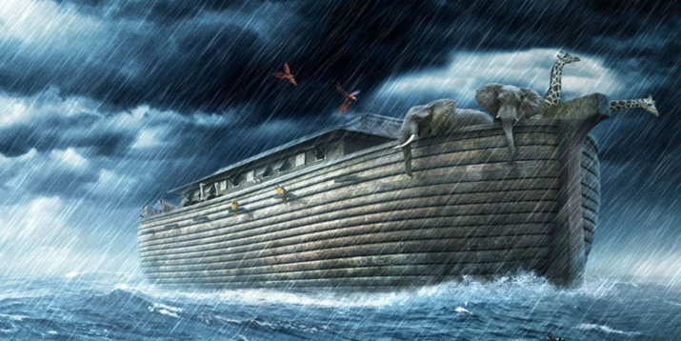
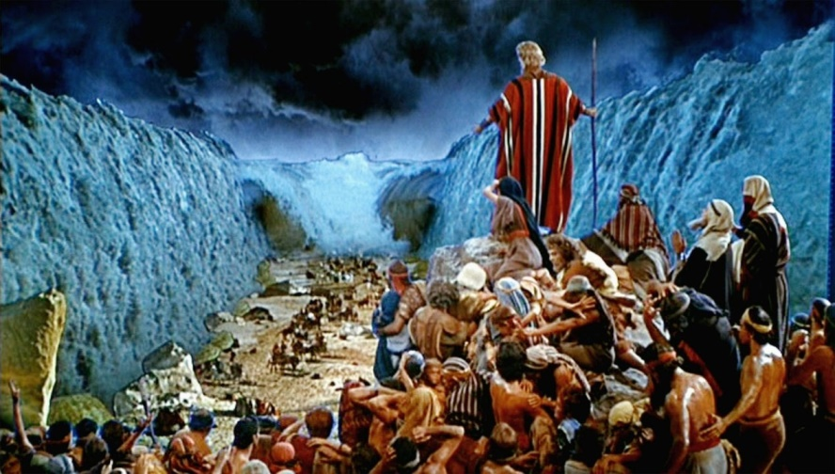
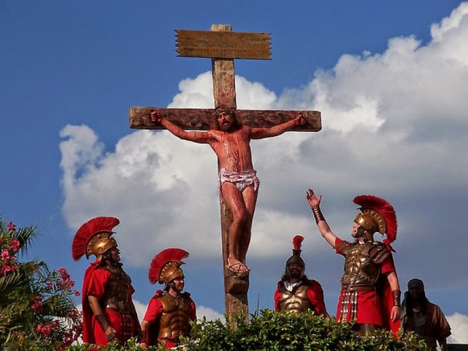
Greatest Interventions of All Time
Noah’s Ark
The Exodus
The Cross Of Christ
Intervention In The Shaking

Slide 8
Make The Vision Clear
Then the LORD replied: "Write down the revelation and make it plain on tablets so that a herald may run with it. Habakkuk 2:2 (NIV)

Slide 9
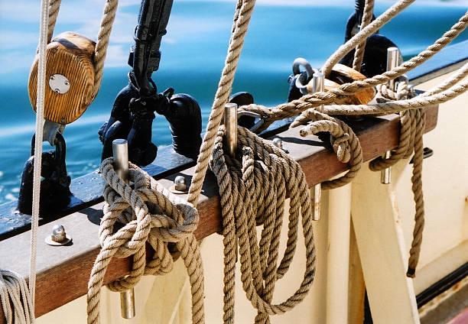
Two Major Things God Is Desiring To Strengthen At LifeGate This Fall
Strengthen Our Vertical With God
Pioneer new levels of Breakthrough Intercession
Strengthen A Culture of Hosting The Presence of The Lord Through Fervent Prayer and Worship
Your rigging hangs loose: The mast is not held secure, the sail is not spread.
Tighten Our Ship
Build stronger “intentional Children ministry”
Create A Culture of Honoring The Corporate Gathering of The Saints and “Respecting” the Property and Building He Has blessed us with

Slide 10
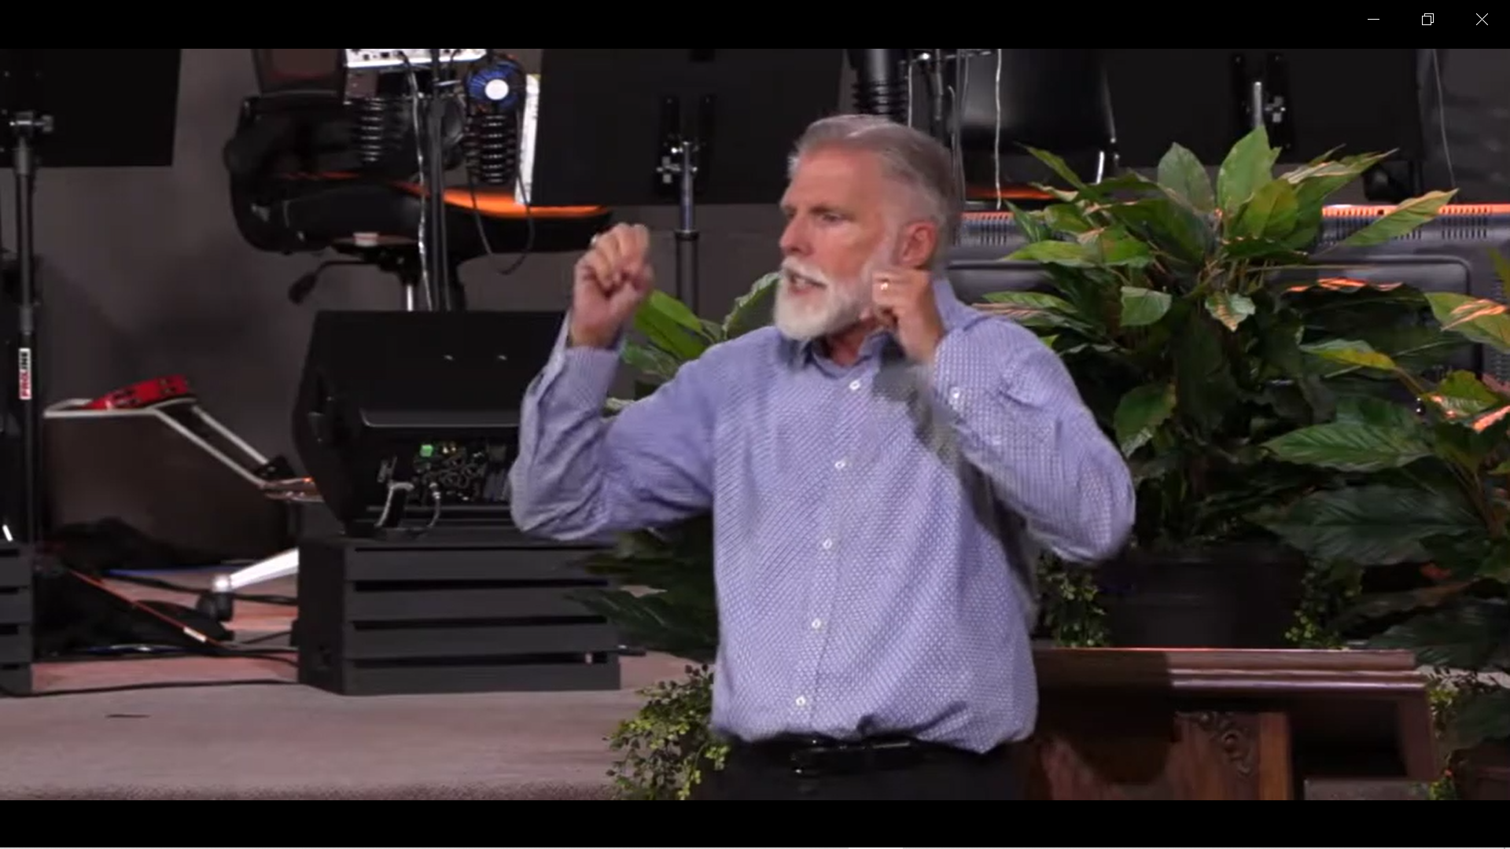
The Prayer Vision
Hosting His Presence

Slide 11
Strengthening Our Youth
And Children For Revival
Esther
David
Samuel
Mary

Slide 12
Ten Year Old Sensitive To God
“A Hand On My Shoulder”
It was a summer evening I was Outdoors playing with my older sister playing under the street light in front of the home we were having a lively time of laughter and fun when suddenly I felt a familiar touch of the Lord in my heart and the feeling of need to call upon God soaked over me. Scarcely knowing what to do I began to repeat the Lord's Prayer over and over again it continued with an intensity that I began to perspire
A group of men were carrying my older brother into the house he had been terribly burned by an explosion by fireworks for 4th of July celebration. In the midst of my sadness I thank God that he would count me worthy to lay a burden prayer upon me small and weak as I was and again I began to repeat the Lord's Prayer I have learned that many times God can lay a burden of prayer on a child and that God can even call a child to pray and he will answer. My brother recovered completely even without a scar.

Slide 13
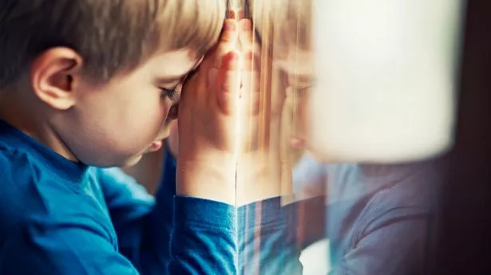
The Revival In Scotland 1860
Impacted Pre-Schoolers
Preschoolers joined older children in deep worship that caused their faces to shine and their feet to dance. Often a spirit of conviction would rest upon them after listening to their Bible story, given in by their teacher with great fervency. At such time, there would be weeping around the altar. And among them moved the slight red-haired girl whose spirit flamed with zeal.
Come, sir, come! the girls in the school are all crying for mercy.' When I entered, some were lying on the floor, some in the arms of the teacher, some in the arms of the monitor, some in the arms of other children; floods of tears were flowing; confession of sin was freely made from little broken hearts; cries for mercy to God; prayers for Jesus to come and save them; earnest prayers for the Holy Spirit to come and take the hard heart out of them, and give them a heart of flesh.

Slide 14
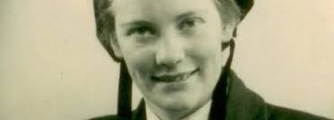
The 1949 Hebrides Revival and the Youth
In the public schools in the 1940’s the children learned Bible stories from their unconverted teachers. Students were also taught the short version of the Westminster Catechism, as well as how to sing many of the Psalms. They were also required to memorize the Ten Commandments and many other selected passages of scripture—but there was no life in it. It was all formality and dead tradition.
But, I was in the mainland of Scotland when the revival broke out, and my immediate reaction was, “I’m not going back to Lewis until this revival is over. They were religious enough already, and I don’t want to become involved. I have my own life, my own ambitions.”
Mary Peckman
From Fishing Family
How glad I am that there were men and women like that in Lewis. When I was away in the world, singing at concerts, dancing in Glasgow, not interested in God, not going to any church. How glad I am that there were men and women who believed God.

Slide 15
Why The Urgency?
We Sense God is strengthening our net to hold more fish as He helps us bring in the HARVEST
"Enlarge the place of your tent, stretch your tent curtains wide, do not hold back; lengthen your cords, strengthen your stakes. ³ For you will spread out to the right and to the left; your descendants will dispossess nations and settle in their desolate cities. Isaiah 54:2-3 (NIV)

Slide 16
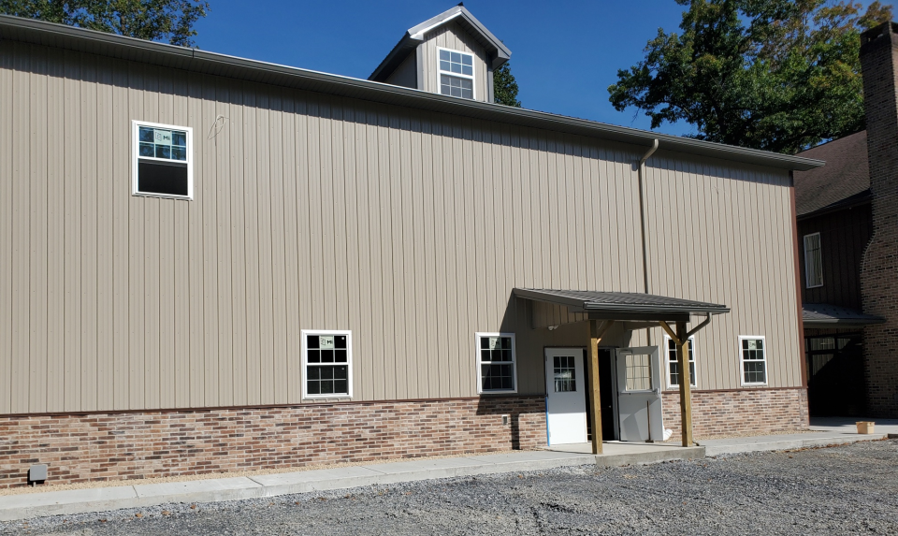
We Are About To Double Our Size
Of Building
We can double our chaos
Or we can double our blessing
We can double our places to run and play and have fun
Or we can double our ability to make warriors our of our children and youth
And we can double our prayer army in hosting the presence of the Lord and bringing His glory into our region

Slide 17
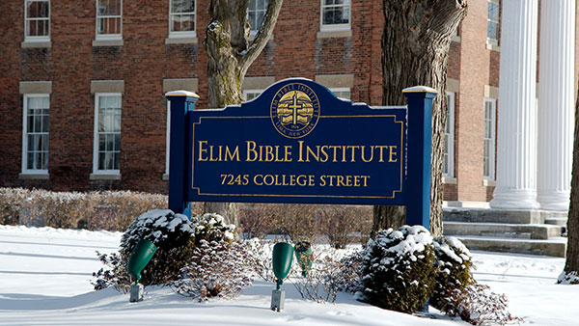
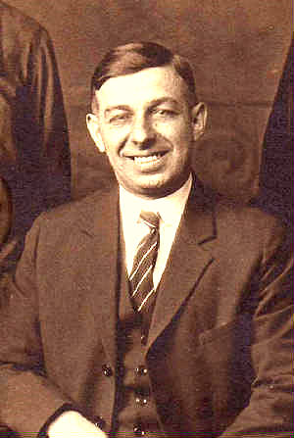
Balance Is Required To Be Healthy
Ivan
Spencer
At such times, God would balance Ivan's leniency with the gift of government, perhaps bringing into play the gift of wisdom, knowledge, or discernment.
Leniency (Grace)
Government (Law)
Laziness, Disrespect
Chaos
fear, control
rigid

Slide 18
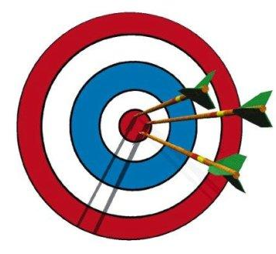
Where We Are Going Requires A Shift
Of INTENTIONALITY FOR MINISTRY
Specifically For LifeGate
Family-Centered
Children’s and Youth Ministry
That is dynamic
Spirit-filled and
Life-giving
Celebrate the victories and learn from the mistakes
More Laborers needed –
Increased honor and respect from
Children – tools to help teachers and leaders – be dynamic
And scalable
Re-inforce and hold accountable that our culture
Is changing – Stronger Organization – communication – tools to teach with

Slide 19
Knowing How To Shift Gears
In Life and Corporate Settings
Consider therefore the kindness (goodness) and sternness (severity) of God: Romans 11:22 (NIV)
FOCUS METER
Fun/ giggly – earthly
Serious, thoughtful spiritual
Shallow
Amusement
Reflective
consideration

Slide 20
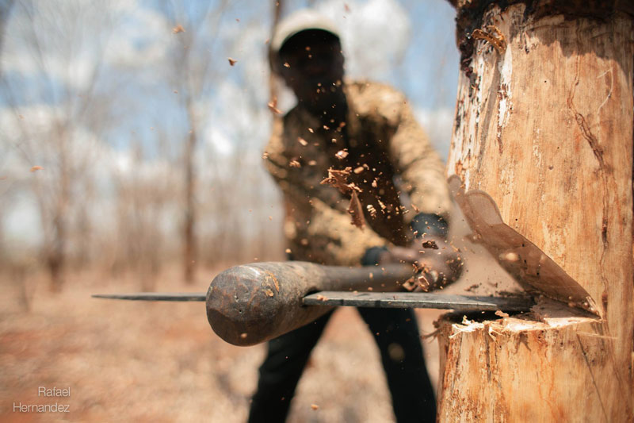
The Cooperation Of Building With God
The “Chop” that was heard round the world
So God said to Noah, "I am going to put an end to all people, for the earth is filled with violence because of them. I am surely going to destroy both them and the earth. ¹⁴ So make yourself an ark of cypress wood; make rooms in it and coat it with pitch inside and out. Genesis 6:13-14 (NIV)
Noah did everything just as God commanded him. Genesis 6:22 (NIV)

Slide 21
The Four Main Rules For LifeGate
Youth and Children
LifeGate Children’s Ministry
1
2
God, Parents, Teachers
Teachers, Each Other , Building
3
4
To ask a question or
to be dismissed

Slide 22
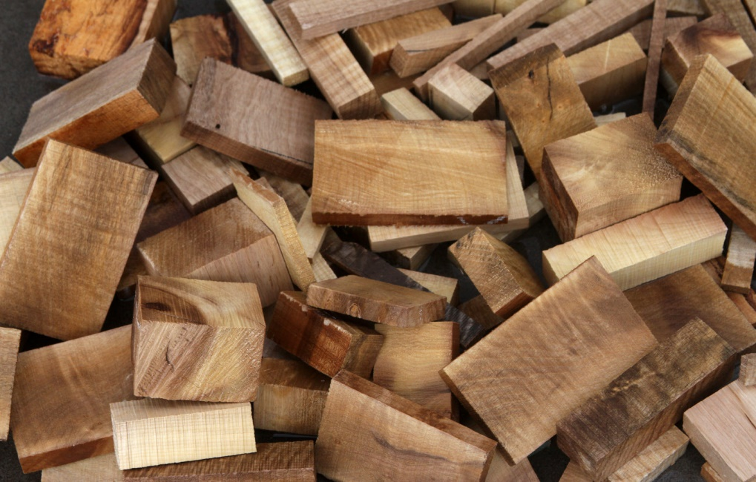
Which One Of The Four Main Rules For LifeGate
Do You Struggle With The Most
Pick Up A Block Of Wood And Write On It The Word

Slide 23
LifeGate Laboring Together
Sign-up sheet for Youth Ministry (Wednesday nights)
Sign-up sheet for Children’s ministry (Sunday Mornings)
Sign-up sheet for Play ground helper
Sign-up sheet for Hall Monitors
Sign-up sheet for Coffee-Time helpers – Once a month Coffee time from 9:30 AM – 9:50 AM
Sign-up sheet for Ushers to help seat people

Slide 24
Sunday Ministry
15 Servants Needed
6 – 8 Grade | 3 – 5 Grade | 1 -2 Grade | Pre-K | Toddlers 2-3 | Infants
2 | 2 | 2 | 2 | 2 | 1
Ushers | Hall/ Gym Monitors
2 | 2

Slide 25
HOW DO WE MAKE THIS PERSONAL?
1. You are in a great SHIFT (A GREAT INTERVENTION) – be aware how God is refining your heart and changing the CULTURE of LifeGate and the whole American Church.
2 . Pray without ceasing for fresh intensified fillings of the Holy Spirit and help us at LifeGate as we HOST HIS PRESENCE.
3. Get Involved ‘AS UNTO THE LORD” to hasten His coming (2 Peter 3:12) with a few of LifeGate’s ministries
4. Become a Destiny Partner with LifeGate and Look for Destiny Partners who will stand with you in the battle as well. (Remember King Samson)

