Slide 1
PREPARING TO POSSESS THE KINGDOM
Sermon For LifeGate
Sunday, October 22, 2023

Slide 2
Lord Everything Feels Like We are Picking At A huge Iceberg with a toothpick – Tom Jones

Slide 3
As I watched, this horn was waging war against the saints and defeating them, ²² until the Ancient of Days came and pronounced judgment in favor of the saints of the Most High, and the time came when they possessed the kingdom. Daniel 7:21-22 (NIV)
⁴ But now be strong, O Zerubbabel,' declares the LORD. 'Be strong, O Joshua son of Jehozadak, the high priest. Be strong, all you people of the land,' declares the LORD, 'and work. For I am with you,' declares the LORD Almighty. ⁵ 'This is what I covenanted with you when you came out of Egypt. And my Spirit remains among you. Do not fear.' ⁶ "This is what the LORD Almighty says: 'In a little while I will once more shake the heavens and the earth, the sea and the dry land. ⁷ I will shake all nations, and the desired of all nations will come, and I will fill this house with glory,' says the LORD Almighty. ⁸ 'The silver is mine and the gold is mine,' declares the LORD Almighty. ⁹ 'The glory of this present house will be greater than the glory of the former house,' says the LORD Almighty. 'And in this place I will grant peace,' declares the LORD Almighty." Haggai 2:4-9 (NIV)

Slide 4
Today’s Word For LifeGate
High Probability of Pushing Some Of Your Buttons
Preparing the Ground For:
Story About Divine Providence
A Warning To Check Your Filters
A Truth Nugget For Singles
A Truth Nugget For Couples
Four Bible Stories

Slide 5
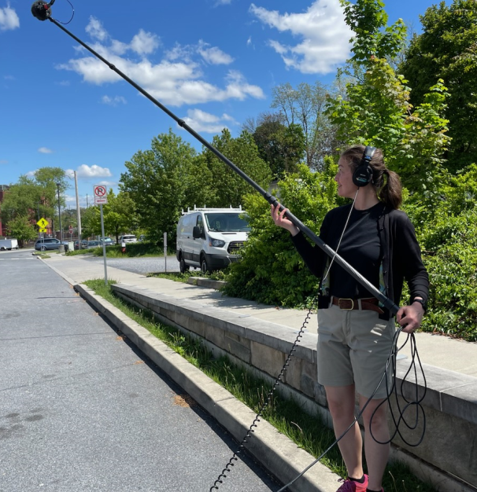
Unusual Divine Providence
Spokane Washington
Lumia
Auberi

Slide 6
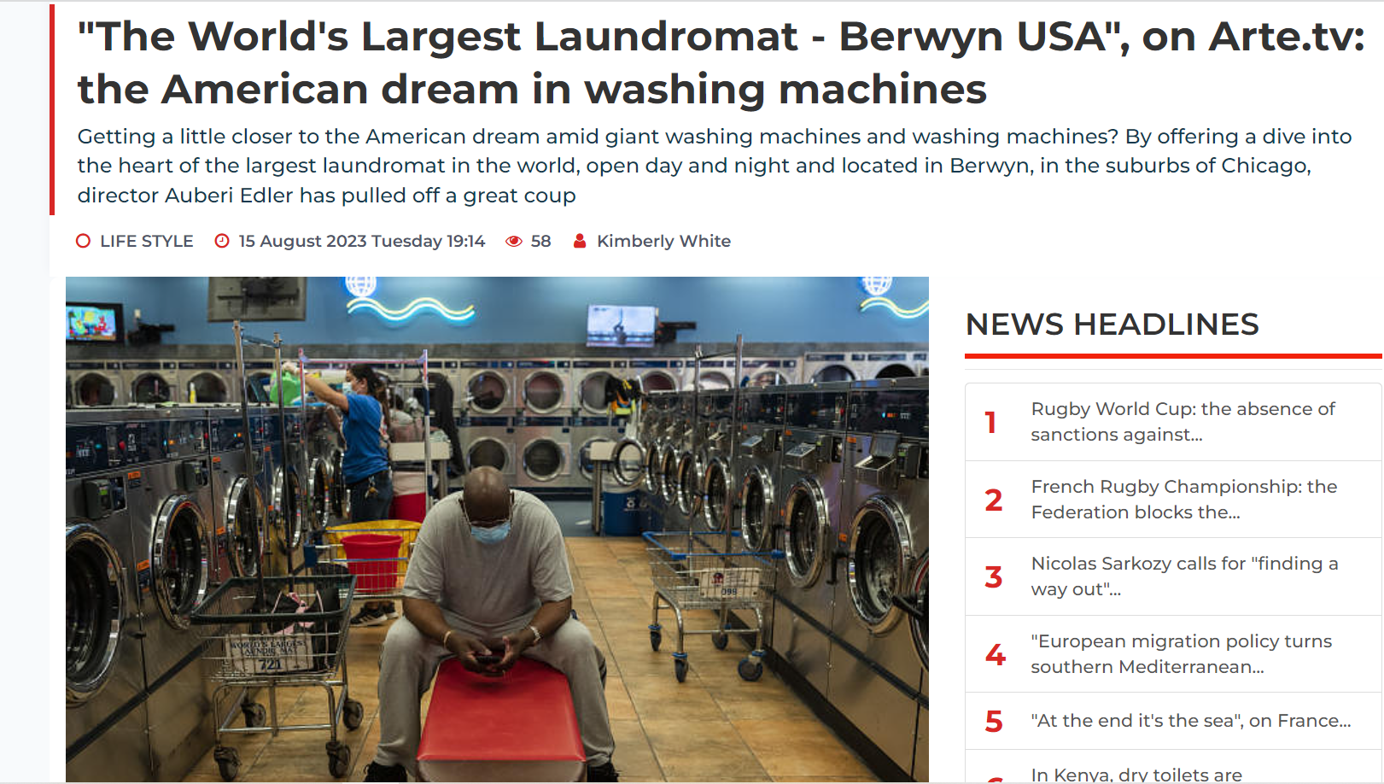

Slide 7
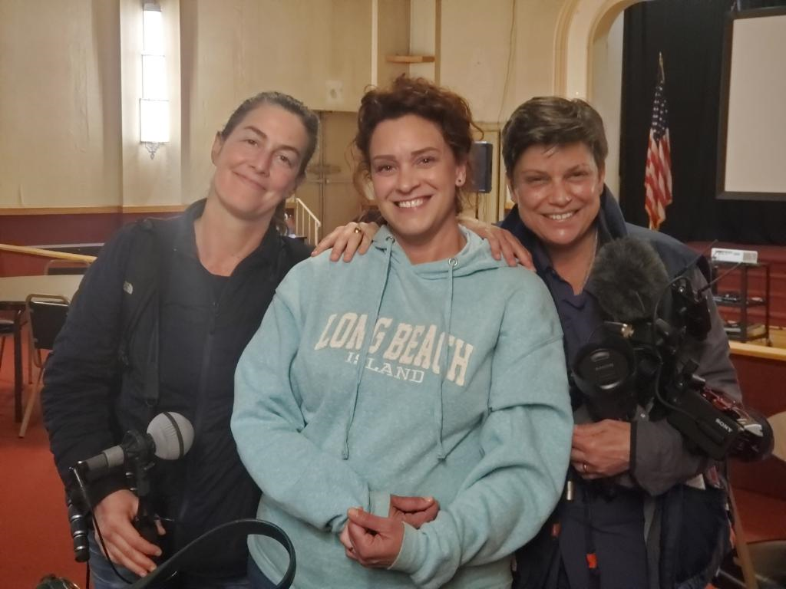
LifeGate Service Will Be Filmed November 12

Slide 8
WHAT GOD IS AFTER –
INTEGRITY – HUMILITY – ACCURACY
ACCOUNTABILITY
The vulnerability of the conservatives in America is that because they distrust the government – THEY ARE OPEN TO EVERY CONSPIRACY – Many have defects in their discernment filters and they swallow conspiracies like kool-aid Vaughn Martin/ Don Lamb
And it is my prayer that your love may be more and more accompanied by clear knowledge and keen perception, for testing things that differ, ¹⁰ so that you may be men of transparent character, and may be blameless, in preparation for the day of Christ, Philippians 1:9-10 (WEY)
Once you embrace a certain Conspiracy theory fully – it can be dangerous because you become ENTRENCHED.

Slide 9
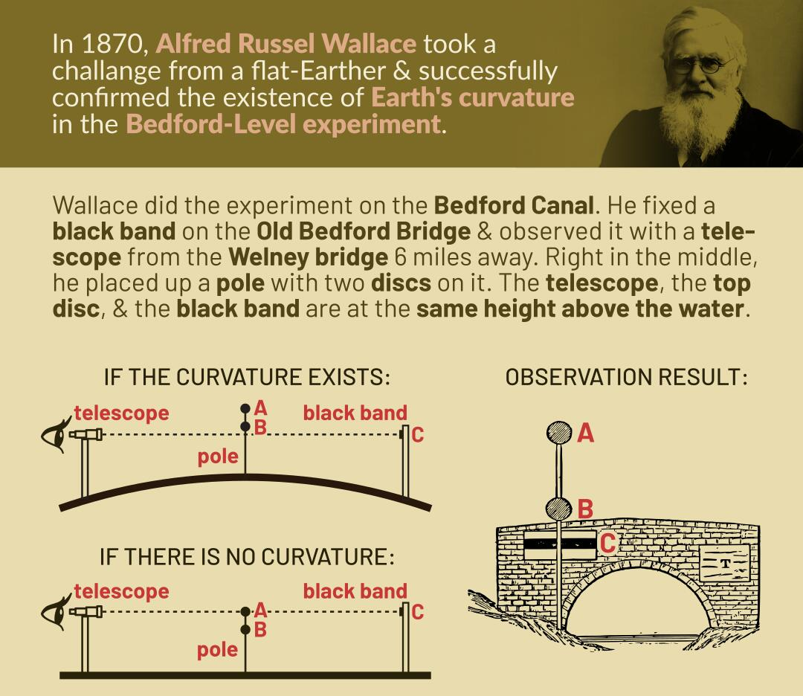
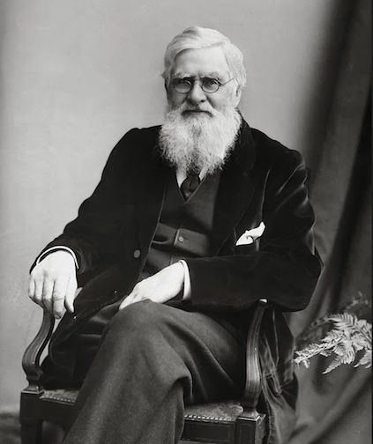
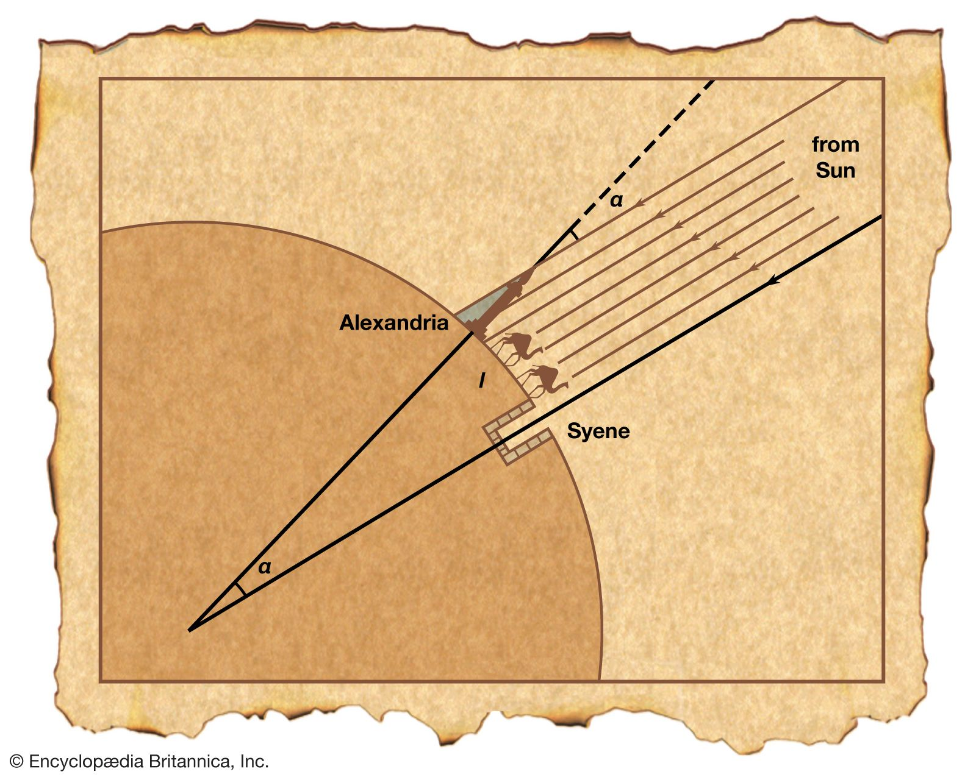
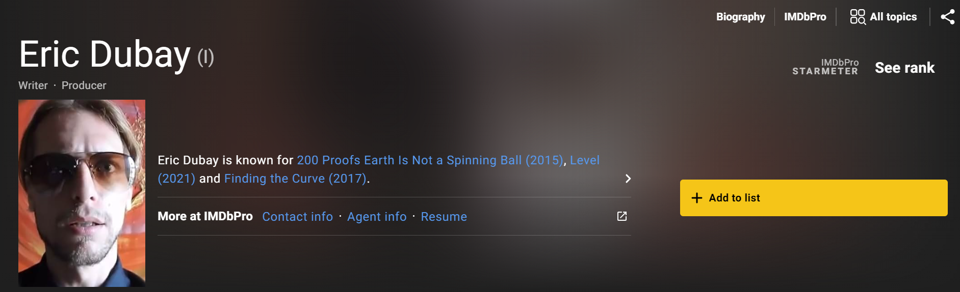
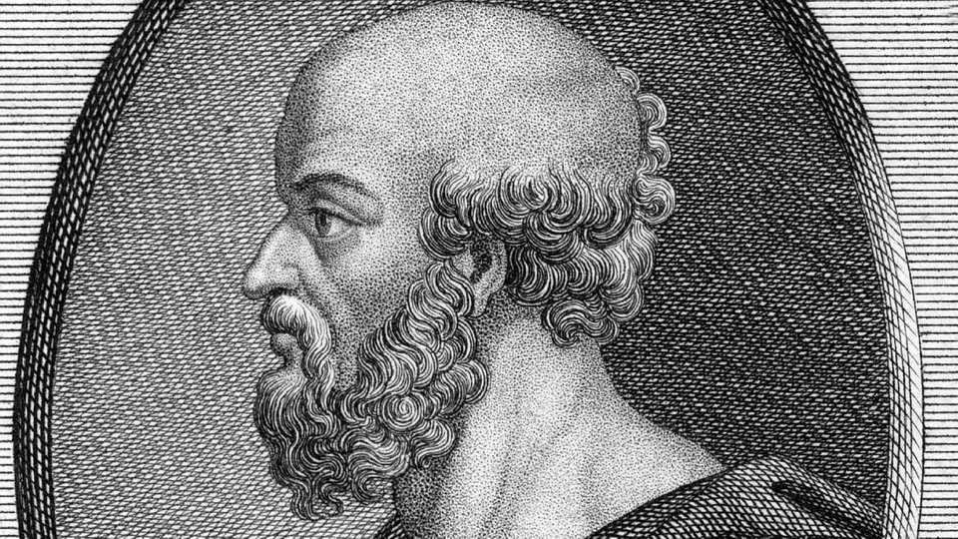
FLAT-EARTH IS A HOAX
Eratosthenes 200 B.C.
Samuel Rowbotham

Slide 10
Is There A Balm In Gilead
YES – JESUS IS THE BALM IN GILEAD
AND THE CHURCH IS THE PILLAR OF TRUTH
THIS IS AN HOUR TO SETTLE IN OUR SOUL TO GO DEEPER WITH GOD. WE ARE LEANING INTO THE BATTLE WITH JESUS – WE ARE NOT RETREATING IN FEAR.
LET’S SETTLE THE UNSETTLED ISSUES OF OUR LIVES AND RUN FORWARD WITH A RENEWED RESOLVE FOR ONE HUNDRED PERCENT FAITHFULNESS TO GOD. Mike Bickle

Slide 11
Single Christians Need to Operate
In Two Levels Love Primarily
Romantic
Sexual
Sacrificial
Self-less
Devotion
Brotherly
Friendship
A generous man will prosper; he who refreshes others will himself be refreshed. Proverbs 11:25 (NIV)

Slide 12
SINGLES ARE NOT ON HOLD
UNTIL THEY GET MARRIED
Do you have any relationships where you bless others – and that you are not into the relationship just to get something from the other person?
SINGLES - Pursue Strong COMMUNITY and find several relationships that run on all cylinders that are COMPLIMENTARY both in giving and taking – Where there is mutual respect and a true “looking forward to being together.”

Slide 13
For Healthy Marriages We need to Operate
In All Three of These Levels of Love
Romantic
Sexual
Sacrificial
Self-less
Devotion
Brotherly
Friendship
Husbands, love your wives, just as Christ loved the church and gave himself up for her Ephesians 5:25 (NIV)
However, each one of you also must love his wife as he loves himself, and the wife must respect her husband. Ephesians 5:33

Slide 14
Being Healed As A Community
IN THIS REVIVAL LORD GET US INTO JOY IN RELATIONSHIPS – PAST ALL THE LITTLE EDGES – THE SPARKING – THE ANNOYANCES – THE MOODINESS – THE FRUSTRATIONS – THE QUIRKINESS – THE HIDDEN VOICES
Then the church throughout Judea, Galilee and Samaria enjoyed a time of peace. It was strengthened; and encouraged by the Holy Spirit, it grew in numbers, living in the fear of the Lord.
Acts 9:31 (NIV)

Slide 15
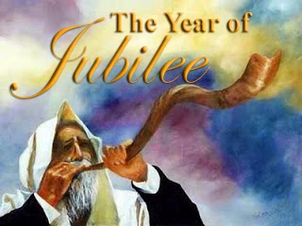
Understanding Strategic Shifts
"Forget the former things; do not dwell on the past. 19 See, I am doing a new thing! Now it springs up; do you not perceive it? I am making a way in the desert and streams in the wasteland. Isaiah 43:18-19 (NIV)
Jubilee Principles
40 Years
God does not want us to bring into the NEXT SEASON – the unfinished STUFF from the previous season

Slide 16
God Could Take His People Out Of Egypt – But Could Not Take Egypt Out Of His People
"Therefore, say to the Israelites: 'I am the LORD, and I will bring you out from under the yoke of the Egyptians. I will free you from being slaves to them, and I will redeem you with an outstretched arm and with mighty acts of judgment. ⁷ I will take you as my own people, and I will be your God. Then you will know that I am the LORD your God, who brought you out from under the yoke of the Egyptians. Exodus 6:6-7 (NIV)
⁴⁰ How often they rebelled against him in the desert and grieved him in the wasteland! ⁴¹ Again and again they put God to the test; they vexed the Holy One of Israel.
Psalm 78:40-41 (NIV)

Slide 17
The Cycle Of Strategic Shifts
1/ Somewhat dull and asleep to the depth of Change and Breakthrough needed
5/ The revival season will last as long as the leadership stays broken and humble and bold and full of prayer and obeys the Holy Spirit
2/ Sensitized to the depth of change required and Hungry for the Presence of the Lord
4/ For those who push through the refining into the NEXT SEASON they are prepared to steward the breakthrough and help bring in the harvest
3/ Intense warfare and attacks and refining
Take place to where the choice is to go deeper or quit

Slide 18
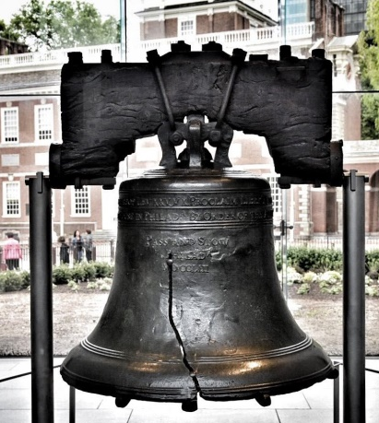
Understanding Jubilee
Consecrate the fiftieth year and proclaim liberty throughout the land to all its inhabitants. It shall be a jubilee for you; each one of you is to return to his family property and each to his own clan. ¹¹ The fiftieth year shall be a jubilee for you "'In this Year of Jubilee everyone is to return to his own property. Leviticus 25:10,11,13 (NIV)
Giving thanks to the Father, who has qualified you to share in the inheritance of the saints in the kingdom of light. ¹³ For he has rescued us from the dominion of darkness and brought us into the kingdom of the Son he loves, ¹⁴ in whom we have redemption, the forgiveness of sins. Colossians 1:12-14 (NIV)

Slide 19
Strategic Shift UNDER ASA
He commanded Judah to seek the LORD, the God of their fathers, and to obey His laws and commands. ⁵ He removed the high places and incense altars in every town in Judah, and the kingdom was at peace under him. No one was at war with him during those years, for the LORD gave him rest. 2 Chronicles 14:4-6 (NIV)
Then Asa called to the LORD his God and said, "LORD, there is no one like you to help the powerless against the mighty. Help us, O LORD our God, for we rely on you, and in your name we have come against this vast army. O LORD, you are our God; do not let man prevail against you." 12 The LORD struck down the Cushites before Asa and Judah. The Cushites fled, 13 and Asa and his army pursued them as far as Gerar. Such a great number of Cushites fell that they could not recover; 2 Chronicles 14:11-13

Slide 20
Strategic Shift UNDER ASA
The Spirit of God came upon Azariah son of Oded. 2 He went out to meet Asa and said to him, "Listen to me, Asa and all Judah and Benjamin. The LORD is with you when you are with him. If you seek him, he will be found by you, but if you forsake him, he will forsake you. 3 For a long time Israel was without the true God, without a priest to teach and without the law. 4 But in their distress they turned to the LORD, the God of Israel, and sought him, and he was found by them. 5 In those days it was not safe to travel about, for all the inhabitants of the lands were in great turmoil. 6 One nation was being crushed by another and one city by another, because God was troubling them with every kind of distress. 7 But as for you, be strong and do not give up, for your work will be rewarded." 8 When Asa heard these words and the prophecy of Azariah son of Oded the prophet, he took courage. He removed the detestable idols from the whole land

Slide 21
Strategic Shift UNDER ASA
They entered into a covenant to seek the LORD, the God of their fathers, with all their heart and soul. 13 All who would not seek the LORD, the God of Israel, were to be put to death, whether small or great, man or woman. 14 They took an oath to the LORD with loud acclamation, with shouting and with trumpets and horns. 15 All Judah rejoiced about the oath because they had sworn it wholeheartedly. They sought God eagerly, and he was found by them. So the LORD gave them rest on every side. 2 Chronicles 15:12-15 (NIV)

Slide 22
Strategic Shift UNDER ASA
ASA – CLEANSED WHAT CAME THROUGH FROM THE PREVIOUS GENERATION THAT WAS BRINGING COMPROMISE TO THE LAND
King Asa also deposed his grandmother Maacah from her position as queen mother, because she had made a repulsive Asherah pole. Asa cut the pole down, broke it up and burned it in the Kidron Valley. 17 Although he did not remove the high places from Israel, Asa's heart was fully committed [to the LORD] all his life. 18 He brought into the temple of God the silver and gold and the articles that he and his father had dedicated. 2 Chronicles 15:16-18 (NIV)

Slide 23
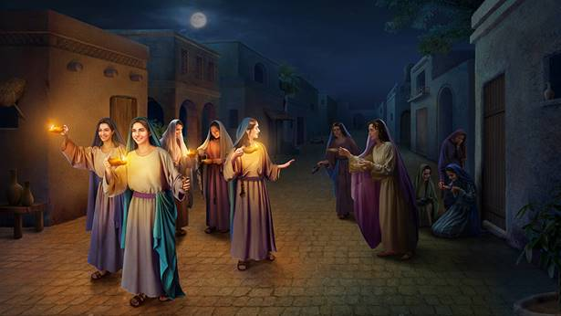
The Wise and Foolish Virgins
Matthew Chapter 25

Slide 24
Jewish Wedding Tradition
Helps Explain the Parable
The journey of marriage begins with a decision to say YES to get married, much like the day when we choose to follow Jesus as our Savior.
During the betrothal period is when the groom travels from his father’s house to the home of the prospective bride. He pays for the dowry (Nedynya), establishing the marriage covenant. This alludes to Jesus coming down from heaven and paying for our sins on the cross, so He can save us and marry us.
The groom returns to his father’s house (which meant being separated from his bride for about 12 months), as he prepares living accommodations for his wife at his father’s property. Jesus did the same, returning to His Father in heaven and preparing a place for us. (John 14:3)
The groom returns for his bride to have a wedding feast, but the groom returns for his bride at a time unknown to her.

Slide 25
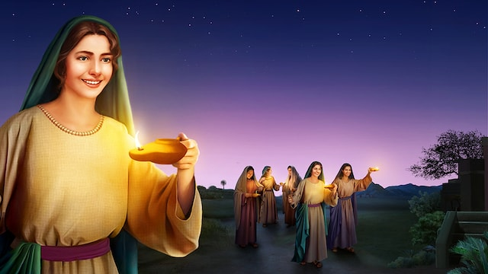
What Are We Bringing Through
Into This Next Season In Our Oil

Slide 26
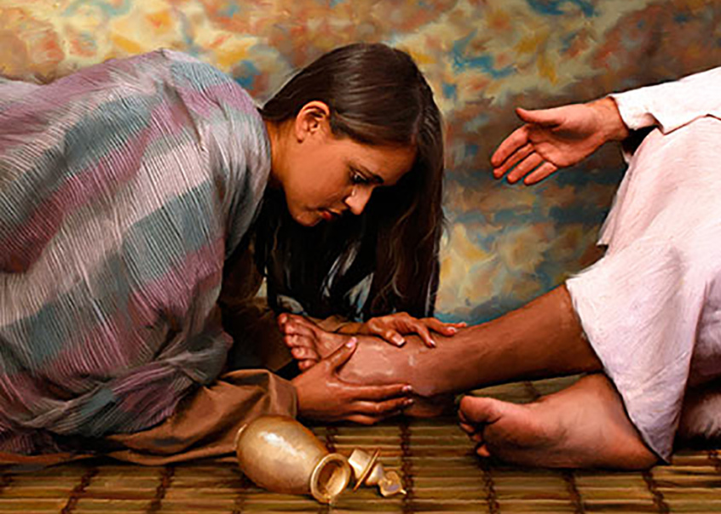
The Pouring Out of
Our Alabaster Jar
On The Lord
The events of Life – the Crushings
Of Betrayal – divorce – failure – hurt – delay disappointment
setbacks
Life Event
Outcome
Tree
Matthew Chapter 26
Bitterness
Cynicism
Anger/ rage
Hardness
Quirkiness
Moodiness
Unbelief/ doubt
Brokenness
Godly sorrow
Forgiveness
Contrite Heart
Maturity
Fruits if the Spirit
Greater faith/ trust

Slide 27
What Are The Fruits That Come From Your Alabaster Jar Before The Lord As A Sweet Aroma
Brokenness
Godly sorrow
Forgiveness
Contrite Heart
Devotion
Maturity
Perseverance
Fruits if the Spirit
Greater faith/ trust

Slide 28
God Takes All of Our Sorrows And Tears and Puts
Them In A Bottle
You have taken account of my wanderings; Put my tears in Your bottle. Are they not in Your book? 9 Then my enemies will turn back in the day when I call; This I know, that God is for me. 10 In God, whose word I praise, In the LORD, whose word I praise, 11 In God I have put my trust, I shall not be afraid. What can man do to me? Psalm 56:8-11 (NASB)

Slide 29
How Do We Allow Oil To Be
Made Out Of The Crushing?
In the same way, the Spirit helps us in our weakness. We do not know what we ought to pray for, but the Spirit himself intercedes for us with groans that words cannot express. ²⁷ And He who searches our hearts knows the mind of the Spirit, because the Spirit intercedes for the saints in accordance with God's will. ²⁸ And we know that in all things God works for the good of those who love him, who have been called according to his purpose. ²⁹ For those God foreknew he also predestined to be conformed to the likeness of his Son, that he might be the firstborn among many brothers. Romans 8:26-29 (NIV)

Slide 30
“Oh! It is grand to be absolutely conquered by the Holy Spirit, and swing out a thousand miles from all the fears of life into the ocean of God’s presence, and work with Him in humility, without stumbling over others, without spiritual pride, and bend to every plan God has for us.” G. D. Watson

Slide 31
HOW DO WE MAKE THIS PERSONAL?
1. You are in a great SHIFT (A GREAT INTERVENTION) – be aware how God is refining your heart and changing the CULTURE of LifeGate and the whole American Church.
2 . Pray without ceasing for fresh intensified fillings of the Holy Spirit and help us at LifeGate as we HOST HIS PRESENCE.
3. Allow the crushing and shaking to produce the oil that will NOT GO out – and become the PERFUME of faith
4. REPENT of anything that wants to come through into this Jubilee season – something that is hanging on from your past that always wants to hinder God’s plans for you.

