Slide 2
Keep the fire of God
Fire
Used for cooking, cleaning
Make metal
Offering sacrifices
To dispose of contamination (Burning clothes, etc)
Used as a weapon

Slide 3
Keep the fire of God
Fire:
The Presence of God
²⁸ Therefore, since we are receiving a kingdom that cannot be shaken, let us be thankful, and so worship God acceptably with reverence and awe, ²⁹ for our “God is a consuming fire.” Hebrews 4:28,29 (Deut. 4:24)

Slide 4
Keep the fire of God
Refiner’s Fire: Malachi 3:2,3
² But who can endure the day of his coming? Who can stand when he appears? For he will be like a refiner’s fire or a launderer’s soap. ³ He will sit as a refiner and purifier of silver; he will purify the Levites and refine them like gold and silver. Then the Lord will have men who will bring offerings in righteousness,

Slide 5
Keep the fire of God
Refiner’s Fire:
⁴ and the offerings of Judah and Jerusalem will be acceptable to the Lord, as in days gone by, as in former years.
⁵ “So I will come to put you on trial. I will be quick to testify against sorcerers, adulterers and perjurers, against those who defraud laborers of their wages, who oppress the widows and the fatherless, and deprive the foreigners among you of justice, but do not fear me,” says the Lord Almighty.

Slide 6
Keep the fire of God
Refiner’s Fire: Daniel 11:33-35
³³ “Those who are wise will instruct many, though for a time they will fall by the sword or be burned or captured or plundered. ³⁴ When they fall, they will receive a little help, and many who are not sincere will join them. ³⁵ Some of the wise will stumble, so that they may be refined, purified and made spotless until the time of the end, for it will still come at the appointed time.

Slide 7
Keep the fire of God
Fire:
Genesis 15:17
¹⁷ When the sun had set and darkness had fallen, a smoking firepot with a blazing torch appeared and passed between the pieces. ¹⁸ On that day the Lord made a covenant with Abram

Slide 8
Keep the fire of God
God’s Word is a Fire:
Jeremiah 20:9
But if I say, “I will not mention his word or speak anymore in his name,” his word is in my heart like a fire, a fire shut up in my bones. I am weary of holding it in; indeed, I cannot.

Slide 9
Keep the fire of God
Fire:
Jeremiah 23:29
“Is not my word like fire,” declares the Lord, “and like a hammer that breaks a rock in pieces?

Slide 10
Keep the fire of God
Holy Spirit is like a Fire
Matthew 3:11 “I baptize you with water for repentance. But after me comes one who is more powerful than I, whose sandals I am not worthy to carry. He will baptize you with the Holy Spirit and fire.

Slide 11
Keep the fire of God
Holy Spirit Fire can be quenched and grieved
1 Thessalonians 5:19 “Do not quench the Spirit.”
Ephesians 4:30 “And do not grieve the Holy Spirit of God, with whom you were sealed for the day of redemption.

Slide 12
Keep the fire of God
God, like a fire wants to refine, purify, cleanse and wants our hearts ignited for Him.

Slide 13
Keep the fire of God
Seven Things about this Fire:
1 Fire brings light
2 Fire brings heat
3 Fire brings purging
4 Fire needs fuel
5 Fire Spreads
6 Fire can be quenched and die out
7 Fire produces smoke but smoke does not produce Fire

Slide 14
Keep the fire of God
Moses was called by fire.
Elijah called down fire.
Elisha made a fire.
Micah prophesied fire.
John the Baptist cried, “He shall baptize you with the Holy Ghost and with fire.”
Jesus said “I am come to send fire on the earth.”

Slide 15
Keep the fire of God
“Just as Moses could not mistake the sight of the burning bush, so a nation could not mistake the sight of a burning man.! God meets fire with fire. The more fire in the pulpit the less burning in hell-fire.” Ravenhill

Slide 16
Keep the fire of God
“Oh we need the fire! Where is the power of the Holy Ghost that slays sinners and fills our altars? Today wer seem much more interested in having churches air-conditioned than prayer-conditioned. “Our God is a consuming fire.” God and fire are inseparable; so are men and fire. Every single one of us is now treading a path of fire- hell fire for the sinner, judgment-fire for the believer! Because the Church has lost Holy Ghost fire, millions go to hell-fire.” Ravenhill

Slide 17
Keep the fire of God
“I do not marvel so much at the patience of the Lord with the stonyhearted sinners of the day. After all, would we not be patient with a man both blind and deaf? And such are the sinners. But I do marvel at the Lord’s patience with the sleepy, sluggish, selfish Church! A prodigal Church in a prodigal world is God’s real problem.” Ravenhill

Slide 18
Keep the fire of God
Seven Things about this Fire:
Lights up the room. Light of the world, keeps you from stumbling
1 Fire brings light:
2 Fire brings heat:
Speaks of Love
You can feel the heat of God’s love when it’s there and you can feel it when it isn’t there.
Matthew 24:12 ¹² Because of the increase of wickedness, the love of most will grow cold,

Slide 19
Keep the fire of God
Genesis 18:20
“Then the Lord said, “The outcry against Sodom and Gomorrah is so great and their sin so grievous”.
What was the sin of Sodom?

Slide 20
Keep the fire of God
Ezekiel 16:49.50 “Now this was the sin of your sister Sodom: She and her daughters were arrogant, overfed and unconcerned; they did not help the poor and needy. ⁵⁰ They were haughty and did detestable things before me. Therefore I did away with them as you have seen.”

Slide 21
Keep the fire of God
Brethren, in the light of the Bema Seat, we had better live six months with a volcanic heart, denouncing sin in places high and low and turning the nation from the power of Satan unto God (as John the Baptist did) rather than die loaded with ecclesiastical honours and theological degrees and to be the laughing stock of heal and of spiritual nonentities. Lampooning “liquor barons” and cursing corrupt politicians bring no fire down upon our heads. We can do both of these, and keep our heads and our pulpits. Prophets were martyred for denouncing false religion in no vague terms. And when we too see “lying religion” cheating men in life and robbing loved ones in death, or when we see priests leading them to hell under the banner of a crucifix, we should burn against them with holy indignation. Later, maybe, to lead the way to a Twentieth Century Reformation, we shall burn on martyr fires.” Ravenhill

Slide 22
Keep the fire of God
3. Fire Purges, refines, cleanses. When you get the fire of God in your life, there is cleansing that takes place. The is purging.

Slide 23
Keep the fire of God
4. Fire of God needs fuel

Slide 24
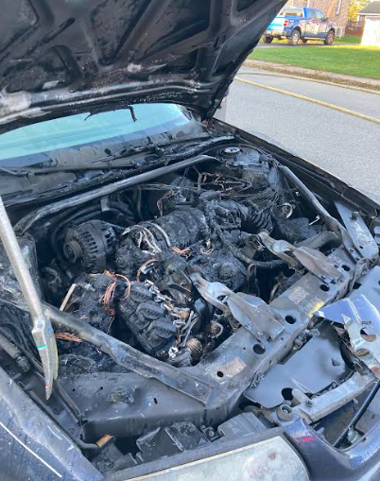
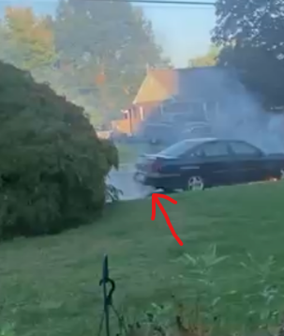
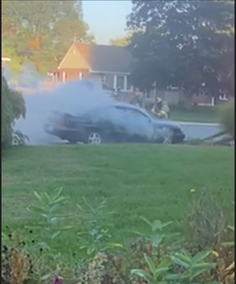
Keep the fire of God
4. Fire of God needs fuel

Slide 26
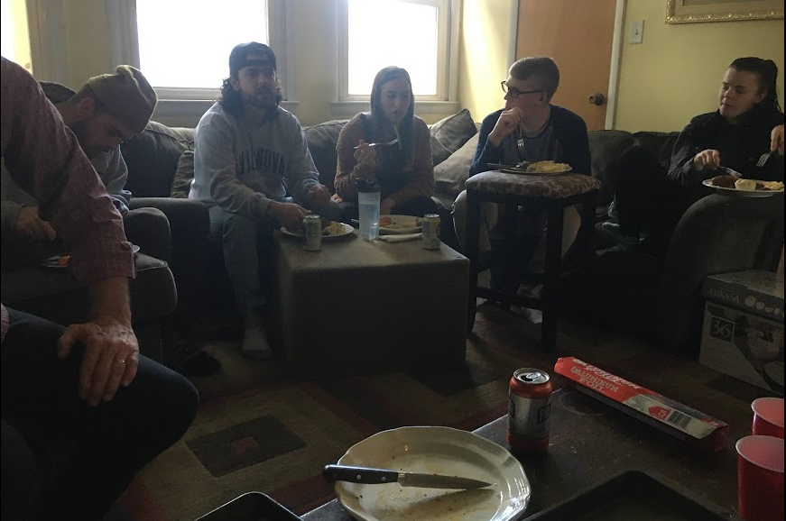
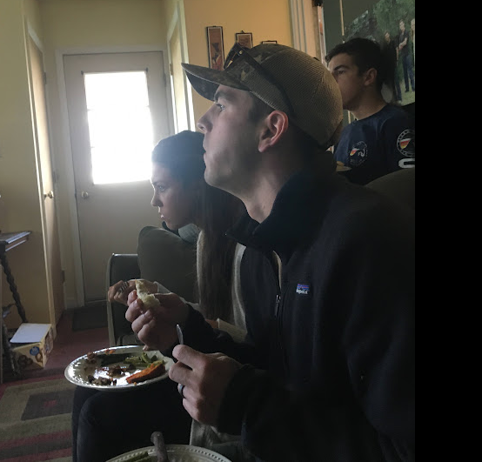
Keep the fire of God
5. Fire Spreads

Slide 27
Keep the fire of God
5. Fire Spreads
When the fire you keep becomes the fire you spread.
When you catch on fire for Jesus, when God burns in you, you will see that you will light other people on fire.
When a father, mother, son, daughter, is burning, he/she lights their family on fire!

Slide 28
Keep the fire of God
6. Fire can die.
Someone can actually extinguish the fire. “Do not quench the Spirit. You can bring water or just stop stoking it or stop adding wood. Firefighters in the spiritual sense are no good. Some of us are stopping fires in our life by our habits. We also have people in our lives sent by the devil to kill the fire, extinguish it.
Are you a firefighter or a firestarter?

Slide 29
Keep the fire of God
7. Fire produces smoke but smoke doesn’t produce fire.
When you catch on Fire, you attract Criticism
Jesus’ family said he was out of his mind.
Cain and Abel- One brother gets on fire for God, brings a sacrifice, God is pleased, the brother doesn’t like it. “Sin is crouching at the door and it desires to have you, but you must master it.”

Slide 30
Keep the fire of God
Smoke can also be the traditions you develop but they don’t bring the fire.
*Be careful that your fire that produces smoke doesn’t cause other people to choke.

Slide 31
Keep the fire of God
Fire leaves ashes. When you lose fire, you get ashes. Ashes are the sign that the fire is gone. They only have memories of the way things use to be like. God told the priests to constantly remove the ashes so that the fire can constantly burn.
¹² The fire on the altar must be kept burning; it must not go out. Every morning the priest is to add firewood and arrange the burnt offering on the fire and burn the fat of the fellowship offerings on it. ¹³ The fire must be kept burning on the altar continuously; it must not go out.”
Levitucus 6:12,13

Slide 32
Keep the fire of God
Fresh passion for Jesus, Fresh fire all the time. God wants to renew you. He doesn’t want you to live for yesterday’s miracles. He wants you to live on the relationship with him today.
Yesterday’s manna will develop worms
Man shall not live by bread alone, but by every word that proceeds out of the mouth of God.
A Rhema word- God still speaks today.

Slide 33
Keep the fire of God
Consider this:
If Abraham just lived on yesterday’s word today, he would have killed his son Isaac.
If he would only lived on yesterday’s manna, or yesterday’s fire, it wouldn’t have produced heat, light, purging. I would have produced ashes.

Slide 34
Keep the fire of God
Does your altar have fire, or does your altar have only ashes?
Has your love for Jesus become a memory of the past or is your love for Jesus burning brighter, clearer every year, month?
Are your memories bigger than your dreams?
Are your fears bigger than your faith?
Is your future bigger than your past?

Slide 35
Keep the fire of God
Your testimony of what God has done are kindling for your desire to burn for Jesus more!
If you say “I used to pray, I used to give, I used to know the Bible, I used to fast and I used to see God work, then your altar has no flame and it has just ashes.

Slide 36
5 things to Keep the fire of God
1. Focus on Jesus’ love for you and NOT your love for Him.
Matthew 26:33 “Peter replied, “Even if all fall away on account of you, I never will.”
1 John 4:19 “We loved because He first loved us.”
You are not the source of fire, you are only the resource.
The Source of Fire is God, His Word, and His Spirit!

Slide 37
5 things to Keep the fire of God
The more you focus on your love for him, the more over confident you will become.
The more you are obsessed with how little you love Jesus, the more discouraged you will become.
2 Corinthians 10:12 We do not dare to classify or compare ourselves with some who commend themselves. When they measure themselves by themselves and compare themselves with themselves, they are not wise.

Slide 38
5 things to Keep the fire of God
The less I focus on how much I love Jesus, the more His Love can flow through me and his fire begins to increase.
When you focus on your love for Jesus, more than his love for you, Four things will happen:
1. You will make Empty promises instead of living in his presence Ex. Peter
2. You will begin to try to earn God’s love, trying to prove to other people that you’re better than other people. Ex “Lord, I thank you that I’m not like this Tax collector. I fast twice a week……….” Luke 18:10

Slide 39
5 things to Keep the fire of God
The less I focus on how much I love Jesus, the more His Love can flow through me and his fire begins to increase.
When you focus on your love for Jesus, more than his love for you, Four things will happen:
3. You will live out of your emotions, but your devotion will be weak.
4. You will have a lot of passion but your passion will lack compassion. Example Peter cut a man’s ear of out of passion but not compassion.

Slide 40
5 things to Keep the fire of God
If your love for Jesus is not anchored in his Love for you, you will cut other people. It will be hype, and lack the commitment to follow through.
Example: Leah having children for Jacob
John called himself “The disciple whom Jesus Loved”.
If you don’t experience that UNCONDITIONAL LOVE, Then your love will never be enough!
This will extinguish your fire.

Slide 41
5 things to Keep the fire of God
2. Wake up your prayer life! Ex. Peter
Matthew 26:40 “Could you not watch with me one hour?”
When your prayer life goes to sleep, your past life will awaken.
Luke 22:31,32 “Simon, Simon, indeed Satan has asked to sift you like wheat. But I have prayed for you that your faith will not fail and when you have returned to me, strengthen your brothers.”

Slide 42
Keep the fire of God
“Love is kindled in a flame, and ardency is its life. Flame is the air which true Christian experience breathes. It feeds on fire; it can withstand anything, rather than a feeble flame; but when the surrounding atomosphere is frigid or lukewarm, it dies, chilled and starved to its vitals. True prayer MUST be aflame.” E.M. Bounds

Slide 43
5 things to Keep the fire of God
“Simon” means “shaky”, “unstable ground”
You see his old life coming back instead of the “Rock”. He was unstable and shaky.

Slide 44
5 things to Keep the fire of God
3. Follow the Holy Spirit and don’t avoid Sacrifice.
When Holy Spirit presses you to go deeper, take greater sacrifice. Many follow him to the point of confessing sin. (Stop drinking, smoking, sexual immorality, etc) but won’t follow him to the point of inconvenience.
Matthew 26:58 “Peter followed him at a distance.”
Following Jesus, may get you killed or at the very least inconvenienced.

Slide 45
Keep the fire of God
“Holy Ghost fire both destroys, purifies, warms, attracts and empowers. Some Christians cannot say when they were saved. But I never knew a man yet who was baptized with the Holy Ghost and Fire and was unable to say when it happened.” Ravenhill

Slide 46
5 things to Keep the fire of God
Matthew 16:24 “Jesus said If anyone desires to come after me, let him deny himself, take up his cross and follow me.”
Giving up sin is not sacrifice!
Between the Holy Spirit and the Altar is your self. He knew you would be uncomfortable.

Slide 47
5 things to Keep the fire of God
4. Avoid warming yourself with the world’s flame. Ex. Peter
Mark 14:54 “Peter followed him at a distance, right into the courtyard of the high priest. There he sat with the guards and warmed himself at the fire.”
It’s attractive
When we lose our affection for Jesus, the world becomes attractive.
It’s addictive
It’s annihilating to your intimacy with God

Slide 48
5 things to Keep the fire of God
Are you entertaining yourself or are you edifying yourself?
Are you nurturing yourself or are you numbing yourself by the fire.
Is your affection for Jesus causing the world to no longer be attractive or the world is so attractive and Jesus is kind of dull?

Slide 49
5 things to Keep the fire of God
Recap:
Focus on Jesus’ love for you
Wake up your prayer life
Follow the Holy Spirit even when it’s inconvenient
Learn to Nurture your Spiritual life instead of numbing yourself with the world’s flame
5. Repentance is the Key to restoration of Fire!

Slide 50
5 things to Keep the fire of God
Godly sorrow leads to repentance 2 Corinthians 7:10
Restitution is not repentance. It’s making things right without getting it right with Jesus.

Slide 51
Keep the fire of God
People consumed by the inner fire of the Spirit are the counterpart in human life of the smashed atom which releases cosmic forces.” Ravenhill
“O that in me the sacred fire
Might now begin to glow
Burn up the dross of base desire,
And make the mountains flow!”
Charles Wesley

Slide 52
Keep the fire of God
“Breathe on me, Breath of God,
Till I am wholly Thine,
Until this earthly part of me
Glows with Thy Fire divine.”
Dr Edwin Hatch

